Slide 1

L-TEK

Slide 2
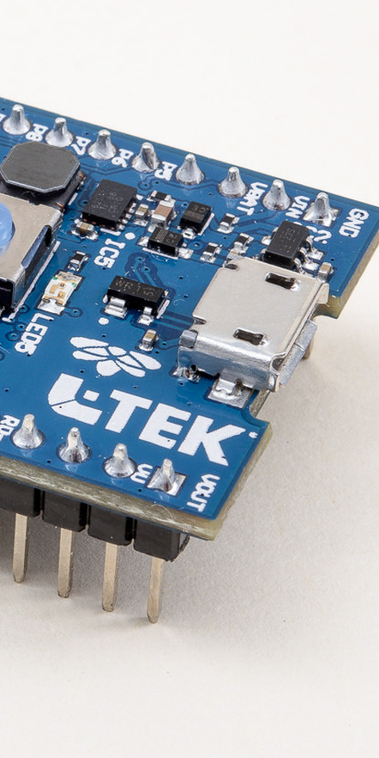
About L-Tek
L-Tek is a family-owned company based in Slovenia
Since 1994 providing High-Quality EMS (Electronic Manufacturing Services)
L-Tek is a technical innovator specialising in and focused upon R&D of mainly IoT solutions, electronic modules and software solutions.
L-Tek is investing a substantial part of the revenue into R&D developments and optimization of manufacturing processes
L-Tek designs and produces medical products under ISO 13485:2016 standard
We are also a manufacturer with complete automized production lines for small and medium-size quantity series of complex, high-tech goods

Slide 3

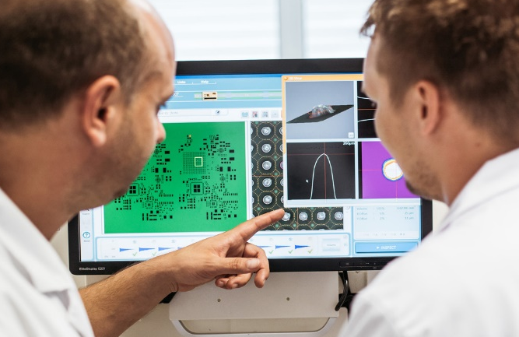
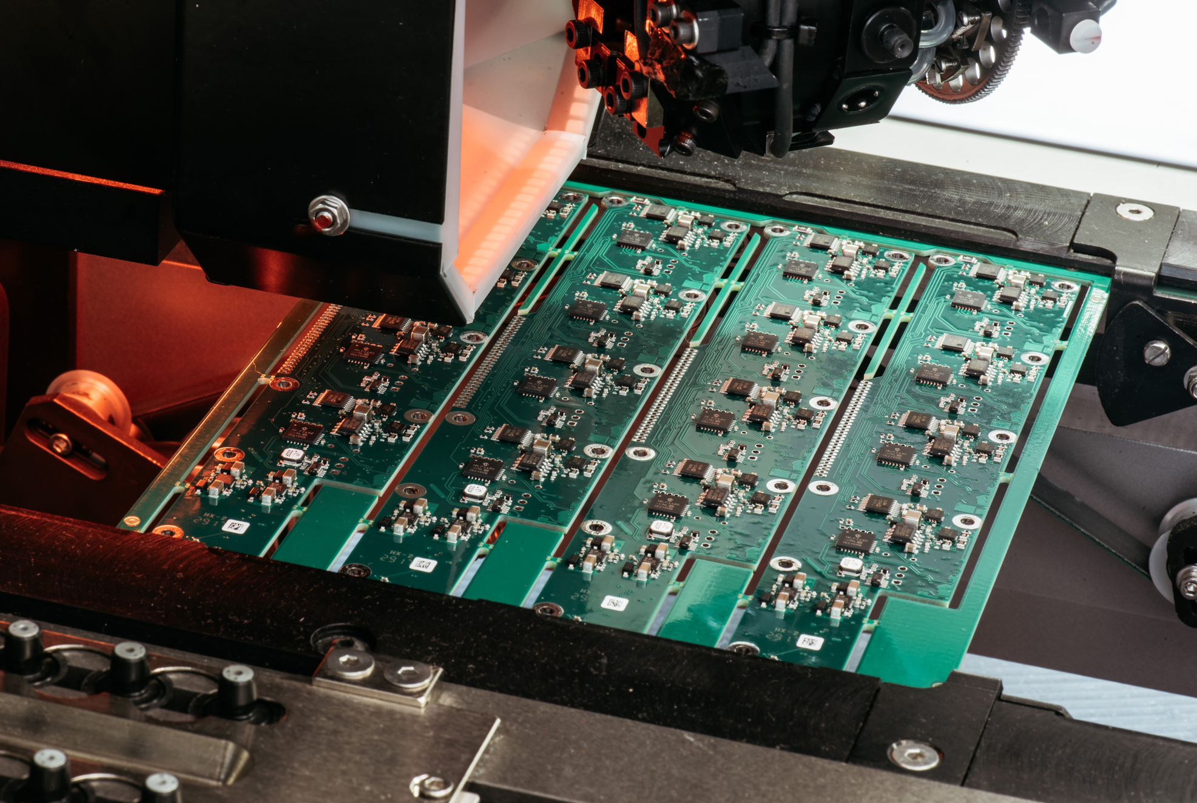
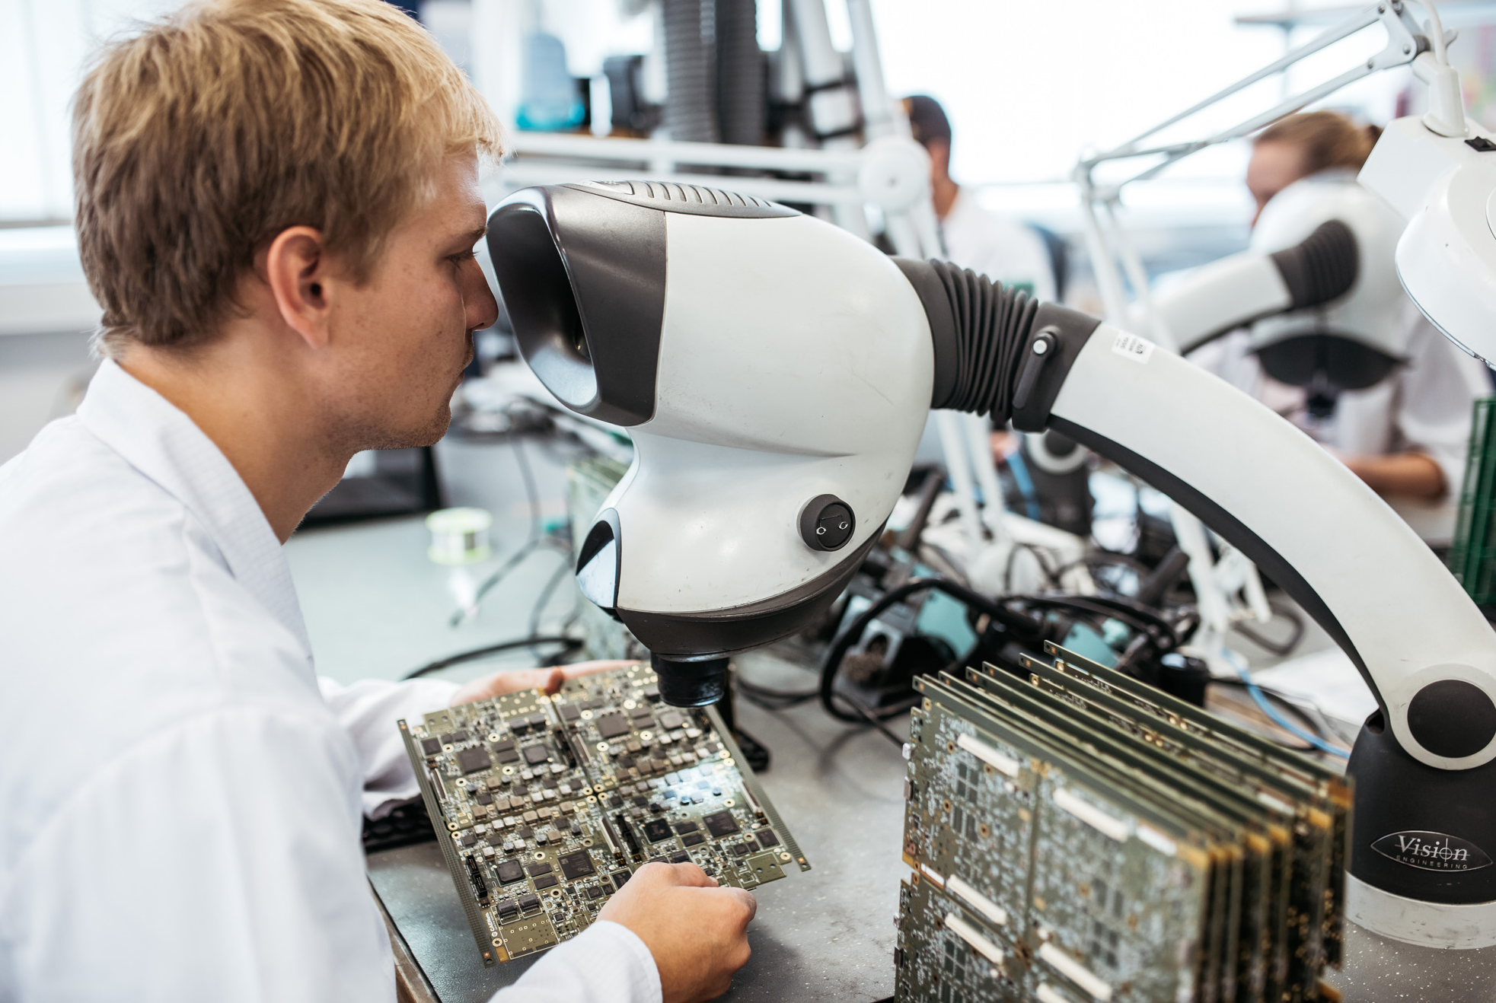
Manufacturing services:
3 SMT production lines
  From prototype to medium-batch size
THT soldering
  Wave soldering
  Selective Soldering
Automatic storage and drying cabinet for components
Comformal coating
Testing services

Slide 4

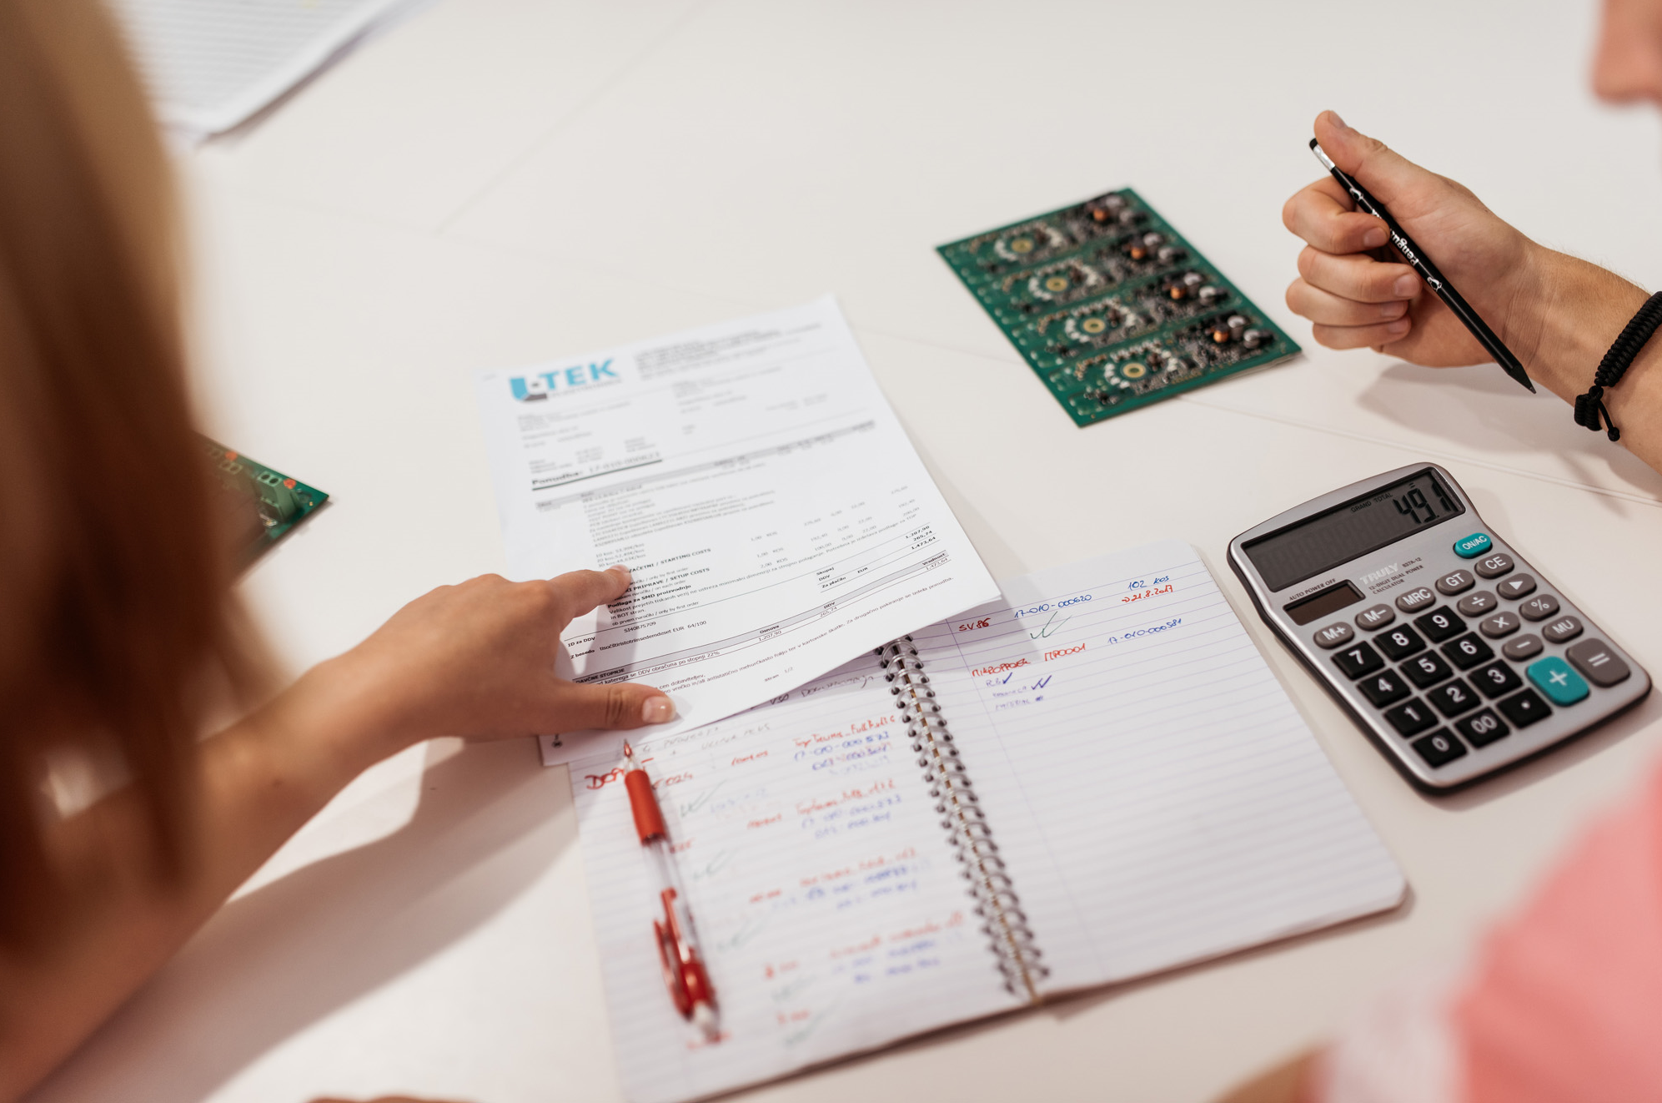

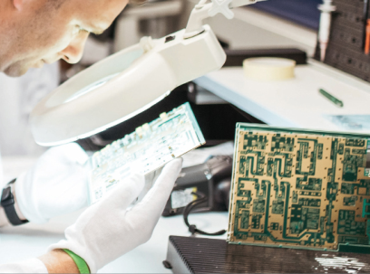
Quality and Control
ISO 9001:2015 certified
ISO 13485:2016 for production of medical devices
Control
  In-line SPI control
  3D AOI control (Aoutomatic Optical Inspection)
  X-Ray

Slide 5

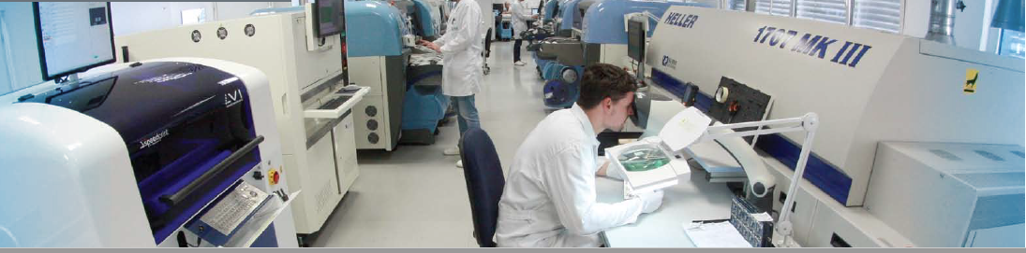
From idea to production
Concept
Control
Quality
Production
Testing
NDA
Idea Generation
Consulting services
Prototype
SPI inspection
AOI inspection
X-RAY
ISO 9001:2015
ISO 13485:2016
ESD controled enviroment
SMD and THT assembling (EMS)
Programming equipment
End-Test services
Done at one location
Box buid assembly
Packaging
Shipping

Slide 6

Thank you

