Slide 1

BASS
Notes:
BASS not for music, but for the IT, IT that brings the music to your companies with our solutions. Wish you all a great day today, a special thank you to the CERN team for your hospiality here and of course many thanks also to the Slovenia team that brought us here and everyone who made this two day event possible. Everybody hi.

Slide 2
Step into the era of safe digitALIZATION
We all know that technology and digital trends are transforming your environment. Because companies are facing with the uncertainty of customers, employees and competition.
Our 25 years worth of rich experiences in fields of information technologies, business informatics, utilities, finance and accounting proved us that tool to rediscover your business is the core: people, process and technology.
Notes:
In the era of digitalization we don‘t have a easy job, because everyone thinks different about this topic. One think is common for all: „Digitalization of our processes is urgent if we want to successfuly colide the newdays problems and chalenges. „ You can not be the first anymore, but do yo want to be the last?

Slide 3


THE LEADING IT COMPANY IN SLOVENIA
WHO ARE WE?
The quality and reliability of software solutions, as well as state-of-the-art information technology for support of business processes, are our everyday obligations.
Primary activity is developing and supporting highly sophisticated software products for public services such as water supply, waste management, remote heating, gas distribution, dwellings management undertakers, cable services...
Notes:
In Slovenia we are the main player on the IT market for the municipalities, public services companies and other companies that face big data, digitalization and other IT chalenges. Our products support all posible services such as water supply, waste management, electricity, remote heating, …. All services that are reproducible, ongoing.

Slide 4

AND STILL AHEAD OF OUR TIME
ACTIVE SINCE 1991
Long term ongoing development and cooperation with experts lead to a solution that put us on the top of usability, functionality, security.
We are unmatched in the field of communal economy, mass billing and complex systems.
Notes:
The company turns thirty in two years and the long term developing, planning and thinking brought us here too.

Slide 5
READY for your business
Processing and billing mass data of:
Meters,
Sensors (IoT, smart apliances,…),
Smart cities, villages, …
(condition, consumption, specification, …)
Digitalization of your processes, papers and business.
High value data presentation with efficent BI tools.
Notes:
Since 1991 we are ready for your business. What does that mean? We are ready for processing a lot of data, speaking in means of billing, digitalization and data presentation with BI tools.

Slide 6

THE BASE FOR LONG TERM BUSINESS ORIENTATION
OUR MISSION
Our mission is to remain a leading information company and to spread to the domestic and foreign markets, especially in the areas of Smart Cities, optimization of mass data processing, IoT devices and all other advanced technologies.
We will continue providing the most advanced technologies in the forms of IT solutions in order to support our customer’s business processes.
Notes:
Our mission stays teh same. We must continue providing the most advanced tecnologies to our customers an to our users. That is our obligation and our main goal.

Slide 7

THE BASE OF LONG TERM BUSINESS ORIENTATION
OUR VISION
BASS d.o.o., Celje is already a significant solution provider on Slovenian market. To align to the market, company needs to spread its activities by merging with other niche players.
The role of leading solution provider for municipal maintenance and sanitation services raises importance for proactive appearance on markets outside Slovenia.
Notes:
Vision? Yes spread the word and our services to other countries outside Slovenia.

Slide 8
For immense transformations a change in mentality is more crucial than change in technology.
Notes:
We are sure that always tecnology is very important, but first, we must accept a change by ourselves.

Slide 9

SPECIALISTS THAT ARE PUSHING TOWARD THE common GOAL
Our team
We have the best team of experts from different areas e.g. Accounting, Billing, Operations and Computer engineering which results in extremely scalable and user friendly software solutions for different industries and needs.
International and domestic education gives the team energy and the constant urge to stay fit in terms of competence, punctuality and maximum availability.
Together we process each idea and each proposal for the best possible experience for the user and us.
Daily challenges by our customers and constantly changing legislation, helps us grow and become valuable.
Notes:
I must say that we have the best team in means of knowledge, experience gained through the years and of course the best support they offer to our clients.

Slide 10
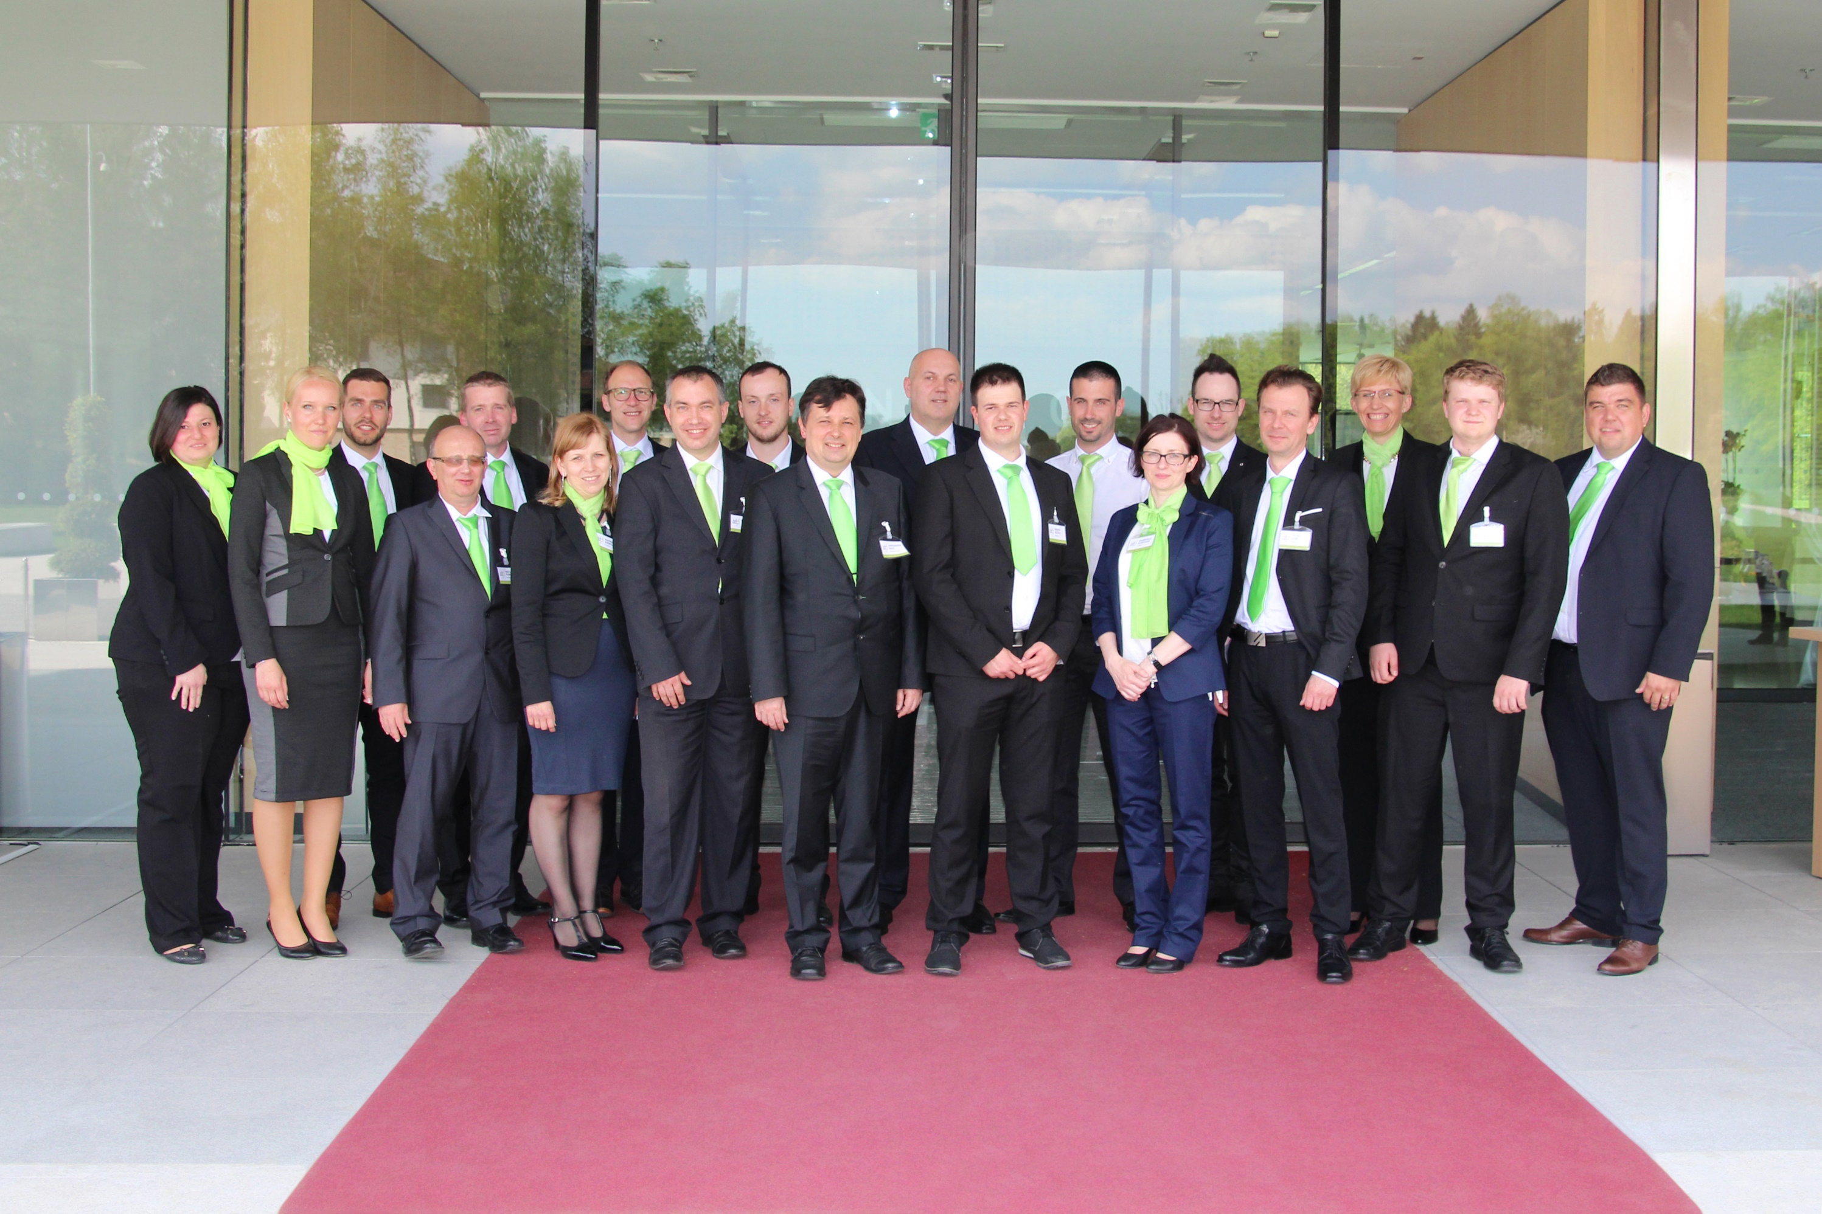
Notes:
Here they are, they are guilty for everything.

Slide 11
We create value with profound research and improvement of core challenges with a goal to find the best possible solution.
Notes:
We are never happy with the first idea or first soluton. We always improve the quality of our services in order to bring the best posible solution served on the best posible tecnology.

Slide 12

Location
Stay in contact
Kontakt
BASS d.o.o., Celje
Ulica XIV. Divizije 14
3000 Celje
Slovenia
T: +386 (0)3 425 77 77
F: +386 (0)3 425 77 66
E: prodaja@bass.si
https://www.bass.si/
Notes:
Thank you, for any further information contact us our just come to our table in the lobby. Have a nice day!

