Slide 1


Slide 2


Global Leader in Control Systems and Software for Science and Proton Cancer Therapy

Slide 3

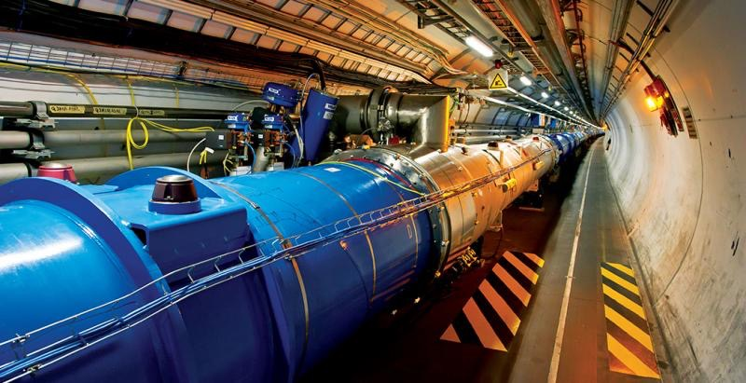



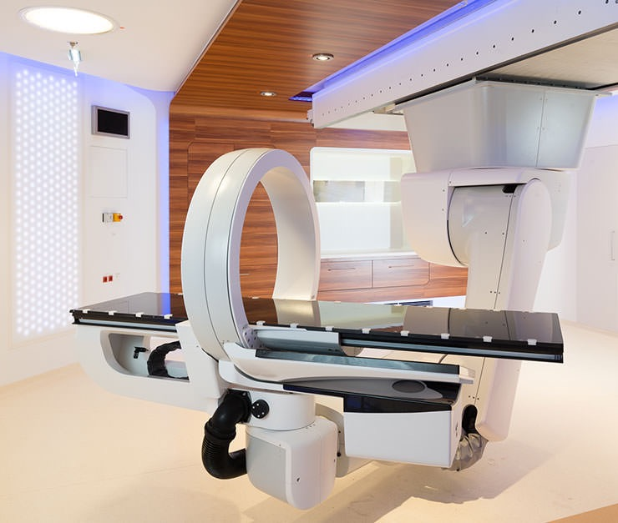
World Leader in Control Systems for Science and Particle Therapy
Building and integrating state-of-the-art software for the most complex, precise and advanced systems in the world.
BIG PHYSICS
NEW ENERGY
ROBOTICS and MANUFACTURING
SPACE AND ASTRONOMY
PARTICLE THERAPY
MedAustron Particle Therapy Centre

Slide 4


Cosylab in Numbers
Worldwide market leader in
Control Systems for large scientific facilities (accelerators, telescopes, fusion, etc.)
Control Systems for Particle Therapy Systems
6 branches
Switzerland, Slovenia, US, China, South Korea, Japan
150+
highly-skilled developers and engineers
250+
successfully delivered projects in 20 countries
Established in 2001, >20% CAGR, Turnover >17M€ in 2017

Slide 5

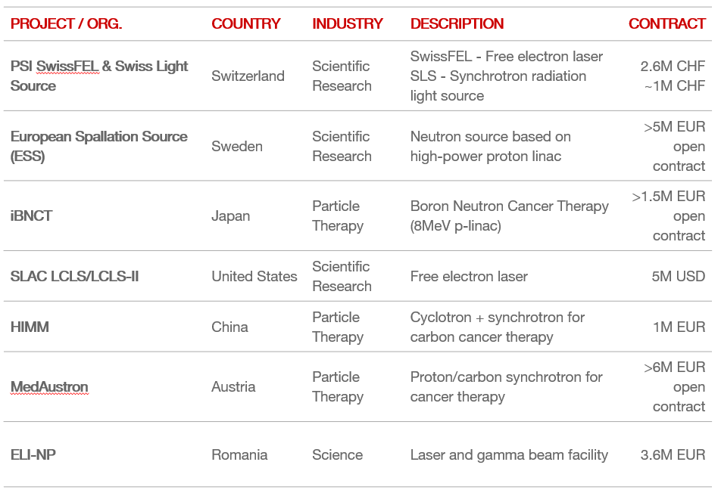






A few reference projects from Sci and PT
Notes:
We participate at 6 of the 10 largest Big Physics International Projects (ITER, ESS, FAIR, E-ELT, European XFEL, CERN) and nearly all major labs worldwide.

Slide 6
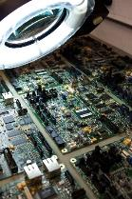

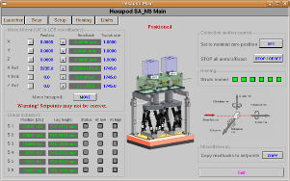
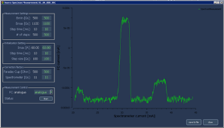
Technologies coverage
Various SW technologies
  Matlab, LabVIEW
  C/C++, Java, Python, .net/C#, ...
  Motion control, inverse kinematics
  SCADA, EPICS, CSS, TANGO,
  Real-time: Linux-RT, VxWorks, RTEMS
  FPGA programming
  PLC
Electronics / Hardware:
  Digital, analog
  Nanoseconds timing
  FPGA, DSP
  PXI, PXIe, uTCA
6

Slide 7


Partnering with COSYLAB
Working flexibly with our partners from ideation to operations:
Business analysis, requirements engineering
System design
SW and HW development
System integration
Installation and comissioning
Documentation
Notes:
People, knowledge, rotation..

Slide 8
Partnering with COSYLAB
Taking the risk away:
Mitigate technical and financial risk
Meet your project deadlines, shorten lead times
Reduce your overall development investment
Manage peak workloads
Focus on your core competency, obtain IP, receive knowledge transfer
...delivering safe, secure, reliable, and compliant systems.
Notes:
Within budget and timely delivery at Cosylab‘s risk.

Slide 9
Familiar with- and recognized by CERN
White Rabbit Timing System open HW intitiative
ARIES partnership (universal timing system)
AVA antimatter physics research project
In the making:
  HITRI project (Proton Therapy in EE) - coordinated by CERN. WP8 (controls and safety) to be led by Cosylab.
  ARIES 2 submission of preliminary proposals (e.g. ACC CS based on COTS components).
Cosylab Switzerland is led by a former ATLAS MET trigger coordinator (+worked on various other projects)

Slide 10
Thank you!

