Slide 1

Arctur d.o.o.
Where creativity meets experience
andrej.kosicek@arctur.si

Slide 2
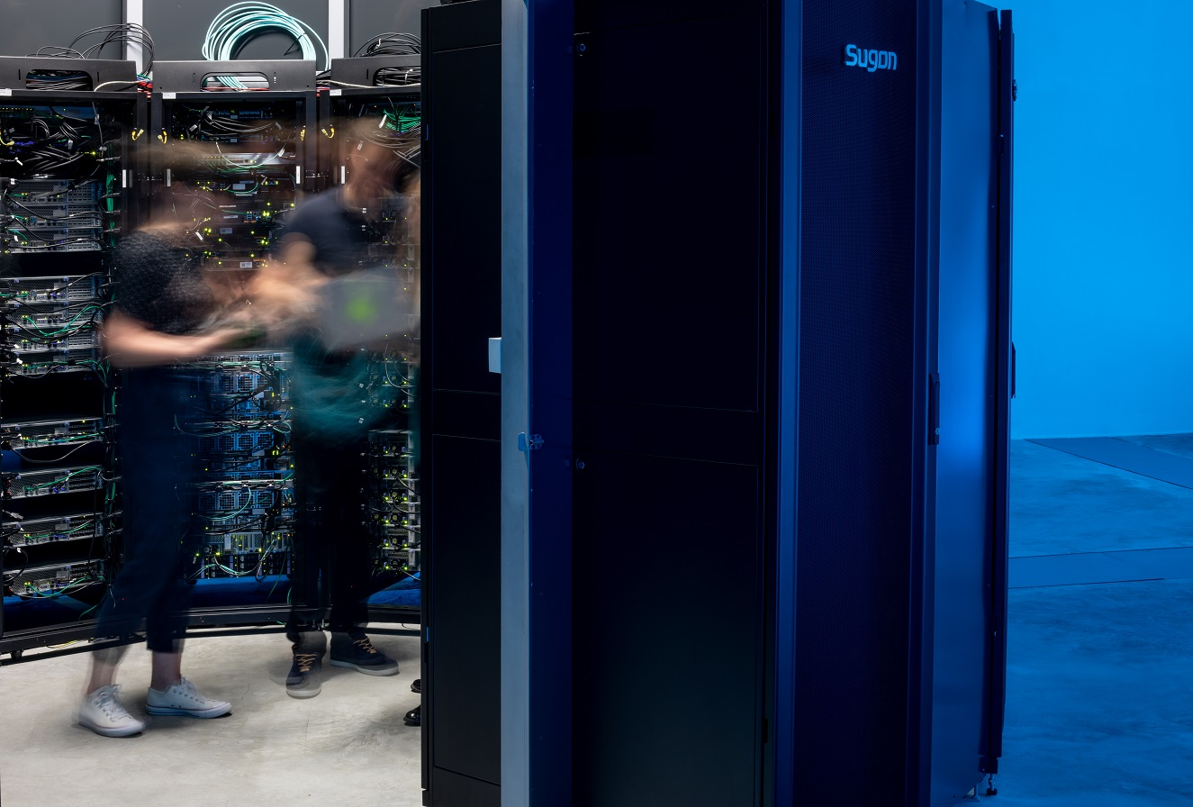
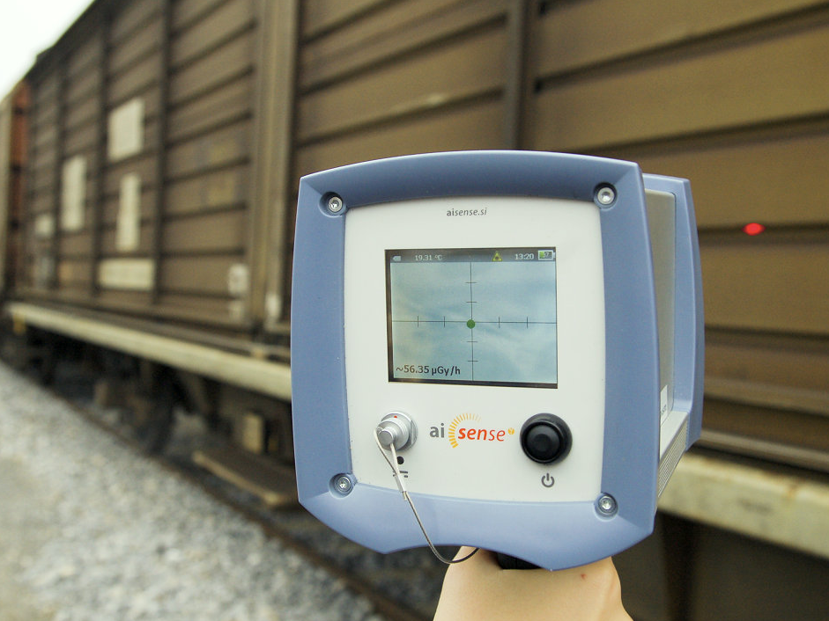
arctur
where creativity meets experience
HPC &
radiation
innovative
big data
detection

Slide 3

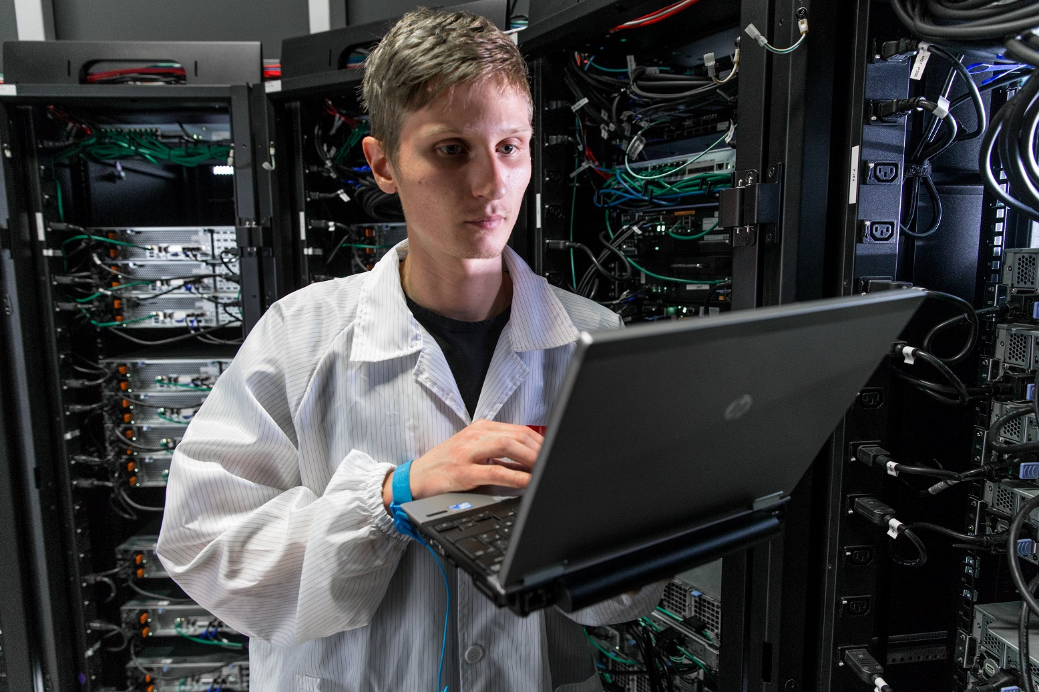
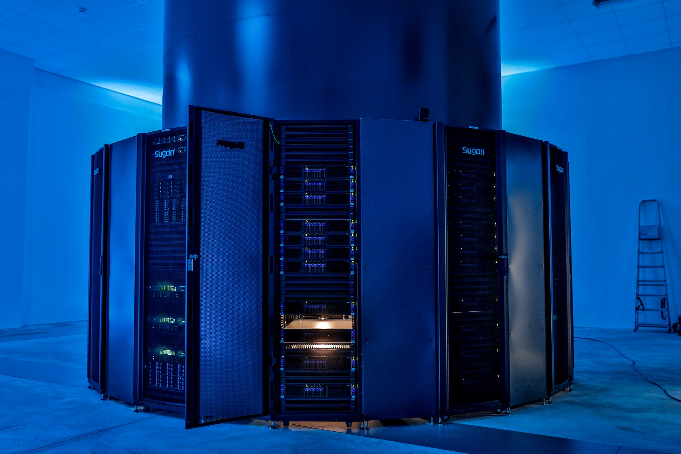
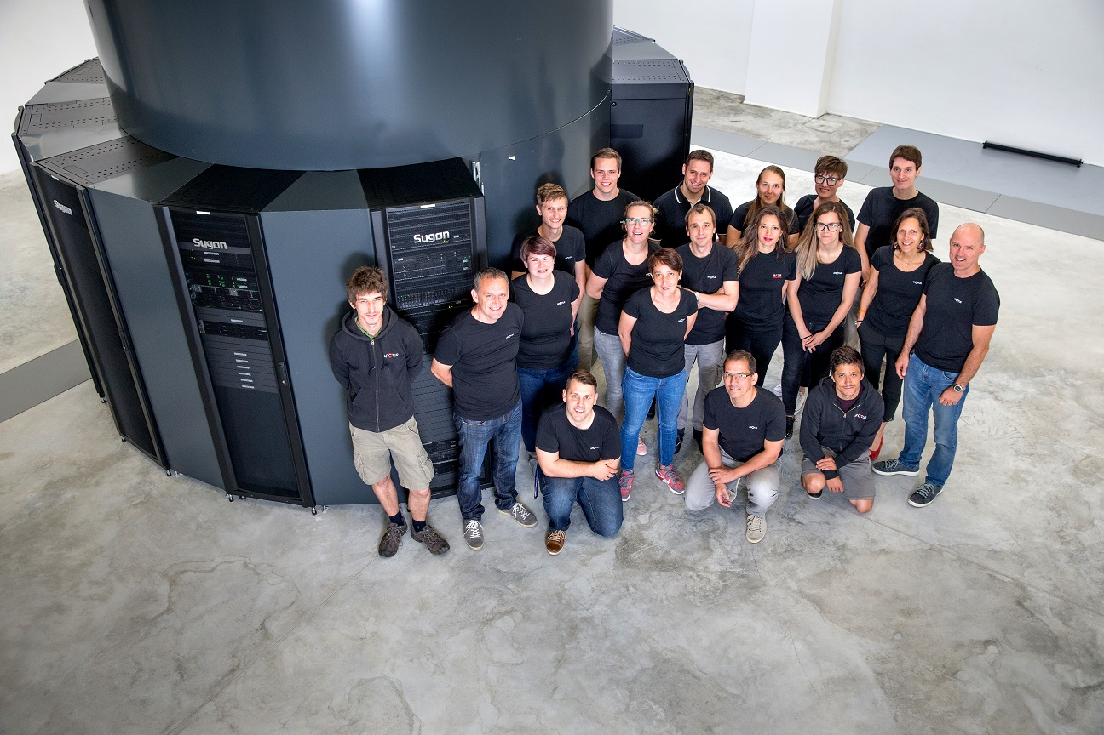
hpc
services
infrastructure and services
team
infrastructure

Slide 4
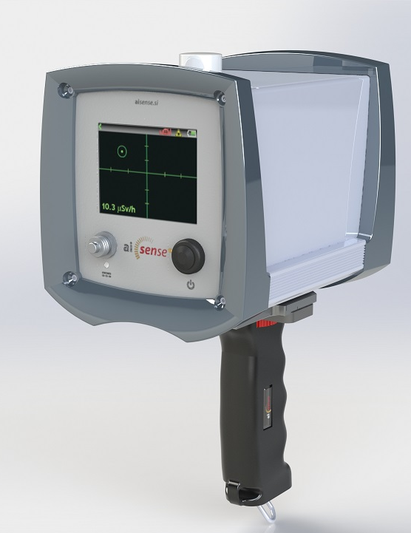
competitive advantages
aisensegamma4
shows direction towards the gamma-ray source in real time
+
it is a complete tool:
direction
dose rate
ID of gamma-ray source
neutron detection

Slide 5
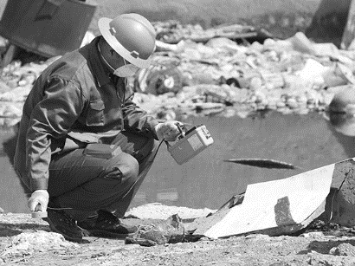
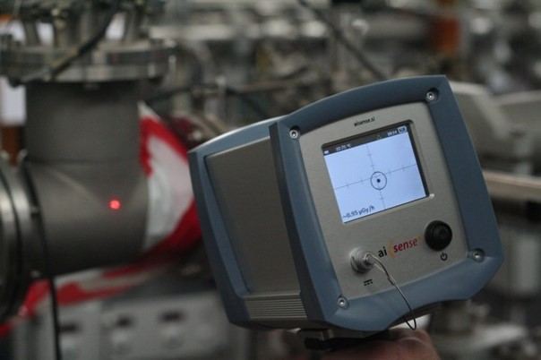
localization of the gamma-ray source
aisensegamma4
classic detector
AISense Gamma4
vs

Slide 6
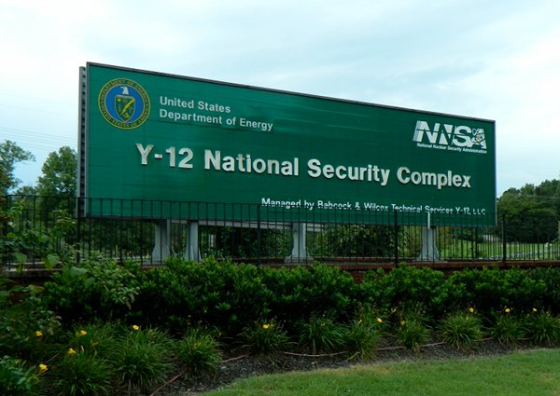
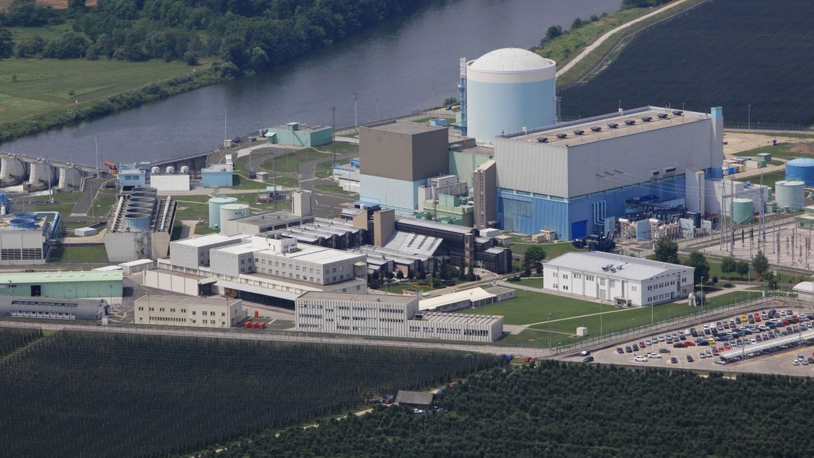
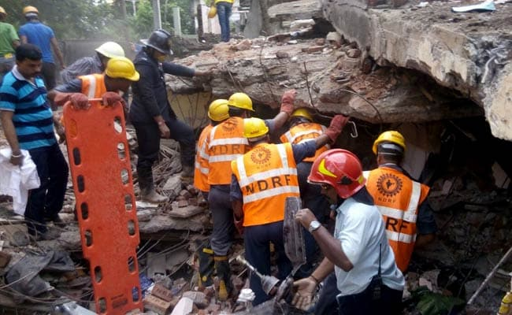
references
aisensegamma4
Y-12 Complex
USA
NPP Krško
Slovenia
NDRF
India

Slide 7
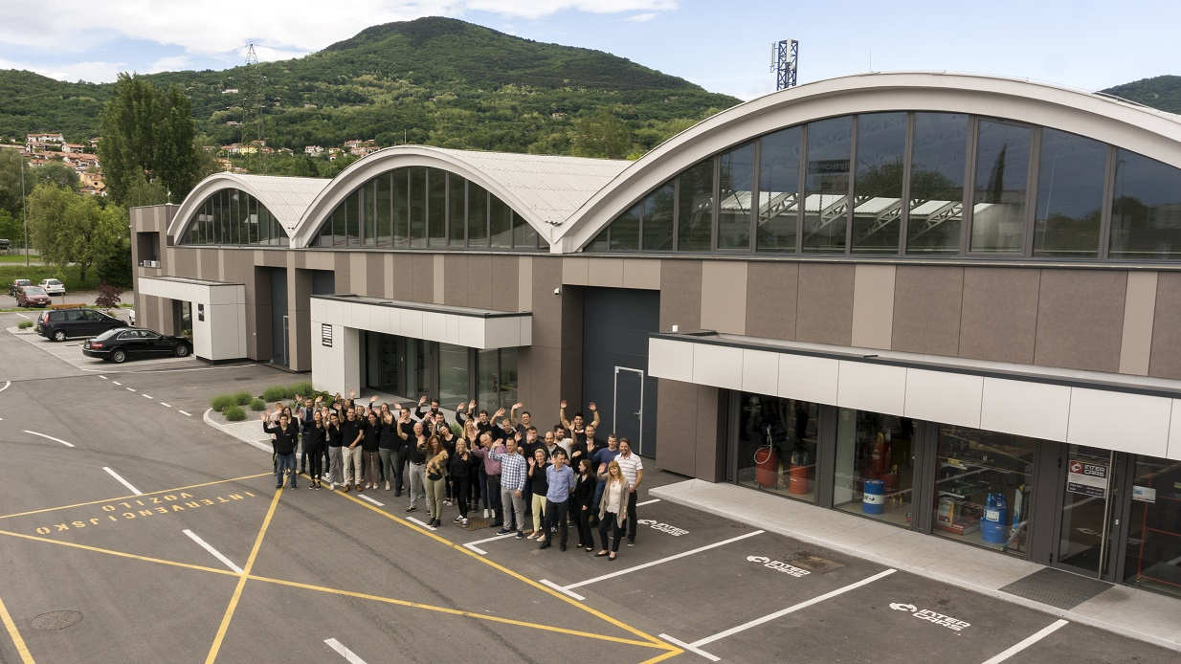
arctur
where creativity meets experience
thank you!

