Slide 1

METRA
Gregor Jenčič

Slide 2
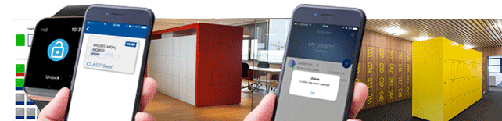

Making internal CERN distribution
secure, discreet and error-free
smarter locking

Slide 3




About Metra
Among global leaders in smart electronic locking systems for intelligent, centrally managed, on-line storage lockers
Smart locker solutions in 60+ countries worldwide (Corporate offices, factories, R&D facilities, nuclear powerplants, oil rigs, hospitals, universities, sport/leisure, etc.)
Locker installations from 50 to 10.000+ intelligent lockers
Access cards (99,9%), Mobile apps, PIN Code, Fingerprint, Barcode, QR code
Integrated with access control and facility systems (Assa Abloy, HID, Kaba, etc.)

Slide 4
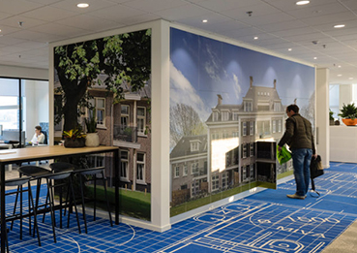
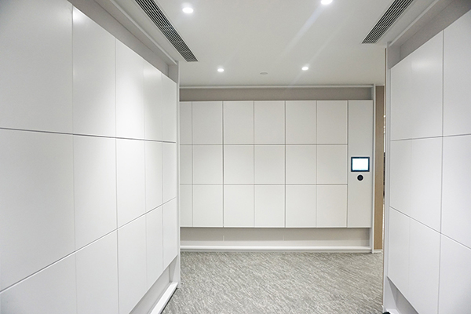
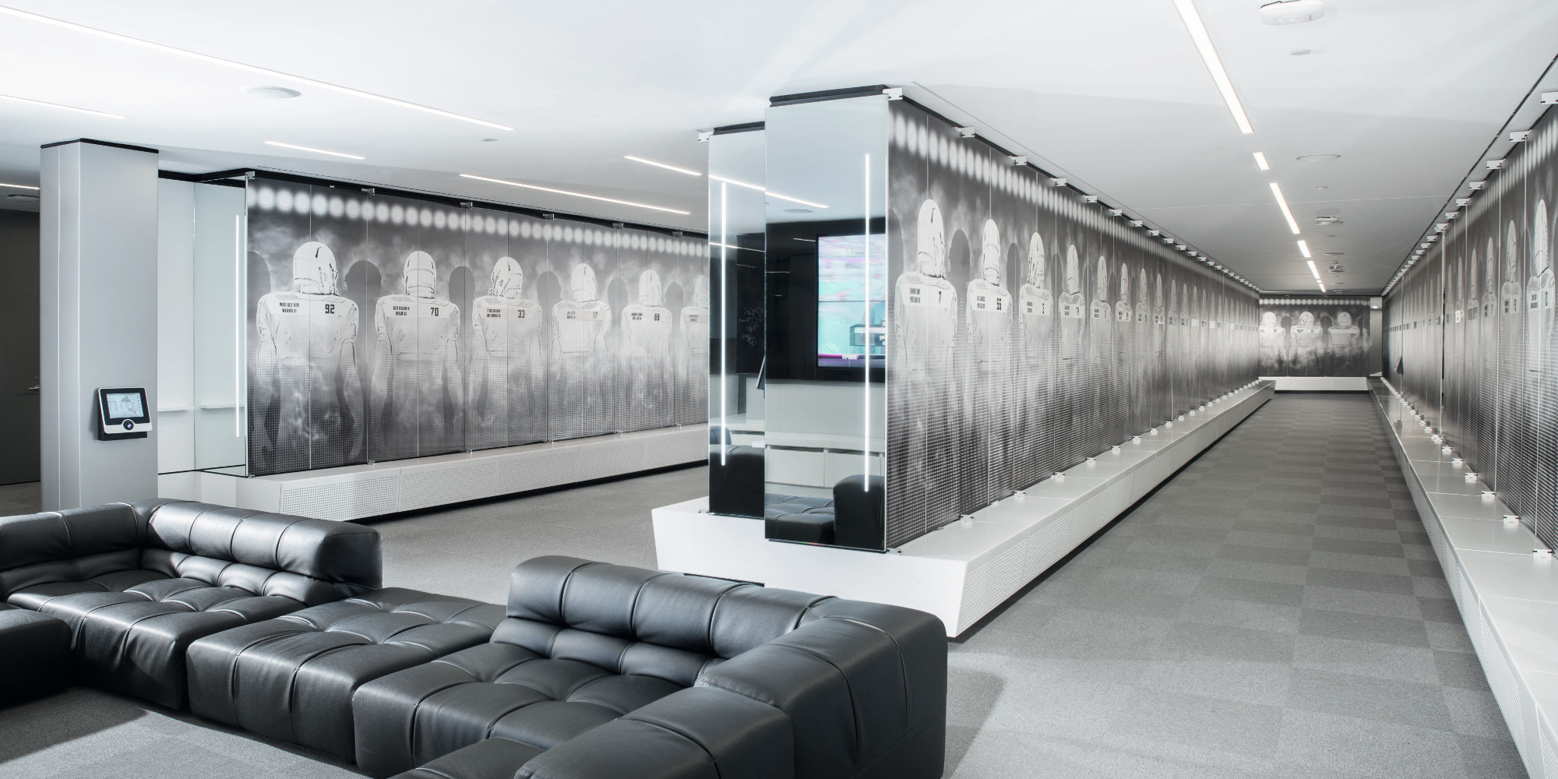
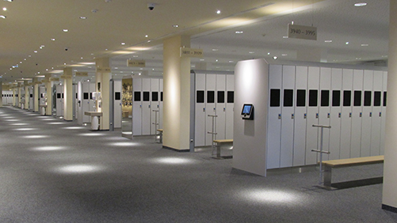
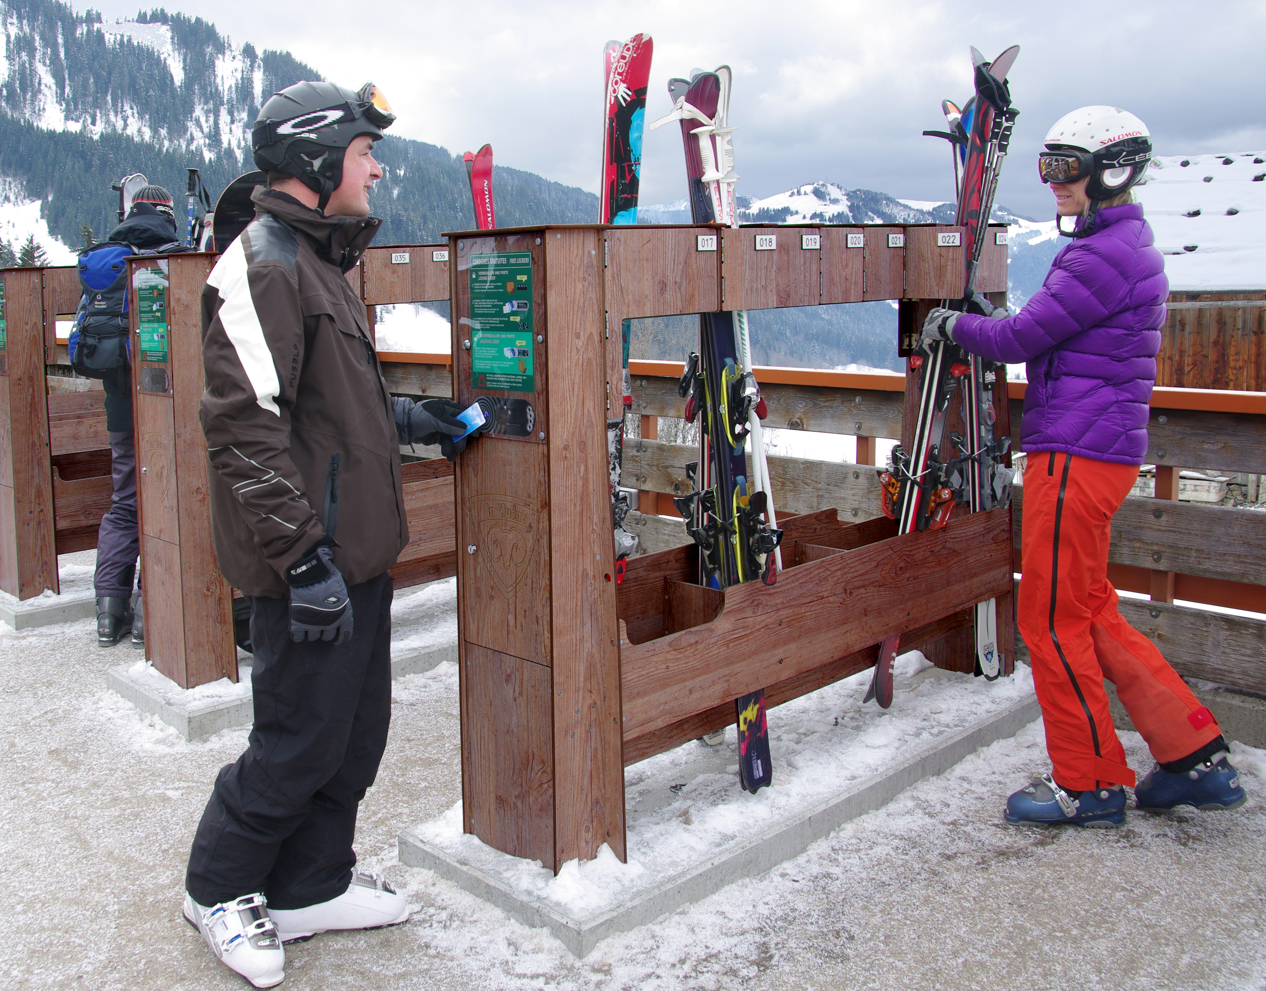
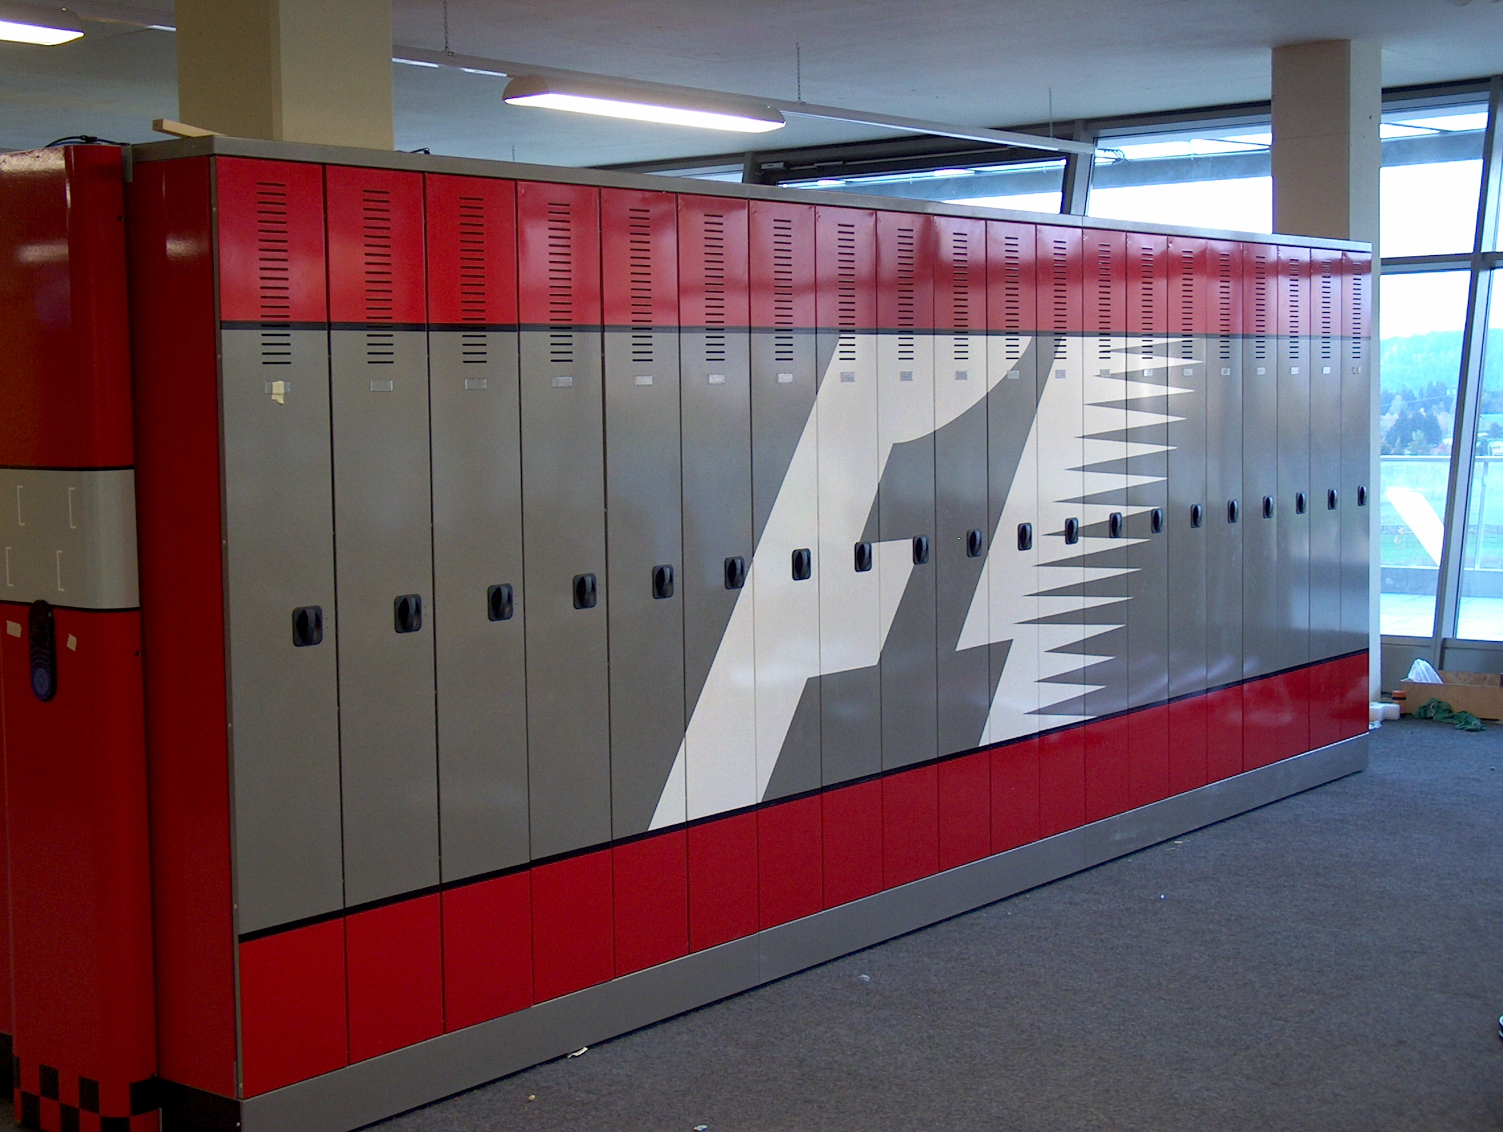
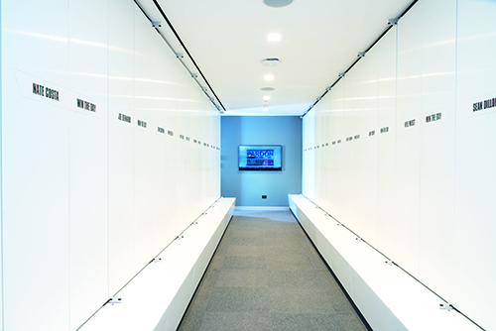
Smart storage locker solutions
Daily lockers (Daily visitors in waterparks, ski resorts, etc.)
Rental Lockers (Payable baggage lockers at airports, stations, on cruise ships, etc.)
Workplace lockers (Activity-based, permanent lockers for employees and students)
Custom storage Platform (For third-party solutions, city bike lockers, beach lockers)

Slide 5
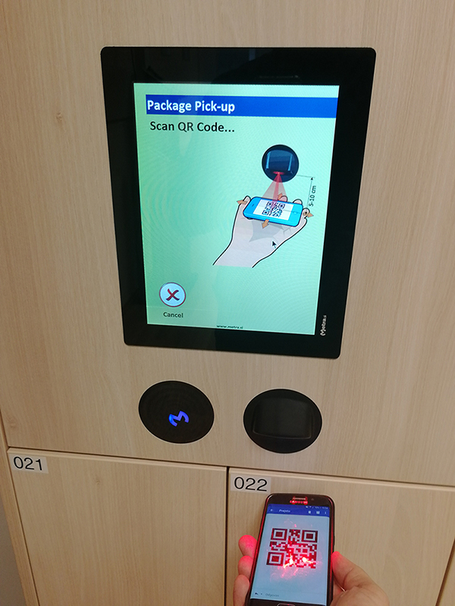
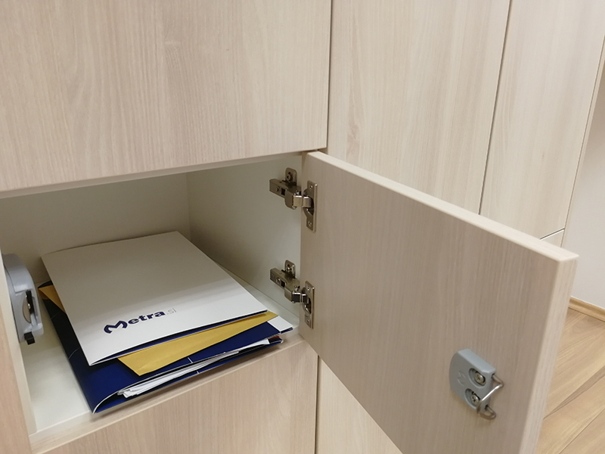
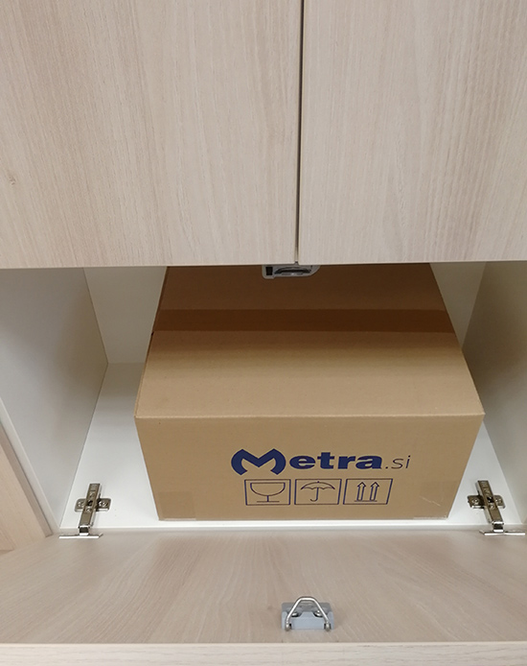
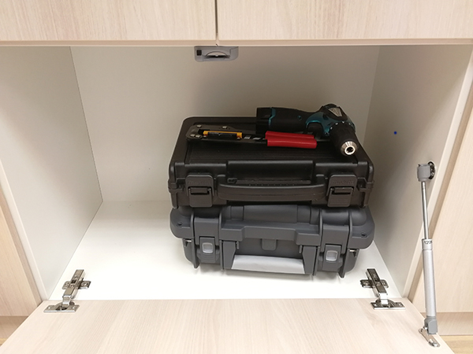
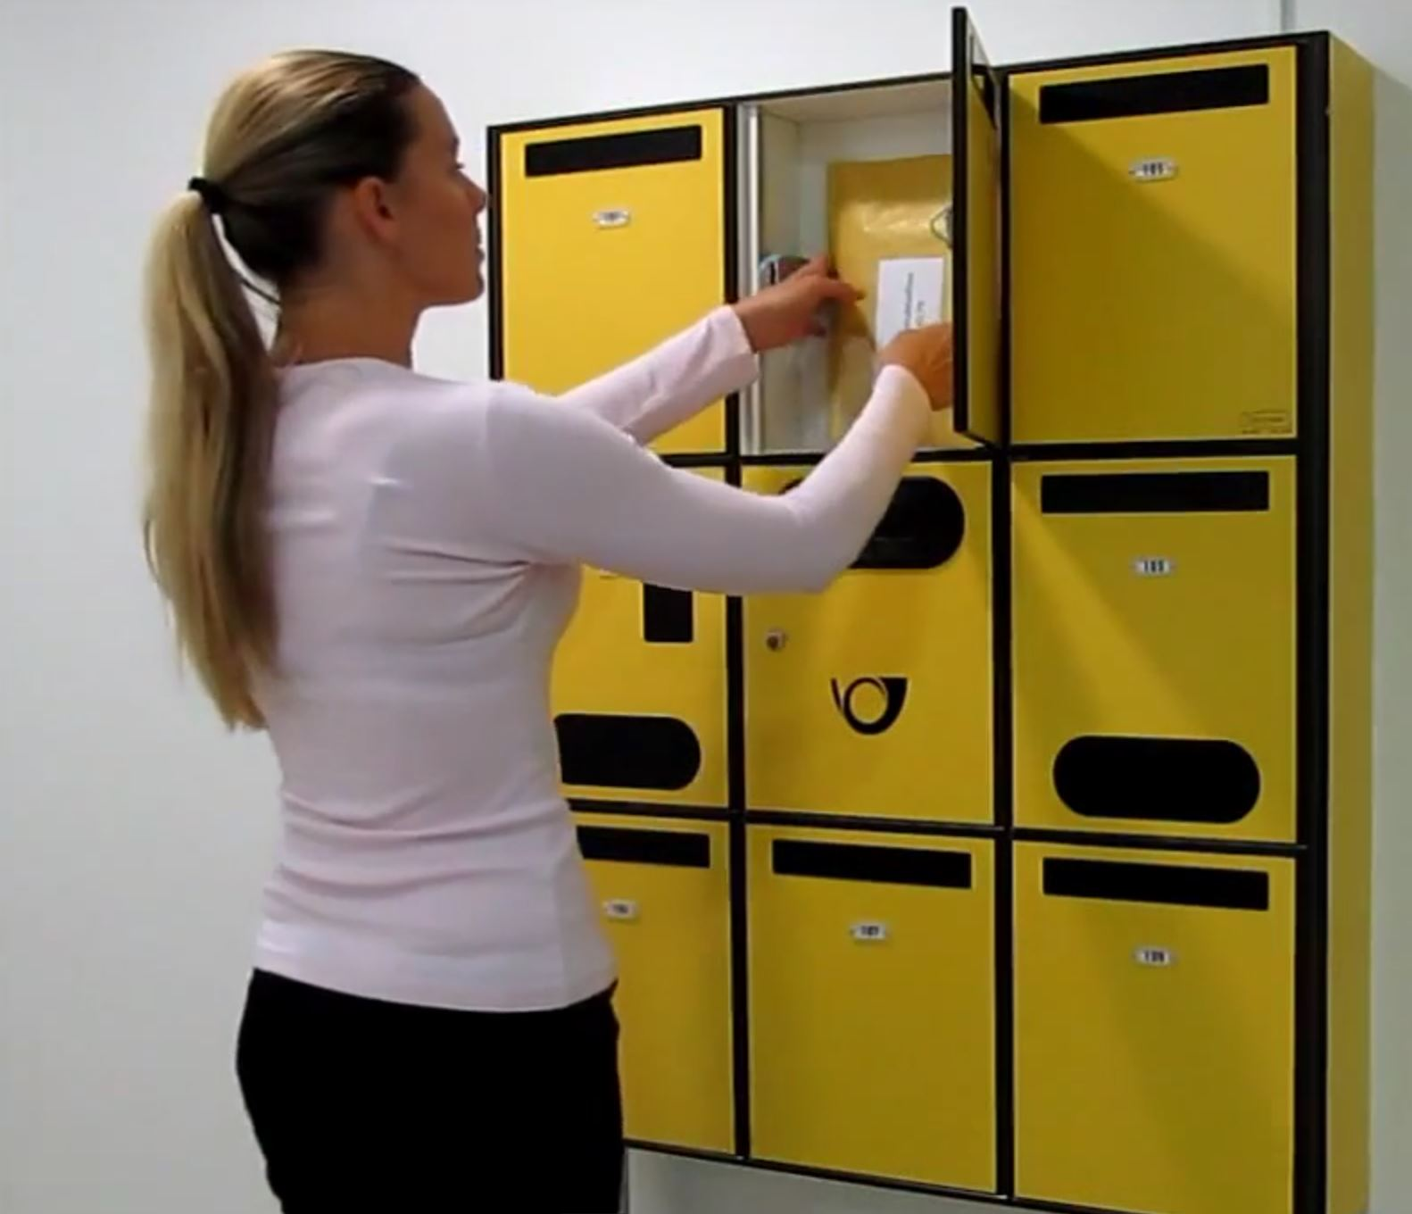
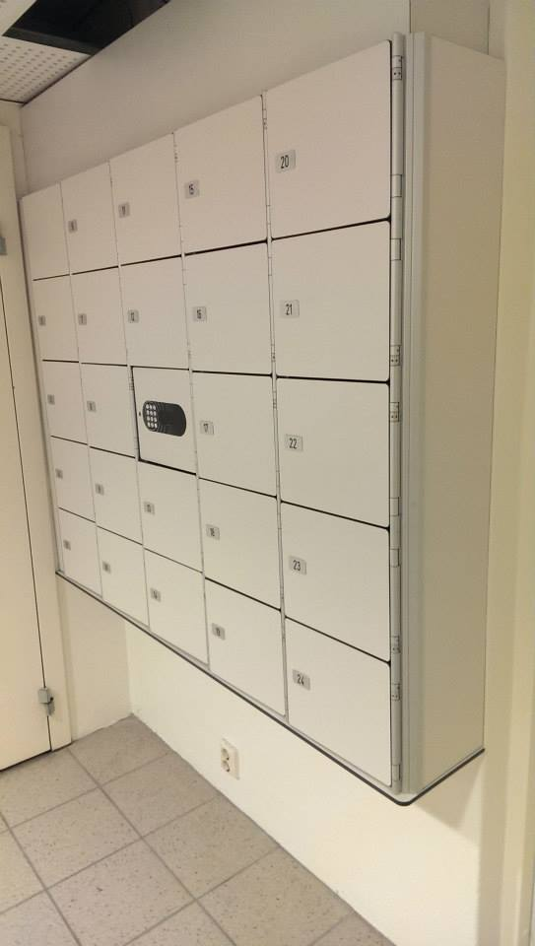
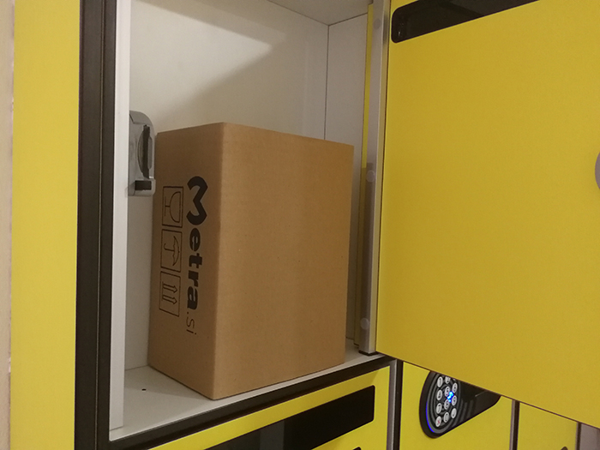
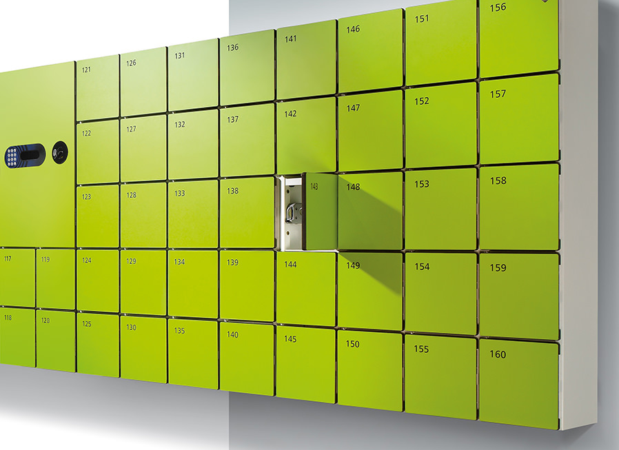
Workplace Delivery & Pick-up lockers
Smart, low-maintenance, centrally managed, user-friendly delivery locker system
Secure, discreet, error-free deliveries/pickups among CERN employees /others
Each one can „send“ items to one or to many recipients, secretary ➔ employees,
employee ➔ employee, employees ➔ courier for outbound post, etc.)
Recipient receives email with pickup info (locker location, unique QR/PIN code)

Slide 6
CERN Delivery & Pickup lockers
Locker banks on strategic locations (Entrance, restaurant, indiv. CERN Buildings)
Lockers at entrance (For incoming post/items + for outgoing post)
At other CERN locations (For internal docs/items + for outgoing post/items)
Secure, discreet, simple, fun delivery and pickup process
Nothing gets lost, forgotten, wrongly delivered/picked up, etc.
Save time, money, less workload for internal distribution personnel (internal deliveries processes „transferred“ to people using it)

Slide 7















The choice of global clients

Slide 8
Thank you for your attention.
Questions?
PS: Welcome to try the smart solution in the hallway

