Slide 1
Transverse-to-Longitudinal Emittance Exchange Using an RF Deflecting Cavity
V. Dolgashev for P. Emma
3 September, 2010
ICFA Beam Dynamics Mini-Workshop on Deflecting/ Crabbing Cavity Applications in Accelerators
Cockcroft Institute, 1-3 September 2010

Slide 2
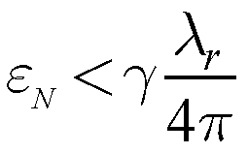
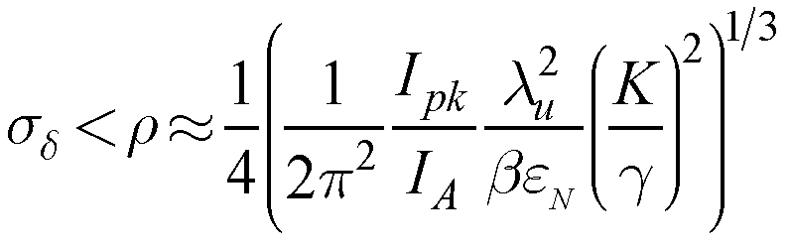
Motivation-1 (for X-Ray FEL)
Transverse emittance must be < radiation wavelength (e.g., ε_{N} < 1 μm at λ_{r} ~ 1 Å)
Energy spread must be < ρ , the FEL parameter
(e.g., σ_{δ} < 0.04%)
So we need γε_{x} < 1 μm, and also γσ_{z}σ_{δ} ≡ γε_{z} < 100 μm
While RF guns produce γε_{x} ~ γε_{z} ~ 1-3 μm
Can we reduce γε_{x} at the expense of γε_{z} ?

Slide 3
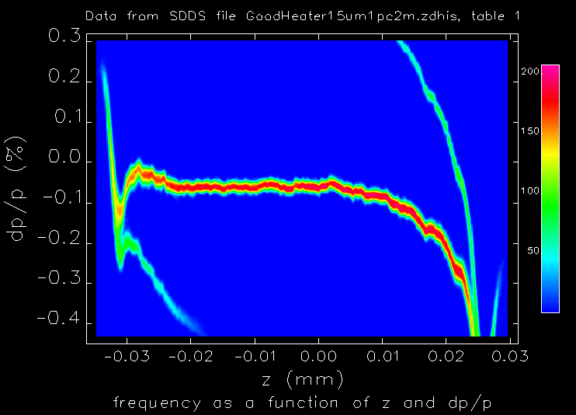
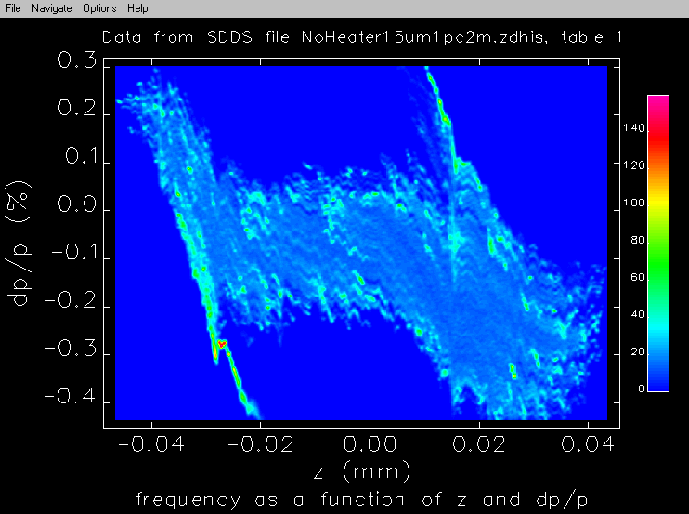
Motivation-2 (for X-Ray FEL)
Very bright beam from RF guns are susceptible to a μ-bunching instability (M. Borland, et al.).
This can be controlled by increasing the intrinsic (slice) energy spread (Landau damped in bunch compressors) → requires a laser heater, but degrades 6D brightness!
heated beam stays cool
beam blows up with no heater
Final LCLS long. phase space at 14 GeV for initial modulation of 1% at λ₀ = 15 μm

Slide 4
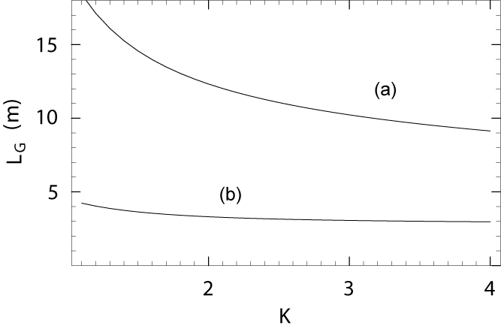
Strategy for FEL
Use ‘flat-beam injector’ to generate a beam such as: γε_{x} ~ 10 μm, γε_{y} ~ 0.1 μm, and γε_{z} ~ 0.1 μm
Exchange emittances (bends + RF deflector): γε_{x} ↔ γε_{z}
Saturate FEL at 0.4 Å with no μ-bunching instability
γε_{x,y} ≈ 1 μm, I_{pk} ≈ 3.5 kA, σ_{δ} ≈ 0.01%
γε_{x,y} ≈ 0.1 μm, I_{pk} ≈ 1 kA, σ_{δ} ≈ 0.01%

Slide 5
Flat Beam Injector (FNAL)
(Y. Derbenev), (R. Brinkmann, Y. Derbenev, K. Flöttmann), (D. Edwards …), (Y.-E Sun)
UV light
skew quads
rf gun
booster cavity
γε_{x} ≈ 0.4 μm
γε_{y} ≈ 40 μm*
X3
X4
X5
X6
X7
X8
experiment
simulation
* Ph. Piot, Y.-E Sun, and K.-J. Kim, Phys. Rev. ST Accel. Beams 9, 031001 (2006)

Slide 6
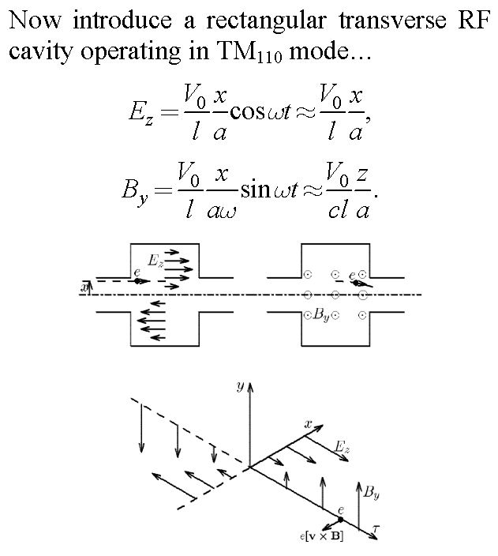
Introduce Transverse RF Deflecting Cavity

Slide 7



Emittance Exchange Beamline
Transverse RF cavity (TM₁₁₀) in a double dog-leg…
ε_{x0}
ε_{z0}
e⁻
k
η
Exchanger perfected by K.-J. Kim (2005)
Particle at position x in cavity gets acceleration: ΔΕ/Ε ≡ δ ≈ kx
This energy deviation δ in cavity causes position change: Δx = ηδ
Choose k to cancel initial position: Δx ≈ ηkx = −x → ηk = −1
Cornacchia, Emma, PRST AB 5, 084001 (2002), & Emma, et al., PRST AB 9, 100702 (2006).

Slide 8
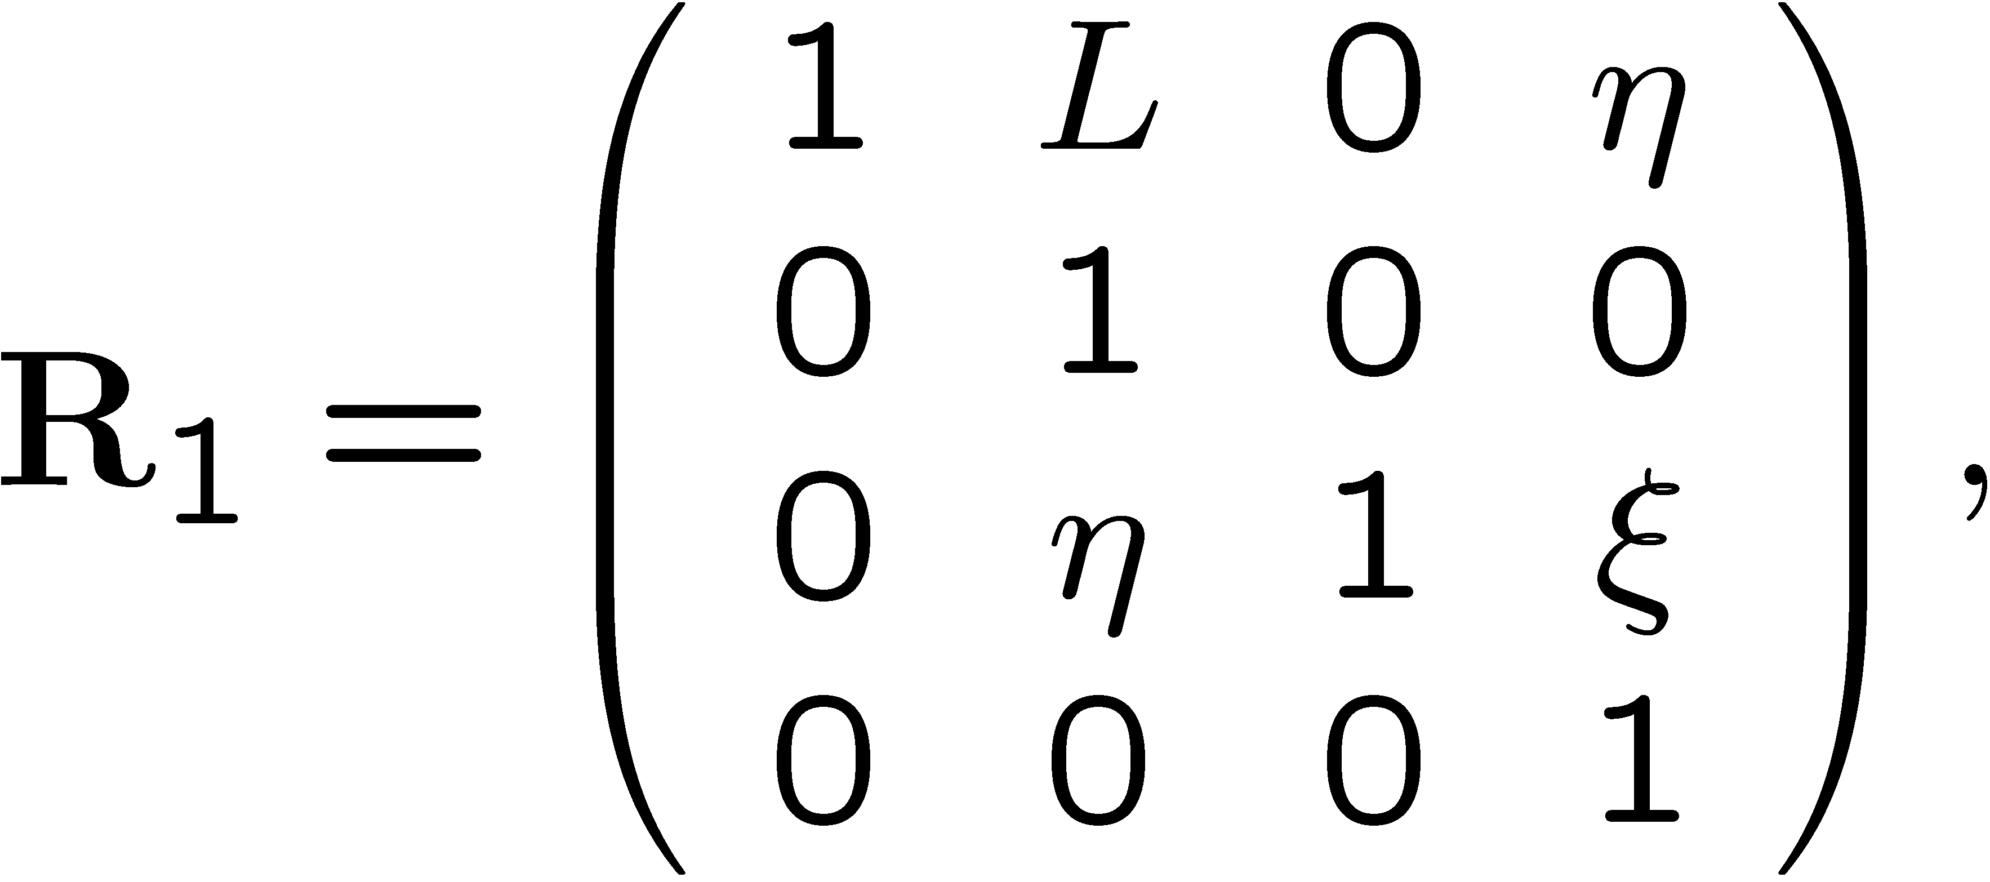
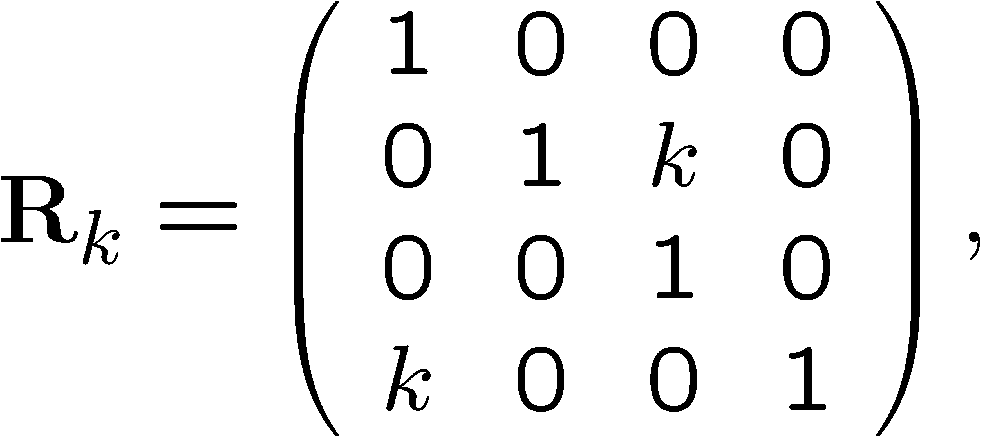

Emittance Exchanger Transfer Matrix
2L
R_{k}
η
R₁
k
R₁
η
rectangular RF deflecting cavity
ξ ≡ R₅₆ of dog-leg
x, z mapping (ignore y coordinate here)

Slide 9
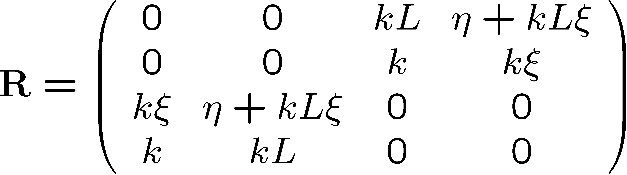
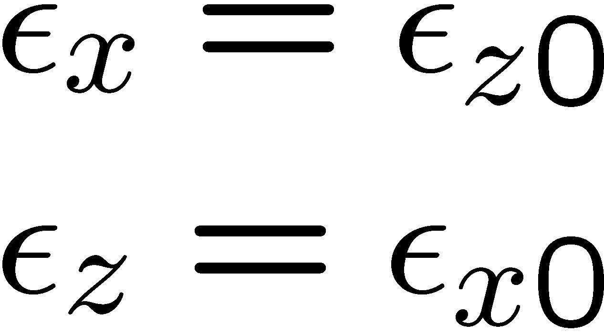
Full Emittance Exchanger
If RF deflector voltage is set to: k = −1/η
…then transverse (bend-plane) and longitudinal emittances are completely exchanged.

Slide 10
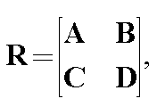
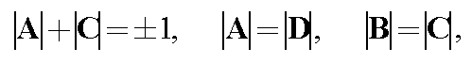
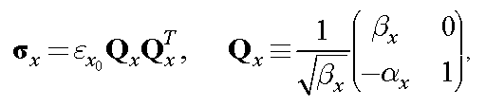
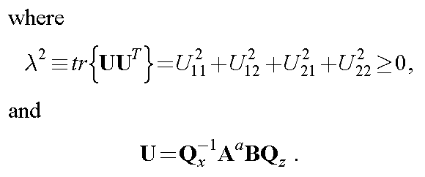
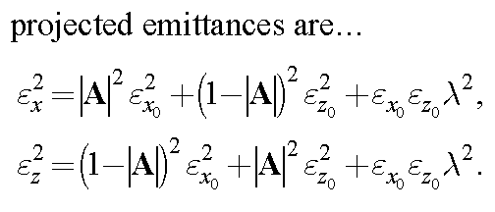
Emittance Exchange Limitations
symplectic conditions
4x4 transfer matrix is four 2x2 blocks¹:
2
Equal emittances remain equal. (if ε_{x0} = ε_{z0} then ε_{x} = ε_{z.})
2
Equal, uncoupled emittances cannot be generated from unequal, uncoupled emittances³. (Setting |A| = ½ produces equal emittances, but then they are highly coupled with λ² ≠ 0.)
[1] K.L. Brown, SLAC-PUB-2370, August 1980.
[2] Thanks to Bill Spence.
[3] E. Courant, in “Perspectives in Modern Physics...,” R.E. Marshak, ed., Interscience Publishers, 1966.

Slide 11
Emittance Exchange Simulation Parameters
Parameters (20 pC bunch charge) | symbol | value | unit
Electron energy | E | 216 | MeV
Dipole magnet length | L_{B} | 20 | cm
Drift length between dipole magnets | L | 1 | m
Bend angle per dipole magnet | θ | 20 | deg
Length of rec. RF cavity | L_{c} | 30 | cm
Initial horizontal norm. emittance | γε_{x} | 9.92 | μm
Initial longitudinal norm. emittance | γε_{z} | 0.080 | μm
Initial rms bunch length | σ_{z}^{G} | 51 | μm
Initial rms slice energy spread | σ_{E}^{G} | 0.9 | keV
Initial energy chirp (δ-z slope) | h | 6.9 | m⁻¹
Initial horizontal beta function | β_{x} | 100 | m
Initial horizontal alpha function | α_{x} | 0

Slide 12
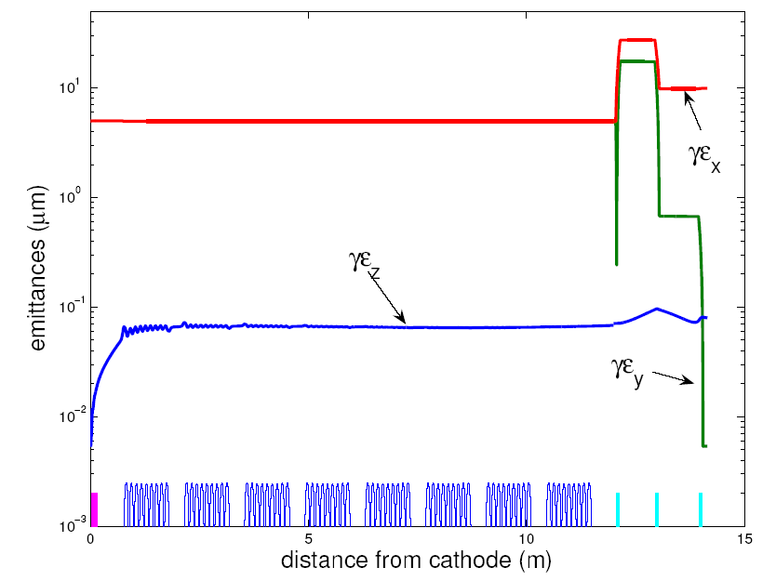
Evolution of Transverse Emittance Along Simulated Photo-Injector Beamline (to 216 MeV)
γε_{x}
9.9 μm
coupled values
intrinsic
γε_{x,y} ≈ 0.23 μm
γε_{z}
0.084 μm
γε_{y}
rf gun
0.0054 μm
acc. cavities
skew quads

Slide 13
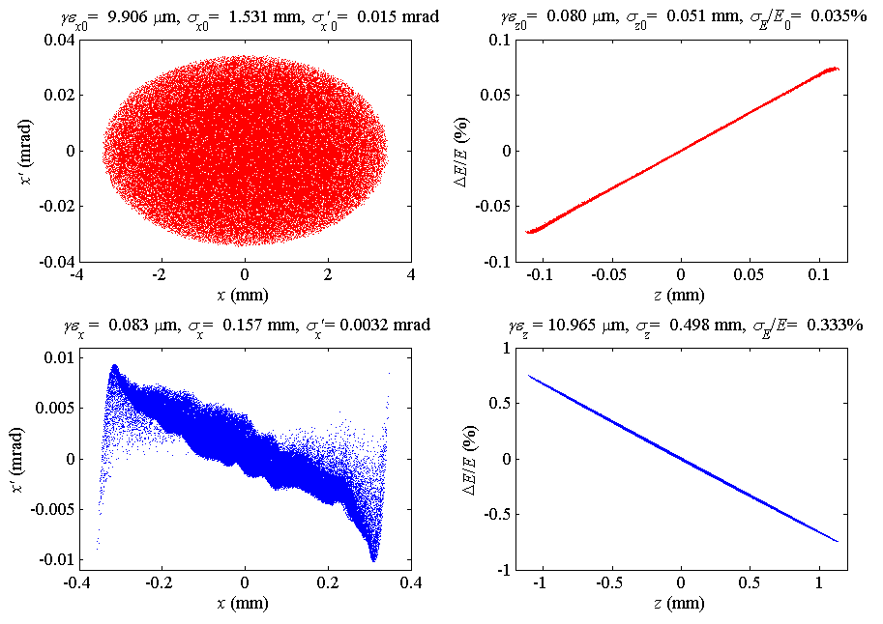
Transverse phase space (left two plots) and longitudinal phase space (right two plots) before (top) and after (bottom) emittance exchange.
BEFORE EXCHANGER
AFTER EXCHANGER

Slide 14
Cavity Thick-Lens Effect Requires Some Attention
tail
Thin-lens gives no x-offset in cavity
head
tail
Thick-lens: B_{y} kick, and then x-offset changes δ
head
l
tail
add ‘chirp’ to compensate: no mean x-offset
head

Slide 15
Unusual System Characteristics
β-tron oscillations disappear
k
Δx′
k
energy error
starts β-osc.
ΔE/E
Need extremely stable energy (0.5×10⁻⁶ rms jitter ⇒ 10% x-beam size jitter)

Slide 16
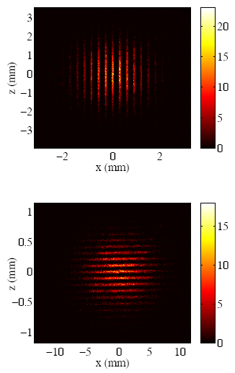
ANOTHER IDEA: Femtosecond Bunch Trains from Phase Space Exchange Technique
Multi-slit mask is used to establish a transverse modulation
Exchanger maps this modulation into temporal
Yin-e Sun, Philippe Piot, Linac’08

Slide 17
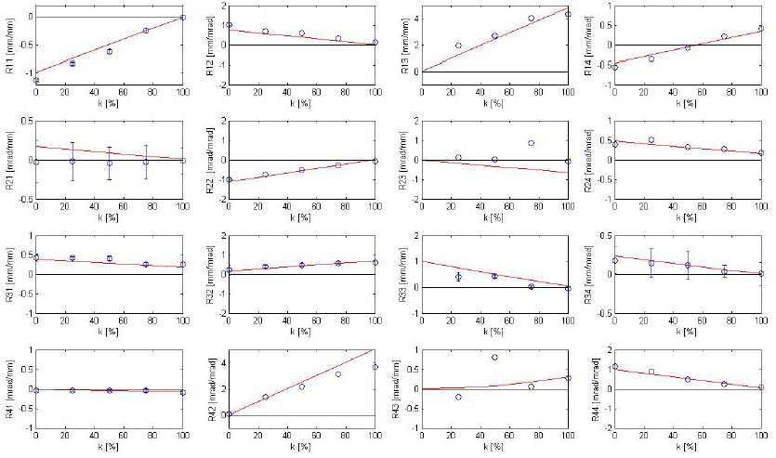
Measurement of Exchange System (FNAL)
4×4 matrix measurement vs. RF power
Both on-diagonal 2×2 sub-matrices = 0 at full RF power (k/k₀ = 100%)
R₁₁
R₁₂
R₁₃
R₁₄
k/k₀ (%)
k/k₀ (%)
k/k₀ (%)
k/k₀ (%)
R₂₁
R₂₂
R₂₃
R₂₄
k/k₀ (%)
k/k₀ (%)
k/k₀ (%)
k/k₀ (%)
R₃₁
R₃₂
R₃₃
R₃₄
k/k₀ (%)
k/k₀ (%)
k/k₀ (%)
k/k₀ (%)
R₄₁
R₄₂
R₄₃
R₄₄
k/k₀ (%)
k/k₀ (%)
k/k₀ (%)
k/k₀ (%)
T. Koeth, Linac’08

Slide 18
Summary
Simulations of flat-beam gun with emittance exchanger suggest possible levels of: γε_{z} ≈ 10 μm, γε_{y} ≈ 0.005 μm, γε_{x} ≈ 0.16 μm
This beam allows shorter wavelength FELs and/or smaller, lower cost accelerators
The resulting large z-emittance should also Landau-damp the micro-bunching instability
Sensitivity to energy jitter may be Achilles heel
Transverse RF opens great new potential !

