Slide 1

EUCARD Collaboration
Crab Cavity Research
Peter McIntosh
(STFC, Daresbury Laboratory)
ICFA Beam Dynamics Mini-Workshop on
Deflecting/Crabbing Cavity Applications for Accelerators

Slide 2
Outline
The Collaboration Team
Description of the Scientific Work
Project Planning/Status
Deliverables/Milestones
Publications/Events
Conclusions
EUCARD SRF-WP10 can be found at: https://espace.cern.ch/SRF/default.aspx

Slide 3




The Collaboration Team
CERN (Switzerland)
  Liasons (F Zimmermann and Ed Ciapala)
  Fellow (Luca Ficcadenti)
    18 m.m. from May 2010
CERN Total 18 m.m.
ULAN-CI (UK)
  RA-Cavity (P Ambattu)
    18 m.m.
  PDRA-LLRF (I Tahir)
    10 m.m.
  Academic-Cavity (G Burt)
    4 m.m.
  Academic-LLRF (A Dexter)
    4 m.m.
ULAN-CI Total 36 m.m.
UMAN-CI (UK)
  PDRA-Cavity (I Shinton)
    16 m.m.
  Academic-Cavity (R Jones)
    2 m.m.
UMAN-CI Total 18 m.m.
STFC (UK)
  WP Coordinator (P McIntosh)
    4 m.m.
  RF Engineer (P Goudket)
    10 m.m.
  Mech Designer (Undefined)
    4 m.m.
STFC Total 18 m.m.

Slide 4
WP10.3 Crab Cavities
Design, build and test a single LHC and CLIC crab cavity structure, including input coupler, mode couplers and tuners.
Design, build and test a LLRF and synchronization system that meets the crab cavity phase and amplitude control specifications for LHC and CLIC.
If the beam time and the necessary hardware become available, validate and test the assembled crab system solutions (as part of wider collaborations) and LLRF control systems on LHC and CTF3 in 2011; otherwise make performance predictions based on the measured noise characteristics.

Slide 5
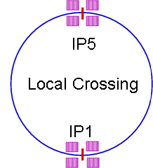
LHC-CC Local vs Global
Local crab crossing preferable (Phase-II):
  Independent control at IPs,
  Avoid collimation/impedance issues.
Need compact cavities to fit in the IR region of the ring.
Lower frequency hopefully!
Small crossing angle (~0.5 mrad):
Global crab scheme is ideal choice for prototype Phase-I:
  Test feasibility of crab crossing in hadron colliders,
  Address all RF and beam dynamic issues,
  Small orbit excursion and tune shifts,
  Compatible with nominal and upgrade options to recover the geometric luminosity loss,
  Collimation optimisation!
  These cavities are feasible using available technology and the gradient requirements are within reach of current technology.
See Rama Calaga’s and Ed Ciapala’s talks on Wednesday

Slide 6
LHC-CC R&D Plan
From LHC-CC08 BNL, 25-26 Feb 2008
EUCARD FP7 Contribution

Slide 7
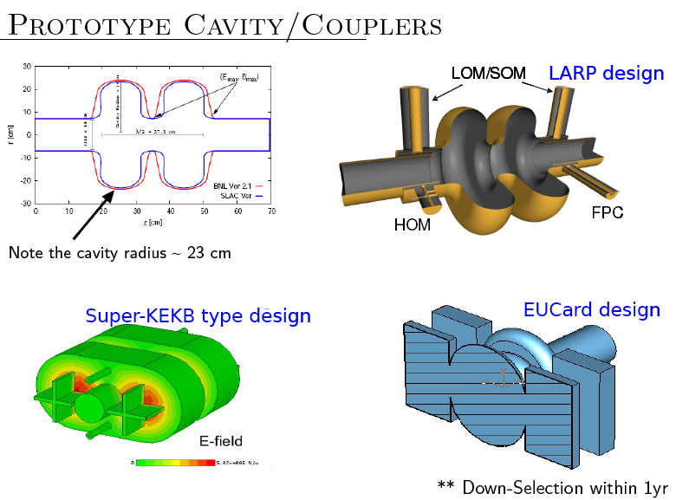
LHC US-LARP Integration (Phase-I)
See Zenghai Li’s talk on Thursday

Slide 8
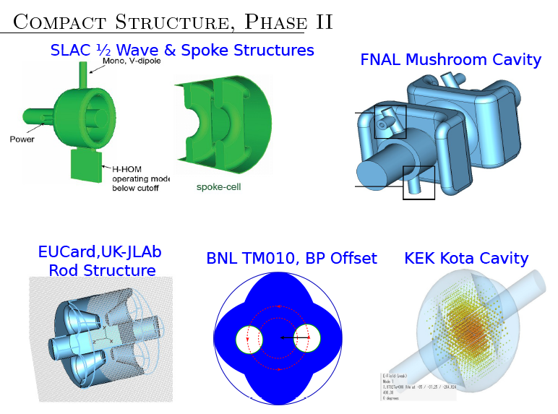
LHC US-LARP Integration (Phase-II)
See Graeme Burt’s talk on Thursday

Slide 9
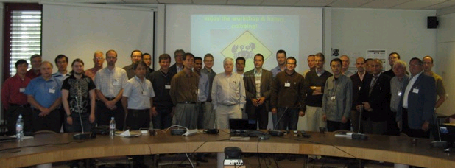
LHC-CC09 CERN: 16-18 Sept 09
After the success of KEKB, CERN must pursue crab cavities for the LHC; the potential luminosity increase is significant.
Machine protection is potential show stopper. Effect of fast cavity changes to be looked at with high priority. Impedance is concern as LHC (and SPS) revolution frequency changing during acceleration, and detuning of the cavity may be more difficult than for KEKB, strong damping of the dipole mode might need to be examined.
Demonstration experiments with beam should focus on the differences between electrons and protons (e.g. effect of crab-cavity noise with beam-beam, impedance, beam loading) and on reliability & machine protection which are critical for the LHC;
  beam test with a (KEKB?) crab cavity in another proton machine (SPS?) may be useful and sufficient.
Both “global” and “local” crab schemes retained as options. Future R&D focus should be on compact cavities, which can be installed in the IR regions of IP1 and 5 as local cavities for the LHC upgrade phase II.
Modifications of IR4 during the 2013/14 shutdown should be looked at; the IR4 region could be used for the installation and test of compact crab-cavity prototypes and for accommodating a possible global crab-cavity scheme.
The crab cavity infrastructure should be kept in mind for all other LHC upgrades.
Steve Myers (CERN Director of Accelerators)

Slide 10
CLIC-CC Design Philosophy
Design 12 GHz TW dipole copper cavity with high group velocity and thick irises:
  12 GHz is compact and has synergy with linac.
  12 GHz makes phase control tolerance larger than for sub harmonic frequency choices.
  TW allows energy flow to mitigate beam-loading.
  Thick irises reduces effects of pulse heating and phase drift.
  Adjacent mode for SW cavities affect phase control performance.
Investigate various damping options.

Slide 11
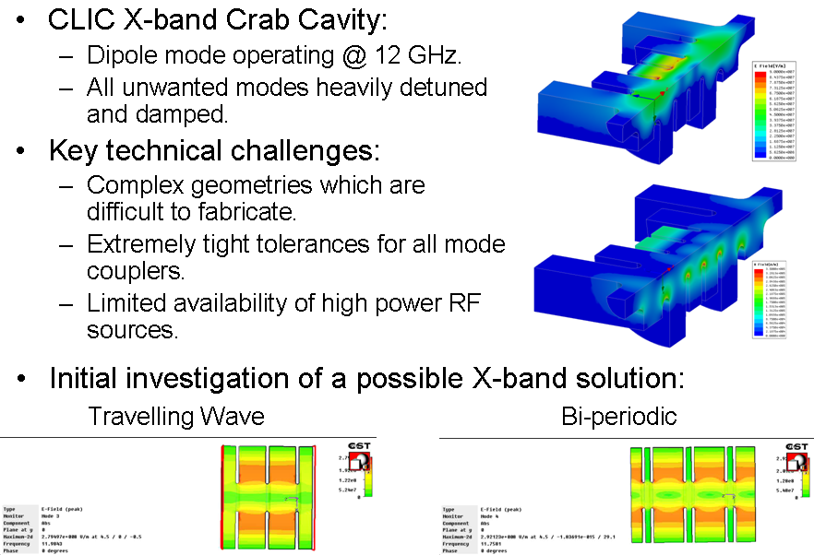
CLIC-CC Developments
See Praveen Ambattu’s talk on Thursday

Slide 12
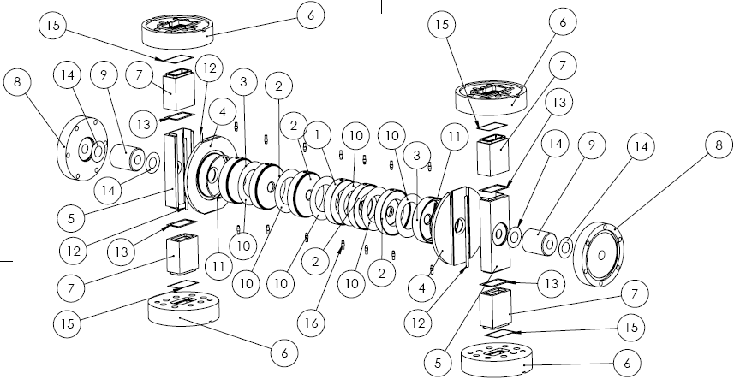
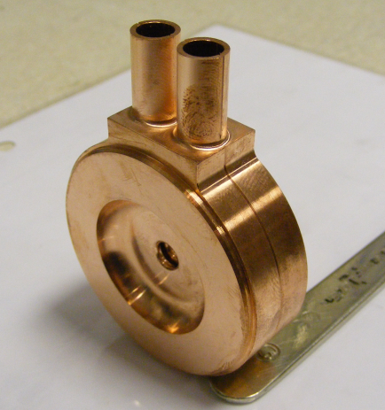
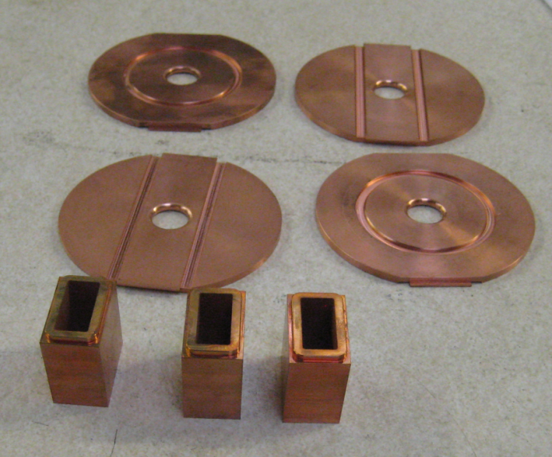

CLIC-CC Fabrication
See Shakespeare’s display material

Slide 13
Crab Cavity LLRF Solutions
LHC-CC
  Anticipate a local crab crossing scheme < 0.522 mrad
  Anticipate 400 MHz SRF cavities
  Meeting single pass synchronisation requirement is straightforward
  Meeting beam-beam instability synchronisation requirement is tough
  Preventing phase noise causing beam blow up is a serious concern
CLIC-CC
  For CLIC anticipate both cavities driven with same Klystron
  Need to assess added phase noise on separate distribution paths
  Need a LLRF system to drive test cavity at CTF3
  Need accurate relative cavity phase measurements for 200 ns pulses
  Need a laser interferometer (not funded in EUCARD)
See Amos Dexter’s talk on Thursday

Slide 14
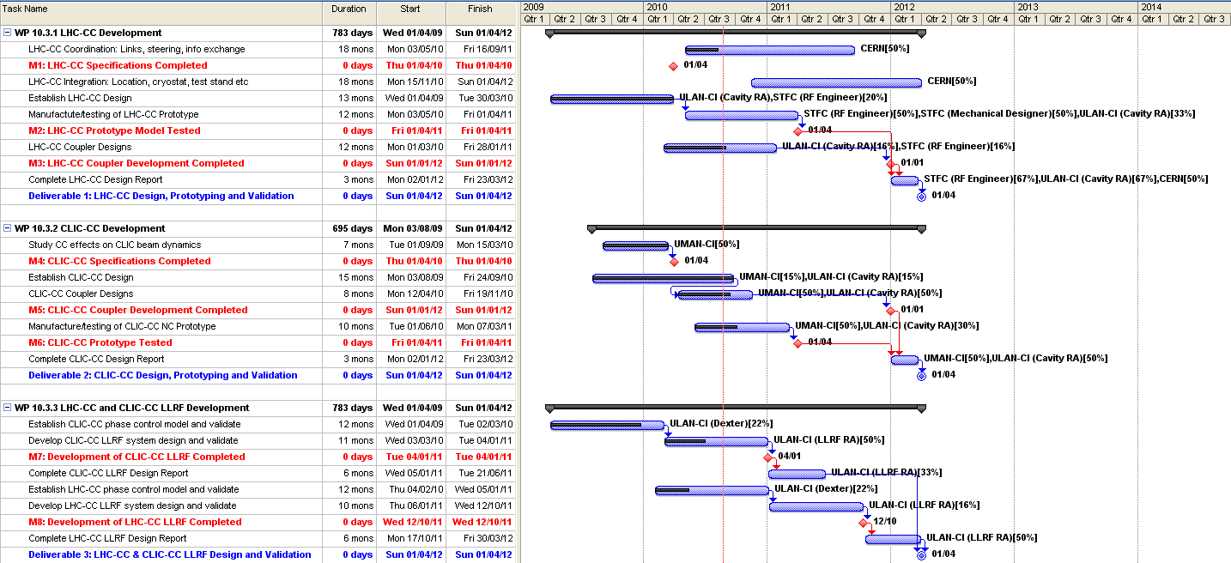
10.3 Project Plan and Milestones

Slide 15
WP10.3 Milestones and Deliverables
Output¹ | Description | Nature² | Delivery month³
M1 | LHC crab cavity specifications completed | R | M12
M2 | LHC model crab cavity completed | P | M24
M3 | LHC coupler development finished | P/R | M33
M4 | CLIC crab cavity specifications completed | R | M12
M5 | CLIC model crab cavity completed | P | M24
M6 | CLIC coupler development finished | P/R | M33
M7 | Development of LHC LLRF system | P | M21
M8 | Development of CLIC LLRF system | P | M30
D1 | LHC crab cavity final report | R | M36
D2 | CLIC crab cavity final report | R | M36
D3 | LHC and CLIC LLRF final reports | R | M36
¹ M = Milestone, D = Deliverable
² Nature: R=Report, P=Prototype, D=Demonstrator, O=Other
³ Counted from the starting date
http://cdsweb.cern.ch/collection/EuCARD

Slide 16
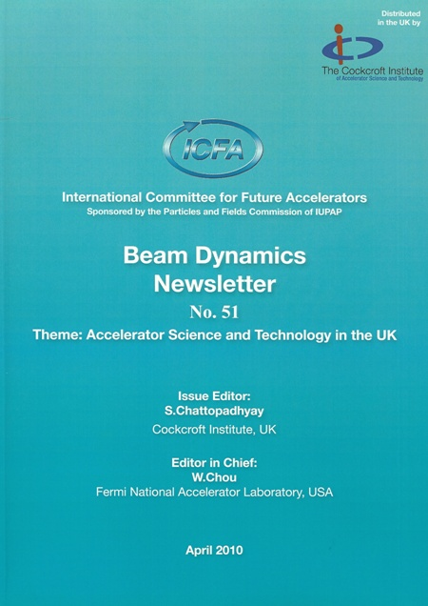
Publications
Status of LHC Crab Cavity Simulations and Beam Studies, R Calaga et al
Particle Accelerator Conference 2009, Vancouver, 2009.
LHC Upgrade Scenarios, F Zimmermann et al
Particle Accelerator Conference 2009, Vancouver, 2009.
Wakefield Damping for the CLIC Crab Cavity, P Ambattu et al
Particle Accelerator Conference 2009, Vancouver, 2009.
Status of LHC Crab Cavity Cryostat, N Solyak et al
Particle Accelerator Conference 2009, Vancouver, 2009.
Novel Geometries for the LHC Crab Cavity, B Hall et al
Particle Accelerator Conference 2009, Vancouver, 2009.
Study with One Global Crab Cavity at IR4 for LHC, Y Sun et al
Particle Accelerator Conference 2009, Vancouver, 2009.
Tune Shift due to Crossing Collision and Crab Collision, Y Sun et al
Particle Accelerator Conference 2009, Vancouver, 2009.
New Cavity Shape Developments for Crabbing Applications, G Burt
Superconducting RF Conference 2009, Berlin, 2009.
Development of Crab Cavity Systems at the Cockcroft Institute, G Burt et al
51st ICFA Beam Dynamics Newsletter, April, 2010.
Novel Geometry for the LHC Crab Cavity, B Hall et al
International Particle Accelerator Conference 2010, Kyoto, 2010.
Evolutionary Algorithms in the Design of RF Cavities, C Lingwood, et al
International Particle Accelerator Conference 2010, Kyoto, 2010.
http://cdsweb.cern.ch/collection/EuCARD

Slide 17
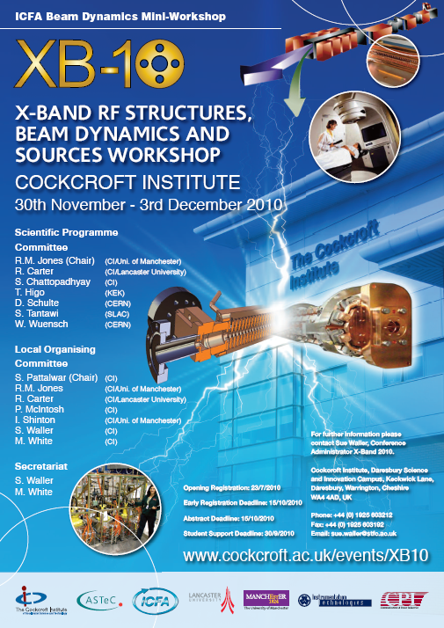
Events
EuCARD ACCNET workshop on LHC crab cavities, “LHC-CC09” at CERN, 16 – 18 Sept 2009.
EuCARD SRF Annual Review 2010, at Cockcroft Institute, 7 – 9 April 2009.
ICFA Beam Dynamics Mini-Workshop on Deflecting/Crabbing Cavity Applications in Accelerators, at Cockcroft Institute, 1 – 3 September 2010.
ICFA Beam Dynamics Mini-Workshop on X-Band RF Structures, Beam Dynamics and Sources, at Cockcroft Institute, 30 Nov – 3 Dec 2010.
EuCARD ACCNET workshop on LHC Crab Cavities, “LHC-CC10” at CERN, 15 – 17 Dec 2010.

Slide 18
Conclusions
EUCARD collaboration team working well.
LHC-CC priority at CERN raised considerably.
Both LHC-CC (phase-I and phase-II) and CLIC-CC solutions identified and prototypes under development.
Synchronisation and RF control requirements for each CC system are extremely challenging:
  Solutions being proposed and investigated.
Various talks identified will provide more details.

