Slide 1
End of contract
entitlements
Jarmila LITRAS
HR-CB-B
17/10/2019

Slide 2
Summary
Travel expenses
Removal expenses
Reinstallation indemnity

Slide 3

1. Travel expenses

Slide 4

Conditions
Homestation* :
  > 20 km from CERN or,
  > 70 km if recruited after 01.01.2007 or ex-local staff
New place of residence:
  > 20 km from the previous place of residence or,
  >70 km from CERN if recruited after 01.01.2007 or ex-local staff
  within 2 years of contract termination.
*Homestation : determined at the time of recruitment, specified on staff contract (see also HRT profile)

Slide 5
Benefits
Reimbursement of a single travel journey (cheapest form of public transport) from CERN to the home station or to the new place of residence (provided that the latter cost does not exceed the cost of the journey to the home station).
Luggage expenses (max. 30 kg by CARGO air freight)
Travel and luggage expenses for the family members provided that they take up residence with the member of personnel
Reimbursement possible before the end of contract
Procedure
Contact departmental secretariat (DAO) for the request
Admin e-guide:
https://admin-eguide.web.cern.ch/en/procedure/payment-travel-expenses-termination-contract

Slide 6
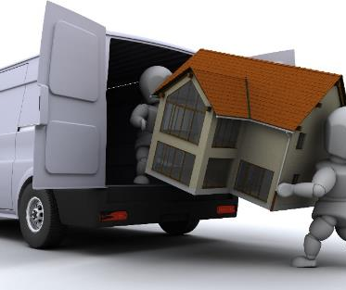
2. Removal expenses

Slide 7
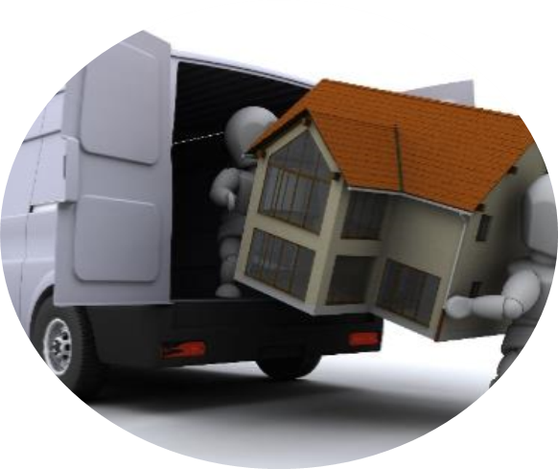
Conditions
Same as travel:
Homestation* :
  > 20 km from CERN or,
  > 70 km if recruited after 01.01.2007 or ex-local staff
New place of residence:
  > 20 km from the previous place of residence or,
  >70 km from CERN if recruited after 01.01.2007 or ex-local staff
  within 2 years of contract termination.

Slide 8
Benefits
Payment of removal expenses for household and personal effects to home station or new place of residence (provided that the latter cost does not exceed the cost of the removal to the home station)
Family situation Category New place of residence | Recipient of the family allowance | Non-recipient of the family allowance
Member State or Associate Member State | 60 m³ | 40 m³
Non-Member State | 25 m³ | 25 m³
Payment of the cost of storing furniture for a maximum period of 12 months

Slide 9
Procedure
Contact the Installation service (SMB department) in advance:
        installation.service@cern.ch
        Location: 73/1-003
        Phone: 7 4407 or 7 4493
Admin e-guide procedure:
https://admin-eguide.web.cern.ch/en/procedure/payment-removal-expenses

Slide 10

3. Reinstallation indemnity

Slide 11

Conditions
Same as travel and removal expenses
not have been dismissed nor have tendered resignation, except in the case of participation in a pre-retirement program

Slide 12
Benefits
Calculation of the reinstallation indemnity:
Minimum and maximum basic salaries taken into account:
Years of service as a staff member | Number of months of basic salary
 | Recipient of the family allowance | Non-recipient of the family allowance
0-2 | 0 | 0
3 | 1 | ½
4 | 2 | 1
5 | 3 | 1 1/2
6 | 4 | 2
7 or more | 5 | 2 1/2
 | Staff Members <01.01.2007 | Staff Members >01.01.2007 (including former Local Staff)
minimum | 6 689 CHF
maximum | n/a |  | 9 892 CHF
      No payment before the last day of contract

Slide 13
Procedure
Complete travel and removal formalities (or formally forgo these rights)
Send the payment request to hr-reinstallation@cern.ch:
  reinstallation form (received with departure formalities)
  departure certificate (if issued) from the former place of residence
  certificate of new residence (tax domicile)
Admin e-guide procedure:
https://admin-eguide.web.cern.ch/en/procedure/reinstallation-indemnity

Slide 14
QUESTIONS ?
Thank you for your attention!

