Slide 2

CERN Pension Fund
Preparing for retirement
Emilie Clerc
Benefits Service
17 October 2019

Slide 3
Retirement Pension
REMINDER:
 | Member before 01.01.12 | Member on or after 01.01.12
Official retirement age | 65 | 67
Amount of retirement pension | 2% last reference salary | 1.85% average of the last 36 months of reference salary
Minimum years of membership | 5 | 5
Maximum years of membership | 35 | 37 years and 10 months
CERN Pension Fund - Benefits Service

Slide 4
Anticipated Retirement Pension
(Art. II 2.05)
CERN Pension Fund - Benefits Service

Slide 5
Deferred Retirement Pension
End of contract before the applicable retirement age
Retirement pension deferred to 65/67 years of age
Anticipated retirement pension from the age of 50/52 onwards
CERN Pension Fund - Benefits Service

Slide 6
Benefits / Contributions
Benefits that may be added to the basic pension (if applicable):
+ family allowance
+ child allowance
Contributions deducted from the basic pension (optional):
health insurance (main premium + complementary for spouse)
life insurance
Reminder:
Educational fees are not reimbursed to beneficiaries
CERN Pension Fund - Benefits Service

Slide 7
Pensions payment
Pensions are paid in CHF in Switzerland
Between the 6th and the 8th of each month for the current month
Payment dates can be found on our website and in the December CERN Bulletin
CERN Pension Fund - Benefits Service

Slide 8
Departure formalities
Application for a pension
Spouse Health Insurance & Professional Income Declaration (SHIPID) (if applicable)
Life insurance (if applicable)
CERN Pension Fund - Benefits Service

Slide 9

Annual communications
CERN Pension Fund - Benefits Service

Slide 10
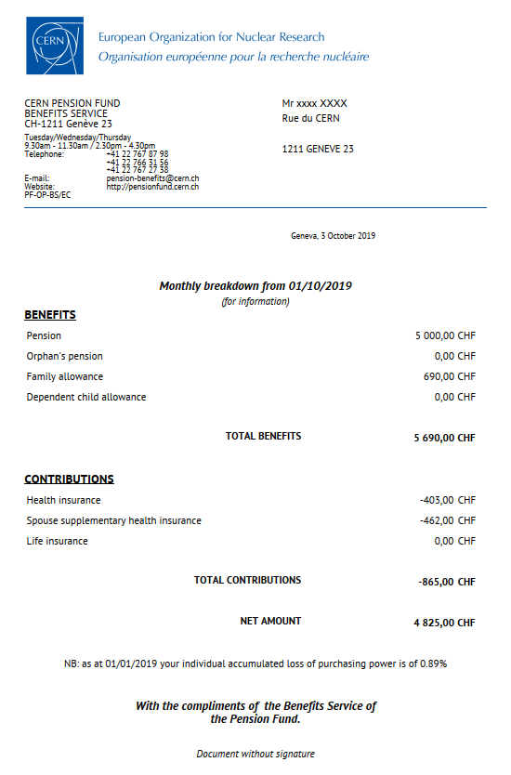

Monthly breakdown (January)
CERN Pension Fund - Benefits Service

Slide 11
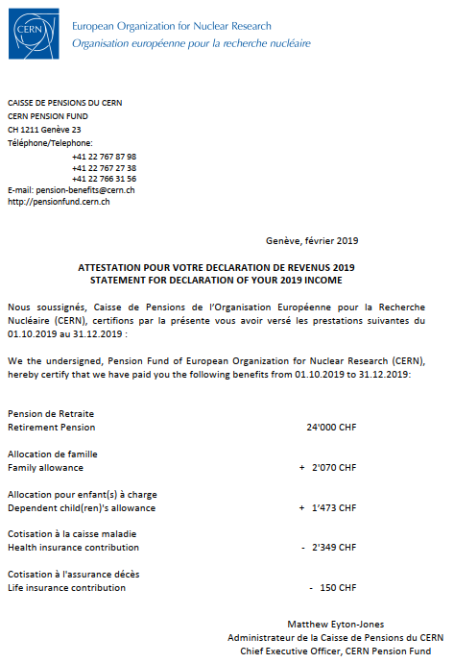
Statement for declaration of income (February)
CERN Pension Fund - Benefits Service

Slide 12
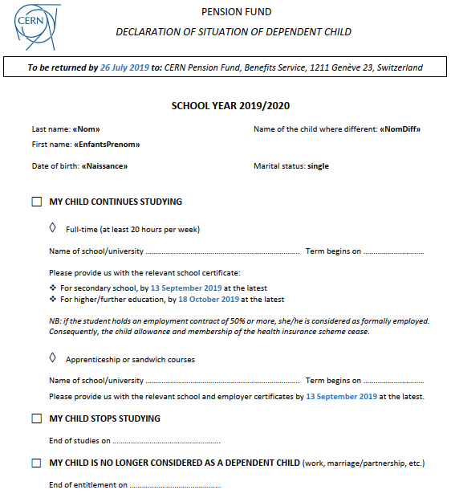
Declaration of intent (June/July)
To ensure continued entitlement to a dependent child allowance you are required to:
complete the «declaration of situation» sent in June/July
send the relevant proof of enrollment
In case of failure to return this form/certificate, payment of child allowance will be suspended
CERN Pension Fund - Benefits Service

Slide 13
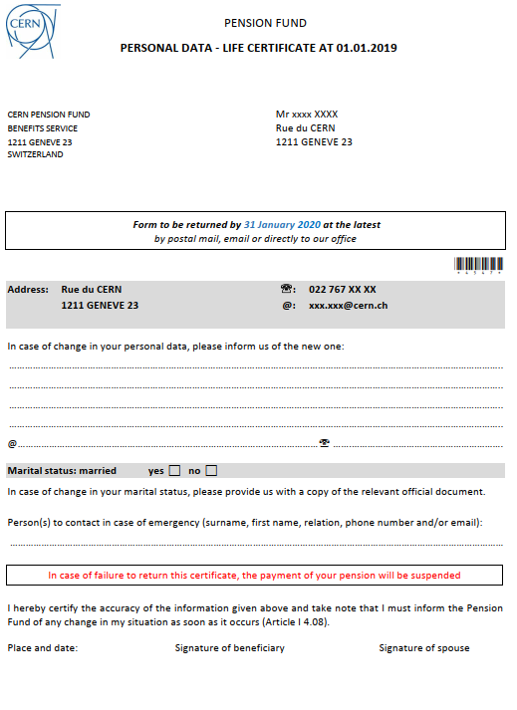
Life certificate (December)
This questionnaire is sent each year in December just before CERN end-of-year closure.
It has to be returned by 31 January at the latest.
In case of failure to return this form, payments will be suspended.
IMPORTANT :
If absent during this period, please contact us before you go away.
CERN Pension Fund - Benefits Service

Slide 14
Duty to provide information
IMPORTANT:
Beneficiaries have to inform the Benefits Service, within 30 calendar days, of any change in their personal data (marital status, address, bank account, etc.).
CERN Pension Fund - Benefits Service

Slide 15
In case of death
Benefits Service has to be contacted as soon as possible
IMPORTANT :
Surviving spouse’s and/or orphan’s pensions are paid in CHF into personal bank account in Switzerland
CERN Pension Fund - Benefits Service

Slide 16
Pension for Surviving Spouse
Entitlement to pension for surviving spouse:
the spouse/partner of a beneficiary whose marriage/partnership dates from at least 5 years prior to the decease and was married prior to retirement
Amount:
55% of the pension of the deceased beneficiary + a fixed sum of 564 CHF (on the basis of the maximum years of membership).
NB: in the case of marriage/partnership to a beneficiary, the spouse/partner has no entitlement to a surviving spouse’s pension (Art. II 5.08); however, the beneficiary can buy the right (Art. II 5.09).
Family allowance is not covered by the purchase of this right, nor can it be bought.
CERN Pension Fund - Benefits Service

Slide 17
Divorced former spouse(s)
Entitled to pension if:
the marriage had lasted 10 years or more
AND
the ex-spouse was receiving an alimony
AND
he/she is 45 years of age or more at the time of the death of the former spouse. This age limit shall not apply if the survivor has at least one dependent child at the time of decease.
The amount of the pension for surviving spouse cannot exceed the amount of the alimony due from the deceased to the ex-spouse.
CERN Pension Fund - Benefits Service

Slide 18
Orphan’s Pension
Due to a "dependent child" recognised by CERN before the end of contract
It is paid up to the age of 20 to children who are unmarried and not holders of a full-time employment.
It will be paid to children over 20 and under 25 years of age who are attending an educational establishment full time or are in vocational training.
equal to:
  24%* for 1 orphan
  34%* for 2 orphans...
    *of the last reference salary
NB: Not applicable to children born after the 1st day of retirement (Art. II 6.09)
CERN Pension Fund - Benefits Service

Slide 19
Other information
Benefits team
Emilie Clerc 5/5-019 Tel: +41 22 76 78798
Pilar Herguedas 5/5-021 Tel: +41 22 76 72738
Garance Louvin 5/5-023 Tel: +41 22 76 63156
Mélanie Mahot 5/5-027 Tel: +41 22 76 74895
Graziella Praire 5/5-023 Tel: +41 22 76 79194
Email: pension-benefits@cern.ch
Web site: http://pensionfund.cern.ch
Rules and Regulations of the CERN Pension Fund
Annual report and Financial statements
Annual information meeting (17 October 2019)
CERN Pension Fund - Benefits Service

Slide 20
THANK YOU FOR YOUR ATTENTION

