Slide 2

SUMMARY
Restitution of Swiss and French Cards.
The 3 month courtesy period (after the end of the contract).
When to start the formalities for a B or a C Swiss Permit?
Useful links for further information.
Maria QUINTAS for the Cards Office
17 Octobre 2019

Slide 3
Restitution of Swiss and French Cards
At the end of your contract, your Swiss and French Cards and those of your family (if applicable) must be returned to the Cards Office in the HR Department.
A certified copy will be given to you, in particular to facilitate an application for a residence permit in Switzerland if you wish to reside there.

Slide 4
The 3 month courtesy period (after the end of the contract)
Employees who are retiring may apply for a three-month courtesy period for them and their family members to organize their final departure from Switzerland or to regularize the remainder of their stay in Switzerland.
This formality must be requested by the staff member while still at CERN. A "courtesy period" form must be submitted to the Cards Office, which will then be forwarded to the Swiss Mission in Geneva.

Slide 5
On the expiry of the courtesy period, the holders of a Diplomatic Swiss Card must return the CD registration plates of their vehicle(s) to the competent cantonal service of their place of residence.
At the same time, families holding a Ci permit must also return it to the competent cantonal service of their place of residence.
Staff members who have given up their C permit when taking up employment at CERN will also have to make a demand via the competent cantonal office.

Slide 6
When to start the formalities for a B or a C Swiss Permit?
  Applications can be submitted at least 2-3 months before the end of your contract at CERN.
  Your permit will only be delivered once the Swiss Card would have been cancelled by the Swiss Mission.

Slide 7
Useful links for further information
OCPM Geneva :
https://www.ge.ch/organisation/office-cantonal-population-migrations-ocpm
https://www.ge.ch/demander-permis-sejour-activite-lucrative
https://www.lausanne.ch/de/officiel/administration/securite-et-economie/controle-des-habitants.html#secteur-suisse-et-permis-c-0
Competent authority in Lausanne :

Slide 8
The Cards Office is at your disposal for any questions or further information.
Human Resources Department
Office : 33/1-024
Open every morning from 8:30 to 12:30
→ open all day the first 2 working days of each month .
Contact : maria.quintas@cern.ch
E-mail : HR-cards.support@cern.ch
Phone no. 79494

Slide 9
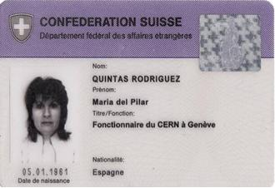
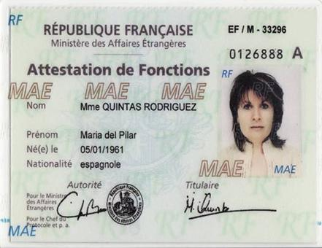
THANK YOU FOR YOUR ATTENTION
DO YOU HAVE ANY QUESTIONS?

