Slide 2
Preparing Your Retirement – CHIS
(CERN Health Insurance Scheme)
Jean-Pol MATHEYS (HR-CB-CMO)

Slide 3
Topics
Keeping the CHIS: What you must do & when
What does and does not change
Obtaining information
Good to know tips
Questions & answers

Slide 4
To keep the CHIS ①
Inform Pension Fund if you want to keep the CHIS, within 30 calendar days of retiring
  !! by default, your CHIS cover ends on the last day of your employment contract at 24:00
  !! if you quit, you will never be allowed back

Slide 5
To keep the CHIS ②
However, if your spouse is an MPE then you have to keep the CHIS as a Main Member
      Later, when your spouse also retires, both of you may then leave the CHIS (forever); if not, you both remain Main Members

Slide 6
Topics
Keeping the CHIS: What you must do & when
What does and does not change
Obtaining information
Good to know tips
Questions & answers

Slide 7
What does & does not change 
Your CHIS contributions will be adjusted when your pension is adjusted (no more when salaries are adjusted), LPP mechanism taken into account (8% loss of purchasing power)
You become a “Post-compulsory Member”

Slide 8
What does & does not change ②
Spouse and dependent children fully covered
  !! Keep PF informed of any change in family situation
Supplementary contribution required for spouse or partner with income from professional activity (or retirement pension) and no other adequate insurance; use paper SHIPID to keep CHIS informed of your spouse’s situation

Slide 9
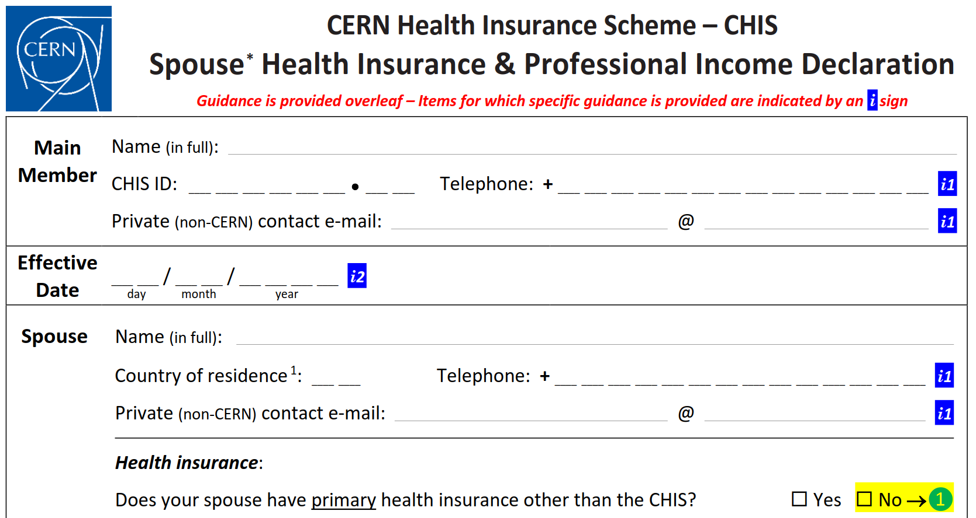
SHIPID
Sorry !
Exists only on paper for retirees

Slide 10
What does & does not change 
You have to remember to ask, fill-in and send back a SHIPID every time there’s a change
  your spouse retirees : her/his income drops, your supplementary contribution may drop too
  your spouse reaches retirement age after a period without work & income : his/her income increases, your supplementary contribution may increase too

Slide 11
Topics
Keeping the CHIS: What you must do & when
What does and does not change
Obtaining information
Good to know tips
Questions & answers

Slide 12

Obtaining Information 
General questions, claims, …
 uniqa@cern.ch  022.767 27 30  UNIQA offices: CERN or downtown Geneva
Medical assistance & Medgate
 +41.22.819.44.77 (esp. when travelling)
CHIS Rules, general advice
 www.cern.ch/chis
(no admin e-guide access anymore – let’s hope this changes soon)

Slide 13
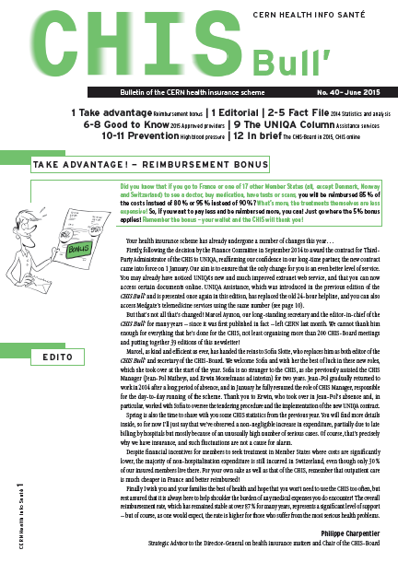

Obtaining Information 
CHIS Bull’
  newsletter: general info, news, tips
  sent by postal mail to your home
CERN’s Official news
  formal notices, major changes
  home.cern/cern-people

Slide 14
Topics
Keeping the CHIS: What you must do & when
What does and does not change
Obtaining information
Good to know tips
Questions & answers

Slide 15
Good to know tips 
Long Term Care (LTC) benefits are there to help when dependency impacts daily life
  contact CERN Social Service and ask for guidance
  ask relative to help with procedure when needed
  three dependency levels (low, medium, severe)
  do not wait for severe dependency to act

Slide 16
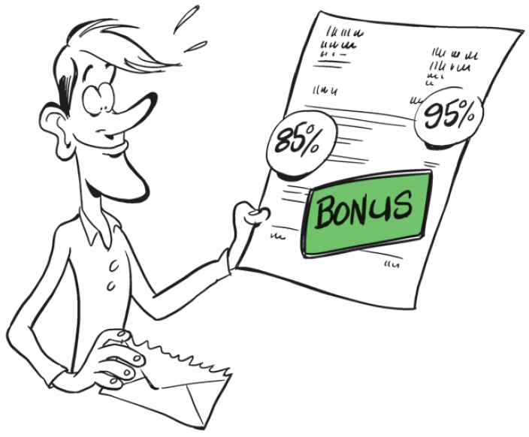
Good to know tips 
Bonus: Go to France or 18 other Member States (all, except DK, NO and CH) to see doctor, buy medication, have tests or scans, and get reimbursed 80% 85% or 90% 95%

Slide 17
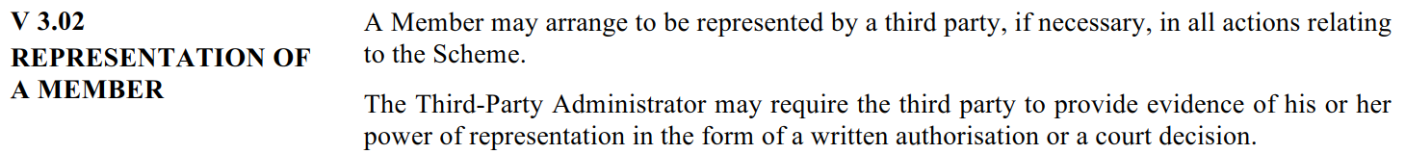
Good to know tips 
New CHIS Rules provide for representation
  ask relative to help, but inform the CHIS
  later formalize, before it’s too late
Check “Information on compulsory health insurance in Switzerland” on CHIS Website

Slide 18
Good to know tips 
Using CHIS as complementary insurance
  if you or your spouse/partner or your child(ren) have another insurance (Sécurité sociale, NHS, …)
  use other insurance first, submit other insurance’s reimbursement statement to UNIQA
  ☺ get much better overall reimbursement rate

Slide 19
Good to know tips 
Send your claims by postal mail or drop them in UNIQA’s office mailbox (it’s safe, no need to enter) having checked you attached proof of payment
Get attestations and other personal documents through your account at extranet.uniqa.net (set it up before you retire)

Slide 20
Topics
Keeping the CHIS: What you must do & when
What does and does not change
Obtaining information
Good to know tips
Questions & answers

