Slide 1

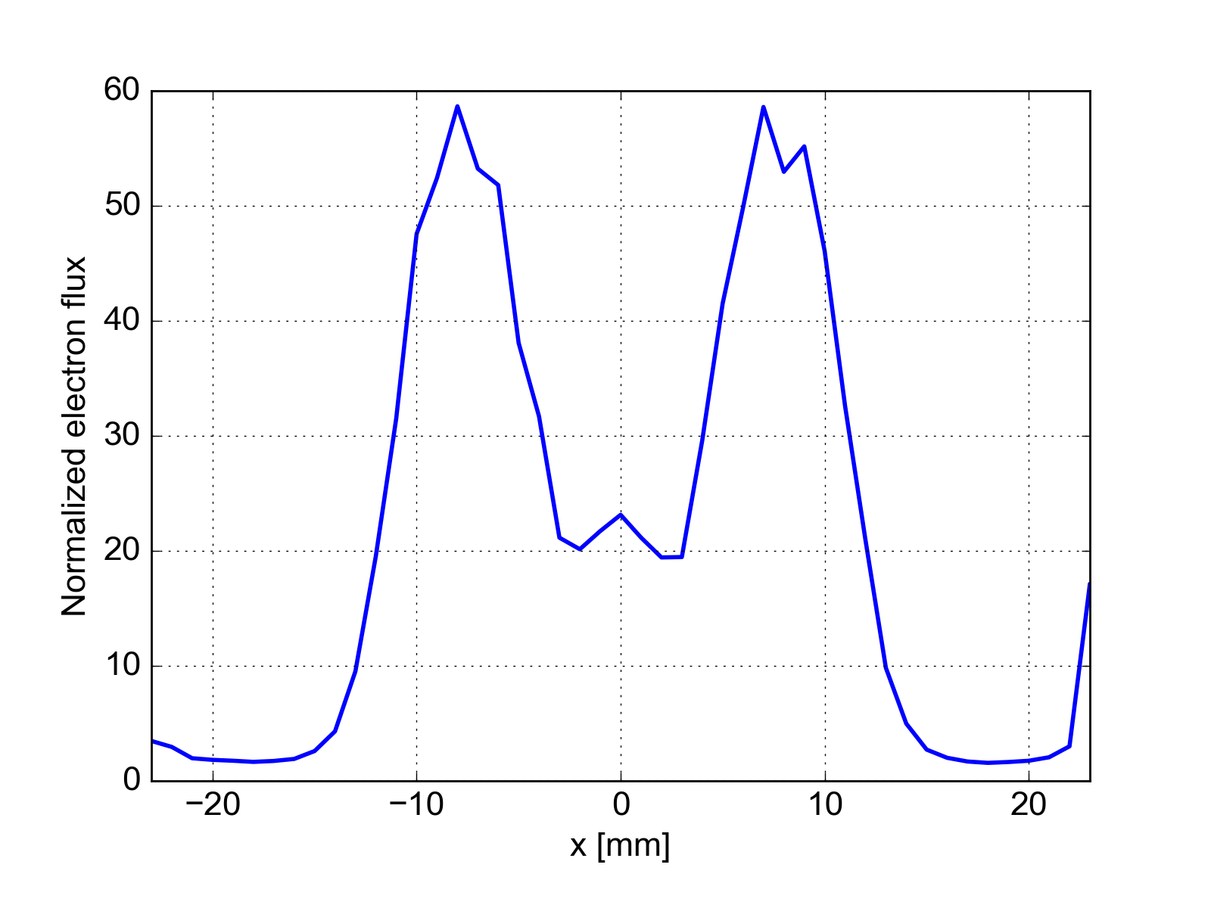
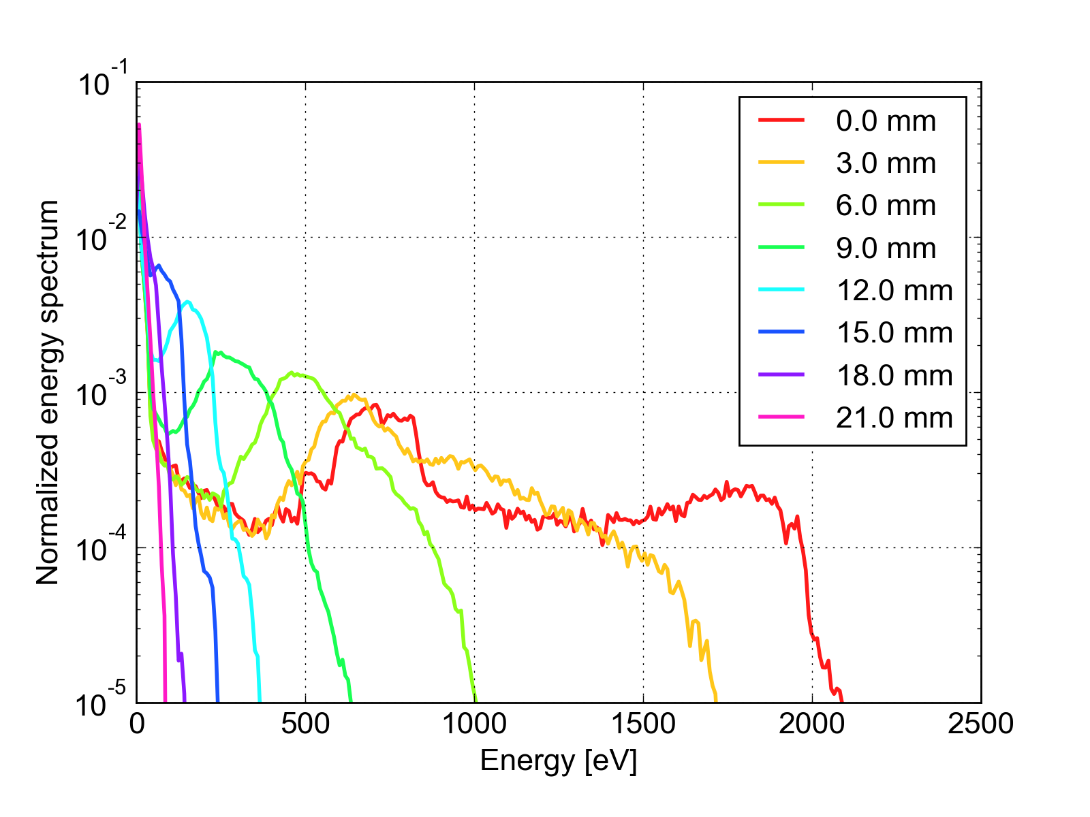
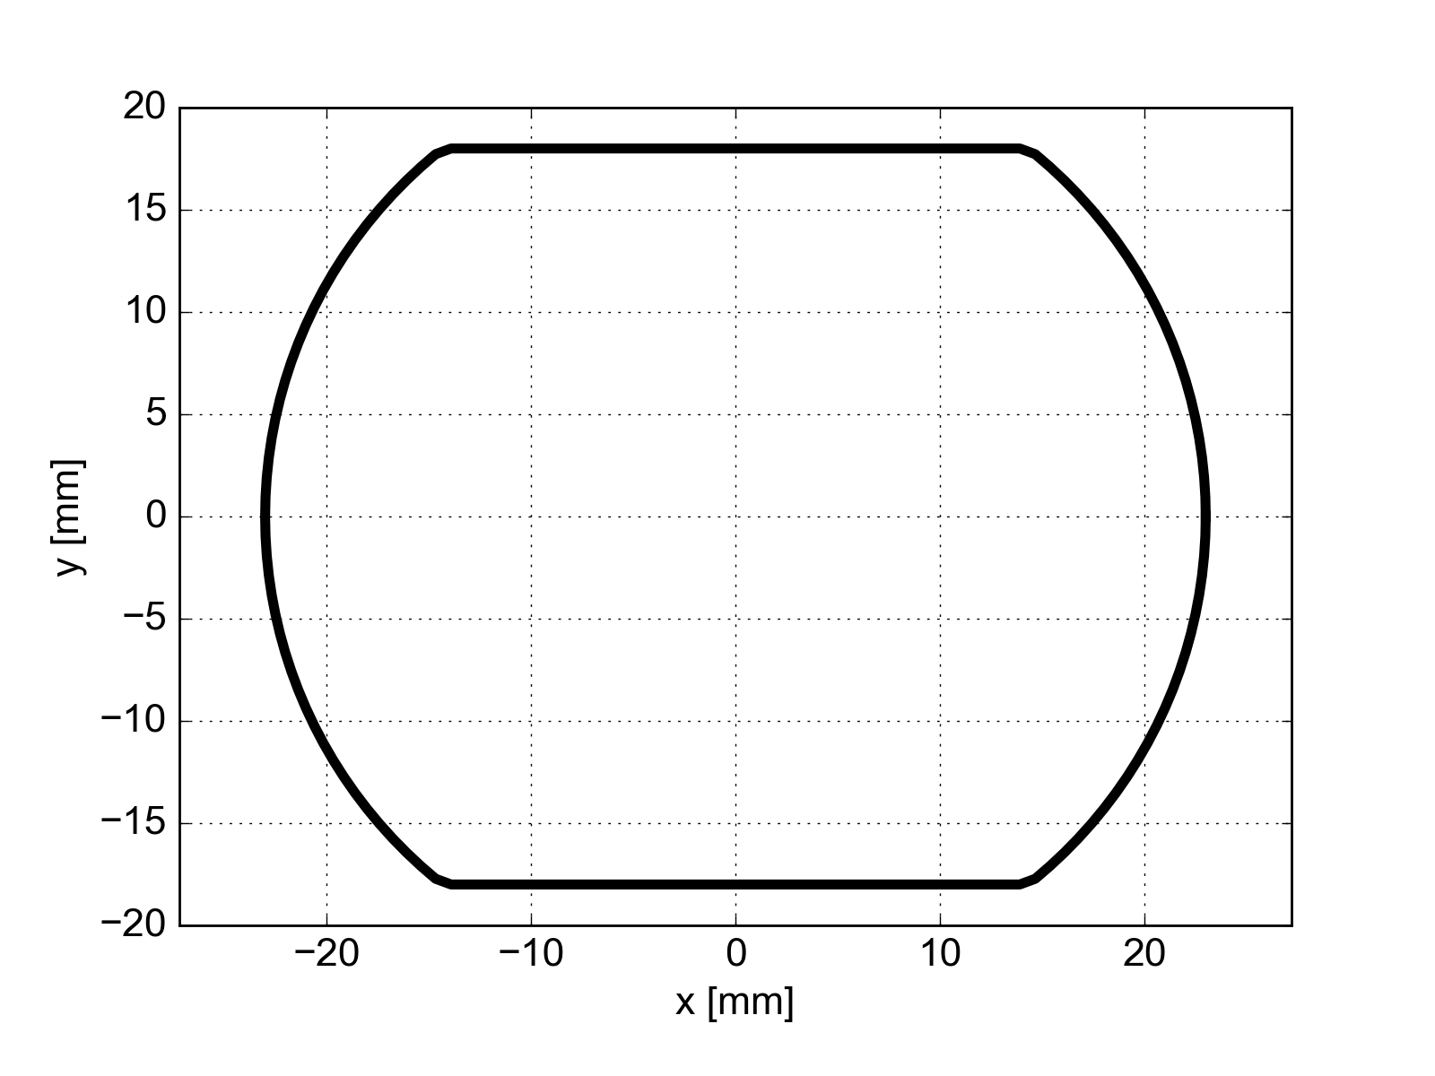
Energy spectrum as a function of the horizontal position
Each curve corresponds to a different horizontal positions
The area of all spectra is renormalized to 1.0

