Slide 1
Implementation of cross-species ionization in PyECLOUD
L. Mether, G. Iadarola
Acknowledgements: K. Poland, G. Rumolo

Slide 2
Outline
Introduction
Cross-species ionization model and implementation
First simulation results

Slide 3
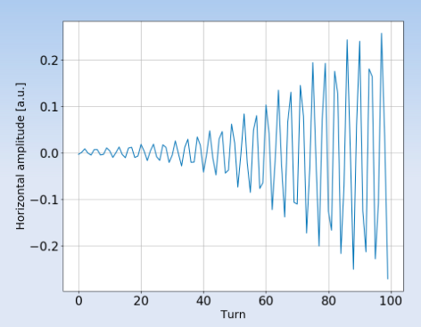

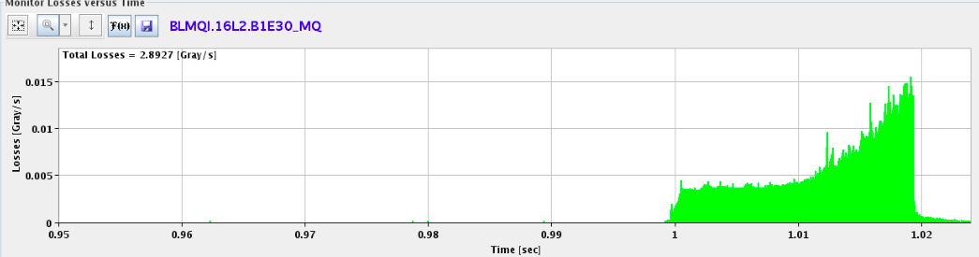
Motivation
  Throughout 2017 operation, abnormal losses were observed in the LHC
  Located in the 16th half-cell left of Point 2 (‘16L2’)
68 premature dumps with the following signature occurred during 2017:
Sudden onset of high beam losses in 16L2
Coherent beam motion with extremely fast rise times
Beam dump either due to losses on the collimation system or directly in 16L2
To stay operational, the LHC was limited to fewer than the nominal number of bunches for most of the 2017 run. Several 16L2 events occurred also in 2018.
X. Buffat
L. Ponce et al.

Slide 4
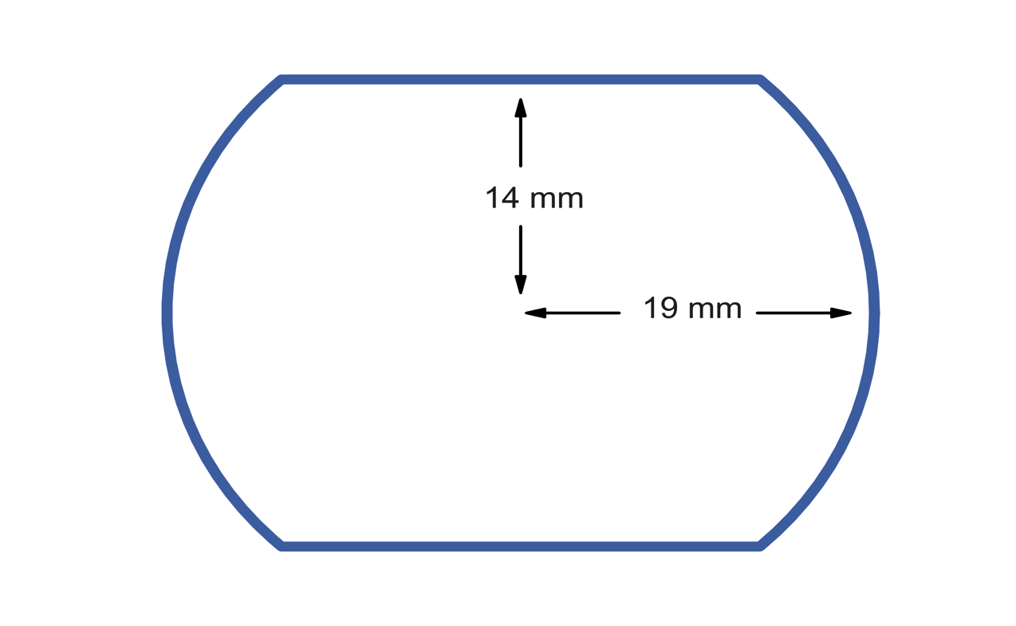
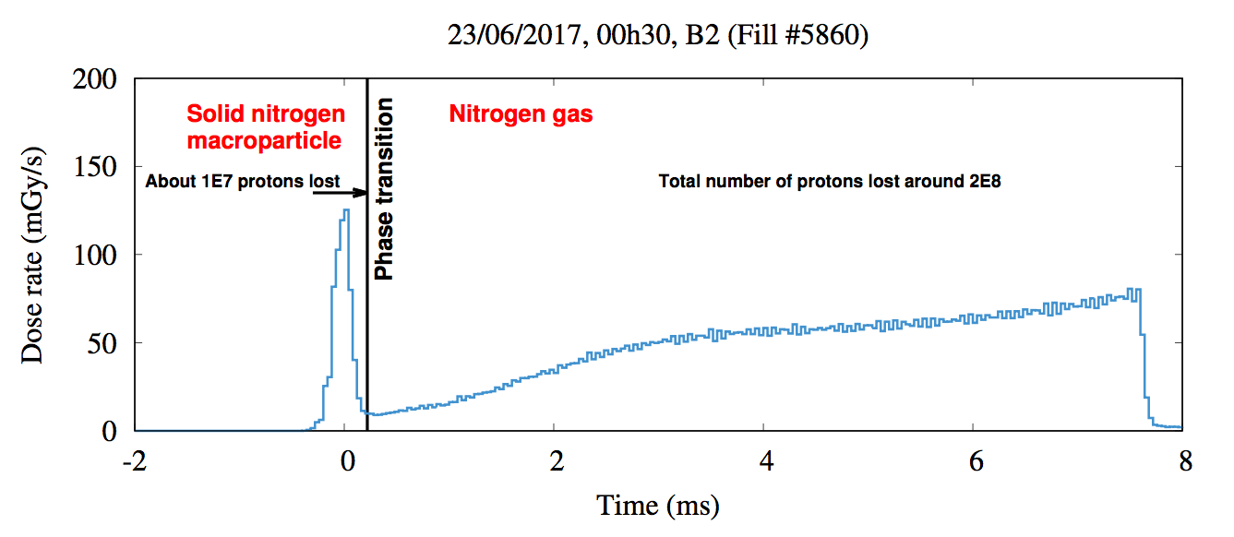
Sequence of events in 16L2
The problems in 16L2 are thought to have been caused by air frozen inside the beam chamber, through the following sequence of events:
A macro-particle of frozen air
(N₂, O₂) is detached,
triggered by e-cloud?
and enters the beam
frozen air
beam
electron
macro-particle
The macro-particle undergoes a phase transition to a gas, leading to a a high local gas density
gas
ion
A. Lechner
The beam ionizes some of the gas in its path. Its interaction with the
The beam ionizes some of the gas in its path. Its interaction with the
generated electrons/ions causes the fast instabilities

Slide 5
Sequence of events in 16L2
The problems in 16L2 are thought to have been caused by air frozen inside the beam chamber, through the following sequence of events:
A macro-particle of frozen air
(N₂, O₂) is detached,
triggered by e-cloud?
and enters the beam
Our aim is to model the last part of this sequence of events:
If we assume a high gas density in the beam chamber, can we reproduce the observations in a consistent manner?
Previous studies and development:
Implementation of multi-species simulations
Multi-species build-up and stability simulations with beam-induced ionization of N₂ gas
See e.g. LBOC #82
New model ingredient:
Implementation of cross-species ionization
The macro-particle undergoes a phase transition to a gas, leading to a a high local gas density
The beam ionizes some of the gas in its path. Its interaction with the
The beam ionizes some of the gas in its path. Its interaction with the
generated electrons/ions causes the fast instabilities

Slide 6
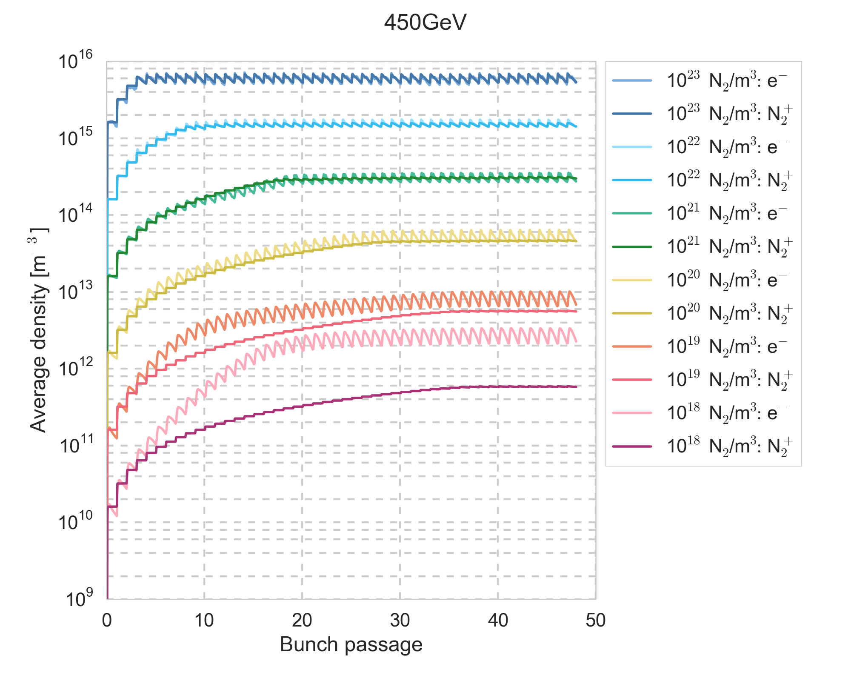
Multi-species build-up
Multi-species simulations show that electron multipacting becomes less important than beam-induced ionization from gas densities around 10²⁰ N₂/m³ and the dynamics are qualitatively and quantitatively different compared to single-species simulations
450 GeV, SEY=1.75

Slide 7
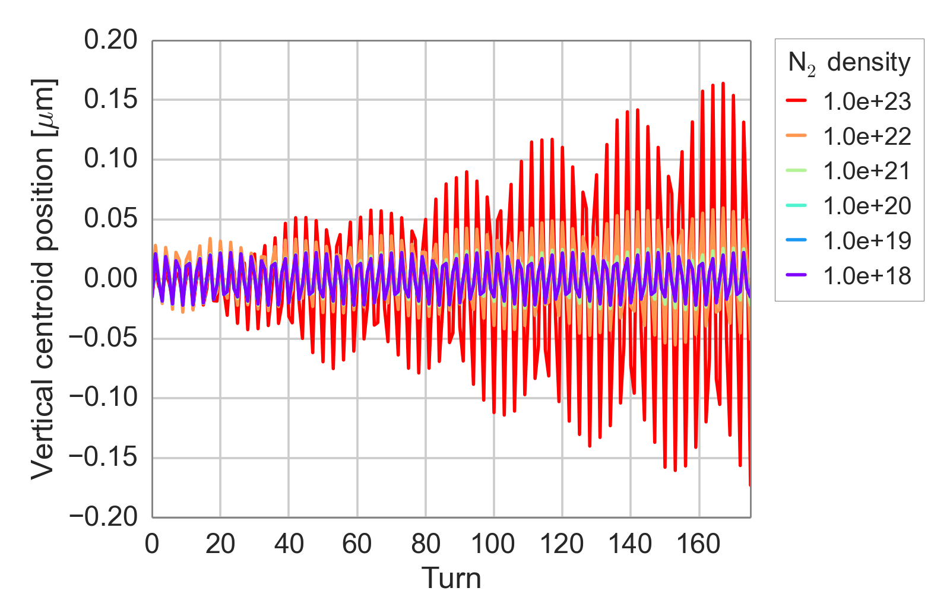
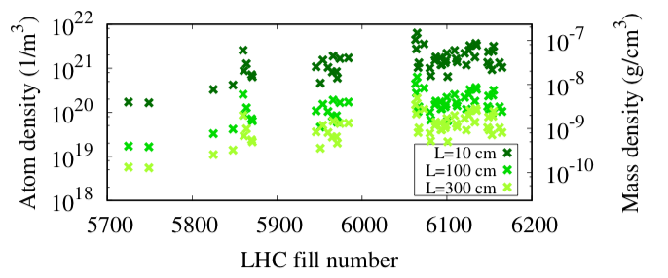
Beam stability
The gas density during the 16L2 events could be estimated based on the observed loss rates
For the 2017 events, N₂ gas densities were estimated to 10¹⁹ – 10²¹ L⁻¹m⁻², with the gas covering the length L
First multi-species beam dynamics simulations show beam instabilities for gas densities ≥ 10²¹ L⁻¹m⁻²
This covers only the upper range of the observed instabilities in the machine
(10¹⁹ – 10²¹ L⁻¹m⁻²)
A. Lechner et al IPAC 2018
Electron-induced ionization, which has been neglected here, may increase the electron and ion densities for a given neutral gas density, if it is important in the studied cases

Slide 8
Gas ionization
The rate of gas ionization events is determined by the ionization cross-section and the gas density

Slide 9
Gas ionization
The rate of gas ionization events is determined by the ionization cross-section and the gas density

Slide 10
Beam-induced gas ionization
The rate of gas ionization events is determined by the ionization cross-section and the gas density
If the projectile is a beam particle, the path length
and with beam particles, we get

Slide 11
Beam-induced gas ionization
The rate of gas ionization events is determined by the ionization cross-section and the gas density
If the projectile is a beam particle, the path length
and with beam particles, we get
In a 2D code, we deal with line densities instead of numbers

Slide 12
Cross-species gas ionization
The rate of gas ionization events is determined by the ionization cross-section and the gas density
If the projectile is a cloud particle, the path length

Slide 13
Cross-species gas ionization
The rate of gas ionization events is determined by the ionization cross-section and the gas density
If the projectile is a cloud particle, the path length

Slide 14
Cross-species gas ionization
The rate of gas ionization events is determined by the ionization cross-section and the gas density
If the projectile is a cloud particle, the path length
and with projectiles we get

Slide 15
Cross-species gas ionization
The rate of gas ionization events is determined by the ionization cross-section and the gas density
If the projectile is a cloud particle, the path length
and with projectiles we get
In a 2D code, we deal with line densities instead of numbers

Slide 16
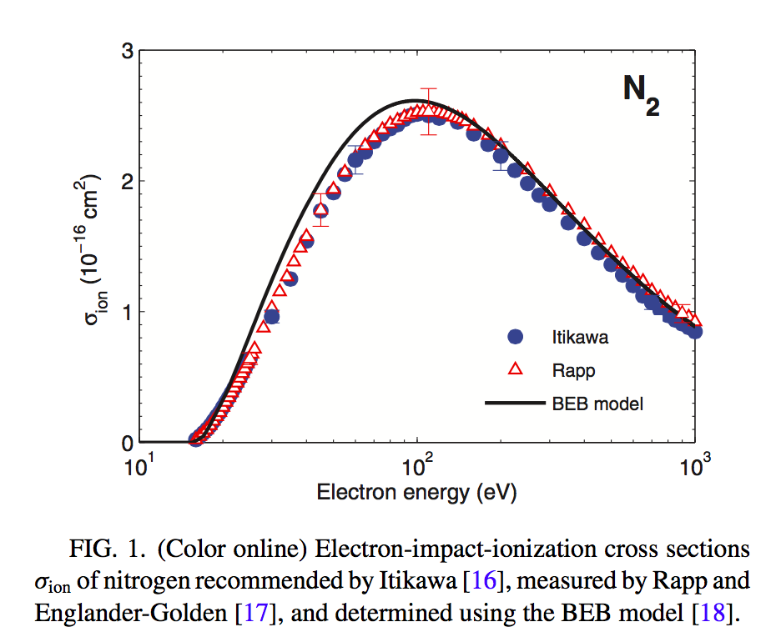
Electron-induced ionization
The beam-gas ionization cross-section at injection and top energy is estimated to be
around 2 Mb = 2 × 10⁻¹⁸ cm²
Electrons in the energy range of 50 – 500 eV have a 50 – 100 times larger ionization cross section than the beam particles
The amount of ionization depends on the electron energy distribution during the simulations
BUG et al., Phys. Rev E.88

Slide 17
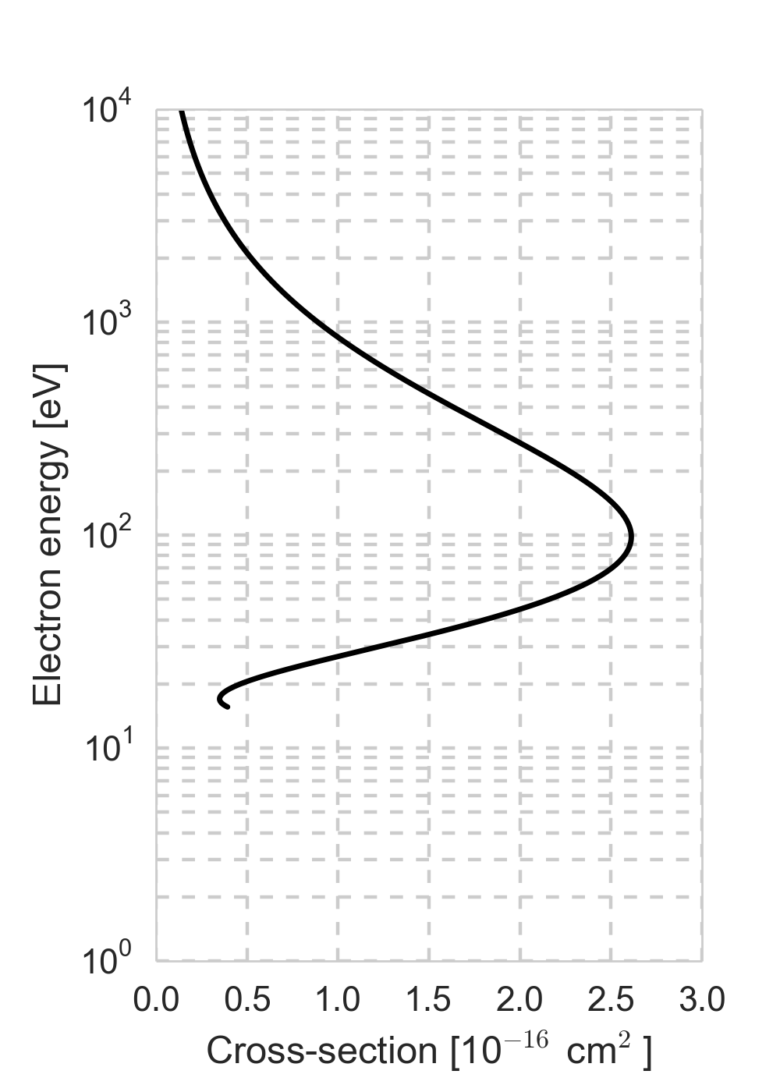
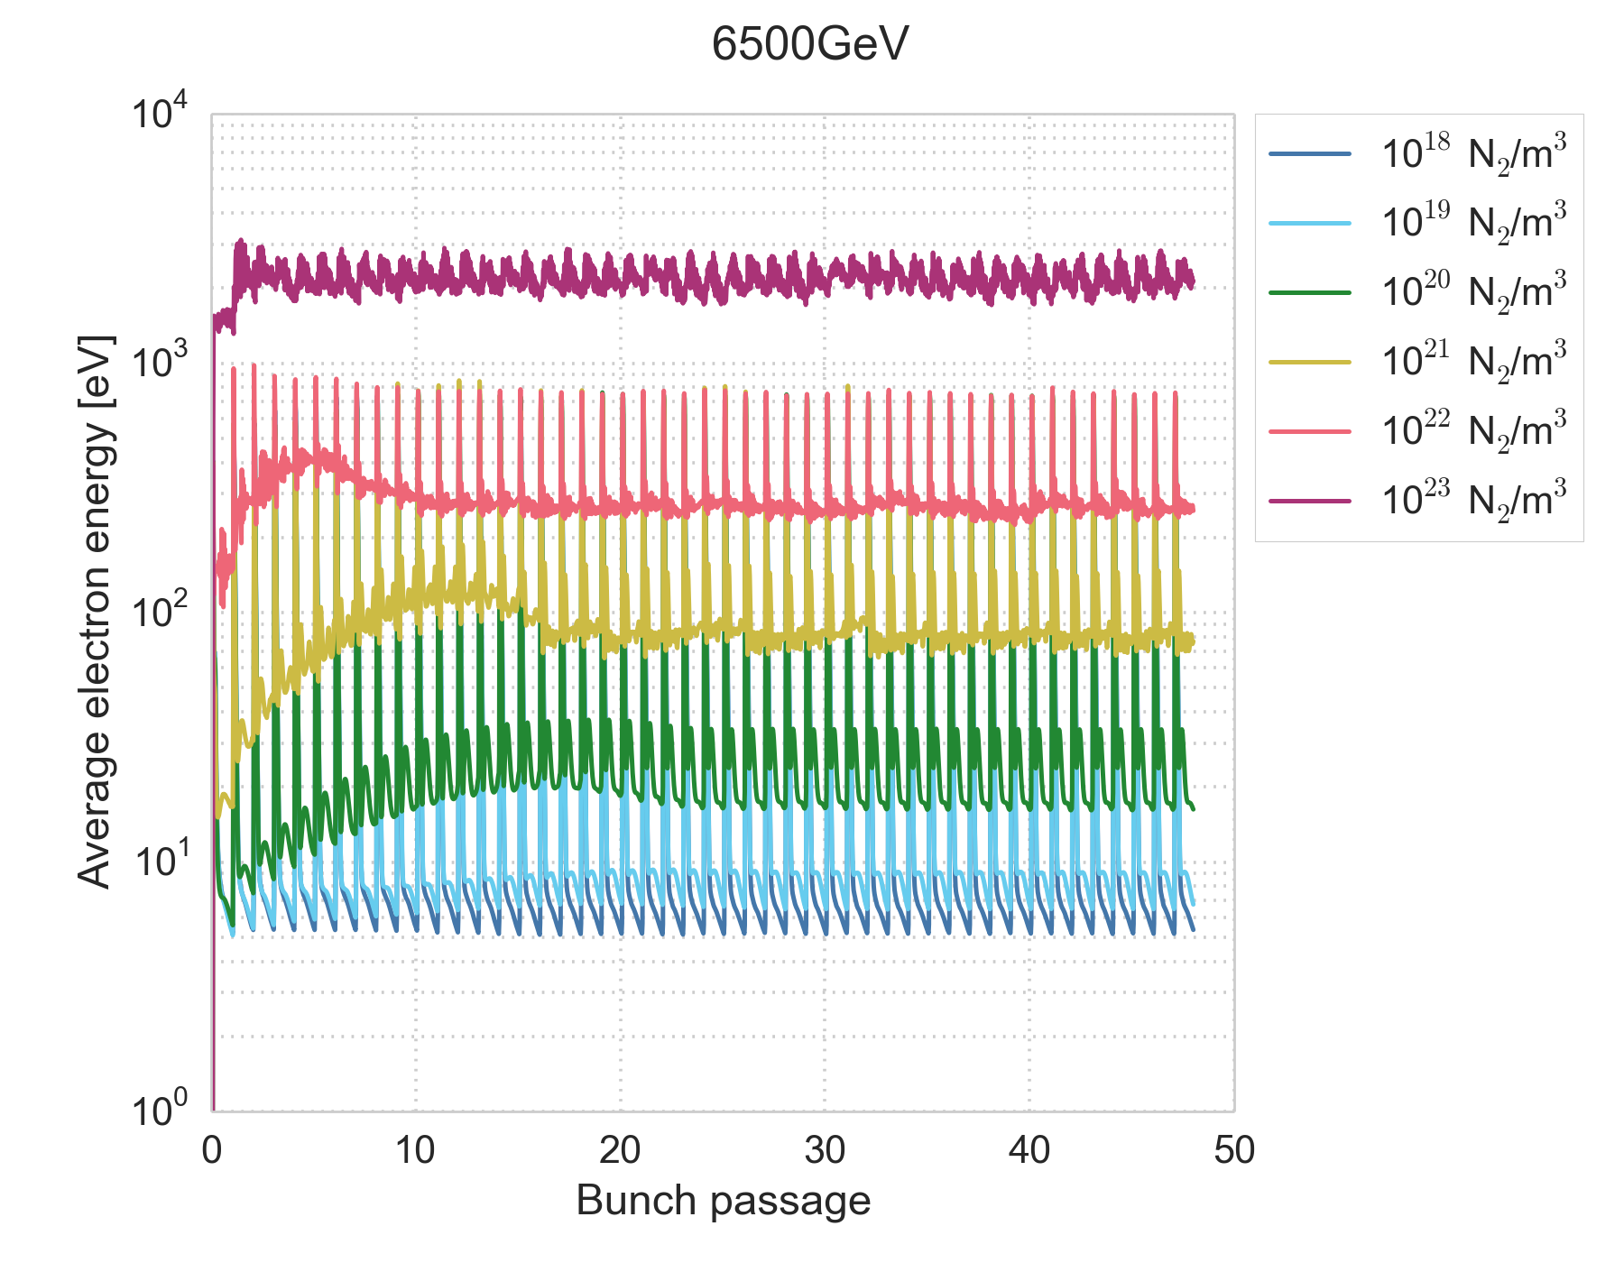
Electron energies
Electron energies during the multi-species build-up were previously analysed
See e-cloud meeting #67
6.5 TeV, SEY=1.75

Slide 18
Electron energies
Electron energies during the multi-species build-up were previously analysed
See e-cloud meeting #67
Energies are favourable for electron impact-ionization in particular for neutral gas densities of 10²⁰ – 10²² N₂/m⁻³

Slide 19
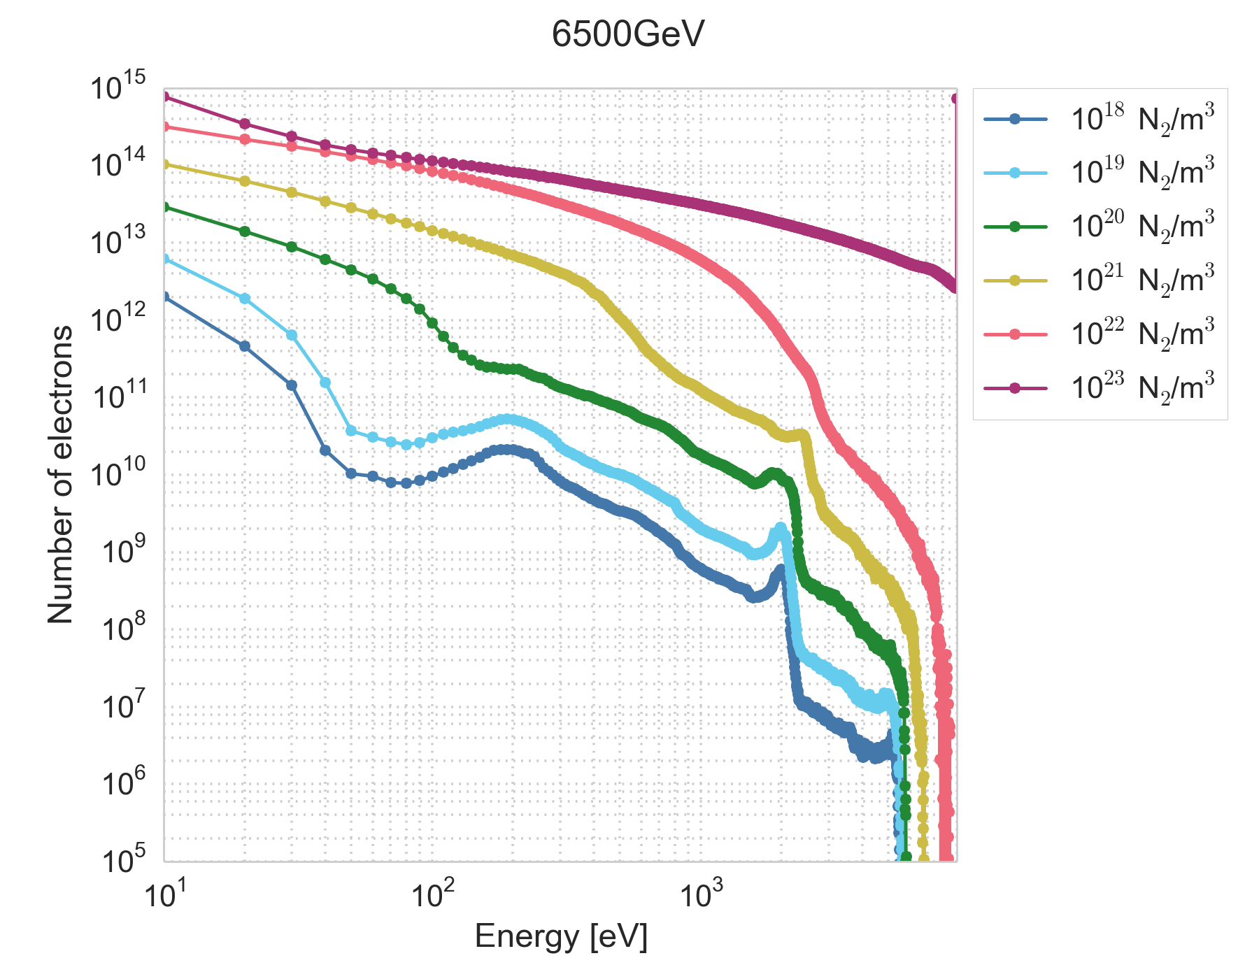
Electron energy spectrum
Electron energies during the multi-species build-up were previously analysed
See e-cloud meeting #67
Energies are favourable for electron impact-ionization in particular for neutral gas densities of 10²⁰ – 10²² N₂/m⁻³
The amount of electrons in the favorable energy range increases with increasing neutral gas density

Slide 20
Electron energy spectrum
Electron energies during the multi-species build-up were previously analysed
See e-cloud meeting #67
Energies are favourable for electron impact-ionization in particular for neutral gas densities of 10²⁰ – 10²² N₂/m⁻³
This gives reason to believe that electron impact-ionization is important for the gas densities that we think occurred in 16L2
The amount of electrons in the favorable energy range increases with increasing neutral gas density

Slide 21
Cross-species ionization model
For the implementation of the cross-species ionization, we want to keep the same simplifying assumptions as are made for the beam-induced ionization
Assume a uniform gas density in the chamber
(no neutral macroparticles – we don’t want to go to full-scale plasma simulations)
Consider single ionization only

Slide 22
Cross-species ionization in PyECLOUD
A new cross-species ionization module has been implemented in PyECLOUD
Holds the necessary information on the user defined cross-species ionization processes
Handles the generation of particles through cross-species ionization
Can handle multiple projectiles and any number of ionization processes per projectile
Other generation processes (secondary emission, photoemission, beam-induced ionization) are performed separately for each cloud
Since the cross-species ionization includes interactions between clouds, all clouds must be handled together
The generating function is called once per time step during build-up simulations

Slide 23
Generation of ionization products
Cross_Ionization.generate()
Called from buildup simulation
Loop over projectiles
  Determine the energies of each macroparticle (MP) in the projectile cloud
  Loop over processes for current projectile
    Call process generation function
Projectile MP info
Ionization_Process.
generate()

Slide 24
Generation of ionization products
Projectile MP info
Ionization_Process.generate()
Interpolate the user input cross-section to the projectile MP energies
Determine the number of product particles to be generated by each projectile MP, using their weight
Cross_Ionization.
generate()

Slide 25
Generation of ionization products
Projectile MP info
Ionization_Process.generate()
Interpolate the user input cross-section to the projectile MP energies
Determine the number of product particles to be generated by each projectile MP, using their weight
Loop over products of process
  For each product calculate the number of new MPs to produce, based on the current default weight of the product cloud
    Non-integer parts define probability to generate 1 MP
Cross_Ionization.
generate()

Slide 26
Generation of ionization products
Projectile MP info
Ionization_Process.generate()
Interpolate the user input cross-section to the projectile MP energies
Determine the number of product particles to be generated by each projectile MP, using their weight
Loop over products of process
  For each product calculate the number of new MPs to produce, based on the current default weight of the product cloud
    Non-integer parts define probability to generate 1 MP
  Define coordinates of new MPs:
    Initial position corresponding to position of projectile
    Initial velocities according to initial energy defined by user input
Return information on new MPs for product clouds
Cross_Ionization.
generate()
Cross_Ionization.
generate()
New product MP info

Slide 27
Generation of ionization products
Cross_Ionization.generate()
Loop over projectiles
  Determine the energies of each macroparticle (MP) in the projectile cloud
  Loop over processes for current projectile
    Call process generation function
    Add info on new MPs from process to list of new MPs for each cloud
After looping over all projectiles and processes, generate new MPs in each cloud
Keep record of number of particles and number of MPs generated per cloud every time step
  Saved to output by pyecloud_saver
Projectile MP info
Ionization_Process.
generate()
New product MP info

Slide 28
Defining the ionization processes
Cross-species ionization is activated by adding in the simulation_parameters input file a dictionary that describes the desired ionization processes:
cross_ion_definitions = {projectile 1: {process 11: process_definitions,
process 12: process_definitions},
projectile 2: {process 21: process_definitions,
process 22: process_definitions}}
process definitions = {target_density, products, cross_section_file,
initial_product_energy, flag_extract_sigma}
projectiles and products must of course correspond to existing clouds

Slide 29
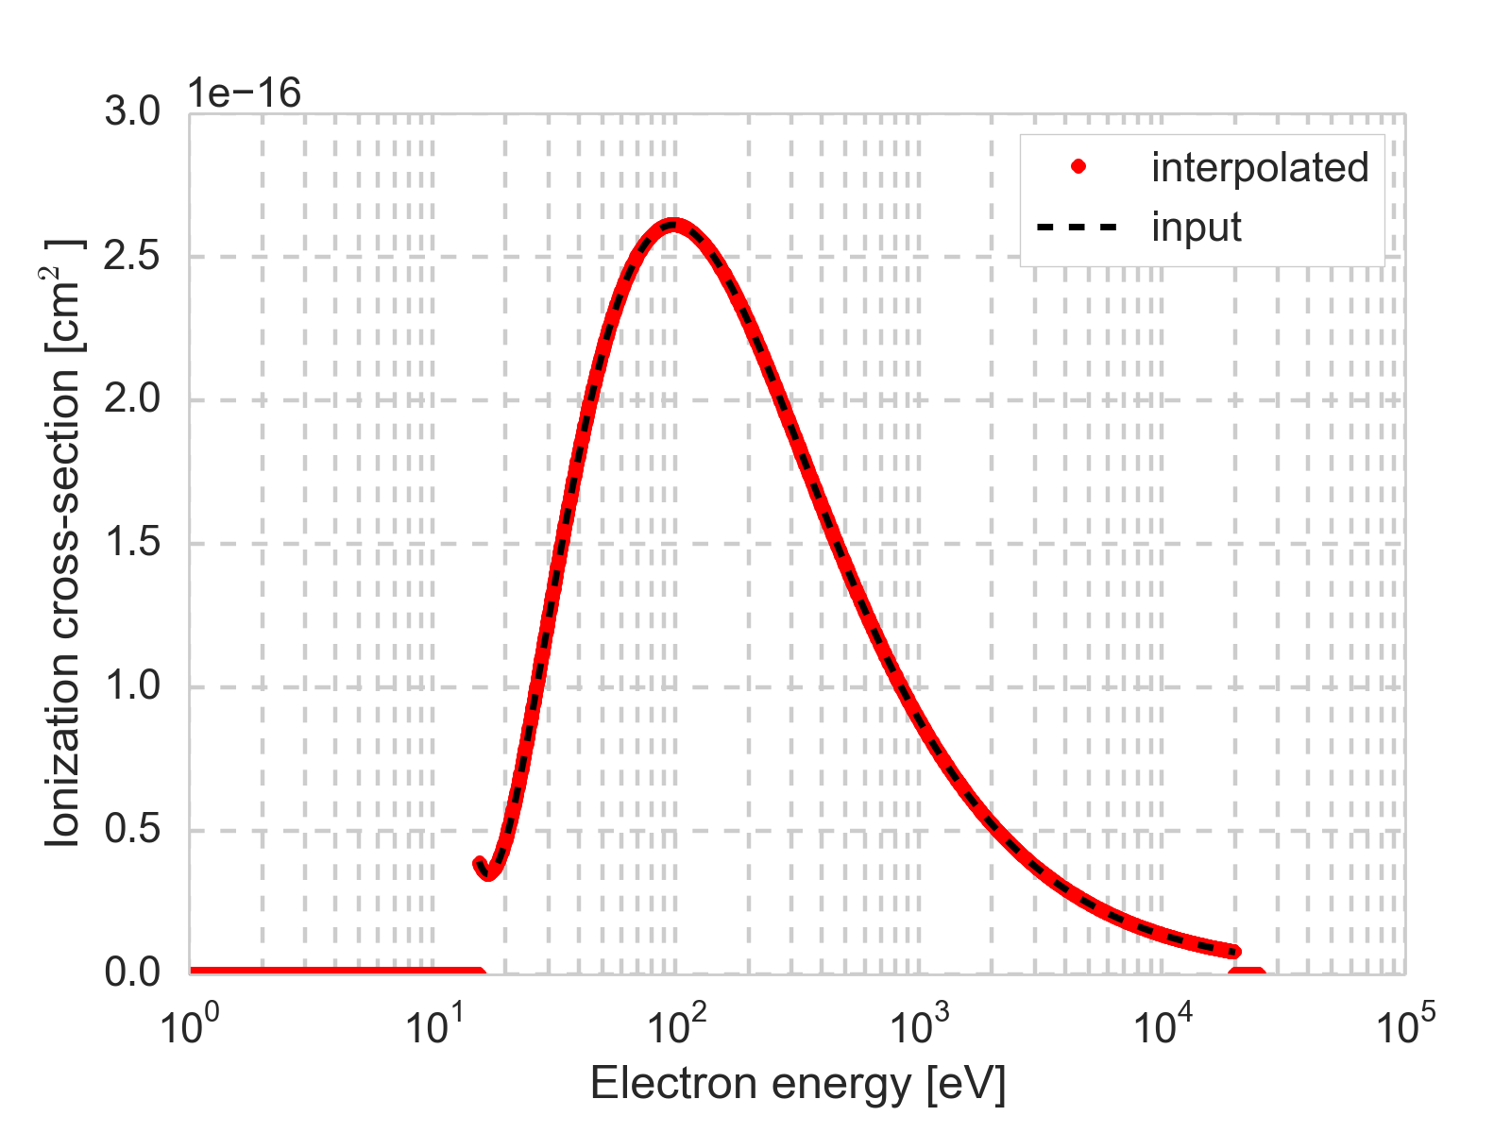
Test routine
The cross-species ionization module also contains a self-test routine, which runs by default at the beginning of a simulation, and saves a file for every process
The interpolation of the cross-section for an array of energies

Slide 30
Test routine
The cross-species ionization module also contains a self-test routine, which runs by default at the beginning of a simulation, and saves a file for every process
The interpolation of the cross-section for an array of energies
The cross-section is explicitly set to zero outside the energy range given in the cross-section input file

Slide 31
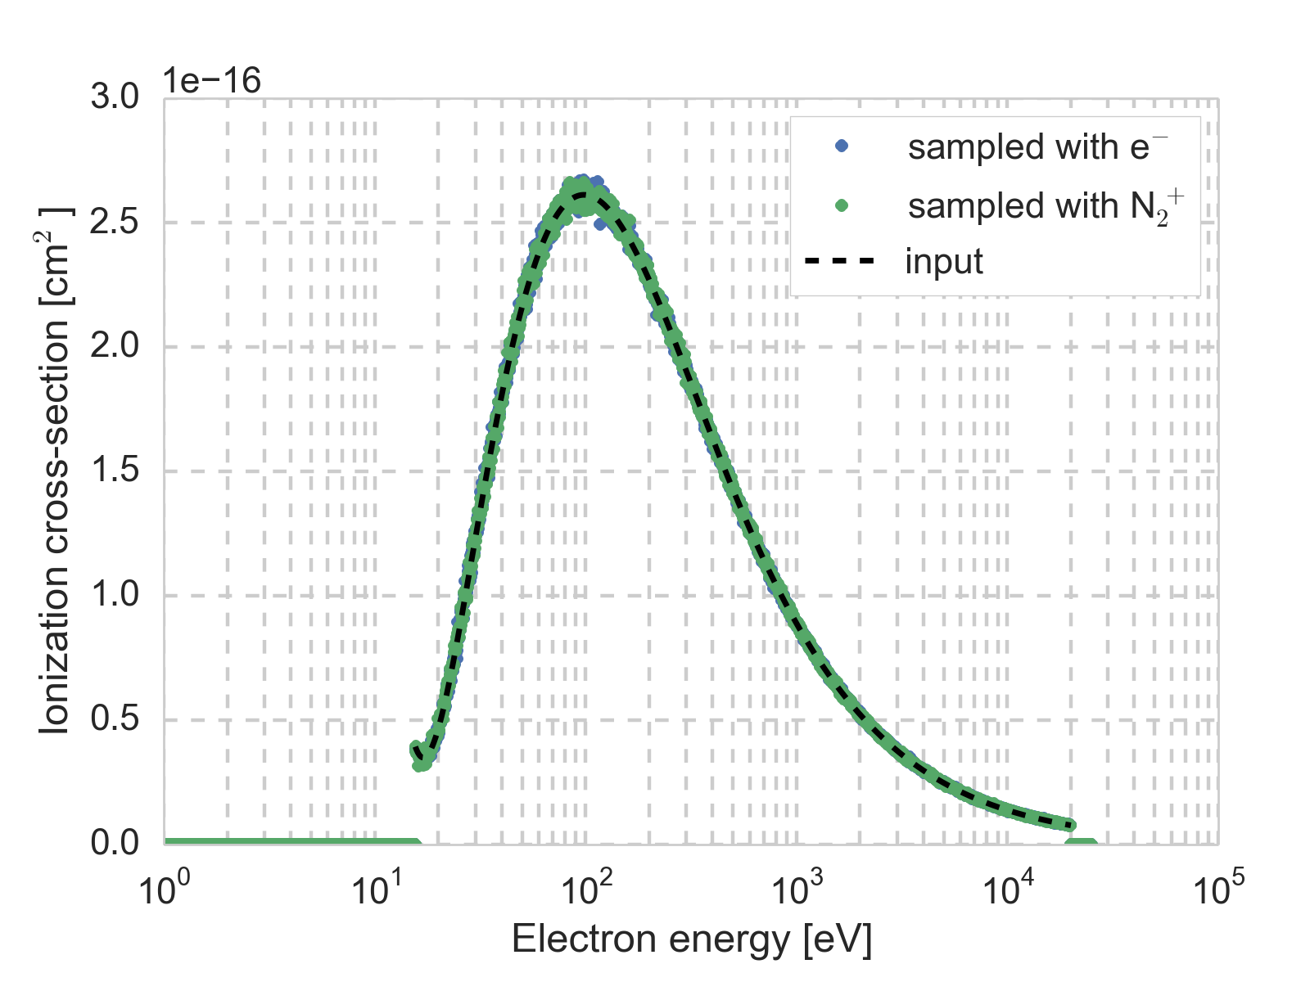
Test routine
Reconstructed cross-sections based on the generation algorithm
  For each energy in an array of energies, a mono-energetic projectile macroparticle distribution is passed to the generate() function
  The cross-section at the corresponding energy is estimated based on the ratio between the total number of new particles to be generated and the total number of projectile particles initially passed to the function

Slide 32
First simulation study
Considered the same simulation set-up as previously studied with multi-species build-up without cross-species ionization
Added electron-induced ionization
cross_ion_definitions =
{'electron':
{'electron-n2':
{'target_density': 1.00e+20,
'products': ['n2', 'electron'],
'cross_section':'cross_section_n2_15.59_20000.00_N1000_log.mat’,
'E_eV_init': 0.,
'extract_sigma': True}}}
Scan over gas densities

Slide 33
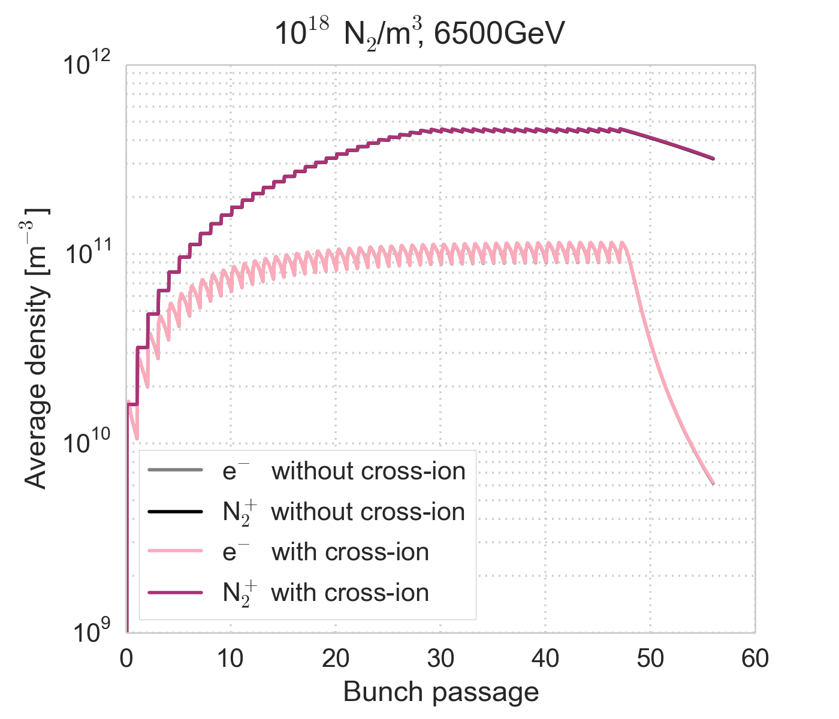
10¹⁸ N₂/m³
Comparing the densities against the equivalent simulation without cross-species ionization
There is no impact of the electron-induced ionization
SEY=1.25

Slide 34
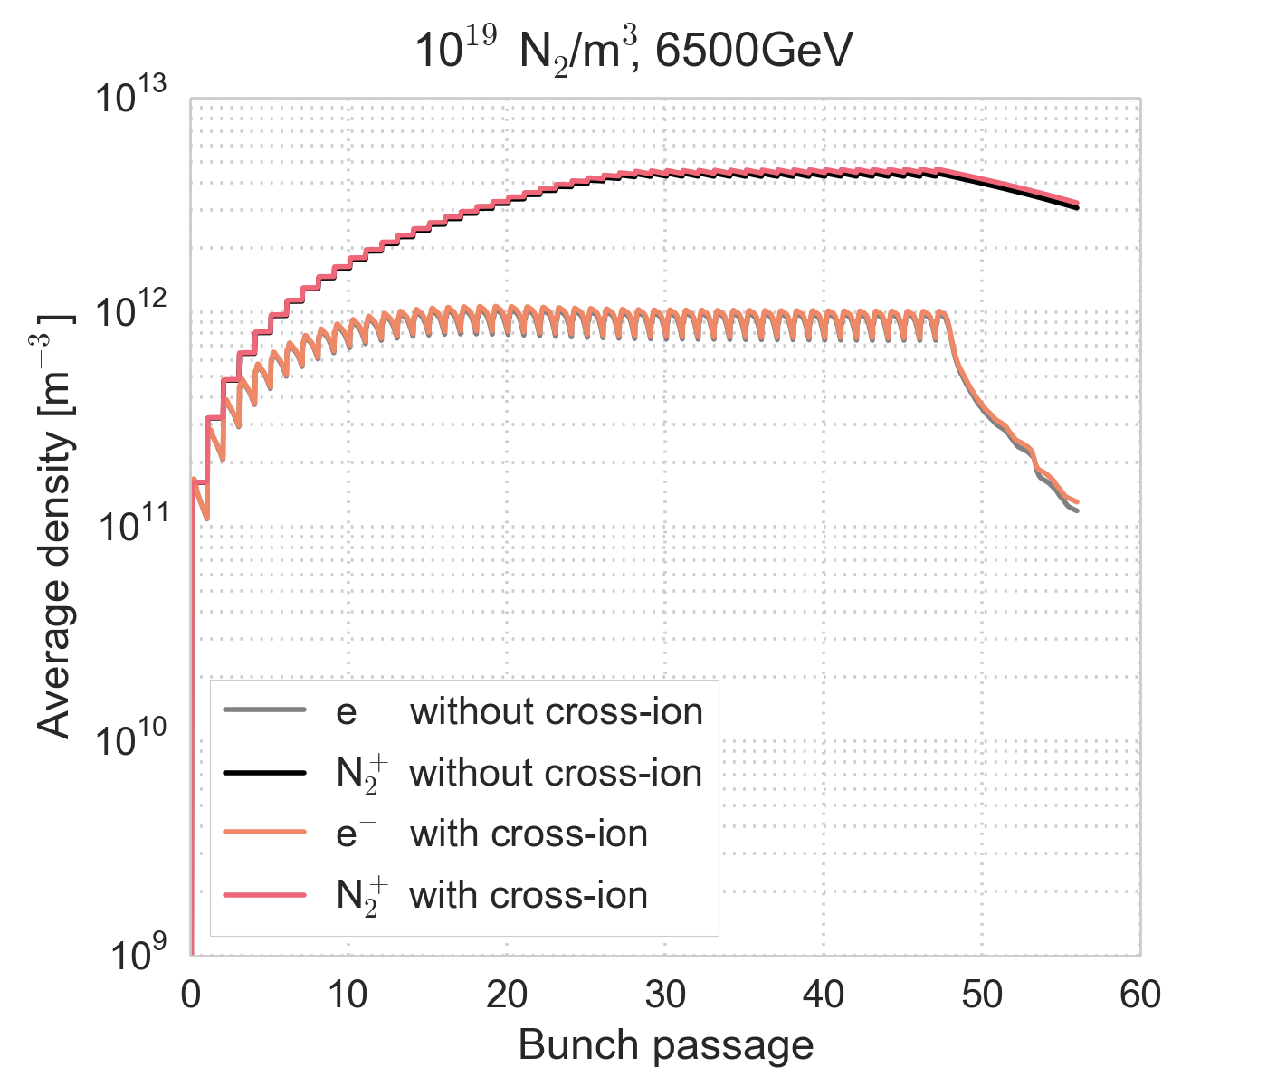
10¹⁹ N₂/m³
Comparing the densities against the equivalent simulation without cross-species ionization
There is hardly any impact of the electron-induced ionization
SEY=1.25

Slide 35
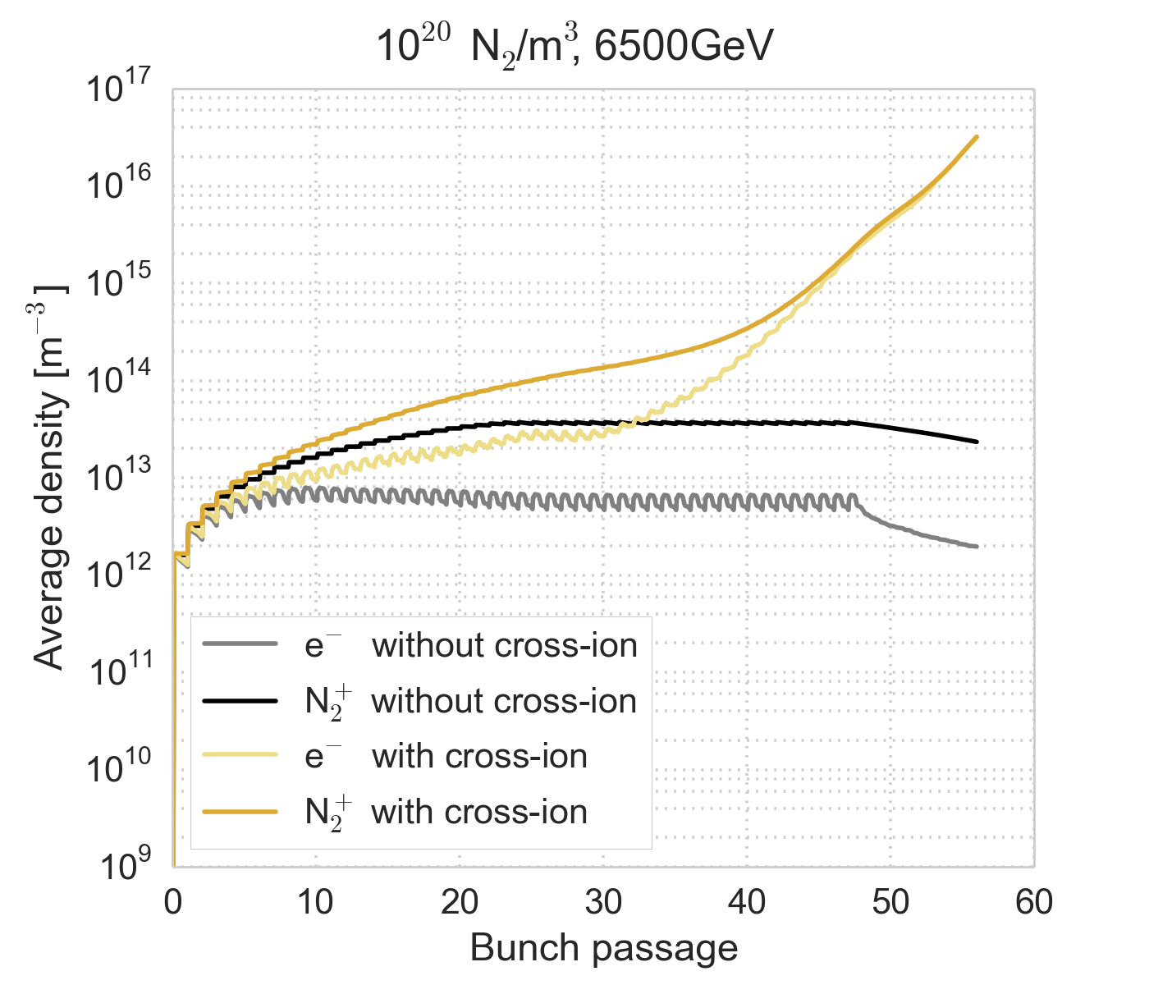
10²⁰ N₂/m³
Comparing the densities against the equivalent simulation without cross-species ionization
The densities grow significantly over the bunch train – in agreement with predictions
Densities continue growing after the end of the bunch train (?)
SEY=1.25

Slide 36
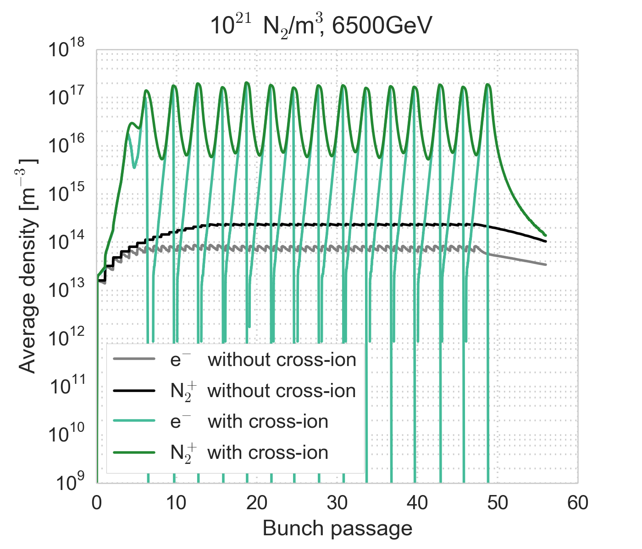
10²¹ N₂/m³
Comparing the densities against the equivalent simulation without cross-species ionization
The densities grow significantly within a few bunch passages
Electrons very noisy
SEY=1.25

Slide 37
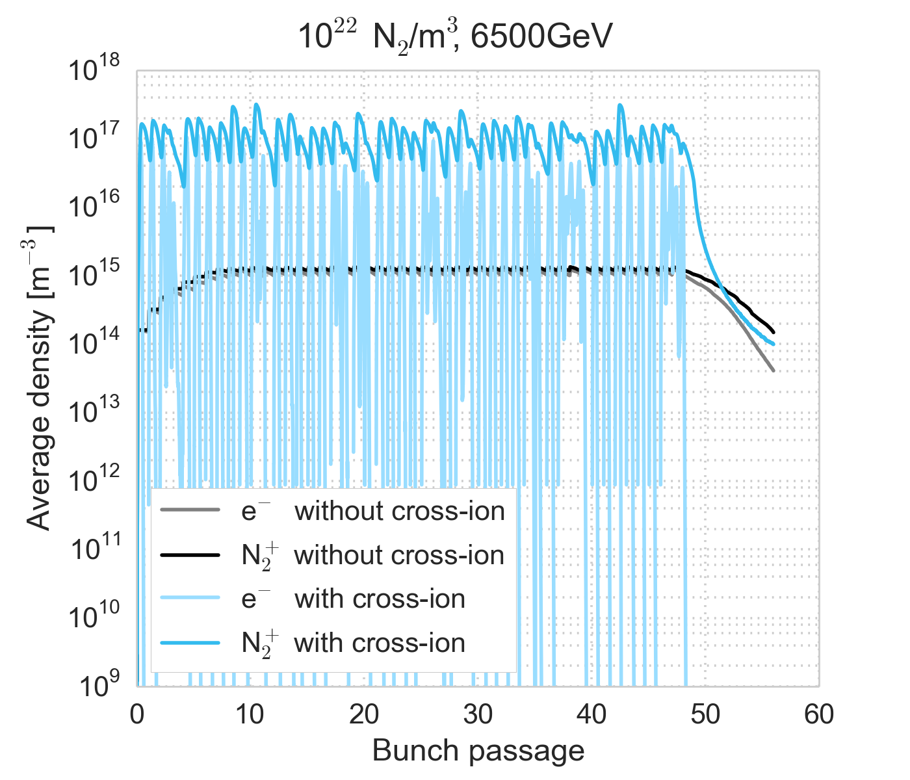
10²² N₂/m³
Comparing the densities against the equivalent simulation without cross-species ionization
The densities reach a saturation value within a single bunch passage
Electrons very noisy
SEY=1.25

Slide 38
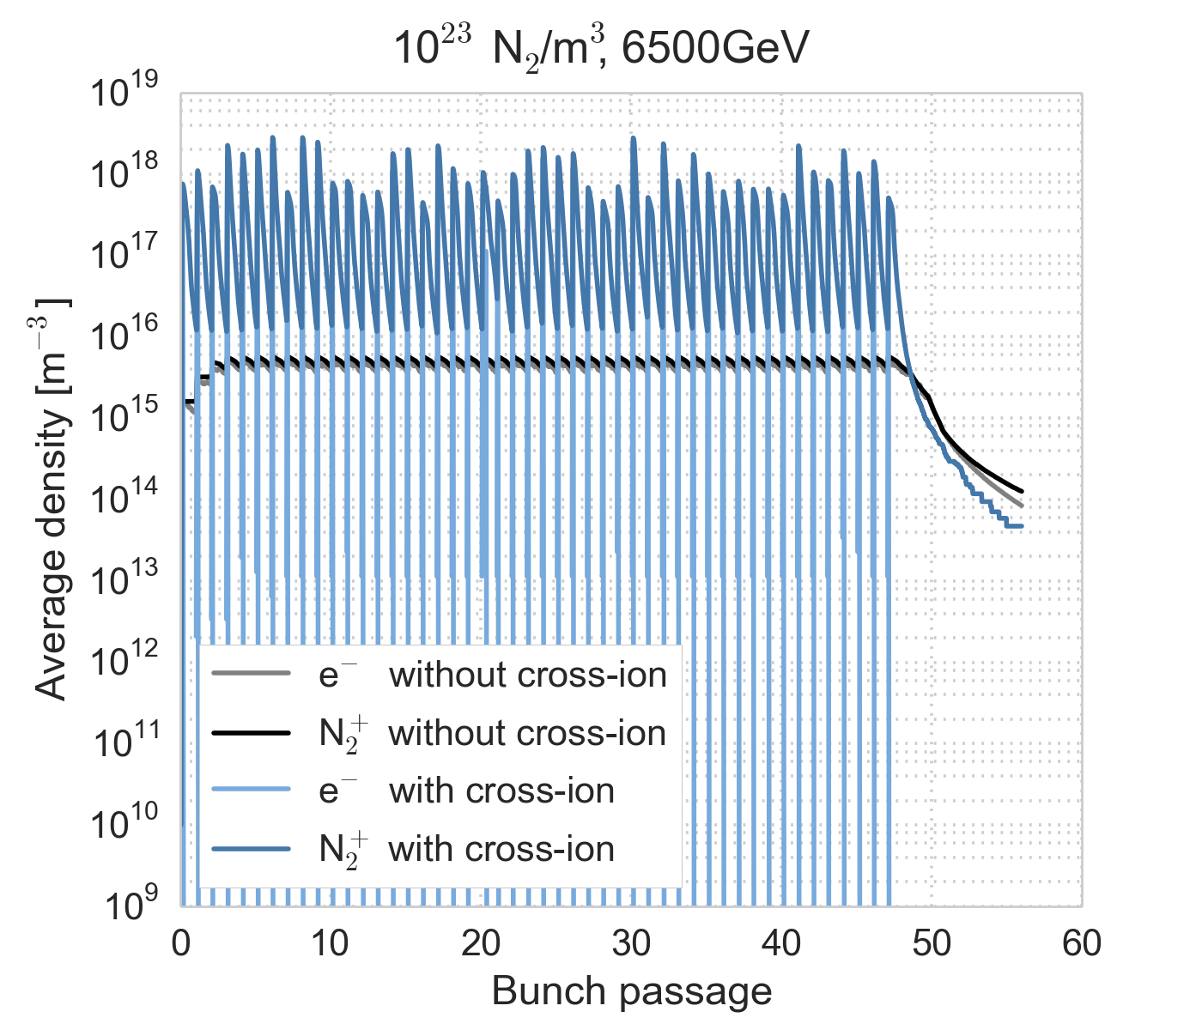
10²³ N₂/m³
Comparing the densities against the equivalent simulation without cross-species ionization
The densities reach a saturation value within a single bunch passage
Electrons very noisy, ions also somewhat noisy
SEY=1.25

Slide 39
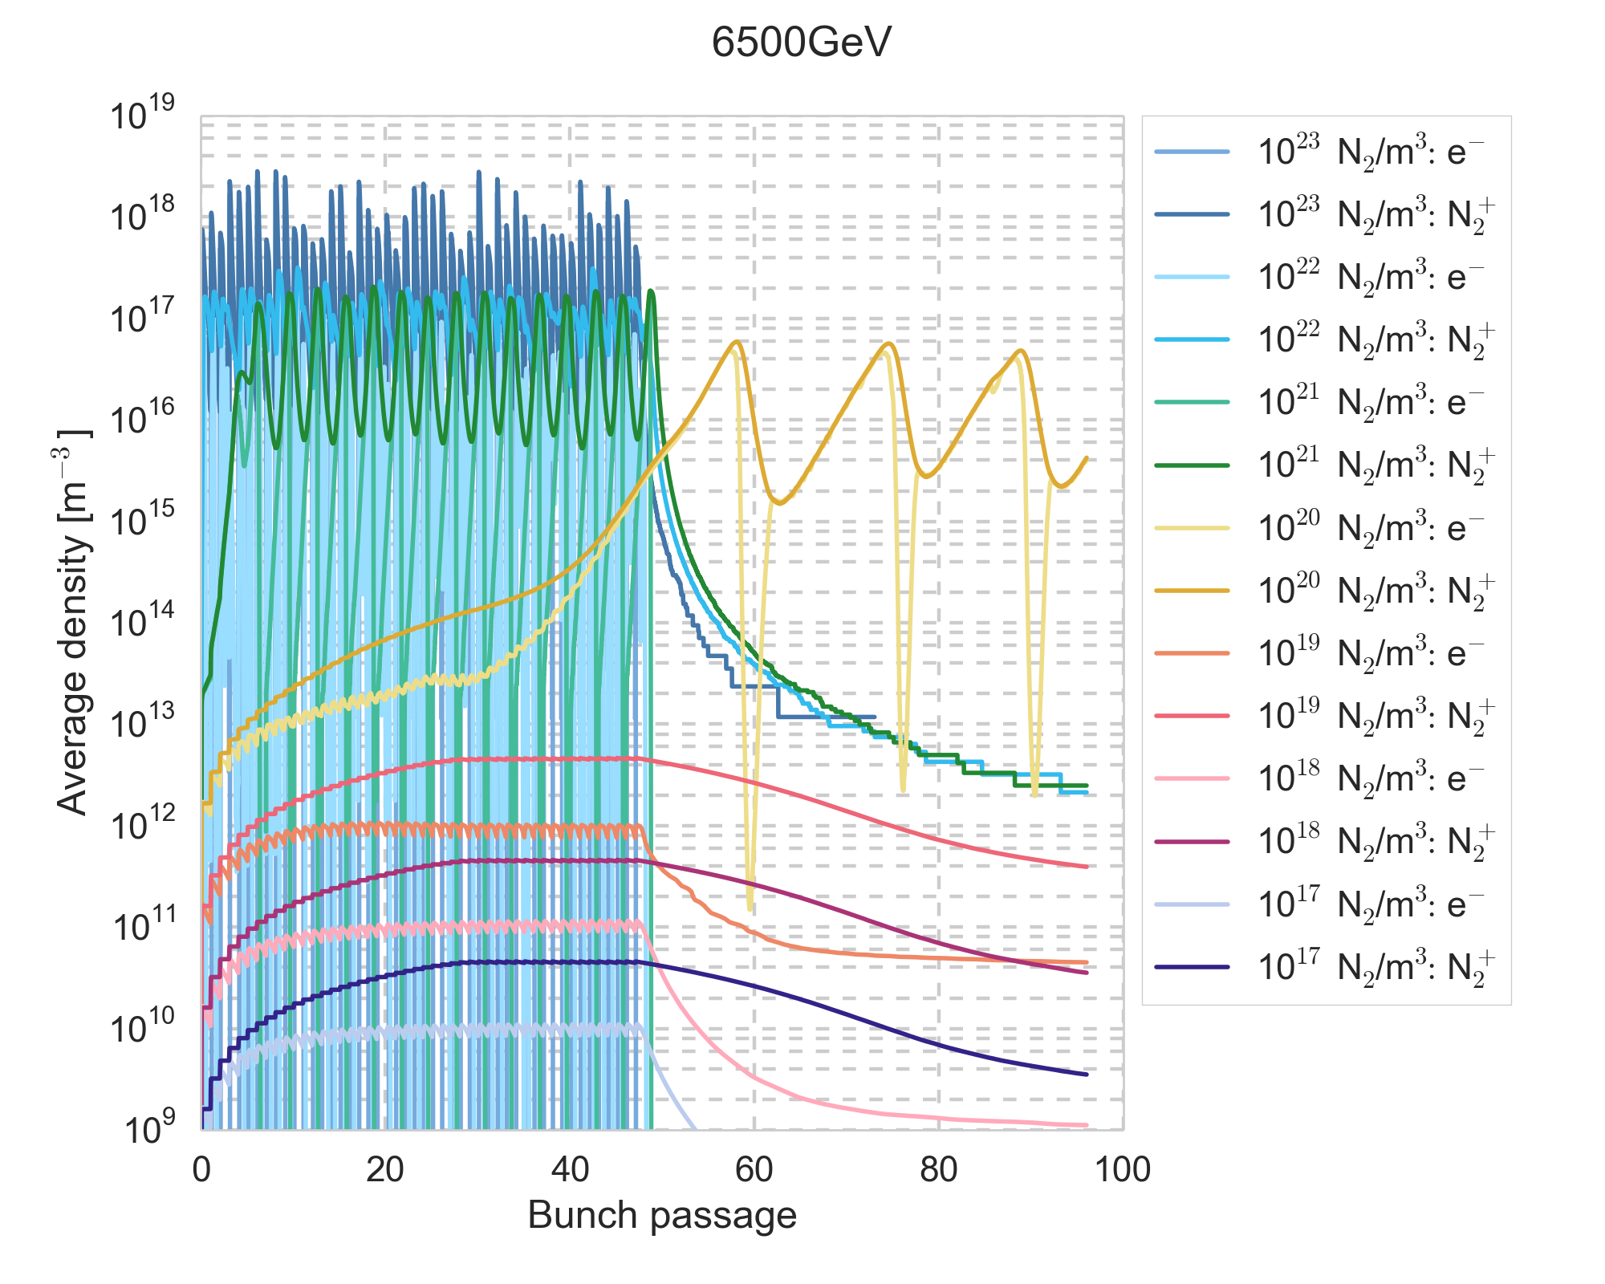
Density dependence
For gas densities from 10²⁰ N₂/m³, electron and ion densities in the range 10¹⁶ – 10¹⁷ m⁻³ are reached. For higher gas densities, electron and ion densities are similar, but reached faster
6.5 TeV, SEY=1.25

Slide 40
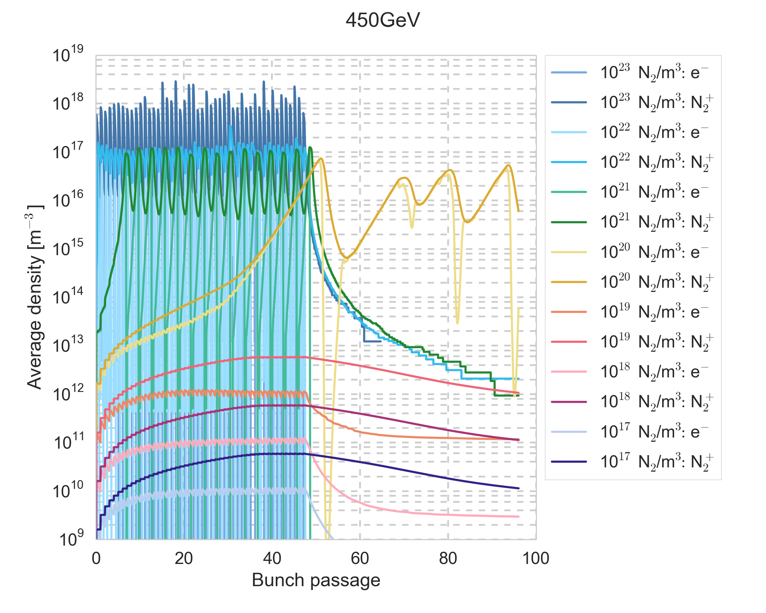
450 GeV, SEY 1.25
For gas densities from 10²⁰ N₂/m³, electron and ion densities in the range 10¹⁶ – 10¹⁷ m⁻³ are reached. For higher gas densities, electron and ion densities are similar, but reached faster
450 GeV, SEY=1.25

Slide 41
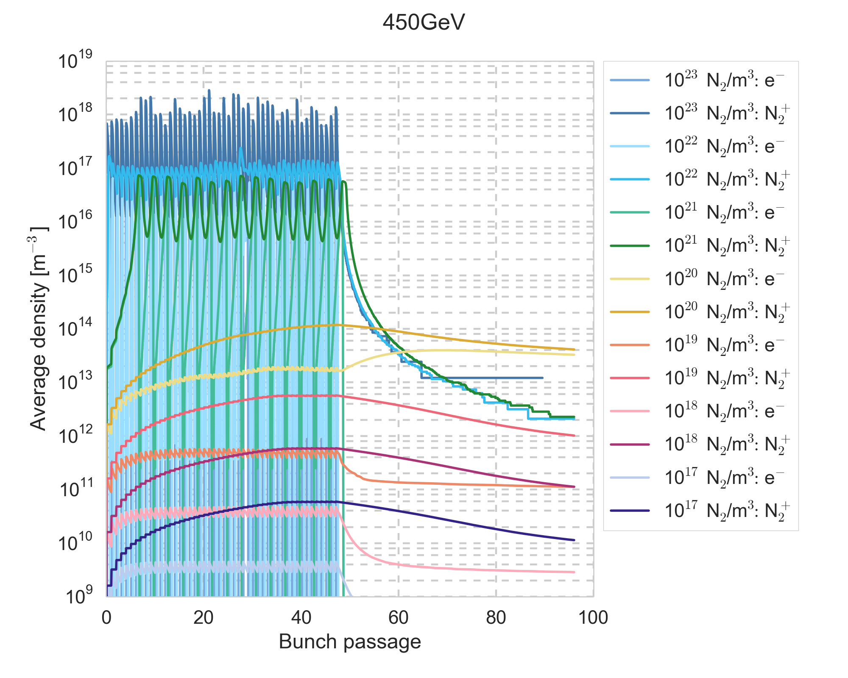
450 GeV, SEY 1.0
With SEY = 1.0, the results are very similar to the previous case, mainly the behaviour of the 10²⁰ N₂/m³ gas density is modified
450 GeV, SEY=1.0

Slide 42
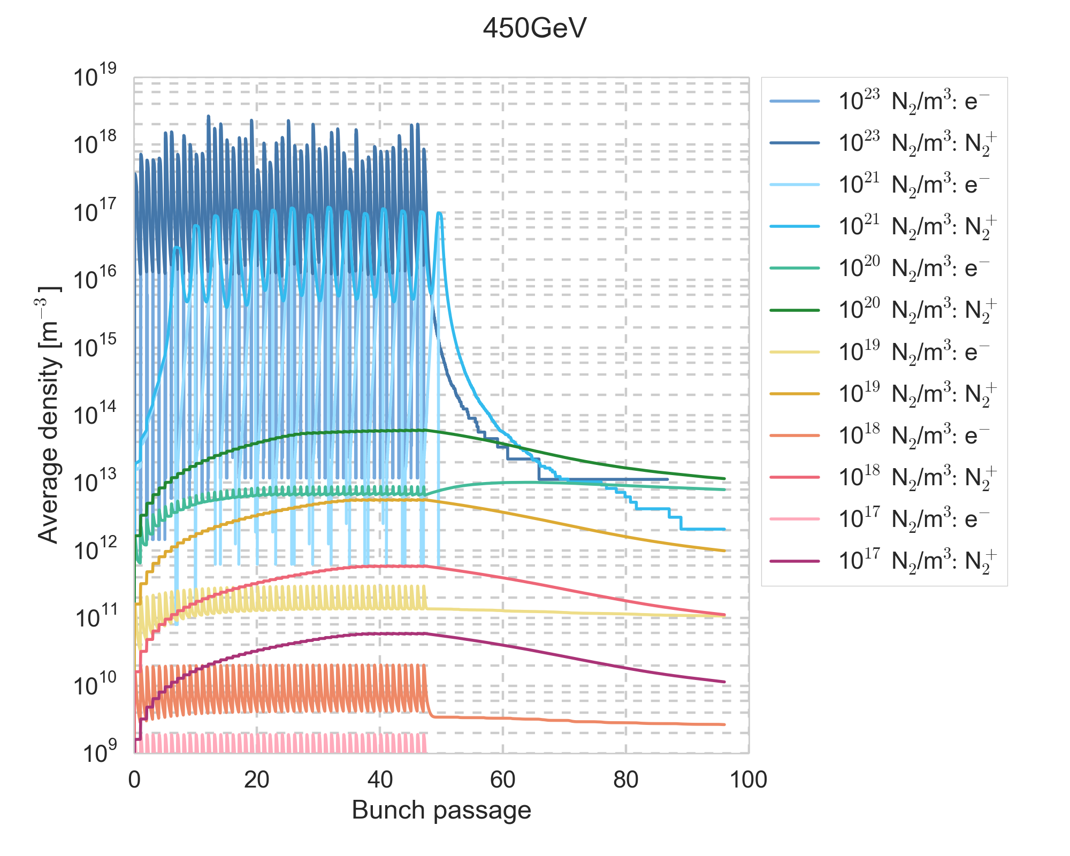
450 GeV, perfect absorber
Wit perfect absorber boundary conditions, the results are very similar to the case with
SEY = 1.0
450 GeV, SEY=0

Slide 43
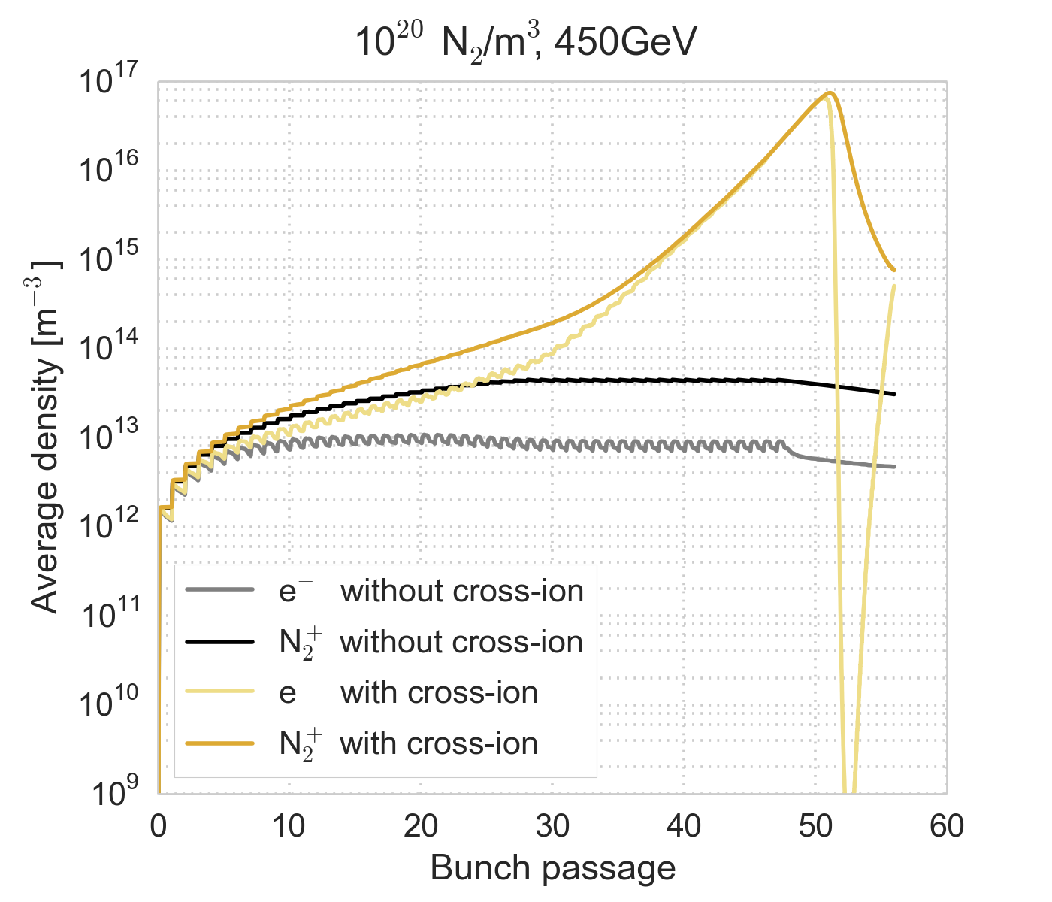
Observations
An unexpected self-sustaining behaviour is observed for a gas density of 10²⁰ N₂/m³ – is it physical?
Appears to be a combined effect of secondary emission and cross-species ionization – it is suppressed for low or no SEY
From a first look at the available output
no clear physical inconsistency could
be identified
Further checks, e.g. the evolution of
the total energy in the system, will
be performed

Slide 44
More observations
With the cross-species ionization, the cloud densities can increase by several orders of magnitude over a single or just a few bunch passages
Although PyECLOUD has good macroparticle size management for electron multipacting, the routines are not perfectly adapted to this case
  Normally the macroparticle number is checked for, and adjusted if needed, at the end of each bunch passage
  Asynchronous macroparticle regeneration has already been implemented, where their number is checked and adjusted if needed, at every time step
  Plan to implement more suitable handling of decreasing macroparticle numbers – hope to reduce the noisiness of electron numbers
Currently cross-species ionization is performed at every simulation time step
If generation over this time step is small → poor sampling of the cross-section
  To be investigated if there is a need for a separate ionization time step

Slide 45
Conclusion & Outlook
Electron-induced ionization was estimated to be important in the 16L2 events
A module for cross-species ionization has been implemented in PyECLOUD to allow for simulations including electron-induced ionization
First simulation studies have been performed and show that the ionization has a significant effect for gas densities from 10²⁰ N₂/m⁻³, as was predicted
In some cases, a self-sustaining behaviour is seen, where generation occurs in the absence of beam – still unclear if the behaviour is physical and real
Further checks and small code improvements e.g. on macroparticle management are required to confirm validity and improve results
Convergence scans to be performed before full-blown simulation studies

