Slide 1
sFGD electronics meeting - intro -
E. Noah & O. Drapier

Slide 2
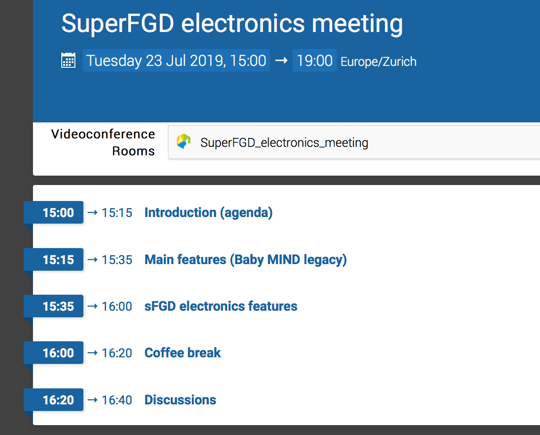
Tour de table
Status of main institutes
CITIROC costing
Main features of electronics (legacy of Baby MIND):
Connectivity to photosensors:
Sampling of CITIROC trigger outputs:
Demonstration with the 10000-cube proto
Main constraints:
Cost
B-field
Space
Connectivity
DAQ throughput
Designing the new system:
Baseline layout (pros-cons)
Alternative layout (pros-cons)
Backplane/Patch-panel design
Number of CITIROCs per FPGA
Power consumption studies
Optical module
Power module
Back-end
DAQ
Tools:
Documentation (tool, database, communication)
Electronics-specific
Project AOB (resources, plan)
Main aim for this meeting:
Review basic constraints/requirements
Agree on a design process
Iterative design process

