Slide 1

Introduction to the 2th International Review of the HiLumi LHC Magnet Circuits
Lucio Rossi – CERN
HL-LHC Project Leader
2th International Review HiLumi Circuits
CERN, 9-20 September 2019

Slide 2
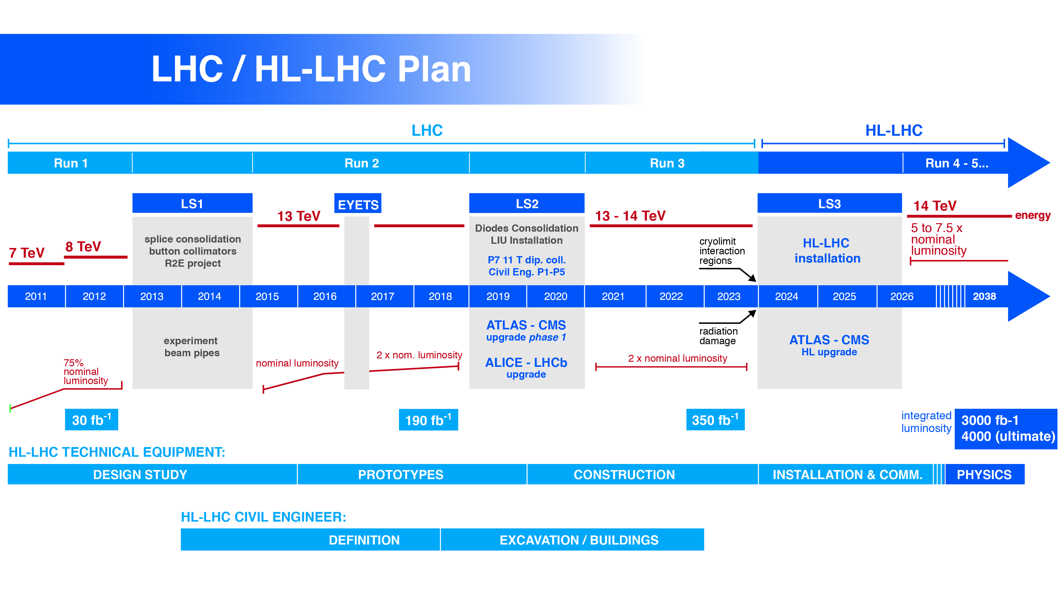

Technical limitation on the istantaneous lumi:
1. Collider (cryolimit in the triplet region) at 2×10³⁴ cm⁻²s⁻¹ twice the nominal design luminosity)
2. Experiments (pile up in the detectors). Designed for PU 40 they are actually dealing with 60 (average)!
Technical limitation on integrated lumi:
1. Collider (radiation damage to the IT magnets – correctors and quadrupoles)
2. Experiments (radiation damage in the Inner Tracker)
Higgs found!
LHC is at 93% of the design energy (now planned for 2021-23)
LHC is 20% above planned luminosity (number of collisions)
Notes:
Radiation damage and halveningtime

Slide 3
Goal of HL-LHC
From EC-FP7 HiLumi LHC Design Study application of 2010
The main objective of HiLumi LHC Design Study is to determine a hardware configuration and a set of beam parameters that will allow the LHC to reach the following targets:
A peak luminosity of L_{peak} = 5×10³⁴ cm⁻²s⁻¹ with levelling, allowing:
An integrated luminosity of 250 fb⁻¹ per year, enabling the goal of L_{int} = 3000 fb⁻¹ twelve years after the upgrade.
This luminosity is more than ten times the luminosity reach of the first 10 years of the LHC lifetime.
Ultimate performance established 2015-2016: with same hardware
and same beam parameters: use of engineering margins:
L_{peak ult} ≅ 7.5 10³⁴ cm⁻²s⁻¹ and Ultimate Integrated L_{int ult} ∼ 4000 fb⁻¹
LHC should not be the limit, would Physics require more…
Experiment are designing for this goal. We need to be compatible with it!

Slide 4
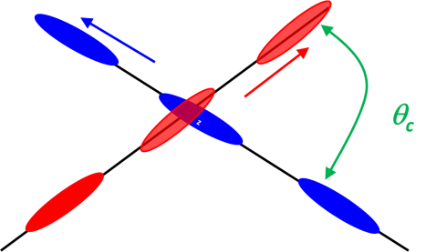

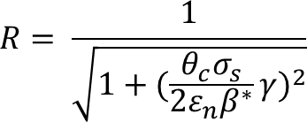
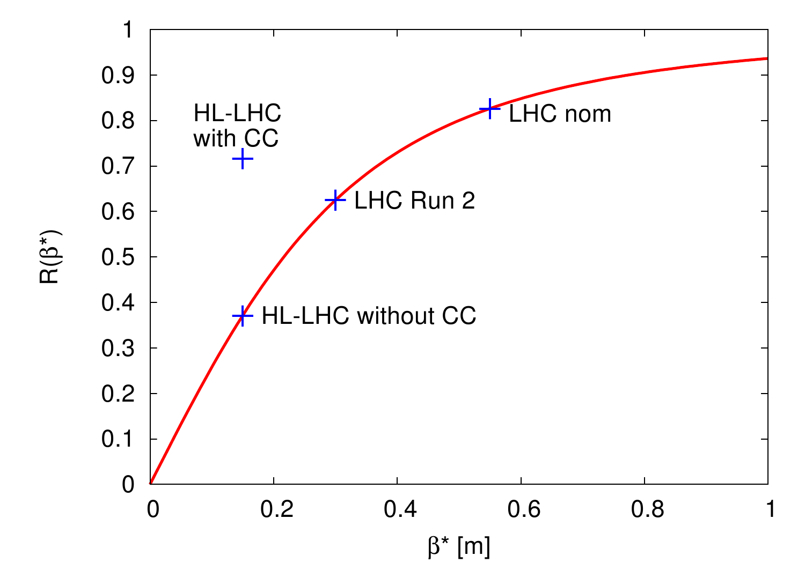
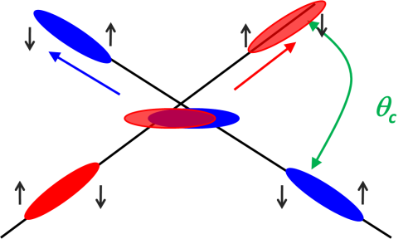
Luminosity: collision rate per unit cross section which parameters count for LHC?
Beam size

Slide 5
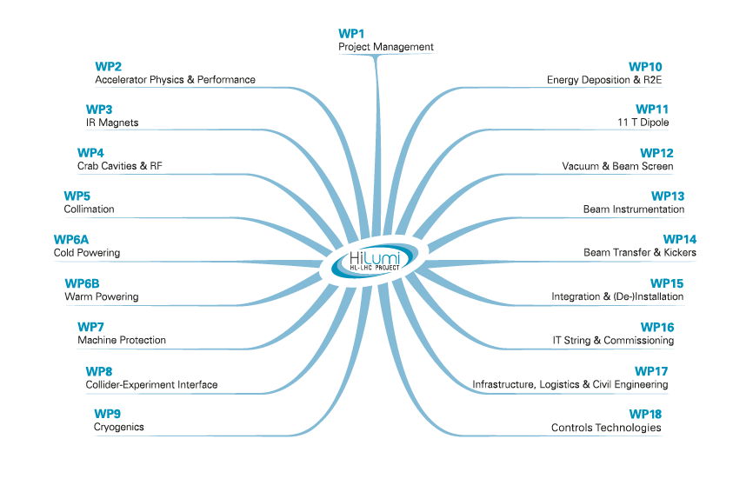
Mr Circuit
Magnet Circuit Forum

Slide 6
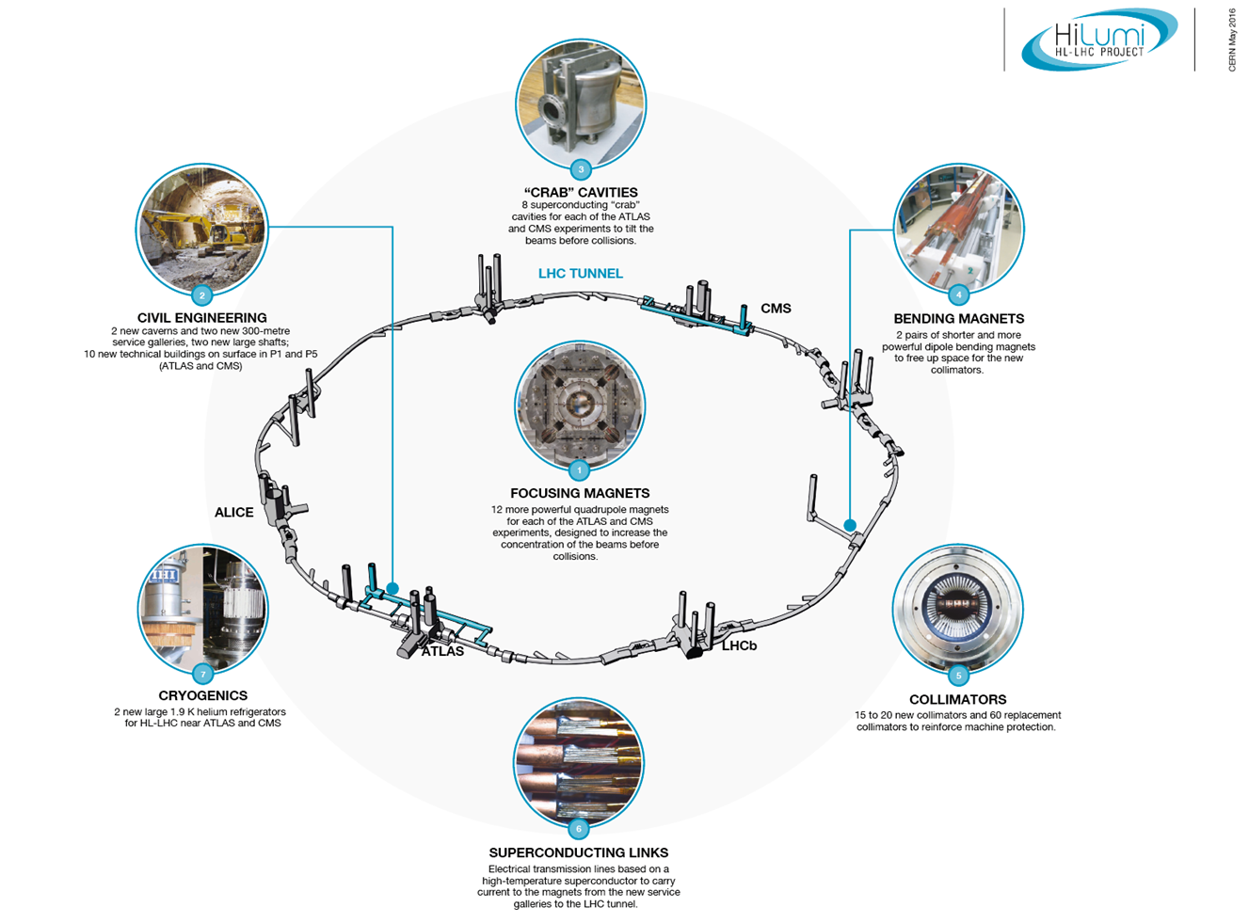
Technology landmarks
LS2 (2020!)

Slide 7





High Luminosity LHC IT region: 50% in-kind from USA
Fundamental role of US for R&D and Design
Connection to LHC (UL)
Service gallery (UR)
SC Links
Q2a
Q1
TAXS
Q2b
CP
Q3
DFX
D1
DFM

Slide 8
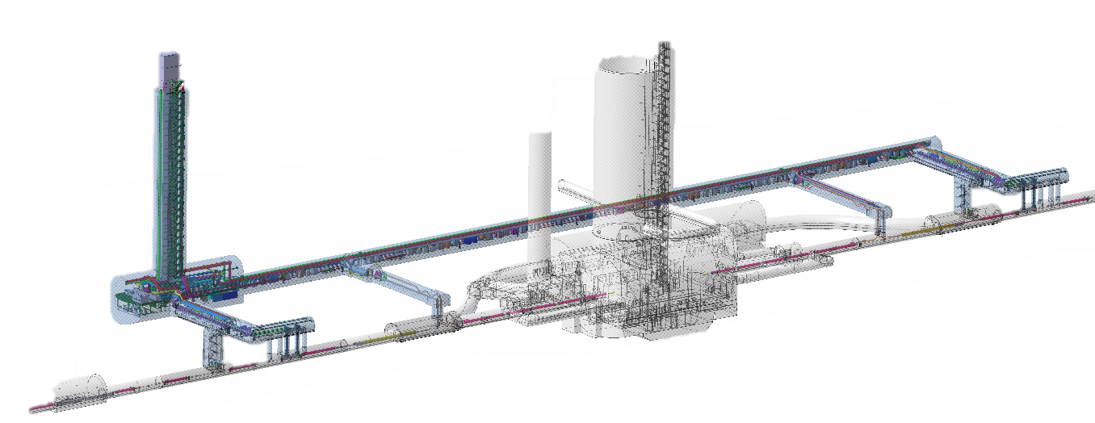
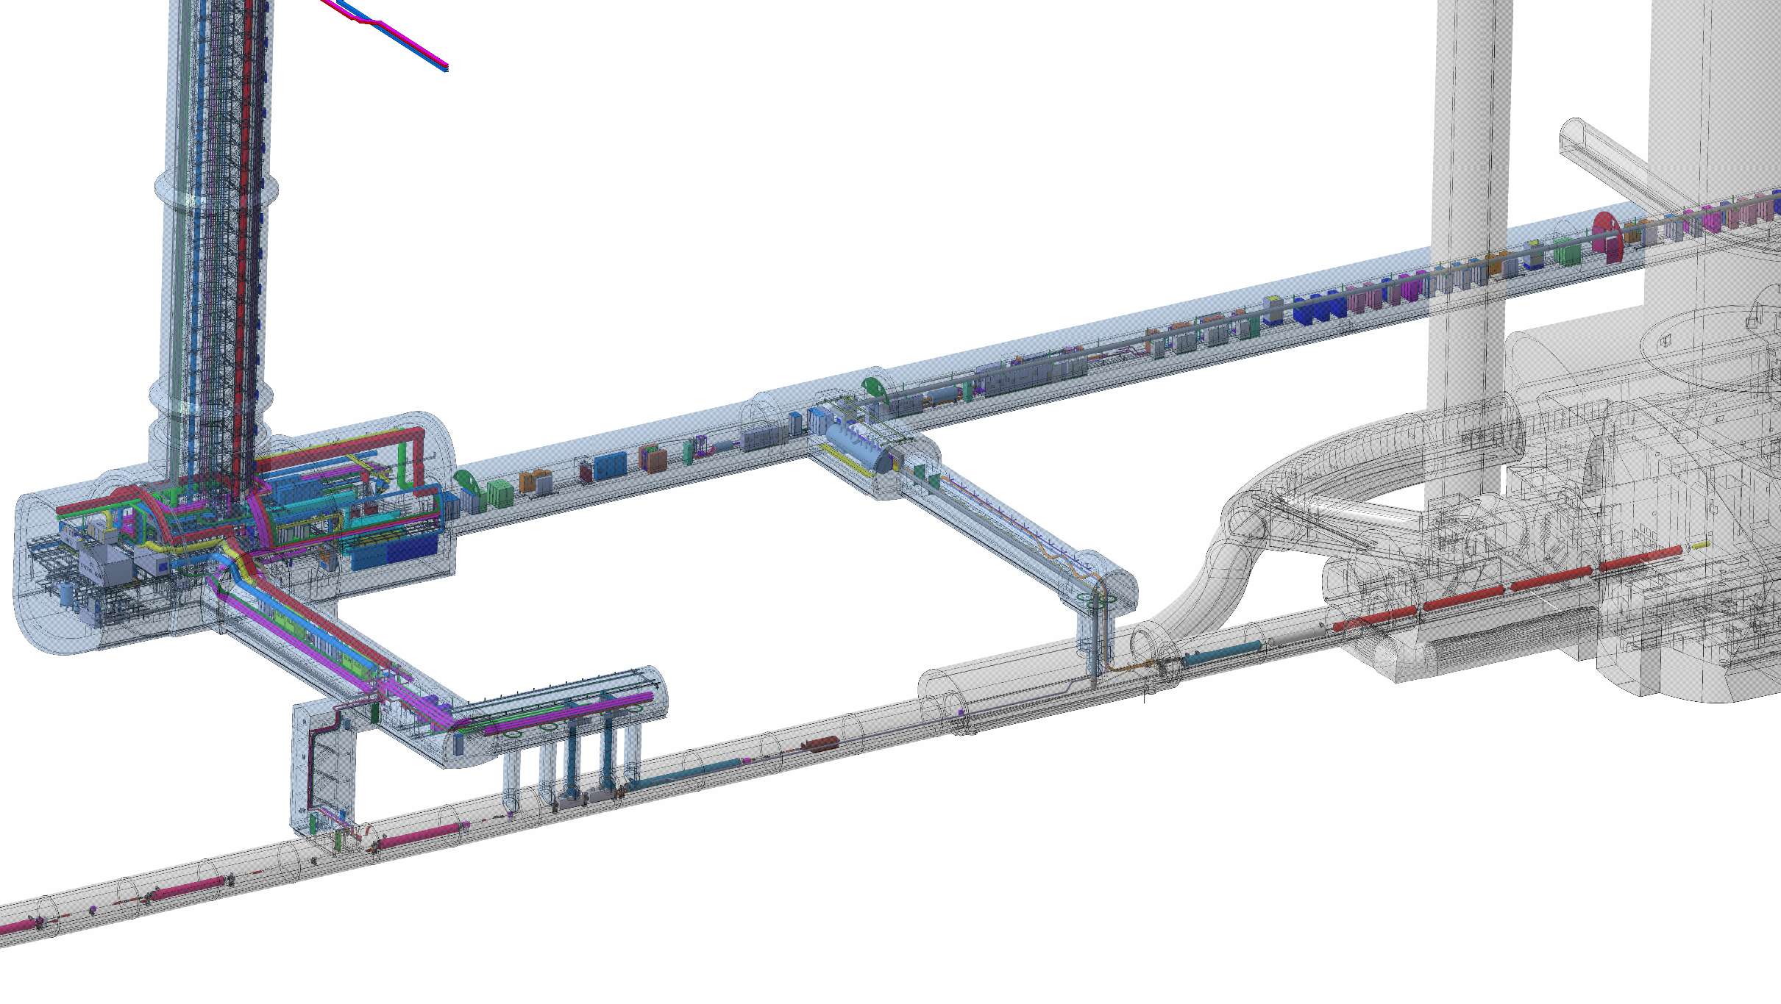
Integration much advanced and detailed
(DFBH/Disconnectors last big piece of the puzzle)
P5
Power Converters
QDS
DFHX_2
DFHX_1
DFHM
US57
UR55
UL57
SCLINK
VALVES
BOX
COLD BOX
Q2A
Q1
UJ57
Q3
Q2B
UA57
CP
Cooling and Ventilation
R571
D1
UPR
DFX
TAXN
CRAB CAVIITIES
D2
All SMRs (change of C.E. layouts) treated to 90% - only a few buldings TBD. No MORE room to make changes!
Q4
Q5

Slide 9
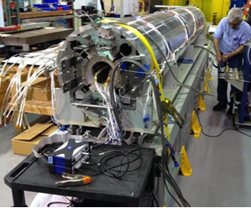
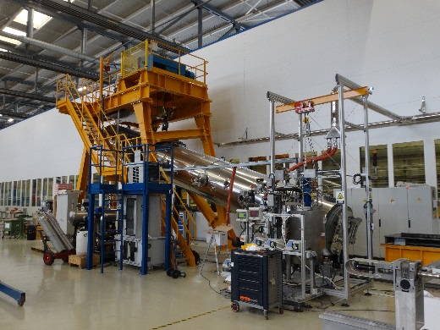
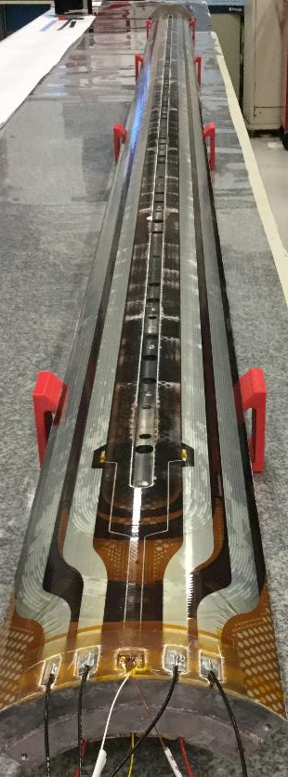
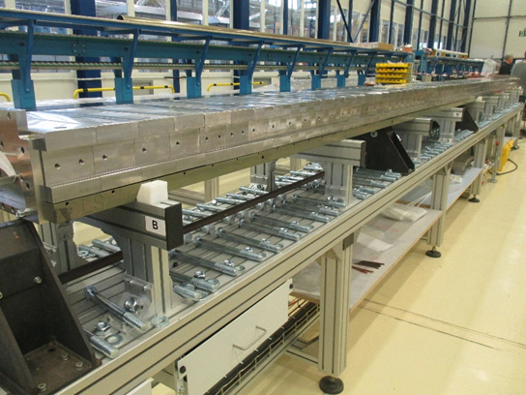
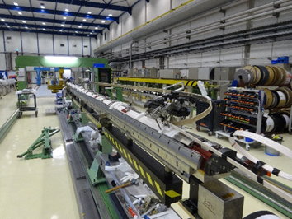
Construction of the 1st and 2nd long (7.5 m!) IT Quad in CERN; in USA winding 4th long magnet
QH issue
Voltage test
Need to be defined ASAP

Slide 10
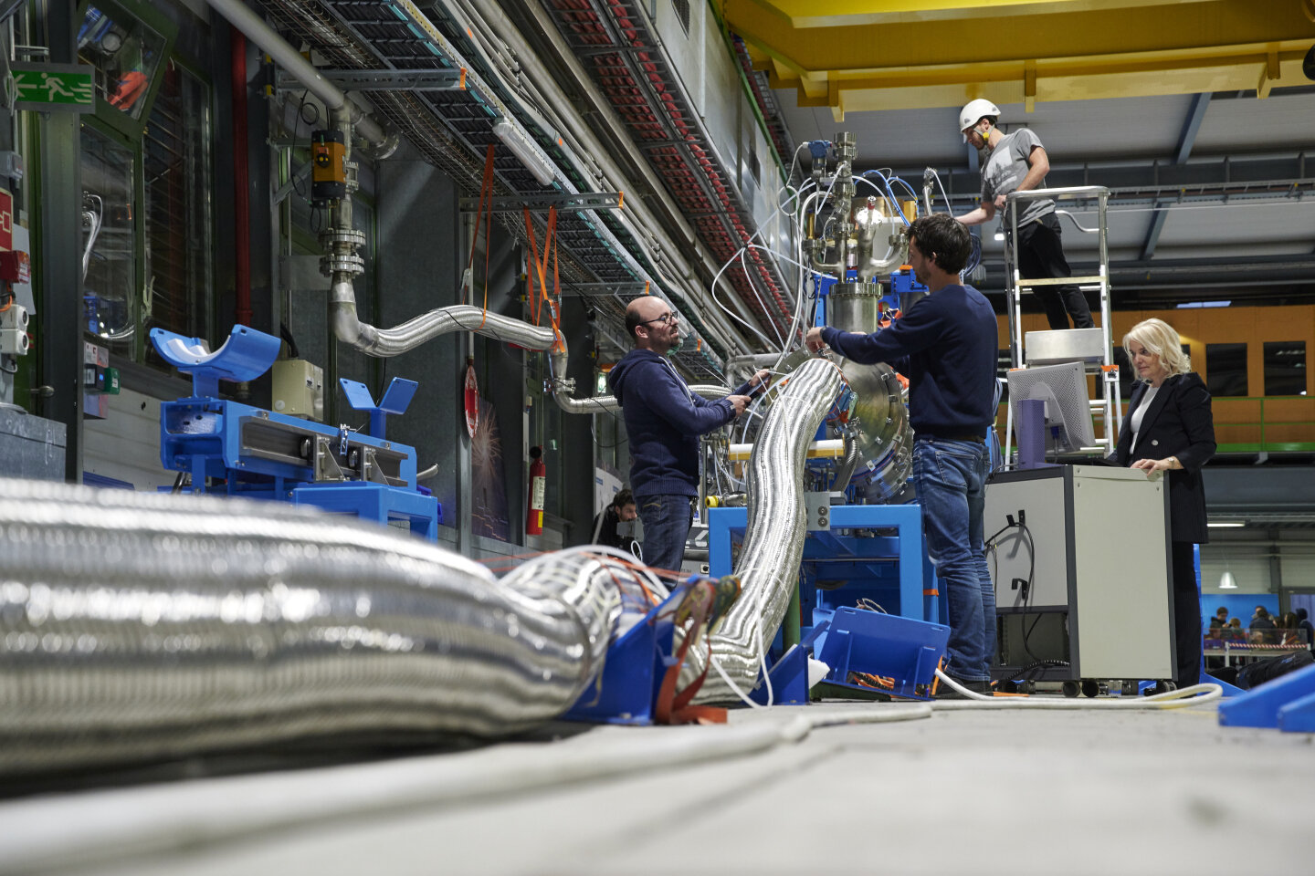
Cold Powering progress!
Very successful test of the system with one 60 m cable main circuit
(2x20 kA, MgB₂@25 K, REBCO@50K)
Flexible 2-wall long cryostat validated!
Local powering of low current circuits.
Design of the Cold Powering system is not yet finished: its validation only next year.
Collaborations UK and SE that require to fix design ASAP since are trying to get financed for the cold boxes while the detail design is not yet fully finished (DFX) or not yet conceptually approved (DFH).
Very good tender of the cabling contract: demonstrator done (see next slide).
MgB₂ wire production is well under way (unique supplier is always a concern)

Slide 11
Half way

Slide 12
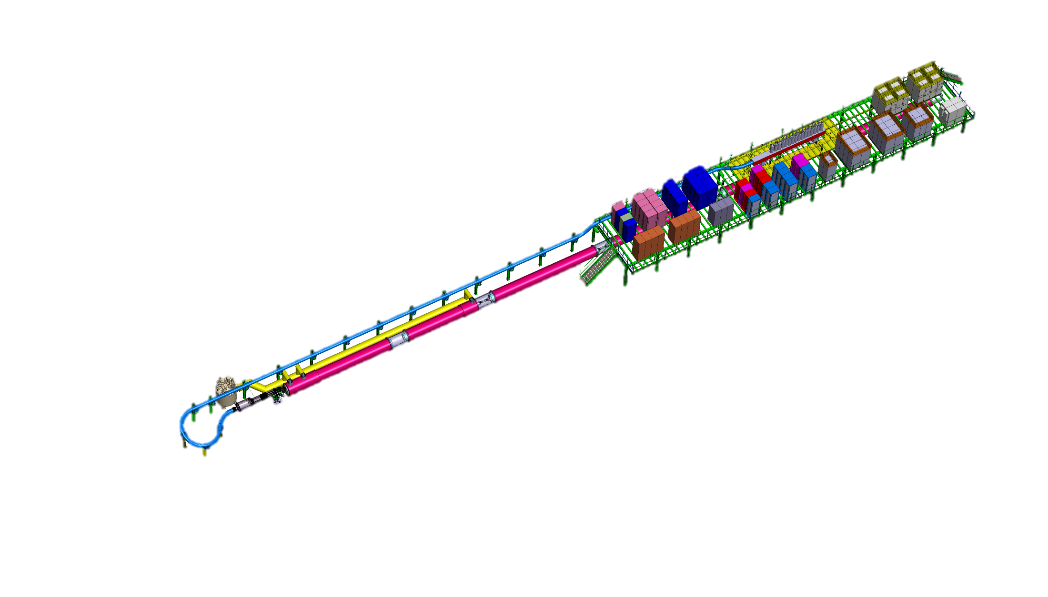
IT String:Test of complete circuits
Scheduled now in 2023
HL LHC IT STRING is foreseen to study the collective behaviour of the IT zone
The main components are: Q1-D1 with complete cold and warm powering
The test stand will be integrated into SM18
Infrastructure upgrade is well advanced
P5L will be reproduced without slope
180 quenches/or power aborts are planned
400 W heat extraction possibility exist
ID CARD of the TEST STAND: HL-LHC IT STRING
TEST Facility LOCATION: SM18 (b. 2173)
TEST DATE: 2021-2023
OPERATIONAL TEMPERATURE: 1.9 K
OPERATIONAL CURRENT: Ultimate (108% I_{nominal} = 18 kA )
MAGNETS: Q1, Q2a, Q2b, Q3, CP, D1
COLD POWERING: SC link ,HTS leads DFH and DFX,
WARM POWERING: 1 x PC for 18 kA + 3 Trim for Q1-Q3 + 6 x 2 kA + 1 x 12 kA + 9x 0.1 kA + WCC
PROTECTION: CLIQ and QH ; EE where is baseline

Slide 13
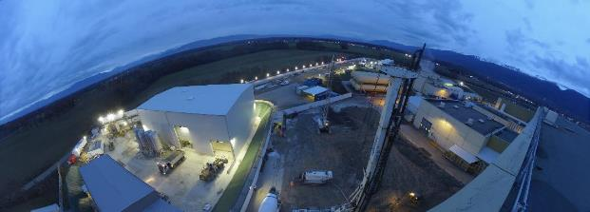
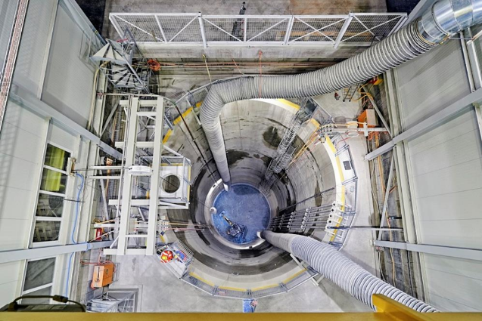
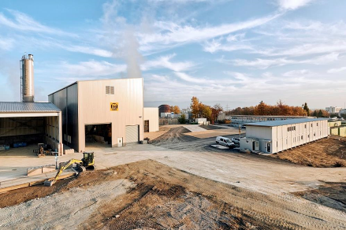
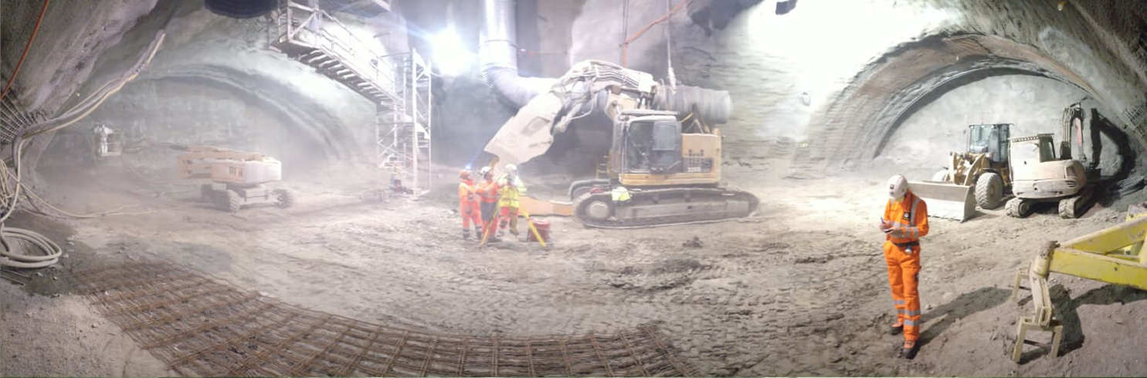
Hilumi Civil Engineer: 2 large shafts; 1 km of new underground; 20 new buildings;
Contract T117 – JVMM (LHC-P1)
Contract T118 – CIB (LHC-P5)

Slide 14
Charge overview
1. To review the final layout of the HL-LHC magnet circuits including the aspects related to powering and quench protection strategies, making sure that the right choices have been made both in terms of circuit optimization and protection reliability;
2. To review the adequacy of the protection of the circuits for the different configurations that are adopted in order to assure safe commissioning and operation with beam. This aspect includes protection in case of quenches, failures of various components or of systems, effects of protection equipment to beam, protection of power converters, etc.;
3. To review the integration of equipment respecting installation and maintainability requirements;
4. To review the proposed instrumentation for protection and the ancillary equipment (feeders, feedthroughs, etc.) and its test in operational conditions in the IT String;
5. To assess on the Electrical Quality Assurance strategy of cold/warm equipment and circuits, making sure that insulation coordination is properly established.

Slide 15
International Review panel members
Akira Yamamoto (KEK-CERN-Chair)
Hans-Jörg Eckoldt (DESY)
Jim Strait (FNAL)
Neil Mitchell (ITER)
Paolo Fessia (CERN)
Steve Gourlay (LBNL)
Link person: Felix Rodriguez Mateos
Scientific Secretary: Samer Yammine

Slide 16
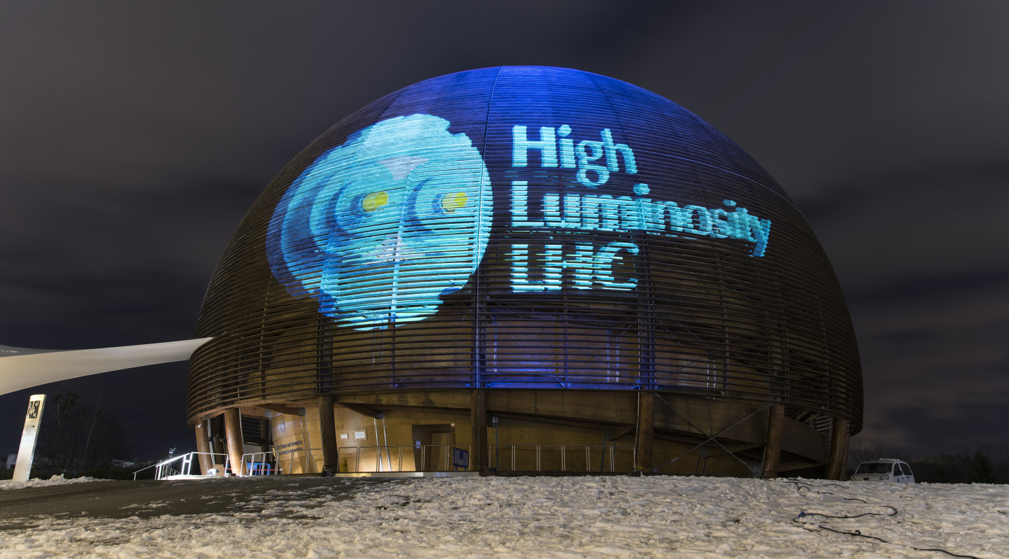
Good Work

