Slide 1







Quick overview on the HL LHC magnets characteristics
E. Todesco
Thanks to E. Ravaioli, F. Rodriguez Mateos, S. Izquiredo Bermudez, and all collaborations
9 September 2019 - CERN

Slide 2
CONTENTS
Few general remarks
Main magnets
  Triplet
  D1
  D2
Correctors
  Nested correctors
  High order correctors
  D2 correctors

Slide 3
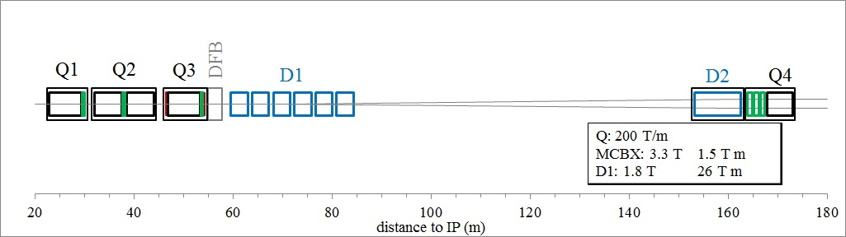
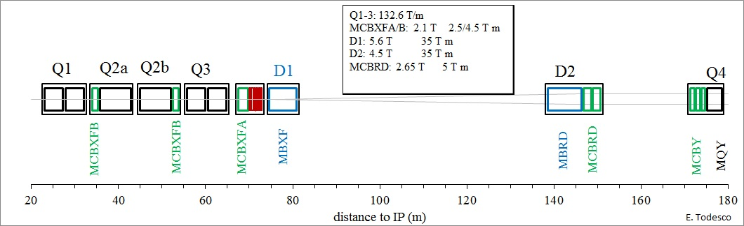
THE HL-LHC IR REGION MAGNETS
LHC: 2008-2023
HL-LHC: ∼ 2025-2035

Slide 4
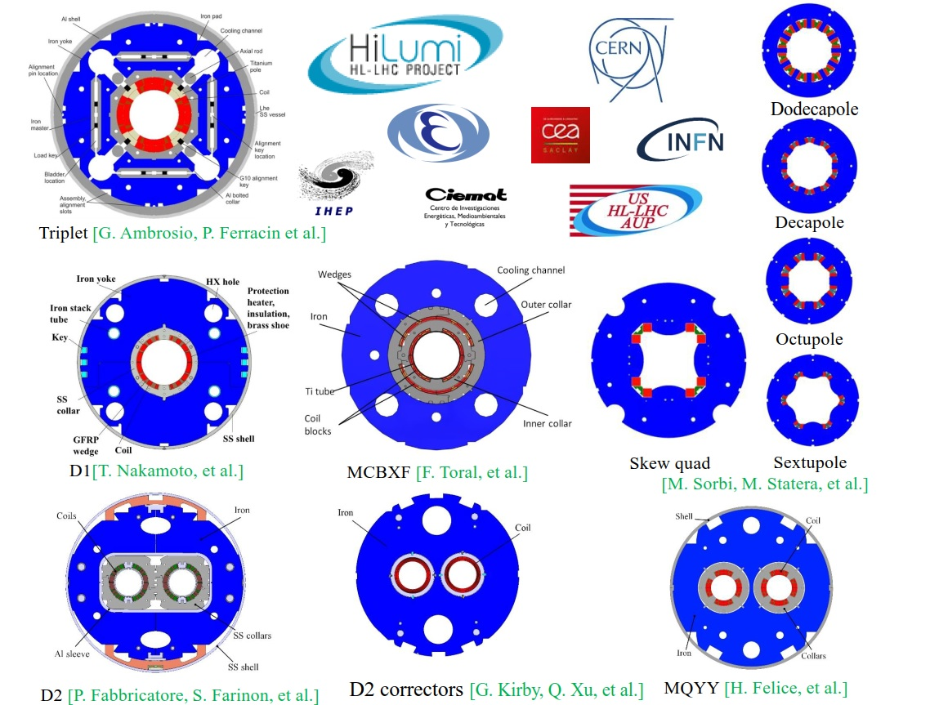
THE HL-LHC IR REGION MAGNETS
100 magnets of 11 different types, done via 6 collaborations
To be ready by 2024

Slide 5
FEW GENERAL REMARKS
All magnets are individually powered with the exception of the triplet
  Featuring a rather complex circuit, described in the following
Magnet protection relies on (see A. Verweij talk)
  Quench heaters and CLIQ (triplet)
  Standard quench heaters (D1 and D2)
  Energy extraction (MCBXFA and D2 corrector)
  Quench propagation (all others)
Max. voltage during quench is ranging from 400 to 800 V
  This value is the input to determine voltage tests (see A. Foussat and G. Ambrosio talks)
Maximum hotspot is set to values ranging from 200 to 350 K
  Depending on the magnet type

Slide 6
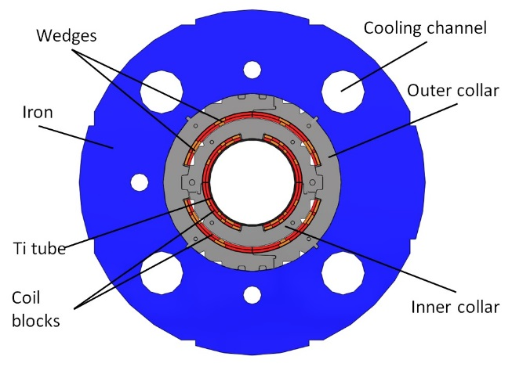
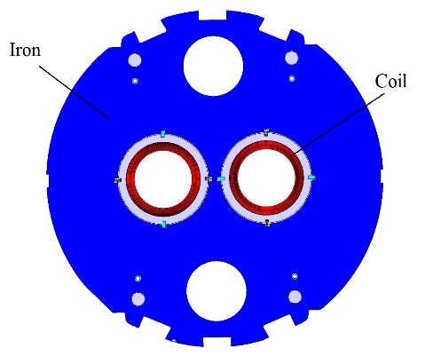
FEW GENERAL REMARKS
We have two cases with mutual inductances between two circuits
  MCBXF: nested corrector, a vertical dipole inside an horizontal dipole independently powered
    Mutual inductance is zero at first order (since fields are perpendicular)
  D2 corrector: double aperture magnet, a vertical dipole on one side and an horizontal dipole on the other one, independently powered
    Mutual inductance is zero at first order (since field is low and iron makes a shield)
MCBXF cross-section
(F. Toral, J. C. Perez et al.)
D2 corrector cross-section
(G. Kirby et al.)

Slide 7
CONTENTS
Few general remarks
Main magnets
  Triplet
  D1
  D2
Correctors
  Nested correctors
  High order correctors
  D2 correctors

Slide 8
THE TRIPLET
Main function
  Reducing the size of the beta function in the interaction region
Operational mode
  Ramps with the main bending from 450 GeV to 7 TeV
  Minor changes at flattop during squeeze may be needed (about 1% variation)

Slide 9
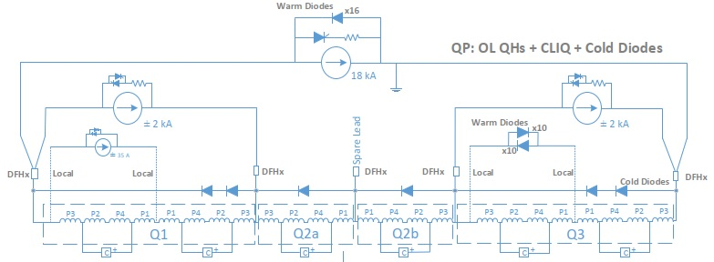
THE TRIPLET
The circuit: all four magnets in series
  16.4 kA nominal
  6 diodes at 1.9 K
Triplet circuit (E. Ravaioli, F. Rodriguez Mateos, et al.)

Slide 10
THE TRIPLET
The circuit: all four magnets in series
  2 kA trims on Q1 and Q3 necessary to tune the optics
    Once established in commissioning, same settings at every run
Triplet circuit (E. Ravaioli, F. Rodriguez Mateos, et al.)

Slide 11
THE TRIPLET
The circuit: all four magnets in series
  35 A trim on Q1a
    To be used only during β* measurements in special sessions (k-mod technique)
Triplet circuit (E. Ravaioli, F. Rodriguez Mateos, et al.)

Slide 12
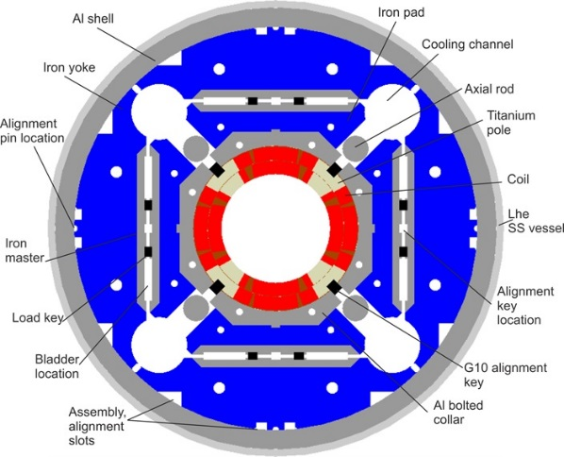
THE TRIPLET
Magnet protection
  Based on outer layer quench heaters
  and CLIQ
  No energy extraction
Max. hotspot 350 K
  Around 270 K in case of no failures
MQXF cross-section
(P. Ferracin, G. Ambrosio et al.)
Triplet circuit (E. Ravaioli, F. Rodriguez Mateos, et al.)

Slide 13
SEPARATION DIPOLE D1
Main function
  Separating the beams from the IP towards the arc
Operational mode
  Ramps with the main bending from 450 GeV to 7 TeV

Slide 14
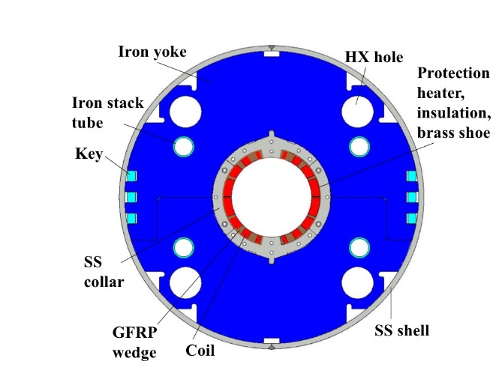
SEPARATION DIPOLE D1
Individually powered, ∼12 kA nominal
  Nb-Ti Rutherford cable
    Same cable as MB LHC outer layer
Protection
  Quench heaters
  No energy extraction
Max. hotspot set to 300 K
D1 cross-section
(T. Nakamoto, M. Sugano et al.)

Slide 15
RECOMBINATION DIPOLE D2
Main function
  Making the beams parallel from the IP towards the arc
Operational mode
  Both apertures ramp with the main bending from 450 GeV to 7 TeV

Slide 16
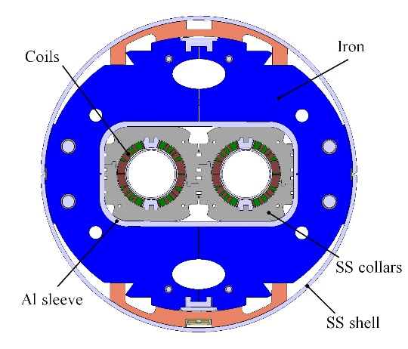
RECOMBINATION DIPOLE D2
Individually powered, ∼12 kA nominal
Nb-Ti Rutherford cable
    Same cable as MB LHC outer layer
  Apertures in series
Protection
  Quench heaters
  No energy extraction
Max. hotspot set to 300 K
D2 cross-section
(P. Fabbricatore, S. Farinon et al.)

Slide 17
CONTENTS
Main magnets
  Triplet
  D1
  D2
Correctors
  Nested correctors
  High order correctors
  D2 correctors

Slide 18
NESTED CORRECTOR MCBXF
Main function
  Opening/closing crossing angle
  Opening/closing separation bump
  Correct triplet misalignment

Slide 19
NESTED CORRECTOR MCBXF
Operational mode
  Ramps with the MB from 450 GeV to 7 TeV
  Then during/after squeeze it covers its main optical task
  Settings values are fixed after optics commissioning
  1.6 kA nominal current

Slide 20
NESTED CORRECTOR MCBXF
Magnet is nested (H and V dipoles)
  Each dipole has individual powering
  Nb-Ti Rutherford cable, impregnated
  Nominal current ∼1.6 kA
Magnets has 2 different strenghts
  4.5 T m (MCBXFA, 2.5 m long)
  2.5 T m (MCBXFB, 1.5 m long)
MCBXF cross-section
(F. Toral, J. C. Perez et al.)

Slide 21
NESTED CORRECTOR MCBXF
MCBXFA protection
  Via energy extraction
  No quench heaters
MCBXFB protection
  Via quench propagation
  No energy extraction, no quench heaters
Max. hotspot 300 K
MCBXF cross-section
(F. Toral, J. C. Perez et al.)

Slide 22
HIGH ORDER CORRECTORS
Main function
  Correct the field errors of the triplet, D1 (and possibly D2) after squeeze
Operational mode
  Each corrector individually powered
  Ramp with the LHC energy to reach the required settings after squeeze

Slide 23
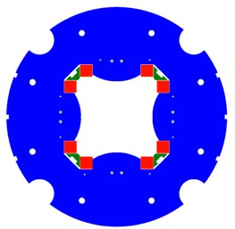
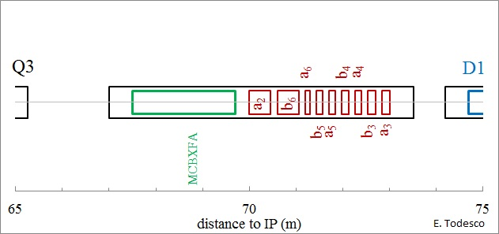
HIGH ORDER CORRECTORS
Skew quadrupole
  Superferric design, Nb-Ti strand
  ∼200 A nominal current
Protection
  Via energy extraction
  No quench heaters
Max. hotspot set to 200 K
Skew quadrupole cross-section
(M. Sorbi, M. Statera et al.)

Slide 24
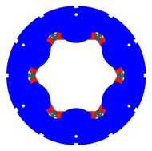
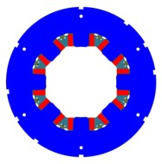
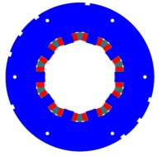
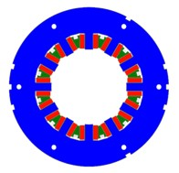
HIGH ORDER CORRECTORS
Sextupole, Octupole, Decapole, Dodecapole
  Superferric design, Nb-Ti strand
  ∼100 A nominal current
Protection
  Via quench propagation
  No energy extraction no quench heaters
Max. hotspot temperature set to 200 K
Sextupole, Octupole, decapole and dodecapole cross-section
(M. Sorbi, M. Statera et al.)

Slide 25
D2 CORRECTOR MCBRD
Magnet has double aperture
  CCT design, Nb-Ti wire
  Each dipole has individual powering
Protection
  Via quench back induced by energy extraction
  No quench heaters
Max. hotspot temperature is set to 200 K
D2 corrector cross-section
(G. Kirby et al.)

Slide 26
THANKS

