Slide 1

Introduction to the HL-LHC Circuits and
Report from Previous Review
Felix Rodriguez Mateos
International Review of HL-LHC Magnet Circuits, 9th - 10th September 2019

Slide 2
Outline
Introduction to the HL-LHC Circuits
Hollow Electron Lenses’ Circuits - brief description
Follow up of the Internal Review in March 2017
The Magnet Circuit Forum
Structure of the Review

Slide 3
Layouts in HL-LHC
Nb3Sn magnets
Interaction region
From the circuits point of view this part of the Matching Section is not modified
LHC Dipole circuit in S67 (shown) and 78
Also denominated MBH; Nb3Sn magnets

Slide 4
Inner Triplets
NB. Quench heaters are not shown

Slide 5
Inner Triplets

Slide 6
Main Aspects for Inner Triplet Circuits
One single circuit per side of the interaction points
Nb₃Sn magnets with a total inductance in the circuit of 255 mH (69 mH for Q1 and Q3, 58.5 mH for Q2a and Q2b)
  Flux jumps do have an impact onto stability and quench detection
Powered from the new galleries using an MgB₂ superconducting link and cold bus bars connecting to the magnet terminals
  CLIQ units and the 35A k-mod power supply are connected to the coils through local feed-throughs, not using the s.c. link
It is a distributed circuit with equipment in different underground areas
Protection is based on Quench Heaters and Coupling Losses Induced Quench (CLIQ) units
Protection strategy: “any quench anywhere fires all”
For the first time cold diodes are going to be used around the interaction points where radiation loads are heavier
The layout has several layers of nested circuits that require smart controls
The connection of the CLIQ units has to mitigate fast effects to beam in case of misfiring of those units
The polarities of the quench heater discharge supplies (HDS) and CLIQ are optimized to minimize voltages developed during quench
The parameters in the crowbars of power converters are optimized to not trigger the cold diodes and to avoid overcurrent exceeding the ratings of the circuit

Slide 7
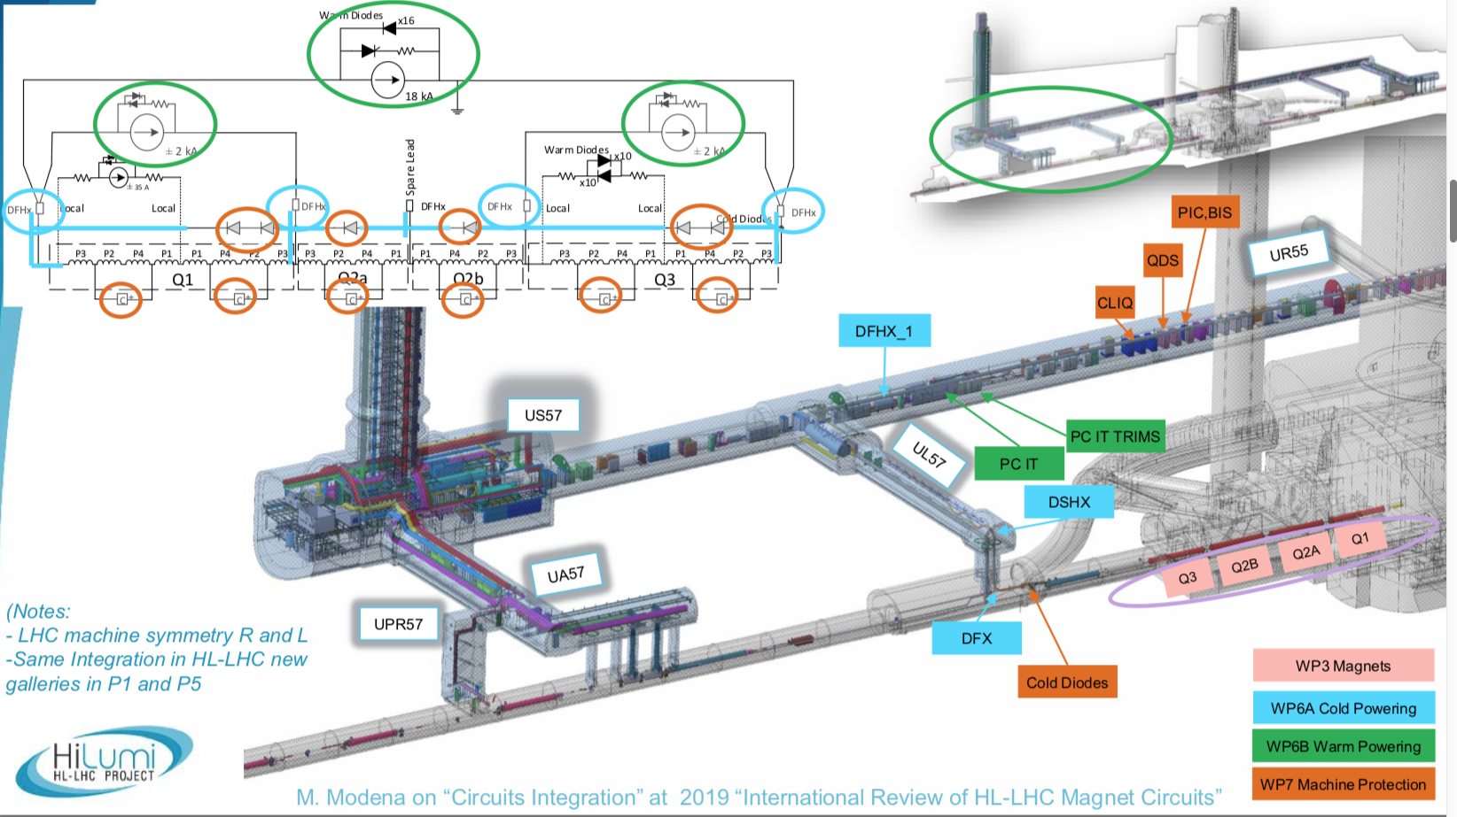
Courtesy Michele Modena

Slide 8
11T MBH Dipoles in S67 and S78
First superconducting magnet of HL-LHC to be put in operation after installation during the present Long Shutdown 2
It replaces a regular 15m-long LHC dipole in positions A9L7 and A9R7
The assembly is made of two, Nb₃Sn 5.5m-long magnets with a collimator in between
Both of these magnets have apertures on same beam in series, with a central point and sharing the same cold diode
In series with another 153 LHC dipoles
Protected with quench heaters and energy extraction
Flux jumps do have an impact onto stability and quench detection
A ±250A trim converter is able to compensate the difference in transfer function of the 11T magnets
2x2 conduction cooled current leads supply the trim current
A special configuration for the protection and interlocks of this trim circuit is required

Slide 9
Orbit Correctors in Inner Triplet (Q1, Q2, Q3)
Two versions of circuit, with either short or long magnets (58/124 mH and 107/232 mH for inner/outer coils respectively)
Powering is realized using the inner triplet superconducting link
Circuits are rated for 2kA with 4-quadrant power converters
The protection is done in one case (long magnets) by energy extraction with 0.3 Ohm resistor, in the other case (short magnets) the discharge is given by the converter’s crowbar resistance (25 mOhm). The latter is however under discussion.

Slide 10
Separation and Recombination Dipoles Circuits
D1 has 24.9 mH and D2 27.4 mH
Powering is realized using the inner triplet and the matching section superconducting links respectively
Circuits are rated 14 kA with 1-quadrant power converter
Magnets are protected by quench heaters
Quench heaters are fired in case of any quench in the s.c. part of the circuit

Slide 11
High Order Correctors on Inner Triplet
Nine high-order corrector circuits in total (skew quadrupole, normal and skew sextupole, octupole, decapole and dodecapole)
Circuit inductances vary from 1.53 H (skew quad) down to 120 mH for the normal and skew decapoles, high magnetic saturation
The quadrupole corrector circuit has a rating of ±200 A whereas all the eight other correctors have a rating of ±120 A
The quadrupole magnet is protected with energy extraction system with a 1.5 Ohm resistor grounded at the mid-point
The rest of the magnets are self-protected and 80 mOhm crow-bars are giving the adequate time constant.
These circuits don’t use the superconducting link but local feeders on the Correctors Package cryostat
Power converters are in all cases 4-quadrant and located in existing LHC underground areas

Slide 12
Orbit Correctors in Matching Section
The inductance of the magnet is 920 mH
Powering is realized using the matching section superconducting link (used also to power D2)
Circuits are rated for 600A with 4-quadrant power converters
The protection is given by an energy extraction system with 1.5 Ohm resistor

Slide 13
Q10 … for completeness
The orbit correctors in Q10 of interaction points 1 and 5 will be changed from 120 A to 60A (LHC versions)
There will be two new 600A lattice sextupoles in series with the rest of the arc families (D and F)

Slide 14
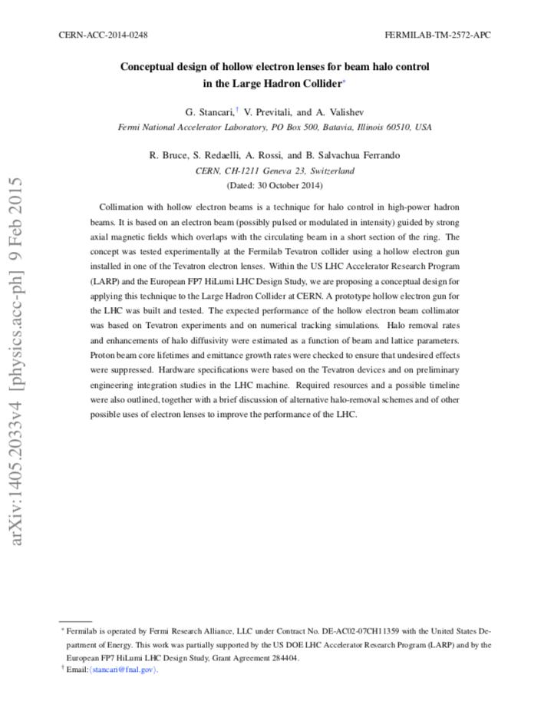
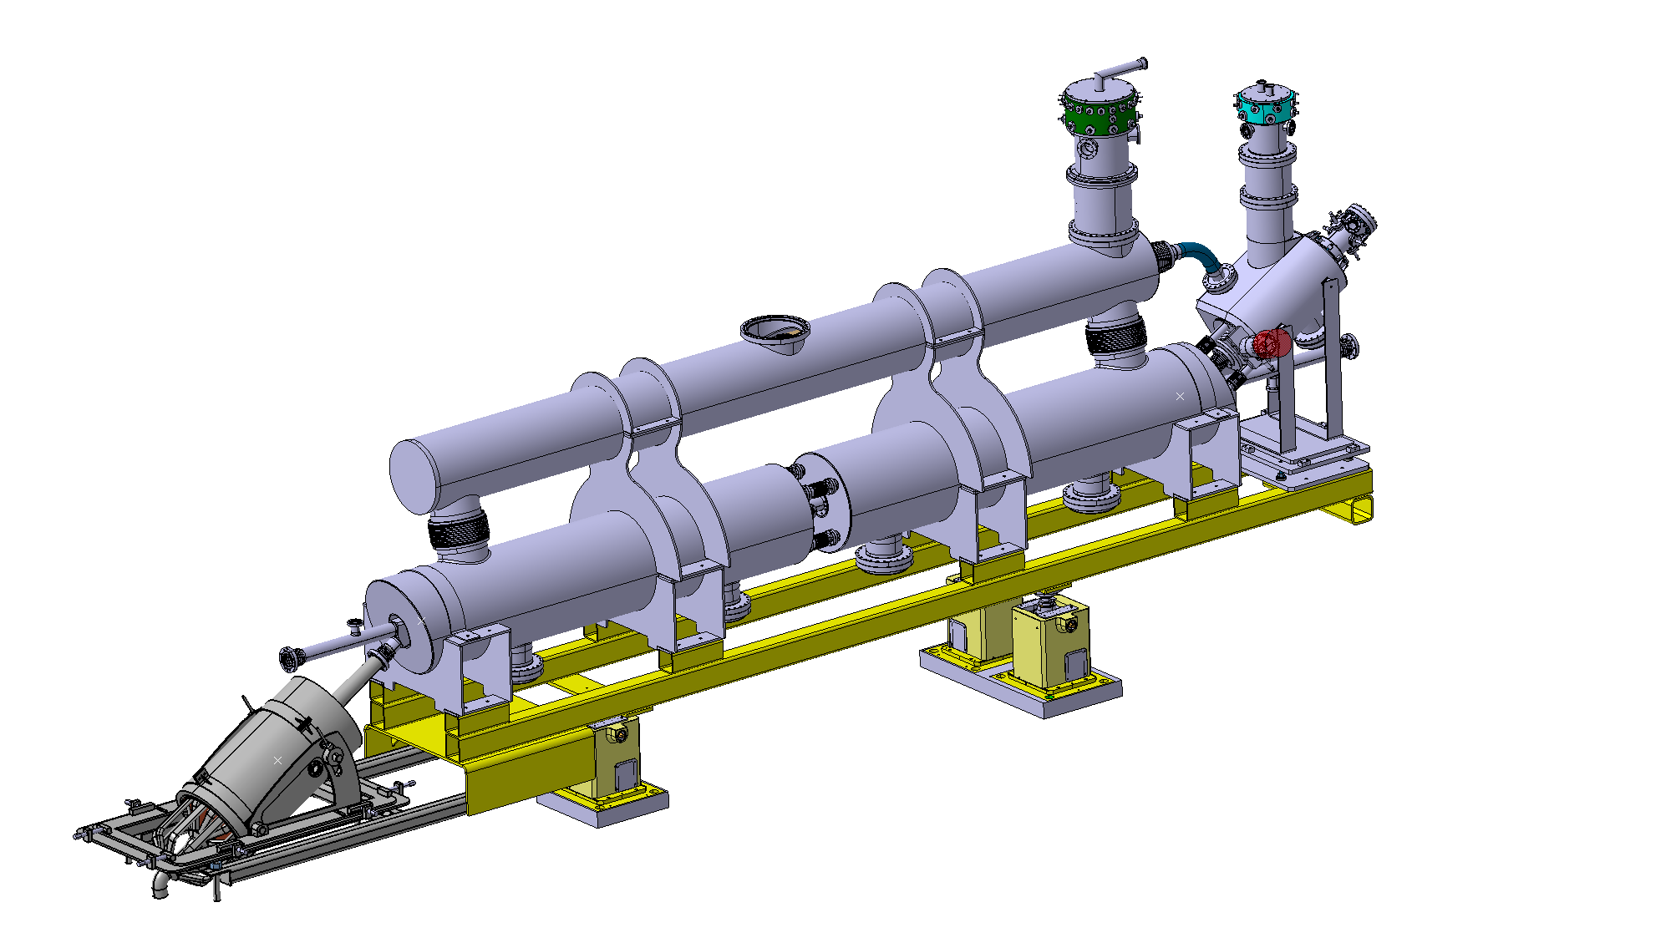
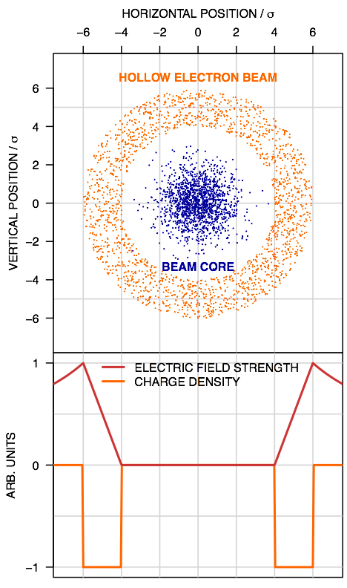
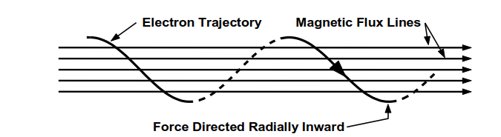
Hollow Electron Lenses Circuits
Electrons are produced by the cathode of an e-gun. A system of superconducting solenoids cooled at 4.5K generates the magnetic field to tune the size and steer the trajectory of the electron ring.
Electron ring
E-gun solenoid
Space for Beam Gas Monitor
HL-LHC protons
Main solenoids
Collector
~ 3500 mm
Courtesy D Perini, G Gobbi, A Rossi, S Redaelli

Slide 15
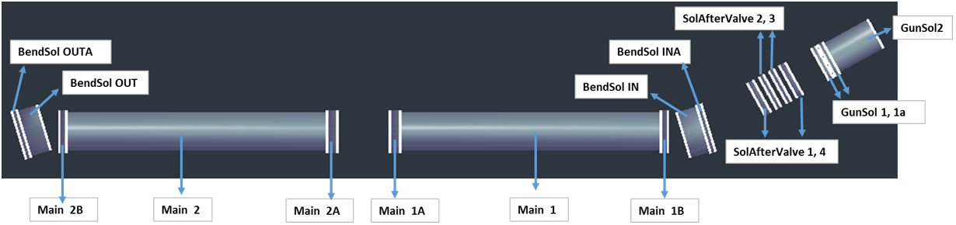
HEL Solenoids – Powering Scheme
Gun Sol. 1 (before and after valve)
Main Solenoid 2
Main Solenoid 1
Gun Sol. 2
PC+EE
330 A
PC+EE
330 A
PC+EE
320 A
PC
257 A
Bending Solenoid Out
Bending Solenoid In
PC+EE
335 A
Total inductances for each unit
 | L_{nom} [mH]
Gun Solenoid 2 | 834.18
Gun Solenoid 1 | 806.74
Bending Sol. In | 1073.24
Main Solenoid 1 | 8877.46
Main Solenoid 2 | 8877.46
Bending Sol. Out | 1073.24
Solenoids are wound with the same wire:
  1.65 mm x 1.05 mm (insulated)
  Cu–SC ratio is 4:1
  Critical current is 750 A at 5T
Nominal currents indicated
Corrector circuits not included
Courtesy Michał Maciejewski, Diego Perini

Slide 16
The HL-LHC Circuits Internal Review took place at CERN
on March 17th 2017
Review Panel
Lucio Rossi (Chair)
Luca Bottura
Rudiger Schmidt
Andrzej Siemko
Thomas Taylor
Davide Tommasini
Akira Yamamoto
Scientific Secretary: Felix Rodriguez Mateos
https://indico.cern.ch/event/611018/

Slide 17
Background for the last (Internal) Review
After months of common work together with the relevant work packages at the Magnet Circuit Forum (MCF, first meeting July 2016, 15 meetings until then, plus several other topical meetings), some points remained open at a conceptual level by the end of 2016.
It was considered as required to call for an Internal Review at CERN in order to get advice on how to close those open points and take appropriate decisions.
The review was hence organized in a focused way (clear questions were asked that speakers should try to document and close with the help of the Panel)
The Review remained at a conceptual level as technical developments of hardware were going to have proper review processes on their side

Slide 18
Review Programme in March 2017
As a part of a re-baselining exercise completed in 2018, hence after the Review, decision was made to keep the Q4, Q5 and Q6 circuits’ configuration as it is today in LHC, including the correctors [ECR EDMS No. 2083813].
We have not included these circuits in this Review.

Slide 19
Follow up of recommendations on 11T Dipole (1/2)
Panel recommends to keep the trim PC, it provides a viable complement to the use of the orbit correctors, reducing their load and adding a degree of redundancy
The trim PC is part of the baseline; studies have been completed which led to decisions with respect to interlocks that will be presented during this Review
A high trim crowbar resistance is required; 250 A to be taken as a nominal design value for the trim current leads
Initially it was thought that a high resistance crowbar would be needed, but detailed studies came to the conclusion that the definition of the resistance is a trade off between limiting the currents in the circuit and not opening the cold diode of the magnet.
The panel remarks that the impact of the trim PC on the QDS in case of powering abort on the 11T and neighbouring MB magnets must be further investigated by simulations and if possible by tests in SM18
Studies have been done at the simulation level and with tests in SM18 (on an LHC dipole with a diode), proving that the design is sound

Slide 20
Follow up of recommendations on 11T Dipole (2/2)
The panel recommends to qualify the current leads by applying the same criteria for the voltage withstand levels as it is done with the similar elements in the circuit.
Tests on prototype current leads for the trim circuit have undergone tests at warm well above the required levels
The panel endorses the fact that the trim power converter and the warm circuit should follow the 2 x (Worst Case Voltage) + 500 V design rule (2 x Full Energy Extraction Voltage + 500 V, therefore around 2.3 kV)
The decision is to qualify the power converter and the warm part of the circuit to 1.3 kV. This is found to be sufficient due to the fact that the maximum voltage seen by the warm part of the circuit to ground is ½ of the full extraction voltage at nominal current (i.e. 415 V). Therefore with the 1.3 kV the criteria above is respected.

Slide 21
Follow up of recommendations on Inner Triplet (1/3)
The panel considers that the presented powering circuit is a robust solution, provided the 2 kA and 120 A SC trim cables in the superconducting link can be upgraded to a rating of about 5-6 kA and 5 MIITs
This has been done and is part of the baseline for the cold powering equipment.
The panel recommends the removal of the Q2a 120 A trim power converter from the baseline. The need for local K-modulation will, however, require an additional small trim of about 30 A for Q1
Removal of Q2a trim has been endorsed by the Project. The same as for the design of the 35 A k-modulation circuit. Both are part of an Eng. Change Request (ECR) on the complete inner triplet circuit that has been presented to the Technical Committee.
The panel is strongly in favour of the crowbar of 30 V proposed (possibly 50 V) for the main power converter that reduces the current ramp down time from 1750 s to less than 500 s
The difficulties to bring the voltage to a value larger than 10 V are due to technological limits and the margin to deal with transients. The baseline today is to stay at 10V. An agreement within the Circuit Forum has been found. Included in ECR.

Slide 22
Follow up of recommendations on Inner Triplet (2/3)
The panel recommends continuing studies on a possible further optimization for the circuit operation. An example is the introduction of cold diodes. The panel recommends to develop and test diodes capable of conducting up to 18 kA and which are qualified for the expected radiation levels and liquid helium operation
Cold diodes are today part of the baseline. Important results were obtained as to qualify diodes which were specially developed for the purpose, under the dose and neutron fluence expected at their final position.
Another alternative is to connect the D1 magnet to the IT main circuit. A study should be done on the application of this topology as a mitigation during machine operation in case of failure of 1 of the 18 kA conductors
Study was done. It is feasible but certainly complicated. The two different circuits would share the same ground. Any problem on one circuit impacts the next one. Difficult for diagnostics. Difficult connections of water cooled cables.
Finally, a scheme for powering the IT and D1 with a single 13 kA PC, supplemented with a nested 5 kA PC, was also briefly discussed.
A basic analysis was done by WP6b. The coupling between circuits complicates the regulation and controls. Very difficult to reach precision with a 4-layer nested configuration.

Slide 23
Alternative options
Degraded mode
A different, nested configuration

Slide 24
Follow up of recommendations on Inner Triplet (3/3)
Changes are required to the present link cable cross-section. In the discussion, a few members of the panel suggested to reconsider the need for spare 18 kA cables within the link. This suggestion may mitigate possible issues (if any) due to the increase of size of the trim cable within the link envelope
The baseline for the s.c. link does not include any spare 18 kA conductor
The panel agrees that one can be confident in the simulations, but experience with magnet testing is sparse, making it difficult to benchmark. The team is therefore encouraged to complete the optimization over the next few months, integrating information from magnet testing. The panel reiterates the importance of the string test for comprehensive validation.
Teams working on simulations and testing magnets do work together, exchanging information. String is on the baseline.
The panel recommends that WP3 devote appropriate attention to the design and integration of the bus-bars in the inner triplet circuits and the cables and feedthroughs for CLIQ. Special attention should be devoted to design and implementation of interconnects and splices
Today feedthroughs, feeders, bus bars, etc receive the required attention, and are common subjects of discussion in between work packages. Design effort on-going.
The panel recommends that a technically competent CERN staffer be designated to take full responsibility for the required studies, including benchmarking
Done

Slide 25
Additional recommendation
For the purpose of ElQA activities, there is a request that switches or similar quick disconnect equipment (separators) be installed between the power converters and the current leads, to facilitate the relevant high voltage testing at the end of shutdowns. Such equipment is quite cumbersome, especially for the 13 and 18 kA circuits, and it would be inconvenient to install it directly at the current lead or power converter terminals of the warm bus-bars/cables joining the two. They will therefore have to be located somewhere in between (preferably close to the current leads due to leakage current limitations to preserve the sensitivity of the ElQA measurements), and space allocated for their installation.
The HL-LHC Project has agreed to include the disconnectors provided that some budget reduction is applied. WP6b (Warm Powering) in collaboration with WP15 (Integration) and Cold powering (WP6a) have initiated since a while the studies to do so. It is widely accepted today that the added value of the disconnectors in terms of safety is high. They also help in the manoeuvres of connecting/disconnecting the superconducting parts of the circuit from converters and cables for insulation verifications at relatively high voltage.

Slide 26
The Mandate to the MCF Magnet Circuit Forum
One of the recommendations of the March 2016 review on HL-LHC Magnet Circuits was:
“… to realize close and regular interaction (communication) between the involved experts and work-packages. This could be possibly done by setting-up of a dedicated working group or by using existing structures to discuss circuit integration and protection on a regular basis and to identify the optimum scheme for each magnet circuit system.”
Mandate
The Magnet Circuit Forum (MCF) is the meeting where all aspects related to powering and protection of the HL-LHC circuits are discussed, in particular the ones pertaining to the optimization of circuit layouts and definition of protection means.
Subjects in the agenda are defined in close collaboration with the relevant WPs.
Interface aspects between systems are clarified through meetings at the forum. To this end, a documentation plan has to be developed and completed.
The aim is to prepare a set of functional interface specifications that can be used as input for the design (technical specifications) of the different systems.
Assessment on realistic failure scenarios and required mitigation strategies on a global basis is part of the activities of the MCF.
The MCF is the meeting where aspects related to high voltage withstand levels are discussed and harmonized.
The MCF reports regularly to TCC and takes up any relevant discussion within the domain of cold/warm powering and protection of the HL-LHC circuits in collaboration with the relevant WPs .

Slide 27
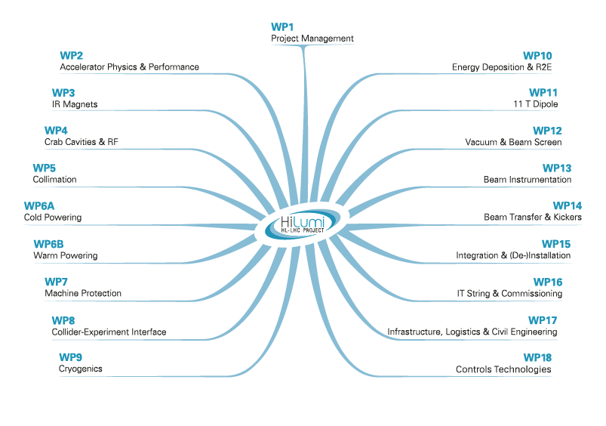
Participants to Forum
About 50 Members regularly invited

Slide 28
Activities and Topics of the Forum
MCF has the responsibility to keep up to date the circuit configurations and parameters. This is done through updates of the Circuit Table and the electrical schemes (see MCF Sharepoint)
So far 54 meetings, properly documented with minutes, list of actions, etc
MCF is also organizing topical meetings with reduced attendance, 27 meetings have taken place so far
The Forum has taken the lead in the preparation of some Engineering Change Requests related to circuit aspects
More information in S. Yammine’s presentation tomorrow on Document Plan and Change Management

Slide 29
Structure of the Review - I
I. Setting the scene – the magnets and the circuits
HiLumi Status and Charge to Review
Quick Overview on the HL-LHC Magnets Characteristics
Introduction to the HL-LHC Circuits and Report from Previous Review
II. Powering layouts
Warm Powering and Adequacy with Respect to Requirements
Cold Powering
Superconducting Bus Bars inside Cryostats
III. Protection and hardware
Quench Protection Strategies
Quench Detection, Related Hardware and Required Instrumentation
Quench Protection Hardware
Feeders for k-mod and CLIQ Applications
Contribution of Power Converters to the Protection of the Circuits
Effects of Protection Equipment on the Beam and Reliability Studies …

Slide 30
Structure of the Review - II
IV. Integration in the HL-LHC environment
Integration Studies
V. Electrical Integrity and Quench Protection Tests
Voltage Withstand Levels
11T MBH: Electrical Integrity and Quench Protection Test Results
MQXF: Electrical Integrity and Quench Protection Test Results
NbTi Magnets: Electrical Integrity and Quench Protection Test Results
VI. Documentation
Document Plan, Management of Change
VII. The system of systems real validation
The HL-LHC Inner Triplet String
VIII. Safety
Safety Aspects

Slide 31
Many thanks, enjoy the Review

