Slide 1

WP6a: HL-LHC Cold Powering
Amalia Ballarino
International Review of HL-LHC Magnet Circuits, 9th - 10th September 2019

Slide 2
The HL-LHC Cold Powering System
WP9 - Cryo
WP15 - Integration
WP7 - Protection
WP17 – WP6b
4
Current Leads (DFLH)
WP12 - Vacuum
WP16 - String
T2≤50 K
Interface to WP3
Nb-Ti to Nb-Ti
HTS
T1≤17 K
MgB₂ to HTS
3
DFH
WP3 - Magnets (λ-plate with Nb-Ti)
1
DF
λ-Plate
2
SC Link (DSL)
Tdesign MgB₂ ≥ 25 K
Tdesign HTS ≥ 60 K
LHe
4.2 K
MgB₂
Nb-Ti – 1.9 K
MgB₂ to Nb-Ti
Nb-Ti to Nb-Ti

Slide 3
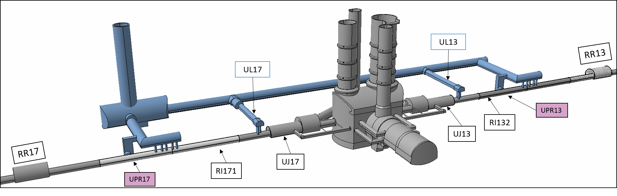
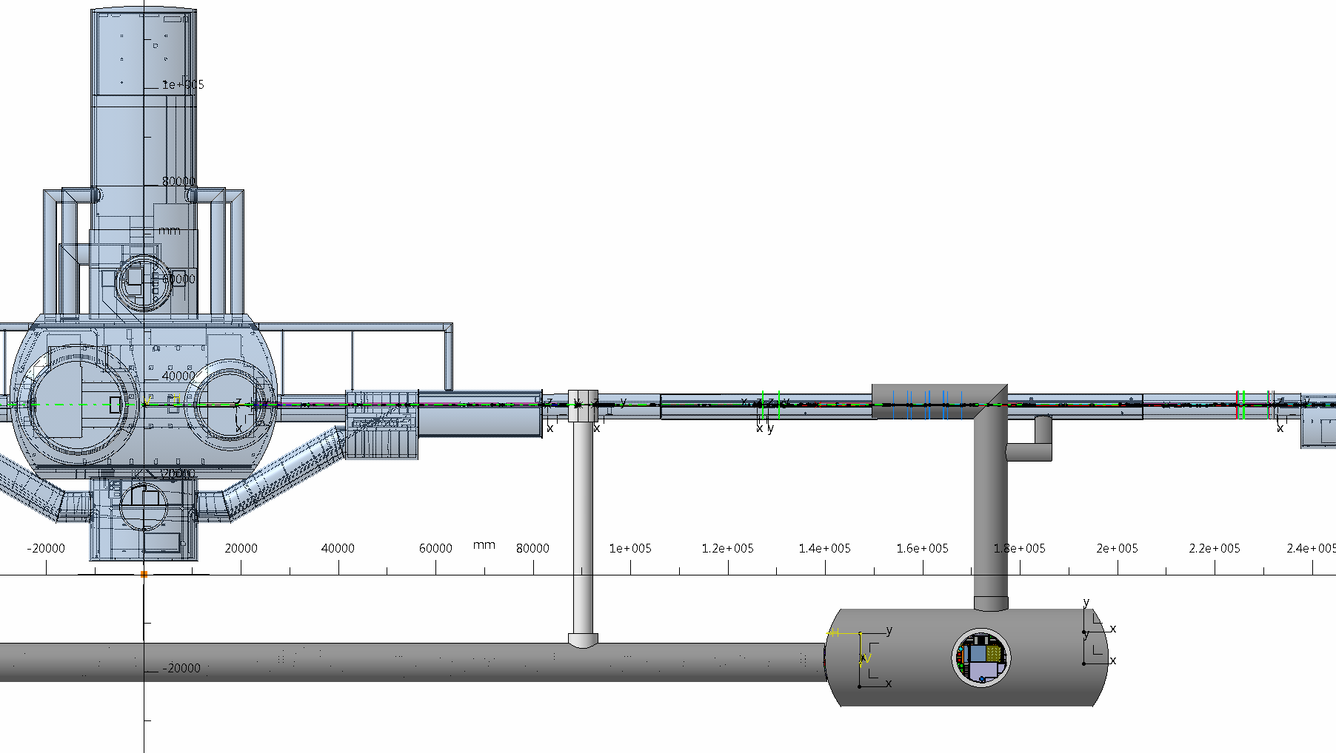
Cold Powering System in LHC underground
Triplets
Matching Section
DFHX
DFHM
Q1 to Q3
CP
D1
D2
Q4
Q5
Q6
Atlas
UL Gallery
LHC Tunnel
DFX
DFM
A. Ballarino
A. Ballarino
3
3

Slide 4
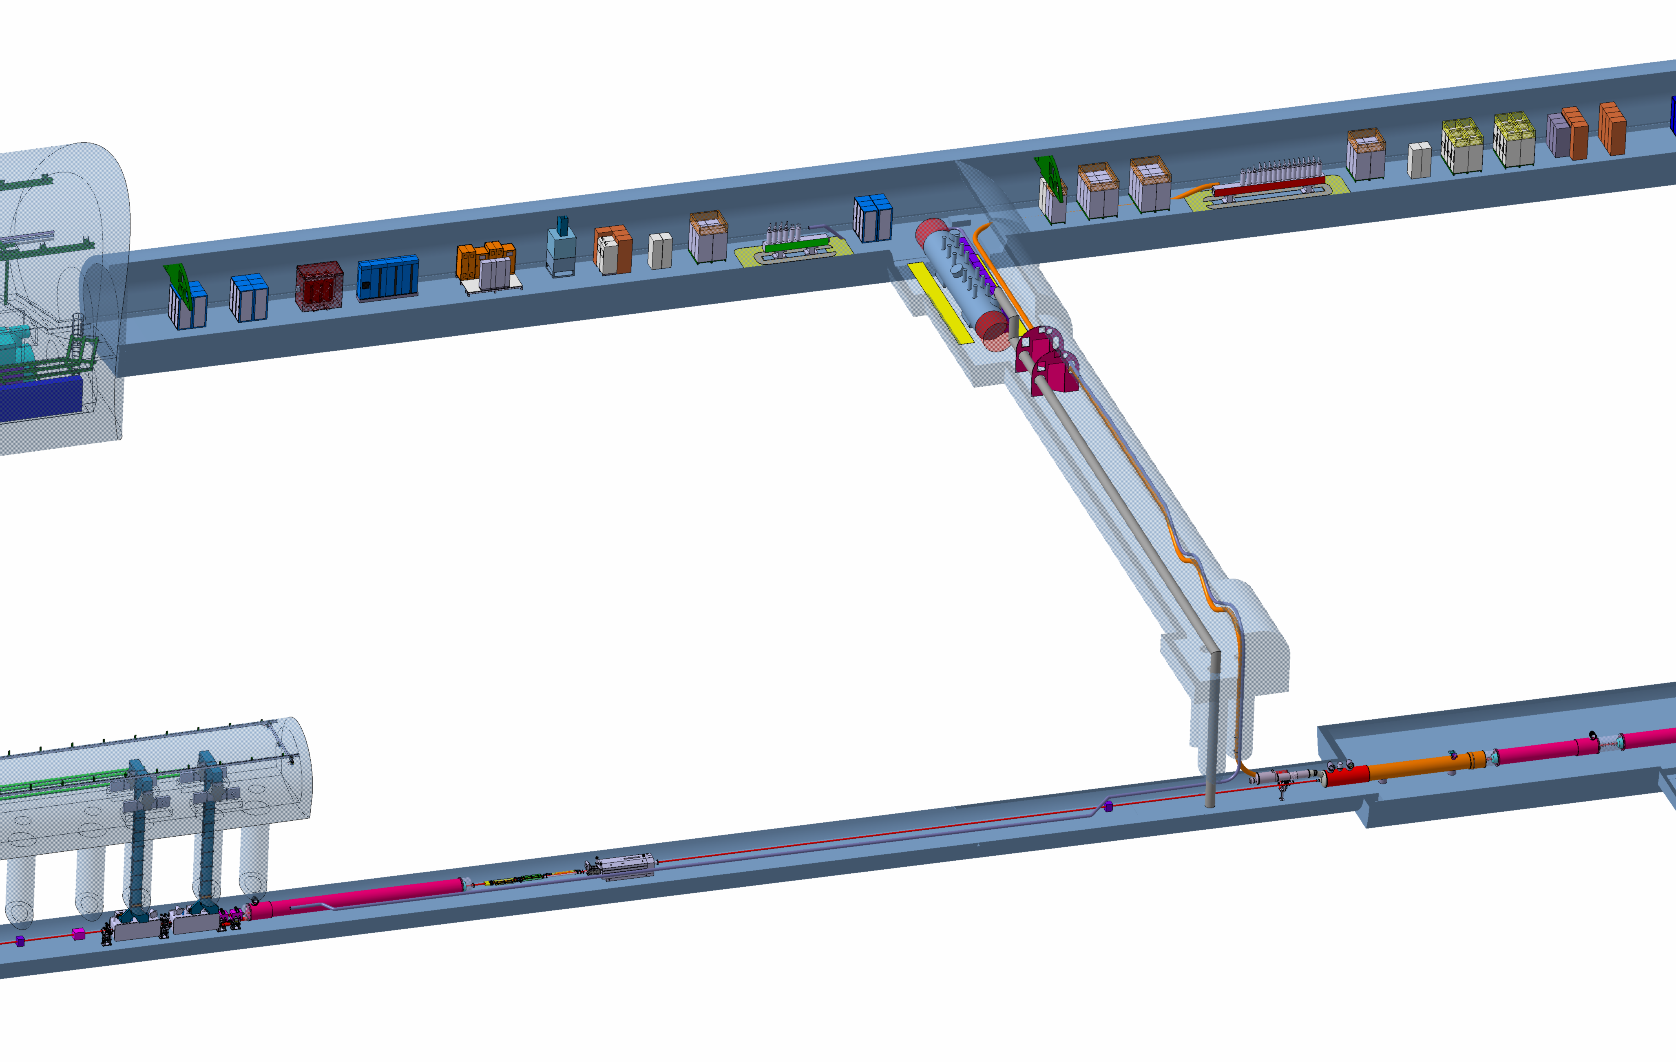
Cold Powering System in LHC underground
Cryostat and leads
Cryostat and leads
DFHX
Power converters
DFHM
Power converters
VALVES BOX
SC Link for Triplets
≈ 100 m
SC Link for
Matching Sections
≈ 130 m
Shaft Φ = 1m
∼ 8 m
DFX
D1
D2 and DFM

Slide 5
Electrical components and design parameters
Number and type of components
Design currents
HV Withstand levels
Protection strategy

Slide 6
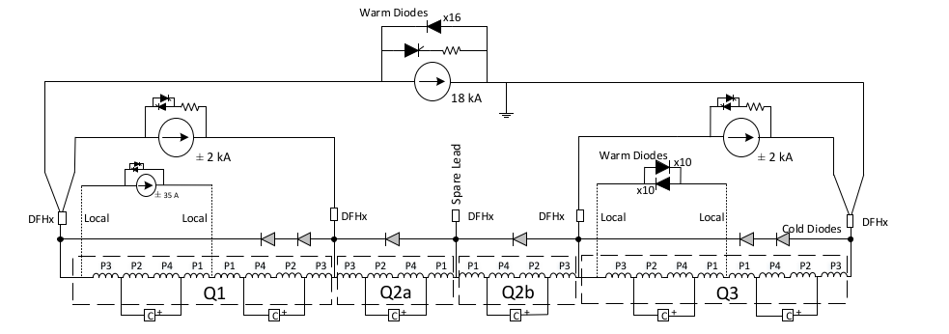
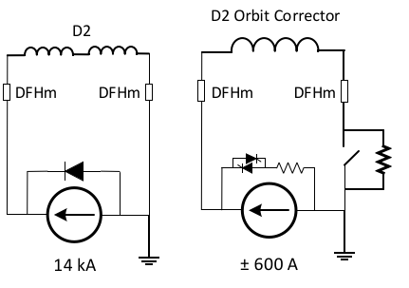
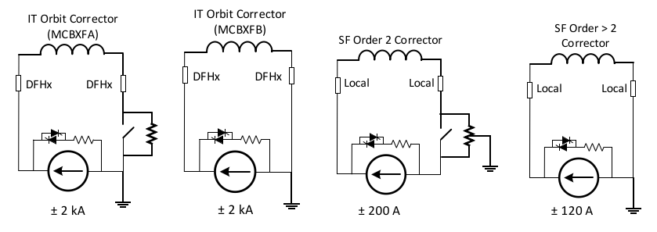
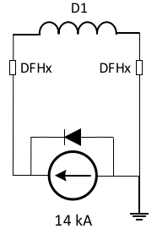
Electrical circuits
Triplets
Matching Sections
One main 18 kA circuit
Two Trims: 2×2 kA (Q1 and Q3)
k-modulation: 1×0.035 kA (Q1a)
In addition: D1, Orbit Correctors and Higher Order Correctors individually powered:
D2 and its Correctors
individually powered

Slide 7
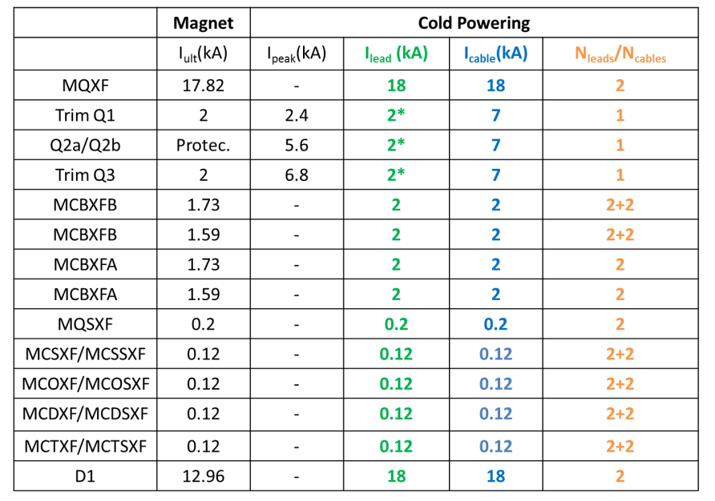

Design Currents: Baseline for Triplets
SC Link
Local Powering
(also k-mod
within WP3)
SC Link
⎜Itot⎜ (SC Link) ∼ 120 kA

Slide 8
Design Currents: Baseline for Matching Sections
D2 and its correctors
 | Iult (kA) | Ileads/cables (kA) | N_{leads} | N_{cables}
D2 | 13367 | 18 | 2 | 2
MCBRD | 0.422 | 0.6 | 8 | 8
⎜Itot|(SC Link) ∼ 31 kA
Ratings for series units (ITs and MSs): 18 kA, 2 kA, 7 kA and 0.6 kA

Slide 9
Number of components
Ten SC Links of two different types (4 for ITs plus 4 for MSs plus one spare per type) for powering the HL-LHC Triplets region and the HL-LHC Matching Sections
Ten DFH cryostats (4 for ITs plus 4 for MSs plus one spare per type)
Ten DF cryostats (4 for ITs plus 4 for MSs plus one spare per type)
176 HTS Current leads (148 for series plus few spares per lead type) for powering the HL-LHC ITs + 50 HTS Current leads (40 plus few spares per lead type) for powering the MSs (226 units in total)
Two Cold Powering System topologies (One for ITs and one for MSs)
Four Cold Powering Systems per topology

Slide 10
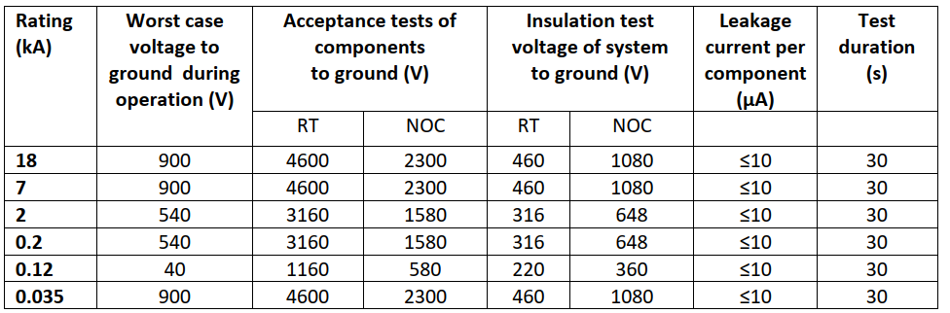
HV Levels - Triplets
RT = Room Temperature (20 ± 5 °C)
NOC = Nominal Operating Conditions. For all WP6s components, it corresponds to
GHe at RT and 1.30 ± 0.05 bar

Slide 11
HV Levels – Matching Sections
D2: treated as for a 18 kA circuit – conservative
18 kA
D2
D2 correctors: 0.6 kA rating, Worst case to ground = 590 V, Components test: 5.7 kV (RT) -
Components test 2.860 kV (NOC)

Slide 12

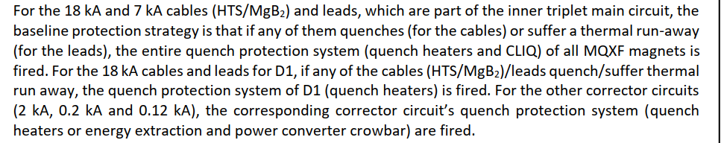
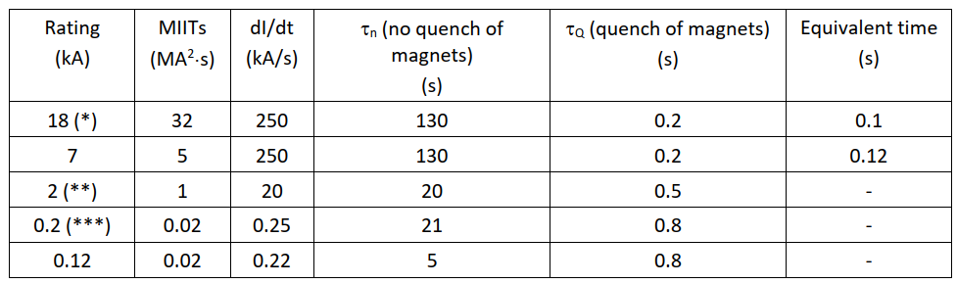
Protection Strategy
System designed when cold diodes not in the baseline

Slide 13
System design – Electrical components

Slide 14
System design – Electrical components
MgB₂ cables

Slide 15
SC MgB₂ Cable Design - Triplets
3
Cu core
Cu braid
2
1
Φ∼7.5 mm
1,2,3 → Instrumentation wires
Φext ∼ 90 mm
Baseline

Slide 16
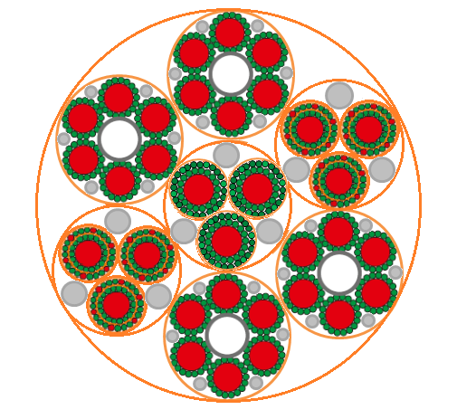
MgB₂ cable design – Triplets
- 18 kA
Protective insulation (outer layer)
MgB₂ wire
Copper stabilizer
4 × 18 kA
Filler
+ 18 kA
3 × 7 kA
Insulation
3× 2 × 2 kA
6 × 2 × 3 kA
3× 7 kA
3 × 2 × 2 kA
+ 13 kA
- 13 kA
Φ∼ 90 mm
A. Ballarino

Slide 17
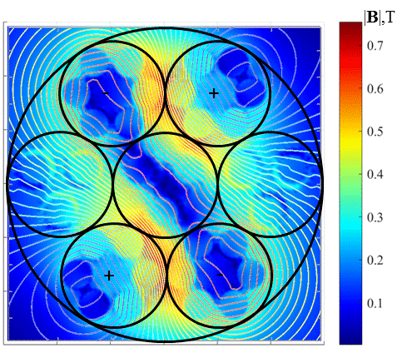
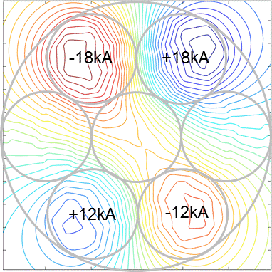
MgB₂ cable - Triplets
Bmax=0.76 T
- 18kA
+ 18kA
+ 13kA
- 13kA
A. Ballarino

Slide 18
SC MgB₂ Cable Design – Matching Sections
1
Φext ∼ 60 mm
1 → Instrumentation wires

Slide 19
Status of cabling activity
Each cable type assembled and electro-mechanically characterized at CERN
Cables (18-strand sub-cable, 18 kA cable, 2 kA coaxial-cable) produced in industry (ICAS, cabling at Tratos cavi) via R&D contracts and electro-mechanically characterized at CERN (including HV testing in Ghe)
Contracts for full scale prototypes (80 m long, one copper and one MgB₂, - for ITs and MSs) and for series production placed in industry – price enquiry in 2018 followed by adjudication (ICAS) at FC Dec 2018. Completed first 80 m long copper prototype cable for IT. Assembly of 80 m long MgB₂ cable for Its is on-going in industry (delivery to CERN planned by end of October 2019)
Validation of cabling parameters and materials completed for ITs

Slide 20
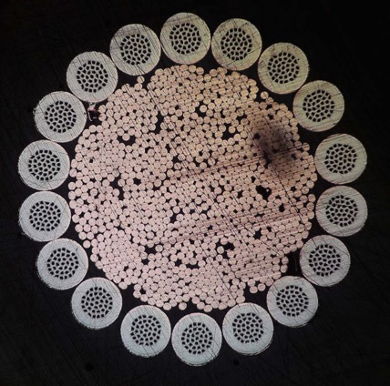
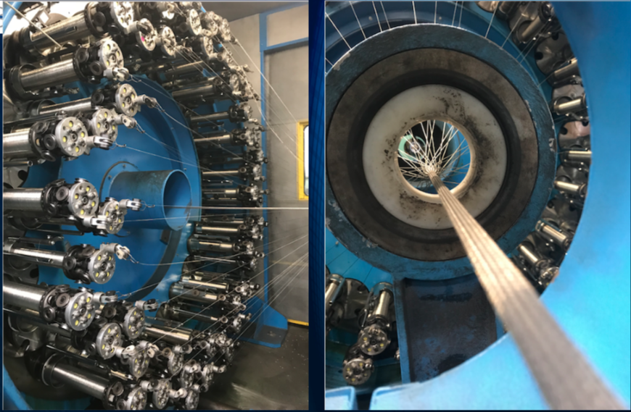
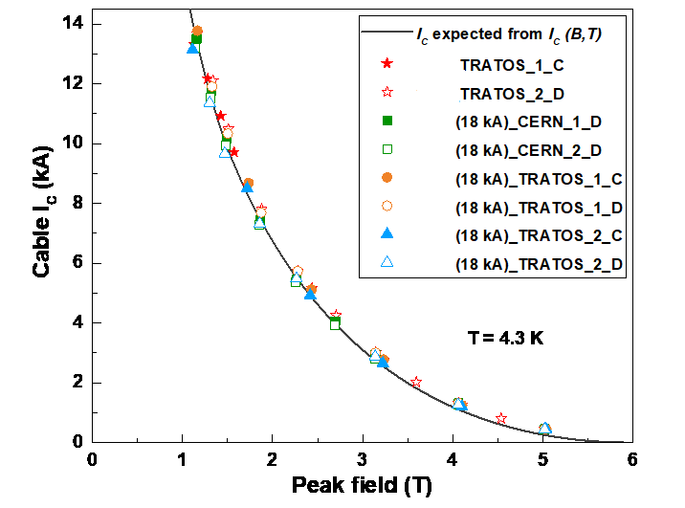
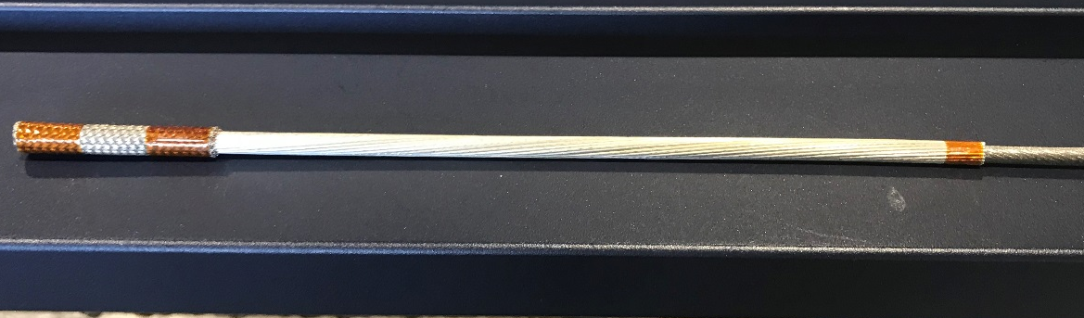
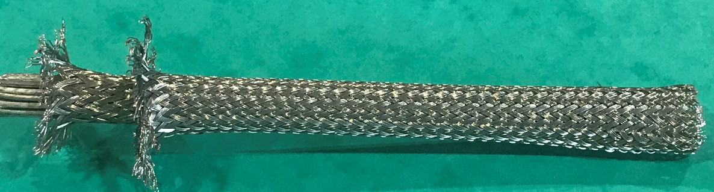
Example of qualification at CERN
Measurement of cables (2 m long)
*
Φcable = 6.5 mm
* Extracted from 18 kA cable

Slide 21

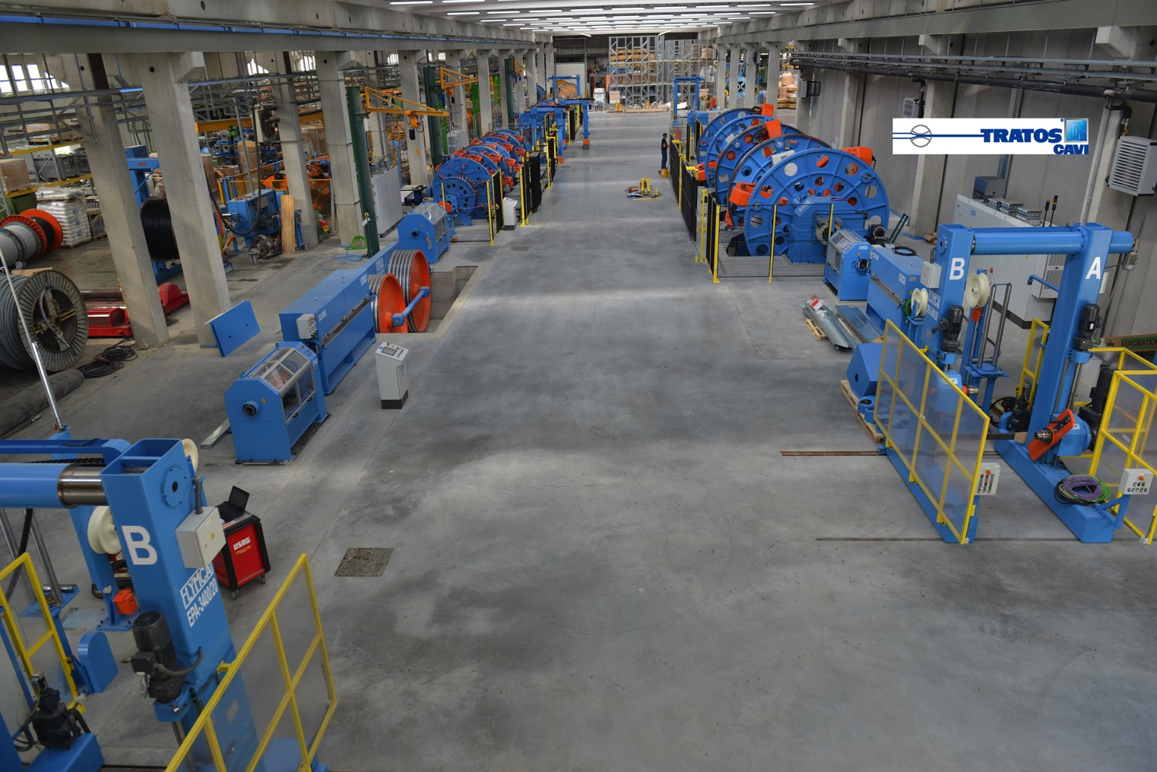
TRATOS installations
used for MgB₂ cables
1+30+36 planetary machine
(well suitable for the 2 kA and 7 kA cables)
1+12 planetary machine
(for the higher (and final!) stage cable assembly)
All equipped with tension (and many others parameters) fine control systems; wrapping machines; ….
Notes:
Planetarymachine for torsion free strand

Slide 22
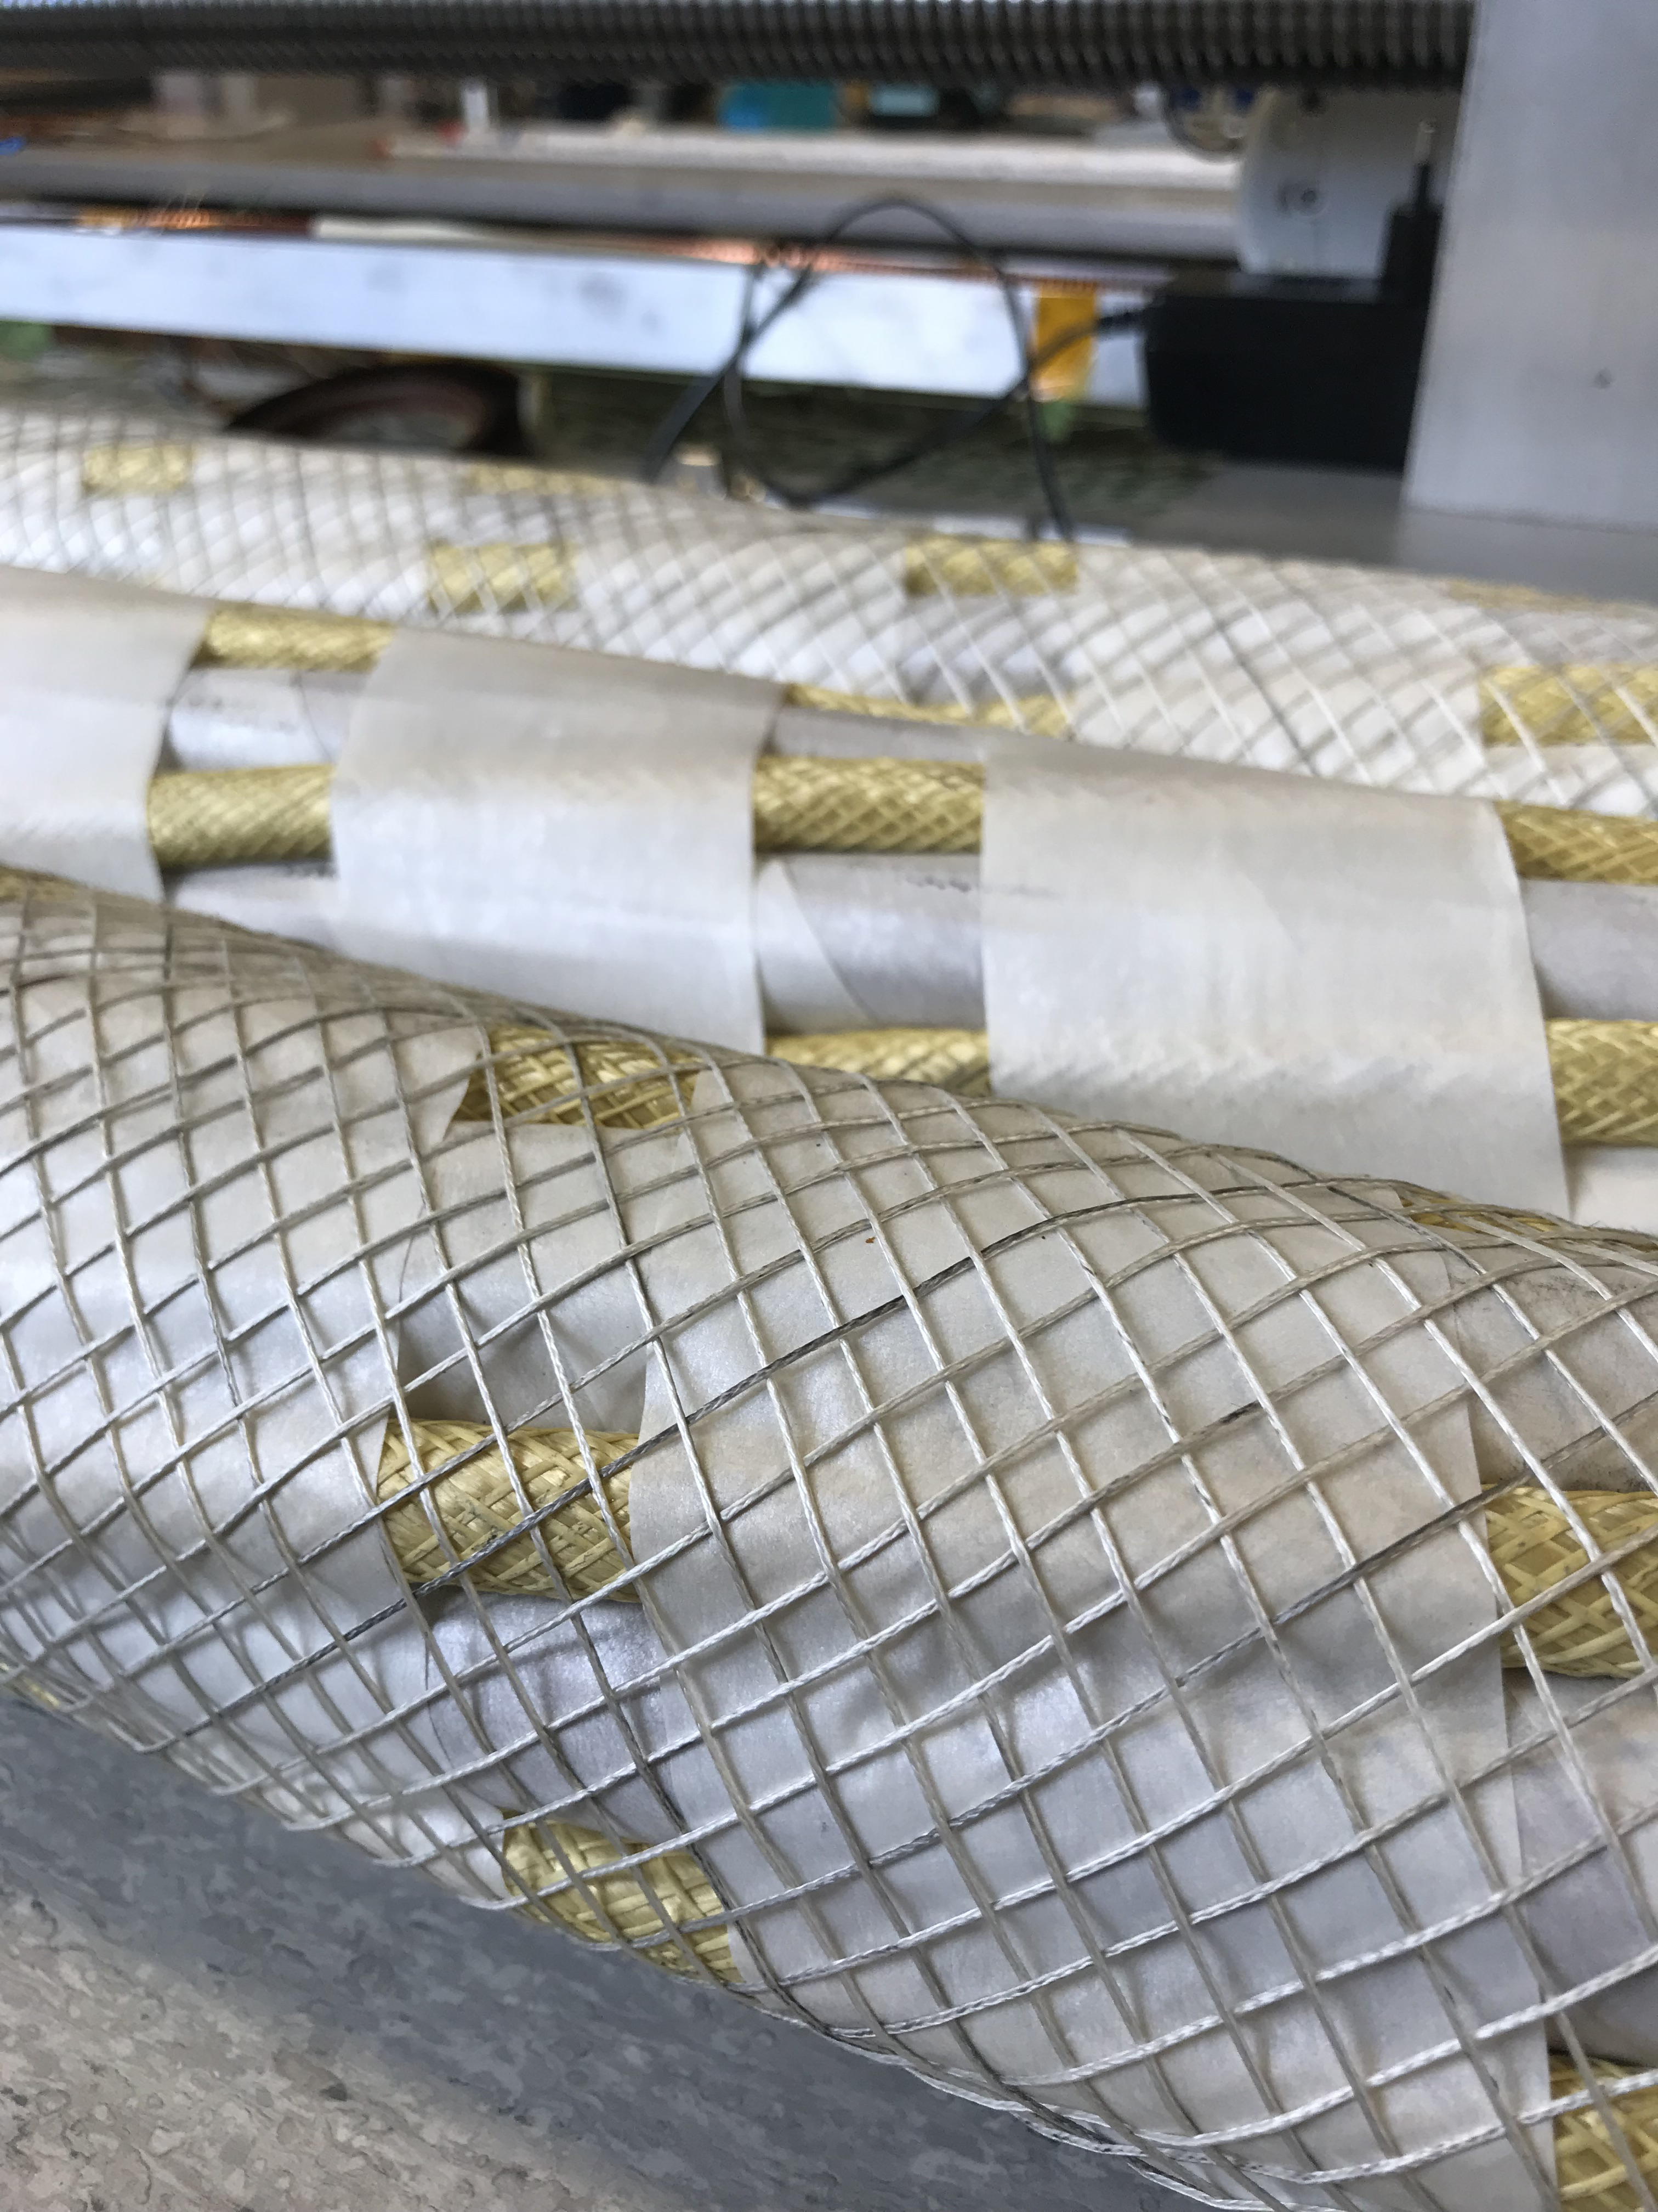
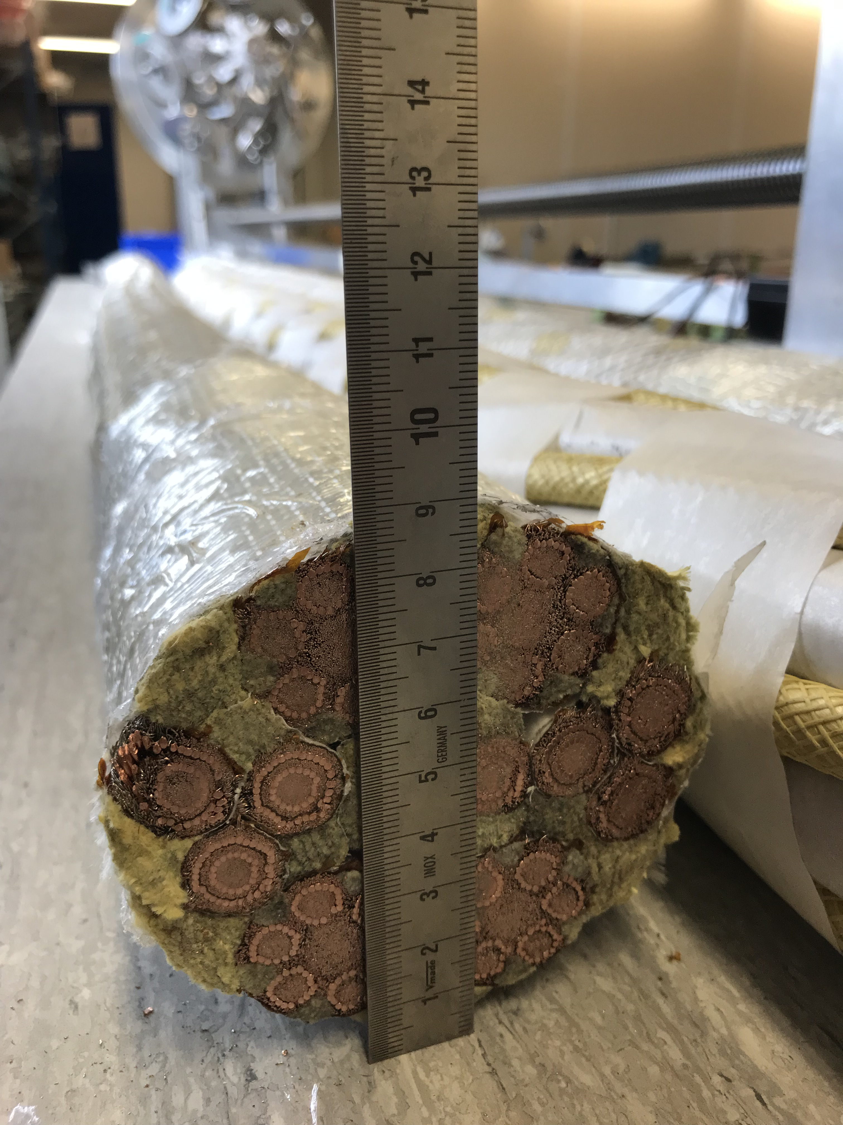
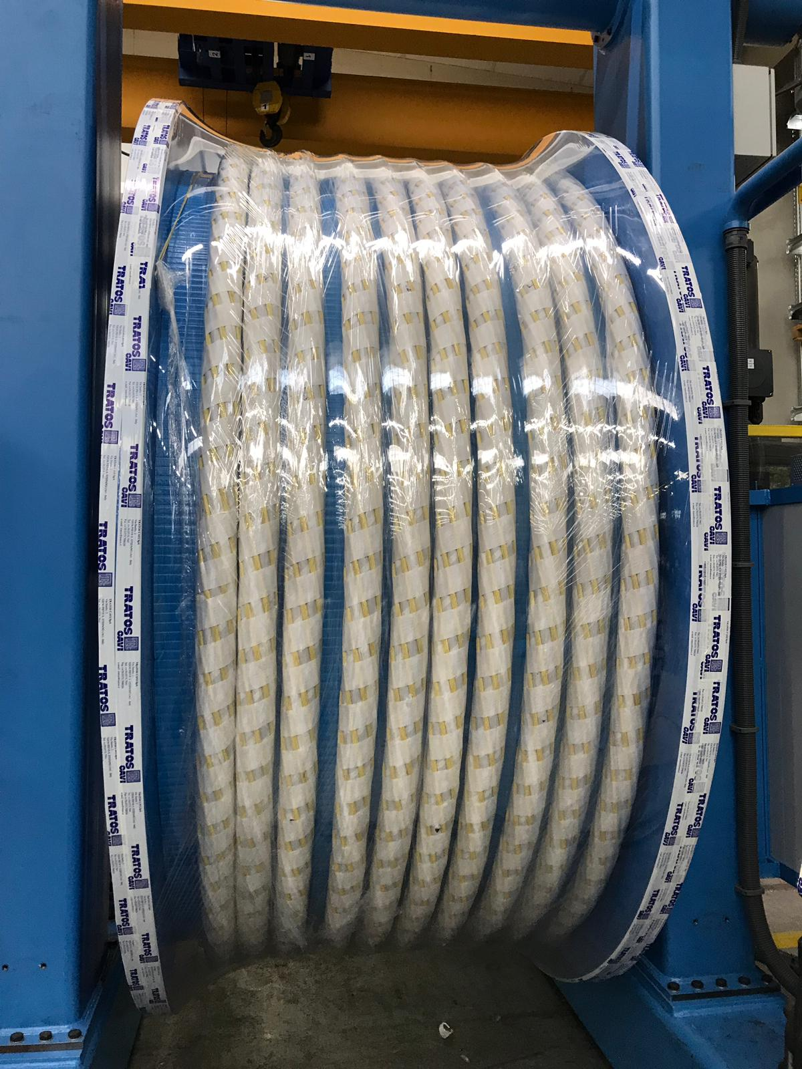
Production of dummy cable – Triplets
Φ∼ 90 mm
Materials: Kapton® tape for electrical insulation, NOMEX® (tape and braid)
Kevlar® wire cabled for fillers (the cable is braided)

Slide 23
Insulation tests at the manufacturing place (in air)
- On-line HV tests: DC spark testing at 12 kV
Instrumentation:
  Zumbach DST 28A, chain electrodes, installed on-line immediately after application of polyimide insulation
Procedure: Fault → automatic machine stop → NCR
Applied successfully during first dummy (copper) cable - for Triplets - production (80 m). No faults detected
Off-line HV tests: 10 kV (50 V/s, 120 s). Ileakage ≤ 10 µA
On final assembly. Each cable to ground and between cables.
Temperature and relative humidity recorded. Applied successfully
during production of first dummy cable for Triplets. Ileakage to be implemented
Minimum tacking distance specified : 25 mm

Slide 24
System design – Electrical components
SC Link cryostat

Slide 25
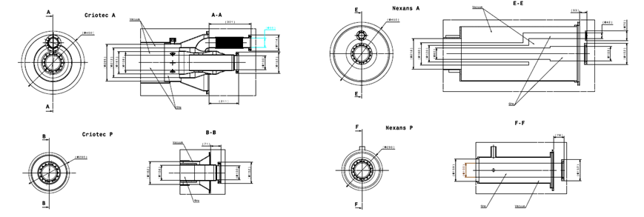
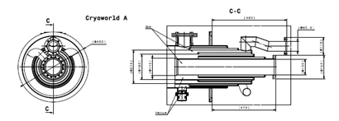
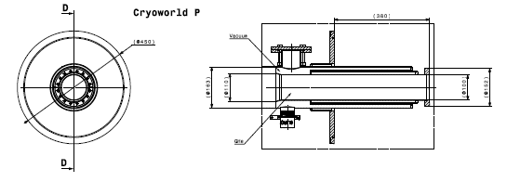
SC Link cryostats
290 mm
176 mm
Baseline: passive cryostat
4-walls
2-walls
3.5 tons
2.3 tons

Slide 26
System design – Electrical components
HTS Current Leads

Slide 27
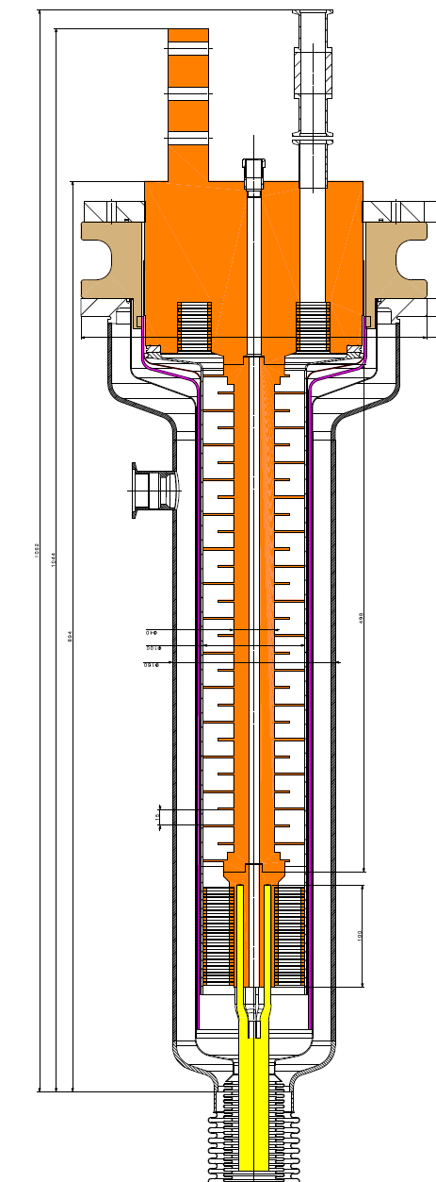
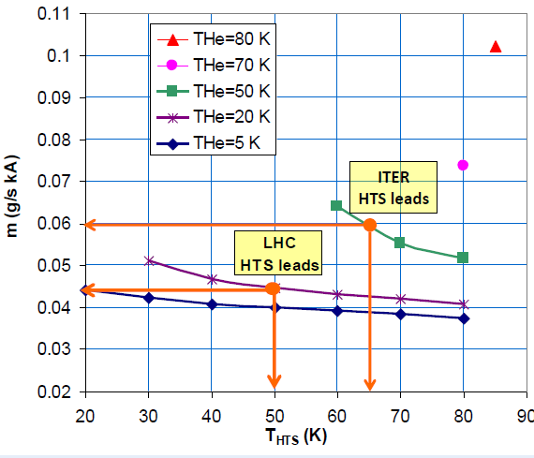
HTS Current leads: 18 kA prototype
18 kA Prototype
Φ=160 mm
Φ=100 mm
Ltot =1 m
LHex =0.5 m
Same technologies as for LHC HTS leads
Δz=15 mm
ΦHex=40 mm
REBCO HTS Superconductor (instead of
BSCCO Ag/Au 2223)
Design currents and HV tests as in slides 7 and 8
Prototype 18 kA built and qualified

Slide 28
Protection

Slide 29
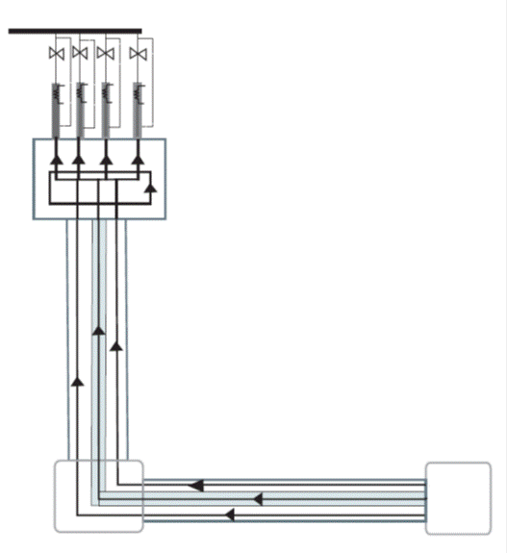
Protection of Cold Powering System: interlocks
Room Temperature
Connection RT Cables/Lead
As in LHC
Warmer end of HTS in each Lead
As in LHC (cryo-interlock)
HTS
Joints MgB₂/HTS
Warmer end of MgB₂ cable (cryo-interlock)
Nb₃Sn wire integrated in the SC Link (Tc ∼ 18 K)
MgB₂
Joints MgB₂/Nb-Ti
LHe
Temperature interlocks trigger a slow power abort

Slide 30
Protection strategy: active protection
Protection of SC circuits
  MgB₂ - Vthr = 50 mV (integration time up to 100 ms)
  Nb-Ti - Vth = 1mV to 5 mV (integration time up to 100 ms)
  REBCO - Vthr = 1 mV - 5 mV, as in LHC (integration time up to 100 ms)
  Resistive part of current leads – Vthr = 100 mV (integration time up to few seconds)
Monitoring of splices
Each signal is doubled for redundancy
In DFH – In GHe
In DFX – In LHe
Joint
Joint
Nb-Ti
HTS
MgB₂
Nb-Ti
Splices in DFX and DFH are accessible
in the tunnel
Monitoring
(splice)
Monitoring
(splice)
Monitoring
(splice)
Protection (Nb-Ti)
Protection (MgB₂ cable)

Slide 31
Protection strategy and hot spot analysis – MgB₂
Quench of 18 kA or 7 kA cables/leads → firing QPS of MQXF magnets
Quench of 13 kA cables/leads of D1 → firing QPS of D1
Quench of 2 kA cables/leads→ Quench heaters or energy extraction
Cu in the MgB₂ cables (core and braids): Cu ETP, Sn coated (5 µm) – RRR^{1,2} ≥ 60
T0=25 K
Rating (kA) | ACu (mm²) | Total MIITs | Tmax
18* | 210 | 15+32 | 26
2** | 34 | 15+8 | 40
7*** | 60 | 15+5 | 30
System designed when cold diodes not in the baseline
Quench of a SC link is a very rare event
¹ R_{273 K}/R_{10 K} after processing to final form/diameter
² RRR measured on pre-production tests ≥ 80

Slide 32
Nb-Ti in DFX
Each MgB₂ cable includes and extension of Nb-Ti cables – to be routed in the tunnel inside the DFX
Two trial geometries of SC Link bus bar:
  35 LHC type 01 strands (Ø 1.07 mm) around a 11 mm diameter multi-filamentary copper core for:
    MQXF main (18 kA, 2 units), MQXF trims (7 kA during transients, 3 units), D1 (13 kA, 2 units)
  21 LHC type 02 strands (Ø 0.825 mm) around a 5 mm diameter multi-filamentary copper core for:
    MCBXF magnets
Electrical insulation:
  Multi-layer Kapton wrapping (50% overlap)
  Final layout under definition

Slide 33
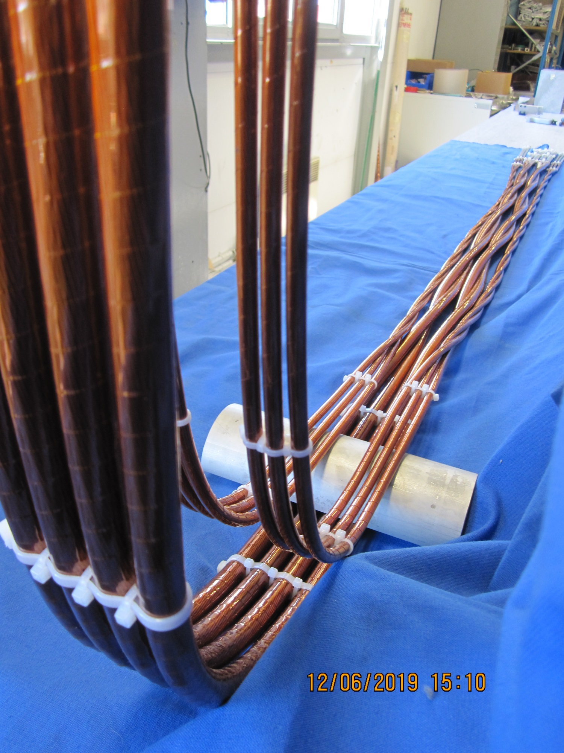
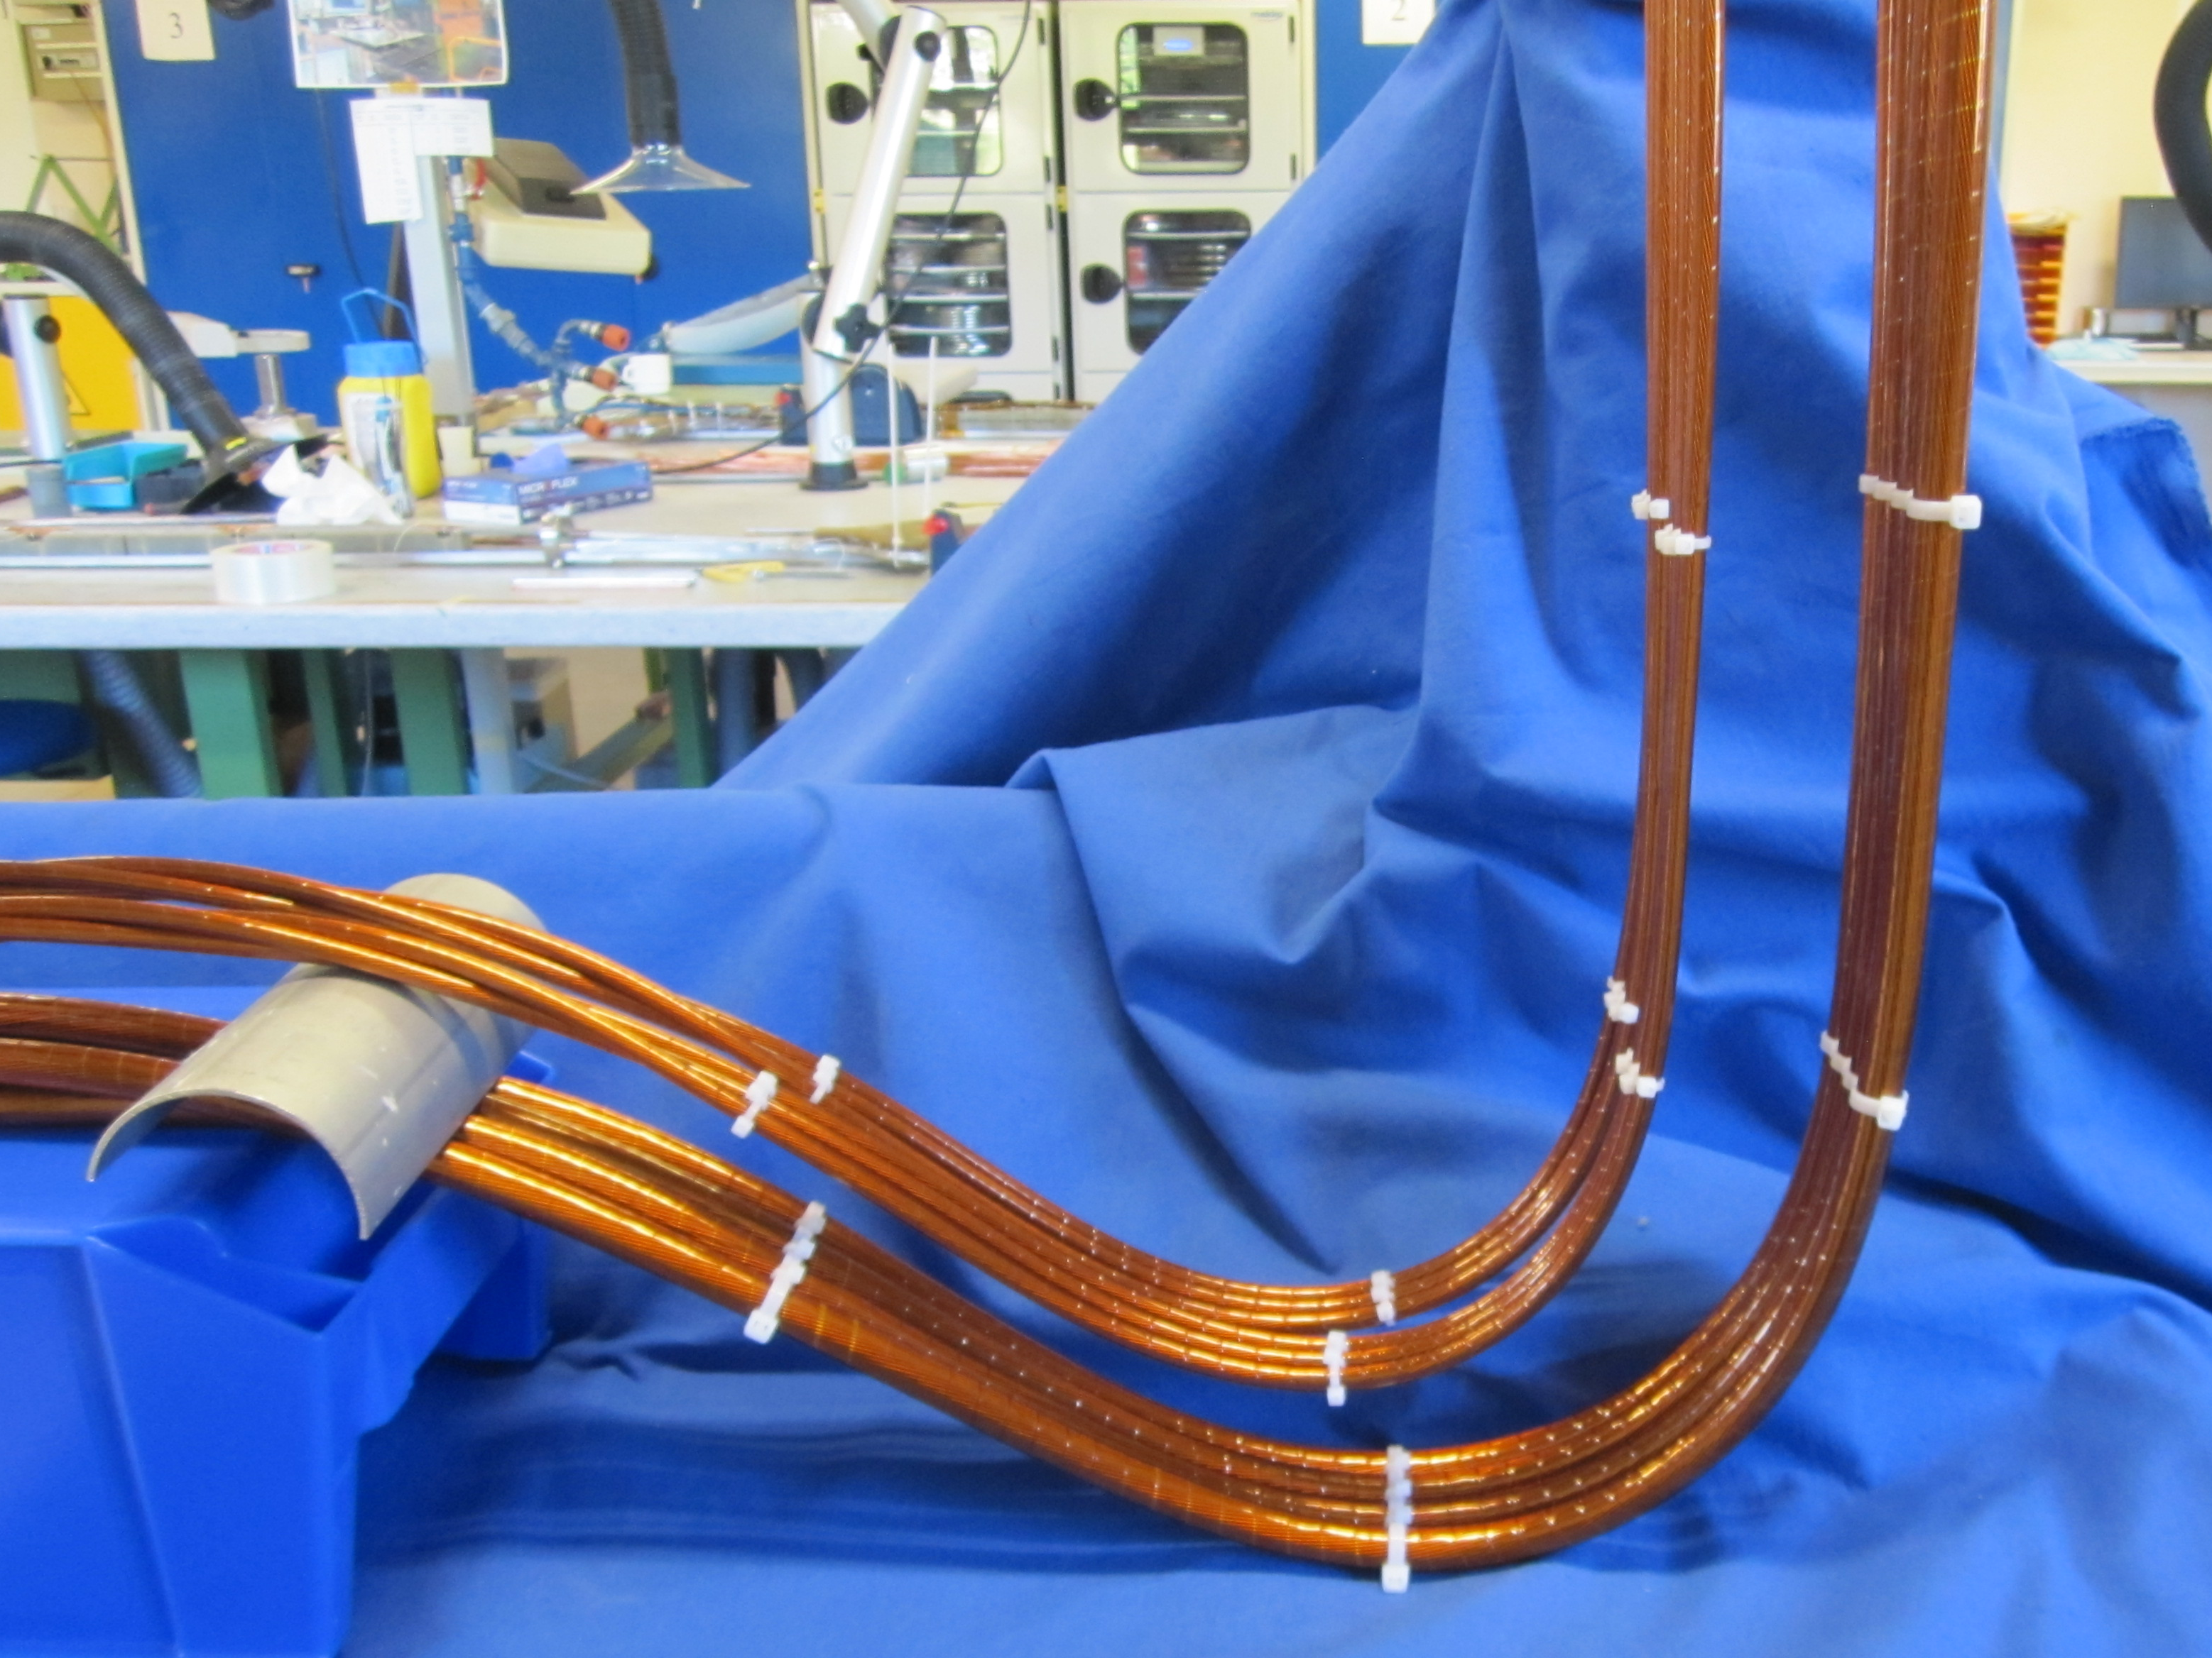
Nb-Ti in DFX: hot spot analysis
R = 125 mm
J. Fleiter, DFX Review, July 2019

Slide 34
System Demonstration

Slide 35
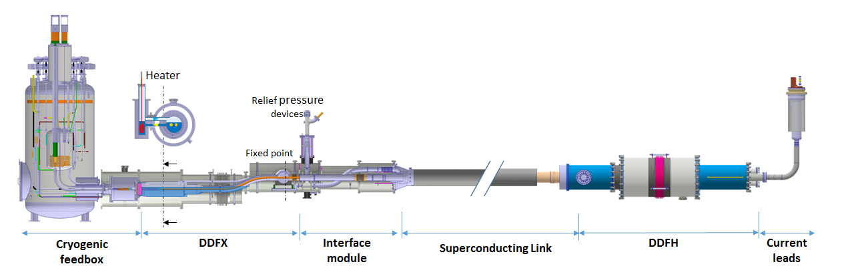
Demo 1
Constructed by WP6a and tested in the SM-18 at different stages.
Last measurement – March 2019 – validation of:
DDFX Demo, DDFH Demo, SC Link with 2×60 m MgB₂ cables made in
industry, 2×18 kA HTS Prototype Current Leads

Slide 36
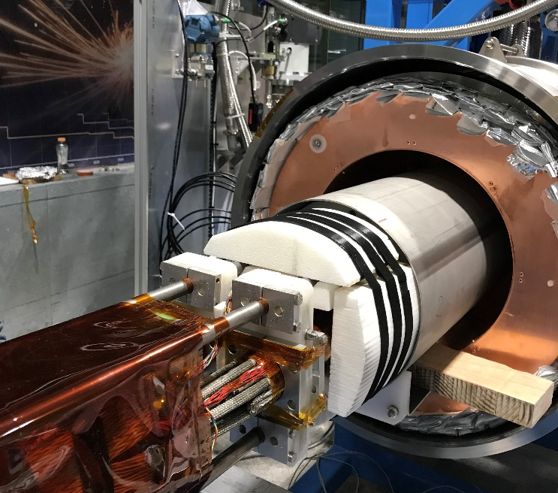
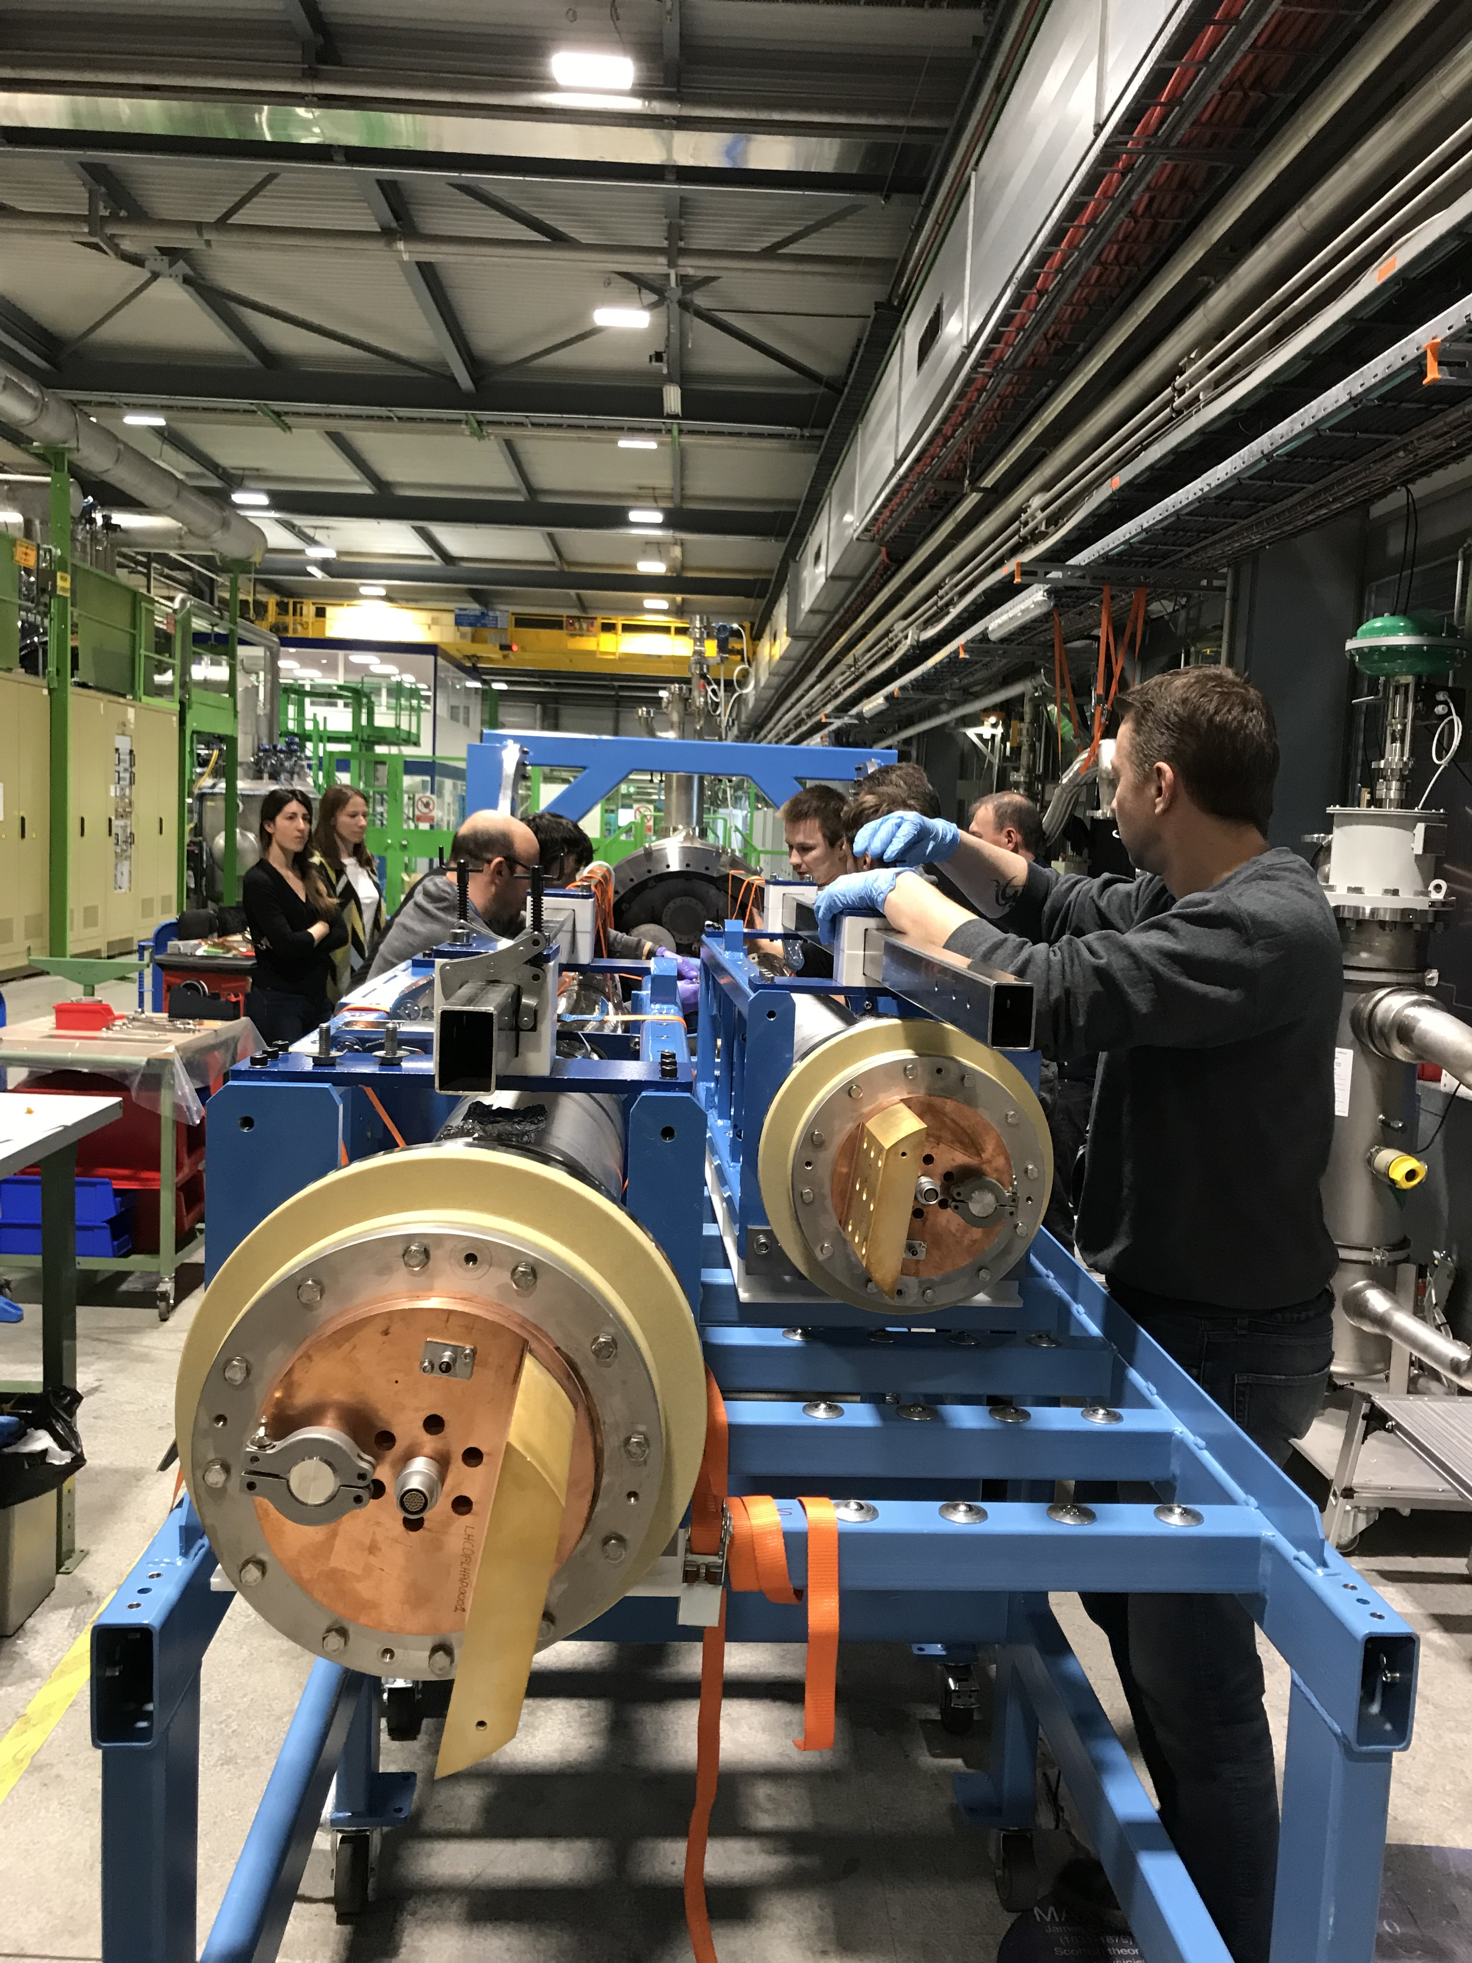
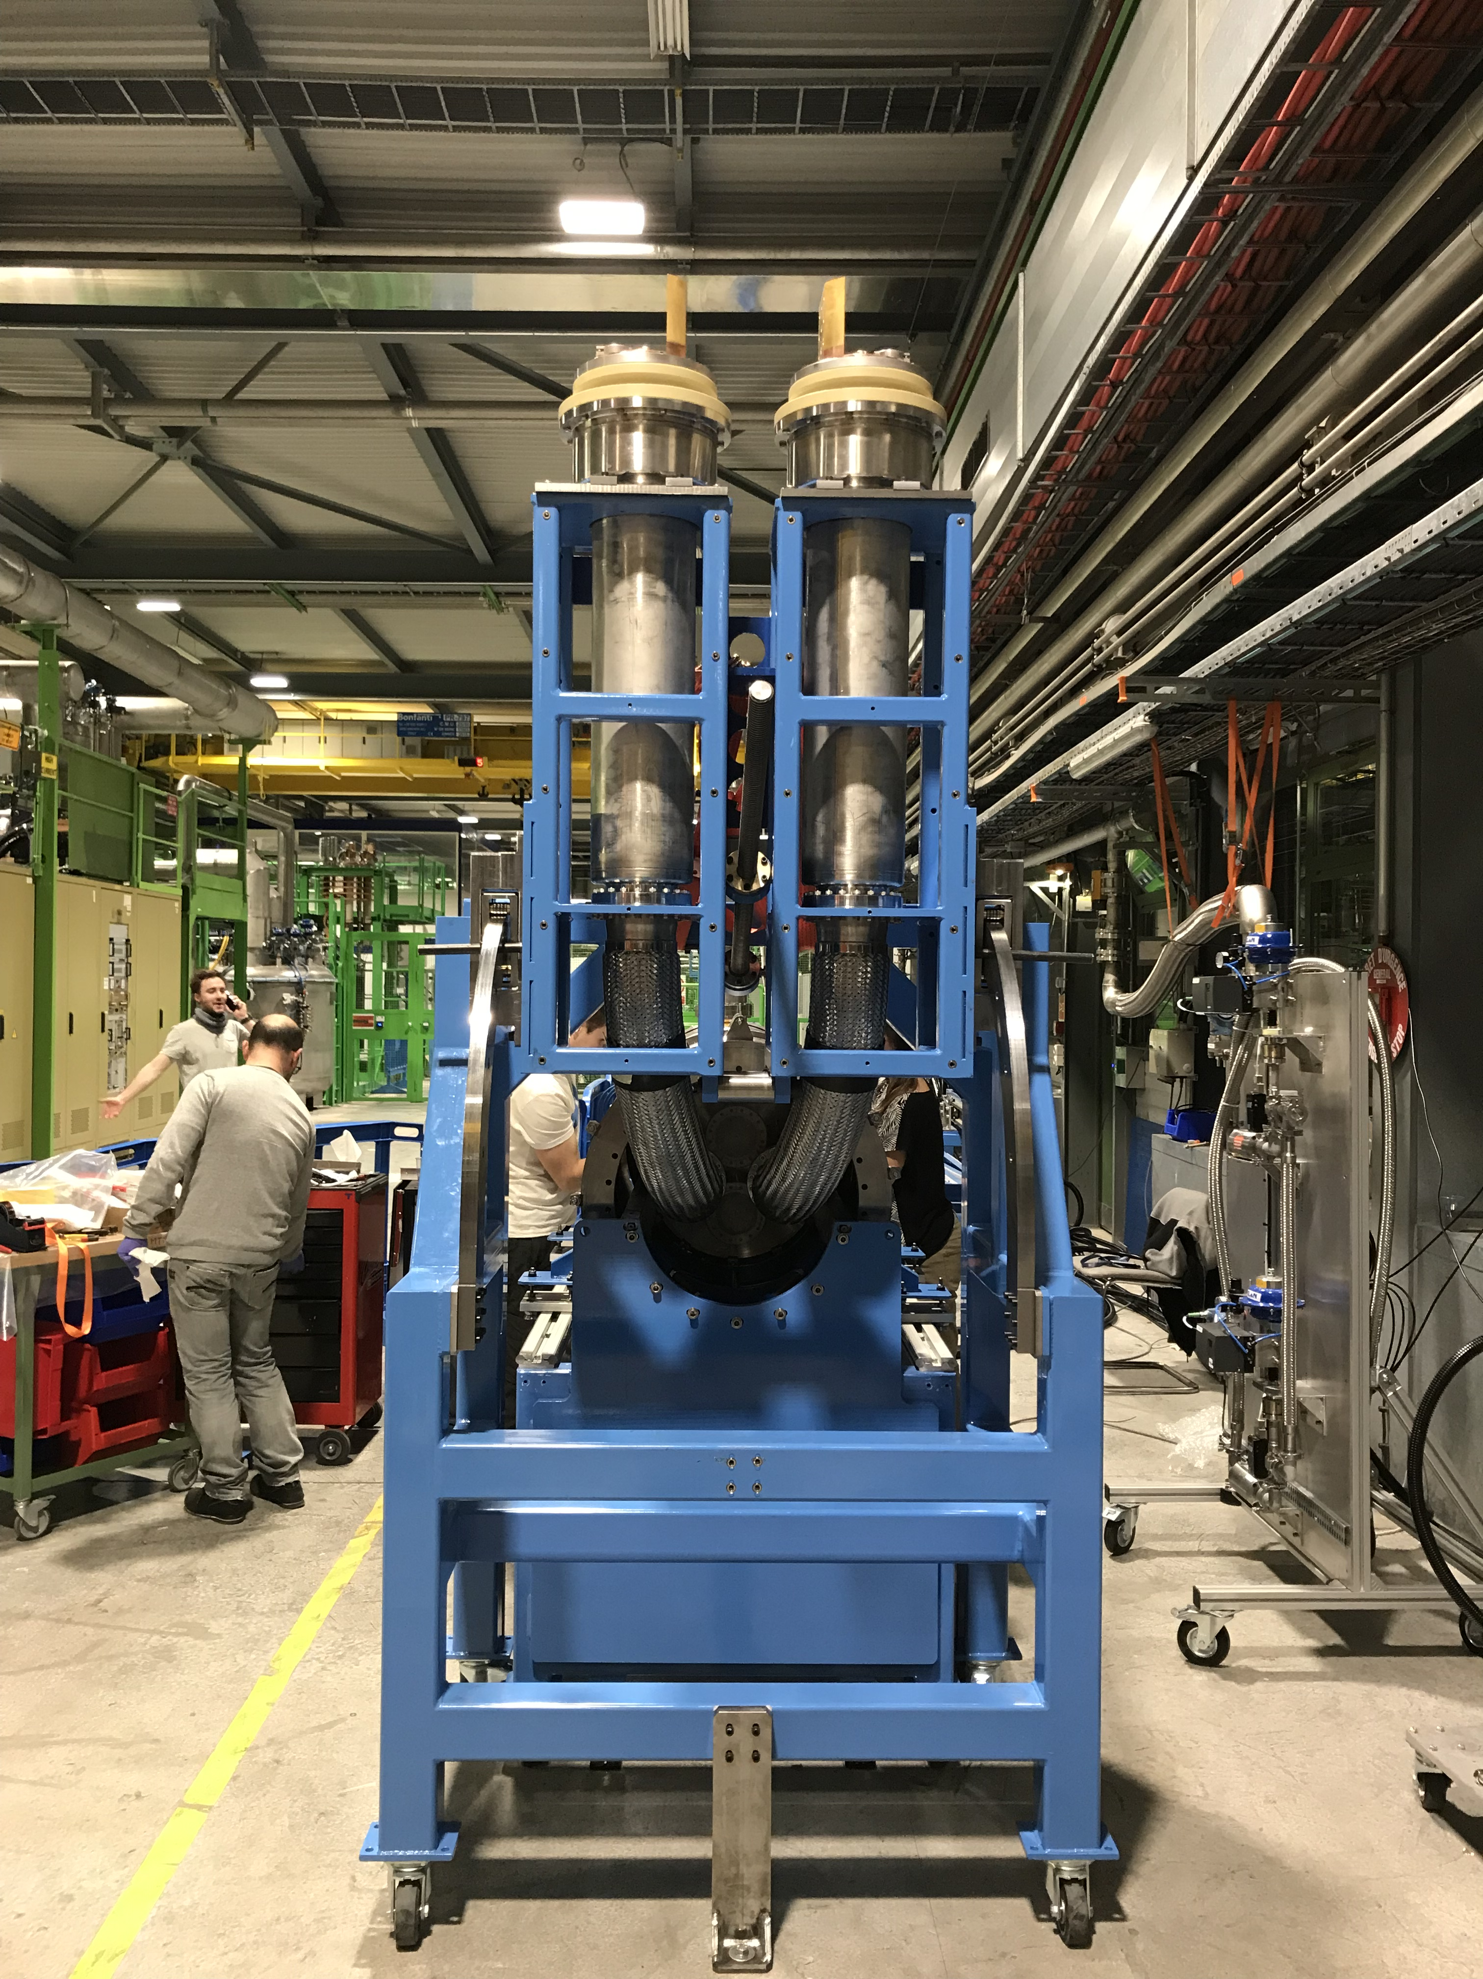
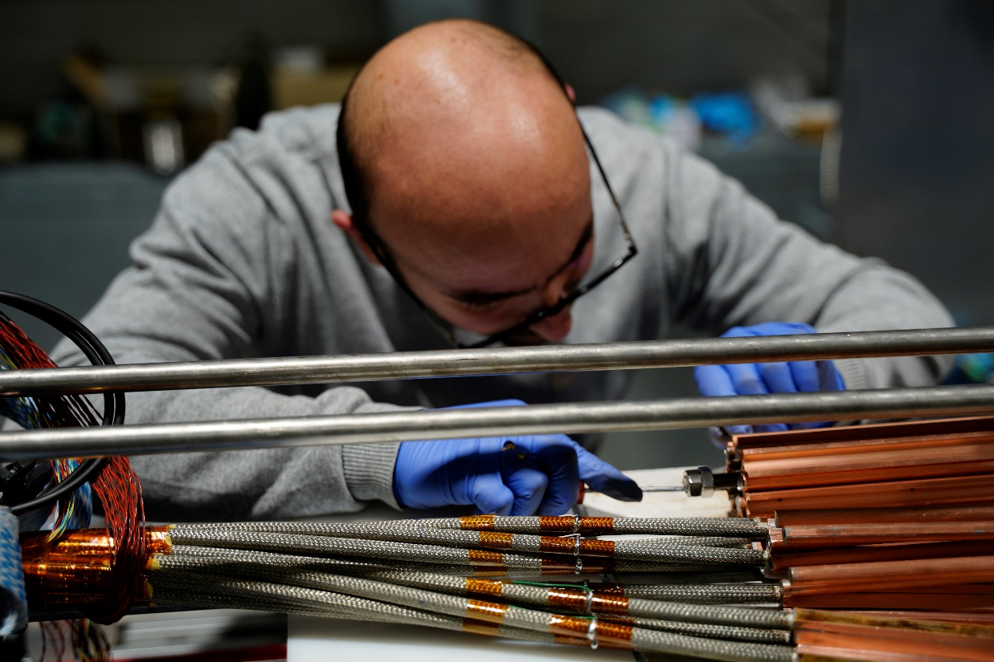
Demo 1

Slide 37
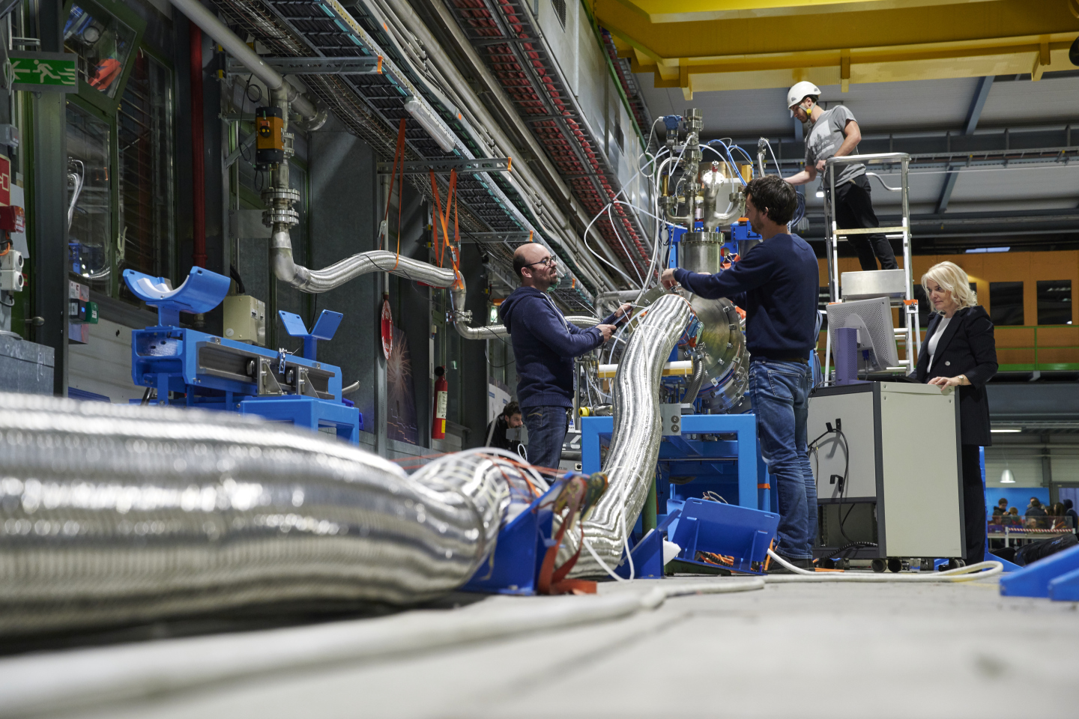
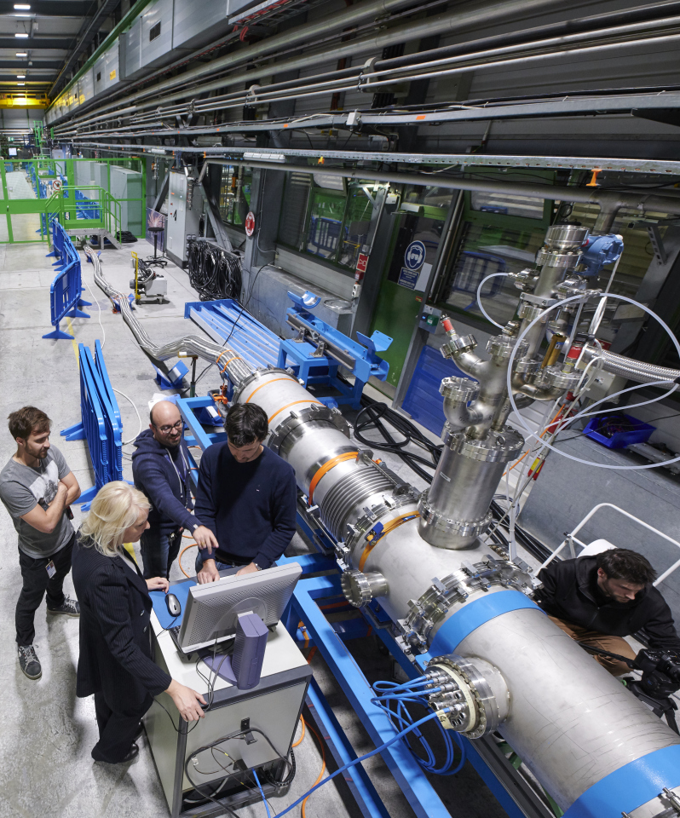
Demo 1
18.8 kA, 1 hour, Tmax MgB₂ =26 K
Tc = 31.3 K at 18 kA
Few nΩ resistances
Several
provoked quenches
Use of QPS as for
LHC

Slide 38
Cold Powering the String
A full size Cold Powering System for the Triplets will be tested in the SM-18 in the first trimester 2021 – “Prototype System Test”
The Prototype System will incorporate pre-series components (DFX, DFH, current leads, SC Link with full length, instrumentation)
After full qualification, the Prototype System will be dismounted and integrated in the String. Integration in the String is requested not before mid-2021
Integration studies have started

Slide 39
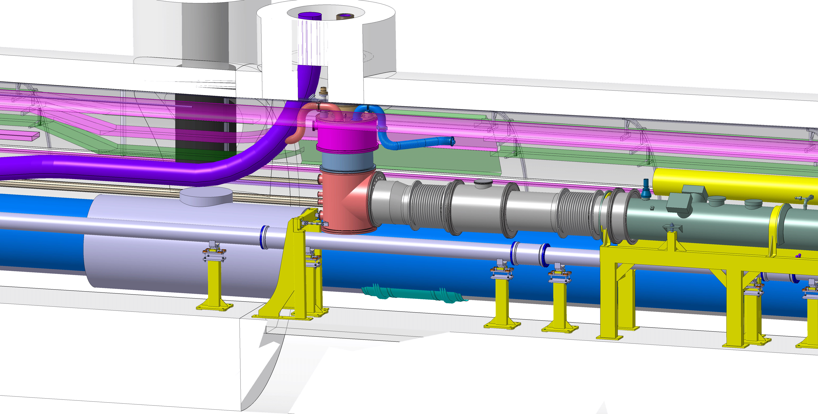
DFX
Detailed Design Review in June 2019

Slide 40
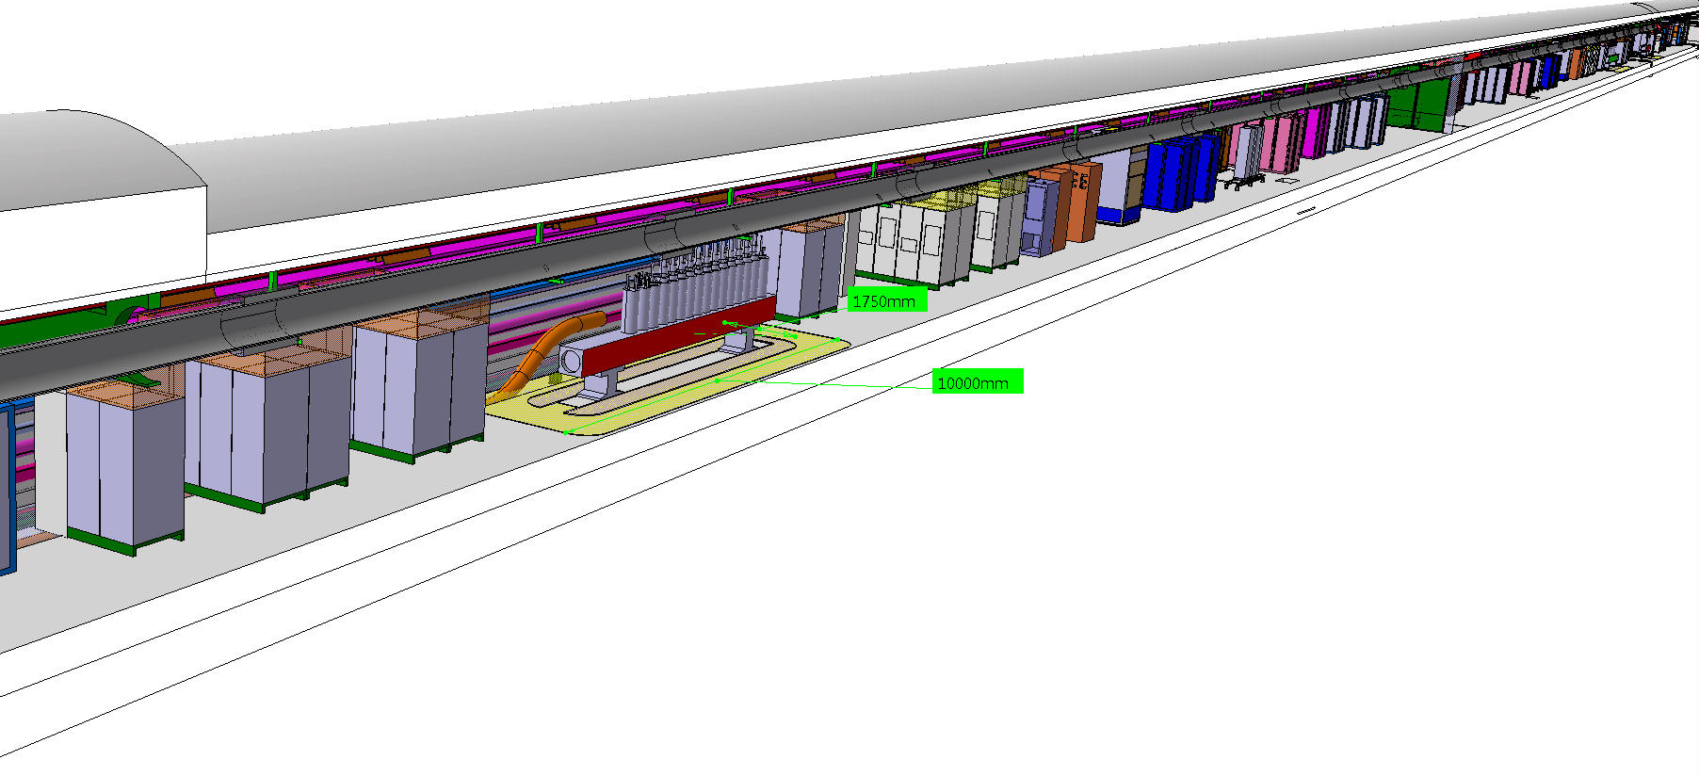
DFH Space Reservation
Reservation of space in the tunnel : 10 m length and 1.75 m width

Slide 41
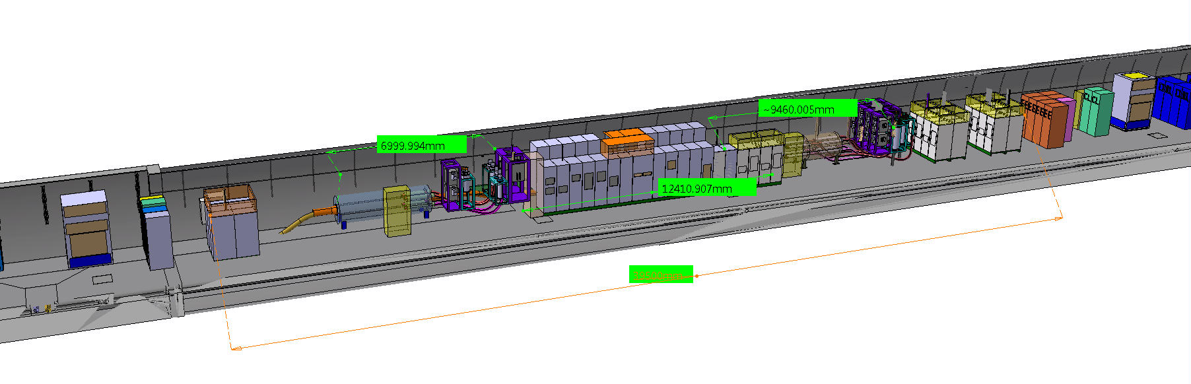
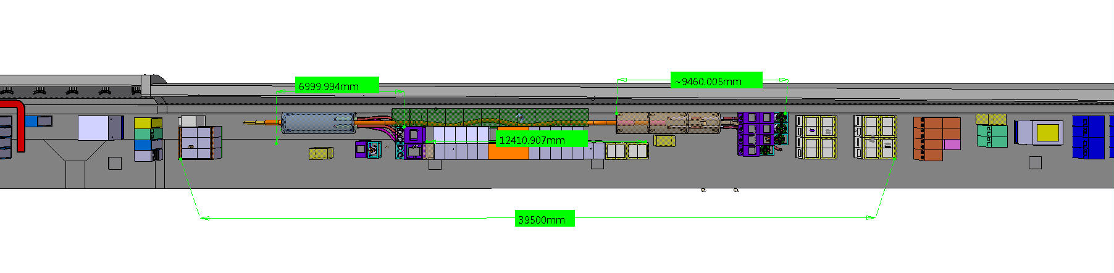
DFH Working Reference
Two modules each 4 m long ø 1,2 m (length without current leads)
Total length with current leads ∼ 15 m (plus SC Link in between)
14.7 m between the modules

Slide 42
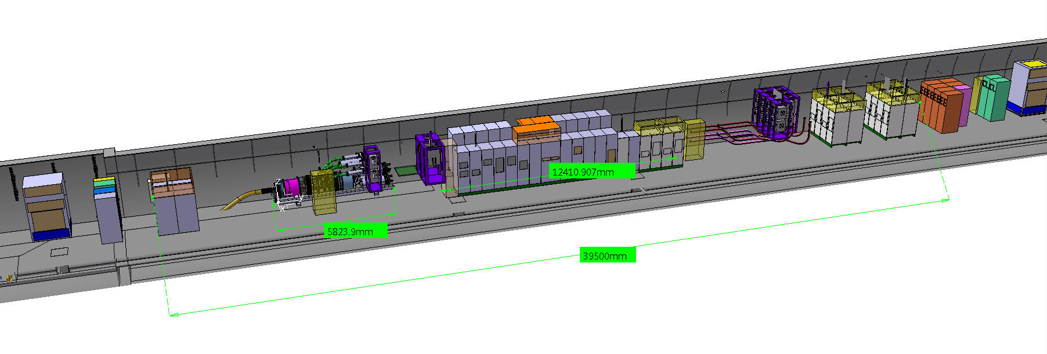
DFH Design under study
One single 4 m long (length without current leads)
Total length – with current leads – 5.8 m (to be compared with 15 m + 14.7 m)
Location of 7 kA and 13 kA basically unchanged
Free space – because of removal of second module – to reduce length of 2 kA RT cables

Slide 43
DFH Design under study
Conceptual Design Review by end of October 2019

Slide 44
Baseline strategy for testing
Each SC Link is cold tested in nominal operating conditions before being lowered in the tunnel. This includes the test of the MgB₂ to Nb-Ti splices
Each current lead is cold tested in nominal operating conditions before being lowered in the tunnel
DF and DFH are not cold tested
MgB₂ to HTS and Nb-Ti to Nb-Ti splices are done in the tunnel

Slide 45
DFH Design under study

Slide 46
Conclusions
Several intermediate components and system tests performed.
Major recent efforts: optimization of cable assemblies during production in
industry and test of Demo 1
From the electrical point of view, the cold powering systems are designed to meet the circuits' requirements
Next validation test: Demo 2. Electrical qualification of full-scale MgB₂ cable for
Triplets, with simultaneous powering of more than one circuit. The cable is being
assembled in industry, Demo 1 is being upgraded for tests in November 2019

Slide 47
Thank you for your attention !

Slide 48
MgB₂ wire - Specification
Wire diameter | mm | 1 | ± 0.2
Wire ovality | mm | ≤ 0.015
Cu fraction | % | ≥ 12
Cu coating | μm | ≥ 30
Filaments eq. diameter | μm | ≤ 60
Filaments Twist Pitch | mm | ≤ 100 | ± 5
Tensile strain at RT * | % | ≥ 0.26
Bending radius after HT* | mm | ≤ 100
Unit Length | m | ≥ 500
RRR (Cu) | - | > 100
Ic(25 K, 0.9 T) | A | ≥ 186
Ic(25 K, 0.5 T) | A | ≥ 320
Ic(20 K, 0.5 T) | A | ≥ 480
n-value@ 25 K and 0.9 T | - | > 20
Cabling of wire
after reaction
* Zero Ic degradation

Slide 49
