Slide 1







Busbars inside the cryostats
E. Todesco, H. Prin, D. Duarte Ramos, M. Mentink (CERN)
M. Baldini (FNAL)
9 September 2019 - CERN

Slide 2
CONTENTS
Requirements
Lay out
Bus bar selection

Slide 3
SPECIFICATION
Most relevant numbers
  Quench load: input parameter given by protection strategy
  Temperature margin : 5 K
  Hotspot: 150 K
Parameter | (units) | Triplet | D1 | MCBXFA/B
Design current | (kA) | 18.0 | 13.0 | 1.73
Operating temperature | (K) | 1.9 | 1.9 | 1.9
Quench integral | (MA² s) | 30 | 29 | 0.27/6.0
Equivalent time constant | (s) | 0.17 | 0.35 | 0.17/4.0
Minimum temperature margin | (K) | 5 | 5 | 5
Voltage test: RT at acceptance¹ | (V) | 4600 | 4000 | 4600
Voltage test: RT in the cold mass² | (V) | 3800 | 2800 | 3700
Test voltage at 1.9 K | (V) | 1900 | 1400 | 2300
Maximum leakage current | (mA) | 10 | 10 | 10
Joint resistance (per joint) | (nW) | 1 | 1 | 3
Maximum hot spot temperature | (K) | 150 | 150 | 150
Maximum dI/dt | (kA/s) | 90 | 36 | 15
Number of thermal cycles | (-) | 50 | 50 | 50
Number of triplet magnet quenches | (-) | 150 | 150 | 150
Maximum envelope internal busbars | (mm x mm) | 30×30³ 19×8.2⁴ | NA | NA
Maximum envelope round busbars (diameter) | (mm) | 45 Ø⁵ 15 Ø⁶ | 10 | 5
Minimum curvature radius magnet leads | (mm) | 50 | 50 | 50
Minimum curvature radius round busbars | (mm) | 70 | 70 | 50
Thermal shrinkage (from RT to operation) | (%) | 0.3 | 0.3 | 0.3

Slide 4
SPECIFICATION
Other relevant numbers
  Insulation given by expected voltage
  Flexibility (curvature radius) required for integration
Parameter | (units) | Triplet | D1 | MCBXFA/B
Design current | (kA) | 18.0 | 13.0 | 1.73
Operating temperature | (K) | 1.9 | 1.9 | 1.9
Quench integral | (MA² s) | 30 | 29 | 0.27/6.0
Equivalent time constant | (s) | 0.17 | 0.35 | 0.17/4.0
Minimum temperature margin | (K) | 5 | 5 | 5
Voltage test: RT at acceptance¹ | (V) | 4600 | 4000 | 4600
Voltage test: RT in the cold mass² | (V) | 3800 | 2800 | 3700
Test voltage at 1.9 K | (V) | 1900 | 1400 | 2300
Maximum leakage current | (mA) | 10 | 10 | 10
Joint resistance (per joint) | (nW) | 1 | 1 | 3
Maximum hot spot temperature | (K) | 150 | 150 | 150
Maximum dI/dt | (kA/s) | 90 | 36 | 15
Number of thermal cycles | (-) | 50 | 50 | 50
Number of triplet magnet quenches | (-) | 150 | 150 | 150
Maximum envelope internal busbars | (mm x mm) | 30×30³ 19×8.2⁴ | NA | NA
Maximum envelope round busbars (diameter) | (mm) | 45 Ø⁵ 15 Ø⁶ | 10 | 5
Minimum curvature radius magnet leads | (mm) | 50 | 50 | 50
Minimum curvature radius round busbars | (mm) | 70 | 70 | 50
Thermal shrinkage (from RT to operation) | (%) | 0.3 | 0.3 | 0.3

Slide 5
BUSBAR PROTECTION STRATEGY
Energy extraction were removed long time ago (2015) with the exception of MCBXFA
18 kA
  In case of quench detection in a magnet, the whole string of magnets is quenched via CLIQ and outer layer heaters
  In case of quench detection in a busbar, the whole string of magnets is quenched via CLIQ and outer layer heaters
13 kA
  In case of quench detection in D1, the magnet is quenched via outer layer heaters
  In case of quench detection in D1 busbar, the magnet is quenched via outer layer heaters
2 kA
  In case of MCBXFB quench, the magnet is protected via energy extraction on the crowbar and via quench propagation in the magnet. We assume a 30 mΩ crowbar.
  In case of quench of the MCBXFB busbar or magnet lead, the busbar or magnet lead is protected via energy extraction on the crowbar.
  In case of MCBXFA quench, the magnet is protected via energy extraction on a 0.3 Ω external dump resistor.
  In case of quench of the MCBXFA busbar of magnet lead, the busbar or the magnet lead are protected via energy extraction on a 0.3 Ω external dump resistor.

Slide 6
CONTENTS
Requirements
Lay out
Bus bar selection

Slide 7
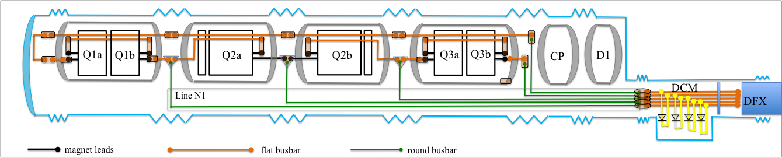
LAY OUT
Main circuit and 18 kA trims
  Magnet leads in Nb-Ti
  One internal busbar going through Q1 Q2 Q3 based on flat cable
  Round cable for trims
  Flat cable for DCM (D1-DFX Connection Module) and passage through lambda plate
  Trims in the N1 line
  Passage through D1 and CP avoided through the N line also for the main
  End return module to avoid breaking symmetry between Q1 and Q3
Conceptual layout of WP3 busbar, triplet circuit (H. Prin, D. Duarte Ramos, E. Todesco)

Slide 8
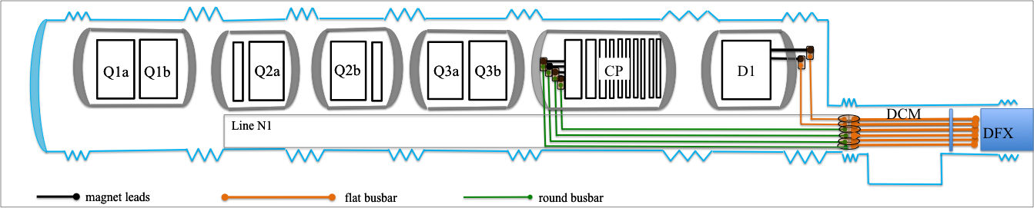
LAY OUT
13 kA circuit D1 and 2 kA circuit MCBXFA
Conceptual layout of WP3 busbar, D1 and MCBXFA (H. Prin, D. Duarte Ramos, E. Todesco)

Slide 9
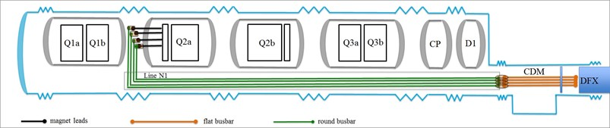
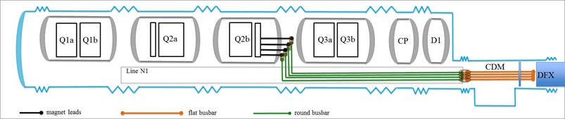
LAY OUT
2 kA circuit MCBXFB
  No need of internal busbar
  Magnet leads (flat cable)
  Round busbar in the N line
Conceptual layout of WP3 busbar, MCBXFB (H. Prin, D. Duarte Ramos, E. Todesco)

Slide 10
QUANTITY AND SCHEDULE
Type | Assembly | Length (m) | Quantity | First needed in
18 kA circuits
Magnet lead 18 kA | MQXFA | 2 | 90 | MQXFAP1 | 01.2017
Magnet lead 18 kA | MQXFB | 2 | 62 | MQXFBP1 | 01.2017
Internal busbar 18 kA | LQXFA | 13 | 11 | LQXFA01 | 03.2019
Internal busbar 18 kA | LQXFB | 12 | 12 | LQXFBP1 | 06.2019
Q1a trim and CLIQ leads | LQXFA | 5 | 66 | LQXFA01 | 03.2019
CLIQ leads | LQXFB | 5 | 24 | LQXFBP1 | 06.2019
Return end | Q1 end | 2 | 5 | String | 01.2021
Round busbar trim1 | N1 line | 55 | 5 | String | 01.2021
Round busbar trim2 | N1 line | 45 | 5 | String | 01.2021
Round busbar trim3 | N1 line | 35 | 5 | String | 01.2021
Round busbar main | N1 line | 23 | 10 | String | 01.2021
Flat busbar CDM | CDM | 2.5 | 25 | String | 01.2021
2 kA circuits
Magnet lead 2 kA | MCBXFB | 2.5 | 24 | LQXFBP1 | 09.2019
Magnet lead 2 kA | MCBXFA | 2.5 | 14 | CP prototype | 06.2020
Round busbar 2 kA MCBXFB Q2a | N2 line | 55 | 5 | String | 01.2021
Round busbar 2 kA MCBXFB Q2a | N2 line | 35 | 5 | String | 01.2021
Round busbar 2 kA MCBXFA | N2 line | 25 | 5 | String | 01.2021
Round busbar 2 kA | Connection to test bench | 13 (Q2) 6 (CP) | 6 | LQXFBP1 | 06.2019
Flat busbar CDM | CDM | 2.5 | 60 | String | 01.2021
13 kA circuits
Flat busbar 13 kA | DFM | 3 | 10 | String | 01.2021

Slide 11
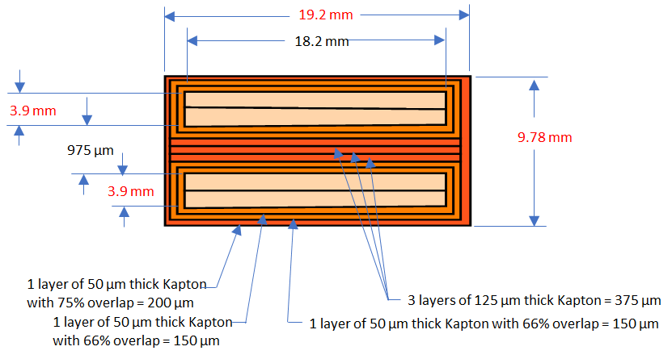
BUSBAR SELECTION
18 kA flat busbar
  Double cable of magnet lead
  34 Nb-Ti strands, 1.065 mm diameter, 1.65 Cu/No_Cu
  22.9 mm² of Cu, 37,7 mm² of sc
  Maximum hotspot ~110 K [M. Mentink EDMS 2052319]
  In production in US
  US-AUP will provide also the internal busbar for the Q2
18 kA internal busbar (M. Baldini et al.)

Slide 12
BUSBAR SELECTION
18 kA round busbar
  Same cable used by WP6
  78 mm² of Cu, 19 mm² of sc
  Maximum hotspot lower than 100 K
13 kA busbar [M. Mentink, EDMS 2061856 and 2110653]
  Nb-Ti cable of D1 with 1.5-mm-thick Cu conductor, same width
  35.4 mm² of Cu, 6.5 mm² of sc
  Maximum hotspot ~100 K
2 kA flat busbar (magnet lead) [M. Mentink, EDMS 2052325]
  MCBXF cable plus a 1.5 mm thick Cu (considering increasing to 2 mm)
  8.8 mm² of Cu, 1.2mm² of sc
  Maximum hotspot ~120 K
2 kA round busbar
  Considering possibility of reusing 6 kA cable of LHC
  11 strand of Nb-Ti, 9 of Cu, 0.85 mm diameter, 1.38 Cu/no_Cu
  8.7 mm² of Cu, 3.6 mm² of sc

Slide 13
FEW WORDS ON OTHER CIRCUITS
HO correctors will go with local powering
D2 main circuit will have the same busbar as D1
  Similar operational current and inductance
MCBRD circuit (400 A nominal) will have the 600 A LHC busbar
  There is energy extraction so busbar protection is not critical [M. Mentink, EDMS 2222746]

Slide 14
CONCLUSION
Specification of busbar is established
Lay out has been finalized
MQXF internal busbar in production, will be provided by US
  Most urgent, needed for mid 2020
Finalizing the selection of all the other busbars
  No issues to make them compatible with requirement
  A critical point is the protection of the MCBXFB busbar, relying on the power converter crowbar

