Slide 1


Quench protection strategies of the magnet circuits
Arjan Verweij, TE-MPE-PE
With input from many, see slides
HL-LHC Circuit Review, 9-10 Sept 2019

Slide 2

Contents
General strategy for quench protection & detection
MgB₂ link and leads
Triplet
  Triplet: mains
  Triplet: RCBXFA/B correctors
  Triplet: High-order superferric correctors
RBXF (D1)
RBRD (D2)
RCBRD (D2 orbit correctors)
RB.A67 and RB.A78 including the MBH (11 T dipole)
Hollow e-lens
VWL=Voltage Withstand Level
WRFS=Worst Realistic Failure Scenario
Conclusions on simulation results are shown in yellow throughout the slides.

Slide 3
General strategy
General strategy for circuit protection:
Study different protection methods and schemes, aiming a good balance between maximum voltage to ground (U_{coil-gnd}) and maximum hot-spot temperature (T_{hot-spot}); typically we like to keep T_{hot-spot} <150 K (busbars), <200 K (Nb-Ti correctors), <300 K (Nb-Ti dipoles) and <350 K (Nb₃Sn coils).
Perform simulations in a realistic but conservative way, considering:
  different quench origins (bus, coil-low-field, coil-high-field).
  realistic quench propagation, hence detection time (t_{det}).
  realistic detection threshold (U_{thres}) and evaluation time (t_{eval}).
  realistic delay in switches of protection equipment.
  realistic failure scenario’s.
  realistic variation in material properties (RRR, Cu/SC ratio).
Build in sufficient redundancy, in order to ‘optimise’ reliability vs availability.
See talk E. Todesco

Slide 4
General strategy
Protection methods:
Cryostability / cold-end recovery / dynamic stability
Self-protection: discharge governed by circuit inductance and coil resistance (due to fast quench propagation) and warm leads
Active protection:
  Energy extraction (EE): switch+dump or eventually warm-leads/crowbar
  Quench heaters (QH’s)
  Coupling Loss Induced Quench system (CLIQ)
Who does what?
Protection studies on magnets made by CERN are done by MSC and cross-checked by MPE.
Protection studies on magnets made by collaborations are done by the collaborations and cross-checked by MSC.
Protection studies on busbars, circuits, CCT magnets, and magnets with CLIQ are done by MPE.

Slide 5
General strategy
Experimental data
Once model/prototype/series magnets are made and tested, the simulations should be compared to the experimental data, see also talk A. Foussat.
Experimental protection studies should be performed at different quench levels (including training quenches), enabling to:
  Measure the voltage build-up from 0 to U_{thres}, and hence verify proper functioning of the QD and firing of QH (and CLIQ),
  Verify the current decay and MIITs,
  Calculate a conservative value of the hot-spot assuming that the quench originates in the peak field area of the coil, and assuming conservative local RRR and Cu/SC.
However:
  Conditions during individual magnet tests will be different from those in the tunnel; simulations are important to correlate both.
  The internal voltage distribution (hence U_{coil-gnd}, U_{coil-QH}) cannot be reliably deduced from the discharge curve, and (updated) simulations remain the baseline for these voltages.

Slide 6
General strategy
General strategy on Quench Detection:
Use a midpoint for quench detection, especially for inductive components (coils).
Decouple busbars and SC leads from the coils, each with their own quench detection threshold and evaluation time. For busbars and leads we usually favour low U_{thres} and long t_{eval}, whereas for coils we usually have high U_{thres} and small t_{eval}.
If needed, consider a current-dependent U_{thres} , especially to overcome the effect of flux jumps and possible converter-induced noise (0-V crossing).
Use 2 channels with independent voltage taps, and use 1oo2 voting.
Make sure that symmetric quenches will also be detected (e.g. use U_{P1}-U_{P2}, U_{P3}-U_{P4} and also U_{P1+P2}-U_{P4+P4})
See talk from R. Denz

Slide 7
General strategy
Busbar protection:
In circuits with active protection, protection of the busbar is usually straightforward.
In circuits without active protection the preferred solution is cryostable busbars. If not possible, sufficient copper stabiliser should be added to handle a slow decay, governed by the inductance of the circuit and the resistance of the warm leads and crowbar.
The effect of irregularities in the busbar, such as resistive joints, quench stoppers, plugs, expansion loops (lyra’s), areas with reduced stabiliser, etc., should be studied in detail.
Take a very conservative approach, also because more stabiliser is good for mechanical stabilisation.
For busbar layout see talk E. Todesco

Slide 8
General strategy
Quench origin | Fast Power Abort
One of the 6 MQXFA/B magnets, 18 kA triplet lead, 7 kA trim lead, main triplet busbars | RQX, RTQX1, RTQX3, RTQXA1
MCBXFA-Hor/Vert, 2 kA corrector lead and busbar | Concerned circuit and the nested one
High-order corrector magnets | Concerned circuit
MBXF (D1), 18 kA D1 lead and busbar | RBXF
MBRD (D2), lead and busbar | RBRD
MCBRD, lead and busbar | RCBRD (both apertures)
MBH magnet or busbar, RTBH busbar | RB

Slide 9
Contents
General strategy for quench protection & detection
MgB₂ link and leads
Triplet
  Triplet: mains
  Triplet: RCBXFA/B correctors
  Triplet: High-order superferric correctors
RBXF (D1)
RBRD (D2)
RCBRD (D2 orbit correctors)
RB.A67 and RB.A78 including the MBH (11 T dipole)
Hollow e-lens

Slide 10
MgB₂ link
18 kA
Triplet mains
3x7 kA
Triplet trims
12x2 kA (co-axial)
RCBXFA/B (hor/vert
orbit correctors)
18 kA
RBXF (D1)
The main triplet, its trims, the D1, and the orbit correctors are powered through the same MgB₂ link.
In principle, the QP will be designed in such a way that a quench in a given circuit will cause a FPA in that circuit, and a ramp down in all the other circuits.
A. Ballarino, https://indico.cern.ch/event/643197/contributions/2624569/

Slide 11
MgB₂ link
T
T
T
warm Cu bus
U_{thres}
t_{eval}
Res. part
of the lead
10-100 mV
O(sec)
HTS part
of the lead
1-5 mV
O(100 ms)
MgB₂ link
50-100 mV
O(100 ms)
LTS bus
1-10 mV
O(100 ms)
Independent active protection of each part with customized detection voltage threshold and evaluation time. (see also presentation R. Denz)
Monitoring of the individual joints (HTS-MgB₂, MgB₂ to LTS) is possible if needed.
Temp. sensors at the warm ends of ‘Res part lead’, ‘HTS part lead’, and ‘MgB₂ link’ will be used for interlocking (excursion will trigger slow power abort).
Longer LTS bus segments have individual quench detection.
A. Ballarino, https://indico.cern.ch/event/643197/contributions/2624569/

Slide 12
MgB₂ link
None of the MgB₂ leads is expected to quench in case of a FPA of any of the circuits.
Each of the MgB₂ leads has sufficient copper to handle the current discharge in case of a quench.
The 18 kA triplet leads will see a fast decaying current (a few 100 ms) but should not quench.
The 3 trim leads (7 kA) might see a transient up to 6.8 kA but should not quench.
During the SM18 string test and/or HWC after LS3 we will study the mutual coupling between the main triplet circuit, the trims, the D1, and the correctors.
Tripping the main triplet or D1 in case of a quench in one of the other circuits should be avoided.

Slide 13
MgB₂ link
Hot-spot, assuming 15 MA²s for detection (ref. A. Ballarino) and T_{init}=25 K
Lead rating | Cu cross- section [mm²] | Detection MITTs [MA²s] | Detection t_{det}+t_{eval} [s] | Discharge MIITs [MA²s] | Discharge Τ [s] | Total MIITs [MA²s] | T_{hot-spot} [K]
18 kA | 200 | 15 | 0.05 | 32 | 0.2 | 47 | 27
7 kA | 36 | 15 | 0.3 | 5 | 0.2 | 20 | 40
2 kA | 34 | 15 | 3.7 | 8 | 4 | 23 | 43
Allowed MIITs for 100 K hot-spot, assuming 0.2 s for detection and T_{init}=25 K
Lead rating | Cu cross- section [mm²] | Detection MITTs [MA²s] | Detection t_{det}+t_{eval} [s] | Discharge MIITs [MA²s] | Discharge Τ [s] | Total MIITs [MA²s] | T_{hot-spot} [K]
18 kA | 200 | 64 | 0.2 | 2800 | 17 | 2860 | 100
7 kA | 36 | 10 | 0.2 | 83 | 3.4 | 93 | 100
2 kA | 34 | 1 | 0.2 | 83 | 42 | 84 | 100
Conclusion: Protection-wise, the MgB₂ leads are very safe

Slide 14
Contents
General strategy for quench protection & detection
MgB₂ link and leads
Triplet
  Triplet: mains
  Triplet: RCBXFA/B correctors
  Triplet: High-order superferric correctors
RBXF (D1)
RBRD (D2)
RCBRD (D2 orbit correctors)
RB.A67 and RB.A78 including the MBH (11 T dipole)
Hollow e-lens

Slide 15
RQX+RTQX1/3+RTQXA1 (Triplet – main quads)
The circuit went through several iteration steps in the last years.
Protection studies have been performed by M. Mentink and E. Ravaioli, and lately also by V. Marinozzi (FNAL). Latest simulation results were presented by E. Ravaioli at the ‘Intl review on the IT Quadrupoles for HL-LHC’ (July 2019), see: https://indico.cern.ch/event/828604/contributions/3471709/

Slide 16
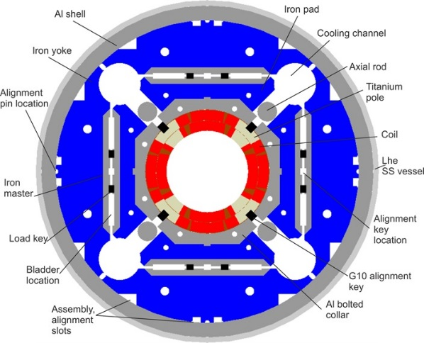
RQX+RTQX1/3+RTQXA1
Nr of circuits | 4 (L1, R1, L5, R5)
Magnets per circuit | 4x MQXFA (US Acc Upgrade Project), 2x MQXFB (CERN)
I_{nom} | 16470 A
L at I_{nom} | 0.255 H
E_{stored} at I_{nom} | 34.5 MJ
Protection | 8 QH’s and 1 CLIQ per magnet (so 48 QH’s and 6 CLIQ’s in total)
WRFS | Failure of 2 QH circuits Failure of 1 QH circuits and 1 CLIQ
MQXF cross-section
(P. Ferracin, G. Ambrosio et al.)

Slide 17
RQX+RTQX1/3+RTQXA1
Main remarks:
No inner layer QH’s due to observed delamination, see S. Izquierdo Bermudez https://edms.cern.ch/document/1972818
Coils self protected <2 kA, OL-QH’s effective >1.5 kA, CLIQ effective >3 kA
Cold diodes only carry current for a short time (τ≈0.17 s) in case of a FPA when there is a quench imbalance between magnets.
The combined protection of QH’s and CLIQ offers a lower hot-spot and increased redundancy, especially important at high currents.
QH characteristics and CLIQ configuration and parameters are optimized to have a fast transition of a large volume of the coil in case of activation.
Diodes, and the connection order and polarities of QH’s, CLIQ and poles are optimized to:
  Reduce the voltage to ground
  Reduce the hot-spot and voltage distribution in case of failures
  Reduce the dipole kick on the beam in case of a spurious triggering of the QH power supply (see also presentation D. Wollmann)

Slide 18
RQX+RTQX1/3+RTQXA1
Hot spot temperatures for MQXFB at I_{nom}=16.5 kA, see https://indico.cern.ch/event/828604/contributions/3471709 (partially cross-checked by V. Marinozzi)
Scenario | Reference parameters | Realistic* parameters randomly distributed | Realistic* parameters with optimised coil order within a magnet
No failures | 231 K | ≤254 K | ≤254 K
2 QH failures | ≤235 K | ≤259 K | ≤259 K
1 CLIQ and 1 QH failure | ≤357 K | ≤403 K | ≤403 K
* Realistic conductor parameters provided by B. Bordini, indico.cern.ch/event/828604/contributions/3471761/
Temperatures at ultimate are about 20 K higher
Hot-spot temperatures are well below 350 K. A hot-spot of about 400 K, in case of the unlikely event of a quench with combined failure of CLIQ and one QH, was deemed acceptable during the triplet review of 15-17 July 2019 (https://indico.cern.ch/event/828604)

Slide 19
RQX+RTQX1/3+RTQXA1
Maximum U_{coil-gnd} for MQXFB at I_{nom}=16.5 kA, see https://indico.cern.ch/event/828604/contributions/3471709 (partially cross-checked by V. Marinozzi)
Scenario | Reference parameters | Realistic* parameters randomly distributed | Realistic* parameters with optimised coil order within a magnet
No failures | 594 V | ≤927 V | ≤636 V
2 QH failures | ≤641 V | ≤920 V | ≤657 V
1 CLIQ and 1 QH failure | ≤578 V | ≤820 V | ≤604 V
Realistic conductor parameters provided by B. Bordini, indico.cern.ch/event/828604/contributions/3471761/
Max U_{coil-gnd} at ultimate are about 160-200 V higher.
Optimising the order of the coils is important to reduce the maximum voltages. 660 V should be taken as the reference.
Peak voltages are reached when T_{coil}=80-120 K and when the QH power supplies are almost fully discharged, so U_{coil-gnd}=U_{coil-QH}. It is important that Voltage Withstand Levels are also tested at these temperatures, see talk F. Rodriguez-Mateos.

Slide 20
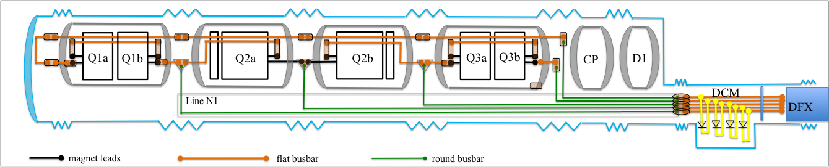
Triplet: 18 kA busbars
H. Prin and D. Duarte Ramos
Estimate of required Cu cross-section, assuming Cu/SC=1.7, RRR=100
t_{det}+t_{eval} [s] | τ [s] | MIITs [MA²s] | A_{Cu} for 100 K [mm²] | A_{Cu} for 150 K [mm²] | A_{Cu} for 200 K [mm²]
400 | 0.17 | 157 | 33 | 30 | 28
500 | 0.17 | 190 | 37 | 33 | 31
600 | 0.17 | 222 | 40 | 35.5 | 33

Slide 21
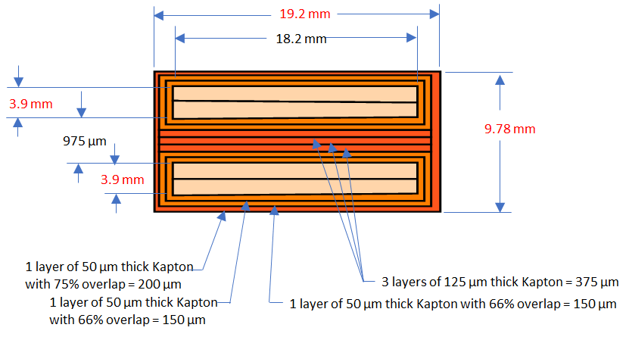
Triplet: 18 kA flat busbar
18 kA internal busbar (M. Baldini et al.)
The flat busbar is an insulated pair of Rutherford-type cables:
34 strands, d_{str}=1.065 mm, Cu/SC=1.65, A_{Cu}=38 mm², A_{SC}= 23 mm².
The hot-spot in this busbar is calculated by M. Mentink, see https://edms.cern.ch/document/2052319 , assuming U_{thr}=10 mV and t_{eval}=500 ms, varying RRR, self-field, cooling conditions, and quench current.
A highest hot-spot of 110 K is obtained, in the case of a current of 18 kA and a RRR of 80.

Slide 22
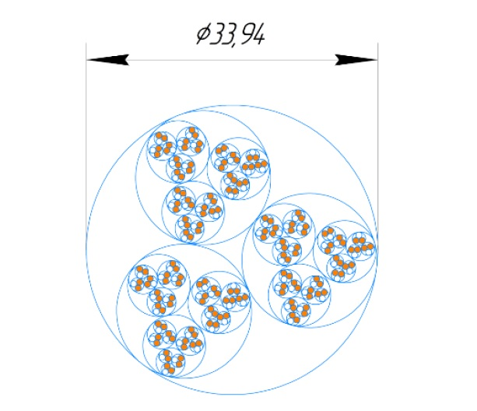
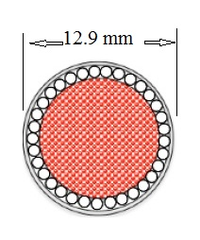
Triplet: 18 kA round busbar
Two round busbars have been considered in recent years, having Cu cross-sections of 84 and 102 mm², so more than double the amount of the flat busbar.
L. Bottura
V. Vitaly et al.
The preferred option is now a round busbar which is also used by WP6, with a cross-section of 78 mm² Cu and 19 mm² SC.
Assuming a RRR>80, all 3 options would give hot-spot temperatures <100 K, as well as any other busbar with a Cu cross-section >50 mm².

Slide 23
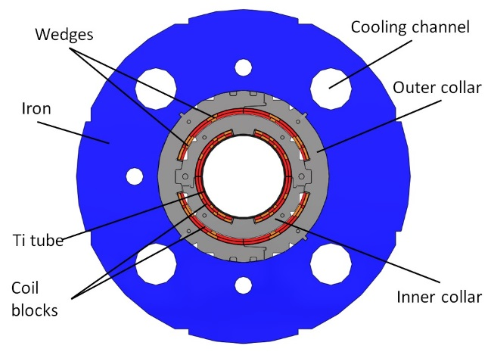
Contents
General strategy for quench protection & detection
MgB₂ link and leads
Triplet
  Triplet: mains
  Triplet: RCBXFA/B correctors
  Triplet: High-order superferric correctors
RBXF (D1)
RBRD (D2)
RCBRD (D2 orbit correctors)
RB.A67 and RB.A78 including the MBH (11 T dipole)
Hollow e-lens
MCBXF cross-section
(F. Toral, J. C. Perez et al.)

Slide 24
Triplet corrector: RCBXFA/B
Latest magnet simulation results were presented at the WP3 meeting on 13/2/2019 by A. Fernandez Navarro and F. Toral (CIEMAT), see https://indico.cern.ch/event/785928/
 | Vertical orbit corr., inner | Horizontal orbit corr., outer | Vertical orbit corr., inner | Horizontal orbit corr., outer
Nr of circuits | 4 | 4 | 8 | 8
Magnets per circuit | 1x MCBXFA | 1x MCBXFA | 1x MCBXFB | 1x MCBXFB
Magn. length [m] | 2.2 | 2.2 | 1.2 | 1.2
Conductor | 18 strand Rutherford cable, d_{str}=0.48 mm, Cu/SC=1.75, RRR_{meas}=140
I_{nom} [A] | 1584 | 1402 | 1625 | 1474
L at I_{nom} [mH] | 107 | 232 | 58.4 | 125
E_{stored} at I_{nom} [kJ] | 134 | 239 | 77 | 143
Protection baseline | EE | EE | Self protected / crowbar | Self protected / crowbar
WRFS | none
For the protection studies the nested inner and outer dipole coils are simulated independently. Possible quench back is not taken into account.

Slide 25
Triplet corrector: MCBXFA (2.2 m)
No cooling to helium, U_{thres}=100 mV, t_{det}=20 ms, t_{eval}=10 ms. Quench at peak field.
A. Fernandez Navarro and F. Toral, https://indico.cern.ch/event/785928/
Current baseline: EE for both inner and outer dipole with R_{EE}=0.3 Ω.
Maximum voltage to be considered for HiPotting should be I*R_{EE} which is about 490 V at I_{nom} and LHe temperature.

Slide 26
Triplet corrector: MCBXFB (1.2 m)
Quench origin in peak field.
Roxie is a 2D code and the added long. quench propagation is too slow, resulting in lower R, hence slower decay and higher hot spot.
Note that U_{coil-gnd} (SQUID) is of course smaller than U_{res,tot} (ROXIE).
A. Fernandez Navarro and F. Toral, https://indico.cern.ch/event/785928/
*SQUID: resistive voltage. ROXIE: voltage to ground.
Baseline is ‘self-protection’ but the coils will be equipped with taps for QD. Simulations using a third model should be done. Possibly the Outer needs EE.

Slide 27
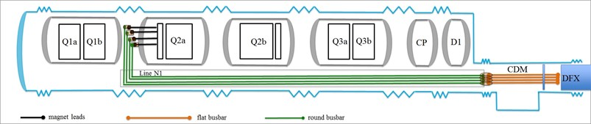
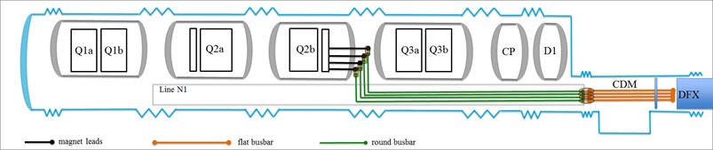
Triplet corrector: 2 kA RCBXFB busbar
H. Prin and D. Duarte Ramos
Estimate of required Cu cross-section, assuming Cu/SC=1.7, RRR=100
t_{det}+t_{eval} [s] | τ [s] | MIITs [MA²s] | A_{Cu} for 100 K [mm²] | A_{Cu} for 150 K [mm²] | A_{Cu} for 200 K [mm²]
500 | 4 | 10 | 8.5 | 7.6 | 7.1

Slide 28
Triplet corrector: RCBXFB busbars
The RCBXFA/B flat busbar comprises 18 Nb-Ti strands (d=0.48 mm, Cu/SC=1.75) shunted with a copper stabiliser (4.35 x 1.5 mm²). So: A_{Cu}=8.6 mm², A_{SC}=1.2 mm².
U_{thres} | 10 mV
t_{eval} | 0.5 s
I | 1730 A
RRR | 80
B_{a} | 0.5 T
R_{crowbar} | 30 mΩ
R_{warm leads} | 1.6 mΩ
τ_{circuit} | 4 s
Cooling to He | No
MIITs | 7.6 MA²s
Hot-spot temp. | 119 K
Simulations by M. Mentink, see https://edms.cern.ch/document/2222740 (Aug 2019).
Various scenario’s have been simulated, such as:
Additional joint resistance,
Local areas without cooling,
Electrical separation between Ruth cable and the Cu stabiliser.
For all cases the hot-spot remained below 120 K.
The round busbar will probably be the same as the LHC 6 kA bus (A_{Cu}=8 mm², A_{SC}=0.5 mm²), which would lead to hot-spots of about 175 K.

Slide 29
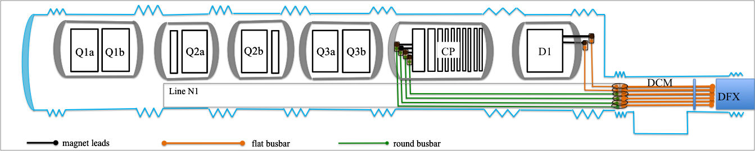
Triplet corrector: 2 kA RCBXFA busbar
H. Prin and D. Duarte Ramos
The flat and round busbars of the RCBXFA will be the same as for the RCBXFB.
t_{det}+t_{eval} [s] | Current [A] | τ [s] | MIITs [MA²s] | Thot-spot for flat busbar [K] | Thot-spot for round busbar [K]
500 | 1700 | 0.8 | 3.6 | 51 | 56
Upon quench detection, the EE will be switched in, resulting in fast current decay, much lower MIITs (than RCBXFB), and hence lower hot-spot, <60 K.

Slide 30
Contents
General strategy for quench protection & detection
MgB₂ link and leads
Triplet
  Triplet: mains
  Triplet: RCBXFA/B correctors
  Triplet: High-order superferric correctors
RBXF (D1)
RBRD (D2)
RCBRD (D2 orbit correctors)
RB.A67 and RB.A78 including the MBH (11 T dipole)
Hollow e-lens

Slide 31
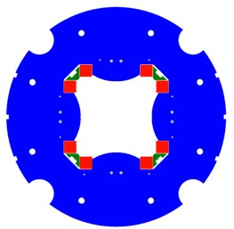
Triplet corrector: RQSXF
Nr of circuits | 4
Magnets per circuit | 1x MQSXF (skew quadrupole)
Magn. length | 0.41 m
I_{nom} | 174 A
L_{diff} at I_{nom} | 1.53 H
E_{stored} at I_{nom} | 31 kJ
Conductor | 0.7 mm Nb-Ti strand, Cu/SC=2.3
Protection | EE
WRFS | none
Skew quadrupole cross-section
(M. Sorbi, M. Statera et al.)

Slide 32
Triplet corrector: RQSXF
Initial magnet simulation results at I_{ult} were presented at the WP3 meeting on 28/6/2017 by V. Marinozzi (INFN) using QLASA software, see https://indico.cern.ch/event/647416/
Without EE, the hot-spot in MQSXF magnet would go up to 132 K, but the peak U_{coil-to-gnd} would go to 633 V.
The baseline is therefore to include EE with grounding in the centre, resulting in a total resistive voltage of 287 V. Simulations should be done to obtain a realistic value for the maximum U_{coil-gnd}.
The table below shows recently updated numbers, presented on 19/6/2019 by M. Statera, for I_{nom} and realistic RRR, see https://indico.cern.ch/event/813962/ .
R_{EE} | 1.5 Ω
T_{hot-spot} | <145 K
Total resistive voltage over the coil | 235 V

Slide 33
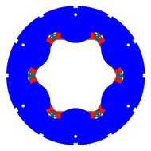
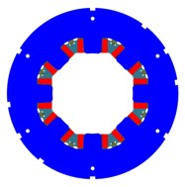
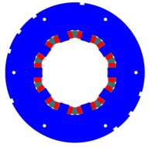
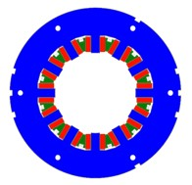
Triplet HO correctors: sext, oct, deca, dodeca
 | RCS(S)XF | RCO(S)XF | RCD(S)XF | RCT(S)XF
Nr of circuits | 8 | 8 | 8 | 8
Magnets per circuit | 1x MCS(S)XF (skew) sextupole | 1x MCO(S)XF (skew) octupole | 1x MCD(S)XF (skew) decapole | 1x MCT(S)XF (skew) dodecapole
Magn. length | 0.168 m | 0.145 m | 0.145 m | 0.469 / 0.099 m
I_{nom} | 99 A | 102 A | 92 A | 85 A
L at I_{nom} | 350 mH | 300 mH | 160 mH | 1000 / 210 mH
E_{stored} at I_{nom} | 1.7 kJ | 1.6 kJ | 0.68 kJ | 3.6 / 0.74 kJ
Conductor | 0.5 mm Nb-Ti strand, Cu/SC=2.3
Protection | Self protection
WRFS | none
M. Sorbi, M. Statera et al.

Slide 34
Triplet HO correctors: sext, oct, deca, dodeca
Initial magnet simulation results at I_{ult} were presented at the WP3 meeting on 28/6/2017 by V. Marinozzi (INFN) using QLASA software, see https://indico.cern.ch/event/647416/
Considering the MIITs calculated by INFN, M. Mentink cross-checked some of the simulation results, see https://edms.cern.ch/document/2222621 .
The table below shows recently updated numbers, presented on 19/6/2019 by M. Statera, for I_{nom} and realistic RRR, see https://indico.cern.ch/event/813962/ .
 | RCS(S)XF | RCO(S)XF | RCD(S)XF | RCTSXF | RCTXF
T_{hot-spot} | 141 K | 164 K | 149 K | 150 K | 175 K
U_{coil-to-gnd} | 39 K | 46 V | 18 V | 19 V | 90 V
Independent MIITs simulations are foreseen by M. Wilczek.
Conclusion: hot-spots remain <170 K, provided that the length of the bare conductor in the connection box is less than 16 mm.
Voltages to be used for the definition of the VWL are between 18 and 90 V.

Slide 35
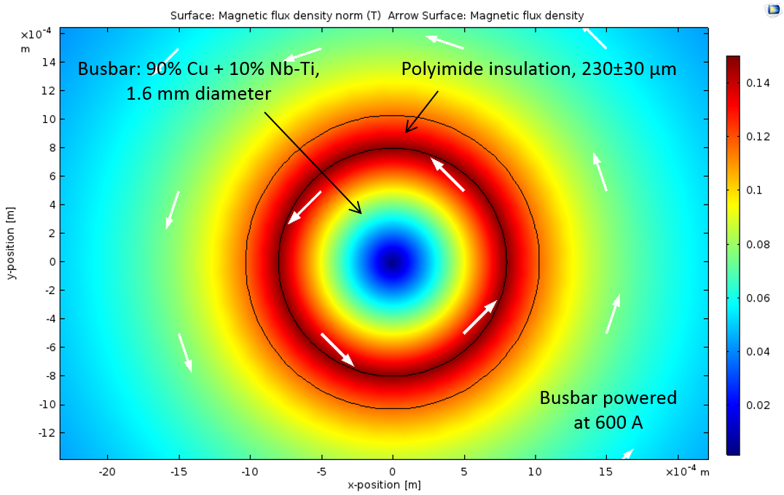
Triplet HO correctors: busbar
The baseline for the busbar is the LHC auxiliary N-line busbar with:
A_{Cu}=1.8 mm²
A_{SC}=0.2 mm².
Simulations done by M. Mentink, see https://edms.cern.ch/document/1897052
The N-line busbar is cryostable for currents below 200 A.

Slide 36
Contents
General strategy for quench protection & detection
MgB₂ link and leads
Triplet
  Triplet: mains
  Triplet: RCBXFA/B correctors
  Triplet: High-order superferric correctors
RBXF (D1)
RBRD (D2)
RCBRD (D2 orbit correctors)
RB.A67 and RB.A78 including the MBH (11 T dipole)
Hollow e-lens

Slide 37
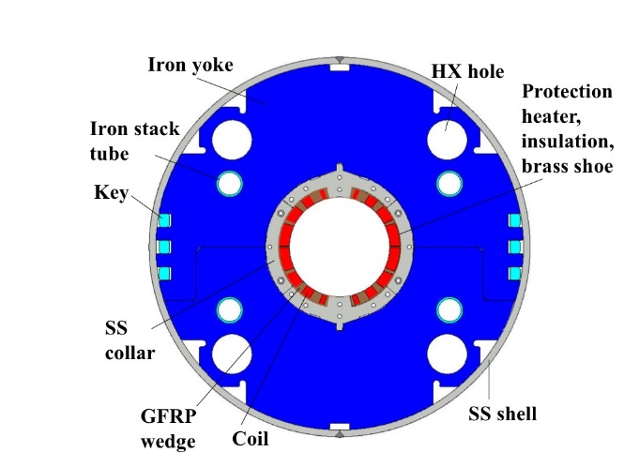
RBXF (D1)
Nr of circuits | 4
Magnets per circuit | 1x MBXF (KEK)
I_{nom} | 12047 A
L at I_{nom} | 27 mH
E_{stored} at I_{nom} | 1.9 MJ
Conductor | LHC dipole outer cable (36 strands, 0.825 mm, Cu/SC=1.95)
Protection | 8 QH’s in 4 circuits
WRFS | Failure of 2 QH circuits
D1 cross-section
(T. Nakamoto, M. Sugano et al.)

Slide 38
RBXF (D1)
Most recent reference for the D1 magnet protection given by KEK (Sept 2018), see https://indico.cern.ch/event/759386/
Review 11-13 Mar 2019: https://indico.cern.ch/event/790845/contributions/3287033/
U_{thres}=100 mV, t_{eval}=10 ms. Quench at peak field.
 | Default case | 1 QH circuit failing (2 QH strips) | 2 QH circuits failing (4 QH strips)
I_{nom} | 12047 A
Max U_{coil-gnd} | 200 V | 250 V | 400 V
 | Default case | 1 QH circuit failing (2 QH strips) | 2 QH circuits failing (4 QH strips)
I_{ult} | 13000 A
MIITs at 13 kA | 23.9 MA²s | 25 MA²s | 27.8 MA²s
T_{hot-spot} | 180 K | 195 K | 240 K
Maximum voltage to be used to define the VWL is 400 V.

Slide 39
RBXF: 13 kA busbars
H. Prin and D. Duarte Ramos
Estimate of required Cu cross-section, assuming Cu/SC=1.95, RRR=100
t_{det}+t_{eval} [s] | τ [s] | MIITs [MA²s] | A_{Cu} for 100 K [mm²] | A_{Cu} for 150 K [mm²] | A_{Cu} for 200 K [mm²]
400 | 0.35 | 97 | 27.5 | 24.4 | 22.7
500 | 0.35 | 114 | 29.8 | 26.4 | 24.6
600 | 0.35 | 131 | 32 | 28.3 | 26.4

Slide 40
13 kA D1 and D2 busbars
The flat busbar is the Rutherford LHC dipole outer-layer cable (36 strands, d_{str}=0.825 mm, Cu/SC=1.95) stabilised with a 1.5x15.1 mm² Cu strip.
So : A_{Cu}=35 mm² and A_{SC}=6.5 mm².
The hot-spot in this busbar is calculated by M. Mentink, see https://edms.cern.ch/document/2110653 , assuming U_{thr}=10 mV and t_{eval}=500 ms, varying:
RRR,
self-field,
cooling conditions,
joint resistance,
expansion loop (1 m long without bonding between cable and strip)
quench current.
The D2 circuit will use the same busbar as the D1, and will have similar MIITs of about 28 MA²s at ultimate current.
A highest hot-spot of 104 K is obtained in both the D1 and D2 busbar

Slide 41
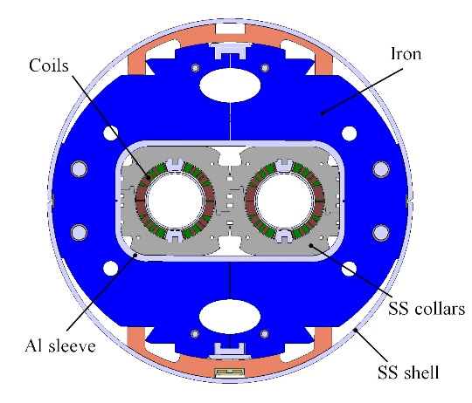
Contents
General strategy for quench protection & detection
MgB₂ link and leads
Triplet
  Triplet: mains
  Triplet: RCBXFA/B correctors
  Triplet: High-order superferric correctors
RBXF (D1)
RBRD (D2)
RCBRD (D2 orbit correctors)
RB.A67 and RB.A78 including the MBH (11 T dipole)
Hollow e-lens
D2 cross-section
(P. Fabbricatore, S. Farinon et al.)

Slide 42
RBRD (D2)
Nr of circuits | 4
Magnets per circuit | 1x MBRD (INFN)
I_{nom} | 12328 A
L at I_{nom} | 30 mH
E_{stored} at I_{nom} | 2.26 MJ
Conductor | LHC dipole outer cable (36 strands, 0.825 mm, Cu/SC=1.95)
Protection | 16 QH’s in 8 circuits. 4 circuits used (1, 3, 6, 8)
WRFS | Failure of 1 QH circuit

Slide 43
RBRD (D2)
P. Fabbricatore Aug 2019, see: https://edms.cern.ch/ui/file/2222536
 | Default case | 1 QH circuit failing (2 QH strips) | 2 QH circuits failing (4 QH strips)
U_{thres} | (100 mV)
t_{eval} | (10 ms)
I | 12 kA
Quench origin | (High field)
T_{hot-spot} | 218 K | 250 K | 302 K
Max U_{coil-gnd} | 130 V | 525 V | 483-779 V *
*: 483 V if 2 QH’s fail in different apertures, 779 V if they fail in the same aperture
Cross-check by S. Izquierdo Bermudez in May 2018 (non-published)
T_{hot-spot} | 205 K | 230 K | -
Max U_{coil-gnd} | 120 V | 490 V | -
525 V is the reference voltage to be taken into account for the definition of the VWL.

Slide 44
Contents
General strategy for quench protection & detection
MgB₂ link and leads
Triplet
  Triplet: mains
  Triplet: RCBXFA/B correctors
  Triplet: High-order superferric correctors
RBXF (D1)
RBRD (D2)
RCBRD (D2 orbit correctors)
RB.A67 and RB.A78 including the MBH (11 T dipole)
Hollow e-lens

Slide 45
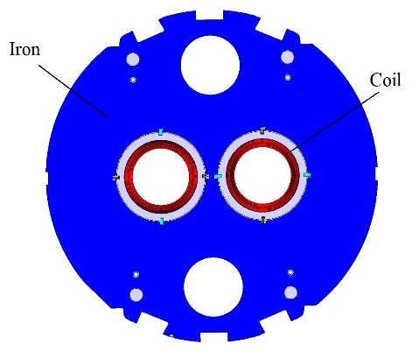
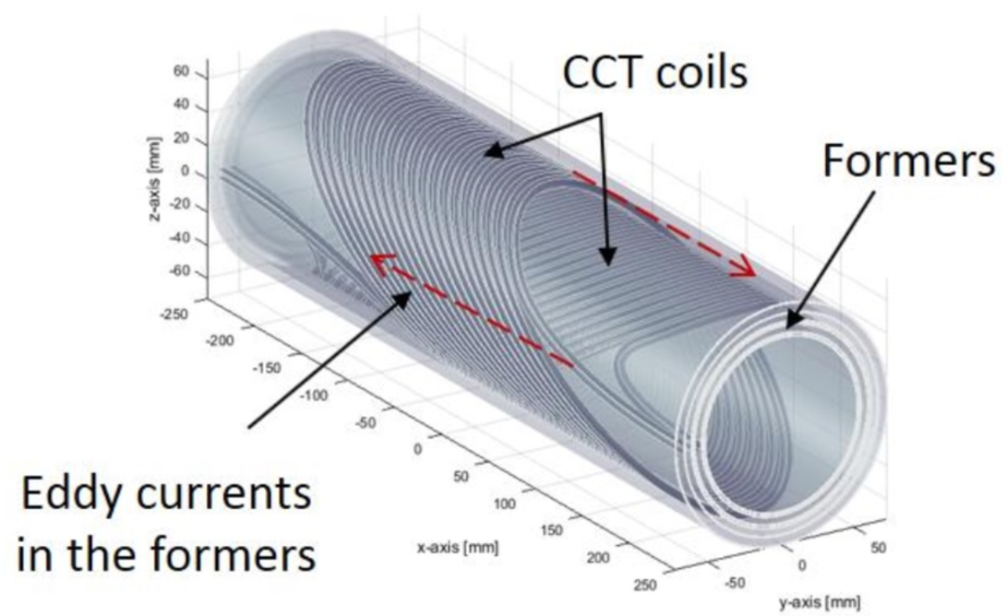
RCBRD (D2 orbit corr)
Nr of circuits | 16
Magnets per circuit | 1x MCBRD (CERN or IHEP)
I_{nom} | 394 A / 425 A
I_{ult} | 435 A / 470 A
L at I_{nom} | 0.97 H per aperture
E_{stored} at I_{nom} | 75 kJ per aperture
Conductor | CERN: 0.825 mm, Cu/SC=1.95 IHEP: 0.825 mm, Cu/SC=1.3
Protection | EE + quenchback
WRFS | none
D2 corrector cross-section
(G. Kirby et al.)

Slide 46
RCBRD (D2 orbit corr)
Most recent reference for the MCBRD CCT magnet protection:
1) M. Mentink using STEAM-BBQ and ProteCCT, see https://edms.cern.ch/document/2222746/
2) Qingjin XU (IHEP) at WP3 meeting on 6/3/2019, see https://indico.cern.ch/event/801069/
Variant | CERN | IHEP | IHEP
Reference | 1) | 1) | 2)
U_{thres} | 100 mV | 100 mV | 100 mV
t_{eval} + t_{switch} | 10 + 10 ms | 10 + 2 ms | 10 + 2 ms
I_{ult} | 435 A | 435 A | 470
Strand RRR | 230 | 230 | 100
Former RRR | 8 | 8
R_{EE} | 1.5 Ω / 1.29 Ω / var | 1.5 Ω / 1.29 Ω / var | 1.4 Ω / var
T_{hot-spot} | 143 / 160 / 167 K | 156 / 177 / 192 K | 249 K / 252 K
U_{coil-gnd} | 651 / 562 / 439 V | 651 / 562 / 439 V | 658 V / 496 V
With the actual baseline of 1.5 Ω, the maximum hot-spot and voltage will be about 150 K and 650 V (590 V at I_{nom}). Reduction of the EE resistance or the use of a varistor could give a significant reduction of the voltage while still keeping the hot-spot <200 K.

Slide 47
RCBRD busbar
The baseline for the RCBRD busbar is the LHC auxiliary N-line busbar with:
A_{Cu}=1.8 mm²
A_{SC}=0.2 mm²
Simulations have been performed by M. Mentink, see: https://edms.cern.ch/document/2222746/
The total MIITs, including detection, validation, and current discharge remain in all cases (varying current and RRR) below 174 kA²s, corresponding to a hot-spot well below 100 K.

Slide 48
Contents
General strategy for quench protection & detection
MgB₂ link and leads
Triplet
  Triplet: mains
  Triplet: RCBXFA/B correctors
  Triplet: High-order superferric correctors
RBXF (D1)
RBRD (D2)
RCBRD (D2 orbit correctors)
RB.A67 and RB.A78 including the 11-T MBH (aka modified RB)
Hollow e-lens

Slide 49
RB with MBH
Nr of circuits | 2 (L/R Pt 7)
Magnets per circuit | 2 x MBH (CERN)
I_{nom} | 11850 A
L at I_{nom} | 130 mH (per assembly)
Stored energy at I_{nom} | 9.1 MJ
Conductor | Nb₃Sn Rutherford
Protection | 32 QH’s per assembly in 16 circuits
WRFS | Failure of 2 QH circuits
The magnet and circuit have seen several modifications over the last years that have an impact on the protection. Since T_{hot-spot} and V_{coil-gnd} are relatively high, even small variations in the design or in some parameters can have an important impact.
Simulations are really numerous due to large number of combinations between quench current, quench location, protection settings, RRR and Cu/Sc distributions, failure scenario’s, etc.
Simulations are still ongoing for the most updated set of parameters.

Slide 50
RB with MBH
Nominal current of 11850 A, impregnated QH’s
Cu/SC=1.15, strand RRR=100, U_{thres}=100 mV, t_{det}=5 ms*, t_{eval}=10 ms
* See: S. Izquierdo Bermudez, https://ieeexplore.ieee.org/stamp/stamp.jsp?arnumber=8272459
MBH magnet studies WITHOUT EE, t_{QH}=5 ms: carried out by S. Izquierdo Bermudez and A. Fernandez Navarro, see https://indico.cern.ch/event/778100 (11 T review, 11 Jan 2019)
Simulation code | Roxie | TALES
 | No QH failing | No QH failing | 1 QH circuit failing | 2 QH circuits failing
T_{hot-spot} [K] | 310 | 320 | 327 | 333
U_{coil-gnd} [V] | 350 | 245 | 570 | 950
CIRCUIT studies WITH EE, t_{QH}=2 ms: carried out by M. Maciejewski, see: https://edms.cern.ch/document/2157321
Simulation code |  | STEAM: LEDET+PSPICE
 |  | No QH failing | 1 QH circuit failing | 2 QH circuits failing
T_{hot-spot} [K] |  | 293 | 299 | 305
U_{coil-gnd} [V] |  | 783 | 1038 | 1457
T_{hot-spot} at max U_{coil-gnd} [K] |  | 166 | 150 | 210

Slide 51
RB with MBH
Ultimate current of 12850 A, impregnated QH’s
Cu/SC=1.15, strand RRR=100, U_{thres}=100 mV, t_{det}=5 ms, t_{eval}=10 ms
MBH magnet studies WITHOUT EE, t_{QH}=5 ms: carried out by S. Izquierdo Bermudez and A. Fernandez Navarro, see https://indico.cern.ch/event/778100 (11 T review, 11 Jan 2019)
Simulation code | Roxie | TALES
 | No QH failing | No QH failing | 1 QH circuit failing | 2 QH circuits failing
T_{hot-spot} [K] | 350 | 340 | 349 | 356
U_{coil-gnd} [V] | 450 | 340 | 680 | 1070
CIRCUIT studies WITH EE, t_{QH}=2 ms: carried out by M. Maciejewski, see: https://edms.cern.ch/document/2157321
Simulation code |  | STEAM: LEDET+PSPICE
 |  | No QH failing | 1 QH circuit failing | 2 QH circuits failing
T_{hot-spot} [K] |  | 322 | 327 | 332
U_{coil-gnd} [V] |  | 974 | 1217 | 1600
T_{hot-spot} at max U_{coil-gnd} [K] |  | 180 | 170 | 176

Slide 52
RB with MBH
Cu/SC ratio and RRR have an important impact on the quench behaviour, especially on the voltage distribution.
We have recently received the info that realistic variations for the production are Cu/SC=1.17-1.21 and RRR=150-200.
Simulations have been redone with STEAM using these new average values, see next slide.
Similar to the triplet circuit, also the variation in Cu/SC and RRR among the coils in the 11 T assemblies will have a significant impact on the voltage distribution. Simulations are ongoing.
Similar to the triplet circuit, it will be important to optimise the coil order in the MBH assembly to reduce the voltages as much as possible.

Slide 53
Modified RB
U_{thres}=100 mV, t_{det}=5 ms, t_{eval}=10 ms, t_{QH}=2 ms, impregnated QH’s
CIRCUIT studies at 11850 A, WITH EE
Simulations by M. Maciejewski, see: https://edms.cern.ch/document/2157321 using STEAM: LEDET + PSPICE
 | Cu/SC=1.15, strand RRR=100
 | No QH failing | 1 QH circuit failing | 2 QH circuits failing
T_{hot-spot} [K] | 293 | 299 | 305
U_{coil-gnd} [V] | 783 | 1038 | 1457
T_{hot-spot} at max U_{coil-gnd} [K] | 166 | 150 | 210
 | Cu/SC=1.19, strand RRR=175
 | No QH failing | 1 QH circuit failing | 2 QH circuits failing
T_{hot-spot} [K] | 287 | 294 | 307
U_{coil-gnd} [V] | 660 | 1005 | 1469
T_{hot-spot} at max U_{coil-gnd} [K] | 150 | 174 | 148

Slide 54
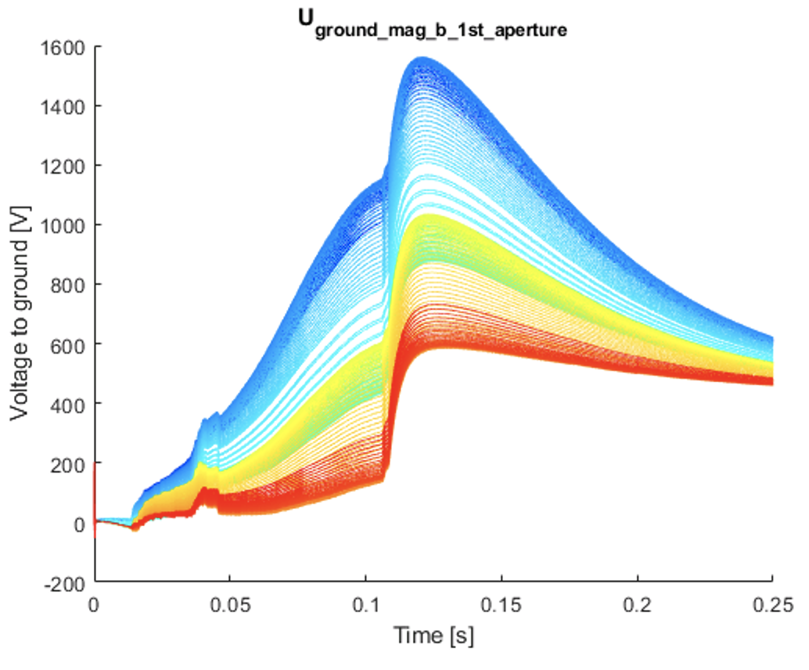
Modified RB
Simulations before consider impregnated heaters. Using external heaters (with 60 um fiberglass wrap) will increase the hot-spot by about 30 K, see F. Savary https://indico.cern.ch/event/778100/contributions/3270000
The maximum U_{coil-gnd} occurs when the local coil temperature is 150-200 K. It is therefor important that the VWL is also tested in this temperature range, see talk F. Rodriguez-Mateos.

Slide 55
Contents
General strategy for quench protection & detection
MgB₂ link and leads
Triplet
  Triplet: mains
  Triplet: RCBXFA/B correctors
  Triplet: High-order superferric correctors
RBXF (D1)
RBRD (D2)
RCBRD (D2 orbit correctors)
RB.A67 and RB.A78 including the MBH (11 T dipole)
Hollow e-lens

Slide 56
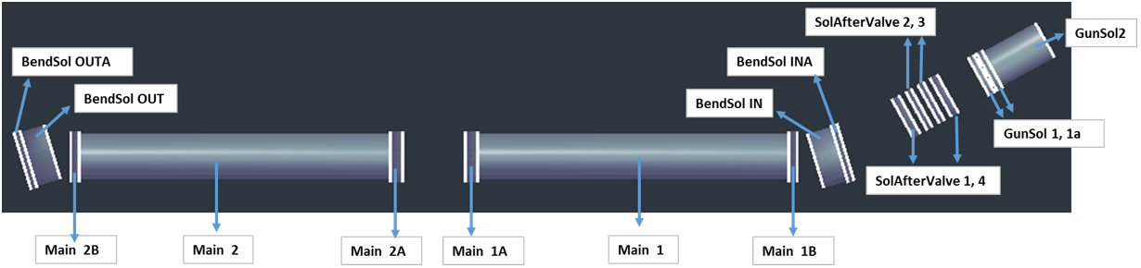
Hollow e-lens
D. Perini and M. Maciejewski at the HL-LHC TCC on 18/4/2019, see https://indico.cern.ch/event/814368/
BendSol
GunSol-2
MainSol-2
MainSol-1
GunSol-1
Quench strategy:
Targets: T_{hot-spot} < 200 K and V_{gnd} < 500 V
EE for each circuit
Assume U_{thr}=100 mV, t_{eval}=10 ms

Slide 57
Hollow e-lens
D. Perini and M. Maciejewski, https://indico.cern.ch/event/814368/
Variant | GunSol-1 | GunSol-2 | BendSol | MainSol-1 & 2
I_{nom} [A] | 320 | 257 | 335 | 330
L [H] | 0.81 / 0.92 | 0.83 / 0.97 | 2.1 / 2.4 | 8.9 / 9.1
E_{stored} [kJ] | 47 | 32 | 135 | 494
B_{nom} [T] | 3.1 | 3.7 | 3.5 | 5
R_{EE} [Ω] | 0.6 (0.2-1.5) | 0.6 (0.12-1.9) | 0.9 (0.65-1.5) | 2.6 (2.5-3.0)
T_{hot-spot} | 70 (200-45) | 55 (200-40) | 130 (200-70) | 175 (200-140)
V_{coil-gnd} | 190 (60-500) | 150 (40-500) | 300 (220-500) | 430 (410-500)
Hot-spots <200 K and maximum U_{coil-gnd} <500 V.
Grounding at the neg. terminal of the converter, except in the MainSol circuits, which should have the grounding in the middle of the EE resistor, to be confirmed with EPC.
Busbar protection should not be an issue since all circuits have EE.
Possibly the two circuits with lower E_{stored} could be self-protected.
Further optimisation might be possible (e.g. adding parallel resistors).

Slide 58
Overview, for I=I_{nom}
 | T_{hot-spot} [K] |  | V_{coil-gnd} at I_{nom} [V] |  | Remarks
 | Nominal | WRFS | Nominal | WRFS
RQX | 231 | 372 | 600 | 660
RCBXFA | 147 | - | 490 | -
RCBXFB | 212 | - | 375 | - | Possibly outer with EE
RQSXF | 145 | - | 235 | - | Cross-check not yet made by CERN
HO triplet correctors | 141-175 | - | 18-90 | -
RBXF (D1) | 180 | 240 | 200 | 400
RBRD (D2) | 200-250 | 302 | 120-150 | 525
RCBRD (orbit corrector D2) | <140 | - | 590 | - | Reduction of the EE resistor value or use of varistor could be considered as long as quench back is guaranteed
RB with MBH | 287 | (307) | 660 | (1470) | Non-uniform distribution of Cu/SC and RRR not yet taken into account
Hollow e-lens | 55-175 | - | 150-430 | - | Preliminary results

Slide 59
Overview MgB₂ link and busbars
 | T_{hot-spot} [K] | Remarks
MgB₂ leads | <45
RQX - flat busbar | <110
RQX - round busbar | <100
RCBXFA orbit corrector | <60
RCBXFB orbit corrector – flat busbar | <120
RCBXFB orbit corrector – round busbar | <175 | Possibly add 20% Cu
RQSXF | cryostable
HO triplet correctors | cryostable
RBXF (D1) | <105
RBRD (D2) | <105
RCBRD (orbit corrector D2) | <100
BTW: 10 years of LHC have shown that most short-to-grounds occur in the busbar system. Add sufficient insulation and stay away from (sharp) metallic objects.

Slide 60
Conclusion
During the design phase of the HL-LHC magnets and circuits, the protection behaviour is simulated by CERN and by external institutes. For the more critical circuits also Worst Realistic Failure Scenario’s have been considered.
As soon as model magnets are produced, comparison with experimental data is necessary, keeping however in mind that the measurements usually give average values, such as I(T), MIITs, V_{coil}, whereas the local U_{coil-gnd}, U_{coil-QH}, and T_{hot-spot} are key for protection.
It is important to keep the conductor parameters, especially Cu/SC and RRR, as uniform as possible during the production of the Nb₃Sn conductors for the triplet and MBH, in order to reduce voltage imbalance and hence U_{coil-gnd}.
In case of variations in Cu/SC and RRR, optimising the positioning of the coils in the Nb₃Sn magnets is beneficial to lower the U_{coil-gnd}.
Reliability of CLIQ is very important since it reduces the hot-spot considerably.
The Nb₃Sn magnets see the maximum U_{coil-gnd} at rather elevated temperatures of 80-200 K. It is important that this is reflected in the definition of the VWL’s.
PS: It would be useful to design the protection of Nb₃Sn magnets based on a ‘maximum thermal-strain’ criterion (besides a ‘maximum hot-spot’ criterion).

Slide 61
Annex slides

Slide 62
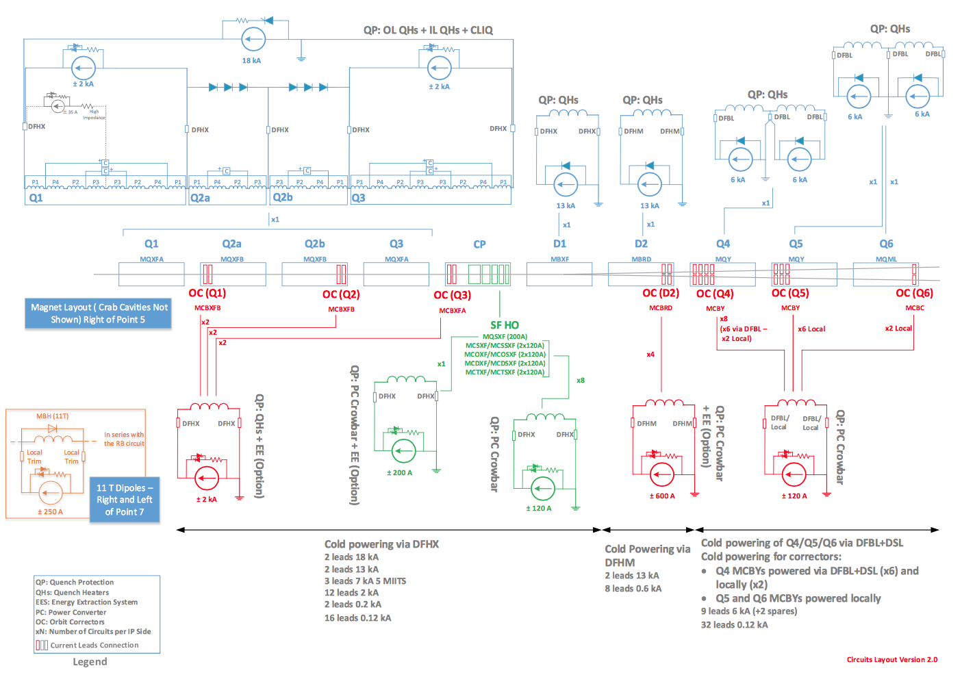

Slide 63
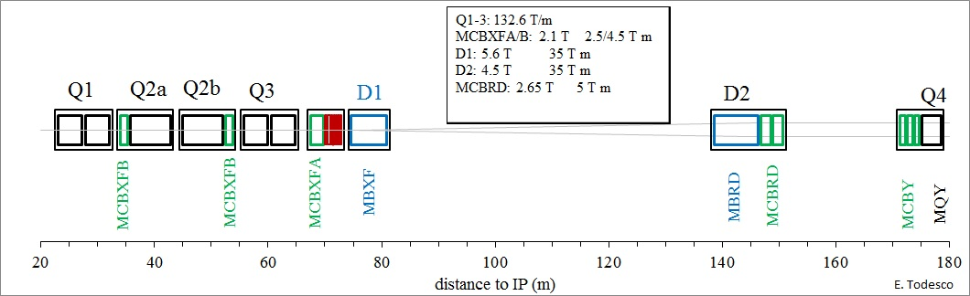
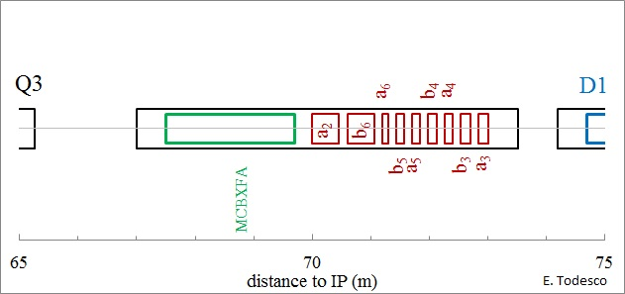
Annex

Slide 64
Overview circuits
Conceptual design review of the magnet circuits for the HL-LHC, 21-23 March 2016, https://indico.cern.ch/event/477759/
Circuit review 2017: 17 Mar 2017, https://indico.cern.ch/event/611018/timetable/
International Review of the Conceptual Design of the Cold Powering System for the HL-LHC Superconducting Magnets, 3-4 July 2017, https://indico.cern.ch/event/643197/
International review on the Inner Triplet Quadrupoles fo HL-LHC, 15-17 July 2019,
https://indico.cern.ch/event/828604/

