Slide 1

Quench detection, related hardware and required instrumentation
R. Denz for WP7
Particular thanks to the quench detection core team: F. Boisier, D. Calcoen V. Froidbise, S. Georgakakis, S. Haas, S. Mundra, T. Podzorny, J. Spasic, J. Steckert
HL-LHC Circuits Review, September 9-10, 2019

Slide 2
Outline
HL-LHC quench detection and related hardware
HL-LHC quench detection systems (QDS)
HL-LHC circuit instrumentation
HL-LHC protection device supervision and triggering
HL-LHC data acquisition & supervision for QDS
Summary

Slide 3
Quench Detection and Related Hardware
HL-LHC quench detection systems (QDS)
  Superconducting magnets and bus-bars, HTS hybrid current leads, superconducting cable links
  Serve as a data acquisition system and interface to QPS supervision
Protection device supervision units (PDSU)
  Distribute QDS trigger signals to protection devices
    Quench heater discharge power supplies (HDS), coupling loss induced quench (CLIQ )
  Provide interlocking and re-trigger capability in case of spurious triggers of protection devices
  Acquire signals from protection devices for post mortem event analysis

Slide 4
HL-LHC Quench Detection Systems
For the HL-LHC QDS a unified approach, the Universal Quench Detection System (UQDS) has been proposed
  Emphasis on the protection of Nb₃Sn magnets and MgB₂ based superconducting cable links
  Flexible and generic system, which can be easily configured according to the requirements of a superconducting element or circuit
Key elements of the UQDS architecture are the analogue front-end channels equipped with a high-resolution analogue to digital converters and the core of the system, the versatile digital platform based on a field programmable gate array (FPGA)
  The FPGA processes the acquired data and executes the quench detection algorithms
A part from the enhanced capabilities for quench detection, the integrated data acquisition system offers significantly higher sampling rates and resolution than previously installed systems.

Slide 5
QDS for HL-LHC: Conceptual Design
Fully redundant architecture → each system consists of two independent units with interlocks in a wired OR configuration

Slide 6
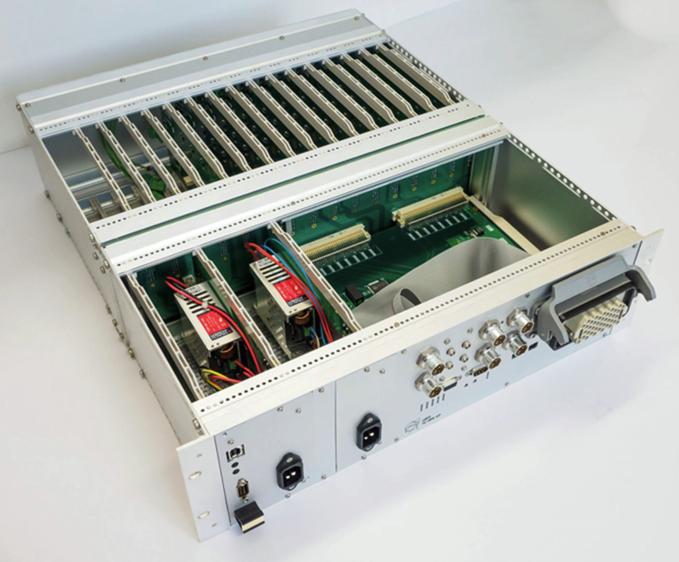
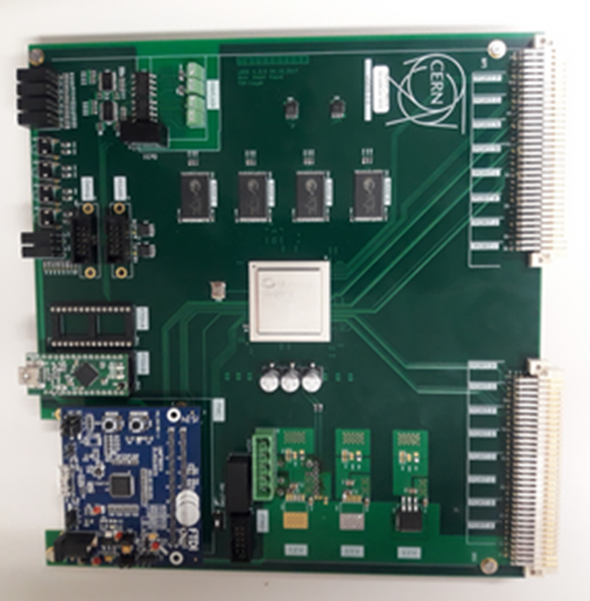
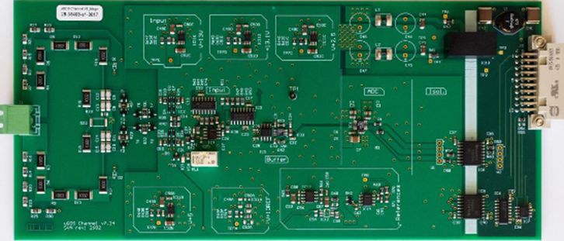
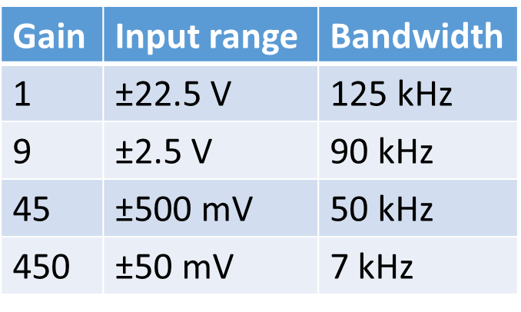

Universal Quench Detection System (UQDS)
aa
UQDS v2.1 crate serving as the base line prototype for the HL-LHC quench detection system.
The core of the system, the FPGA based versatile digital platform
Analog front-end channel (16/32 per UQDS crate).
200 Gy, 10 Gy per year, no single event upsets

Slide 7
UQDS: Firmware
The UQDS functionality is to a very large extent software defined
The firmware is implemented in the FPGA using the VHDL hardware description language
  FPGA architecture allows parallel execution of tasks e.g. the readout of the analog input stages
  The controlled execution of the quench detection algorithm is assured by a finite state machine
Modular firmware structure using standardized verified functional blocks
  Simplified firmware creation process based on scripts defining hardware constraints and required quench detection functionality

Slide 8
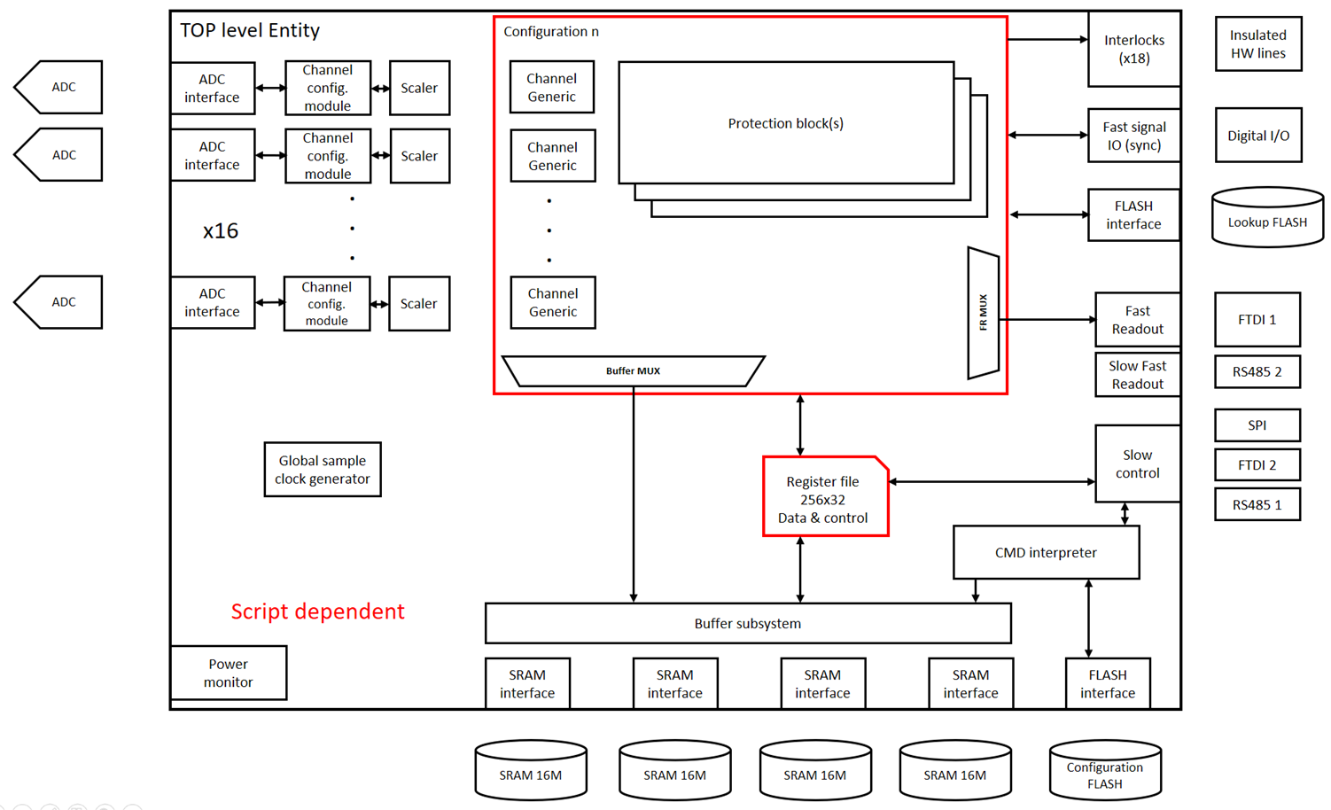
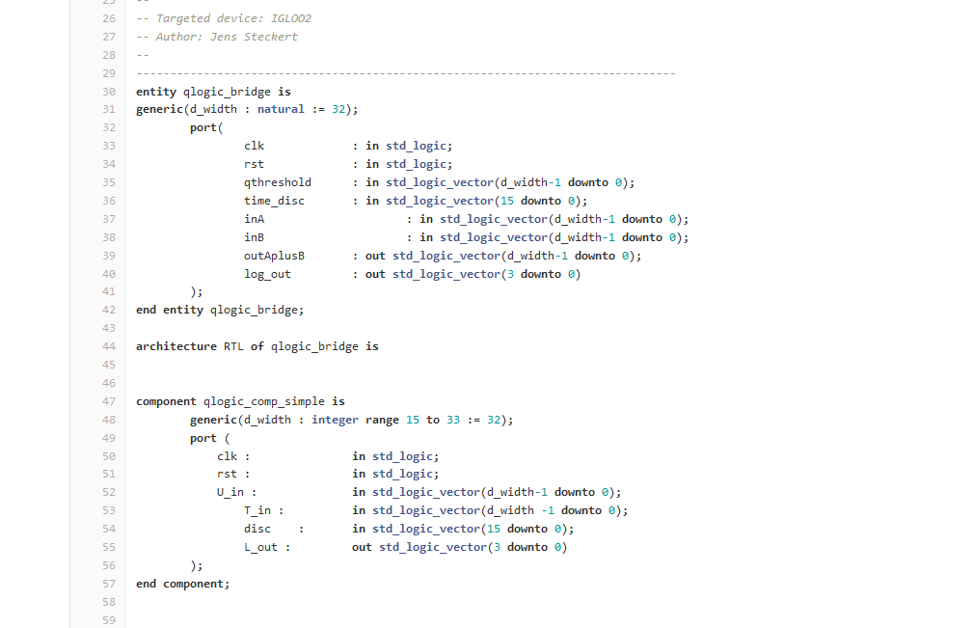
UQDS: Firmware Structure

Slide 9
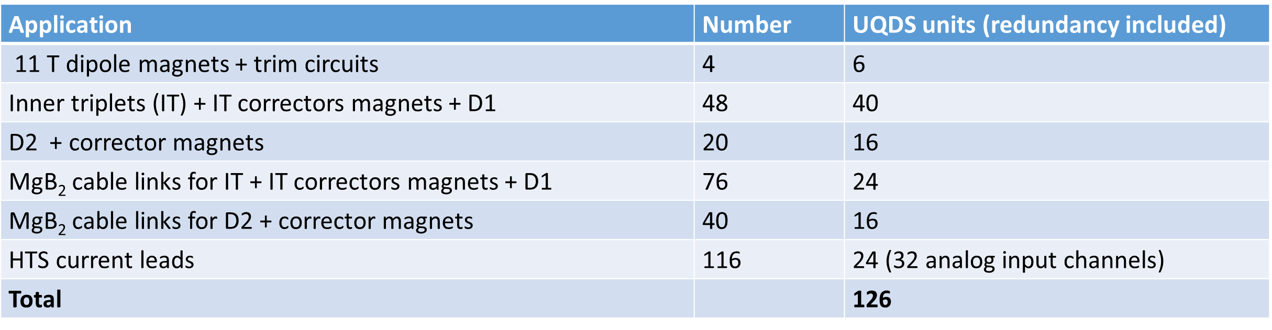
UQDS Implementation
Within the HL-LHC project, UQDS systems will be used for all new magnets requiring active quench detection, the superconducting cable links and hybrid HTS current leads
  Covers 72 superconducting circuits
  The installation of the quench detection systems for the 11 T Nb₃Sn dipoles is currently in preparation; hardware procurement has been started

Slide 10
UQDS Applications
After the completion of the R&D phase including an exhaustive type test campaign, the first systems were deployed on the SM18 magnet test benches
  The deployment of HL-LHC quench detection systems on the magnet test benches, allows to identify and overcome possible problems at an early stage prior to installation.
UQDS systems serve as well as quench detection system for the B180/FAIR magnet test bench and will be deployed for the upgrade of the FRESCA I and II superconducting cable test facilities

Slide 11
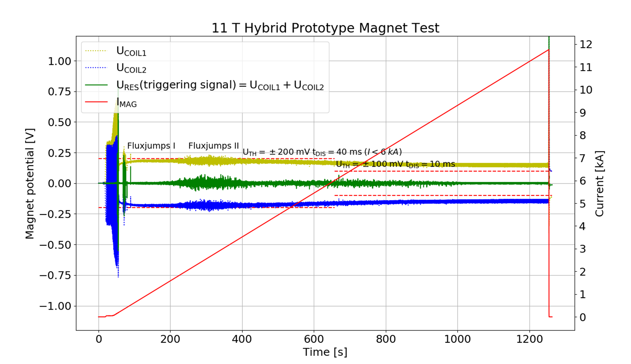
UQDS – 11 T Hybrid Prototype Magnet
Recorded data of a training quench of a 11 T hybrid prototype magnet at I = 11762 A. The UQDS system has been configured with current depended detection settings to overcome the flux jump region at low currents.

Slide 12
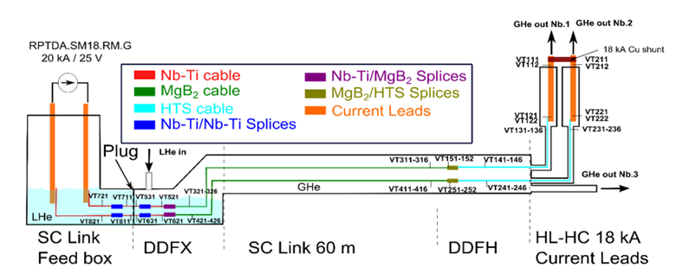
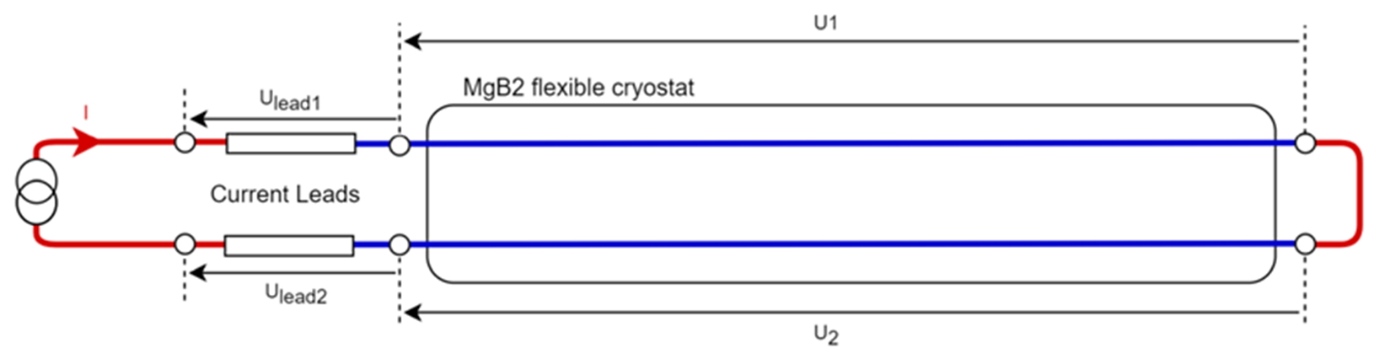
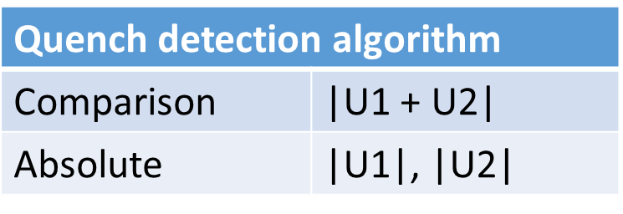
UQDS – 18 kA MgB₂ Cable Link
Type test of the 60 m 18 kA prototype MgB₂ cable link confirmed the design of the quench detection system
Validation with inductive loads e.g. for assessing possible cross talk still pending (→ IT string)

Slide 13
HL-LHC circuit instrumentation
Circuit instrumentation is crucial for the proper functioning and performance of the quench detection system
  Not easy to change after installation; one needs to get it right from the very beginning
  Base-line for the definition of the quench detection logic
All voltage taps used for quench detection are redundant
Circuit current is measured either by a dedicated current sensor or acquired from the power converter current signal (if available)
  Protection of Nb₃Sn magnets requires current dependent detection settings
The installation of the novel current derivative sensors remains optional
  Requested for insertion region quads as soon as available

Slide 14
HL-LHC QDS Instrumentation Baseline
Instrumentation must provide all information required for quench detection and diagnostic purposes
  Requirements from beam physics e.g. implementation of feed back algorithms must be taken into account
  All quench detection systems are equipped with integrated broken wire detection → activates device interlocks
Every pole of a magnet is instrumented
  QDS system measures the voltage over each pole of a magnet using an isolated channel
Internal magnet bus-bars are covered by overlapping voltage taps for the poles
Bus-Bars between magnets and magnets to superconducting cable links are covered by dedicated, isolated channels

Slide 15
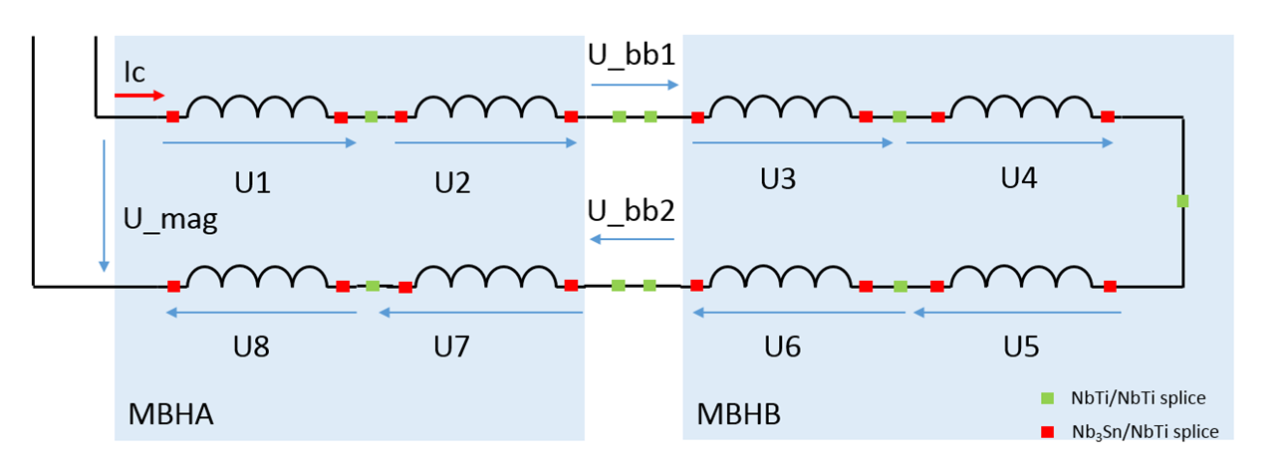
QDS Instrumentation MBH
8 x pole voltages for asymmetric and symmetric quench detection
2 x interconnection bus-bar for bus-bar protection
1 x total magnet voltage (for diagnostics)
1 x circuit current for the implementation of current depending detection settings
2 x fully redundant UQDS units
+ Trim circuit current lead and bus-bar protection systems

Slide 16
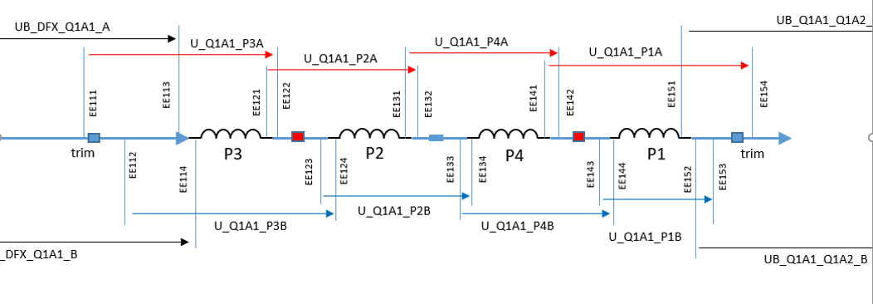
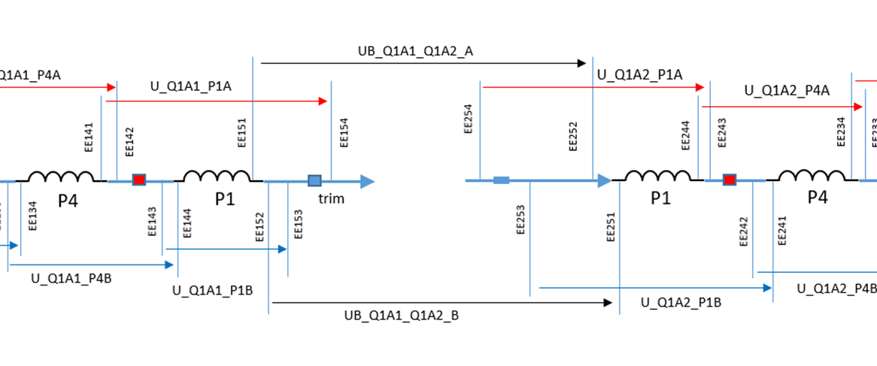
QDS Instrumentation IT
For details see MCF #53 (https://indico.cern.ch/event/841117/), presentation by J. Steckert
Individually instrumented poles allow for flexible quench detection schemes
Dedicated voltage taps for interconnection bus-bars

Slide 17
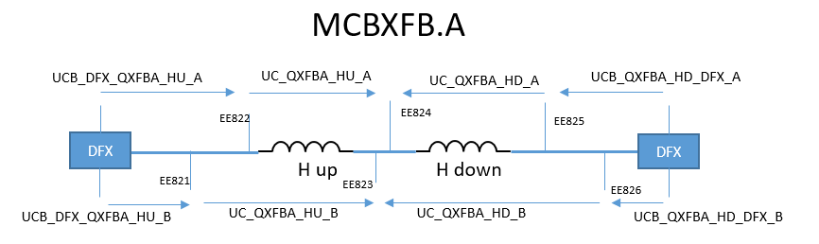
QDS Instrumentation MCBX Correctors
Both poles of the corrector are compared by a bridge (or virtual bridge) based quench detector
Bus-bars between magnet and DFX need to be protected by dedicated channels
Current and/or current derivative sensors can be added if required

Slide 18
HL-LHC Protection Device Supervision and Triggering
The supervision and activation of the quench heater circuits and CLIQ units is managed by a dedicated protection device supervision unit (PDSU).
  The PDSU records data from quench heater and CLIQ discharges with sampling rates up to 192 kS/s and ensures the correctly timed activation of the HDS and CLIQ units.
  CLIQ discharge currents measured by dedicated current transducers
In case of spurious activation of HDS or CLIQ, the PDSU unit issues a fast power abort signal to the powering interlock controller and forces the trigger of the not yet activated units.

Slide 19
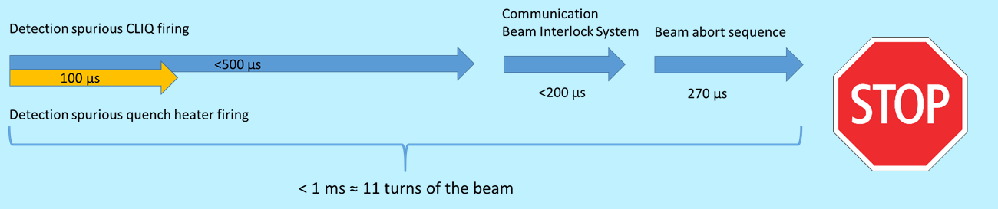
IT Protection Trigger Layout
PC
Current loop, source in power converter
Redundant
Protection
Triggers
Trigger &
supervision
48 x
HDS
PDSU A
UQDS 1A
Vtaps + I
.
.
.
UQDS 1B
Vtaps + I
6 x
CLIC
PDSU B
.
.
.
.
.
.
Trigger &
supervision
Vtaps + I
UQDS 3B
PIC
Beam Interlock System
Powering Interlock Controller

Slide 20

11 T Protection Trigger Layout
RB (main dipole circuit) QPS current loop
8 x
HDS
Trigger &
supervision
PDSU
UQDS 1A
Vtaps + I_{RB}
8 x
HDS
Protection
triggers
Trigger &
supervision
UQDS 1B
Vtaps + I_{RB}
Trigger coupling
11 T PDSU provides HDS supervision and trigger distribution
Re-triggering and interlocking functionality not required
TRIM PC
PIC
Vtaps(TRIM) + 4 x I_{TRIM-LEAD}
UQDS
Power Converter
Powering Interlock Controller

Slide 21
HL-LHC and QPS data acquisition & supervision
The UQDS built-in data acquisition has significantly enhanced capabilities, which will ease circuit diagnostics and fault analysis especially during the LHC hardware commissioning phase.
  20 Bit analog signal resolution with up to 125 kHz bandwidth; absolute timing synchronization < 100 μs
Data transmission to surface by field-bus links
  11 T UQDS: legacy field-bus (WorldFip™)
  All other devices: Ethernet based solution offering significantly higher bandwidth

Slide 22
Summary
The HL-LHC quench detection systems are based on a completely new development taking into account the specific requirements for the HL-LHC circuits.
Recent tests with prototype magnets and superconducting cable links confirmed the validity of the designs for the next generation of quench detection systems.
The complex and crucial circuit instrumentation is to a very large extent defined and validated.
The first use case in LHC will be the protection of the Nb₃Sn 11 T dipoles to be installed in sectors 6-7 and 7-8; looking forward to 2020

