Slide 1

Contribution of Power Converters to the Protection of the HL-LHC Circuits
S. Yammine for WP6b
International Review of HL-LHC Magnet Circuits
2019-09-09
Acknowledgments: J.P. Burnet, V. Herrero, N. Kuczerowski, M. Martino, M. Mentink, S. Pittet, E. Ravaioli, F. Rodriguez Mateos, Y. Thurel, H. Thiesen, G. Willering and MCF members

Slide 2
Content
Overview of the Powering of the HL-LHC Circuits
General Considerations for the Power Converter Contribution to Circuit Protection
Power Converter Contribution to the Protection
  Case of the 11T Dipole Trim Circuit
  Case of the Inner Triplet Main Circuit
  Case of the 2 kA Corrector Circuit - MCBXFB
  Case of the 120 A Corrector Circuits
Circuit Disconnector Boxes and Contribution to Protection and Safety
Conclusion

Slide 3
Overview of the Powering of the HL-LHC Circuits

Slide 4
Overview of the Powering of the HL-LHC Circuits

Slide 5
General Considerations for the Power Converter Contribution to Circuit Protection

Slide 6
General Considerations
Magnet circuits are by nature inductive and the current should not be interrupted
All power converters in LHC and HL-LHC contain a crowbar system
  Provides a path to the current in all powering aborts (due to quenches or not)
In general, the crowbar system consists of
  One or several diodes in parallel (for high current) in case of 1-quadrant power converter
  One or several thyristors in parallel in case of 2-quadrant power converter
  Thyristors back-to-back in case of 4-quadrant power converters
  Possibly resistances in series to ensure faster discharge of the circuit

Slide 7
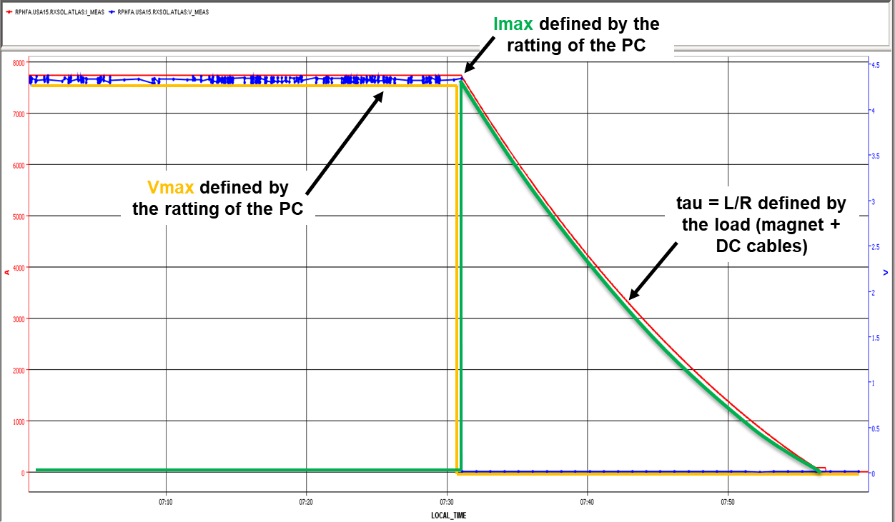
General Considerations
Main parameters for the crowbar design
  The rated peak current of the crowbar is defined by the power converter
  Dissipated energy and current decay profile are defined by the magnet properties
  Crowbar shall be able to discharge the magnet energy
  Series resistance is mandatory in some cases to reduce temperature of the diodes or thyristors
  Crowbar shall be natural air cooled to support discharge in case of water fault
  Auto-triggered i.e. no need of external energy to trigger or maintain the crowbar

Slide 8
Power Converter Contribution to the Protection – 11T Trim Circuit

Slide 9
11T Dipole Trim Circuit
For aborts at -250 A, elevated crowbar resistance leads to conduction of bypass diode
At RB energy extraction/voltage over 11T = 15 V, resistance limits current in the trim
Suitable resistance (60 mΩ) is chosen to limit the trim current during discharges
Impact on cold diode conduction is tested (see next two slides)

Slide 10
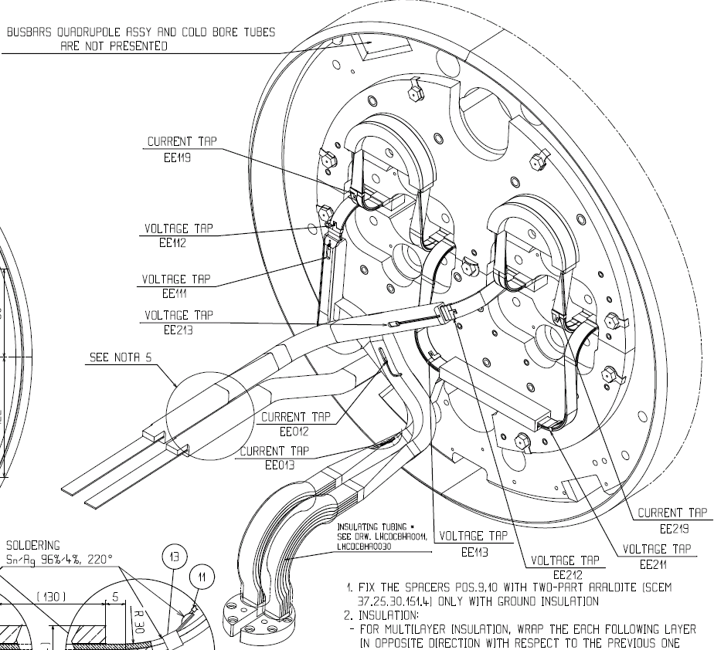
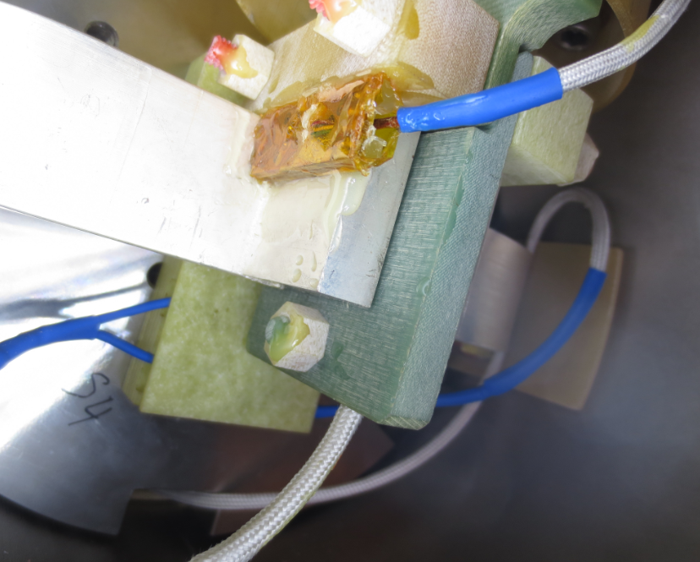
Thermal Investigation of the Current in the Diode
Main bus bar will quench at a temperature of about 7-8 K
The test is to verify if this limit could be reached at the level of the T-section
EDMS 1728094 (test description)
EDMS 1733527 (test results)
Tests performed on MB1235
SC bus bar
Cu bus bar
Temperature probe glued to the busbar, just below halfmoon connection
diode
Test Preparation by L. Grand-Clement
G. Willering in MCF no. 9

Slide 11
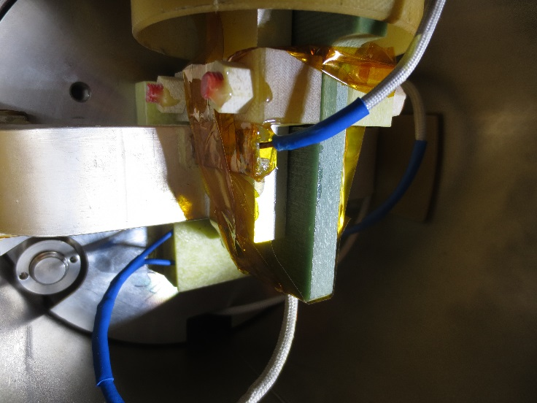
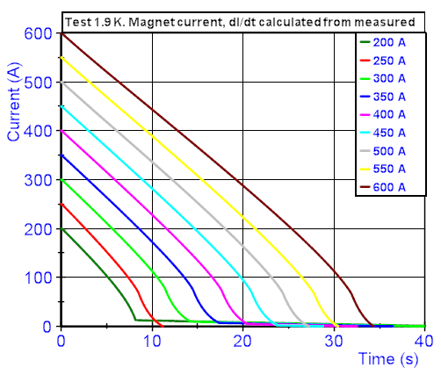
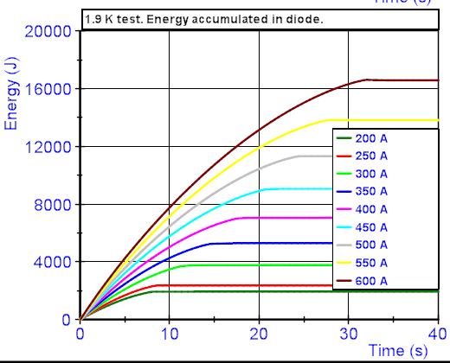
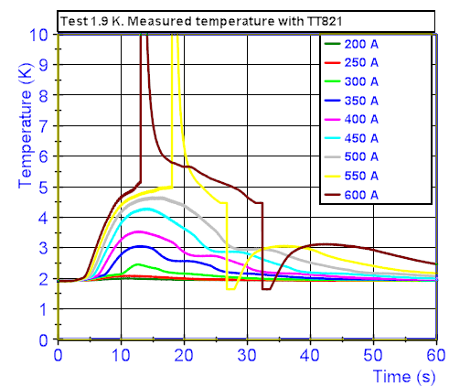
Test Results for Thermal Impact at 1.9 K
Even with 600 A (7 times the expected energy) no quench in main bus bar
Test shows significant margin
Up to 600 A
Up to 17 kJ
Up to 5.5 K
L. Grand-Clement
Change in range of cernox conditioner
G. Willering in MCF no. 9

Slide 12
Case of Short Circuit in 11T Trim
Analysis of potential short circuits over the trim crowbar performed
Initial current equal to 11.85 kA
Trim cable resistances defined at 30 mΩ (10 V limit in converter operation respected)
Trim leads or busbars show over voltage → Fire the QPS of the 11T MBH
Short resistance increases
Courtesy of M. Maciejewski, M. Mentink
12

Slide 13
Power Converter Contribution to the Protection – Inner Triplet Main Circuit

Slide 14
Inner Triplet Circuit
RQX crowbar is the main driver of the discharge time of the IT main circuit
It allows discharge in case of slowly evolving problems (e.g. cryogenics)
Discharging the circuit faster leads to a quench of magnets at a lower current
A recommendation from 2017 Circuits Review to impose 30 V crowbar (possibly 50 V)

Slide 15
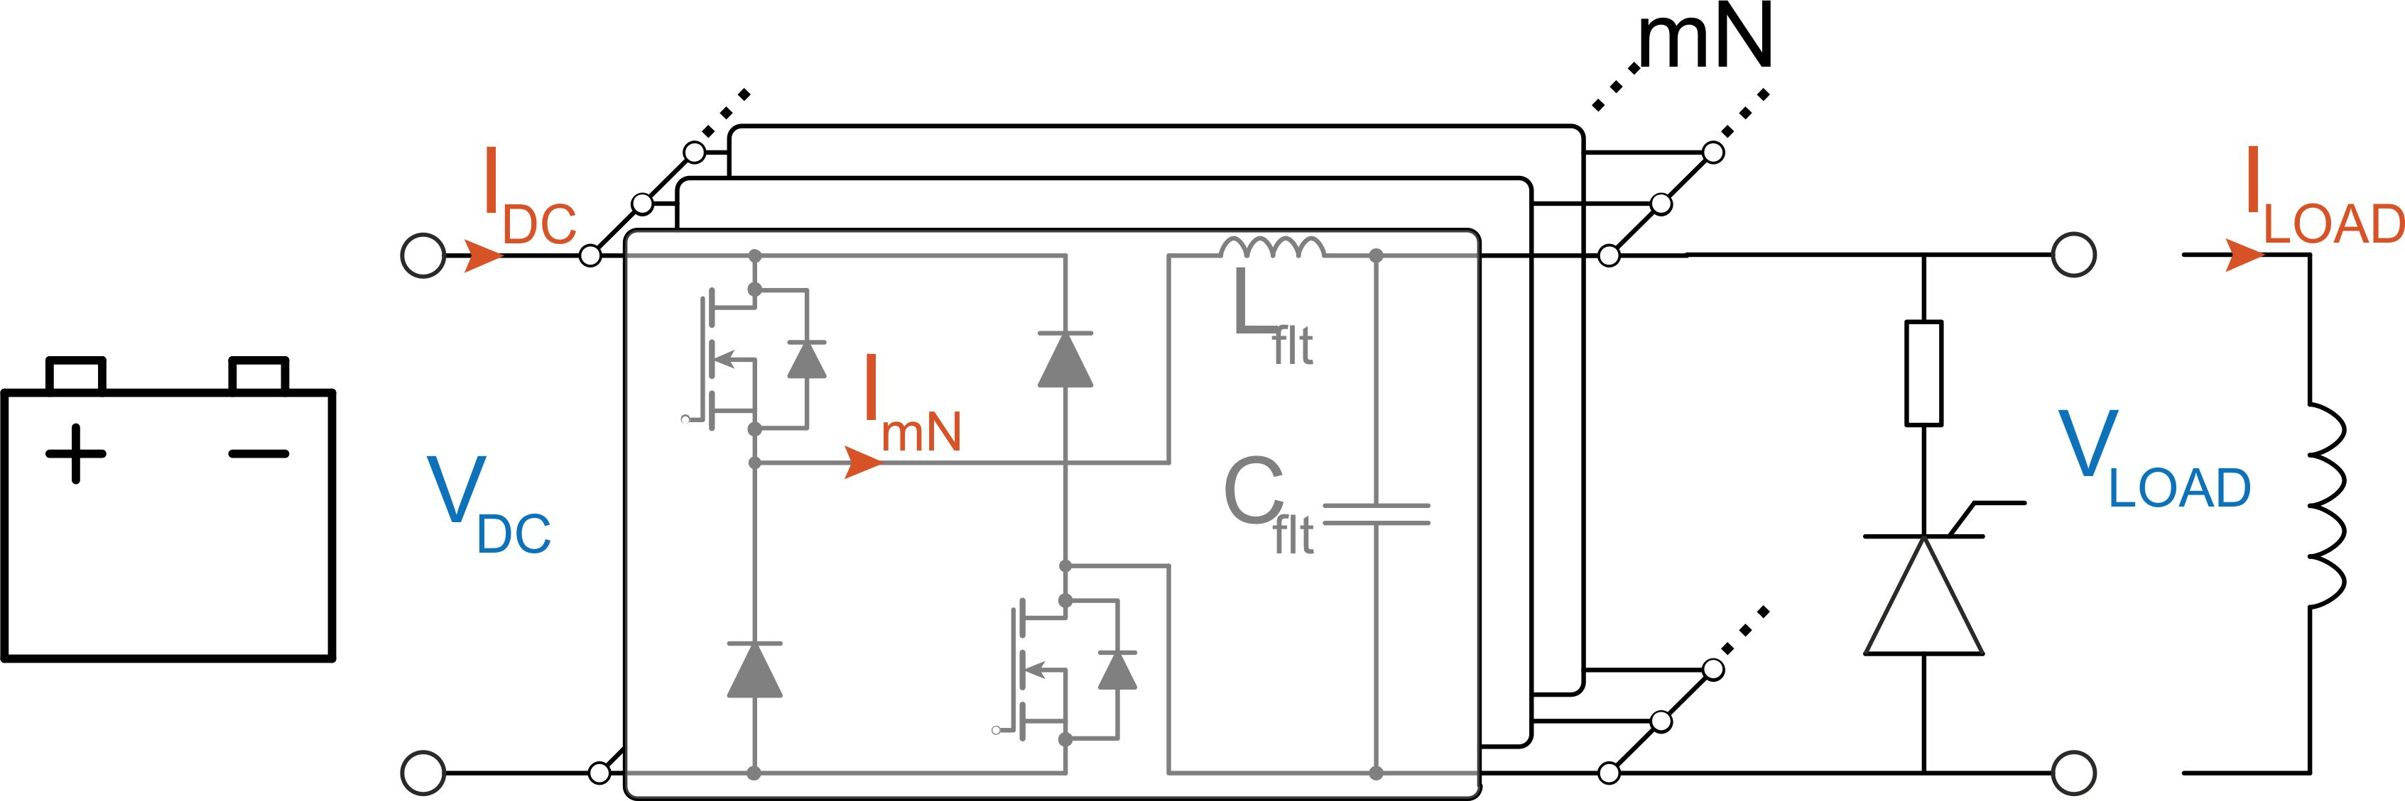
Inner Triplet Circuit
RQX crowbar is linked to the 18 kA power converter design
  Battery system is connected directly on the DC bus-bar of the sub-converter
  Diodes of the output stage in parallel with the crowbar
  Crowbar voltage (also during transients) should be less than battery voltage (20 V)
  With this topology, the DC crowbar voltage is maximum 10 V (0.5 mΩ)
  Higher crowbar voltage leads to significant change in topology and scope of development (extra cost)
  10 V Crowbar proposed and accepted by the concerned parties (e.g. cold powering team)
Battery limit (20 V)
Example of the Transient Voltage in a 10 V Crowbar

Slide 16
Trim Crowbar Values
During crowbar discharges without quench, only sub-circuit resistances limit the current
Trim circuits have a lower limit for passive resistance (crowbar + room temperature cables)
Current looping is limited to the design criteria of each sub-circuit
  Passive resistance of Q1 Trim = Passive resistance of Q3 Trim > 2 mOhm (ensured by Crowbar)
  Passive resistance of Q1a k-mod circuit > 56 mOhm (ensured by room temperature cables)

Slide 17
RTQX1 and RTQX3 Crowbars with Cold Diodes
When a crowbar discharge without quench occurring, a voltage over the crowbar is present
In case of trim negative current, a forward voltage across the diodes over Q1 and Q3 is applied
In case of the IT circuit, it is highly desirable not to have a conducting diode in non-quenching scenarios (see next slides)
Trim Voltage

Slide 18
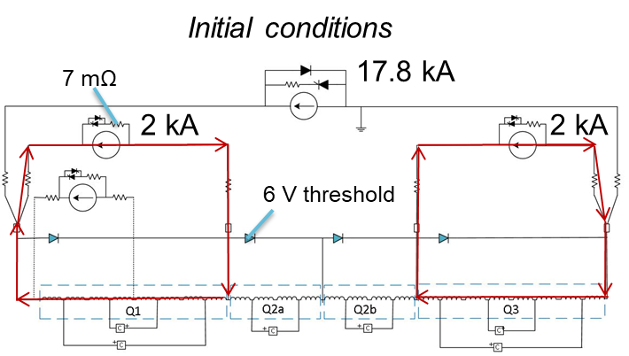
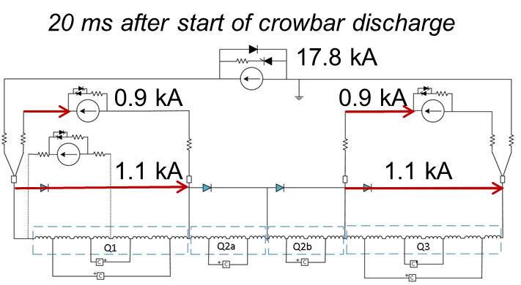
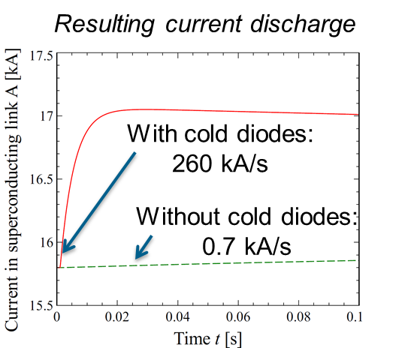
RTQX1 and RTQX3 Crowbars with Cold Diodes
What happens if a cold diode is triggered spuriously ?
Crowbar Discharge → Q1 and Q3 diodes short inductive loads of Q1 and Q3 PCs
Estimated 40 µH cable inductance
Resulting ramp rate = 260 kA/s
High probability of QPS trigger
Courtesy of M. Mentink

Slide 19
RTQX1 and RTQX3 Crowbars with Cold Diodes
If QPS not spuriously triggered, current decay in the cold diodes has a thermal impact
Temperature rise could quench the bus-bar (> 50 kJ dissipated)
Current profiles during diode discharge
Energy Dissipated in the Diodes = 50-100 kJ

Slide 20
RTQX1 and RTQX3 Crowbars with Cold Diodes
To add margin on the turn-on voltage of the parallel branch containing the diodes
  Two cold diodes are introduced across Q1 and two across Q3
  Turn-on voltage per diode is around 6V (reference) → 12 V in total
  Voltage developed in Q1 and Q3 trim branches is around 5V
  Margin of 7V to account for transient behaviour
0.5 mΩ
2 mΩ
2 mΩ
110 mΩ
110 mΩ

Slide 21
Power Converter Contribution to the Protection – 2 kA Corrector Circuit - MCBXFB

Slide 22
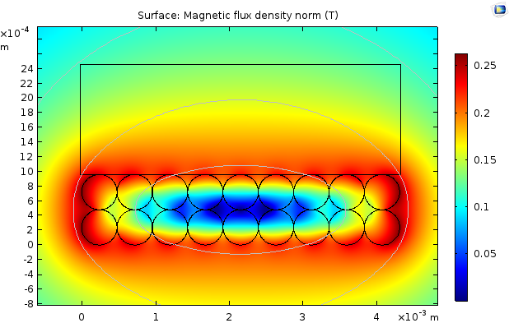
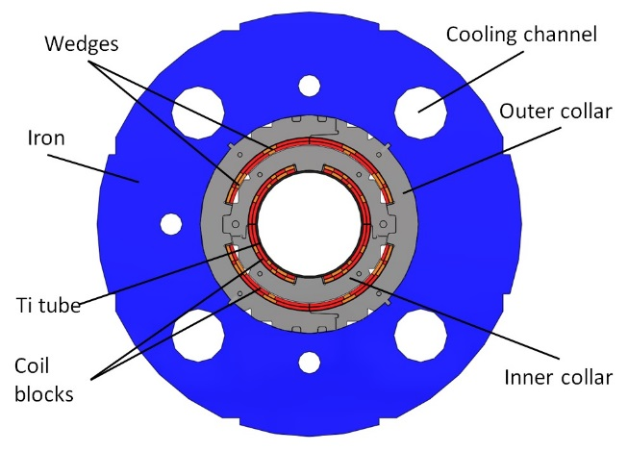
RCBX Circuit with the MCBXFB
MCBXFB magnet is protected via quench propagation (studies undergoing)
Superconducting bus-bar can be protected provided the discharge time constant is not more than 5s (Rcircuit ≈ 25 mΩ)
MCBXF Cross Section
Self-field generated by the MCBXF bus bar powered at 1.73 kA.

Slide 23
RCBX Circuit with the MCBXFB
Power converter crowbar at 25 mΩ proposed to protect the bus-bars
WP6b has done the reliability analysis on the crowbar
Due to modular design and N+1 redundancy, six modules are in parallel to the crowbar
Probability of short that bypasses the crowbar with the present design cannot be disregarded
In this scenario, the bus bar cannot be protected by the crowbar
Therefore, WP6b recommends to use energy extraction for this circuit
Courtesy of V. Herrero

Slide 24
Power Converter Contribution to the Protection – 120 A Circuits

Slide 25
Super Ferric High Order Circuits Protection
Super ferric quadrupole circuit is protected by energy extraction with active detection
Super ferric quadrupole current leads detection is ensured by the detection system
Higher order correctors are protected via quench propagation
Higher order correctors depend on converter control for power abort (as in LHC)
Voltage signals of current leads are received by converter for powering abort
Crowbars for 120 A converters contain 80 mΩ and cables are 50 mΩ
A failure in short circuit over the crowbar is not a major issue

Slide 26
Power Converter Contribution to the Protection – Recapitulation on Crowbar Values

Slide 27
Crowbars for HL-LHC Circuits
Circuit | Rated Current (kA) | Crowbar Resistance (mOhm) | Crowbar Maximum Voltage (V) | Duration of Crowbar Discharge (mins) | Dissipated Energy (kJ) | Rationale for Crowbar Value
RQX | 18 | 0.5 | 10 | 18 | 41000 | Battery voltage limitations
RTQX[1/3] | 2 | 2 | 4 | 18 | 200 | Current looping and diodes
RTQXA1 | 0.035 | 2 | 9* | 18 | 2 | Similar system as 2 kA**
RD1-RD2 | 14 | 0 | 0.3 (Diode) | 6 | 2500 | No need for resistance
RCBX | 2 | 25 | 51 | 0.5*** | 260 | Protection for MCBXFB sc bus bars
RCBRD | 0.6 | 50 | 31 | 1*** | 82 | LHC reference
RQSXF | 0.2 | 50 | 11 | 2*** | 30 | LHC reference
SF O>2 | 0.12 | 80 | 10 | 0.3 | 4 | LHC reference
RTB9 | 250 | 60 | 15 | 9 | 216 | Limit 11T trim current
* Due to overcurrent during quench
** Study undergoing
*** Without Firing EES

Slide 28
Circuit Disconnector Boxes and Contribution to Protection and Safety

Slide 29
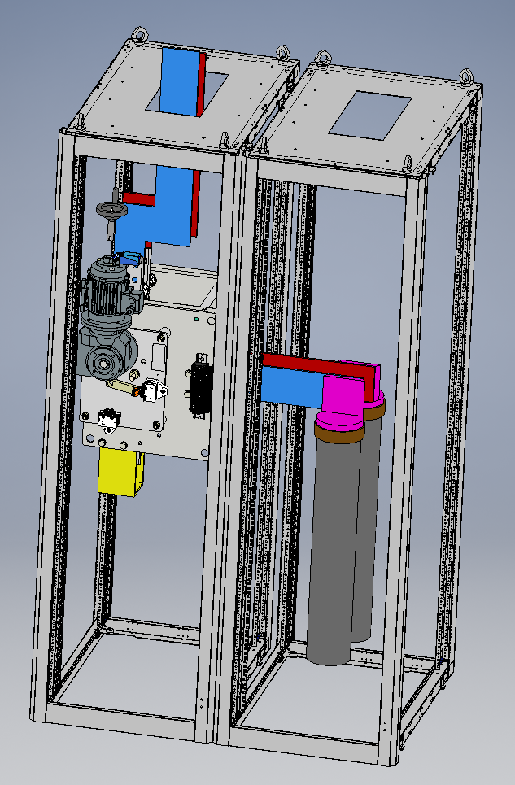
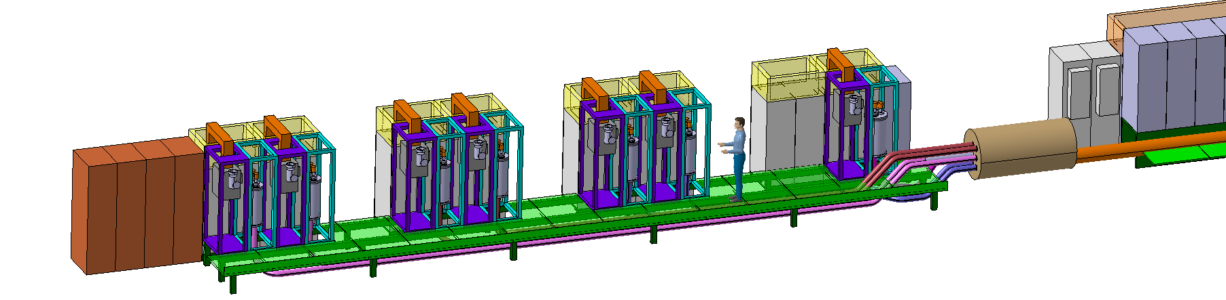
Circuit Disconnector Boxes
Circuit disconnector boxes
  Electrical Racks IP2X
  Room Temperature Bus Bars
  Disconnecting Devices
  Earthing Devices
  Electronics and PLC for supervision and interlocking
Notes:
To add the meetings

Slide 30
Circuit Disconnector Boxes
Electrical safety
  Any intervention on electrical systems should be done with respect to NFC 18-510 (French standard applicable at CERN by safety code C1).
  Lock-out procedures need to be defined and need to respect the 5 steps (separate, lock-out, identify, voltage check, earthing and short-circuits).
  Any electrical equipment shall respect IP standard (EN 60529).
  Disconnection mandatory on DC part of the inner triplet circuit due to the presence of RQX batteries
Earthing of electrical systems
  Earthing and short circuit with proper equipment is mandatory before intervention
  Applicable for low voltage (< 1kV) if multiple sources are identified (NFC 18-510)
  Many direct sources exist (trims, CLIQ, IFS boxes)
  Many indirect sources (insulation failure): all circuits passing through the sc link, QH circuits, CLIQ of the IT circuit going through the sc link
Notes:
To add the meetings

Slide 31
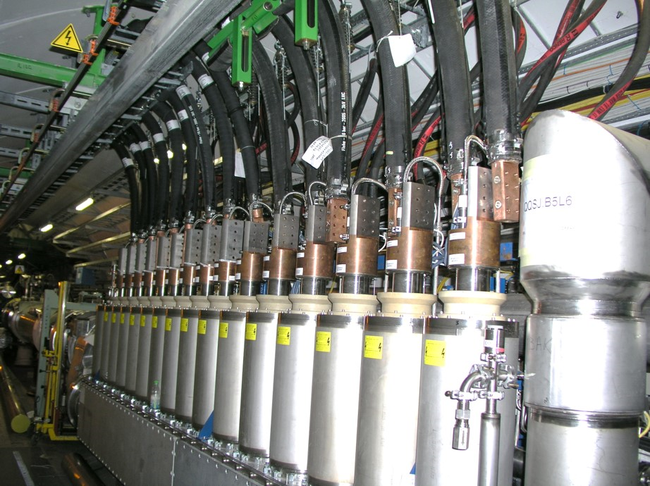
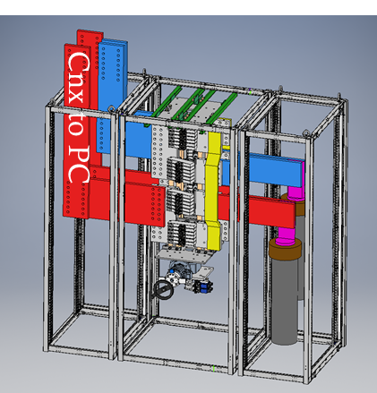
Circuit Disconnector Boxes
Safe and fast operation
  No need for cable disconnection for ElQA intervention
  No additional risk on fragile current leads due to shock, force or torque from disconnecting cables
  No additional risk on personnel (i.e. use of ladders) for disconnecting and reconnecting
Example: DFBA System in LHC
Notes:
To add the meetings

Slide 32
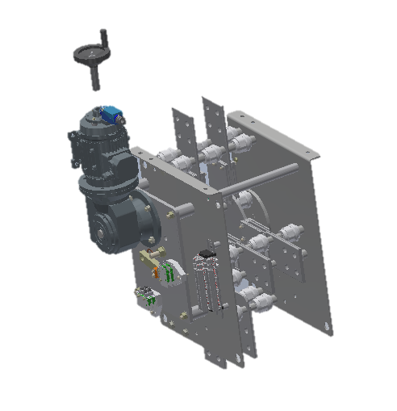
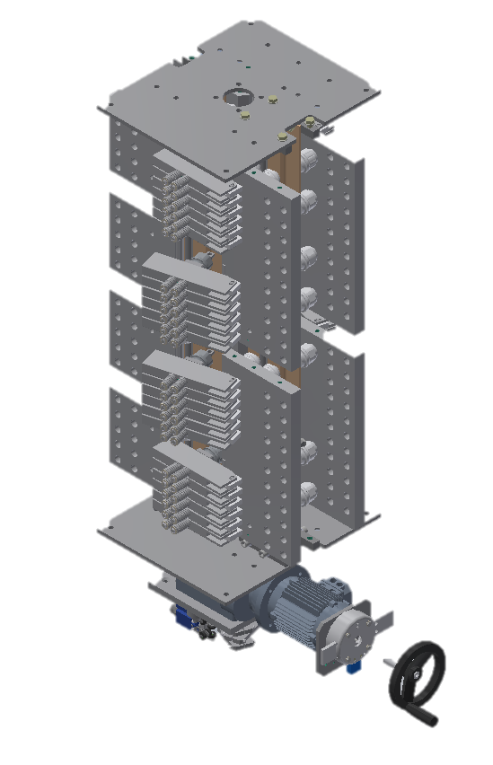
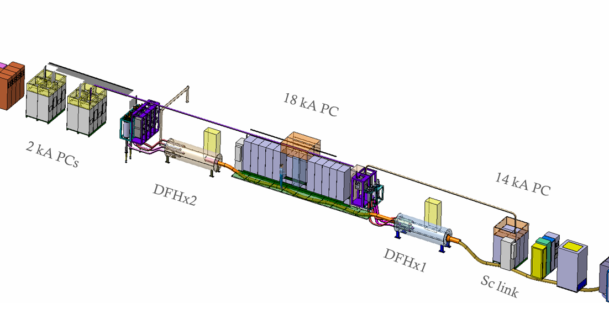
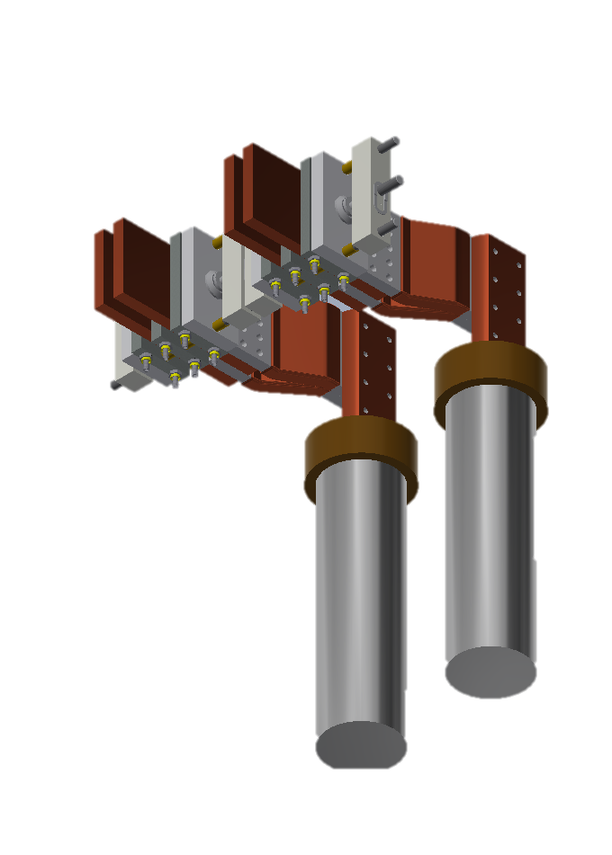
Circuit Disconnector Boxes
Working reference conceptual design
2 kA disconnector racks concept
18 kA disconnector racks concept

Slide 33
Conclusion
Power converter systems contribute in many cases to circuit protection
Crowbar and its resistance are central elements in circuits without active quench protection
In many cases, the crowbar reduces the chance of triggering the quench protection system
Even though the crowbar is very reliable, a short over the crowbar cannot be disregarded
IT, 11T trim, high order corrector circuits have fall-back strategy against shorts over crowbar
WP6b recommends using energy extraction for the RCBX circuits (discussions undergoing)
Disconnectors increase the safety for intervention on the circuits and provide faster operation

Slide 34
Thank you for your attention

