Slide 1

HL LHC Inner Triplet STRING
M. Bajko
HL-LHC IT STRING Coordinator
International Review of HL-LHC Inner Triplet Circuits, 9-10th of September 2019

Slide 2
CONTENT
The HL LHC STRING Motivation and Goals
Components of the HL-LHC IT STRING
Layout of the HL-LHC IT STRING in SM18
Test Program
Summary
Status of activities
Conclusions

Slide 3
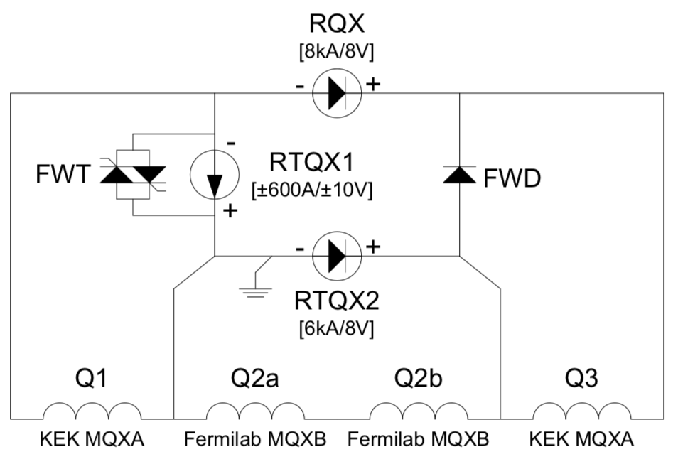
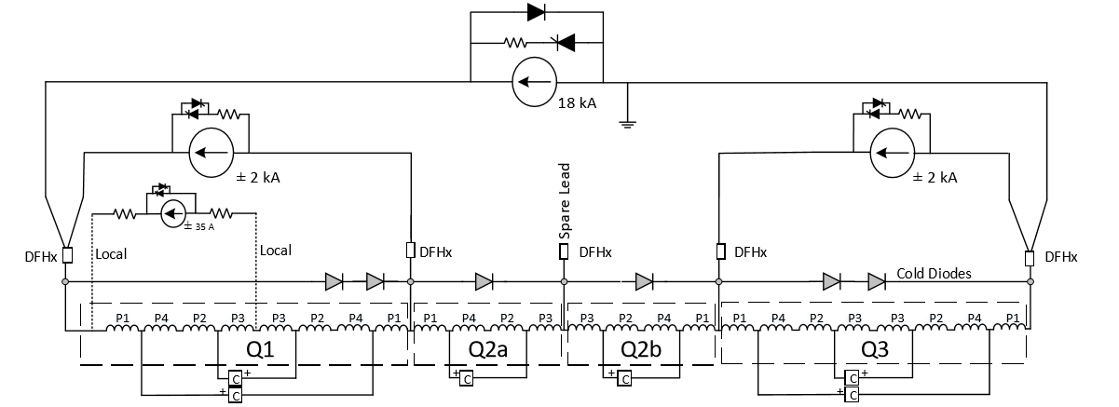
The HL-LHC IT STRING MOTIVATION
In the HL-LHC configuration, the Inner Triplet (IT) with the most complex electrical powering circuit of the machine in the region of IR1 and IR5 will be heavily modified.
LHC
HL-LHC

Slide 4
The IT zone : HL-LHC IT vs LHC
In the HL-LHC configuration, the Inner Triplet (IT) region of IR1 and IR5 of the present
LHC will be heavily modified.
LHC
HL-LHC
In particular the Q1-Q2-Q3-D1 magnets (but not only) will be completely different from the present LHC magnets, mainly due to the new technology they are based.

Slide 5
The IT zone : HL-LHC IT vs LHC
In the HL-LHC configuration, the Inner Triplet (IT) region of IR1 and IR5 of the present
LHC will be heavily modified.
HL-LHC
D1 magnet will be superconductor instead of normal conductors as is today in the LHC.

Slide 6
The IT zone : HL-LHC IT vs LHC
In the HL-LHC configuration, the Inner Triplet (IT) region of IR1 and IR5 of the present
LHC will be heavily modified.
HL-LHC
In addition, the aperture will be much larger, the cold mass configuration will be completely different and the corrector package will be substantially modified as configuration and technology, too.

Slide 7
The IT zone : HL-LHC IT vs LHC
In the HL-LHC configuration, the Inner Triplet (IT) region of IR1 and IR5 of the present
LHC will be heavily modified.
HL-LHC
The IT quadrupoles:
Q1, Q2a,Q2b,Q3 will use Nb₃Sn superconductor instead of the Nb-Ti used by the present LHC ones.

Slide 8
The IT zone : HL-LHC IT vs LHC
In the HL-LHC configuration, the Inner Triplet (IT) region of IR1 and IR5 of the present
LHC will be heavily modified.
HL-LHC
…and will be made via a HT superconducting link and new generation superconducting current leads
Powering cables or BB and disconnections
18 kA
13 kA
2 kA
The powering of the magnets will be with higher current than the present LHC IR magnets

Slide 9
The IT zone : HL-LHC IT vs LHC
In the HL-LHC configuration, the Inner Triplet (IT) region of IR1 and IR5 of the present
LHC will be heavily modified.
HL-LHC
The protection of the magnets based on Nb₃Sn superconductor technology will be different from the present ones (ex. CLIQ and new QH) due to its particulate characteristics at low and medium field and the high magnetic energy stored ( 1.2 MJ/m, 2-4 x higher than in LHC) in the magnets in operational conditions.
Powering cables or BB and disconnections
18 kA
13 kA
2 kA

Slide 10
The IT zone : HL-LHC IT vs LHC
In the HL-LHC configuration, the Inner Triplet (IT) region of IR1 and IR5 of the present
LHC will be heavily modified.
HL-LHC
Powering cables or BB and disconnections
We foresee for the first time a FULL remote alignment.
18 kA
13 kA
2 kA

Slide 11
The HL-LHC IT STRING GOAL
The HL-LHC IT STRING will serve as a test bed for matters or conditions that either :
  cannot be tested as a part of the components acceptance and characterization program, or
  depend on the response of the integrated system.
a.We do not pretend to do this, due to the timing. The HL-LHC IT STRING is planned such that is too late to be used for qualification of the single components and « known un-knowns » are cured at the level of the design.
b. We ruther look after unforeseen failures and « un-known un-knowns » of the integrated system during its installation, operation and dismountling

Slide 12
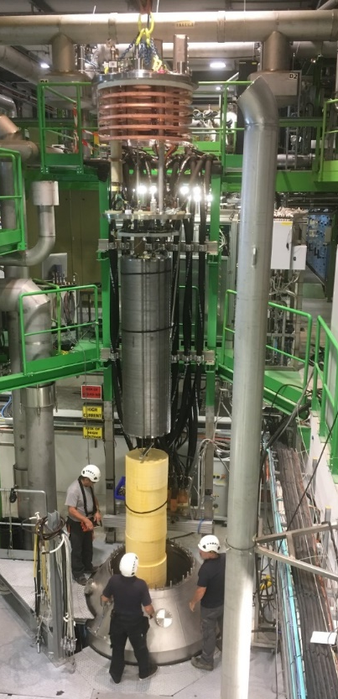
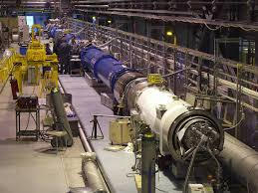
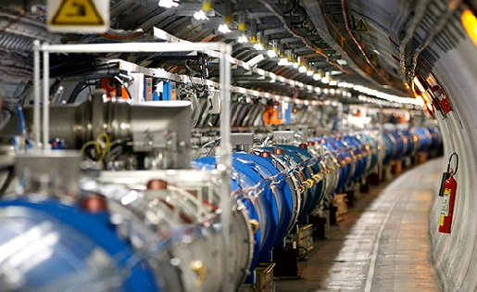
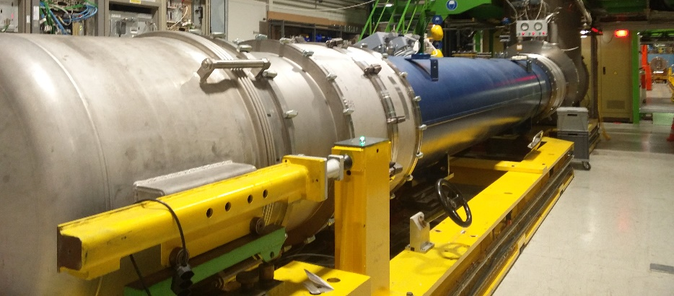
Qualification of the HL-LHC IT zone
(seen from the magnets side…..)
….but applied also for the other components as well
Individual test of model magnets
early enough to give feed back to the design
The sole test of a complete circuits
While running them on the surface and in advance to reduce tuning time in the tunnel
Complete Circuits test of cold masses in the tunnel
Individual test of prototype and series cold masses to qualify the magnets and reduce training time in the tunnel
ON MAGNETS
ON CIRCUITS
HL-LHC IT STRING

Slide 13
The HL-LHC IT STRING MOTIVATION
The main motivation is to represent, as far as reasonably achievable in a surface, the various operation modes and make of the HL LHC IT STRING a test stand to STUDY and VALIDATE the COLLECTIVE BEHAVIOURE of the different systems: magnets, magnet protection, cryogenics for magnets and superconducting link, magnet powering, vacuum, and interconnections between magnets and superconducting link, alignment.
Ref. HL-LHC IT STRING Scope https://edms.cern.ch/document/1693312/1
Alternative configurations ( to the one presented here) have been studied and reported at the TCC with dedicated cost and resources. These alternatives ( shorter or at room temperature without powering ) where not retained, as they have been not giving nor the expected savings and nor a sufficient experience that would reduce the time of the HWC of the HL-LHC.

Slide 14
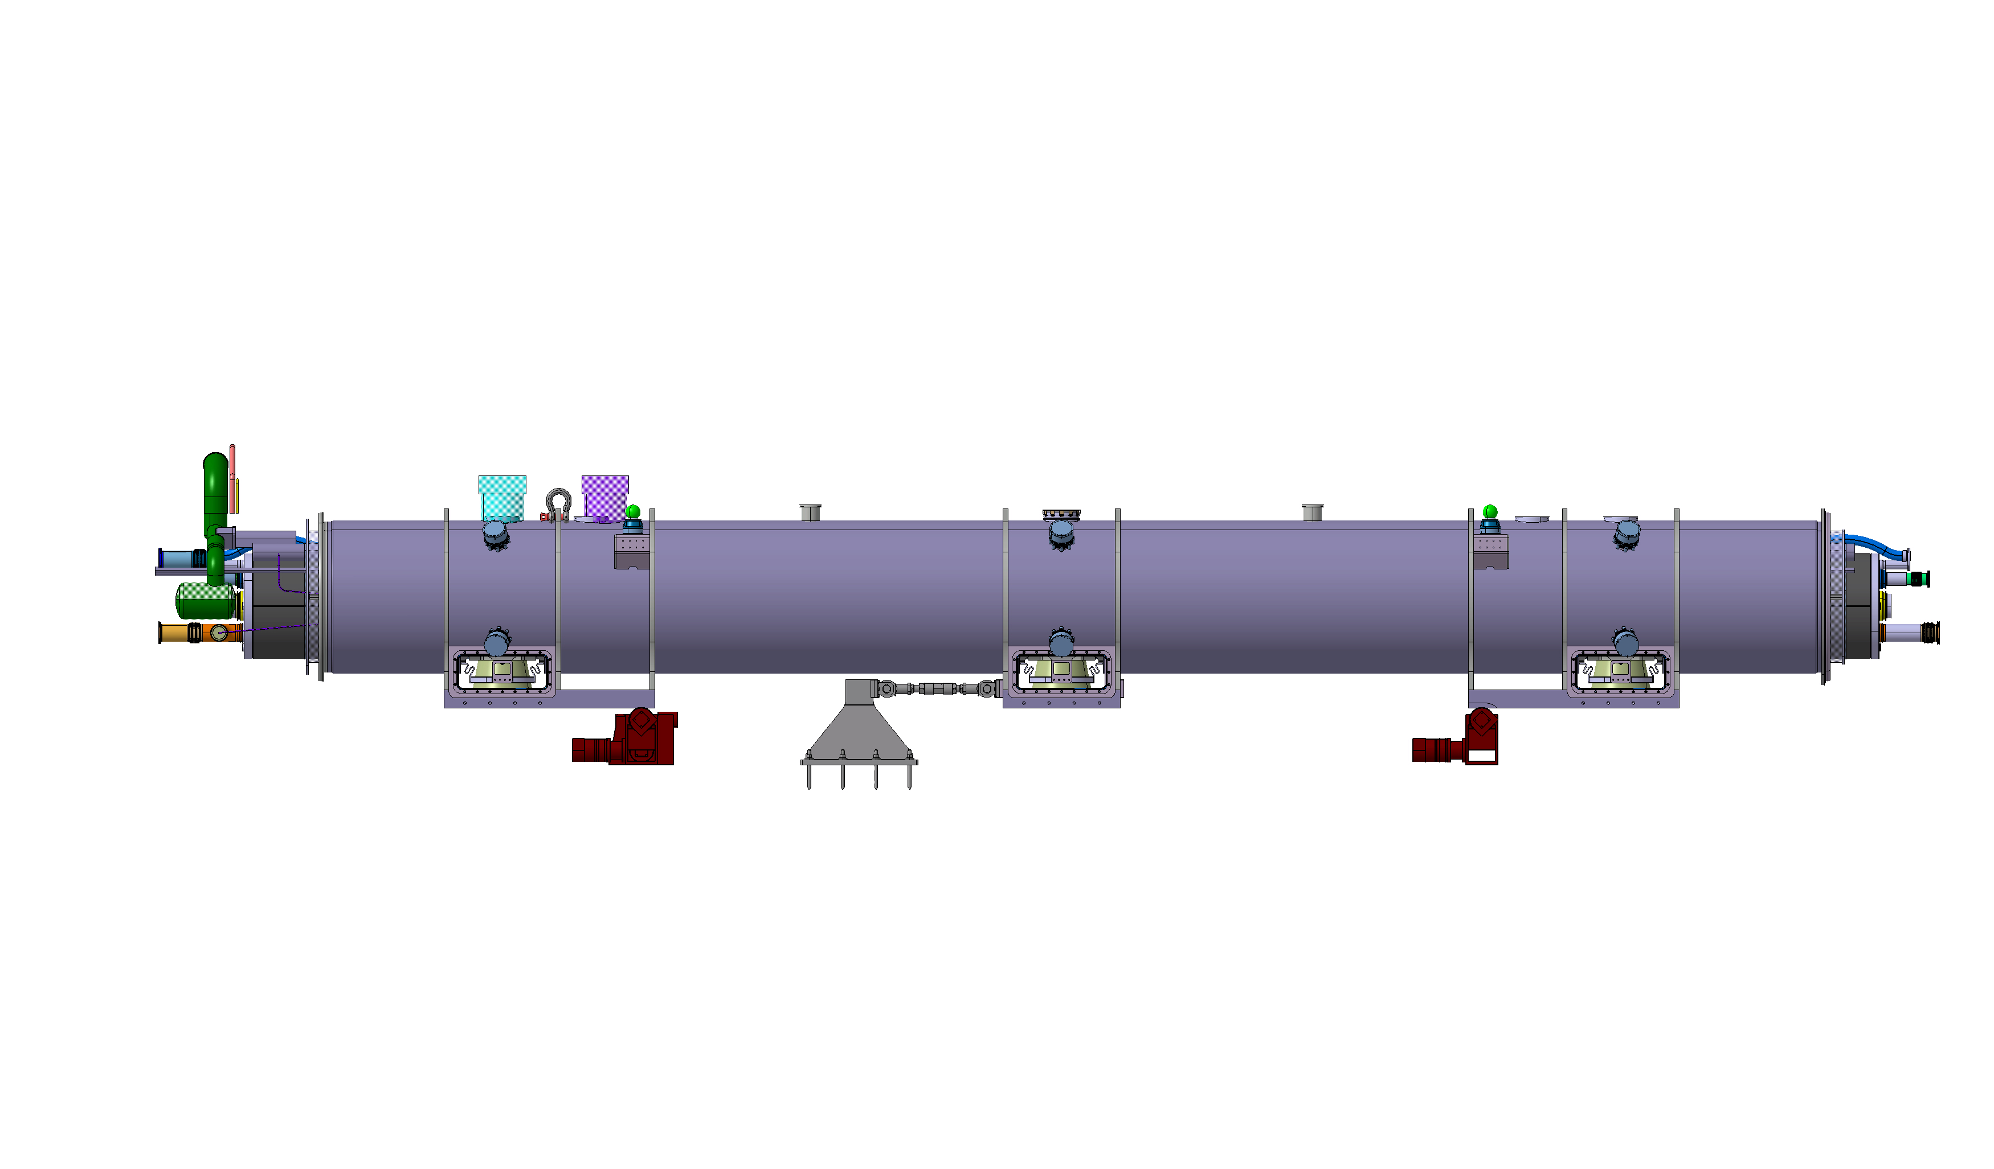
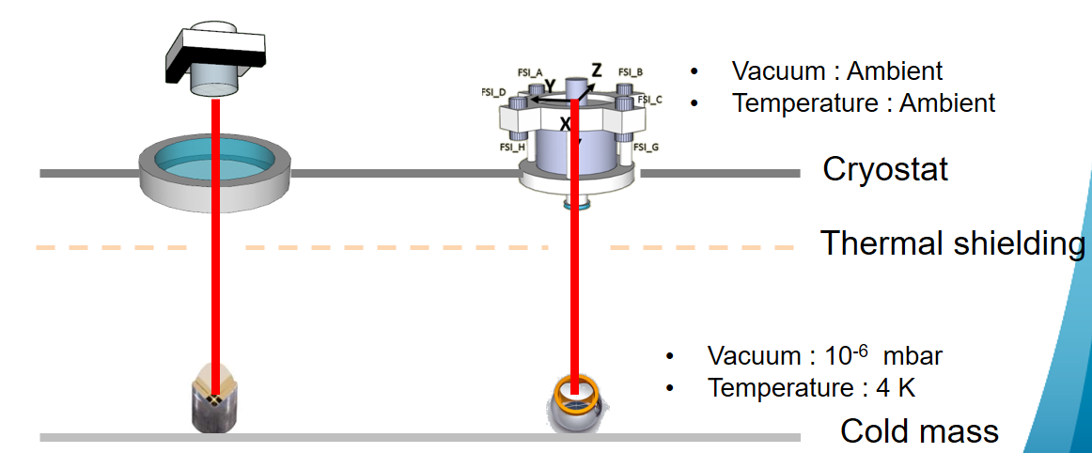
The strongest arguments for the STRING tests
Validation of the complete electrical circuit, its protection and its different failure scenarios that has been simulated, but never before tested.
Validation of the structure, the fully remote alignment system, measurement of the target values with real loading conditions at cryogenic temperature, before and after quenching.
Build up a set of procedures and a team with expertise in all domains and make them working together for successful and possible the shortest LS3.

Slide 15
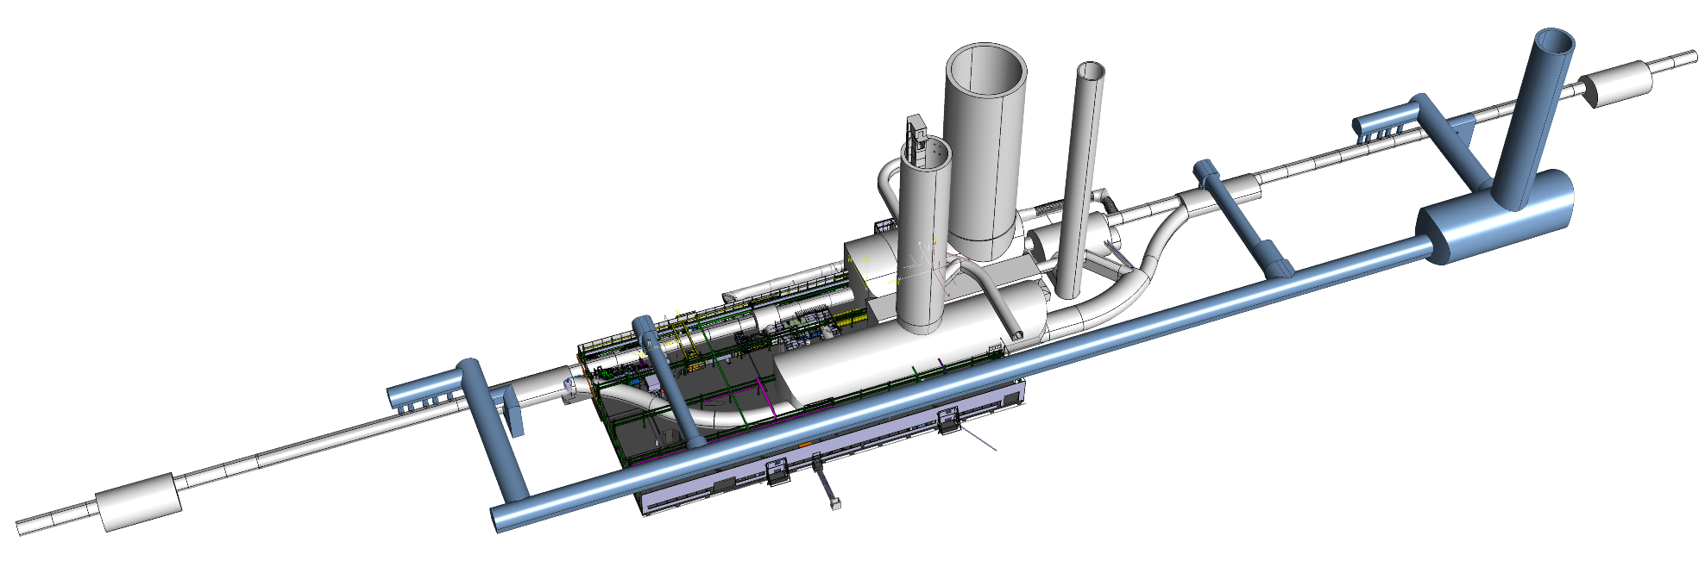
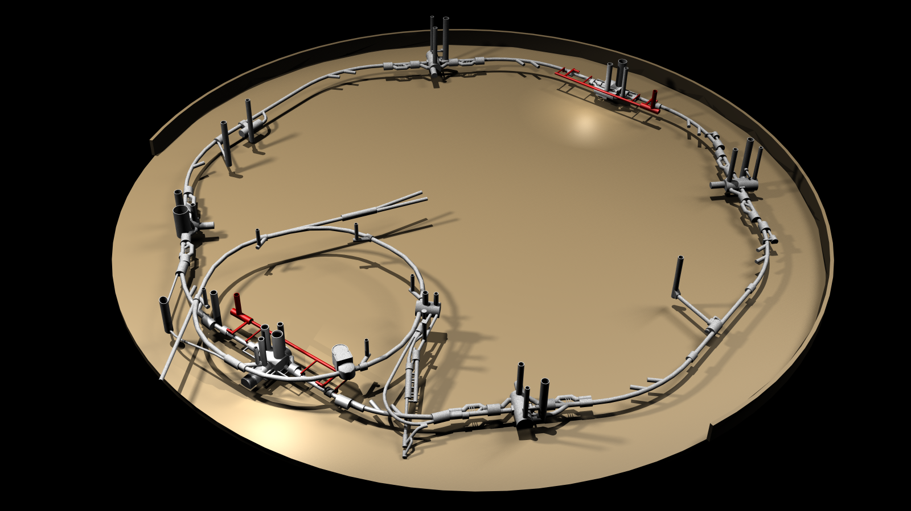
Layout of the HL-LHC IT STRING
P5L is the most complicated and coherent set up with the SM18 installations and the tunnel is the smallest . We plan to reproduce the space allowed in that place of the tunnel for the interventions
P4
P5
P3
HL-LHC
P6
P2
There are 2 essential difference (not affecting the electrical circuits):
  We do not reproduce the SLOPE of the LHC tunnel.
  We do not plan to use beam screen
SPS
SM18
P7
P1
P8
The electrical circuits of the HL-LHC IT STRING are identical to those of the HL-LHC.

Slide 16
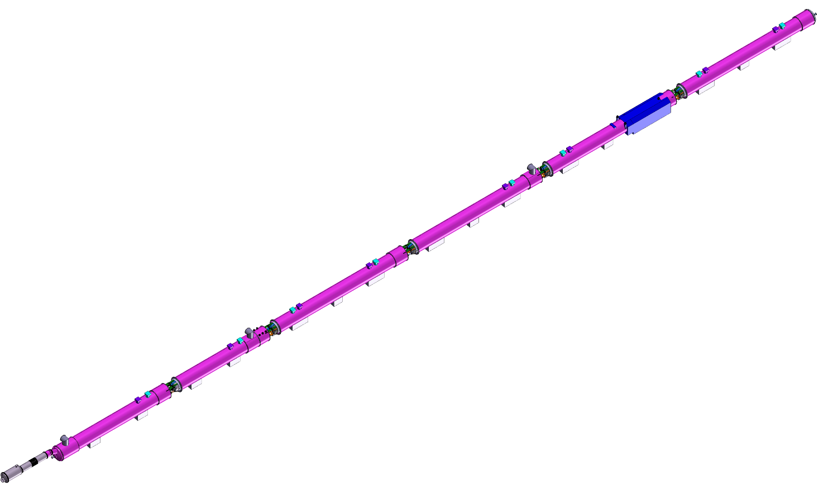
Main Components and operation conditions
Q1
IP5
BPM
STRING defined between Q1 and D1, powered through Sc link
Additional instrumentation (if any) will be added only on prototypes
Common vacuum is an economic solution considered as baseline
DXF, DSH, DSL of 120 m : the first prototypes
Protection as in the HL-LHC ( CLIQ, QH, EE)
Powering as in HL-LHC
Cooling similar to HL-LHC
Prototype
Prototype
Q2a
Prototype
BPM
Prototype
Q2b
optional
Series
Q3
Series
CP
Series
Operation temperature 1.9 K
Powering to Iultimate
1 thermal cycle to room temperature
1 quench / day during operation
Cryogenics designed to allow max 400 W heat extraction
D1
Prototype
DFX
Prototype
All components are “like series” (prototypes) or series and are owned by the WP (ex. Magnets)
All infrastructure or components that can not be re-used in the HL-HC are owned by WP16 ( ex. Cryogenics)

Slide 17
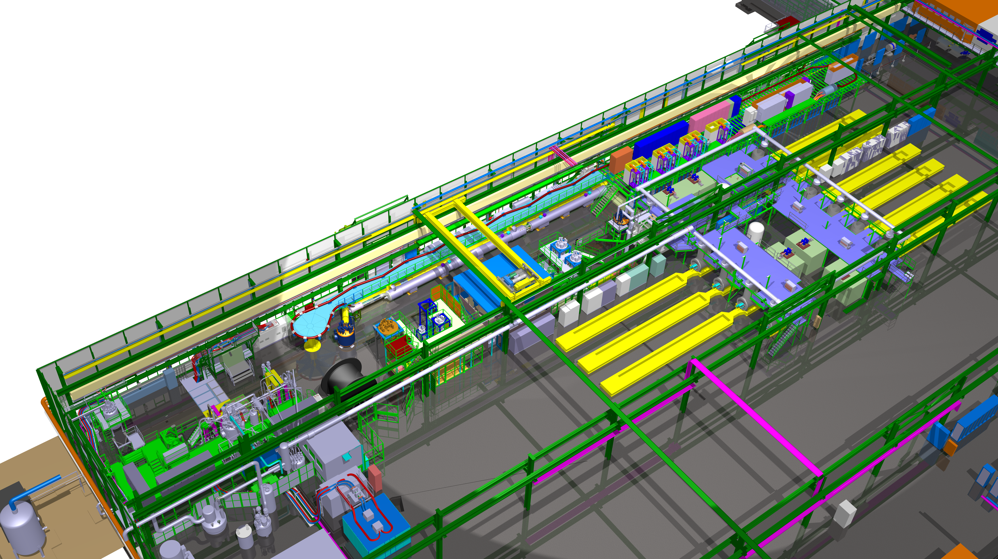
Main Steps of the HL-LHC IT STRING
Installation
Inter-
connection
Cooling
HWC
Exp @ Inom
Training to Iultimate
Thermal Cycle
HWC to
Iultimate
Exp @ I ultimate
Warm up
This stage is performed on different conditions but following the same procedures as in the tunnel. This allows us to exercise and improve the procedures. Time will be larger for most of the steps than in the tunnel as some of the componenets will arrive early.
This is a real chance to optimse procedure to reduce time in the tunnel at the installation.
Integration
by. A. Kosmicki

Slide 18
Interconnections IT STRING
Installation
Inter-
connection
Cooling
HWC
Exp @ Inom
Training to Iultimate
Thermal Cycle
HWC to
Iultimate
Exp @ I ultimate
Warm up
This is a very important milestone as from this stage we have electrical and hydraulical circuits (not already and individually tested components!!)
300 K
Test of power converters connected to the DC cables in short circuit, including controls for powering, ramp, monitoring
Individual System Tests of Powering Interlock Control
Power Converters
not connected to Magnets
Individual System Tests of the Quench Protection and Energy Extraction Systems
Electrical Quality Assurance

Slide 19
COOLING of the IT STRING
Installation
Inter-
connection
Cooling
HWC
Exp @ Inom
Training to Iultimate
Thermal Cycle
HWC to
Iultimate
Exp @ I ultimate
Warm up
During cooling check of alignment stability, measure displacements and thermal contraction effects and maybe HV tests at intermediate temperature
300 K
Electrical Quality Assurance, first time at cold on the interconnected magnets
1.9 K

Slide 20
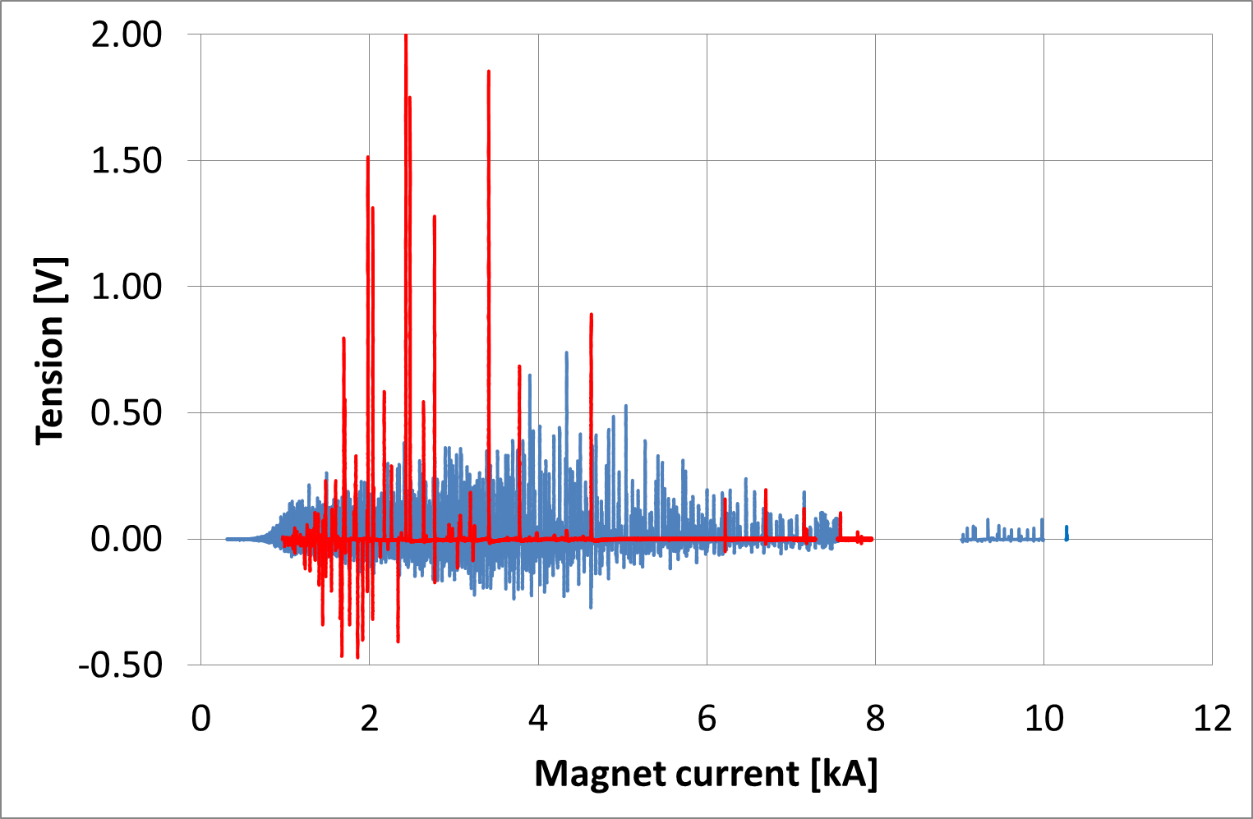
HWC @at cold OF THE IT STRING
Installation
Inter-
connection
Cooling
HWC
Exp @ Inom
Training to Iultimate
Thermal Cycle
HWC to
Iultimate
Exp @ I ultimate
Warm up
Individual System Tests of Powering Interlock Control
Electrical Quality Assurance
Test of power converters connected to the DC cables in short circuit, including controls for powering, ramp, monitoring
Individual System Tests of the Quench Protection and Energy Extraction Systems
Commissioning of the electrical circuits one by one or in groups at low, intermediate and nominal currents before repeating it in unison again at low , medium and nominal current.
Power Converters
connected to Magnets
1.9 K
LHC HWC

Slide 21
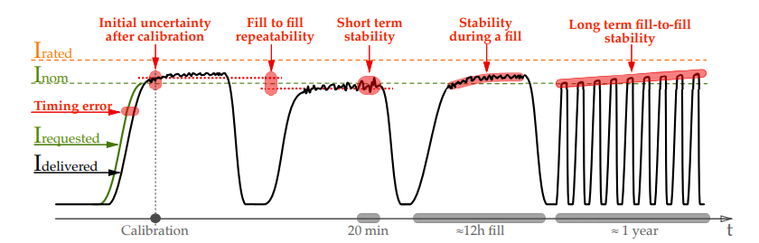
Experimental Program 1
Installation
Inter-
connection
Cooling
HWC
Exp @ Inom
Training to Iultimate
Thermal Cycle
HWC to
Iultimate
Exp @ I ultimate
Warm up
    Check of crosstalk during normal operation and causing trips e.g. by applying orbit feedback
  Verification of various simulations and circuit models
  Limitations for maximum current ramp rate or acceleration → essential to test the closed orbit correctors with LHC operational scenarios e.g. by applying orbit feedback
  Validation of fully automated analysis of faults + automated/remote fault recovery
    Check of crosstalk during protective actions e.g. trip of a corrector circuit causes trigger of triplet protection
  Optimization of quench detection systems
  Optimization energy extraction systems
  1st time CLIQ operation with a string of magnets
Courtesy of D. Gamba – WP2

Slide 22
Experimental Program 2
Installation
Inter-
connection
Cooling
HWC
Exp @ Inom
Training to Iultimate
Thermal Cycle
HWC to
Iultimate
Exp @ I ultimate
Warm up
Check of FAILURE scenarios
  Accidental firing of quench heaters or CLIQ units
    Already observed with DQHDS but not straightforward to test in LHC
    New interlock logic to cope with spurious triggers of CLIQ units
  Powering failures
    Normally not a concern for circuit protection but may cause triggers of detection systems → can create additional machine downtime
  Mains failures
    Should be fully transparent if UPS test & supervision done correctly
The experimental program is under development; other test than described here may come or change

Slide 23
Summary of test @ cold OF THE IT STRING
Installation
Inter-
connection
Cooling
HWC
Exp @ Inom
Training to Iultimate
Thermal Cycle
HWC to
Iultimate
Exp @ I ultimate
Warm up

Slide 24
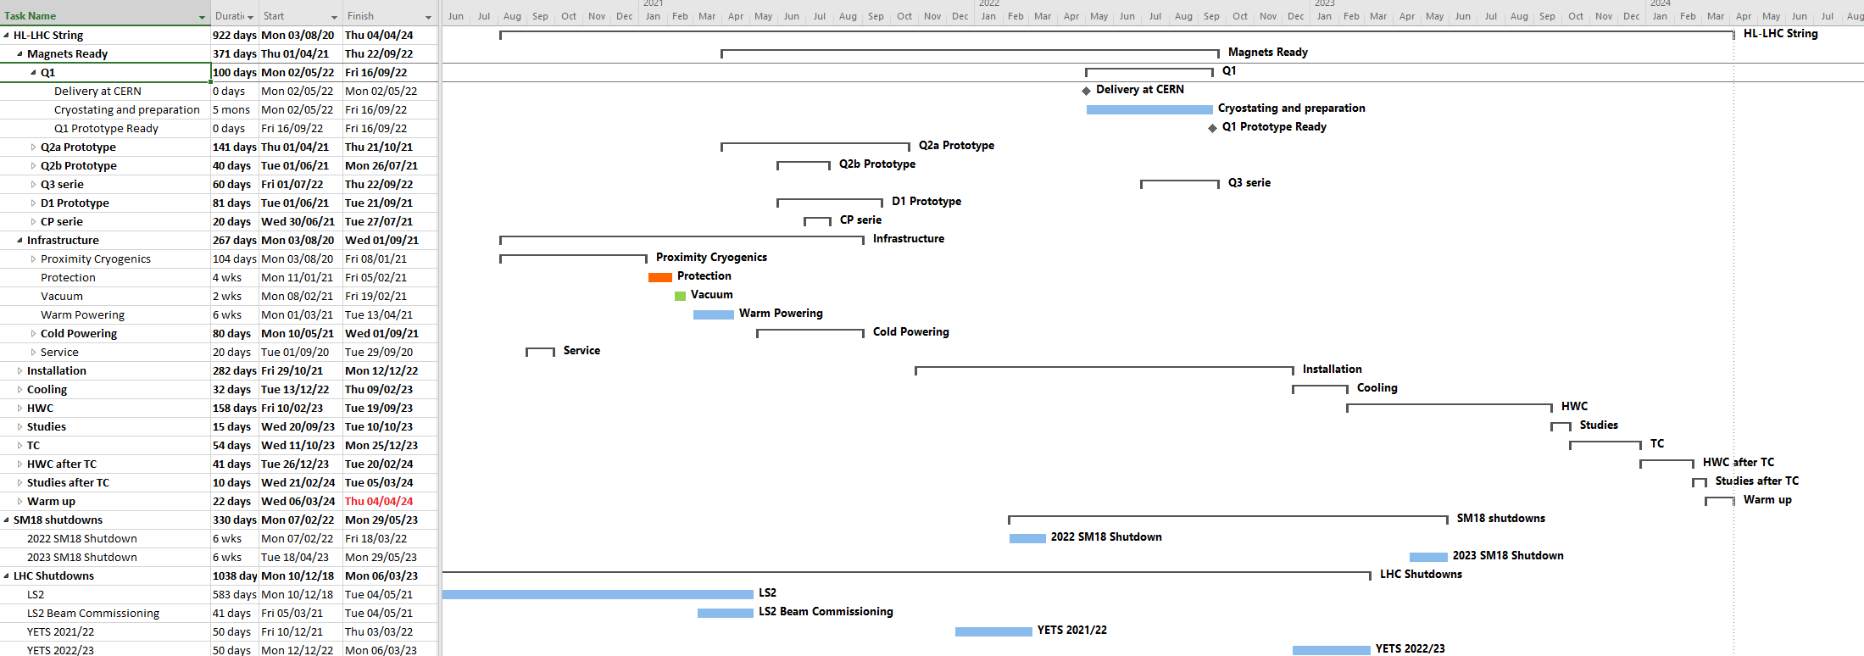
HL-LHC IT STRING PLANNING
Sept 2022
1.5 months
3 months
3 months
Dec 2023
March 2024
The STRING test PLANNING was created considering:
Input from the master plan regarding the delivery of magnets
We implemented the 2 yearly shut-down of SM18 of a duration of 6 weeks each (as usual) and in the most optimal position for test of magnets
We consider about 170 prorogued quenches with 1 quench / day for quenches at 80-100% I nom or higher

Slide 25
Not possible to test in the HL-LHC IT STRING
IT-String does not gives the opportunity to, (but it is assumed that is acceptable):
measure the magnetic field nor its effects on the rest of the systems as. ex. generated by the quench heaters & CLIQ ( tested on individual magnets)
check the beam screen related issues and its installation, beam induced heat loads ( tested on individual magnets)

Slide 26

Impact of IT STRING on Machine
(HWC and operation)
Highest priority items based on potential impact on performance/availability are:
  Magnet protection: fundamental to test protection strategy in realistic operating conditions, including impact on all involved systems
  Cross-talk between circuits: assess impact ad potential limitations for operation
  SC links: performance in the presence of inductive load
  Powering: control strategy in realistic environment (e.g. handling of flux jumps)
  Fully remote alignment: performance could be critical for HL
One of the added values of the STRING is to address also ‘unknown unknowns’ (low probability, potentially high impact)

Slide 27
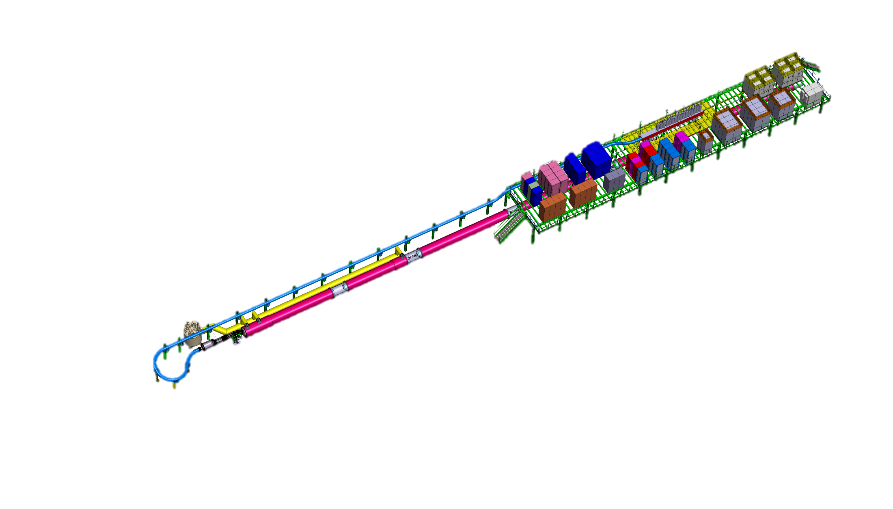
Summary
HL LHC IT STRING is foreseen to study the collective behaviour of the IT zone
The main components are: Q1-D1 with complete cold and warm powering
The test stand will be integrated into SM18
Infrastructure upgrade is well advanced
P5L will be reproduced without slope
180 quenches/or power aborts are planned
400 W heat extraction possibility exist
ID CARD of the TEST STAND: HL-LHC IT STRING
TEST Facility LOCATION: SM18 (b. 2173)
TEST DATE: 2021-2023
OPERATIONAL TEMPERATURE: 1.9 K
OPERATIONAL CURRENT: Ultimate (108% I_{nominal} = 18 kA )
MAGNETS: Q1, Q2a, Q2b, Q3, CP, D1
COLD POWERING: SC link ,HTS leads DFH and DFX,
WARM POWERING: 1 x PC for 18 kA + 3 Trim for Q1-Q3 + 6 x 2 kA + 1 x 12 kA + 9x 0.1 kA + WCC
PROTECTION: CLIQ and QH ; EE where is baseline

Slide 28
Status
The tour of the WPs and groups has been done and we have a good understanding of their needs.
Service infrastructure is well advanced and allows the STRING operation with limited constrains in the SM18 ( in parallel with RF and magnet testing).
Main components are defined and we are in the optimization of their use (ex. beam screen)
Integration is well advanced, but still ongoing component design (ex. powering) does not allowed us to finalize it.
The main steps are defined as it would be the main steps of the HL-LHC 1st HWC campaign.
The cryogenic infrastructure of the STRING could be defined insuring with a given scenario (1 energetic quench/ day) the test in parallel of RF cavities, Magnets and Sc link systems.
Based on the WPs request we could set up a test program which is mainly in the shadow of the HWC.
A risk analysis for the STRING (test stand) in SM18 has been started.
HL LHC IT STRING is foreseen to study the collective behaviour of the IT zone
The main components are: Q1-D1 with complete cold and warm powering
The test stand will be integrated into SM18
Installation will start late 2020; Testing 2021- 2023
Infrastructure upgrade is well advanced
P5L will be reproduced without slope
180 quenches/or power aborts are planned
400 W heat extraction possibility exist

Slide 29
Conclusions
The HL LHC IT STRING is a test stand to STUDY and VALIDATE the COLLECTIVE BEHAVIOURE of the different systems
The HL LHC IT STRING is not going to be used for the design or production validation of any of the individual components of the HL-LHC. The quenches of the IT STRING are mostly provoked not natural quenches that is verifying memory of magnets!
It is a dry run for the LS3 of the IT zone and target to optimize the interventions and reduce time of LS3, looking for unexpected failure modes and unknown unknowns.
It is an unique opportunity to operate the whole system on surface and demonstrate the ultimate operational condition before LS3
It is a great occasion to train a team of experts
HL LHC IT STRING is foreseen to study the collective behaviour of the IT zone
The main components are: Q1-D1 with complete cold and warm powering
The test stand will be integrated into SM18
Installation will start late 2020; Testing 2021- 2023
Infrastructure upgrade is well advanced
P5L will be reproduced without slope
180 quenches/or power aborts are planned
400 W heat extraction possibility exist

Slide 30
Thank you for your attention
Thank you for all collaborators
(speakers today or not, but having contributed to the work)
Gianluigi Arduini, Vincent Baglin, Amalia Ballarino, Luca Bottura, Serge Claudet, Michal Duda, Helene Mainaud Durand, Vittorio Parma, Serge Pelletier, Antonio Perin, Felix Rodriguez Mateos, Gerhard Schneider, Michal Krupa, Ezio Todesco, Rob Van Weelderen, Jean-Paul Burnet, Paolo Fessia, Reiner Denz, Jan Hansen, Germana Riddone, Paolo Ferracin, Herve Prin, Antoine Kosmicki, Thibaut Lefevre, Mirko Pojer, Markus Zerlauth, Delio Duarte Ramos, Andreas Herty, Michele Martino, Lucio Fiscarelli, Daniel Wollmann, Estrella Vergara Fernandez, Luca Sburlino, Jean-Claud Guillaume, Hugues Thiesen, Arjan Verweij, Samer Yammine, Massimo Giovannozzi, Paolo Fessia, Andrea Apollonio, Emmanuel Bigot, Arnaud Devred
for the many constructive discussions

