Slide 1
Document Plan and Management of Change
Samer Yammine on behalf of the Magnet Circuit Forum
International Review of HL-LHC Magnet Circuits
2019-09-10

Slide 2
Content
Introduction
Magnet Circuit Forum Related Documentation
  HL-LHC Magnet Circuits Table of Parameters
  HL-LHC Magnet Circuits Layout
HL-LHC Baseline Documentation Related to the Magnet Circuits
  Functional Specifications Documentation
  Electrical Design Criteria Documentation
  Engineering Change Requests
  Circuits Documents
  Technical Design Reports
Introduction to CERN Official Documentation
  CERN Layout Database
  Electrical Diagrams in CERN Drawing Directory

Slide 3
The Mandate to the Magnet Circuit Forum
One of the recommendations of the March 2016 review on HL-LHC Magnet Circuits was:
“… to realize close and regular interaction (communication) between the involved experts and work-packages. This could be possibly done by setting-up of a dedicated working group or by using existing structures to discuss circuit integration and protection on a regular basis and to identify the optimum scheme for each magnet circuit system.”
Mandate
The Magnet Circuit Forum (MCF) is the meeting where all aspects related to powering and protection of the HL-LHC circuits are discussed, in particular the ones pertaining to the optimization of circuit layouts and definition of protection means.
Subjects in the agenda are defined in close collaboration with the relevant WPs.
Interface aspects between systems are clarified through meetings at the forum. To this end, a documentation plan has to be developed and completed.
The aim is to prepare a set of functional interface specifications that can be used as input for the design (technical specifications) of the different systems.
Assessment on realistic failure scenarios and required mitigation strategies on a global basis is part of the activities of the MCF.
The MCF is the meeting where aspects related to high voltage withstand levels are discussed and harmonized.
The MCF reports regularly to TCC and takes up any relevant discussion within the domain of cold/warm powering and protection of the HL-LHC circuits in collaboration with the relevant WPs .

Slide 4
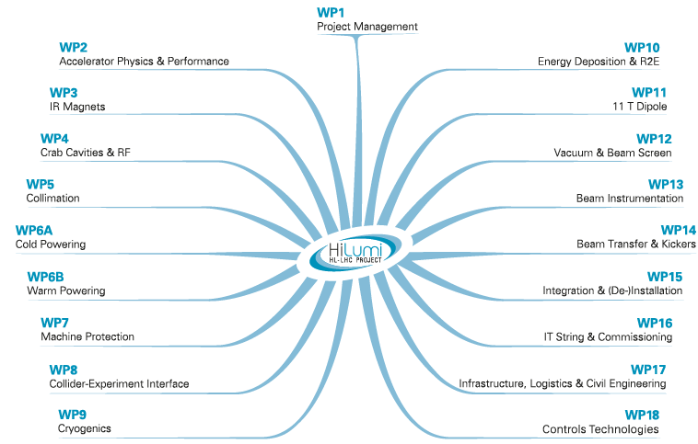
Introduction
Magnet Circuit Forum (MCF)

Slide 5
Introduction
Proper documentation is fundamental for any part of the project
The main questions to address
  Do we have the necessary information in writing ?
  Is the information properly communicated to all Work Packages ?
  Are concerned parties aware of the information ?
  Is the information easily accessible ?
  Is the information properly referenced ?
  How to follow “living” documents ?
  How to trace change ?
  Is the information coherent with the HL-LHC project baseline documentation ?
  Is the information coherent with CERN official documentation ?

Slide 6
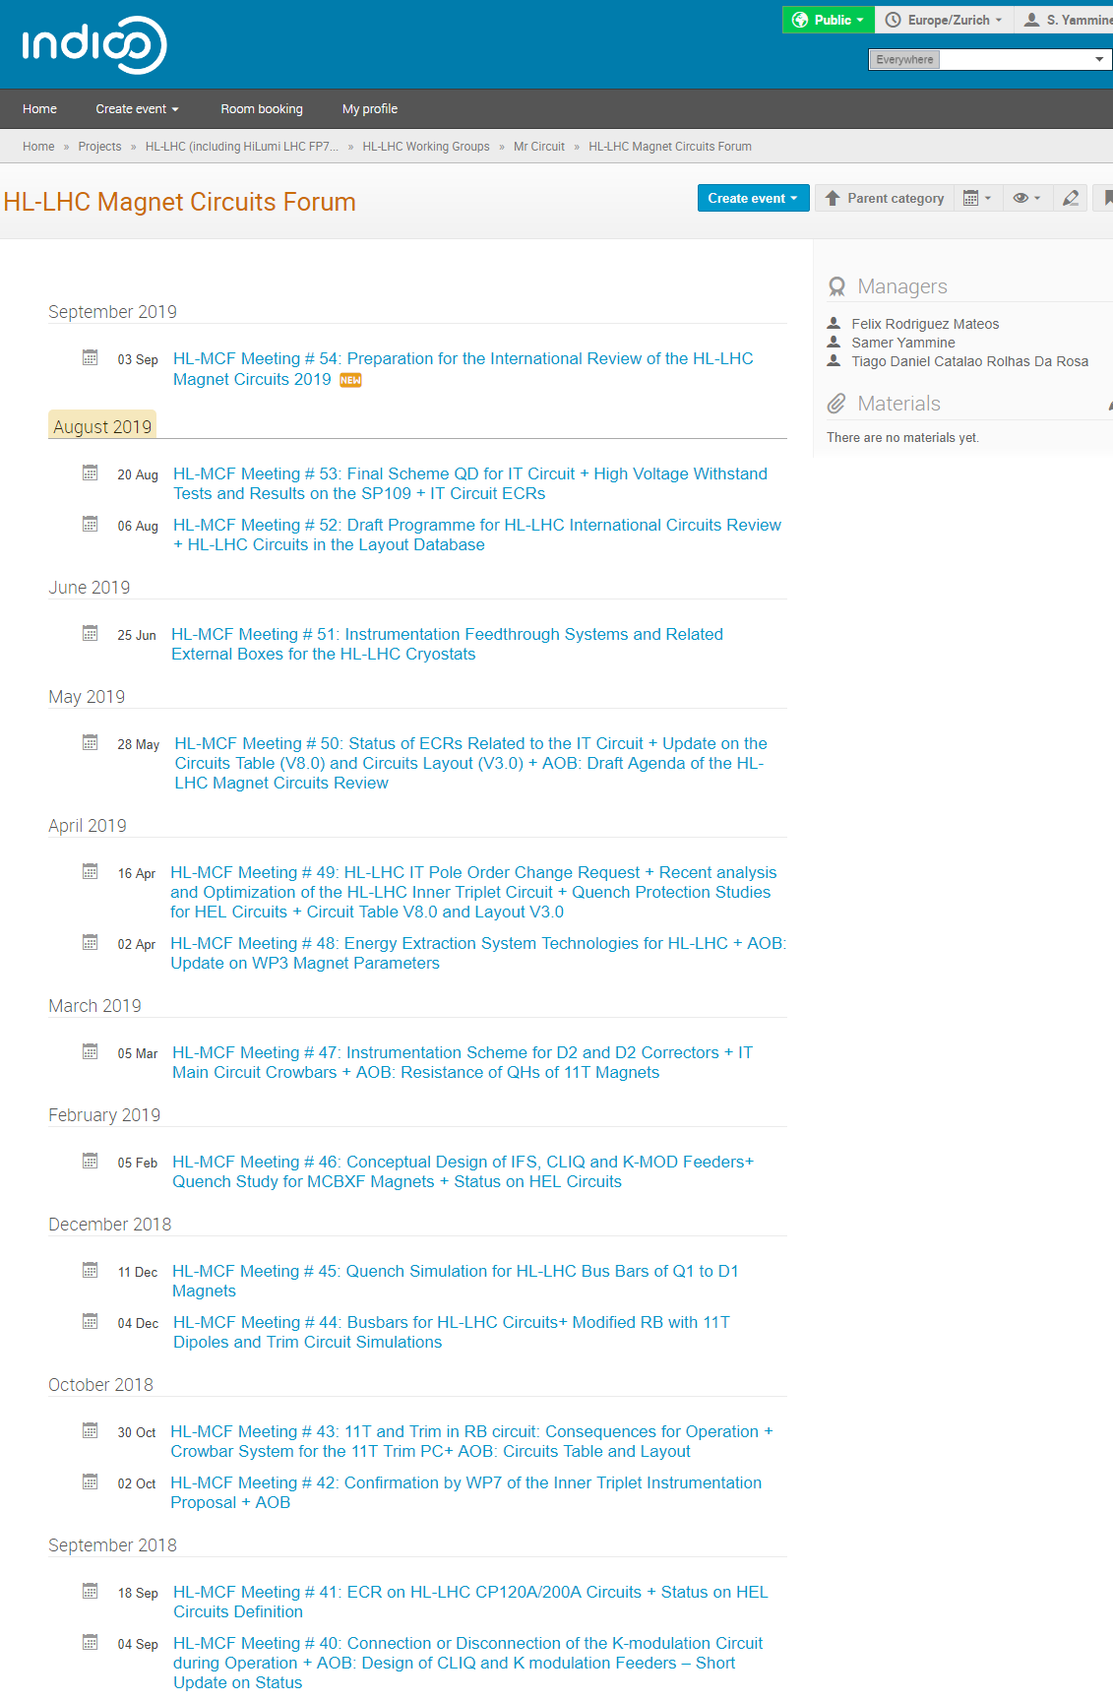
Introduction
Documentation related to circuits are co-ordinated in the MCF meetings
54 regular MCF meetings with 50 members from different WPs
27 topical meetings with reduced attendance
Minutes of meetings include the discussions on circuit information
In average, one in every two meetings, the documentation is addressed

Slide 7
MCF Related Documentation

Slide 8
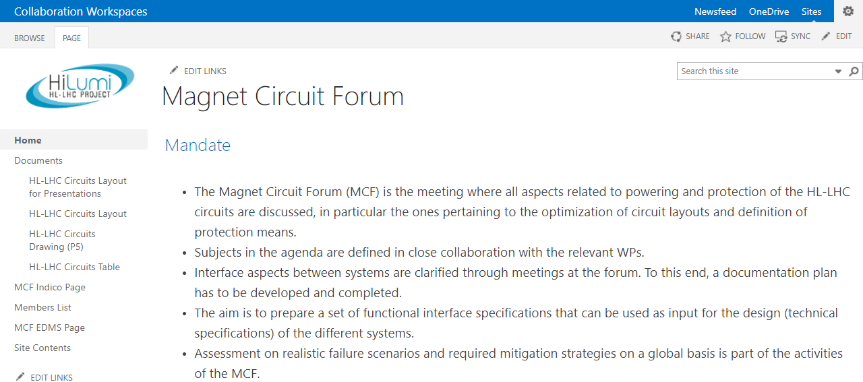
MCF Related Documentation
Magnet Circuit Forum Main Reference Documents
  The HL-LHC Circuits Layout
  The HL-LHC Circuits Table
https://espace.cern.ch/project-HL-LHC-Technical-coordination/MCF/Circuits%20Table
https://espace.cern.ch/project-HL-LHC-Technical-coordination/MCF/Circuits%20Layout/Hilumi_Circuits_Layout_V3.1.pdf

Slide 9
Lifecycle for MCF Related Documents
1. Acquiring change requests from different Work Packages
2. Presenting changes at Magnet Circuit Forum
3. Uploading to Magnet Circuit Forum sharepoint
4. Check by different Work Packages (3 weeks)
5. Presenting circuits changes to HL-LHC Technical Coordination Committee (+ECR)

Slide 10
HL-LHC Circuits Layout
https://espace.cern.ch/project-HL-LHC-Technical-coordination/MCF/Circuits%20Layout/Hilumi_Circuits_Layout_V3.1.pdf

Slide 11
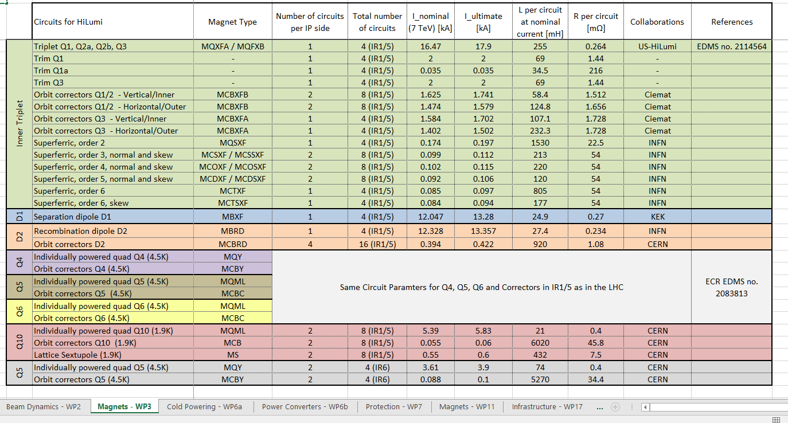
HL-LHC Circuits Parameters Table
MCF leads the update of the circuits parameters table
  In coordination with the different Work Packages
  An excel sheet per involved Work Package
  Main circuit parameters are shown (circuit current, inductance, resistance, operation conditions, etc.)
https://espace.cern.ch/project-HL-LHC-Technical-coordination/MCF/Circuits%20Table

Slide 12
HL-LHC Baseline Documentation

Slide 13

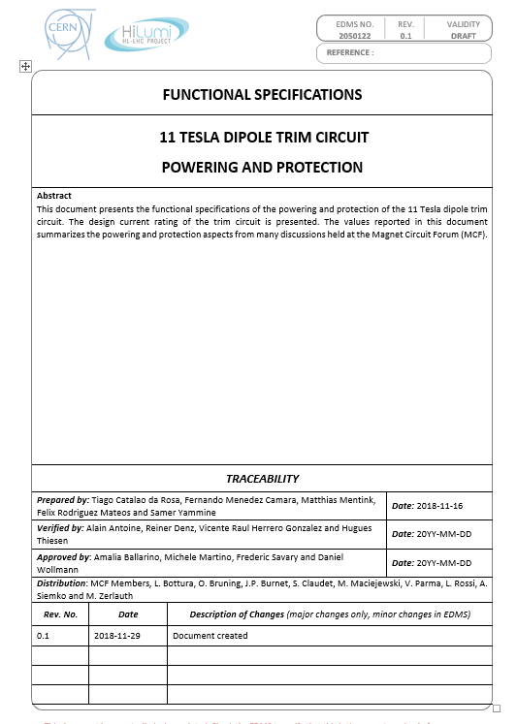
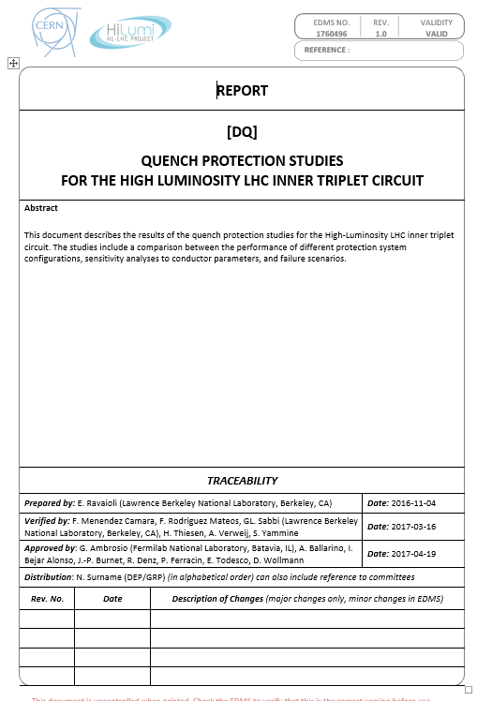
Circuital Functional Specifications Documents
Magnet Circuit Forum team has worked with different WPs
  To define the functional specifications of the relative systems
  To coordinate the studies on the circuits (quench protection, powering, etc.)
  To write the circuital requirements for the systems

Slide 14
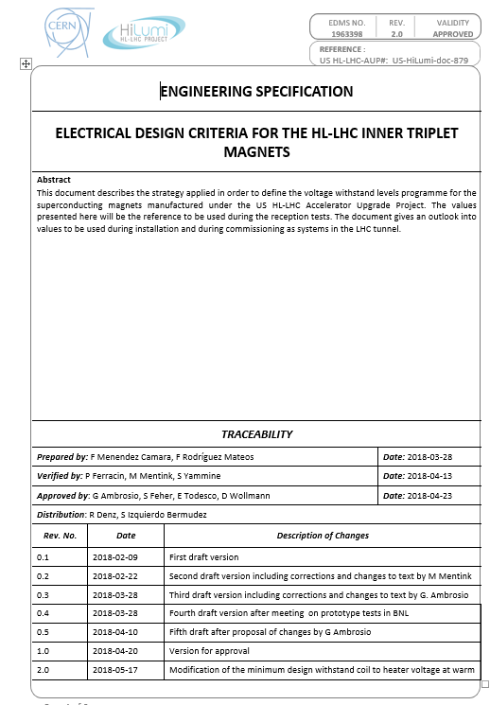
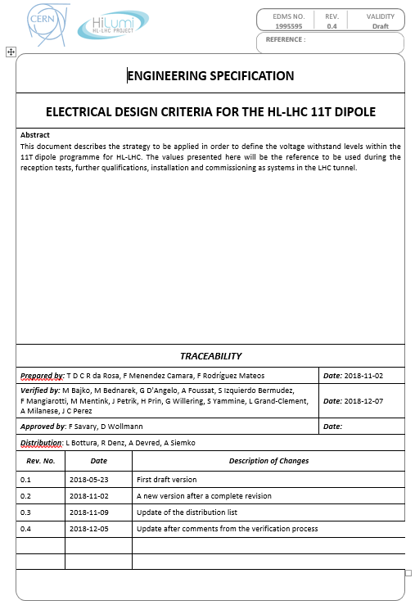
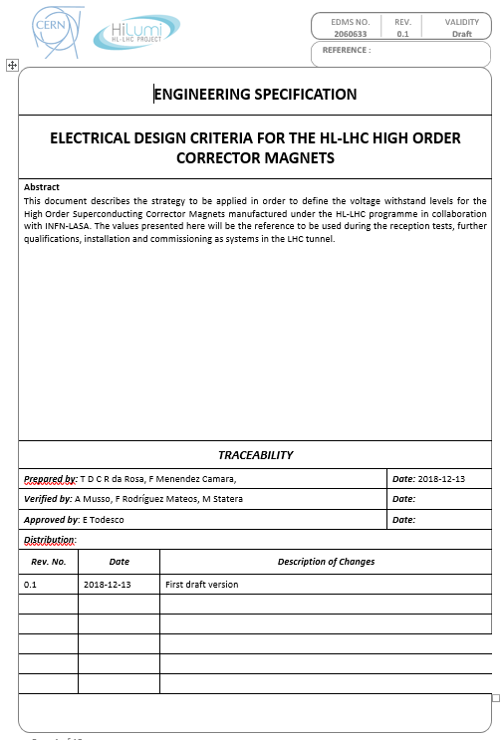
Electrical Design Criteria Documents
MCF has worked to define the electrical design criteria of the circuits
  See Talk of Felix Rodriguez Mateos – Monday 09/09 p.m.

Slide 15
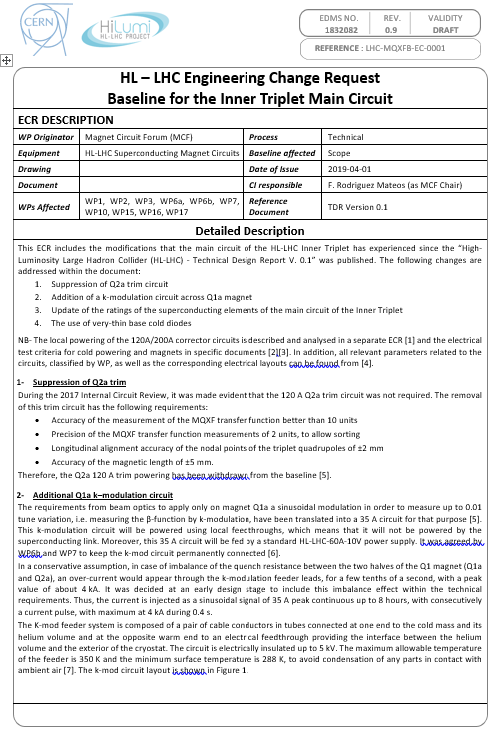
Engineering Change Requests (1/2)
Request for change in the triplet circuit baseline has been launched
  Suppression of the Q2a trim circuit
  Addition of a circuit for k-modulation across half of Q1 (Q1a)
  Update of the rating of the superconducting cables
  Use of cold diodes as a supplementary quench protection element
  Change of the pole order and polarities of the magnet
  Change of the CLIQ connections

Slide 16
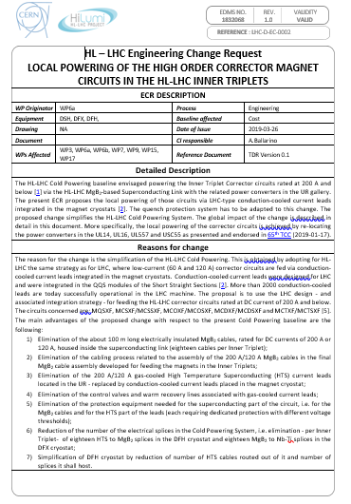
Engineering Change Requests (2/2)
Request for local powering of high order circuits approved
  ECR launched in collaboration with WP6a (cold powering)
  Leads to the simplification of the HL-LHC cold powering
  Power converters placed in LHC galleries (UL14, UL16, UL557 and USC55)

Slide 17
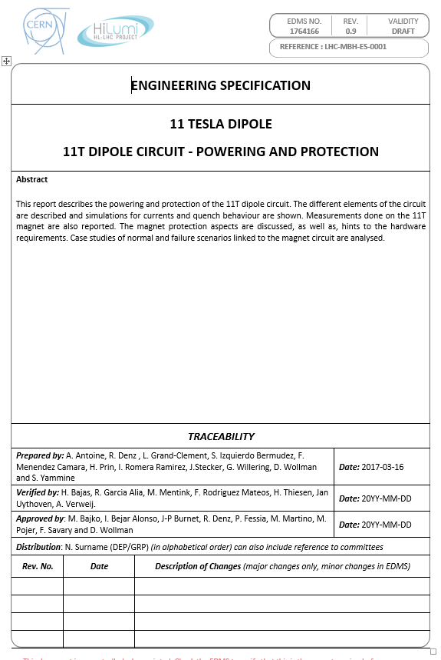
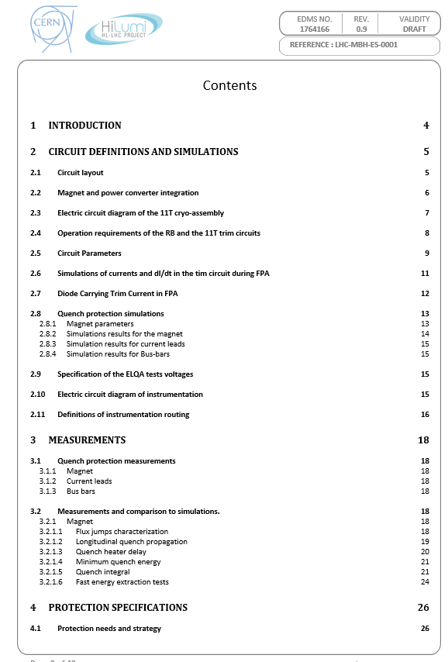
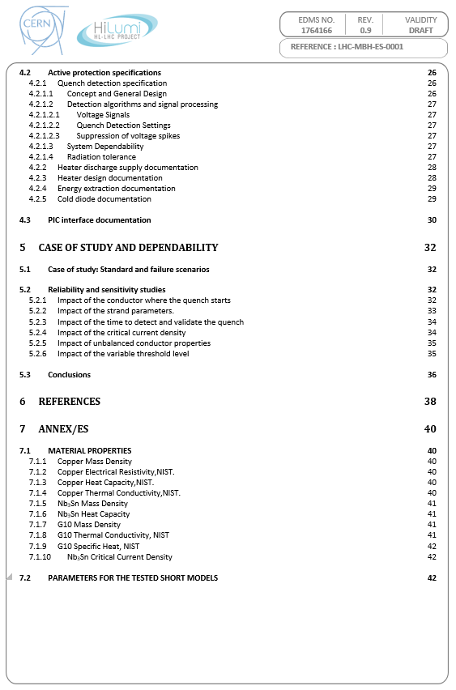
Circuits Documents
MCF has initiated work to define one document per magnet circuit
  Document contains all powering, protection and ElQA aspects of the circuits
  7 documents in total (11T Dipole, Triplet, D1, D2, Triplet Correctors, High Order Correctors and D2 Correctors)

Slide 18
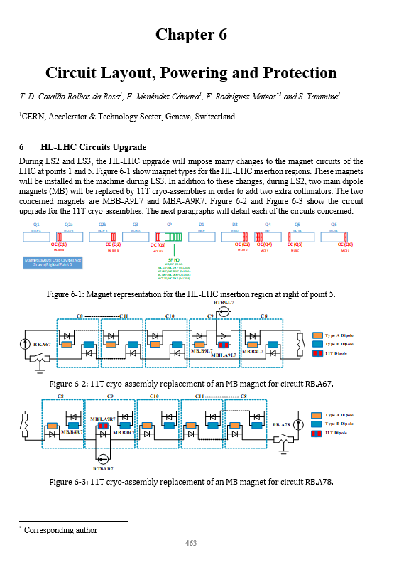
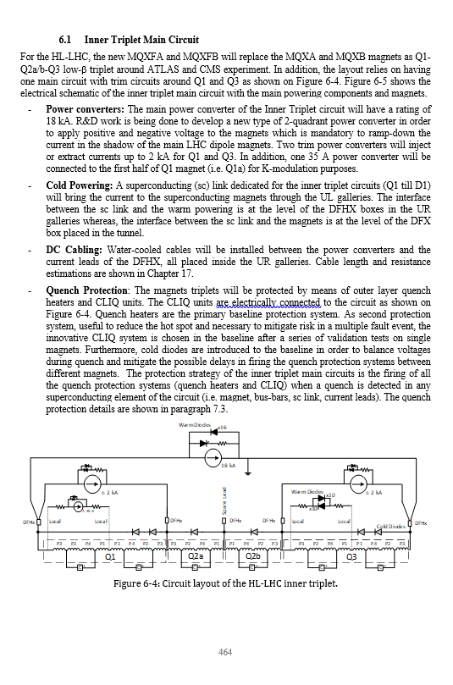
Technical Design Report
MCF has contributed to the circuit related chapter
  Chapter on circuit layout, powering and protection to reflect the baseline
  An overview of the circuits for HL-LHC and the electrical quality criteria

Slide 19
CERN Official Documentation

Slide 20
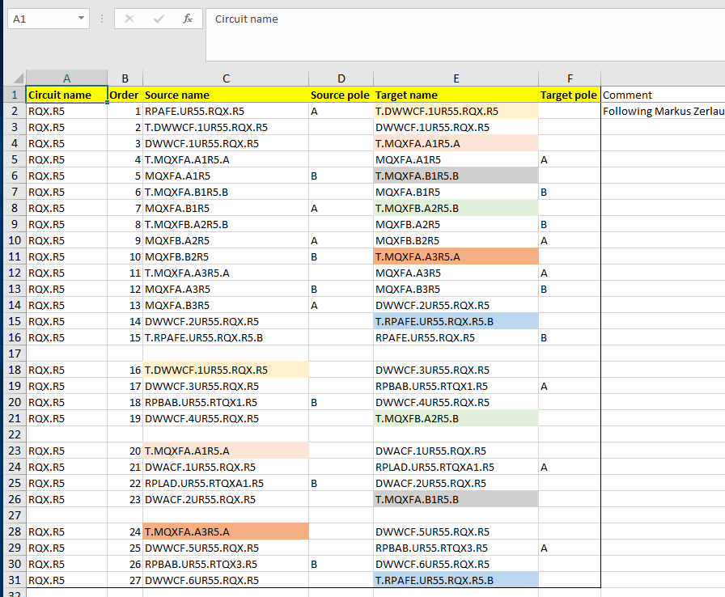
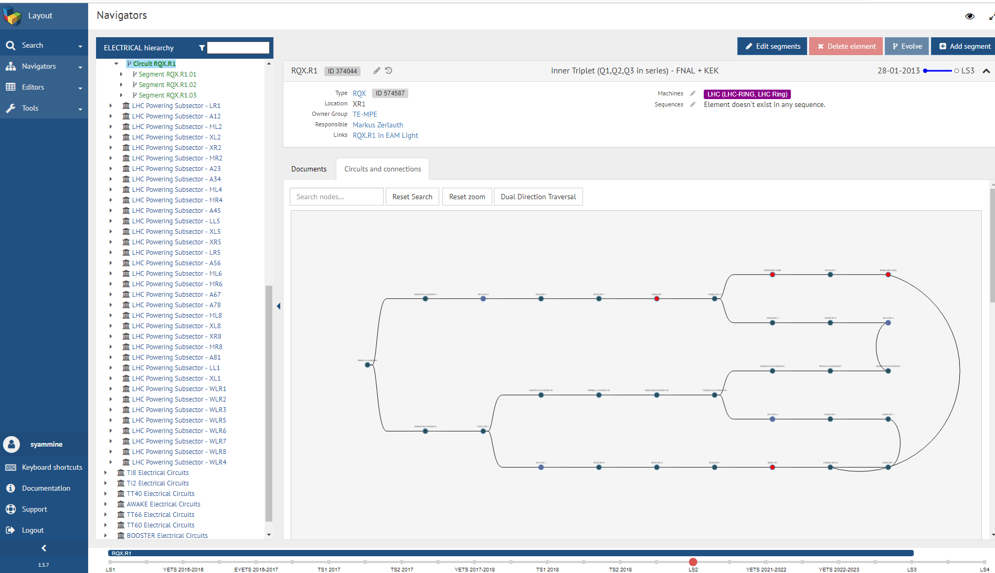
CERN Layout Database
Layout Database is the official database for circuits parameters at CERN
  MCF is coordinating the activity to introduce correct circuits parameters and layout
Circuits Layout
Circuits Description File
Target

Slide 21
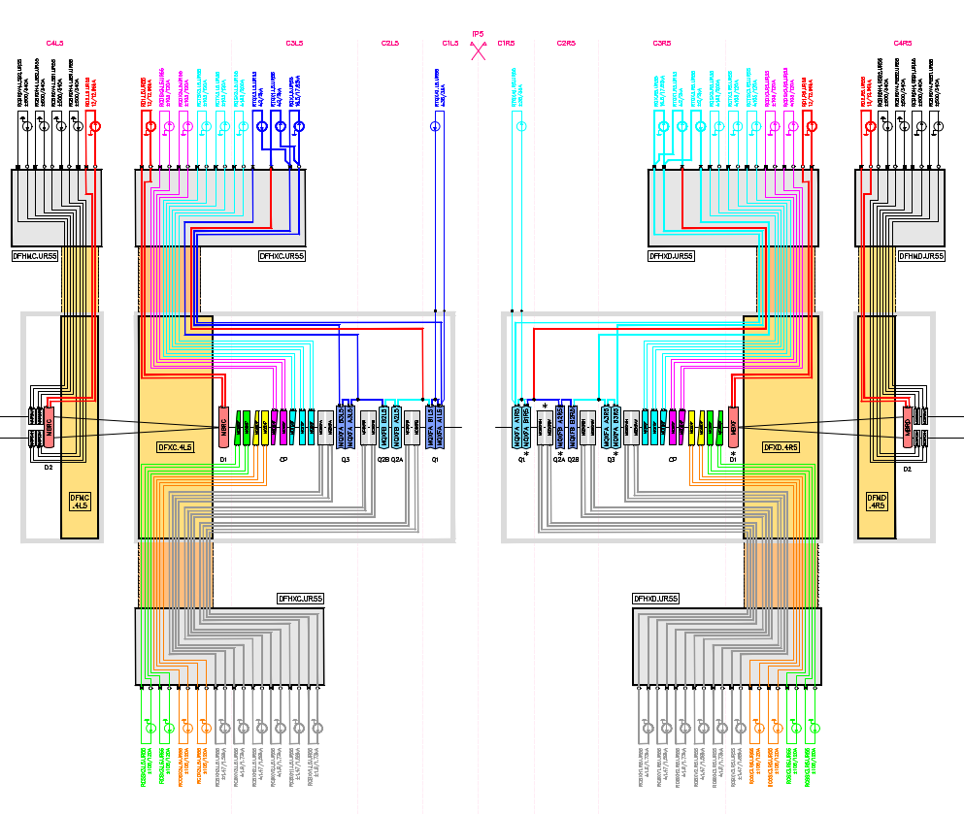
Electrical Diagrams in CERN Drawing Directory
LHCLSD drawings are official documents for electrical diagrams
  MCF is coordinating the introduction of circuits diagram at IP1/5 and IP7

Slide 22
Summary
Magnet Circuit Forum coordinates the documentation related to circuits
  Living documents have been created to reference and follow ongoing work
  Contribution to HL-LHC Project Documentation in coordination with the project office
  Contribution to the CERN official documentation to include 11T Dipole and IR circuits

Slide 23
Thank you for your attention

