Slide 1
Safety Considerations for Magnet Circuits
Thomas Otto, HL-LHC PSO
International Review of HL-LHC Magnet Circuits

Slide 2
Overview
Where do we stand now ?
What is special about HL-LHC powering ?
Achieving Electrical Safety Conformity
Electrical Safety Standards
HL-LHC Safety Process
Safety Workflow and Documentation
Conclusions

Slide 3
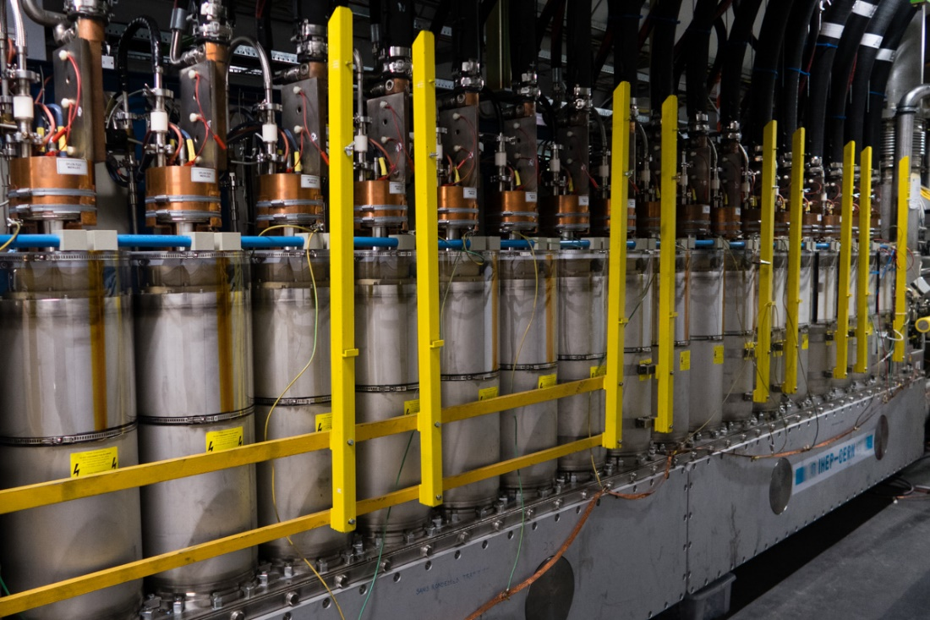
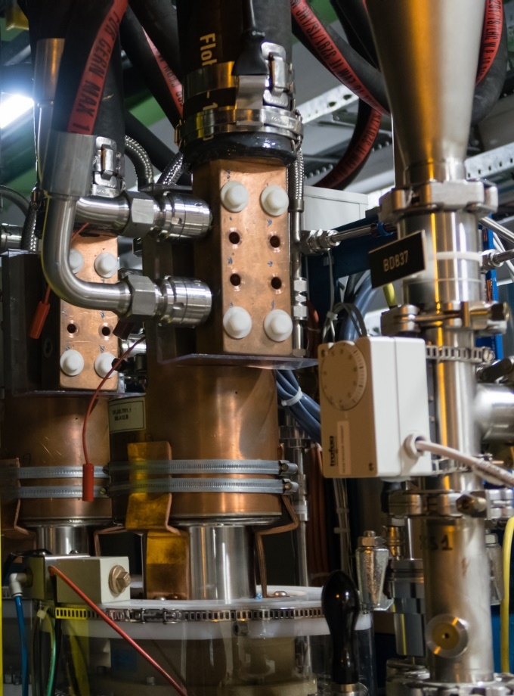
The present situation: LHC DFB
No standard applied
Electrical conductor accessible
Only powered when no personnel in LHC

Slide 4
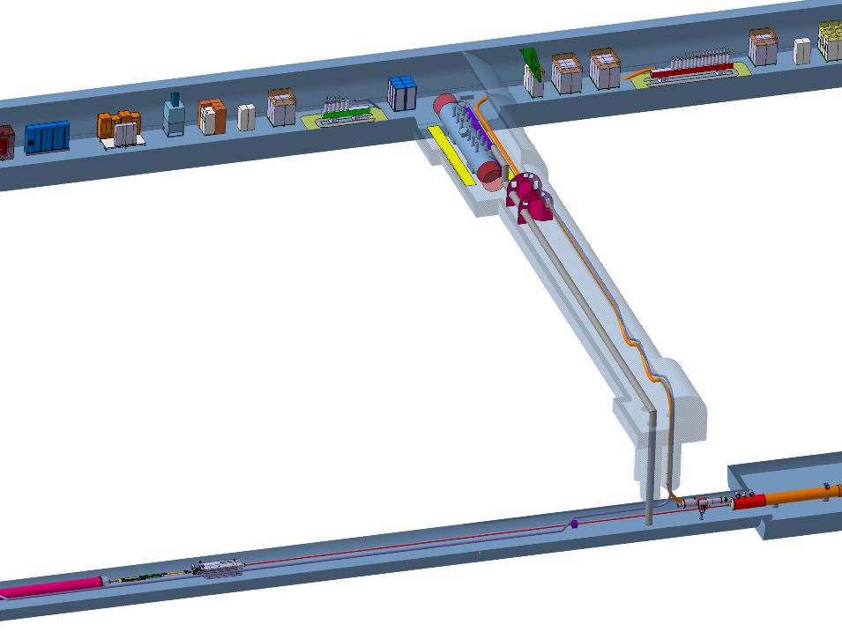
What is special about HL-LHC ?
The Underground areas for
  Power converters
  Disconnector boxes
  DC Feedboxes (DFH)
are accessible to personnel
during accelerator operation
Exposure hazard to
  Direct and indirect electrical contact
  Electrical arcs
Equipment must meet safety conformity standards

Slide 5
Achieving Electrical Safety Conformity
Identify and analyse Directives relevant to the equipment,
Perform a risk assessment in order to identify the requirements to which the product must respond.
Identify the EN/IEC standards,
Prove the compliance of the equipment to the Directive:
  It’s up to the manufacturer to identify the required means of control and testing to prove the conformity of its product with the Directive.
  An independent organism could be required for this control (design report, tests, etc…),
Compile the technical documentation
From G. Le Godec, TE-EPC

Slide 6
Electrical Safety Standards
CERN Safety Code C1
  Refers to applicable regulations in the host states
European Directive 2014/35/EU
(low voltage < 1500 V d.c., < 1000 V a.c.)
IEC standards e.g.
  IEC 61800-5-1 for power drive systems
  IEC 60529 for protection of enclosures (IP code)
  Other applicable IEC or EN standards for specific aspects
CERN Regulations
  IS 23 and IS 41 on Fire Safety and Radiation Resistance of cable insulations, fibres and organic materials in general.

Slide 7

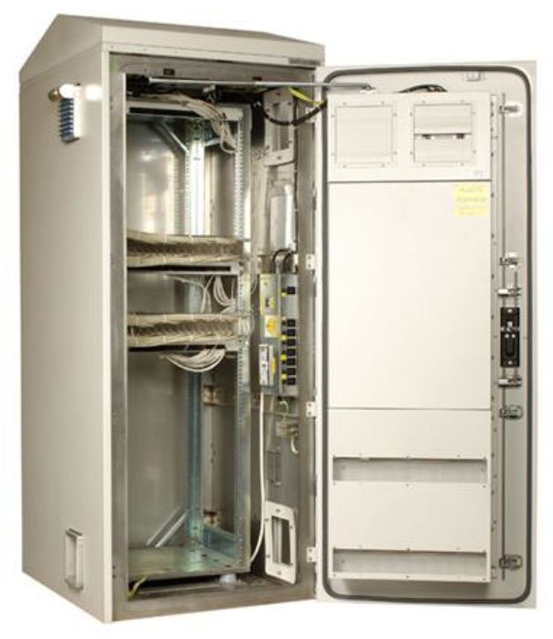
Protection against accidental contacts and arcs
This is example is overdesigned (IP 55)
IP 2x protection against accidental contact
Overhead water protection where required
For all electrical components (PCs, disconnector box, current leads…)

Slide 8
Use of Batteries
Energy storage system in PC for triplet magnets
LTO batteries (Li₄Ti₅O₁₂) with capacity of 40 MJ
Li-Ion batteries can develop exothermal reactions and become a fire hazard
This subject is under close review in industry (transportation, storage of energy from renewable sources, …)
CERN will implement the state-of the-art safety technology for the selected battery type
A local fire suppression system is possible

Slide 9
In-Kind Contributions
In-Kind contributions have to follow the same rules as equipment procured by CERN
This should not pose problems because IEC standards have universal applicability.

Slide 10
HL-LHC Safety Workflow
Identification of Equipment (“System”)
  Hazard Register
  Standard Mitigation (CERN rules, EU directives, Int. Standards, guidelines from professional associations or occupational safety institutes)
HSE assessment if this is a system with “major safety implication” (mSi)
  Risk assessment if standard mitigation not readily available
  Risk-specific mitigation
  HSE Safety Clearance (where required)

Slide 11
Safety Workflow
Simplified from EDMS 1827925 v.2.0

Slide 12
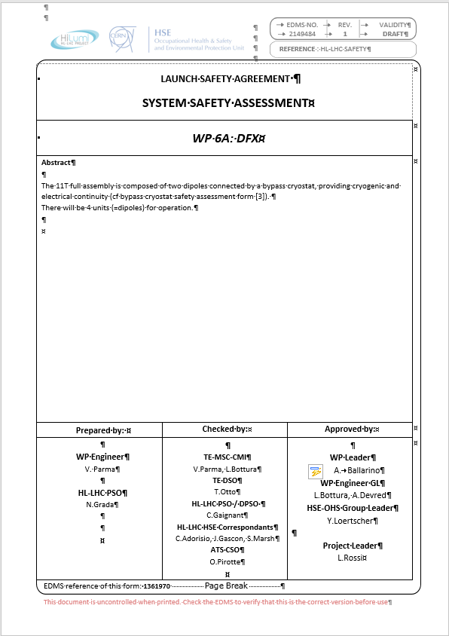
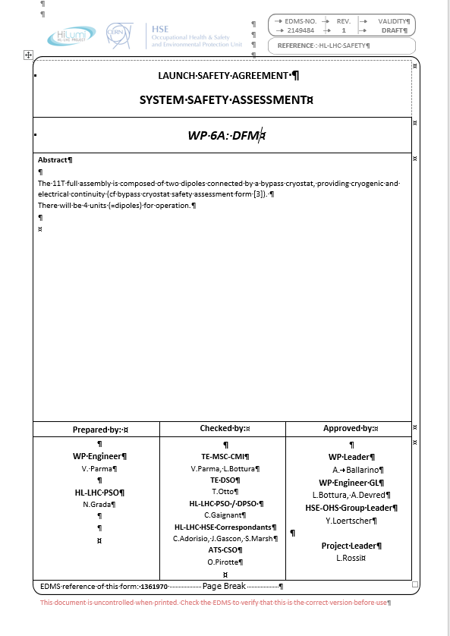
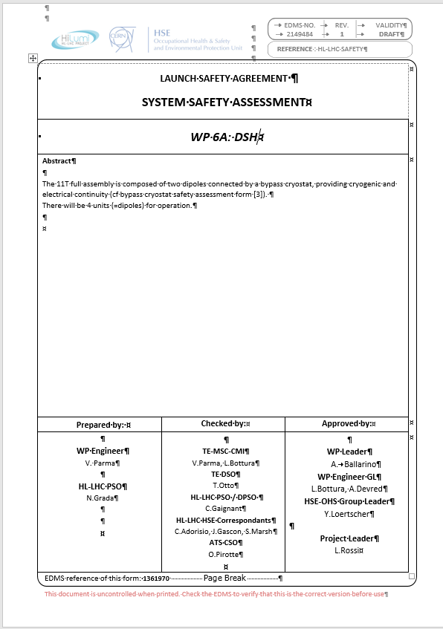
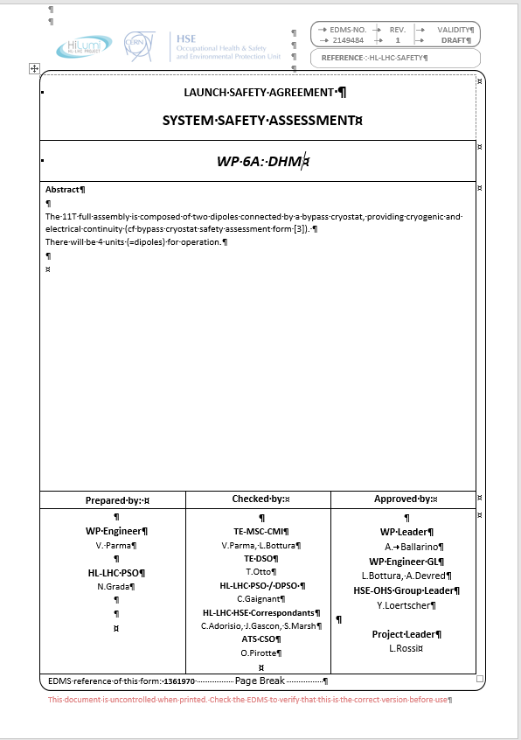
Safety Documentation
System Safety Assessment (SSA)
Document travels between project and HSE unit
  (Sub-)system description
  Hazard register
  Definition of mitigation measures
  Risk assessment, where required
  Safety clearance
Links to EDMS locations:
  WP3
  WP6a
  WP6b
  WP11

Slide 13
Summary
Electrical installations under full power are accessible to personnel
Design and construction must meet international safety standards
Particular focus on IP rating of all components and batteries
A safety workflow between Work Packages, Project Safety Officers and HSE Unit exists and has already proven its effectiveness

