Slide 1
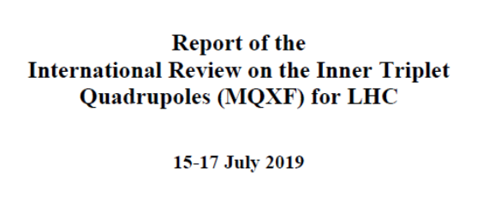

Slide 2
New Test & Present Design
Does the present design meet the proposed test/requirement?
Answer: yes (with limited statistic)
Fig 5. Heater-Coil HiPot in He gas (1 bar) after magnet training
MQXFAP1b
prototype
Proposed test

Slide 3
Long Term Reliability
Is QH insulation performance getting worse with number of quenches or thermal cycles?
Answer: No
  MQXFS1: 350 quenches
  and 7.5 thermal cycles
1st failure

Slide 4
Helium Pressure During Quench
QH-Coil HiPot is performed in ~1 bar He gas
During quench the pressure of He trapped in bubbles is expected to increase significantly providing additional margin against voltage breakdown
Max at I__{Ultimate}

