Slide 1
How are the splices made between the trim bus bars (11T MBH), the k-mod and the CLIQ feeders (QXF), as well as the trim bus bars to the magnet leads (QXF) at the level of the cold mass?
H. Prin
2019-08-29 CM Meeting

Slide 2
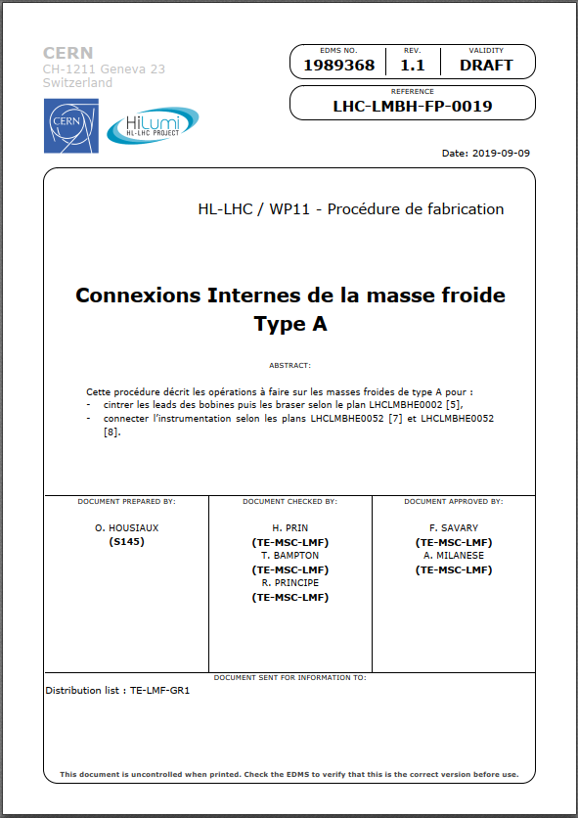
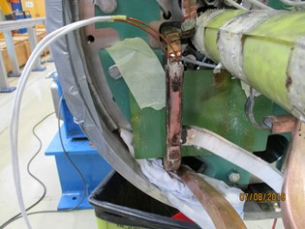
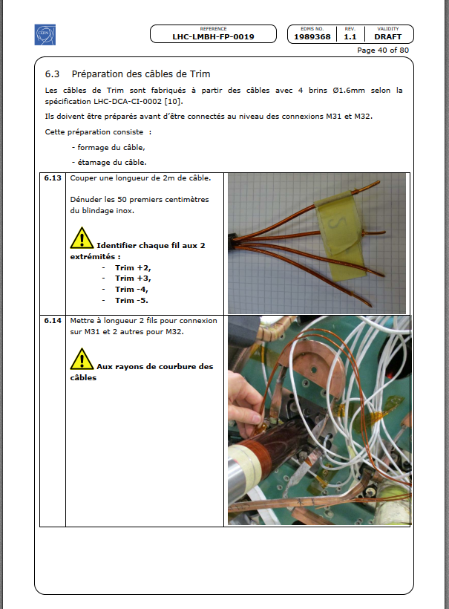
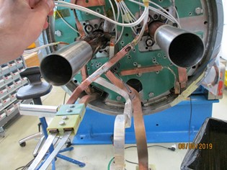
11T Trim busbars connection to the main circuit (inside the cold mass)
Procedure described in LHC-LMBH-FP-0019 (EDMS 1989368) page 40 to 62
https://edms.cern.ch/document/1989368/1.1

Slide 3
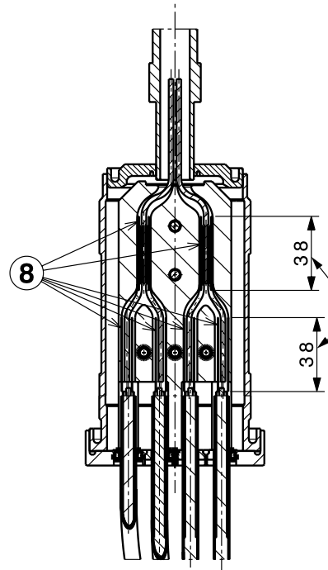
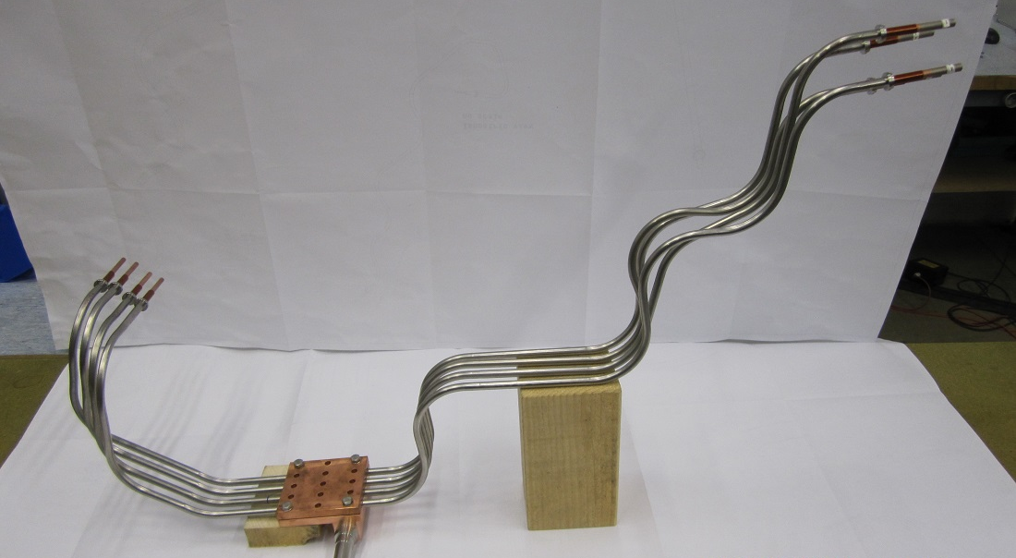
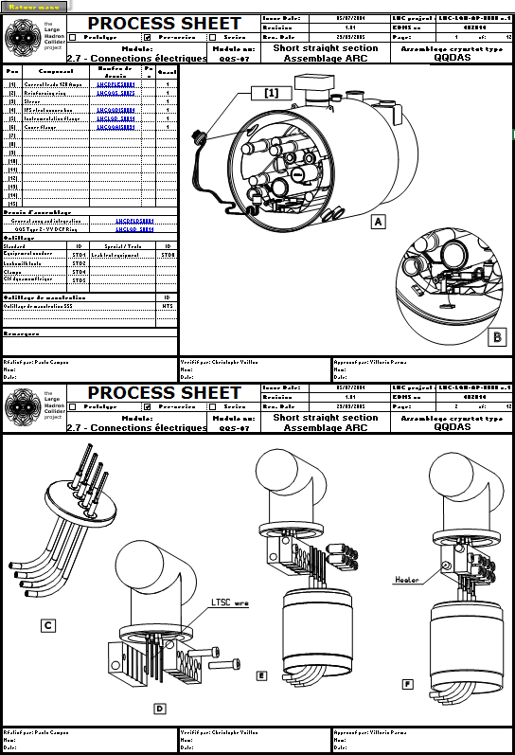
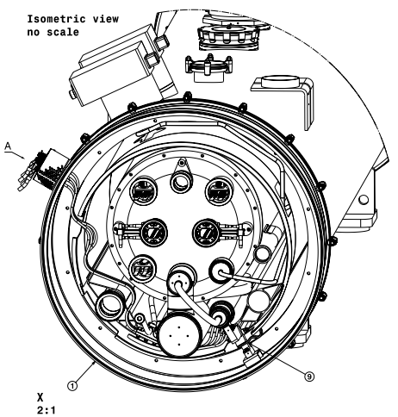
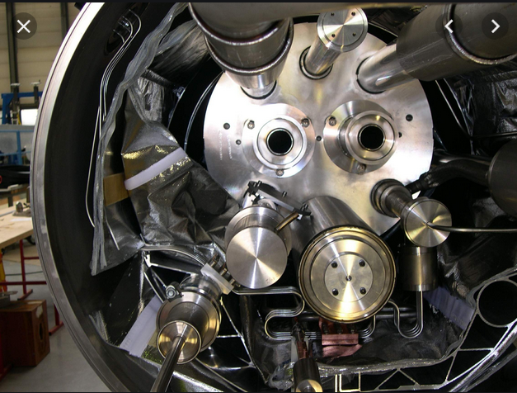
11T Trim busbars connection to the conduction cooled feedfrough
LHC Sc 600A cable Ø5.6mm
(4wires Ø1.6mm) from the cold mass
Connections identical to the ones used in the LHC SSS for the 60 and 120A leads to feed the orbit correctors.
Pieces and procedures are identical, only the position differs

Slide 4
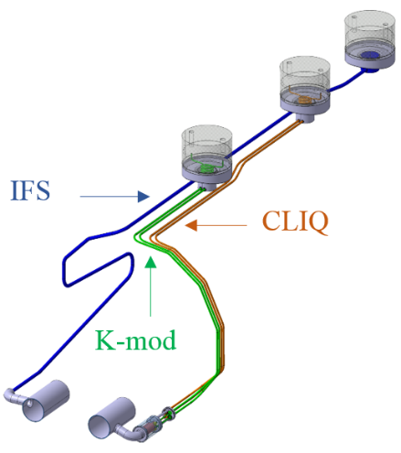
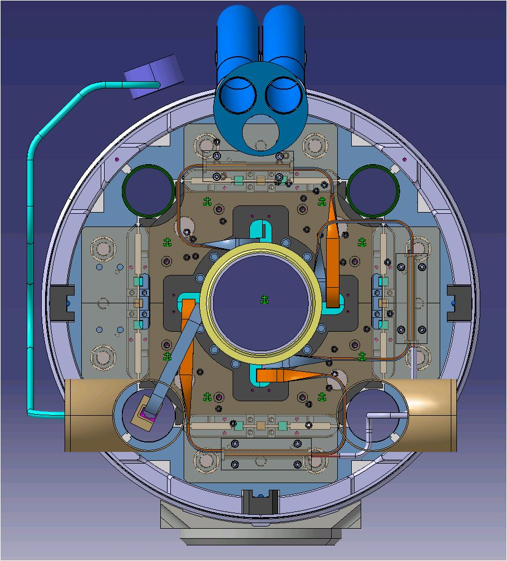
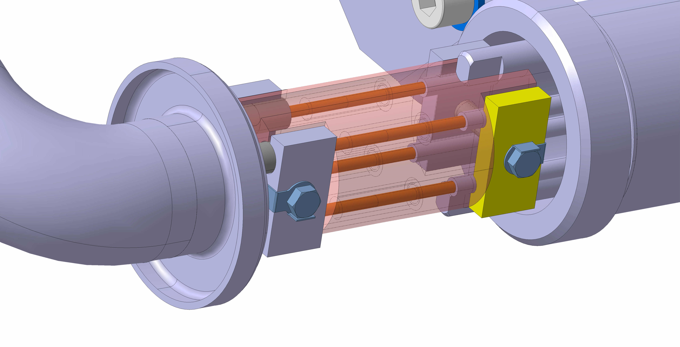
CLIQ splicing to MQXFB leads
No development launched yet
To be adapted from the procedure that was used from the first CLIQ test on a LHC main dipole (MB2387). Very similar to the 11T trim connections, the groove in the copper stabiliser has to adapt the CLIQ cable dimensions
Connections to MQXFA (US) might be different, see next slide
CLIQ cable (10mm² Habia)
Specification
https://edms.cern.ch/document/2214983/1.0
Certificate of conformity of the 200m ordered
https://edms.cern.ch/document/2214990/1

Slide 5
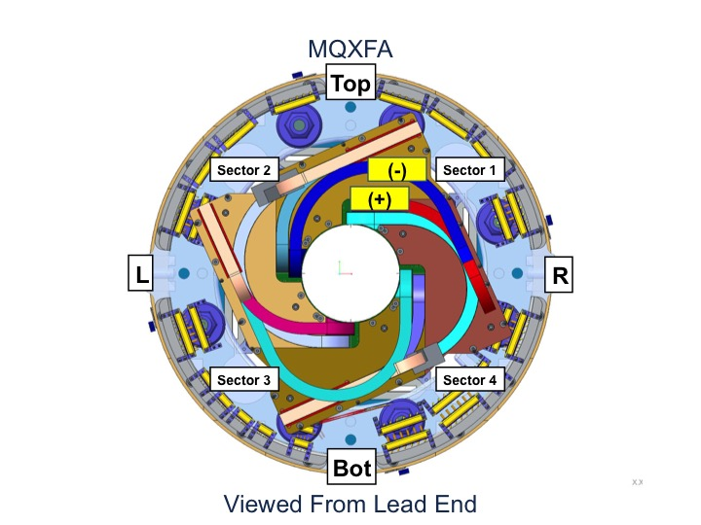
k-mod Connections
To be addressed to our US-LARP colleagues (no k-mod leads in the Q2 cold masses made at CERN)
Design of the connection boxes is significantly different from US and CERN magnets
P2
P1
P3
P4
Q1/Q3
Q2

Slide 6
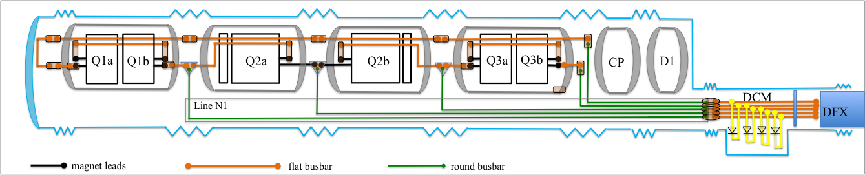
18kA Trim connections to the magnet leads
Design
Splices to be soldered in the magnets interconnections in the tunnel
Prototype splices were produced with two different round 18 kA cables.
The round cable is first soldered to a Cu housing using Sn96Ag4 solder. Afterwards the assembly is soldered onto the flat Rutherford cable busbar using Sn60Pb40 solder, in order to prevent de-soldering of the round cable.
E. Tsolakis, et al, “Busbar technology development for the HL-LHC inner triplet magnets”, submitted

Slide 7
18kA Trim connections to the magnet leads
On going developments
Non destructive testing
The splice quality has been verified by four-point resistance measurements using a digital micro-ohmmeter, with a test current of 10 A at ambient temperature.
Electrical tests and micro-tomography show that in the prototype splice centre 12 cm are well stabilised and soldered. The splice extremities will be further improved.
Splices will be validated by cold tests at high current.
Courtesy of C. Scheuerlein

