Slide 1
Experience with quench protection equipment effects on the beam in LHC
- additional slides
A. Apollonio, T. Cartier-Michaud and D. Wollmann for WP7
With inputs from: M. Blumenschein, D. Carrillo, R. Denz, B. Lindstrom, E. Ravaioli, F. Rodriguez Mateos, M. Mentink, A. Siemko, D. Sollich, J. Uythoven, M. Valette, A. Verweij, C. Wiesner, M. Zerlauth
International Review of HL-LHC Magnet Circuits 9.-10.09.2019, CERN

Slide 2
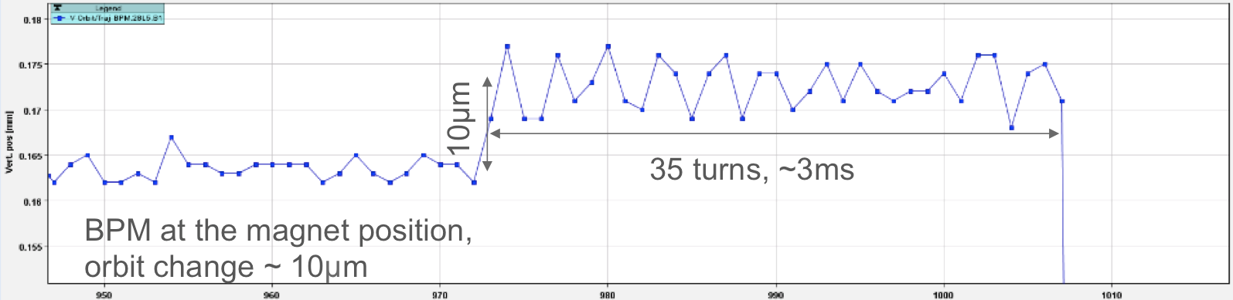
Orbit oscillation during LHC dipole quenches
Losses observed during beam dump following a magnet quench (2017) → traced back to small orbit oscillation ~ 35 turns (3 ms) before the beam dump)
Analysis of previous beam dumps due to dipole quenches (all around the ring) revealed that this behavior can be observed systematically for beam dumps triggered via QPS → PIC →BIS
Check with QPS experts revealed that up to 5 ms delay between quench heater power supply and PIC trigger could be explained by variation in opening times of mechanical relays
Effect has never been observed for LHC triplet (probably due to different QPS architecture)

Slide 3
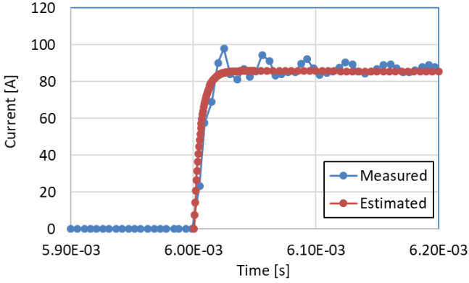
Quench heater discharge: Ultrafast current rise
Ultra fast effect, quench heaters reaching full current/field within less than 1/2 LHC turn
  MB: ~ 29 us; MQXF: ~ 35 us
Spurious triggering of one QH unit cannot be excluded

Slide 4
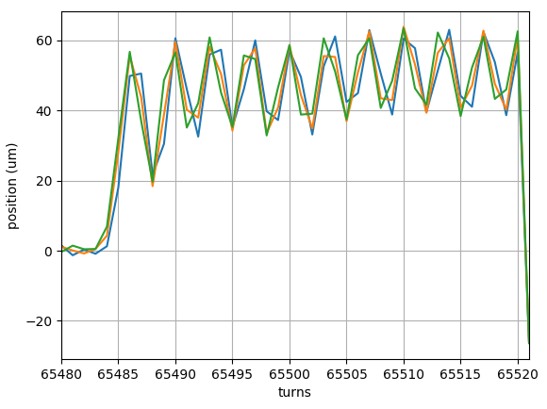
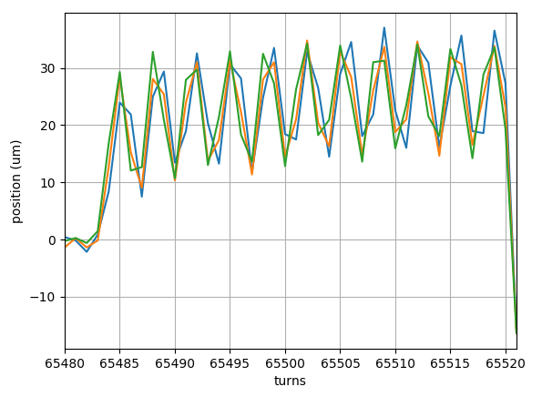
Dedicated experiments with MB.C28L5
MB.C28L5
Beam screen temperatures ~20 K (nominal) and ~70 K
Quench heaters fired at injection energy (450 GeV), 5822 A (3.5 TeV) and 10792 A (6.5 TeV)
Kick & magnetic field from quench heaters reconstructed beam position changes
3.5 TeV
Measured beam excursion at ADT pick-up (Q7R5)
6.5 TeV

Slide 5
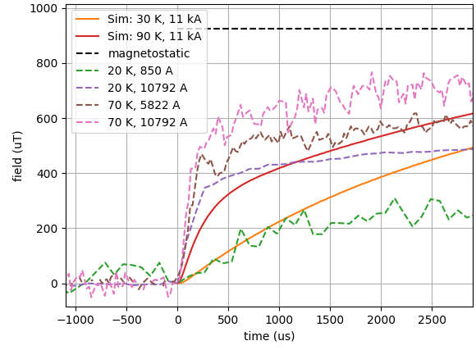
Experience from LHC dipoles (dedicated experiment)
Triggering of QPS in test mode via current source
Fast rise of field from quench heaters reaching up to 70 % of magneto static value after 1 ms
Measurements show two time constants.
Rise time depends on beam screen temperature and main circuit current
Qualitative good agreement with expectation
Quantitative discrepancy between simulations and measurements
Detailed studies of shielding effects required (experiments & simulations)

Slide 6
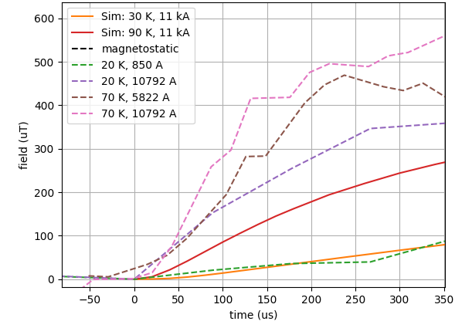
Rise time of magnetic field (10 % → 65 % at 1 ms)
110 us
140 us
175 us
500 us

Slide 7
Summary from LHC dipole experiment results
Effect of beam screen temperature increase from 20 K → 70 K:
  Faster rise time and higher magnetic field reached as expected
  Quantitative changes not reproduced by models
Effect of increased main field with beam screen at 70 K:
  Faster rise time and higher magnetic field reached as expected
  Quantitative order of change correct, details to be understood
Effect of increased main field with beam screen at 20 K:
  Much faster rise time and significantly higher magnetic field reached
  Relative change in good agreement with models
Energy (TeV) | I (A) | T (K) | ρ (10⁻¹⁰Ω.m) | QH field rise time (10% → 65% at 1ms) (us) | fraction of magnetostatic field after 1 ms
0.45 | 850 | 20 | 2.5 | 500 | 0.22
6.5 | 10792 | 20 | 5.22 | 175 | 0.47
3.5 | 5822 | 70 | 17.4 | 140 | 0.57
6.5 | 10792 | 70 | 18.52 | 110 | 0.69

Slide 8
Expected kicks from HiLumi magnets with all QH fired
Magnet (all QH) | LHC kick (sigma) | → | HL-LHC kick (sigma)
MB | 0.3 | → | 0.5
D1 | 1.4 | → | 2.0 → < 0.5
D2 | 1.2 | → | 2.4 → < 0.5
11 T - dipole | 0.04 | → | 0.4 → 0.03
Triplet | 2.5 | → | 33.7
Triplet (single QH) | 0.6 | → | 1.3
Comparison of kicks from quench heaters discharges (magnetostatic values)
Impacts of quench heaters on beam has been reduced/mitigated for HL-LHC magnets by change of connection schemes (dipole → quadrupole fields)
  Applied for 11 T, D1 and D2
HL triplet quench heater connection scheme has been optimised to reduce the effect of a spurious discharge of a single quench heater.
Measurements during MQXF short model test and new HL triplet beam screen were not conclusive due to limited bandwidth of measuring devices → dedicated studies required

Slide 9
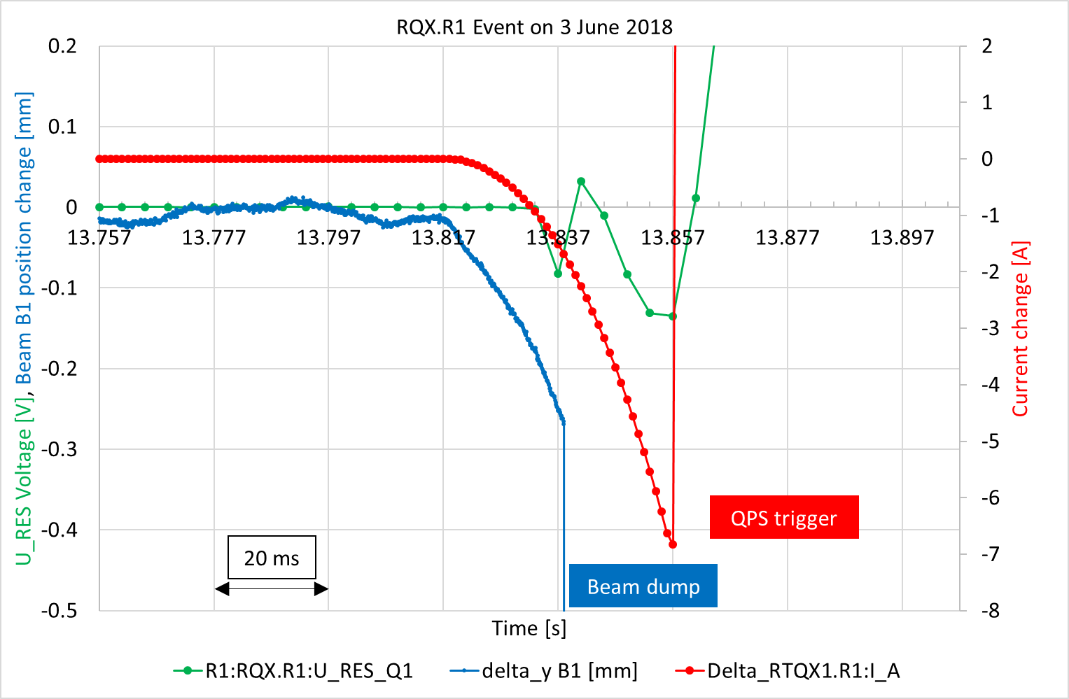
Effect of quench in LHC triplet on beam
Event overview:
Symmetric quench of RQX.R1 due to cryo-control problem
Orbit offset of ~250 um with dI = 1.7 A (I_circuit = 6.2 kA) causing beam loss induced beam dump
QPS triggering ~20 ms after beam dump
Detailed analysis of event documented in internal note: B. Lindstrom, E. Ravaioli, "Analysis of the sequence of events in the RQX.R1 circuit on 3 June 2018"
Small changes in triplet current can cause important beam kicks due to big beta functions and crossing angle (beam offset from magnetic centre)
Quenches are sufficiently slow to allow dumping the beams before critical loss levels are reached
HL triplets will have symmetric quench protection

Slide 10
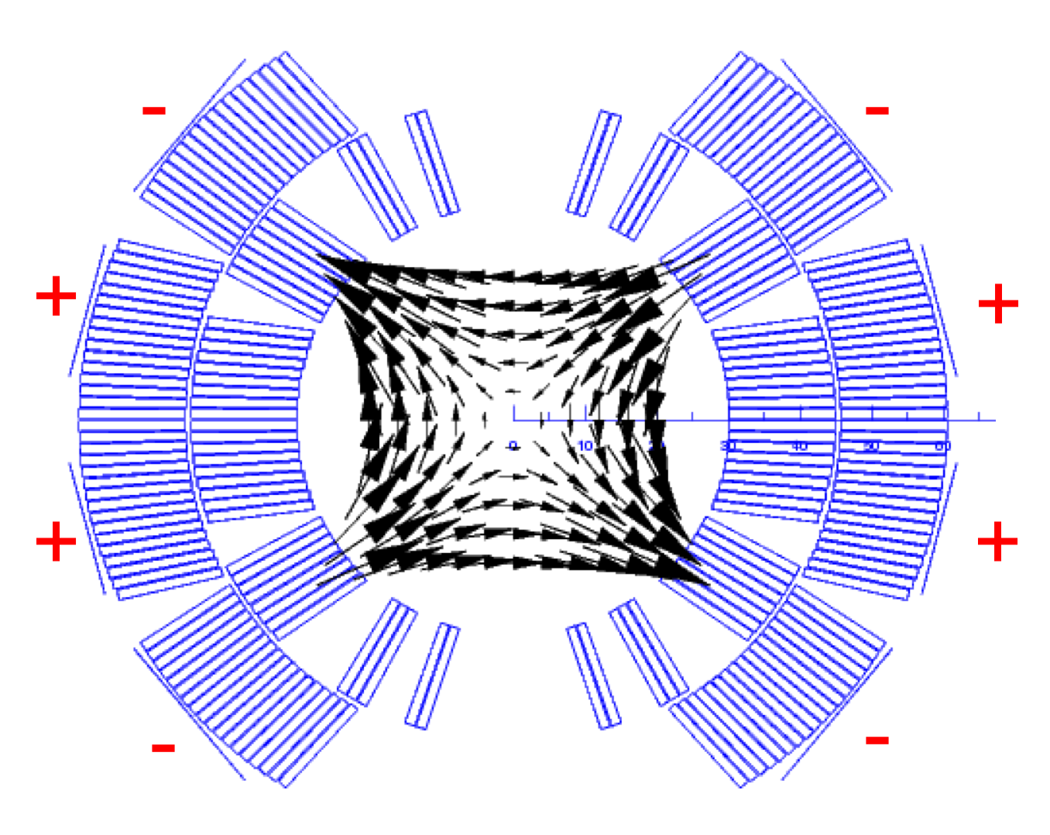
Mitigations for effects of magnet protection equipment on beam
QHs in quadrupole connection schemes (or other higher orders) instead of skew dipole scheme, if possible when taking into account other critical parameters (e.g. voltages heater to coil)
Interlock sequence needs to ensure that beams are dumped before the quench heater and CLIQ discharge is triggered
Symmetric quench detection for inner triplet
CLIQ connection scheme to avoid asymmetric discharges in poles
Interlocking spurious discharge of CLIQ and quench heater power supplies
Study shielding of beam screen & coils → simulations & experiments
Polarity of 11 T QH strips
Step | Duration
Detection QH discharge (di/dt ≈ 4 MA/s) | 100 μs
Detection CLIQ discharge (di/dt ≈ 200 kA/s) | < 500 μs
Communication DQHSU → PIC → BIS | 12 μs
Beam abort sequence | 270 μs
Total | < 1 ms

Slide 11
CLIQ slides for reference

Slide 12
Effect of one spurious CLIQ dis-charge in IT
Old baseline
A spurious discharge of a single CLIQ unit cannot be excluded

Slide 13
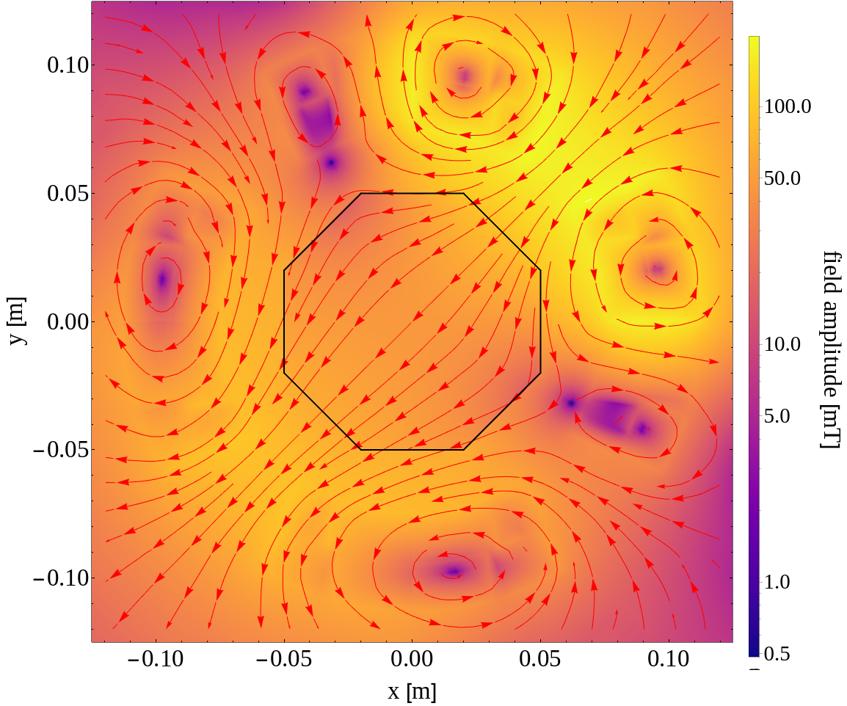
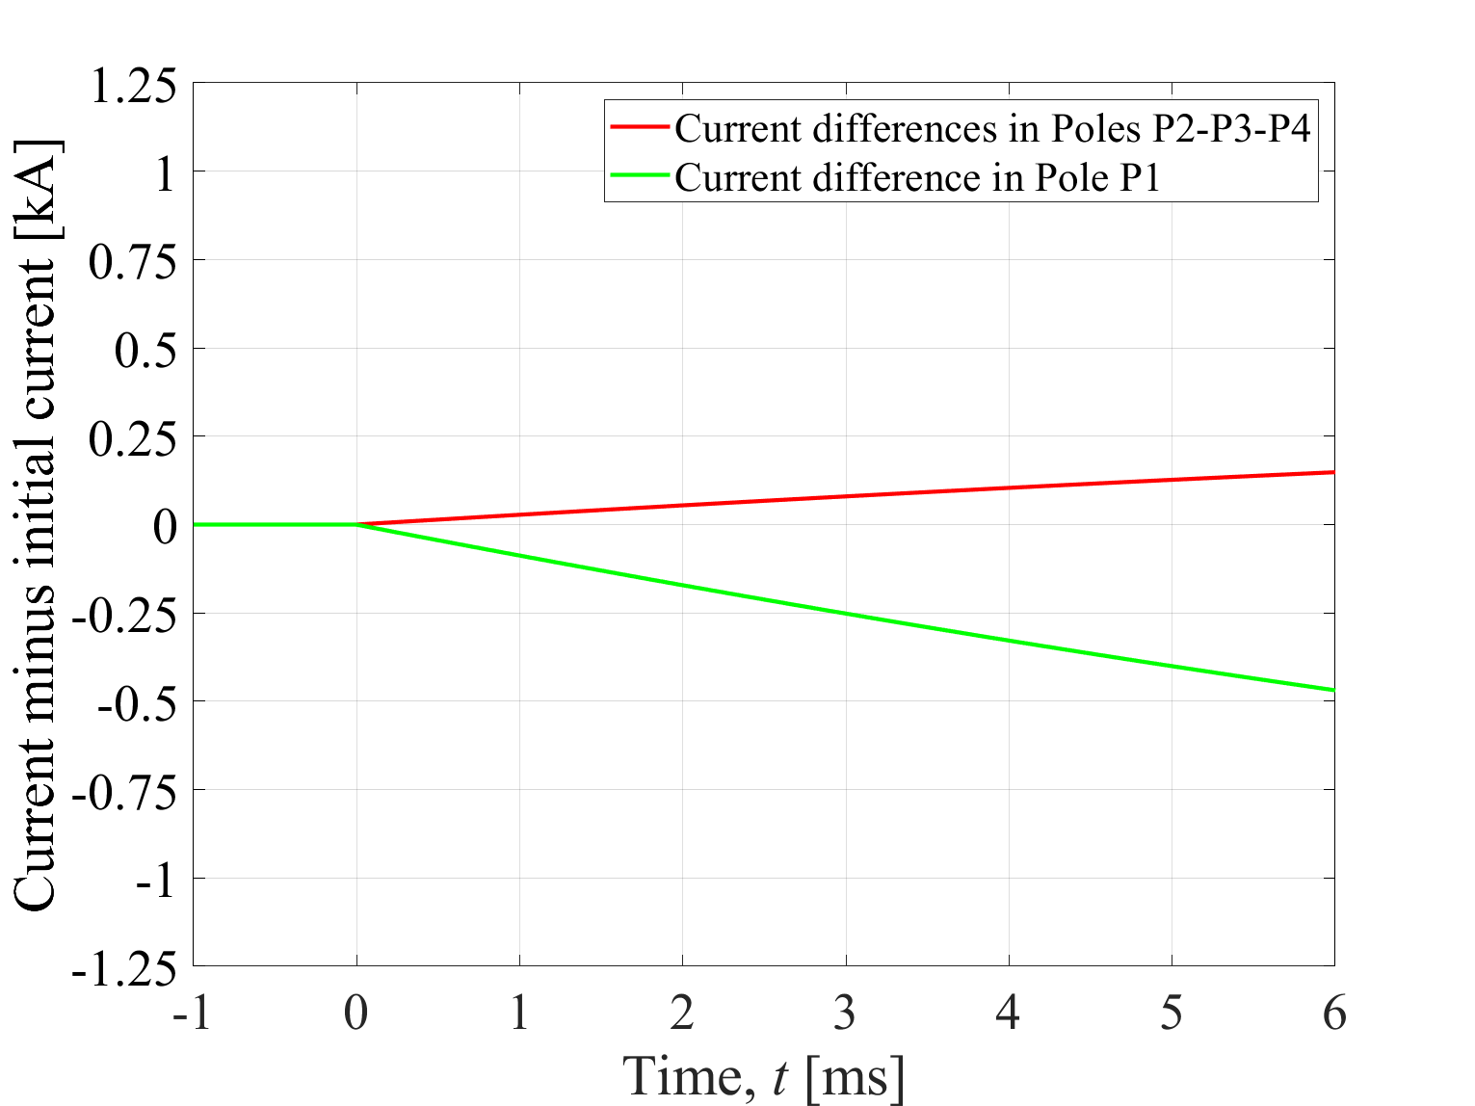
Spurious CLIQ discharge in Q1/Q3
Asymmetric discharge into the poles of the Q1a/b (respectively Q3a/b)
Skew dipole field in magnet causing kick of beam
Additional (much weaker) dipole component during discharge of magnet current due to beam offset (Q1: up to 9.8 mm, Q3: up to -17.1 mm)

Slide 14
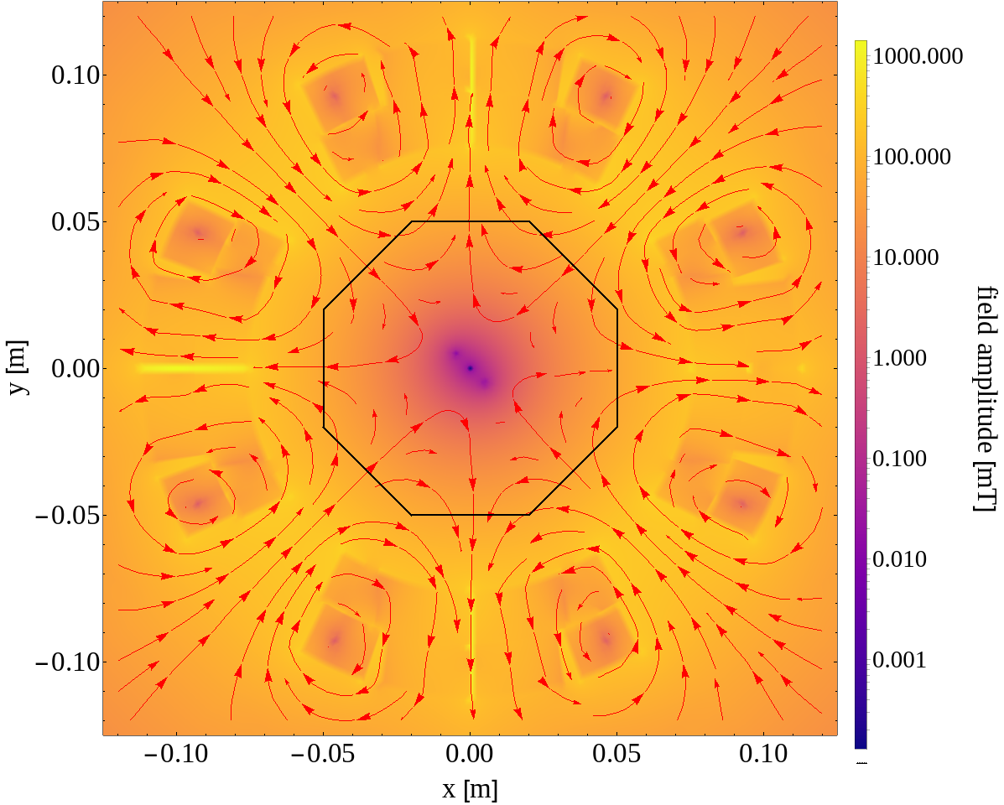
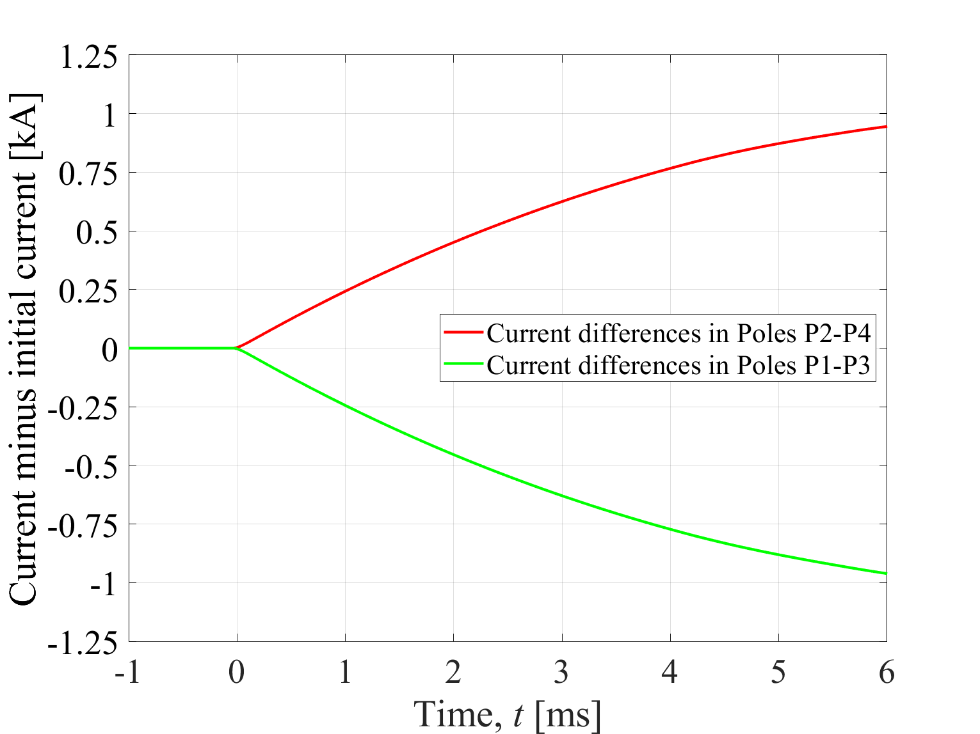
Spurious CLIQ discharge in Q2
Symmetric discharge into P1-P3 and P2-P4 of Q2a/b
Octupolar field
Dipole component developing during discharge of magnet current due to beam offset (up to 16.6 mm) in Q2

Slide 15
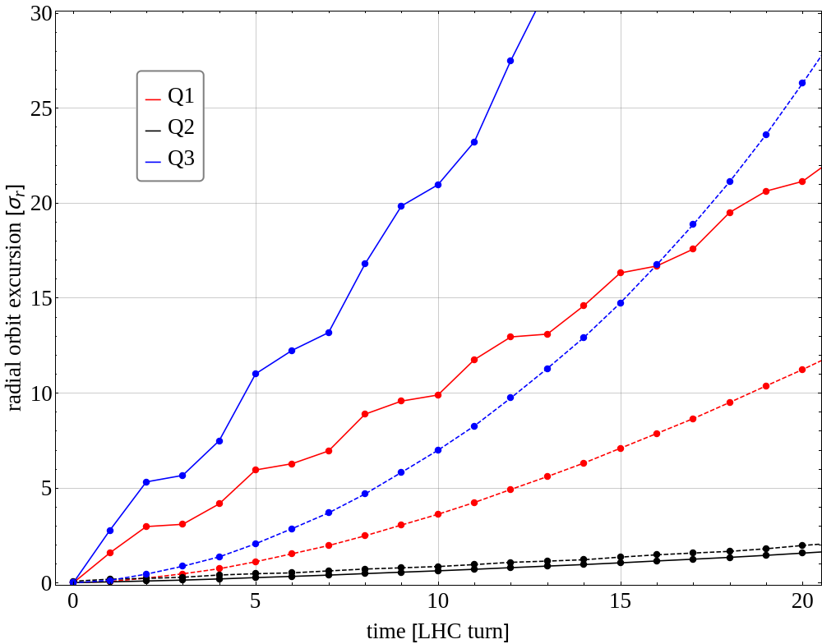
Effect on the circulating beam
Solid lines: without beam screen
Dashed lines: with beam screen (model not validated)
Critical orbit excursion ~1.5 sigma
Spurious discharge of one CLIQ unit into Q1 or Q3 causes critical orbit excursion within one LHC turn (89 us) → no possibility to actively interlock
CLIQ discharge into Q2 reaches critical levels only after ~ 20 turns → sufficient time to actively interlock and dump the beams before critical loss levels will be reached

Slide 16
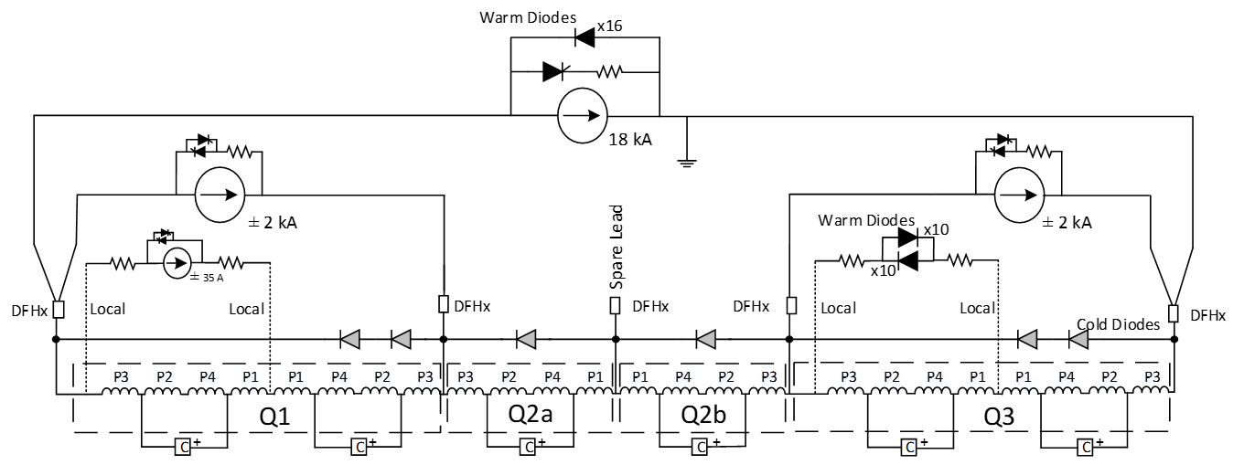
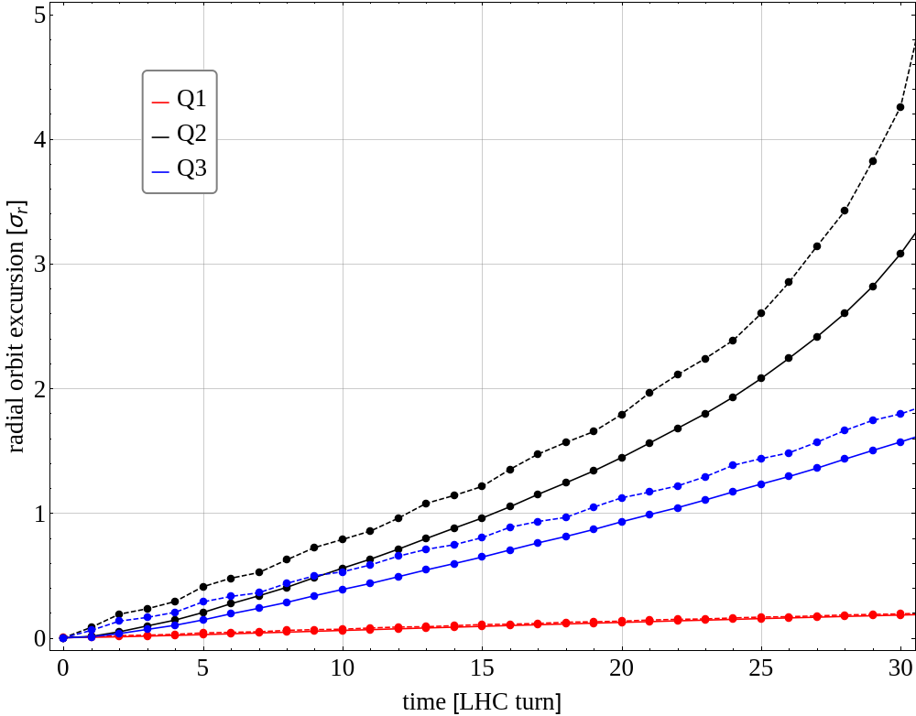
Mitigation of effect of spurious CLIQ firing on circulating beam
Current baseline
Implementation of a Q2 like CLIQ connection scheme for Q1 and Q3 in current IT baseline
CLIQ discharge creates octupole fields in Q1, Q2 and Q3
CLIQ discharge in Q1 and Q3 less critical than in Q2
Spurious discharge of CLIQ units will be interlocked → beam dump ensured within < 1ms after start of discharge
Step | Duration
Detection QH discharge (di/dt ≈ 4 MA/s) | 100 μs
Detection CLIQ discharge (di/dt ≈ 200 kA/s) | < 500 μs
Communication DQHSU → PIC → BIS | 12 μs
Beam abort sequence | 270 μs
Total | < 1 ms

