Slide 1
Impact of 440GeV Protons on Superconducting Wires and Tapes in a Cryogenic Environment
A. Will et al.
Karlsruhe Institute of Technology (KIT) / CERN (TE-MPE-PE)
Gentner Day 30.10.2019

Slide 2
Beam impact on s.c. magnets - Example
Injection Failure LHC
LHC BEAM
particle shower
Quench ! Damage ?
Injection kicker magnets
Superconducting magnet
Injection absorber
One such event per year in today’s LHC possible. No damage observed so far.
in HL-LHC:
    increase of beam intensity
    new inner triplet magnets using Nb₃Sn
  investigate the damage limits of superconducting magnets !
Slide Courtesy V. Raginel, EUCAS 2017, “First Experimental Results on Damage Limits of Superconducting Accelerator Magnet Components due to Instantaneous Beam Impact”

Slide 3
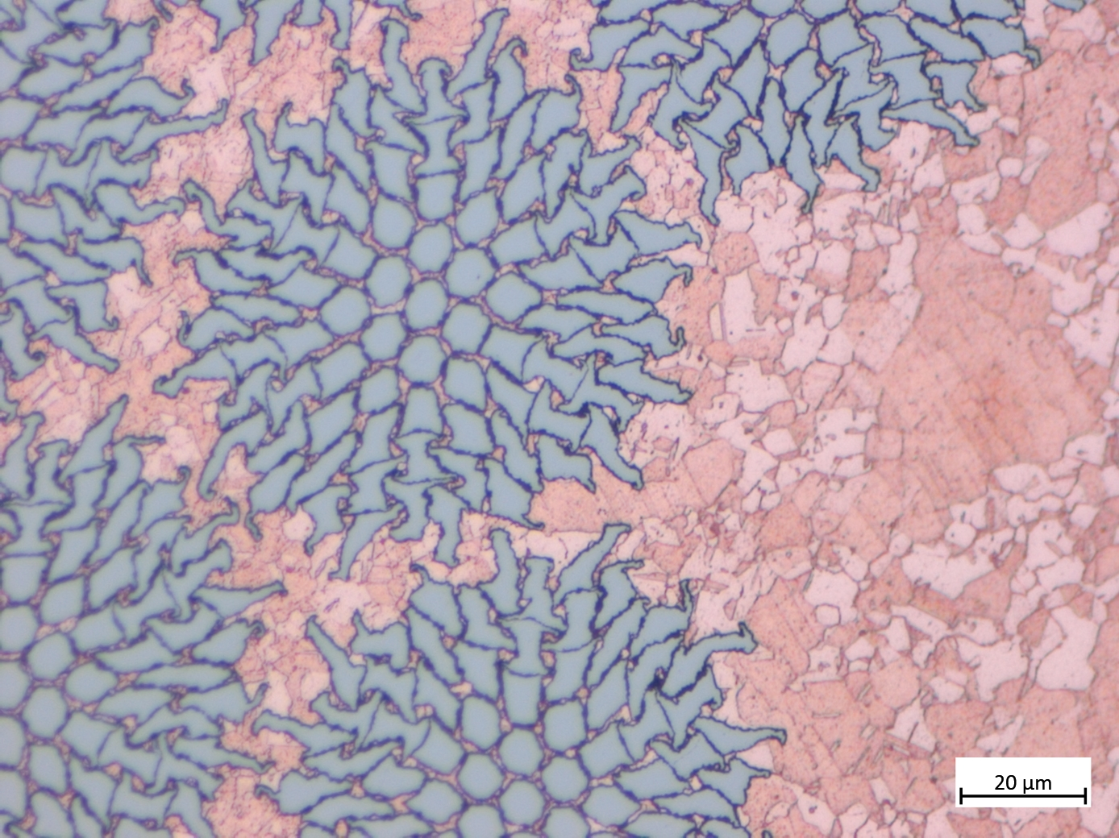
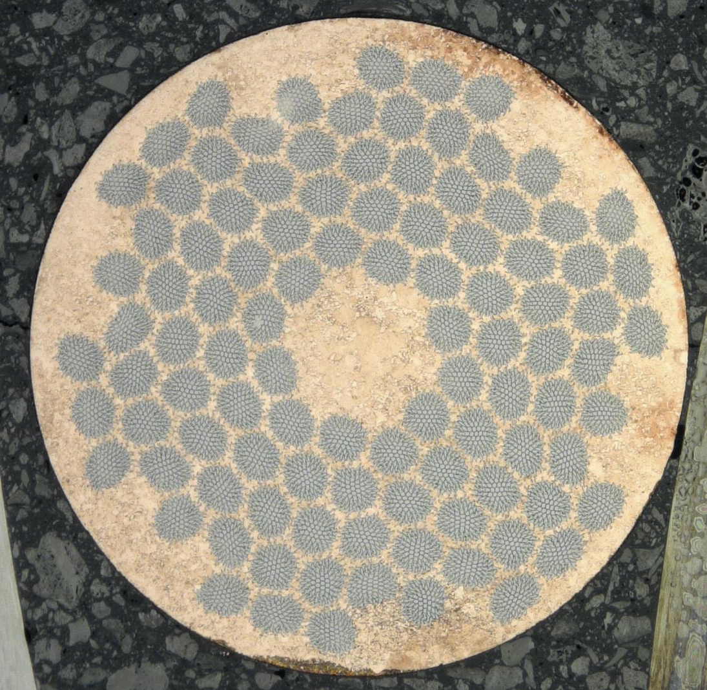
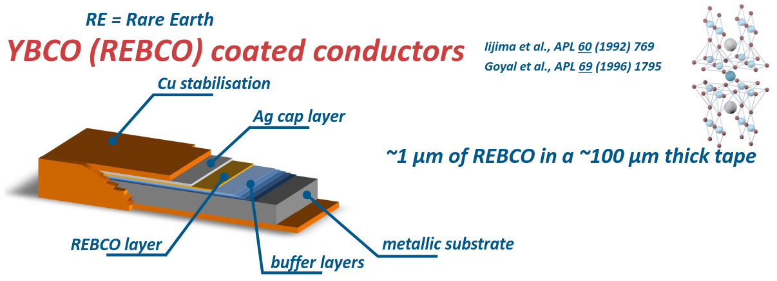
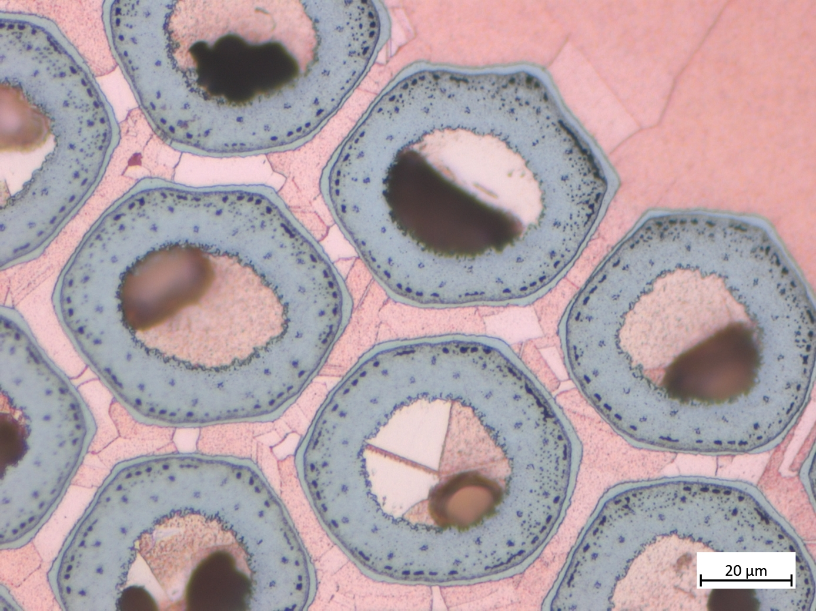
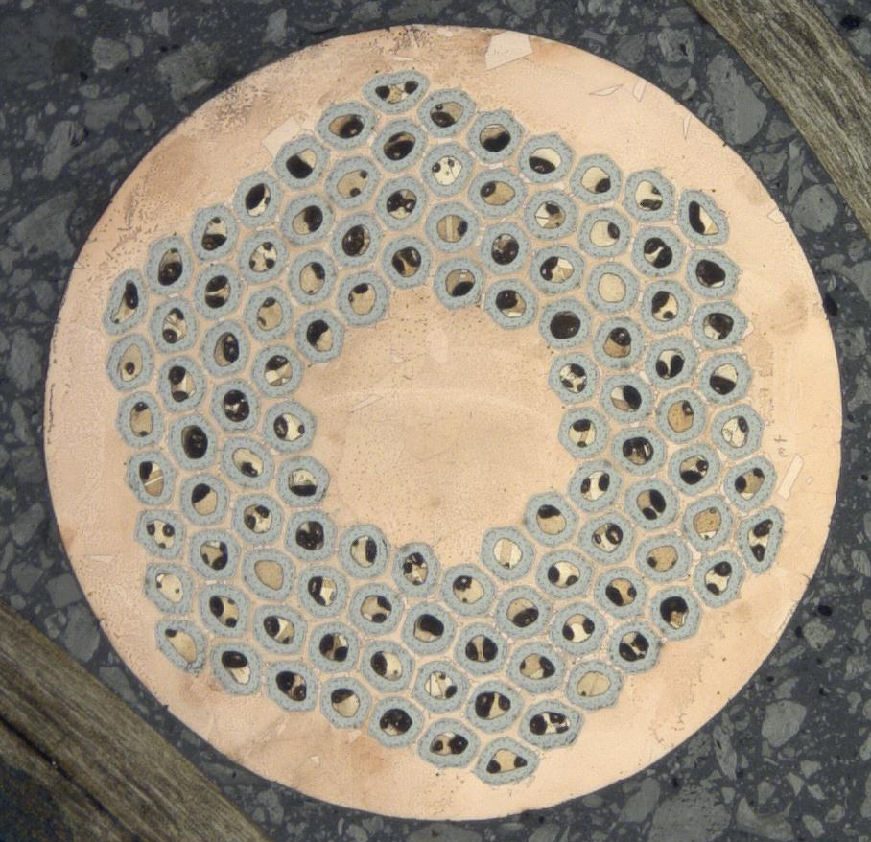
Superconducting wires/ tapes
Nb-Ti strand (LHC)
Nb₃Sn strand (HL-LHC)
HTS tapes
(future acc. magnets..?)
Image from C. Senatore, Lecture on Superconductivity, 2018
Image courtesy M. Meyer, CERN

Slide 4
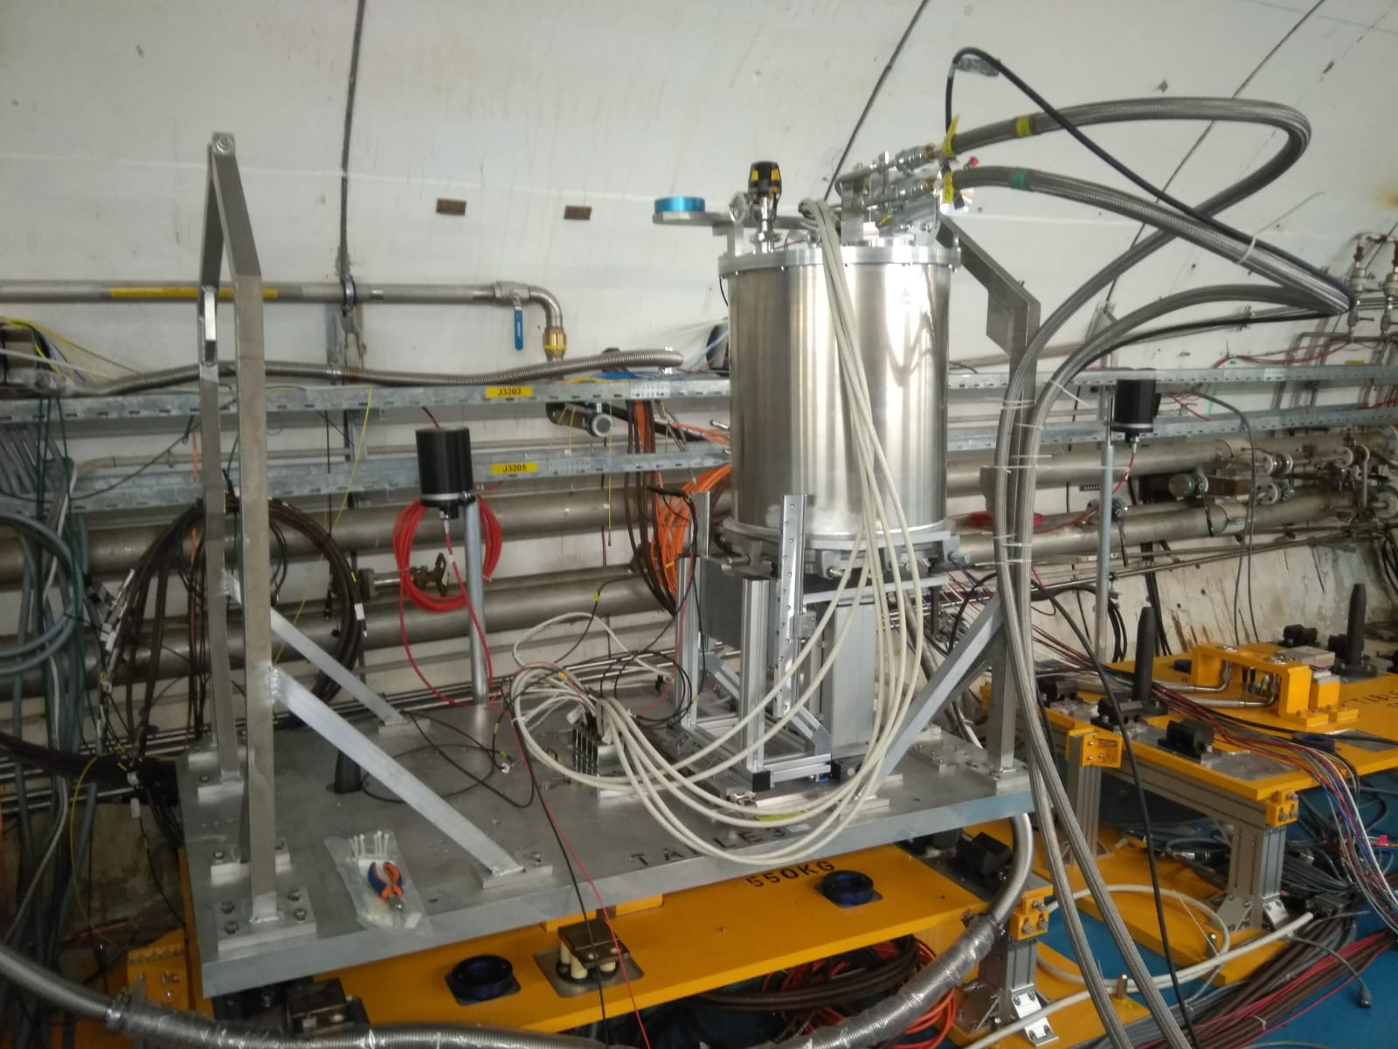
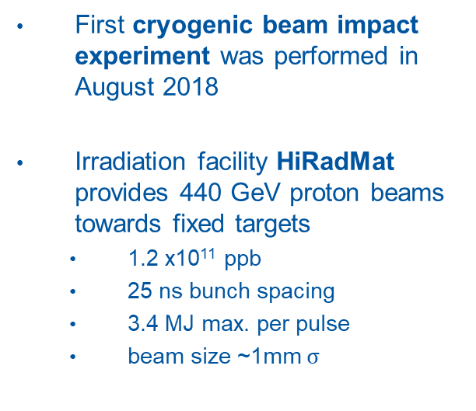
Beam impact experiment at cryogenic temperatures
First cryogenic beam impact experiment was performed in August 2018
Irradiation facility HiRadMat provides 440 GeV proton beams towards fixed targets
  1.2 x10¹¹ ppb
  25 ns bunch spacing
  3.4 MJ max. per pulse
  beam size ~1mm $σ$
p+
horizontal stage
vertical stage
Notes:
Maximum pulse parameters
7.2 μs pulse length
3.4 MJ stored beam energy

Slide 5
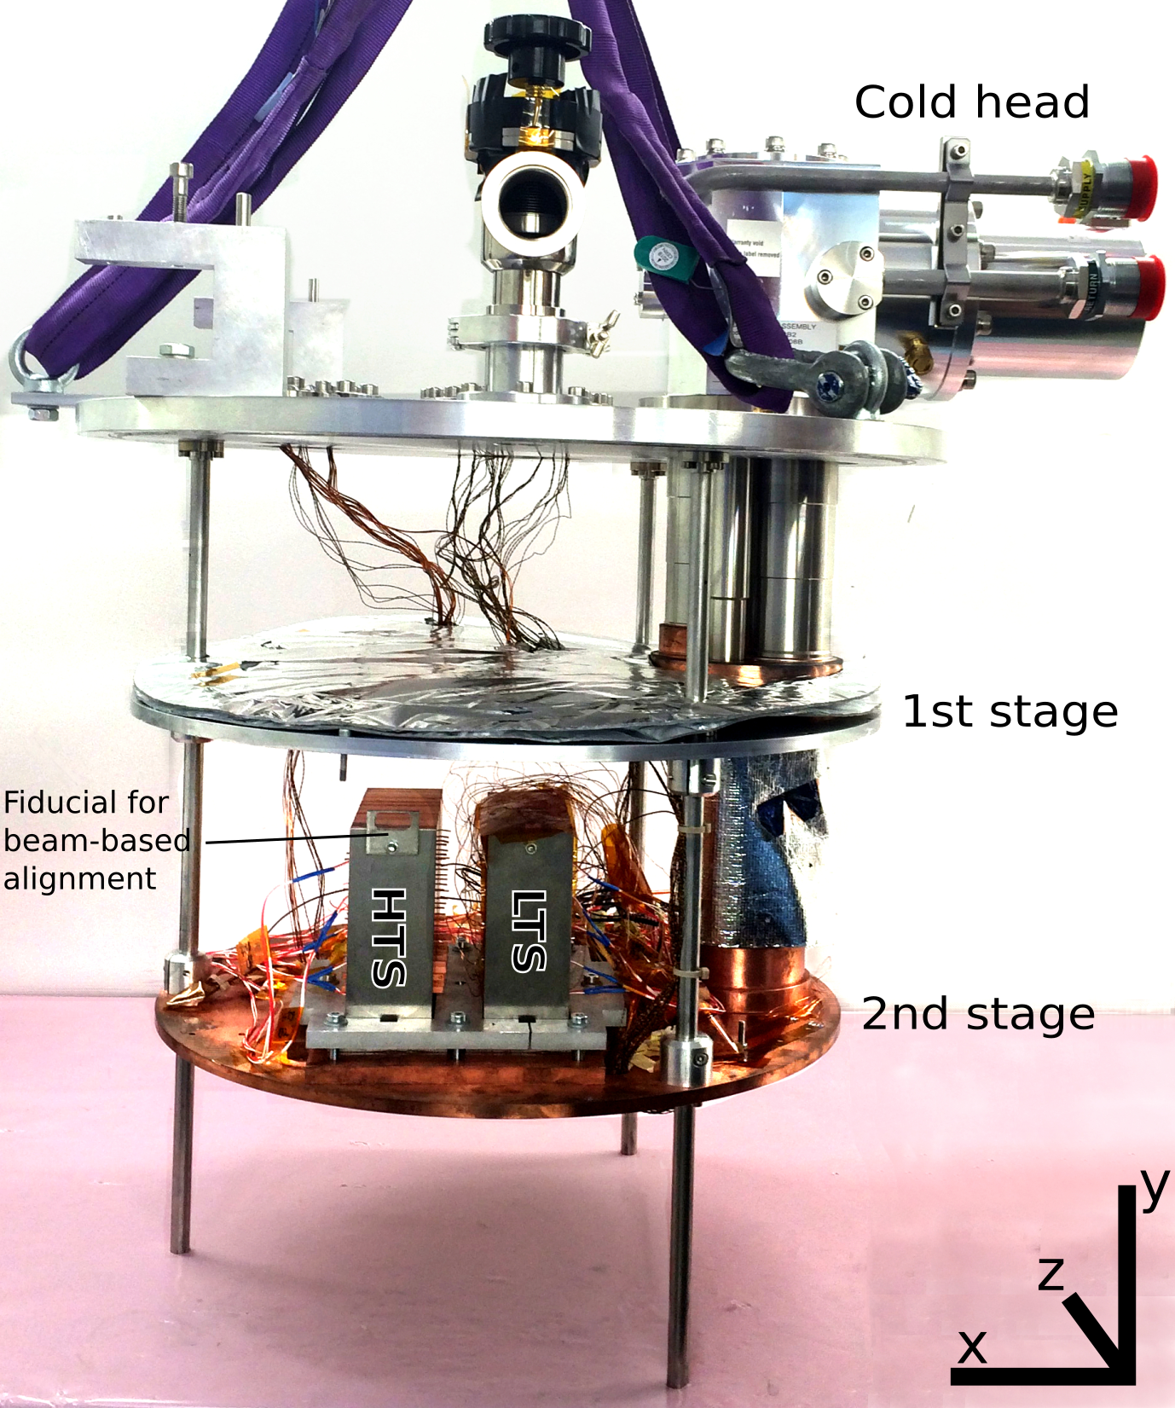
Experimental set-up
Cryocooler based cryostat to cool samples to ~4K
s.c. strands placed within stacked copper holders
2 x 10 samples Nb-Ti
3 x 10 samples Nb₃Sn
6 x 7 YBCO tapes
11 shots of 3e12 p @ 440 GeV
5

Slide 6
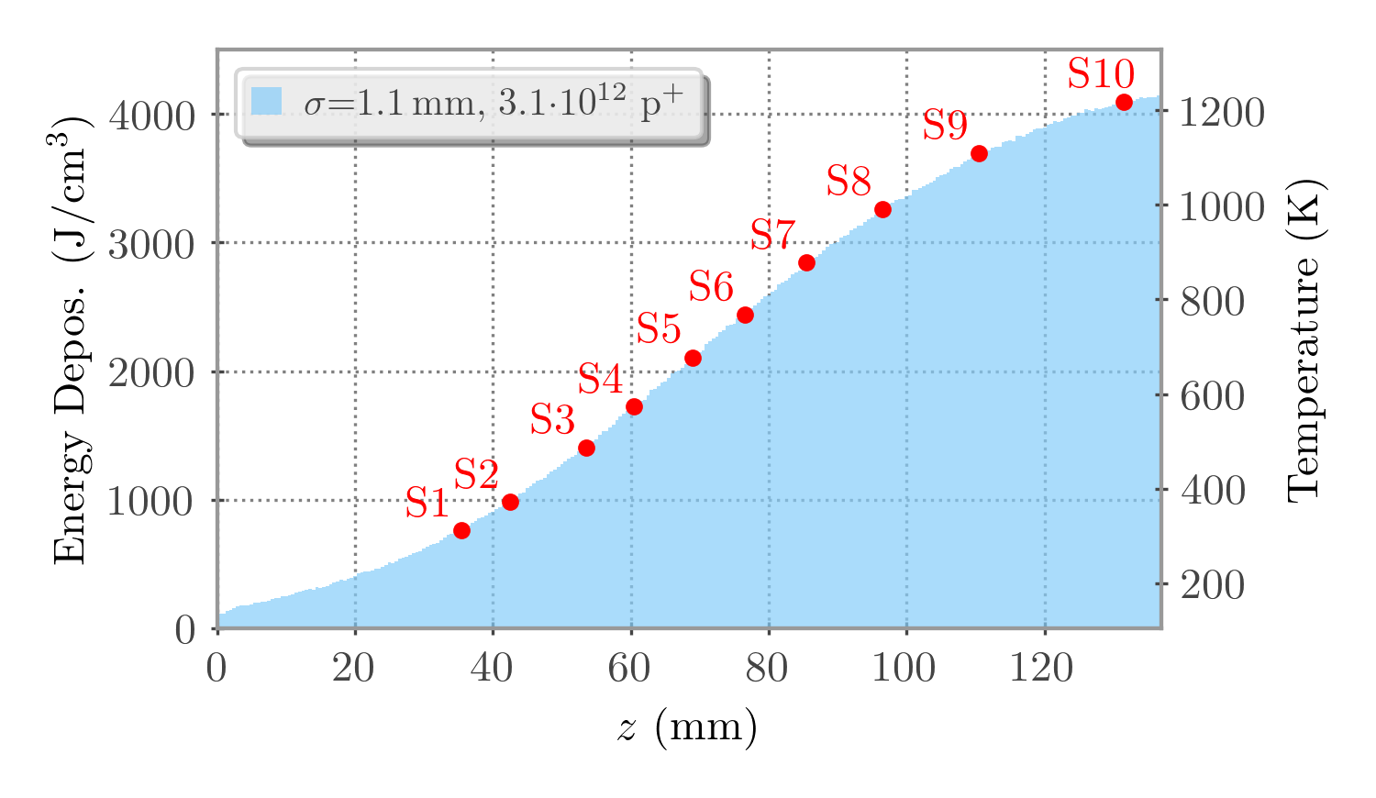
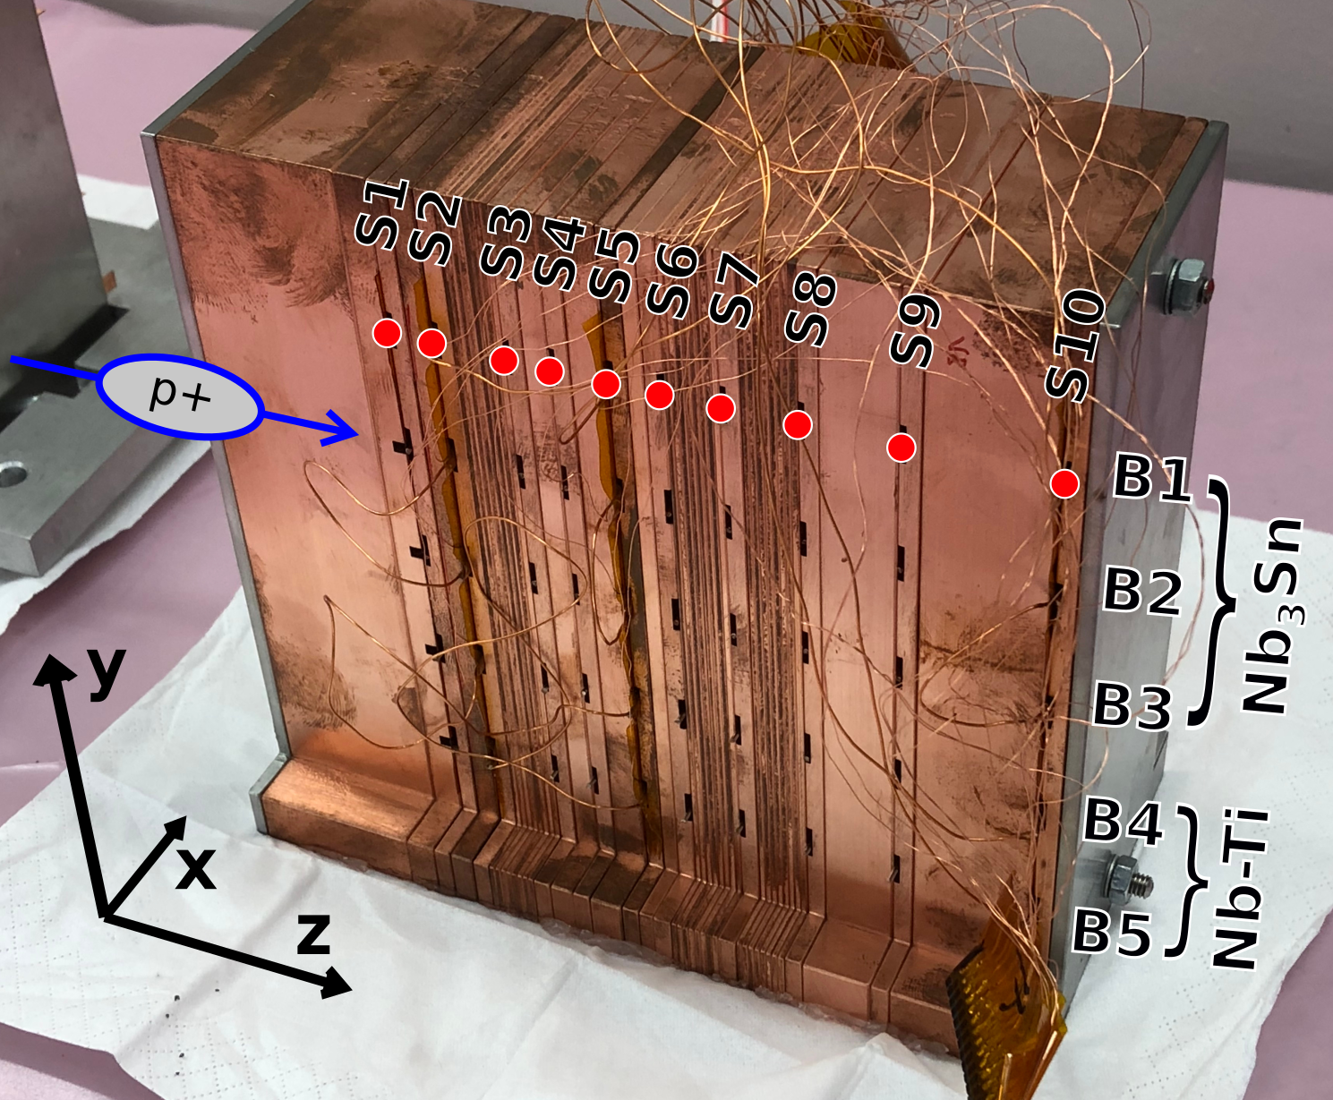
Sample Holder
Energy deposition
  Temperature reached along a block of copper for 440 GeV proton beam, simulated with FLUKA
  Embedded samples along beam axis reach various hot spot temperatures
As in real failure case
  proton beam interacts with matter before impacting superconductors

Slide 7
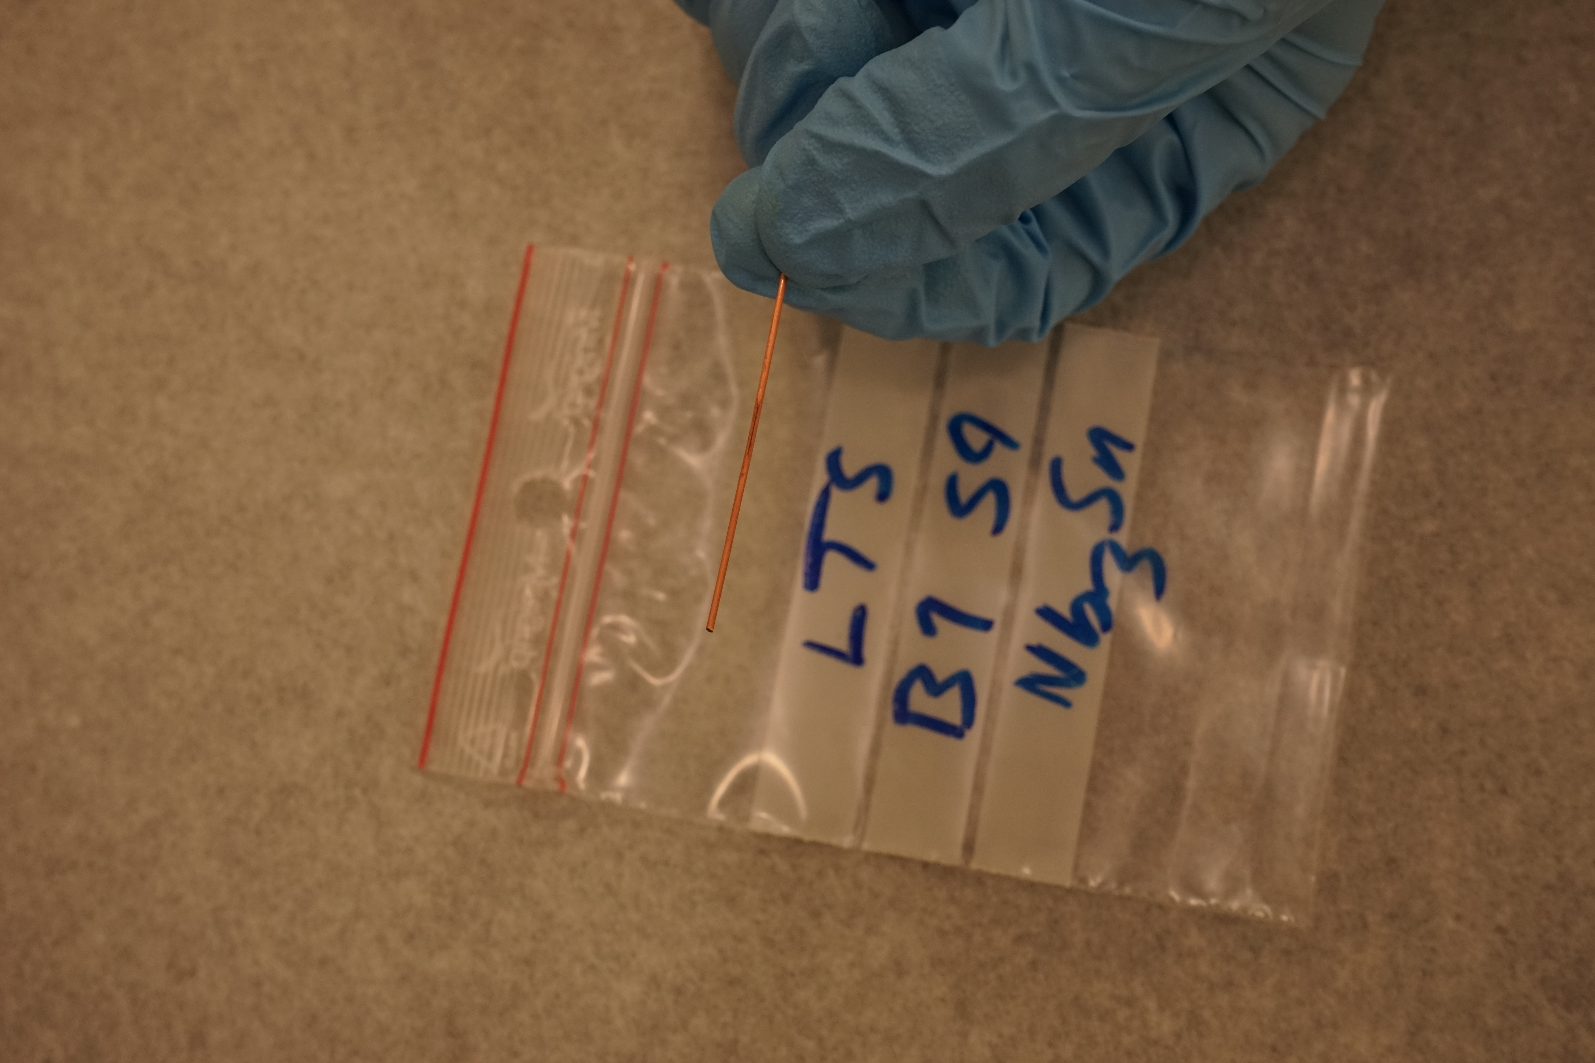

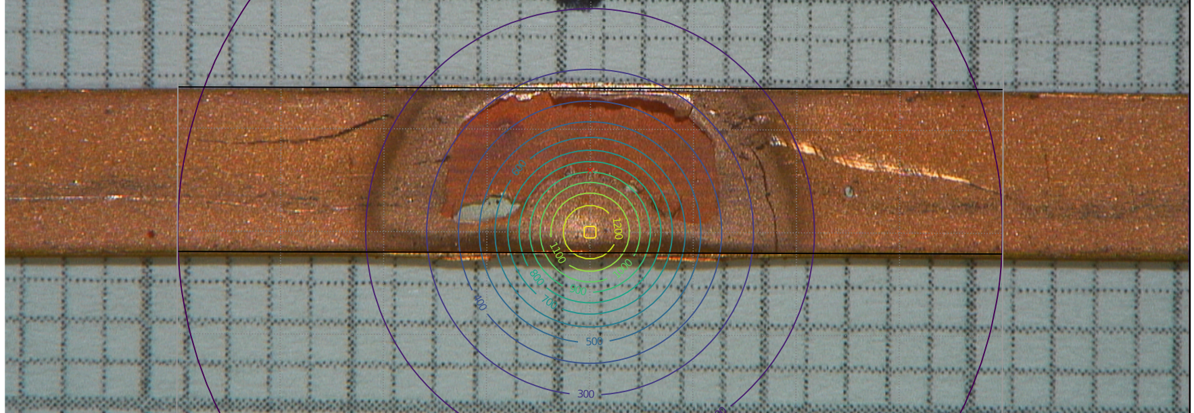
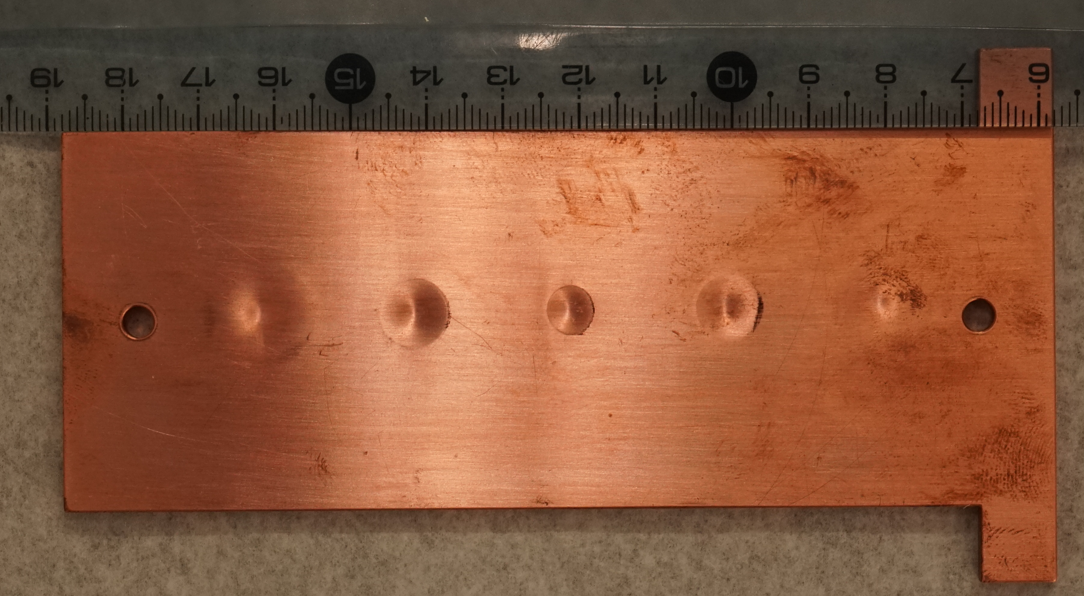
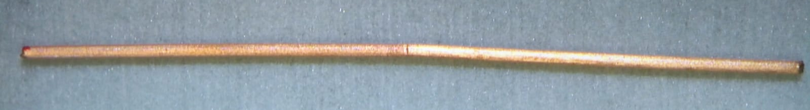
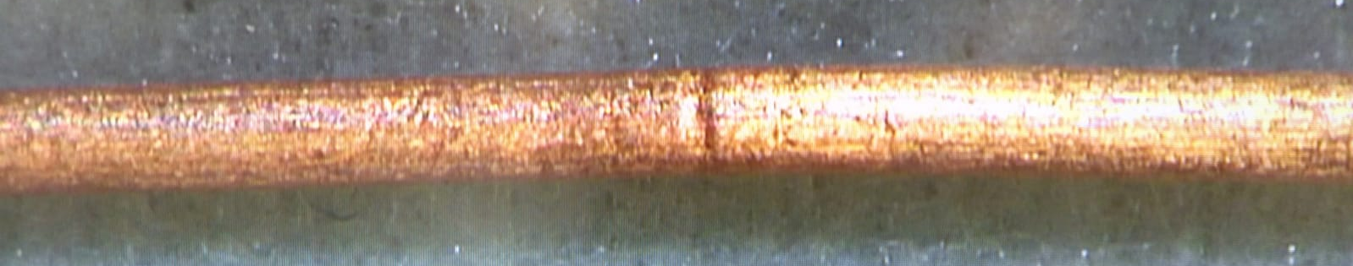
Visual inspection after beam impact
Nb₃Sn, hot spot ~ 1150 K
YBCO tape
B1
Nb₃Sn, hot spot ~ 800 K
B3
hot spot ~1200 K

Slide 8
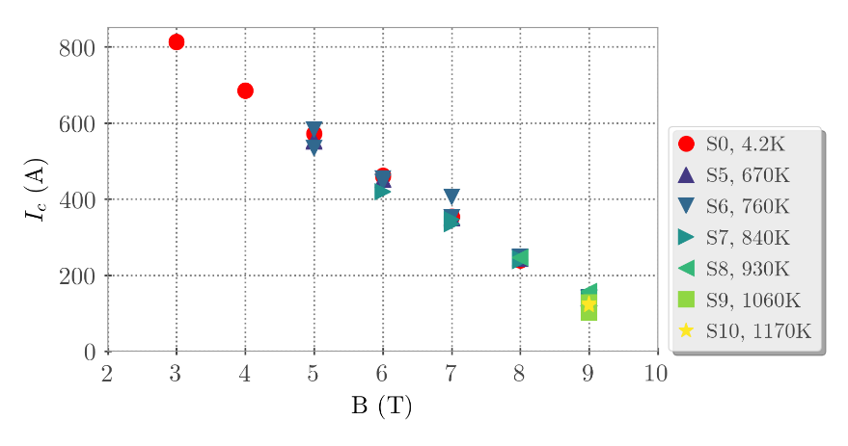
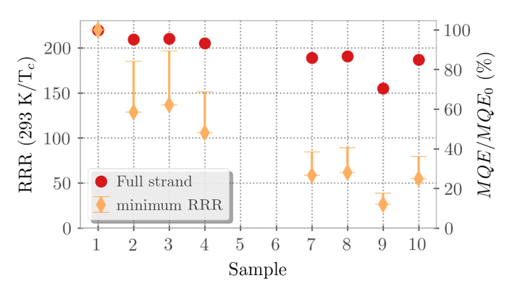
I_{c} in Nb-Ti strands after beam impact
No degradation of I_{c} observed
I_{c} measurements increasingly difficult at lower fields/higher currents, with increasing hot spot temperature
  Indicating issues with thermal stability of strands
Measurements indicate significant reduction of RRR at beam impact position → reduced minimum quench energy (MQE)
  MQE significantly reduced for samples with hot spots > 800 K
8

Slide 9
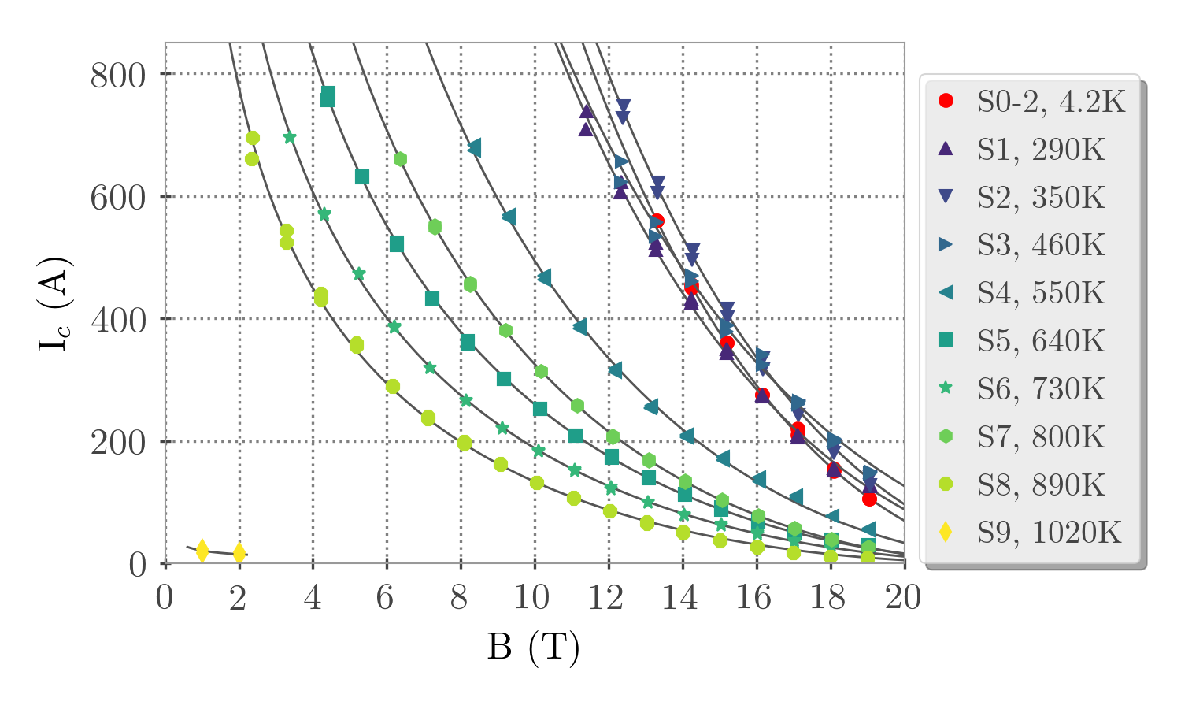
I_{c} in Nb₃Sn strands after beam impact
Significant I_{c} degradation for hot spots > 460 K
No measurable transport current for hot spots > 890K → samples destroyed
9

Slide 10
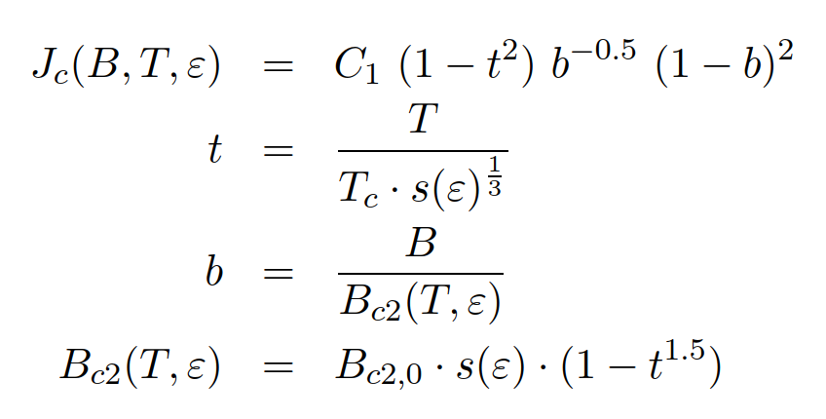
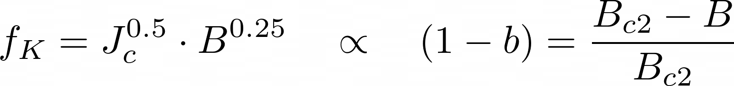
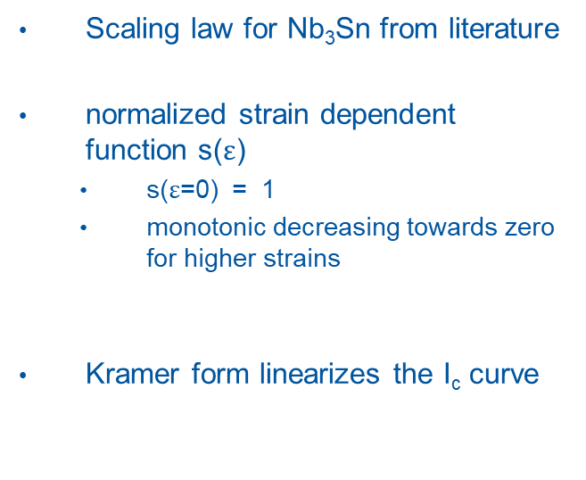
Nb3Sn Strain dependence
Mentink, Goedeke et al.
Scaling law for Nb₃Sn from literature
normalized strain dependent function s($ε$)
  s($ε$=0) = 1
  monotonic decreasing towards zero for higher strains
Kramer form linearizes the I_{c} curve

Slide 11
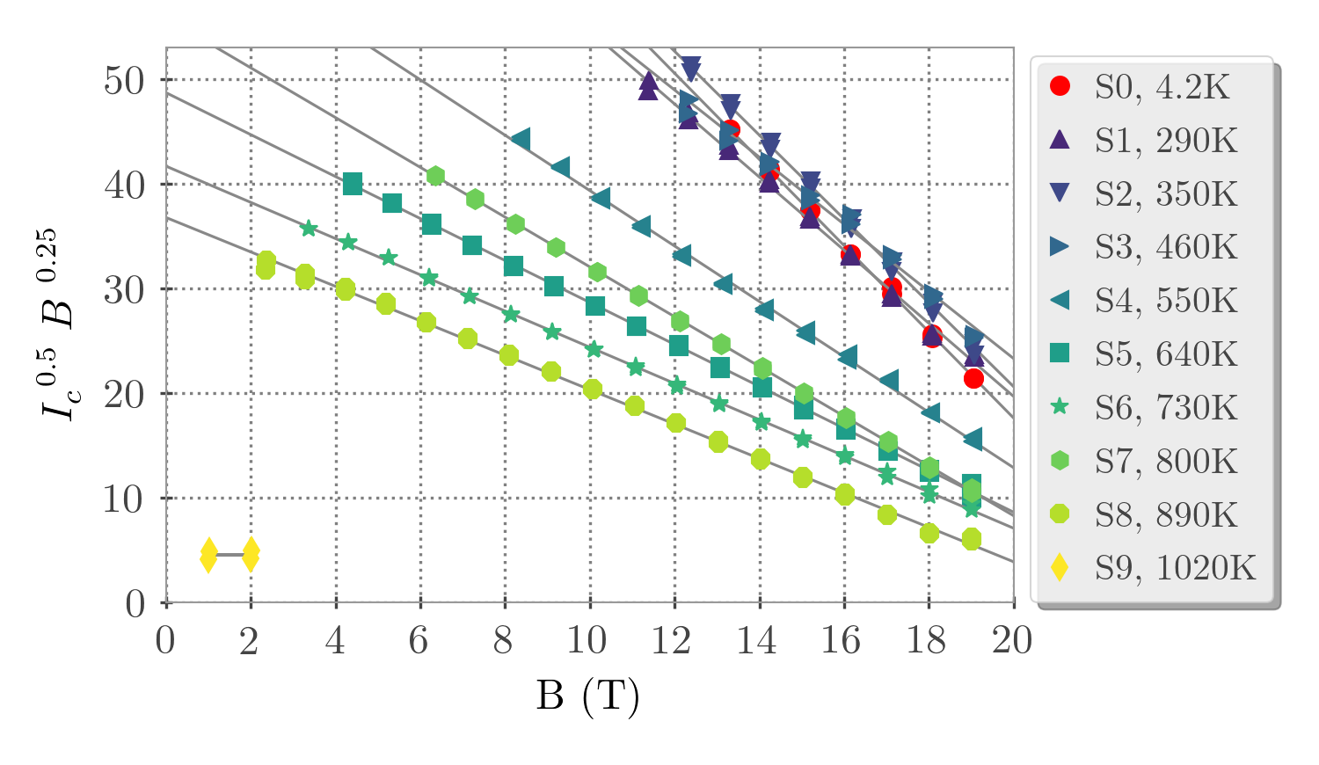
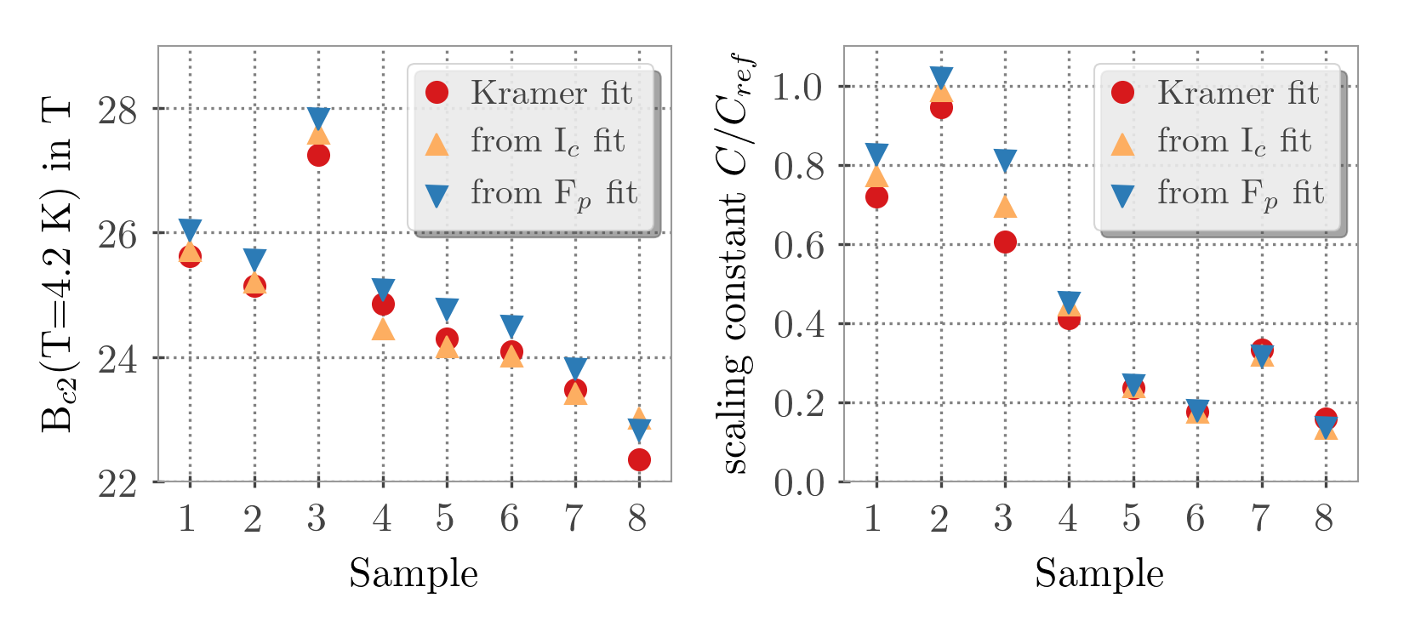
B_{c2} of Nb₃Sn strands after beam impact
Kramer fit:
B_{c2} degrades with increasing hotspot temperatures due to plastic deformation of copper matrix
  B_{c2} remains > 22 T for samples S1-S8
I_{c} degradation dominated by reduction of effective cross section due to filament breakage
11

Slide 12
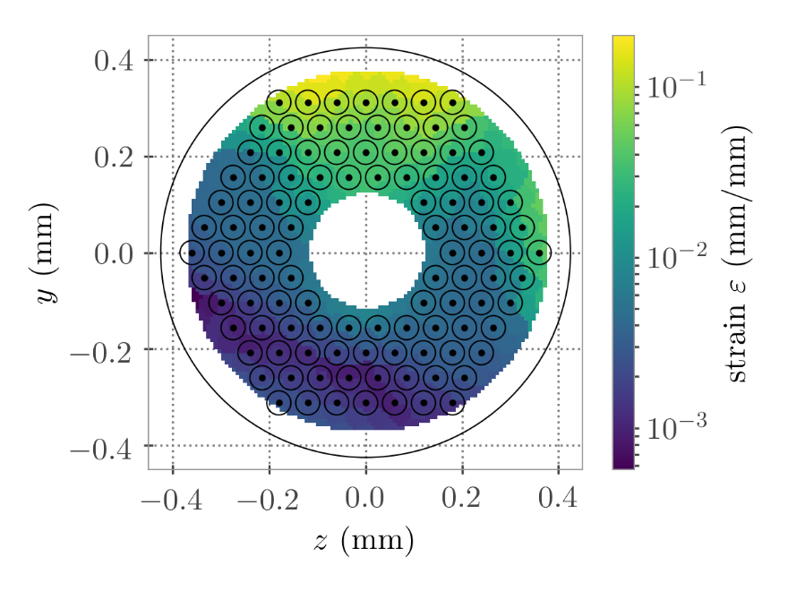
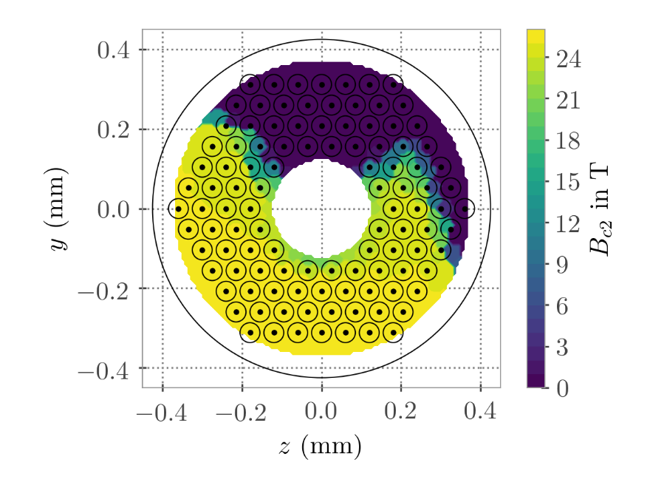
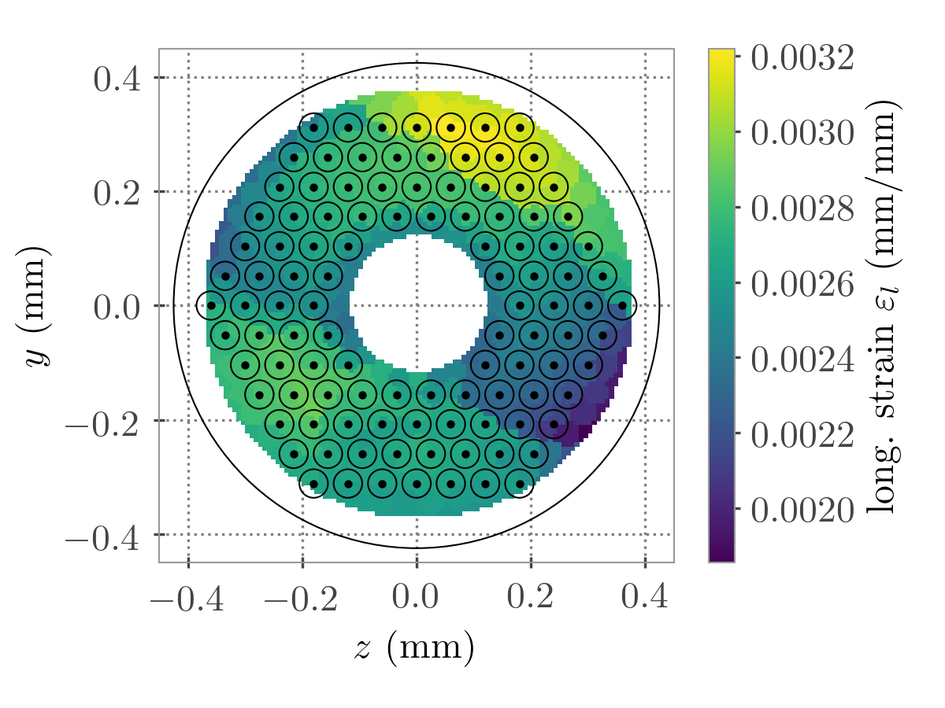
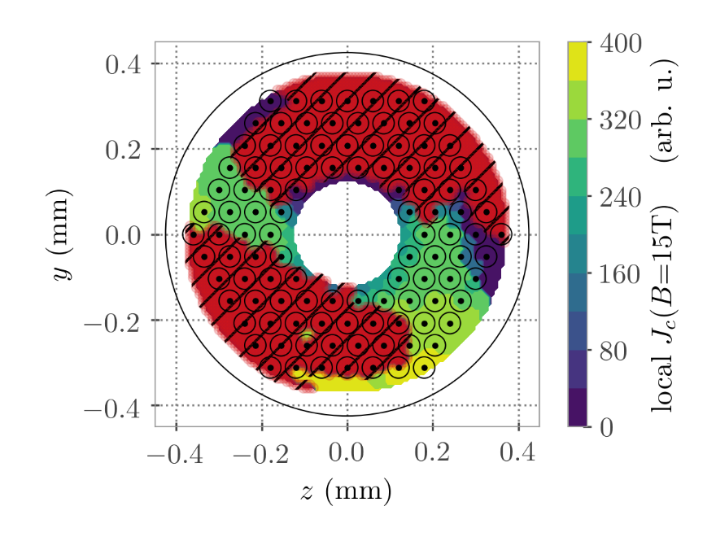
Results of thermo-mechanical simulations
B_{c2} distribution from microscopic theory
Thermo mechanical simulations performed* with ANSYS
  study the stresses within the strand cross-section due to thermal gradients and expansion
  study the interaction of the strands with the sample holder
  Use scaling laws from literature to predict I_{c} degradation of full strand
  Filament cracking via “strain irreversibility cliff” model (Cheggour et al.)
Local lattice strain
Scaling laws
Axial strain
J_{c} distribution from microscopic theory + cracked filaments
*Bachelor Thesis J. Schubert, to be submitted soon
12

Slide 13
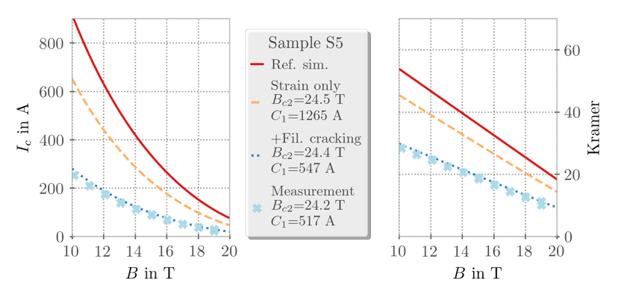
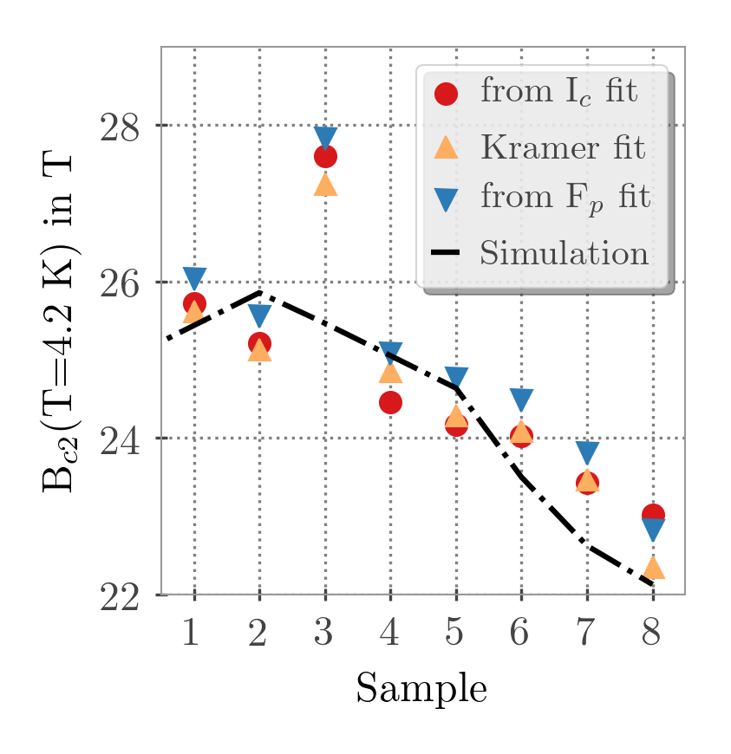
I_{c} simulations for Nb₃Sn
Measured I_{c} and B_{c2} degradations well reproduced in the simulations
Absolute I_{c} degradation due to filament breaking hard to predict, but easy to fit, if I_{c} is measured.
  Results
  B_{c2} degradation dominated by lattice strain
  J_{c} degradation combination of lattice & axial strain, major part due to filament cracking
13

Slide 14
Conclusions & Outlook
Beam induced damage experiment performed with Nb-Ti, Nb₃Sn strands and YBCO tapes @ 4.2 K reaching hot spot temperatures of up to 1200 K
Nb-Ti
  no I_{c} degradation observed
  Reduced thermal stability of strands (MQE)
Nb₃Sn
  Significant I_{c} degradation for hot spots > 460 K
  B_{c2} degradation observed in all samples
  Sources identified with the help of thermo-mechanical simulations
    Filament breaking due to too high axial strain → dominating factor for I_{c} degradation
    Residual strain from copper matrix and other copper/ bronze phases → B_{c2} degradation & small I_{c} degradation
Microscopic analysis and tomography for most damaged Nb₃Sn strands planned to verify model of filament breakage
YBCO tapes to be measured and compared to simulations
14

Slide 15


A. Will, D. Wollmann, J. Schubert, A. Oslandsbotn, A. Monteuuis, K. Stachon, A.S. Mueller, A. Bernhard, M. Bonura, C. Senatore, M. Mentink, A. Verweij, B. Bordini
Thanks to all Collaborators
HiRadMat Team (F. Harden, A. Bouvard, V. Clerc, C. Saury, Y. Kadi, M. Butcher, J. Lendaro, J. Merino, L. Grec, ...), SPS OP shift crew, TE-MPE (F. Rodriguez Mateos, M. Bednarek, G. D'Angelo, M. Favre, B. Lindstrom, M. Vaananen, A. Liakopoulou, A. Siemko, R. Schmidt, R. Berberat, S. Kaufmann), TE-MSC (G. Kirby, A. Ballarino, B. Bordini, L. Bottura), TE-CRG (T. Koettig, ...), EN-STI-TCD (D. Grenier, ...), BE-BI (E. Effinger, C. Zamantos)
University of Geneva (C. Senatore, M. Bonura, C. Barth, D. Zurmuehle)
BRUKER (A. Usoskin)
Scientific Magnetics (P. Penfold, B. Retz-Jones)
Work supported by the Wolfgang-Gentner-Program of the
German federal ministry of education and research

