Slide 1



Gentner Programme
Main Programme points
  special German Doctoral Student Programme
    in addition to the existing CERN Doctoral Student Programme
    funding (subsistence) by BMBF (German Federal Ministry of Education and Research)
    extra funds for Students’ travel to Germany and for Supervisors’ travel to CERN
  eligibility
    open to EU nationals
    students need to be enrolled at a university in Germany
  mid- and long term goals
    better usage of CERN resources by Germany
    better connection between German Universities and CERN
    long-term: more Germans at CERN (Doctoral Students, Fellows, Staff)
      presently only ~6.6% German staff (174/2638), but 20.6% contribution of DE to CERN budget
      IT: 11.9% (10.4% contribution), GB: 8.0% (16.1% contribution), ES: 6.2% (7.1% contribution)

Slide 2
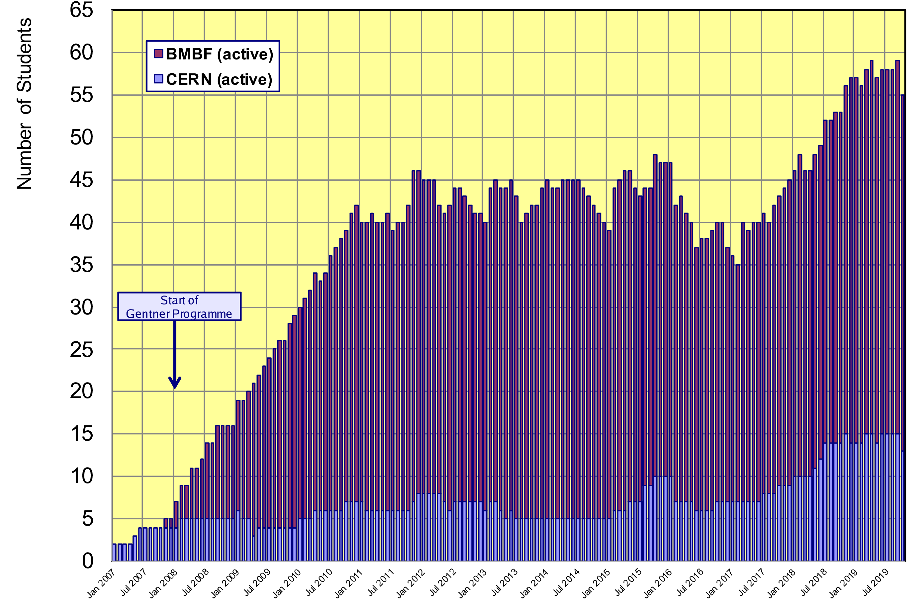
Status Gentner Programme
Presently 42 active Gentner Students (only 8 female = 19%!)
  further 13 Germans in regular CERN Programme
General trend: fewer number of applications by women over past 2-3 years!
Had ~30% women over many years
No obvious reason known

Slide 3
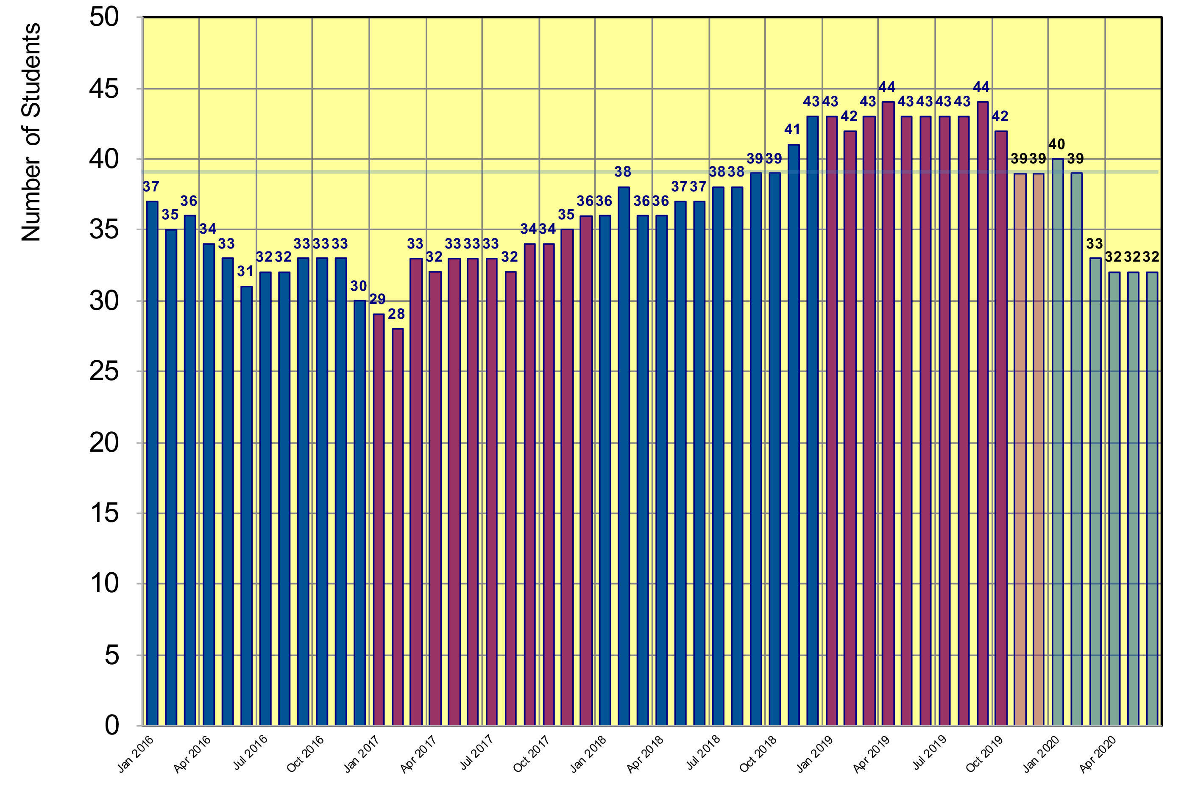
Status Gentner Programme
Projection until June 2020
  based on preferred starting date given by selected students
projection
Drop due to unfavorable EUR/CHF exchange rate
39 students foreseen in Gentner agreement
gap to be filled by students from 2019-2 selection
2019
2020

Slide 4
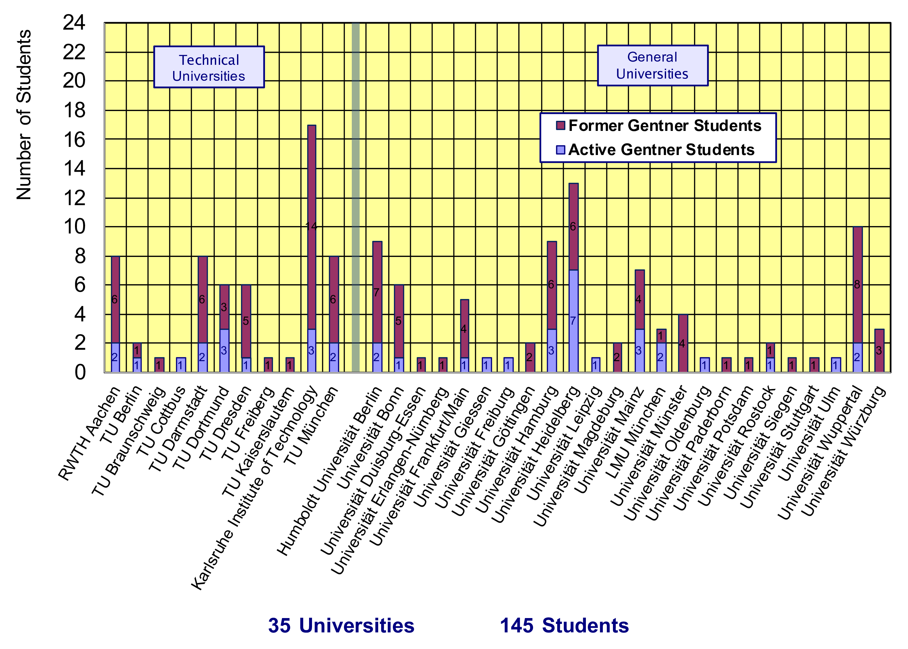
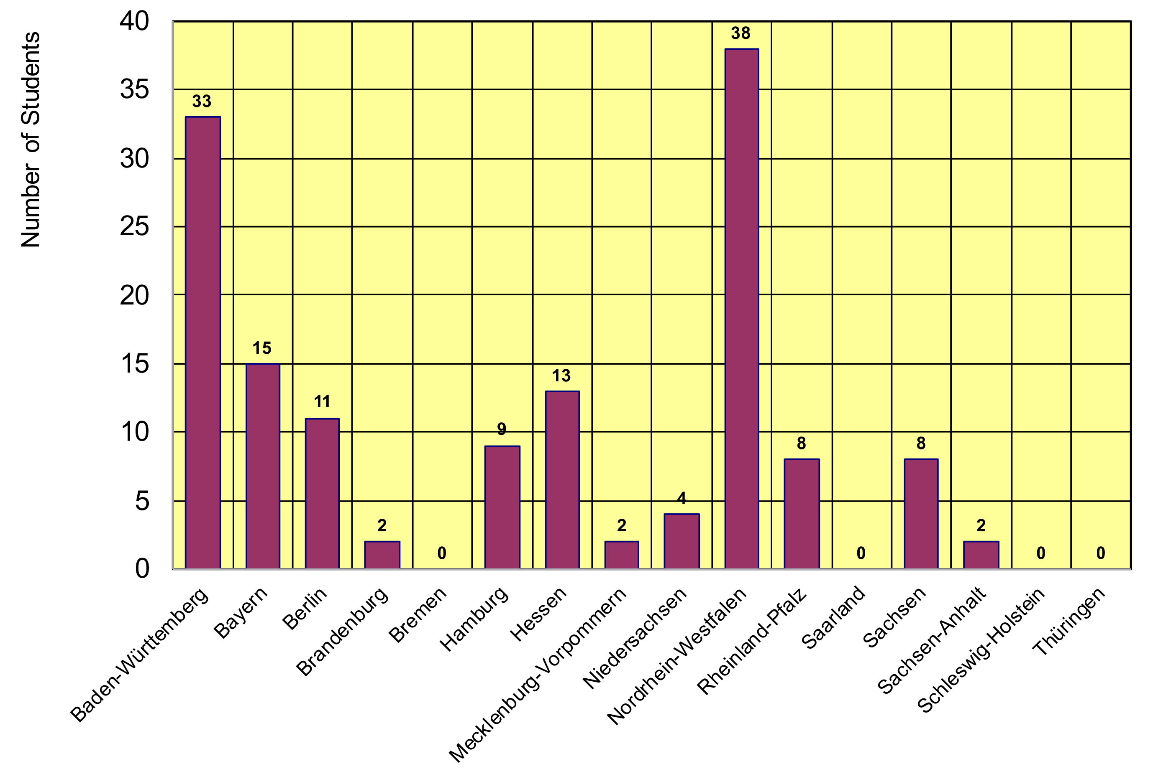
Gentner Students
  coming from 35 different Universities in Germany
    new since April 2019: Universität Giessen
  12/16 German States
    NRW and BW are leading
    only a few small(er) States are missing

Slide 5
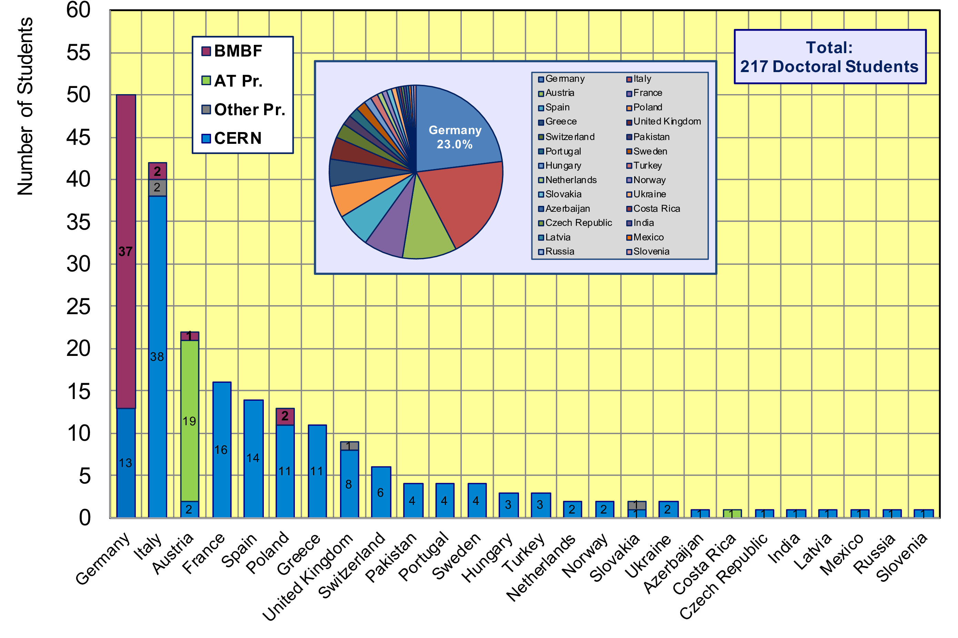
CERN Doctoral Students
Nationalities of all Doctoral Students at CERN
  Germans (50 Students, 23.0%) are leading

Slide 6
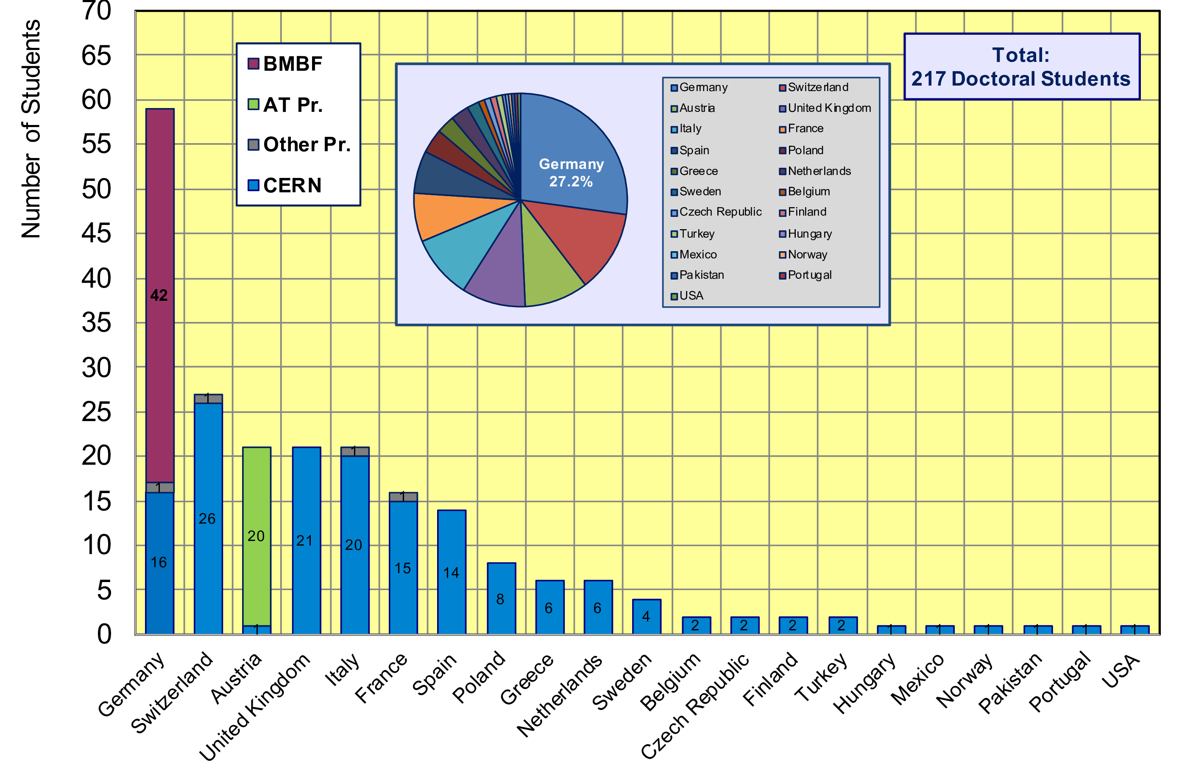
CERN Doctoral Students
Home University Country of all CERN Doctoral Students
  59/217 Students enrolled at German Universities (27.2%)

Slide 7
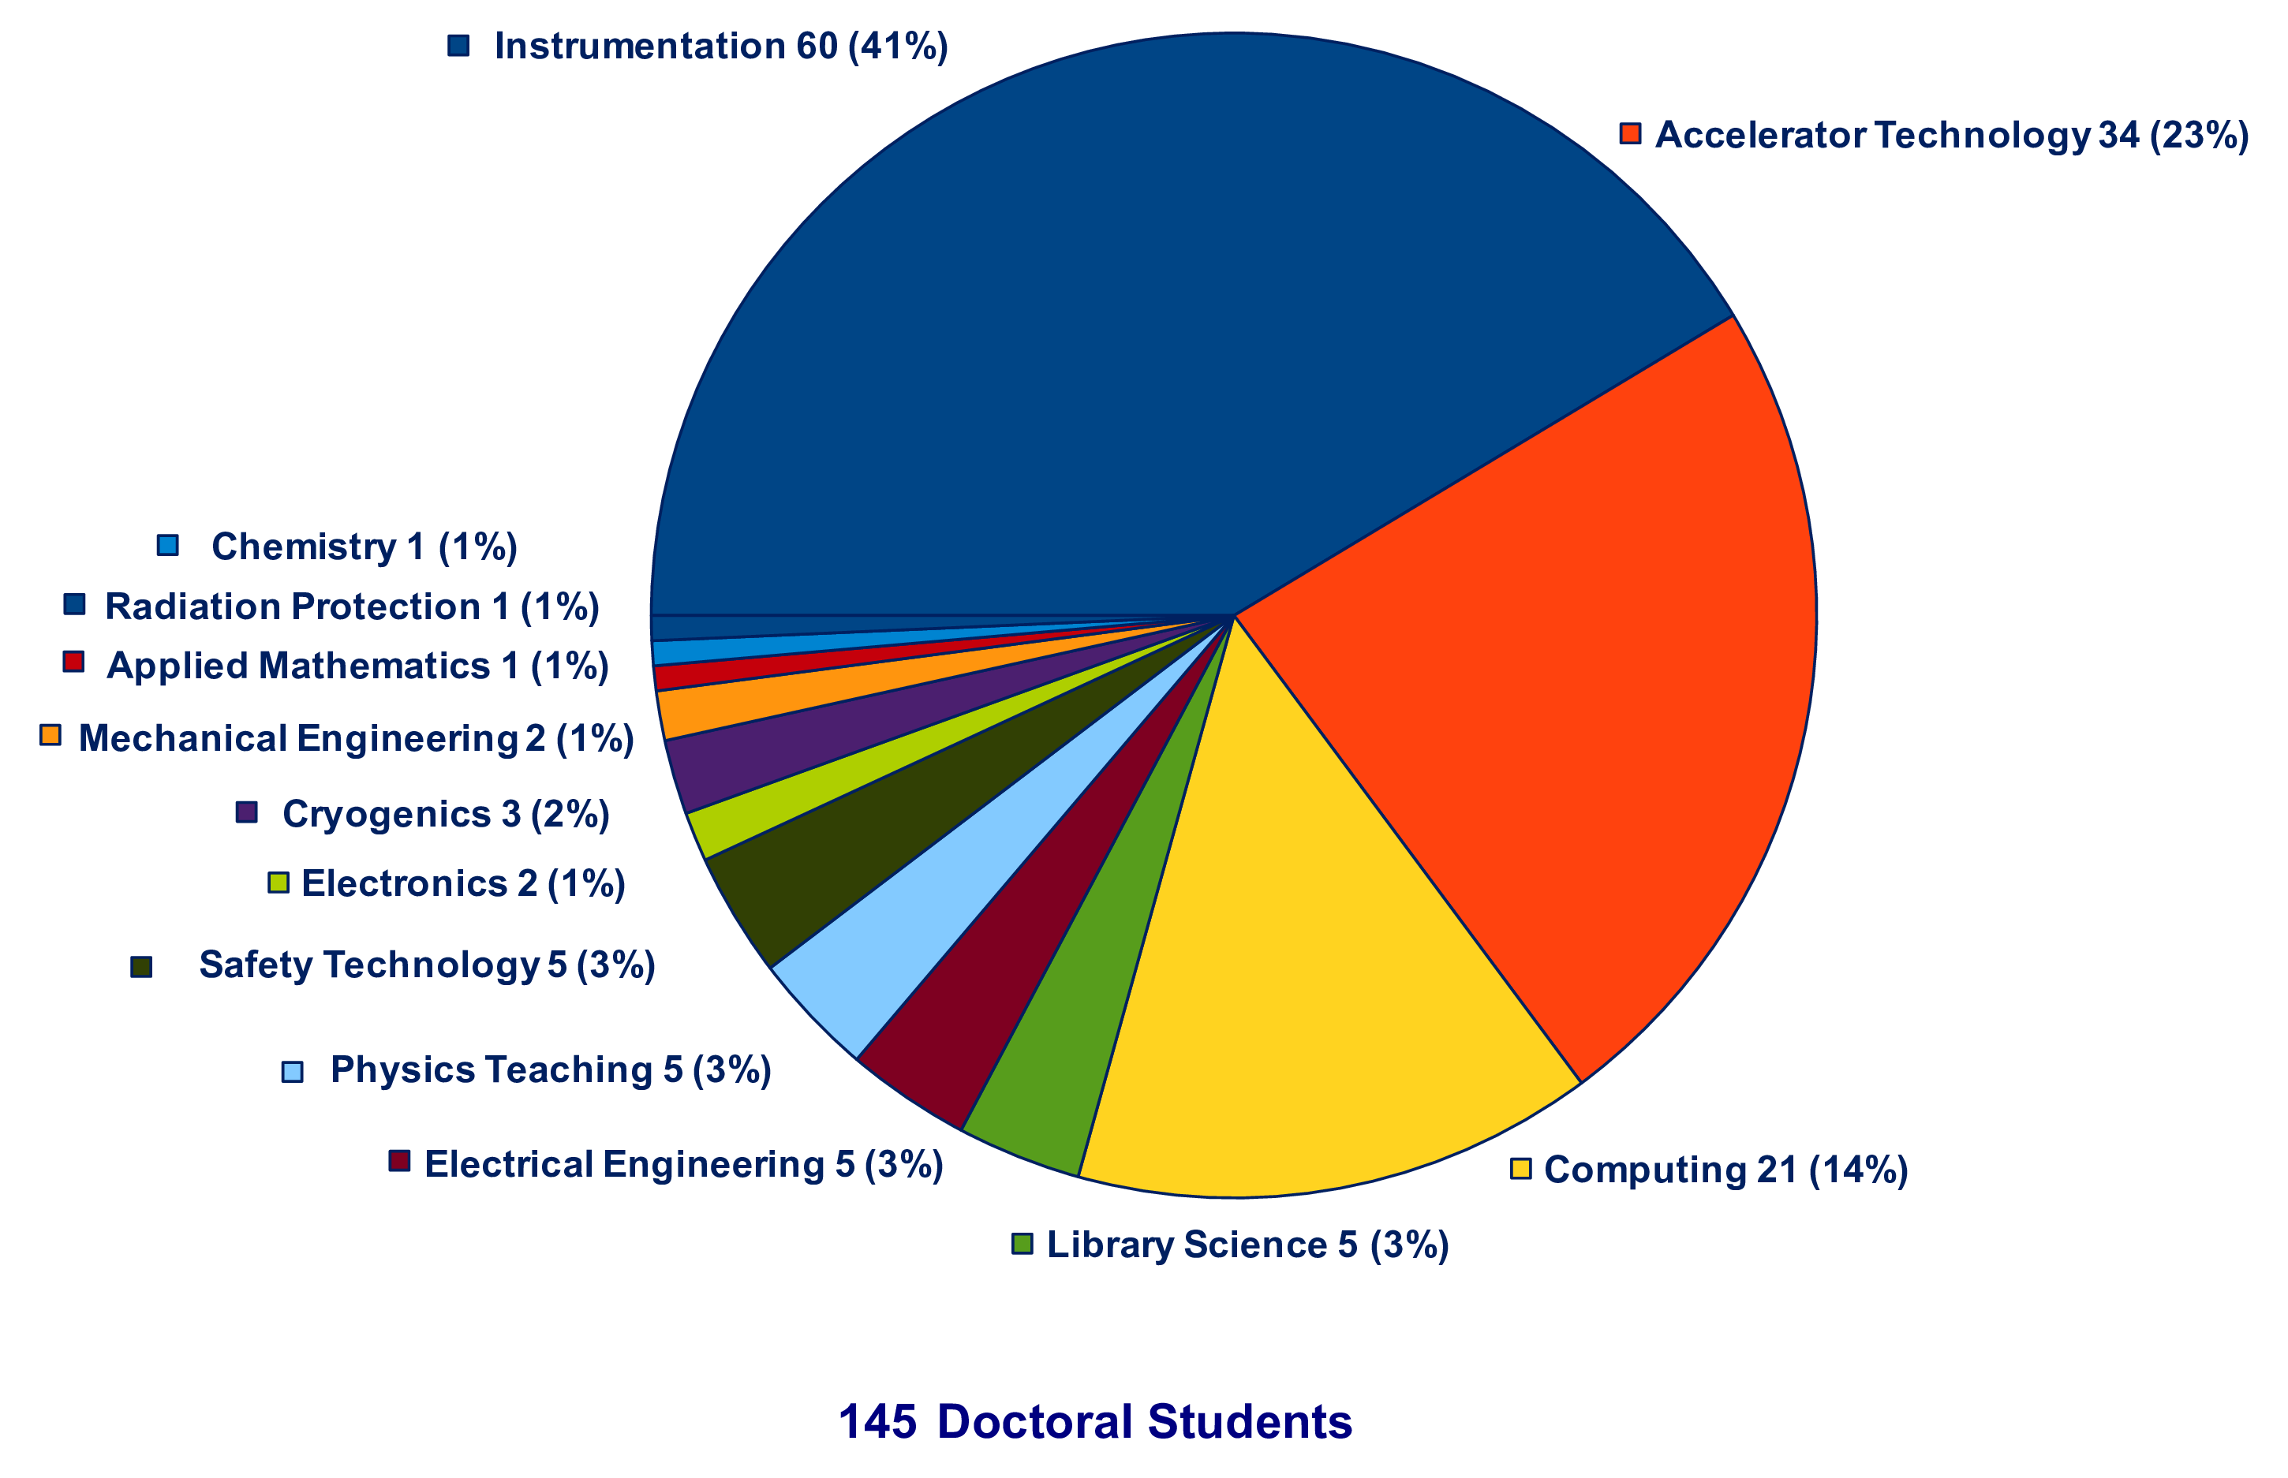
Thesis Topics of Gentner Students
(active + former)
Majority of topics in Instrumentation (41%), Accelerator Technology (23%), Computing (14%), all others = 22%
basically no change over the past years

Slide 8
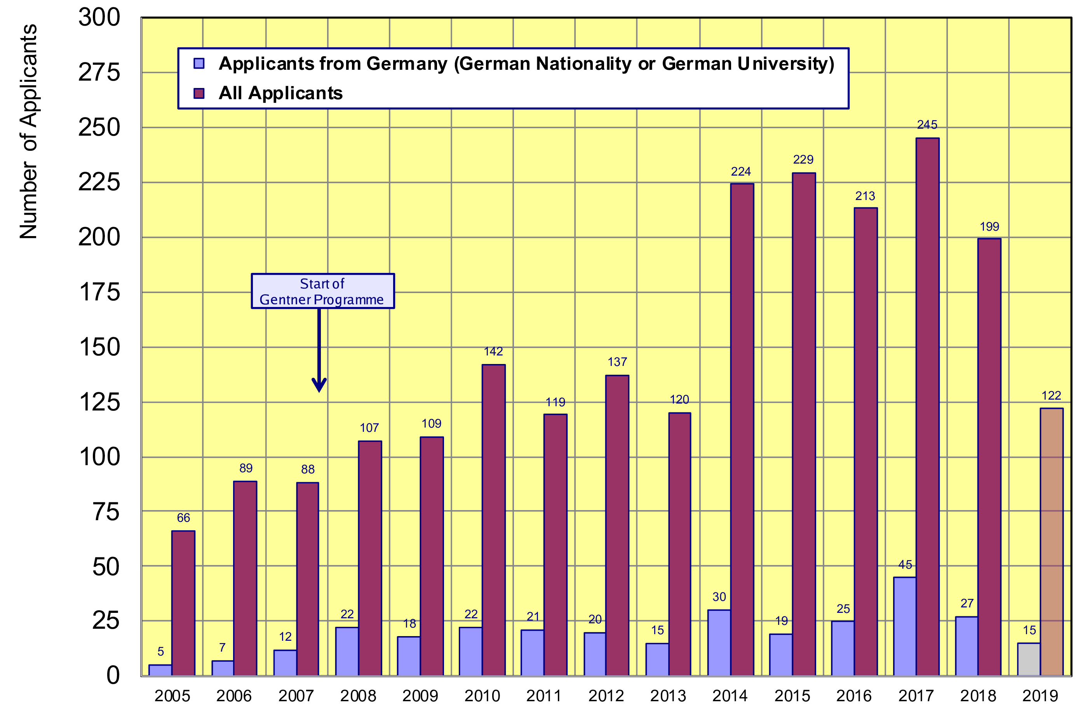
Doctoral Student Applications
Typically ~24 applicants/year from Germany (~stable since 2008)
    27 applications from DE in 2018 (11 selected for the Gentner Programme)
only one selection
board in 2019 so far
average: ~24

Slide 9
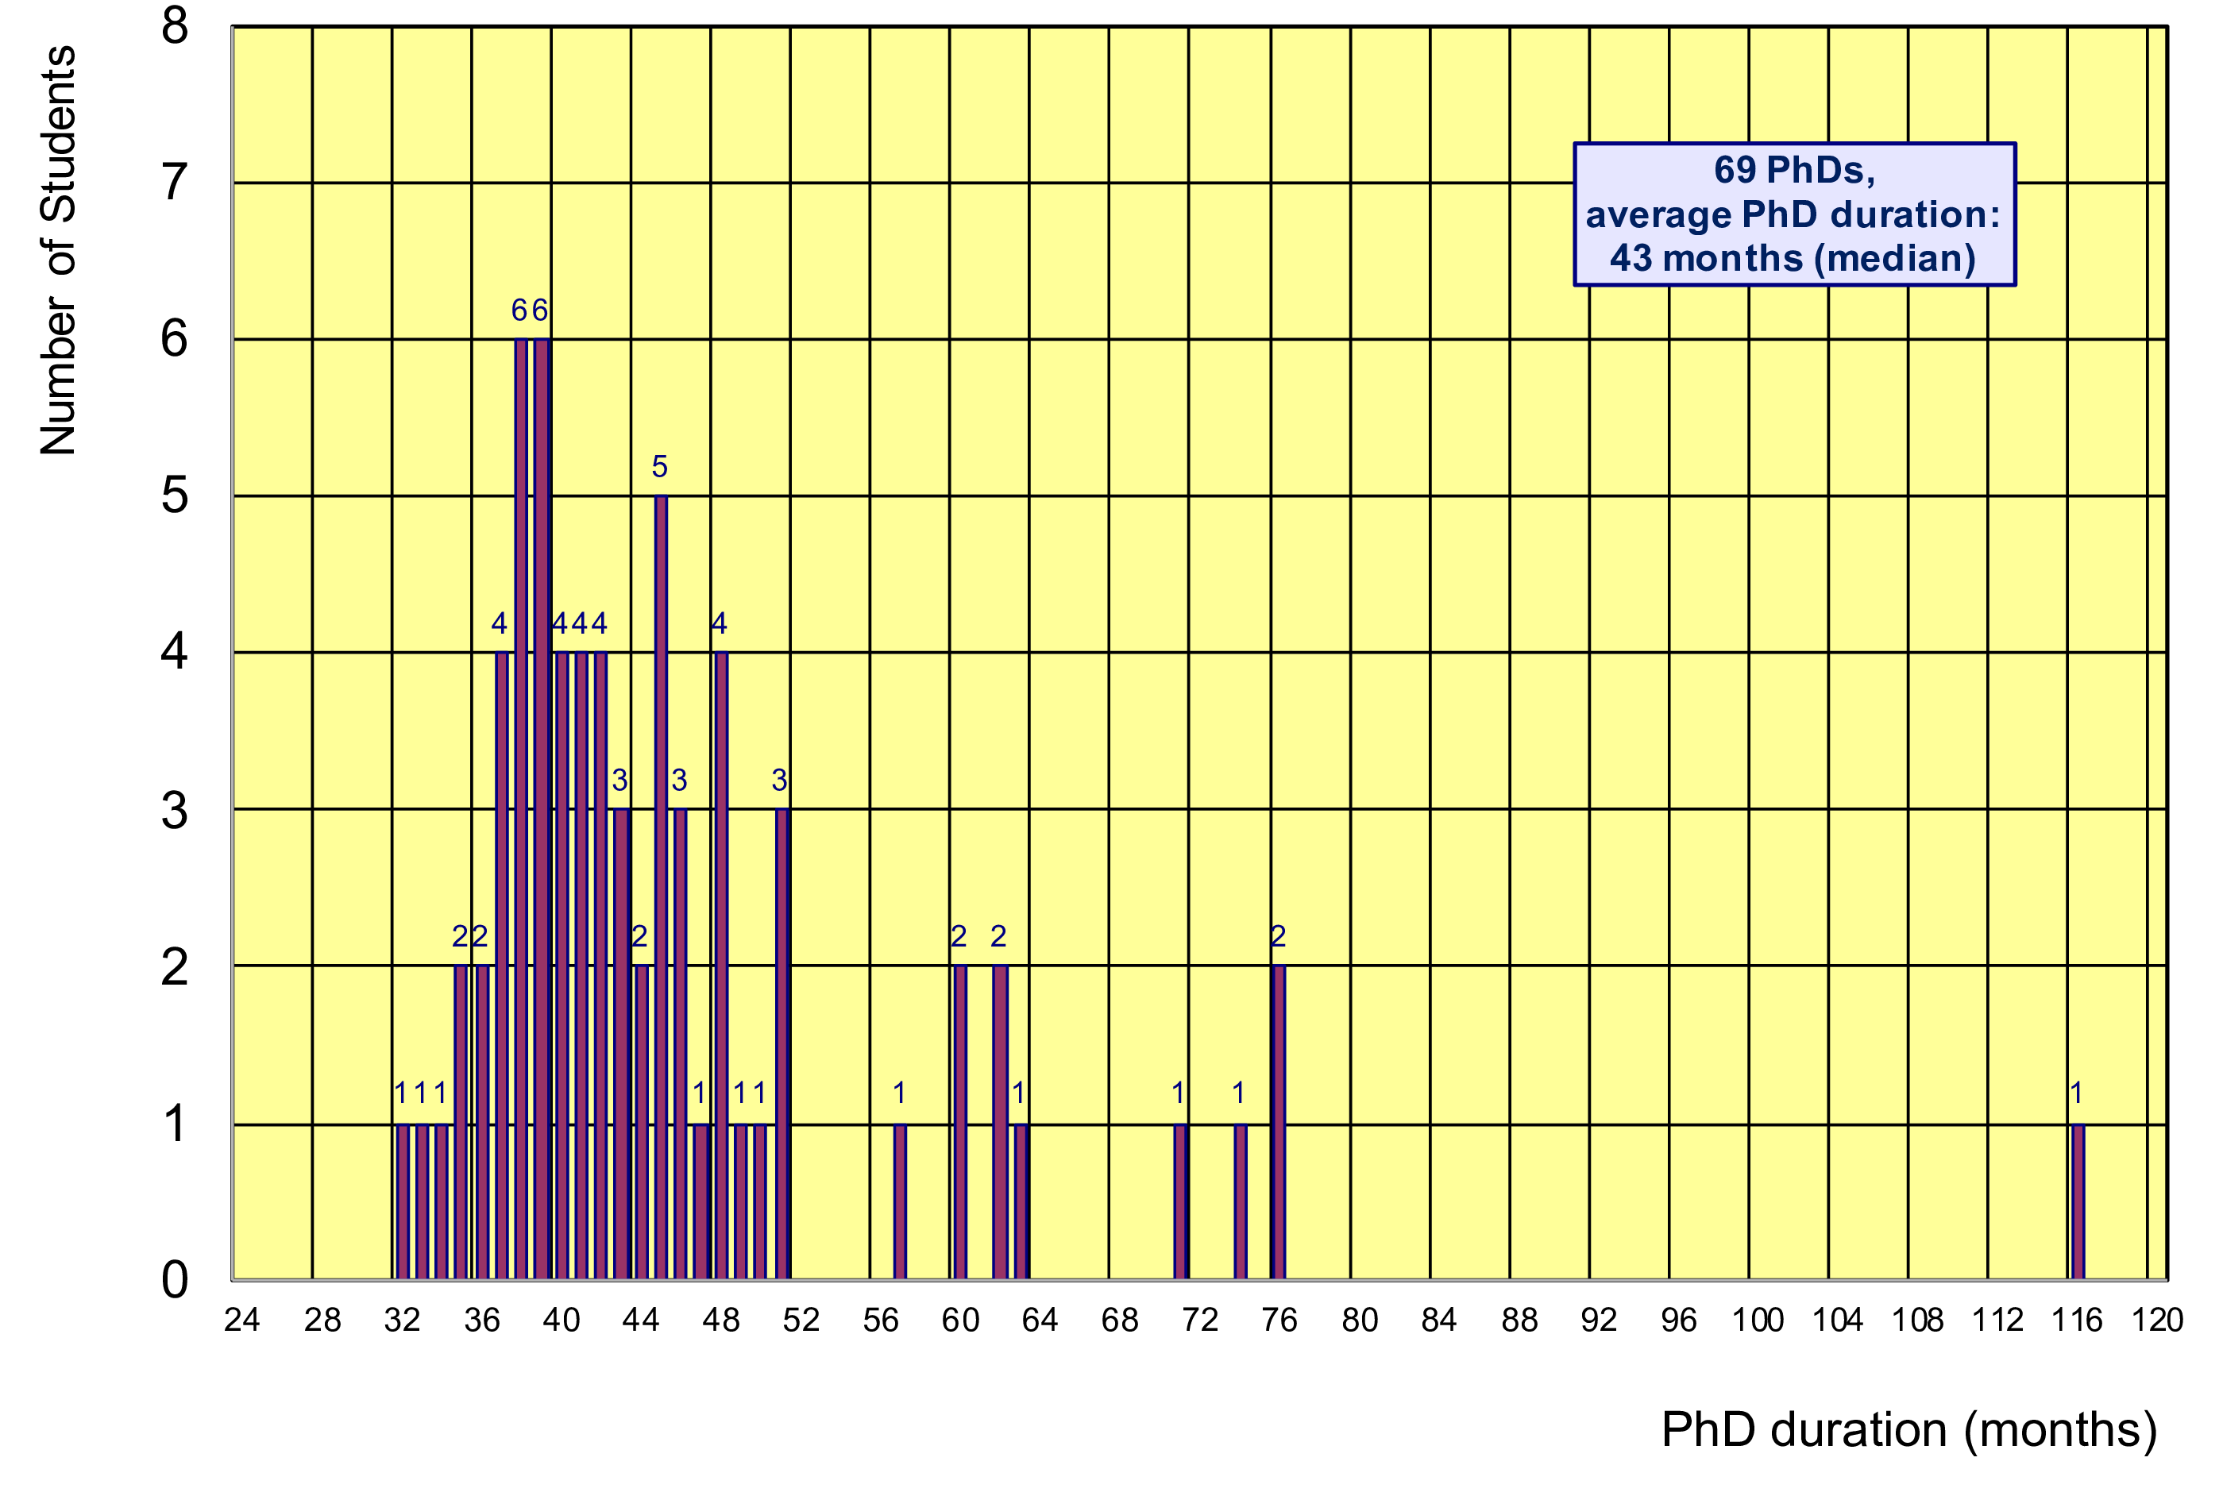
Former Gentner Students
69 PhDs so far (15 female = 22%), 9 Students have cancelled their PhD
    average age at PhD (defense): 30.9 years (median)
    average duration of PhD: 43 months (median) = 7 months after end of CERN 3-years contract
Physics PhDs in Germany (2018)
20.9% female PhDs students
31.0 years (median) at PhD
54 months (median) duration of PhD
7/69 students (10%)
needed ≤ 3 years

Slide 10
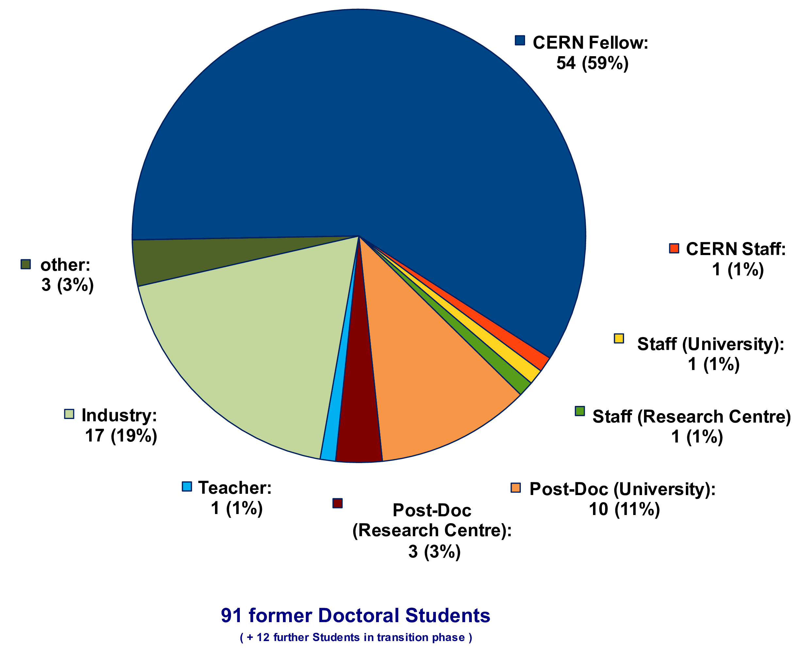
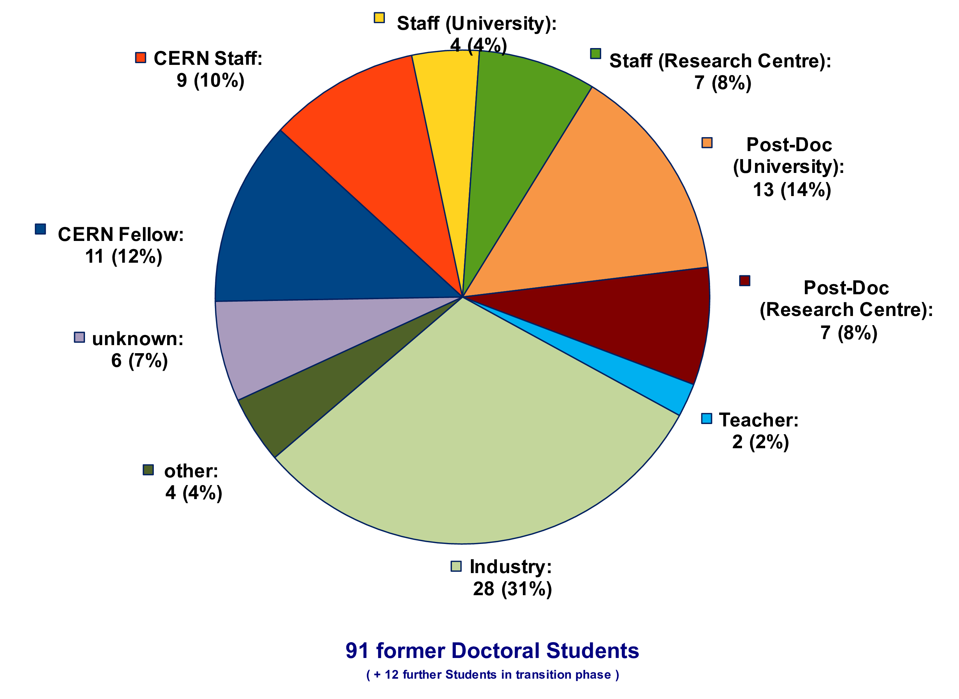
Whereabouts of Gentner Students
  first employment of 59% of the Gentner Students: CERN Fellow(!)
First Employment
Present Employment
presently 9 CERN Staff Members,
2 with indefinite contract
3 Staff were/are supervising Gentner students

Slide 11
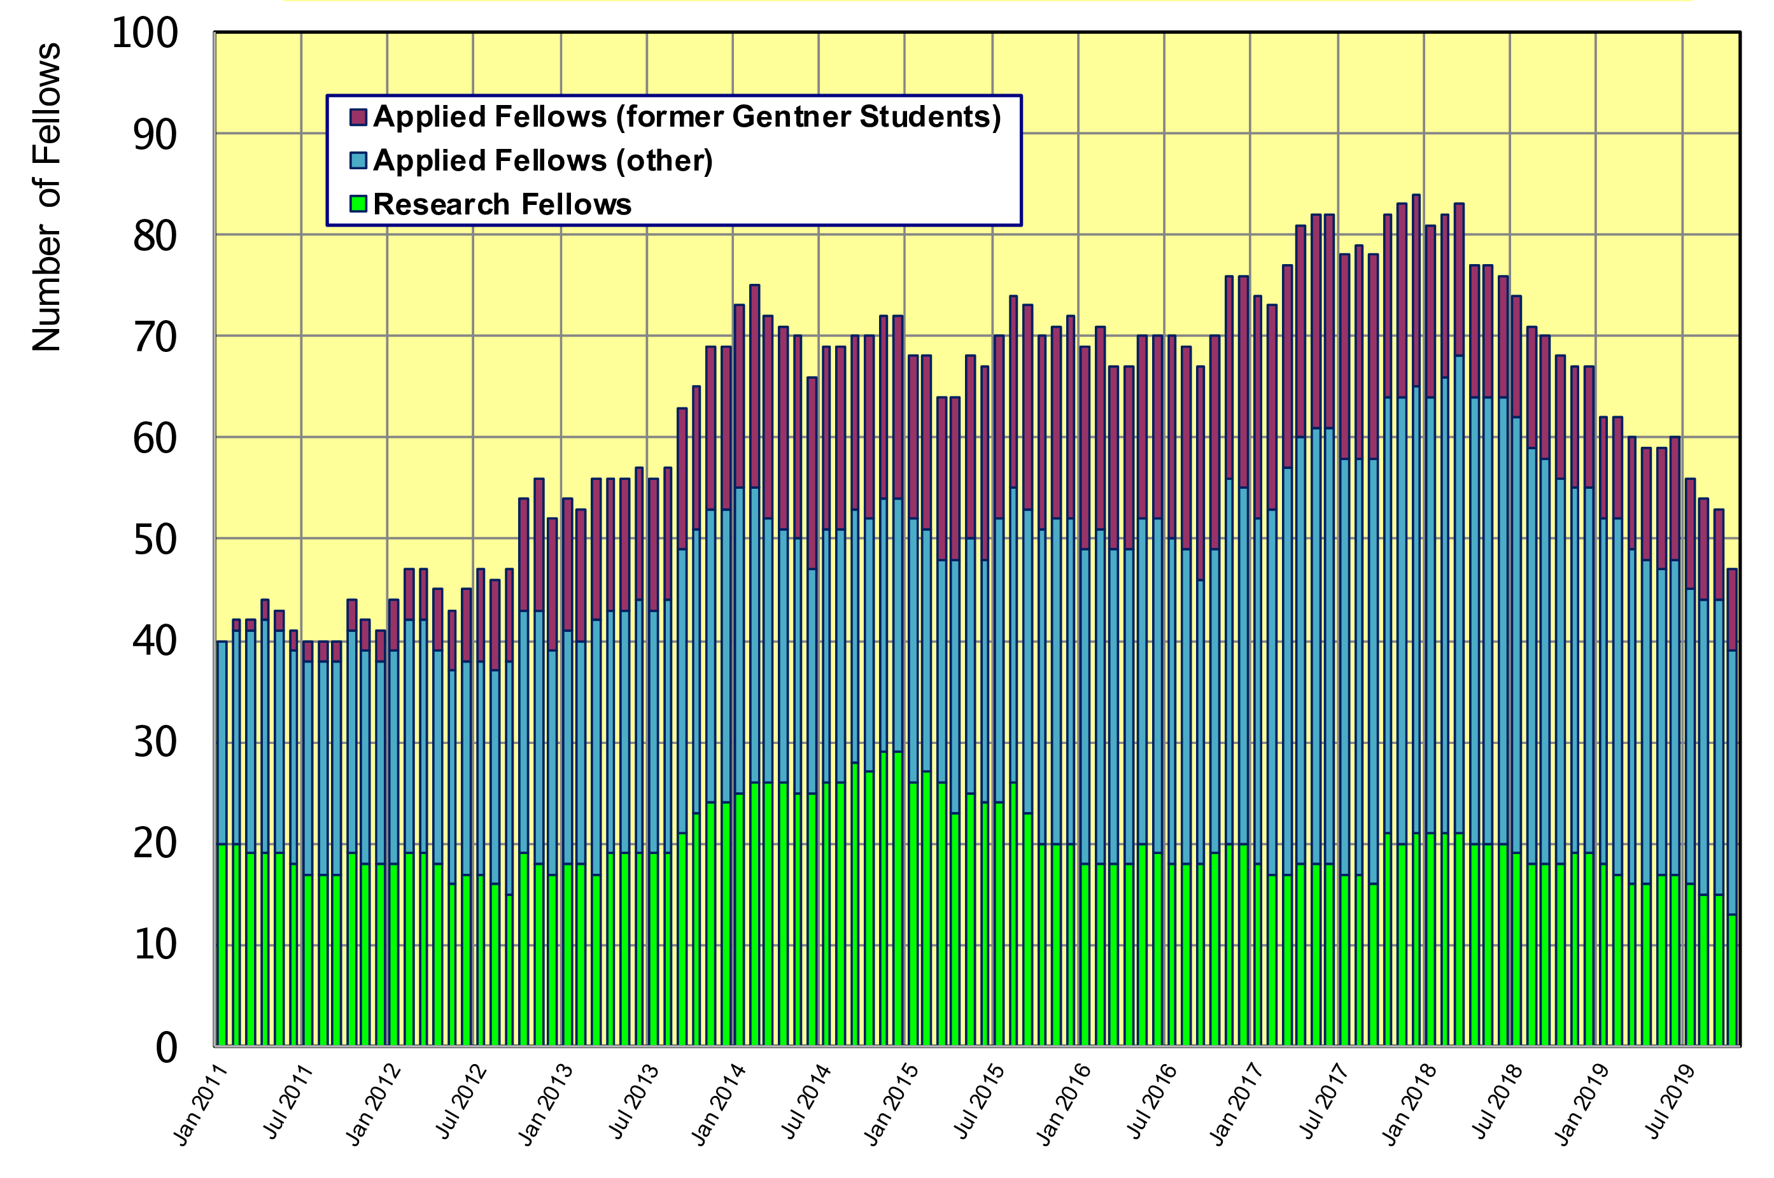
Gentner Students → Fellows
  significant increase of DE Fellows by former Gentner Students
    general trend: fewer former Gentner students become Applied Fellow, also generally fewer German Applied Fellows
alarming
trend !!!

Slide 12
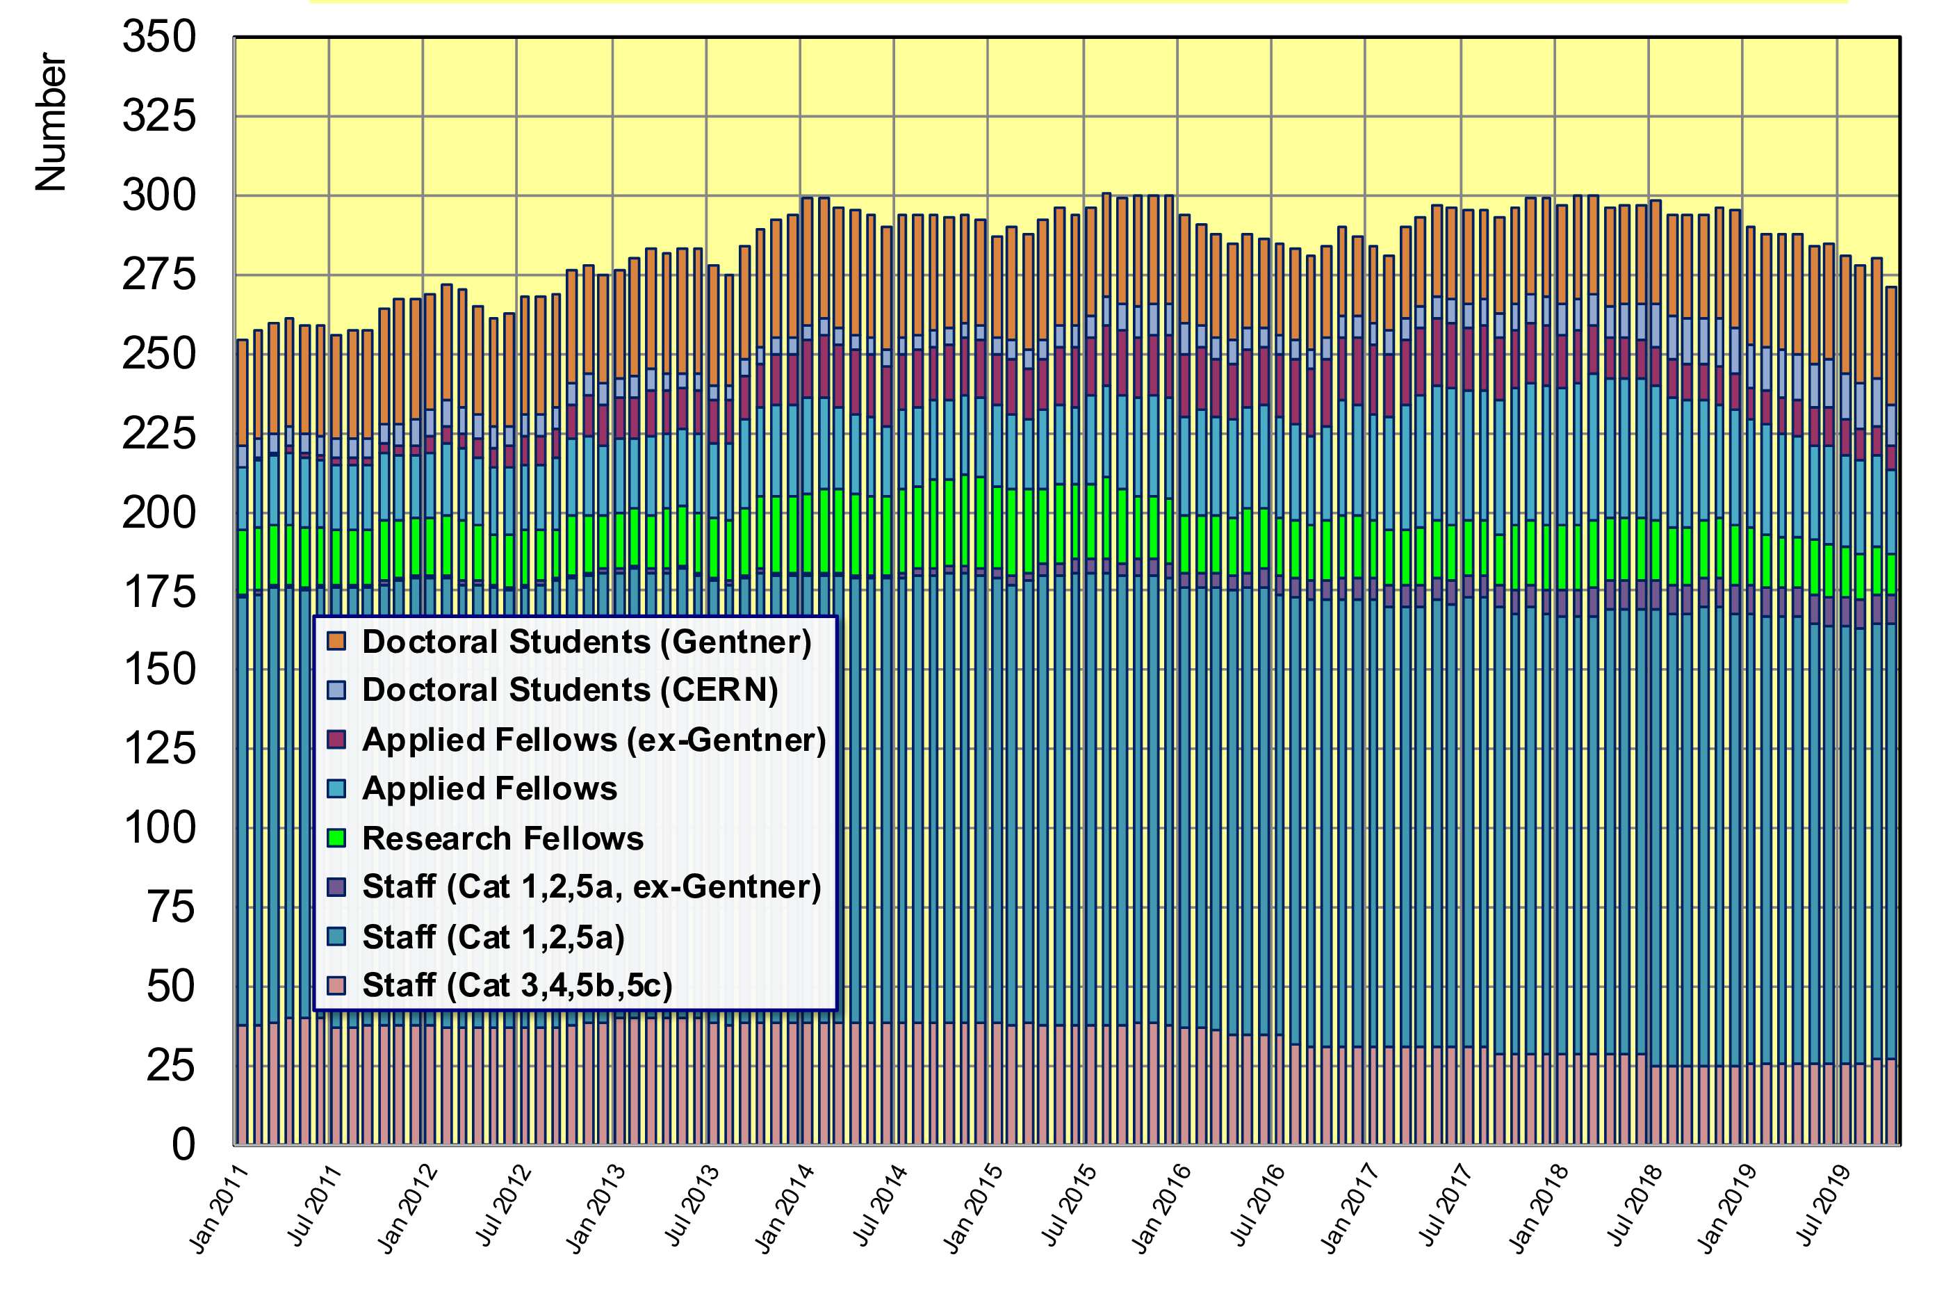
Gentner Students → Fellows, Staff
  271 German Doctoral Students, Fellows and Staff right now
    37 active + 17 former (German) Gentner Students at CERN (= 20% of DE personnel)

Slide 13
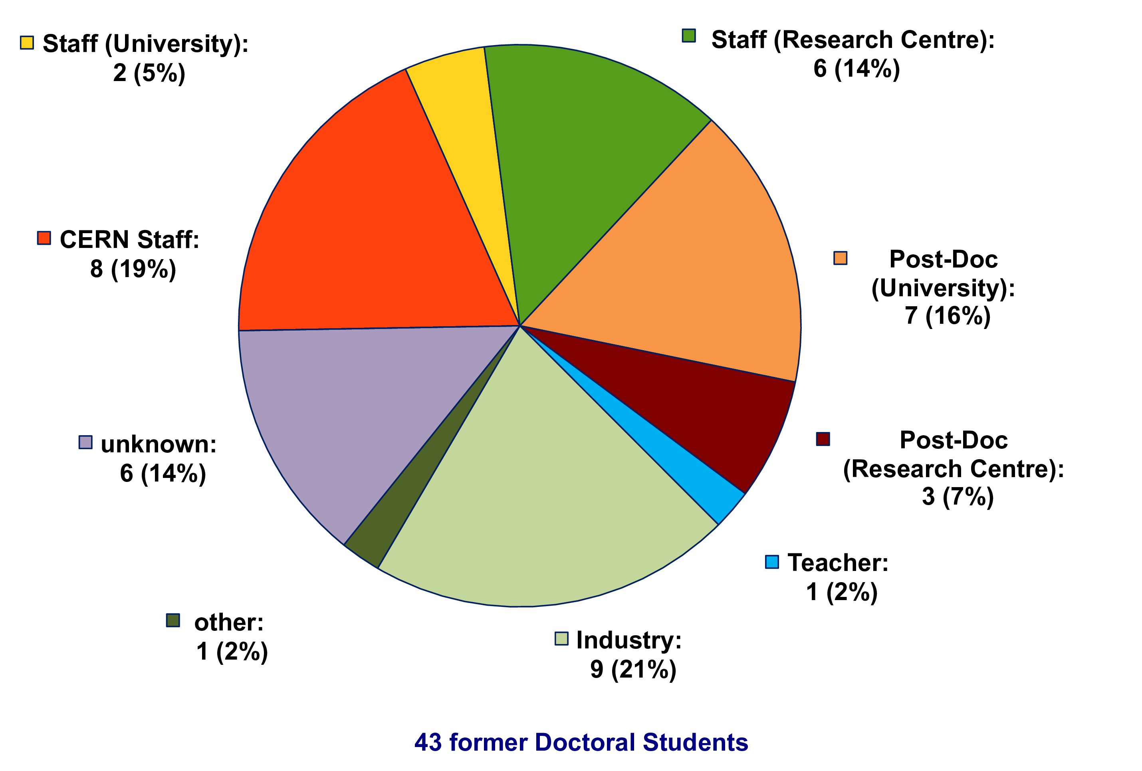
Whereabouts of Fellows
(former Gentner Students)
  many Fellows stay in academic research after their fellowship
    19% became CERN staff, 42% moved to University or Research Centre
todays guest speaker

Slide 14
General News
Travel
  travel to home universities well used
    longer stays as in previous years because of participation at graduate schools and more(!) and longer teaching duties
  travel to national symposia less well used
    easy for physicists: spring meetings of German Physical Society
      but less participation compared to previous years
      use this opportunity to present your work and for networking(!)
    more difficult to find appropriate national symposia for non-physicists
      only limited number of meetings can be considered as national symposia, e.g. VDI meetings for engineers, CCC (Chaos Computer Club) meetings for computer scientists
New HR Doctoral Student Coordinator as of 1 November
  Samuel Chopard → Priscilla Marinho Valavicius

Slide 15
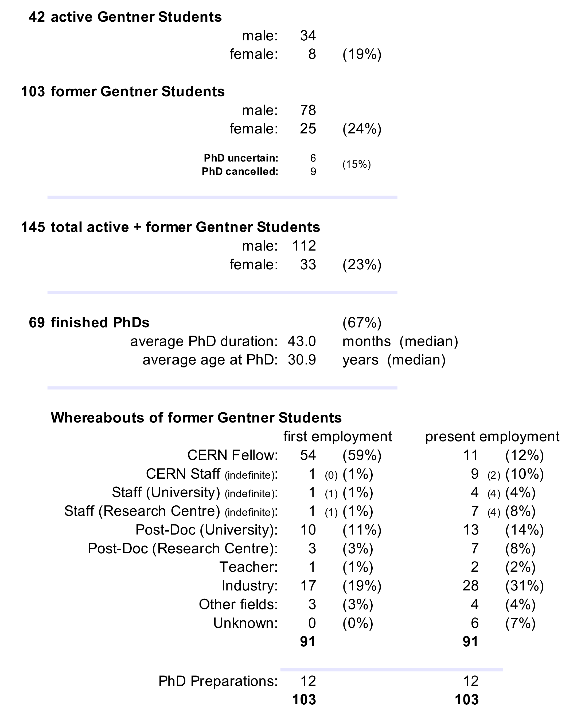
Summary Gentner Programme
  number of students above 40 over last months (nominal: 39 students)
    will drop to nominal 39 students soon
  number of female students was slowly rising again to 20% (from 12%)
    but still low number of female applications
  fewer Gentner students are becoming Fellow
    more students went to private sector
Next Gentner Day:
29 April 2020 (tbc)

