Slide 1
MCBX design
Jesús Ángel García-Matos and Fernando Toral (CIEMAT)
Paolo Fessia, Juan Carlos Pérez and Ezio Todesco (CERN)
Acknowledgements:
P. Abramian, J. Calero, I. Castro, M. Domínguez, A. Fernández, L. García-Tabarés, D. Lopez, T. Martínez, J. Munilla, J.A. Pardo, J.M. Perez, P. Sobrino, (CIEMAT)
S. Izquierdo Bermúdez and N. Bourcey (CERN)
International Review, 11th September 2019

Slide 2
Index
Magnet and cable specifications
Magnetic design
Mechanical design
Magnet protection
Manufacturing concept
Validation tests
Short Mechanical Model
Conclusions

Slide 3
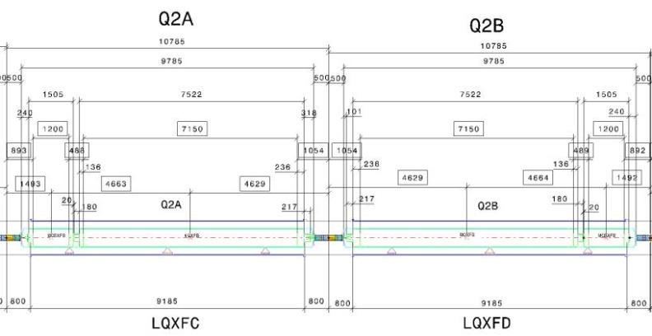

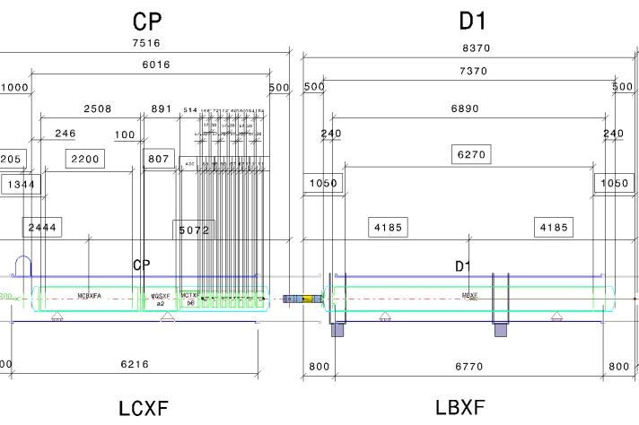

MCBXF
Orbit Correctors
MCBXFB (2.5 T∙m)
MCBXFA
(4.5 T∙m)

Slide 4
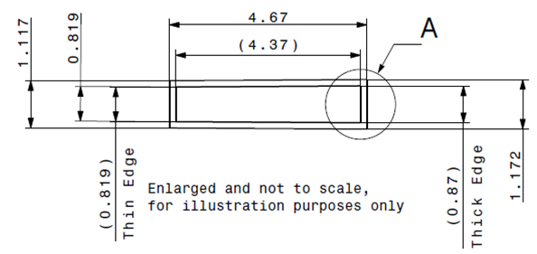
Magnet and cable specifications
MCBXF Technical specifications
Magnet configuration | Combined dipole (Operation in X-Y square)
Integrated field | 4.5 (A) / 2.5 (B) Tm
Minimum free aperture | 150 mm
Nominal current | < 2000 A
Radiation resistance | 35 MGy
Physical length | < 2.5 (A) / 1.505 (B) m
Working temperature | 1.9 K
Iron geometry | D1 (A) / MQXF (B) iron holes
Field quality | < 10 units (1E-4)
Fringe field | < 40 mT (Out of the Cryostat)
Vertical dipole field
(2.1 T)
Combined
dipole field
(Variable orientation)
Horizontal
dipole field
(2.1 T)
Cable Parameters
No. of strands | 18
Strand diameter | 0.48 mm
Cable thickness | 0.845 mm
Cable width | 4.37 mm
Key-stone angle | 0.67º
Cu:Sc | 1.75

Slide 5
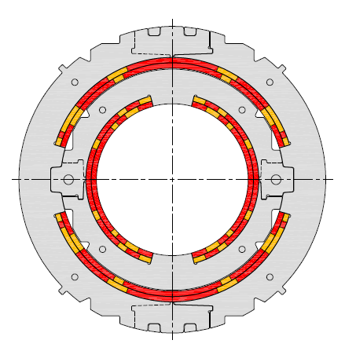
Magnet and cable specifications
MCBXF Technical specifications
Magnet configuration | Combined dipole (Operation in X-Y square)
Integrated field | 4.5 (A) / 2.5 (B) Tm
Minimum free aperture | 150 mm
Nominal current | < 2000 A
Radiation resistance | 35 MGy
Physical length | < 2.5 (A) / 1.505 (B) m
Working temperature | 1.9 K
Iron geometry | D1 (A) / MQXF (B) iron holes
Field quality | < 10 units (1E-4)
Fringe field | < 40 mT (Out of the Cryostat)
Radiation resistance requires mechanical clamping
Cable Parameters
No. of strands | 18
Strand diameter | 0.48 mm
Cable thickness | 0.845 mm
Cable width | 4.37 mm
Key-stone angle | 0.67º
Cu:Sc | 1.75
Working point < 65%

Slide 6
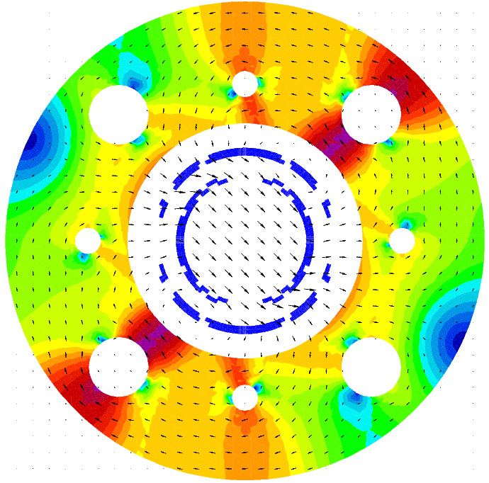
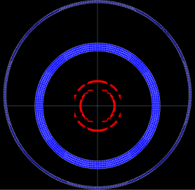
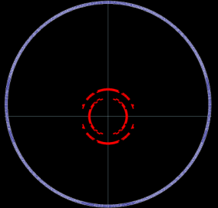
Magnetic Design: Iron saturation
Iron saturation causes the variation of sextupoles with the current (up to 30 units in the worst case)
The difficulty arises because the field changes in two ways depending on the powering scenario: Orientation and intensity.
Other yoke configurations are tested…
… but they do not meet the fringe field requirement: Dipole field decays with 1/r².
Therefore, we have to choose between:
  High fringe field or
  High variation of the multipoles with the current.

Slide 7
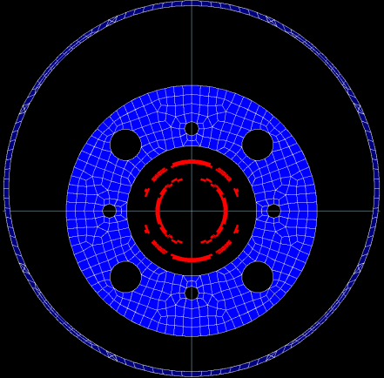
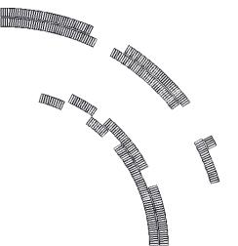
Magnetic Design: Final 2D design
Inner Dipole (ID) & Outer Dipole (OD) parameters | Units | ID | OD
Nominal field | T | 2.15 | 2.26*
Nominal Field (Combined) | T | 3.12
Nominal current (short) | A | 1625 | 1474
Nominal current (long) | A | 1584 | 1402
Coil peak field (Combined) | T | 4.13 (ID)
Working point (combined) | % | 50.1
Differential self inductance at Inom / m | mH/m | 48.7 | 104
Stored energy/m | KJ/m | 64 | 119.3
Aperture | mm | 156.2 | 230
Iron yoke Inner Diam. | mm | 317.2
Iron yoke Outer Diam. | mm | 614
Torque | Nm/m | 1.4×10⁵
Max fringe field, 20 mm out of the cryostat | mT | 29
Total number of turns | - | 140 | 191
Cable length needed for each pole/coil | m | 360 | 487
Whole iron option is chosen:
It meets fringe field requirement.
It has smaller Lorentz forces.
* Higher field necessary to compensate the longer coil end at the outer dipole.
Difficult
winding

Slide 8
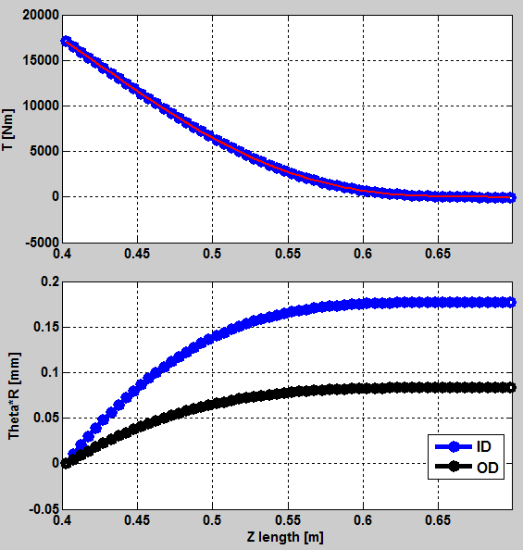
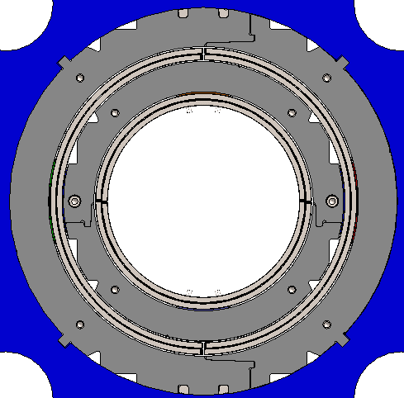
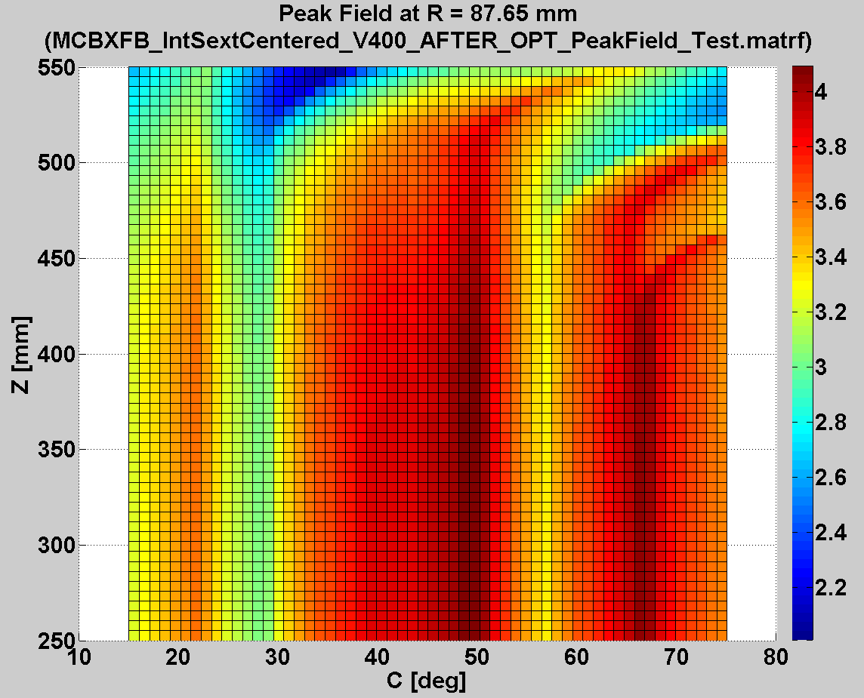
Detailed magnetic design:
Torque and peak field at coil ends
Torque cannot be azimuthally locked at coil ends.
Coil ends should be shortened to improve the torque clamping.
Look out endspacer design not to be too slender.
Field is not aligned with coil poles at nominal current (45º orientation)
Peak field is always at the straight section.

Slide 9
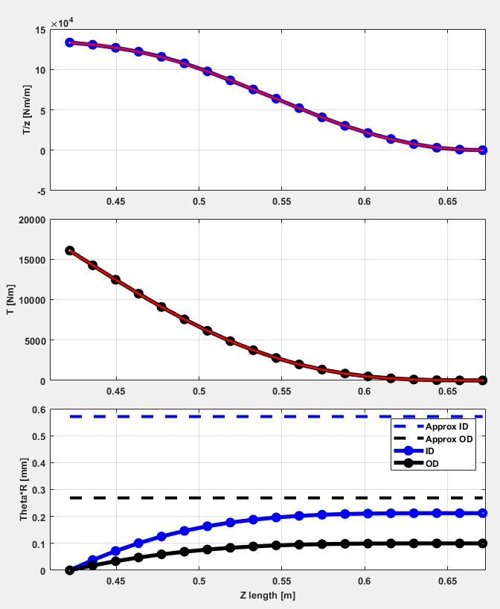
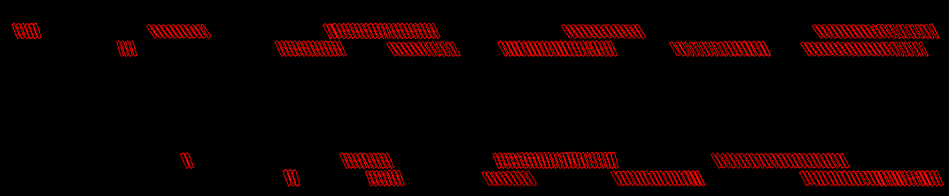
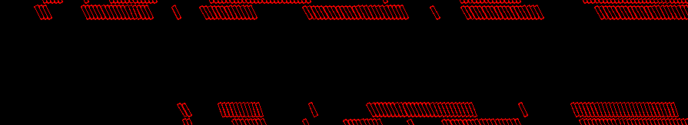
3-D Magnetic Design:
Shorten coil ends
Torsion estimations due to torque at coil ends
260 mm
210 mm
216 mm
170 mm
Coil ends were shortened to increase the coil length supported by collars.
The optimization is very slow:
  More than 100 design variables are used and their range have to be carefully controlled
  Endspacers can not be too slim.
  Block jumps conductors have to be carefully placed to avoid cable distortions.
Around 50
different endspacers, specially slender for the outer coils

Slide 10
Magnetic Design:
Sensitivity analysis
Small changes in the conductor positioning or dimensions, specially in the inner dipole, causes great changes in the multipole values.
0.3 mm thinner interlayer
∆b3 ≅ - 5 units
(3D)
∆a3 ≅ + 0.8 units
0.001 mm thinner cable
∆b3 ≅ + 3 units
(2D)
∆a3 ≅ - 1.25 units
Coil deformation due to collaring is not included in the 3D magnetic simulations. The potential field errors will be compensated later, after learning from magnetic measurements on the prototype.

Slide 11
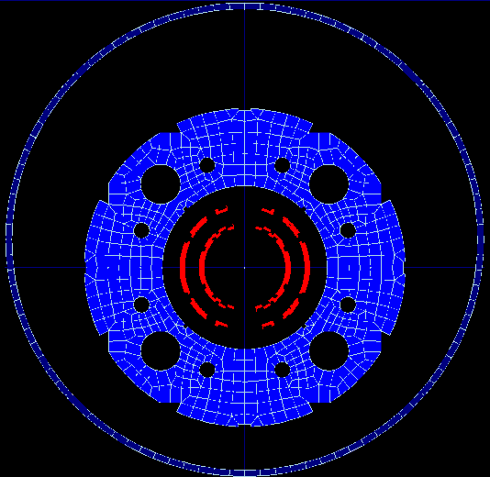
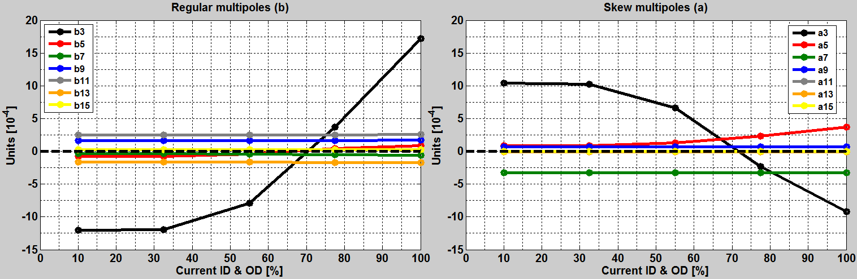
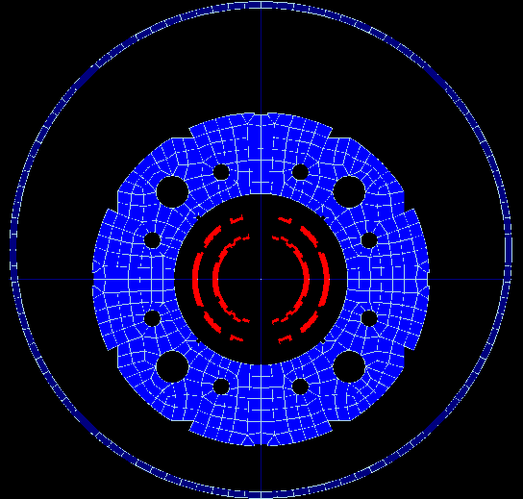
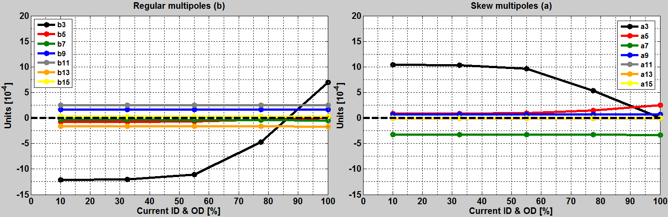
Magnetic design: *MCBXFA Ø77 VS Ø60 mm
Ø77 mm
∆b3 ≅ +30 units
∆a3 ≅ -20 units
10 units less of variation!!!
Ø60 mm
∆b3 ≅ +20 units
∆a3 ≅ -10 units
* Plots for both dipoles ramping simultaneously (Same results ramping ID or OD)

Slide 12
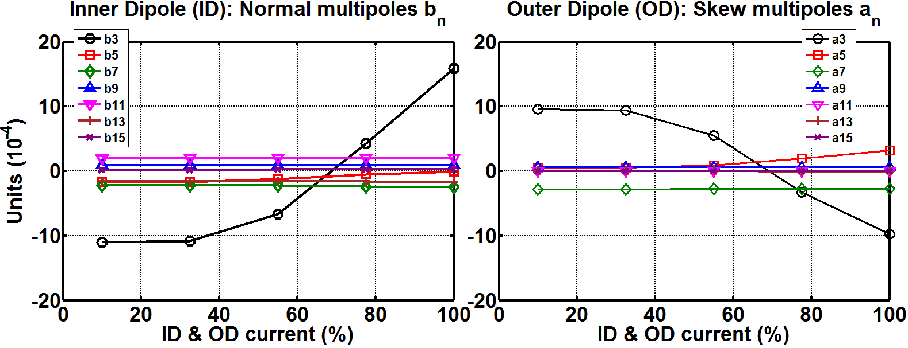
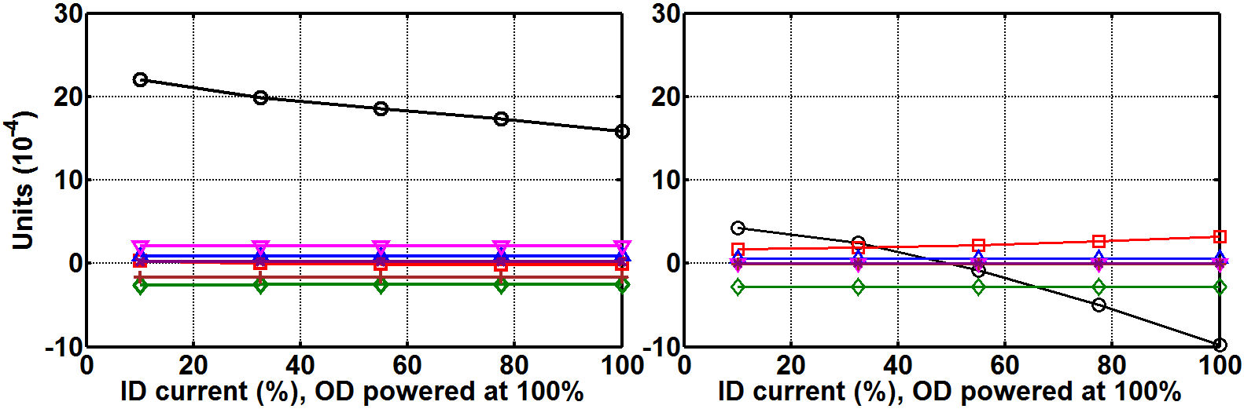
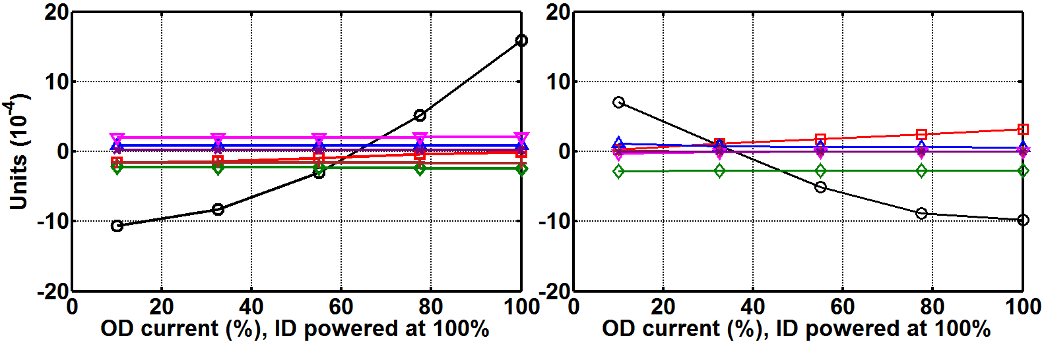
Detailed 3D magnetic design:
Computation strategy and field quality
Optimization needed for any powering scenario
(infinite cases)
Reduced to only three powering scenarios
Each case takes like an hour to compute (3D iron)
The optimization is performed without iron.
The objectives are shifted to take it into account.
< +/-15 units required

Slide 13
Index
Magnet and cable specifications
Magnetic design
Mechanical design
Magnet protection
Manufacturing concept
Validation tests
Short Mechanical Model
Conclusions

Slide 14
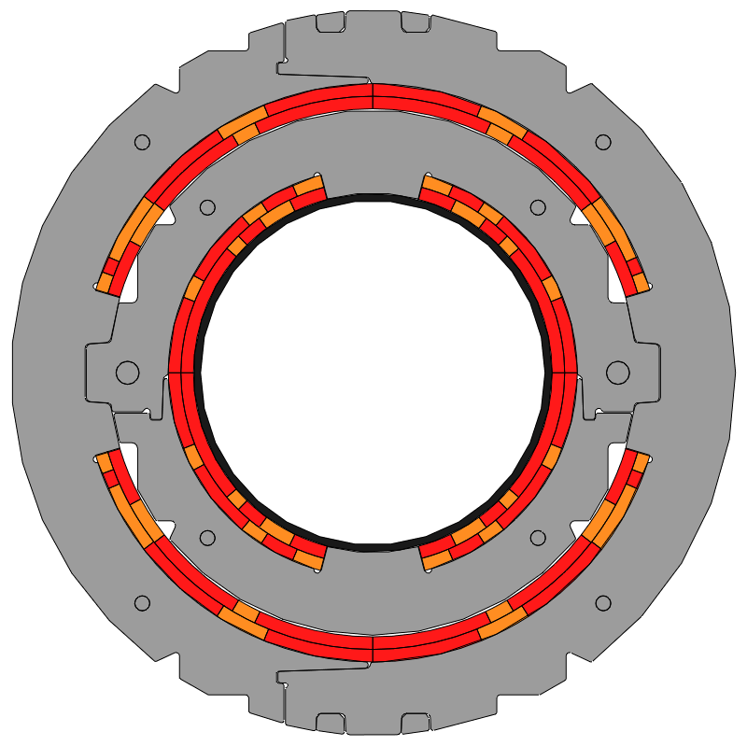
Mechanical design: Radial deformations
The action of an external shell or increasing the outer collars thickness do not reach the inner coils, given the assembly gap between inner collars and outer coils.
1 mm GAP
The only way to decrease the inner dipole deformation is to increase inner collars thickness.
Forces orientation
(Same current on both dipoles)
B
Self Supporting collars:
Inner collar outer diam.= 230 mm (Thickness = 27 mm)
Outer collar outer diam. = 316 mm (Thickness = 33 mm)
1 mm GAP
Differences between the axis of the elliptical shape of the coils (108% IN ):
Inner dipole = 0.6 mm
Outer Dipole = 1 mm

Slide 15
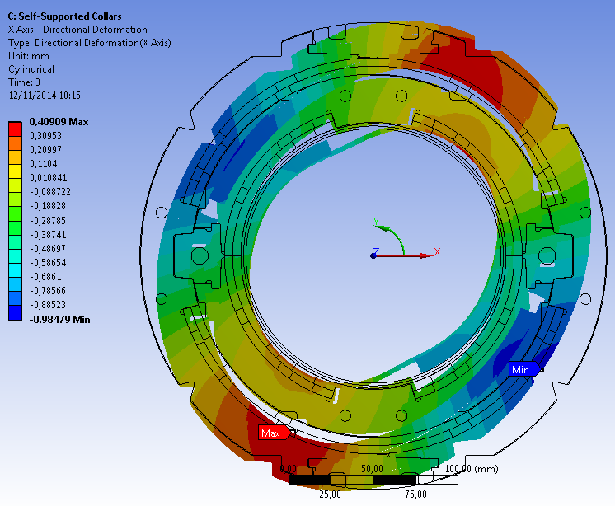
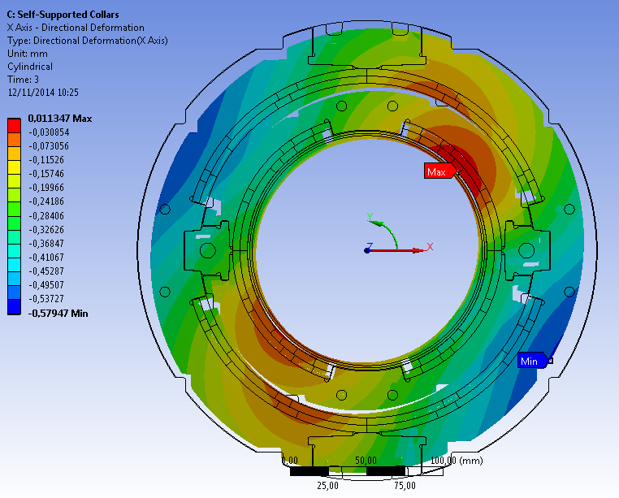
Results: Large radial collar deformations
Outer Collar Diam.= 275 mm
Outer Collar Diam.= 300 mm
Displacement
scaling = 19
Displacement
scaling = 19
Forces
orientation
B
Ellipticity ≅ 1.4 mm VS Ellipticity ≅ 0.6 mm
Field quality effect (Ansys2Roxie) :
∆b3= 9 units
∆a3= 6 units

Slide 16
Mechanical design: Torque locking
When both dipoles are powered their perpendicular magnetic fields try to align the coils.
This is avoided through key-shaped inner collars which match into the outer ones.
Torque locking
B_{OD}
Torque locking
B
B_{ID}

Slide 17
Mechanical design: Azimuthal deformations
Azimuthal coil displacements are not symmetric respect the midplane.

Slide 18
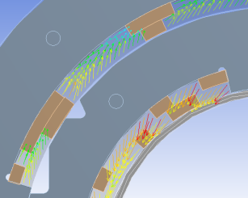

Mechanical design: Azimuthal deformations
Azimuthal coil displacements are not symmetric respect the midplane.
The pole turn on one side of the collar nose is compressed, as on the other side, it is prone to lose contact.

Slide 19
Mechanical design: Azimuthal deformations
Inner collar interference = 0,25 mm
Outer collar interference = 0,35 mm
Interference between collar noses and the pole turns of the coils is introduced.
With the values presented and E_{cable_blocks} = 40 GPa:
Coils edges remains under compression at every powering scenario.
The compressive stress is not too high through the different assembly and operation stages.
Since, E_{cable_blocks} could be half the expected or even less, interference is planned to be tuned up using shims.

Slide 20
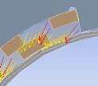

Mechanical design: Radial inward forces
Due to the nested dipole configuration, inner coils tend to deform into the aperture (0,1 mm without friction).
Some space (3 mm) is kept for a Ti tube to be inserted if necessary (we hope not!).

Slide 21
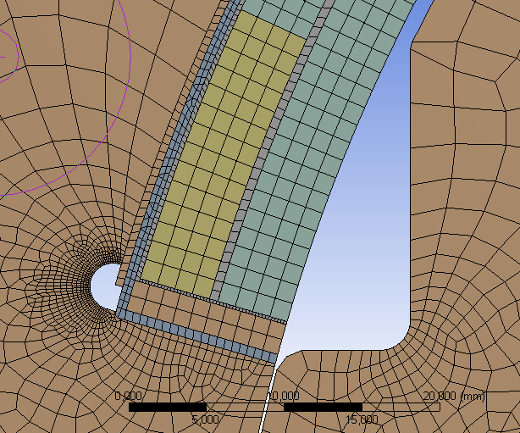
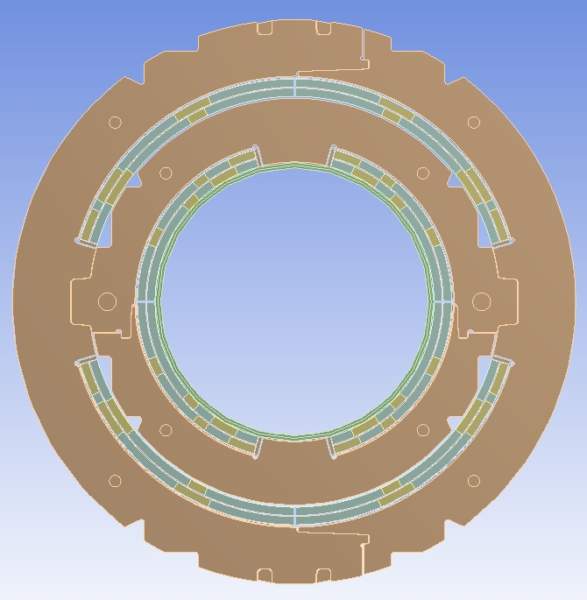
Mechanical design:
Evolution of FEM model
Detailed coil model:
Azimuthal and radial collaring shoes.
Interlayer insulation
Ground insulation
Quench heaters
Difficulties to achieve convergence:
No symmetry can be applied (longer times and difficult support definition).
Many elements with different materials in contact.
Take care of excessive penetration in contacts
Difficult to mesh thin elements properly.

Slide 22
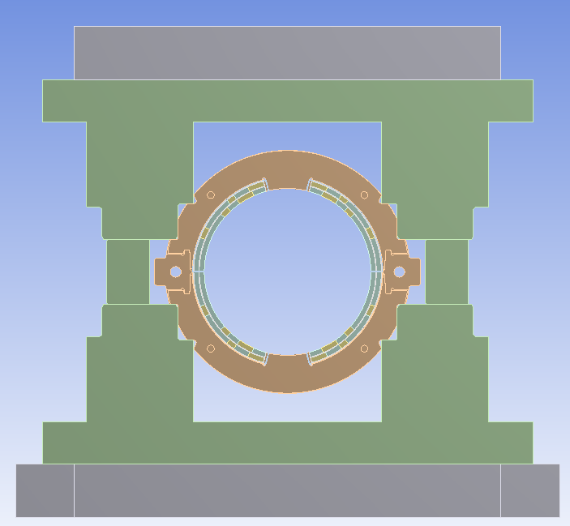
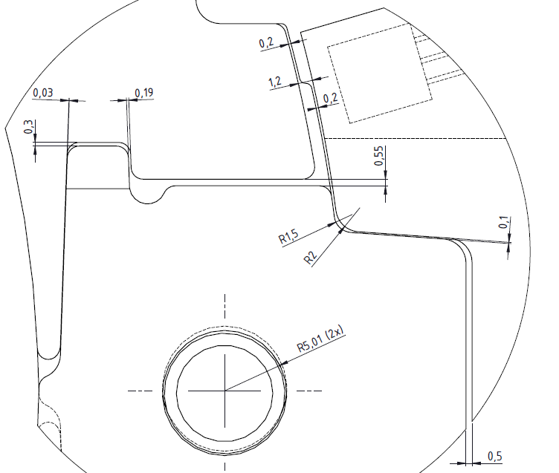
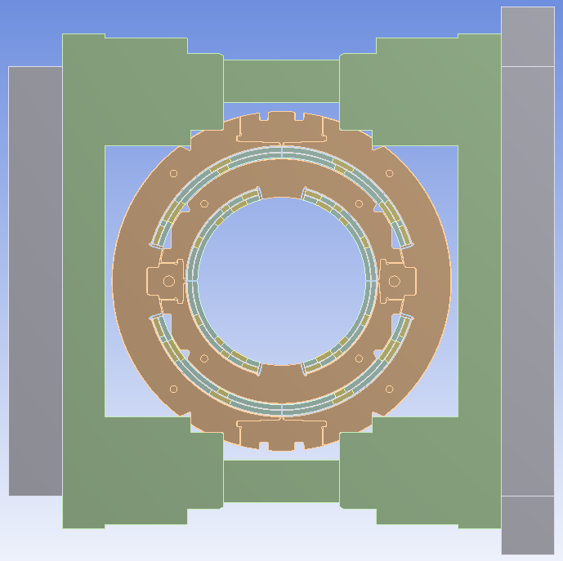
Mechanical design:
Simulation of collaring
Achieved goals:
Monitoring stress at the coils when the pins/keys are inserted.
Sizing of the stoppers needed to limit the press displacement.
Checking that all clearances are the correct ones in order to assure assembly.

Slide 23
Mechanical design: material properties and results
Dipole | Turn | Collaring | Spring-back | Cool down | Nominal current
Inner | Pole | 136 | 95 | 34 | 6
 | Midplane | 130 | 101 | 37 | 65
Outer | Pole | 160 | 123 | 57 | 22
 | Midplane | 155 | 133 | 41 | 79
Compressive stress (MPa)

Slide 24
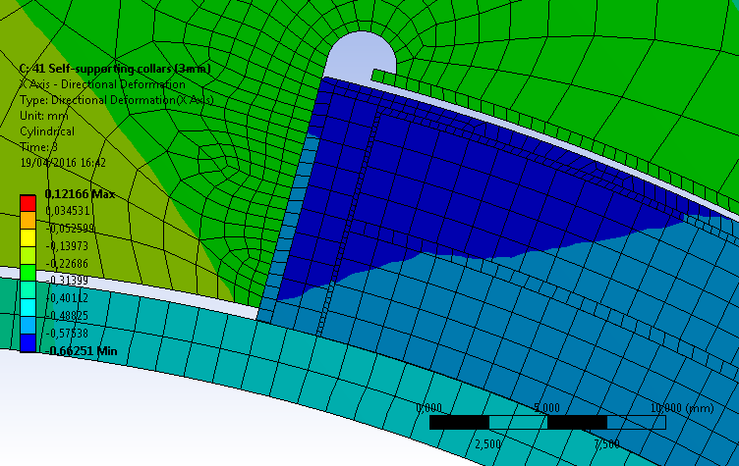
Mechanical design:
Results
In this detailed model we obtained also good results but…
Coils seem less stiff than in the previous model.
The applied interference is not enough to keep the coils attached to the collars
A short mechanical model will be used to validate the simulation
If necessary, interference can be added by placing shims between the coils and the collar nose.
We tend to trust more the previous model as it is much simpler.

Slide 25
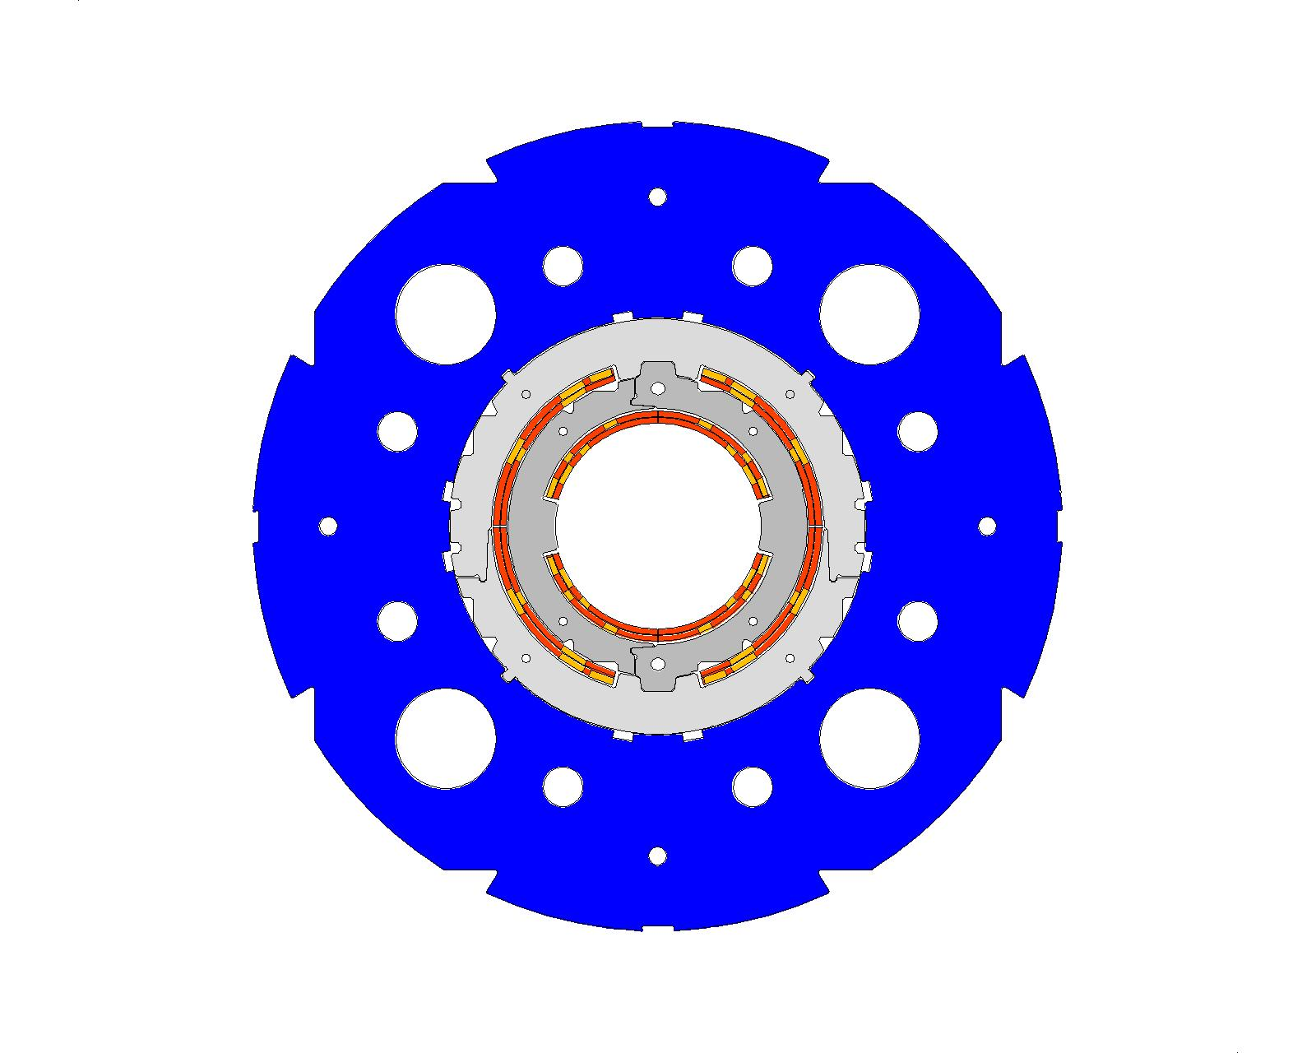
Mechanical model
Wedges
Cooling channel
Iron
Outer collar
Coil blocks
Inner collar

Slide 26
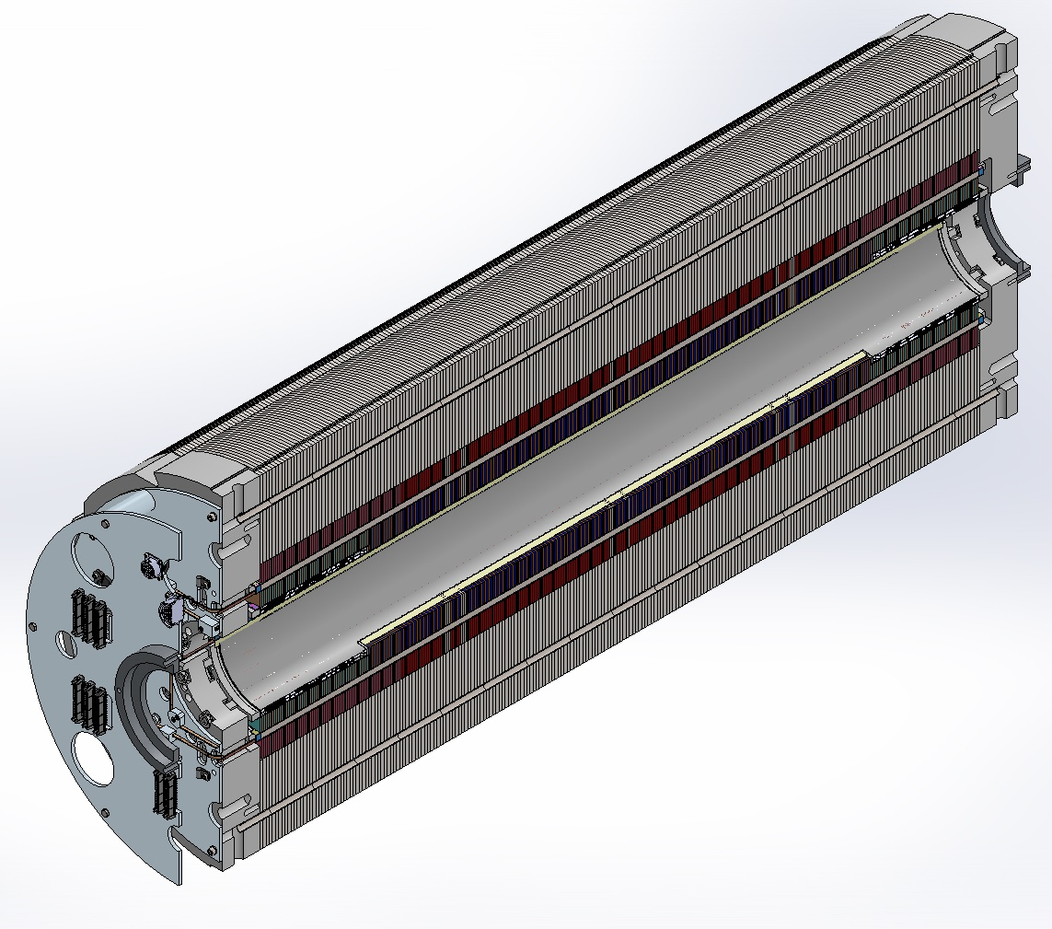
Magnet engineering design: endplates (I)
There is no shell or inertia tube.
Two endplates with eight stainless steel rods compress the iron laminations and hold the axial Lorentz forces.
There is no contact between the collars and the endplates.
The endplates are 70 mm thick but they cannot be considered as infinitely rigid.
We want to apply the axial pre-stress just to guarantee contact at the coil ends when cooled-down.

Slide 27
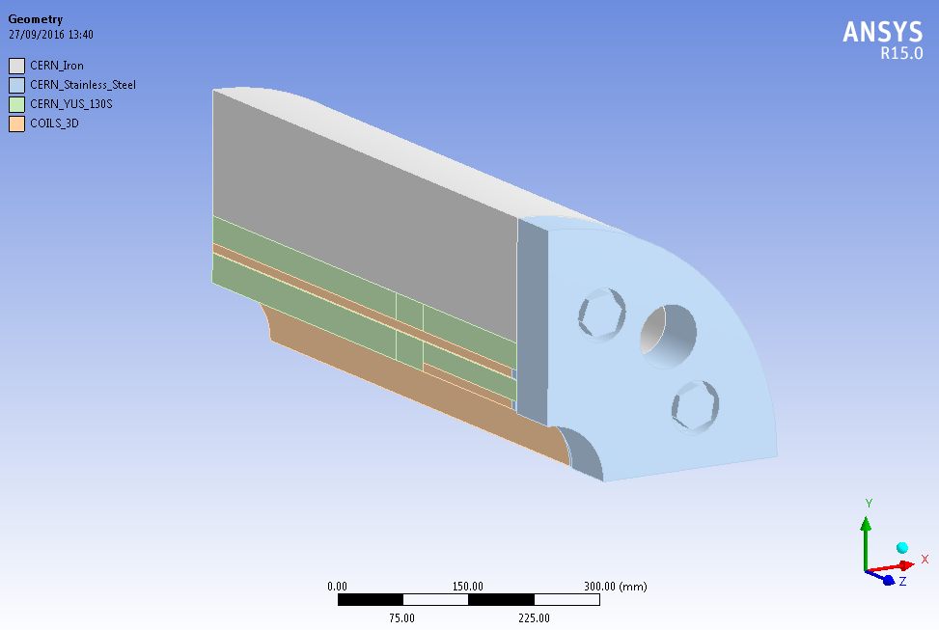
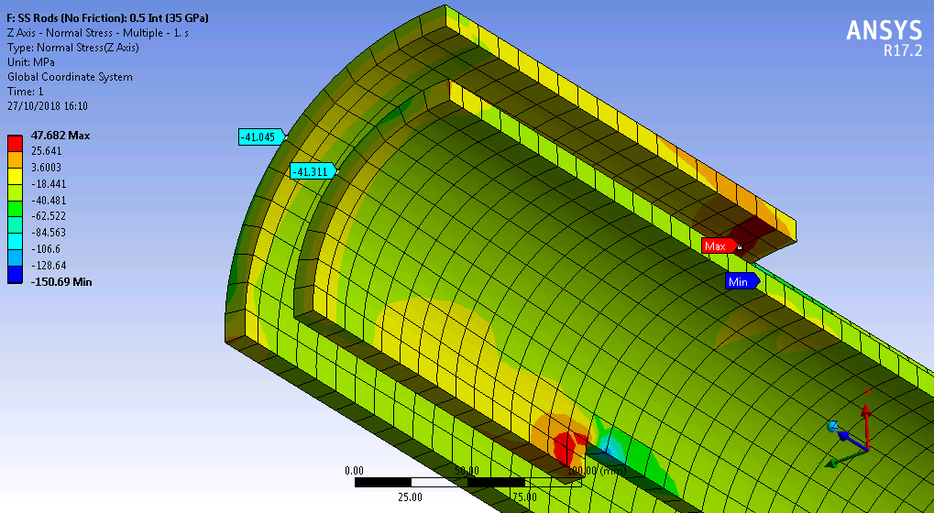
Magnet engineering design: endplates (II)
Two models have been developed to analyze the mechanical problem:
  Analytical based on Roark’s formulas
  3-D finite element model
Friction is neglected. All materials are assumed as isotropic in a first approach. Three load steps: assembly, cool-down and energization.
Both models agree on the results. For the first load step, to provide a pressure of 40 MPa on the coil ends, the analytical model needs 69 MPa at the rods and the numerical one, 60 MPa.
However, it is not a good assumption to consider isotropic iron yoke. The axial modulus of elasticity will be measured during assembly to decide the value of the axial coil pre-stress.
Yoke
Outer dipole coil
End plate
Collars
Inner dipole coil

Slide 28
Index
Magnet and cable specifications
Magnetic design
Mechanical design
Magnet protection
Manufacturing concept
Validation tests
Short Mechanical Model
Conclusions

Slide 29
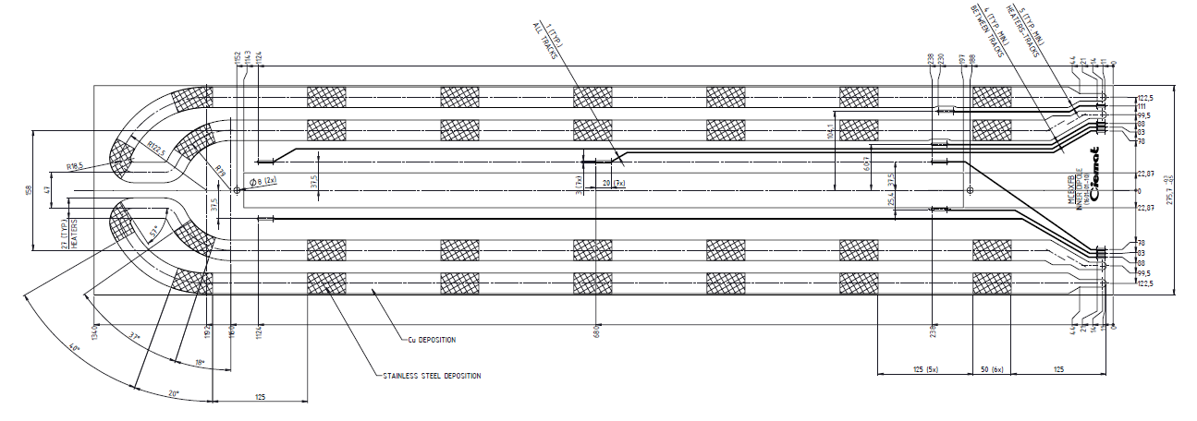
Protection (2016)
Quench simulation with CIEMAT code SQUID, based on finite difference method.
Baseline strategy is: short magnet is self-protected, long one is protected by dump resistor.
Heaters are being implemented in the short prototype for validation. If successful, they will be likely implemented instead dump resistor.
Heaters produced by 927 team.
One voltage tap per cable block and at both sides of the layer jump.

Slide 30
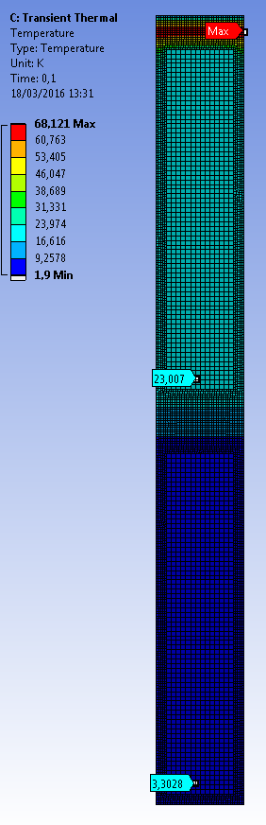
Protection (2016):
Quench Heaters evaluation
Dump resistors are not the preferred option given the high cost of the switch.
Quench heaters need to be considered.
Our in-house code is improved to take into account spacers, layer jumps and quench heaters
Quench heaters delay is obtained by means of a thermal simulation in ansys (around 14 ms)

Slide 31
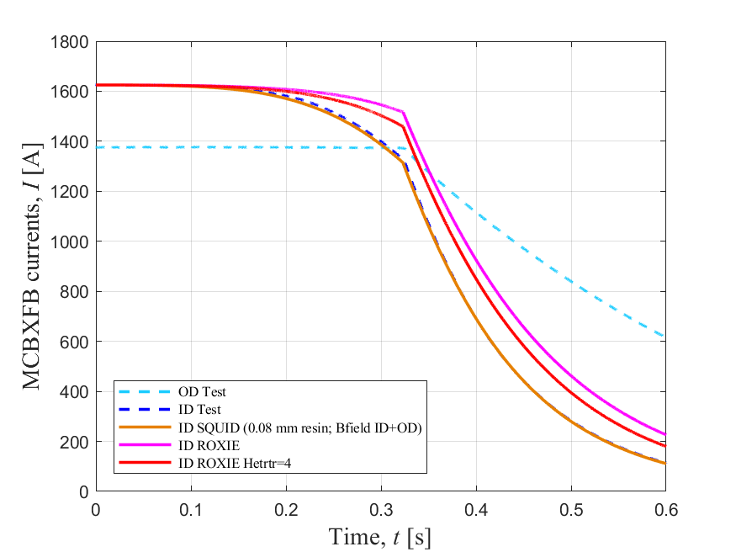

Q21: Quench in ID at 1625 A with dump resistor with 300 ms delay (August 2019)
Quench in the pole turn of the Inner Dipole at nominal current with OD at 1376 A.
t=0 at the initial quench. 13 ms for quench detection plus 10 ms for quench validation.
0.3 Ohm dump resistor with 300 ms delay from validated quench.
Measured RRR=140.
SQUID predicts very good the discharge assuming an excess of resin.
ROXIE is not able to reproduce the current decay even improving the transverse thermal conductivity.

Slide 32
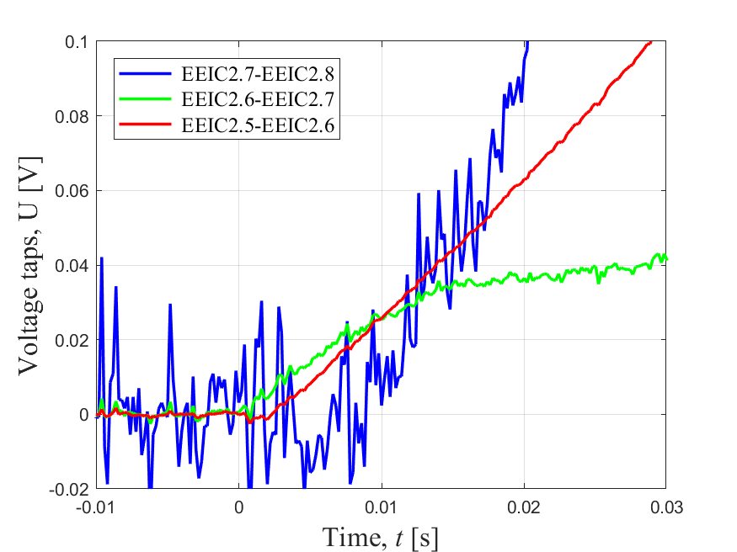
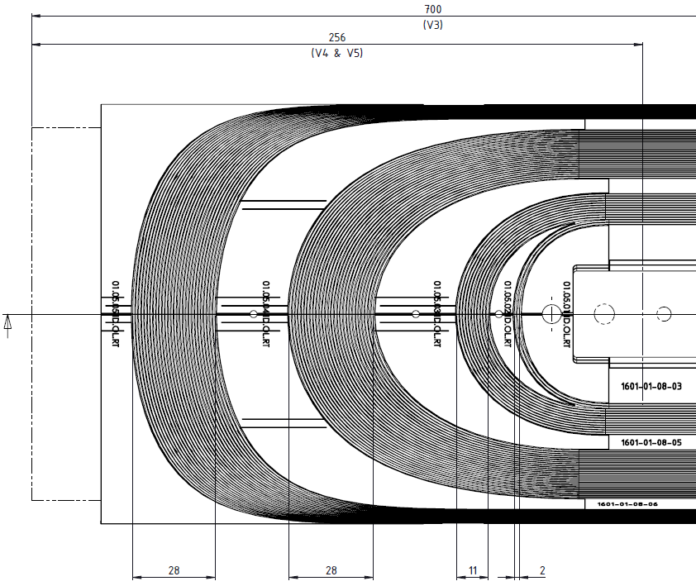
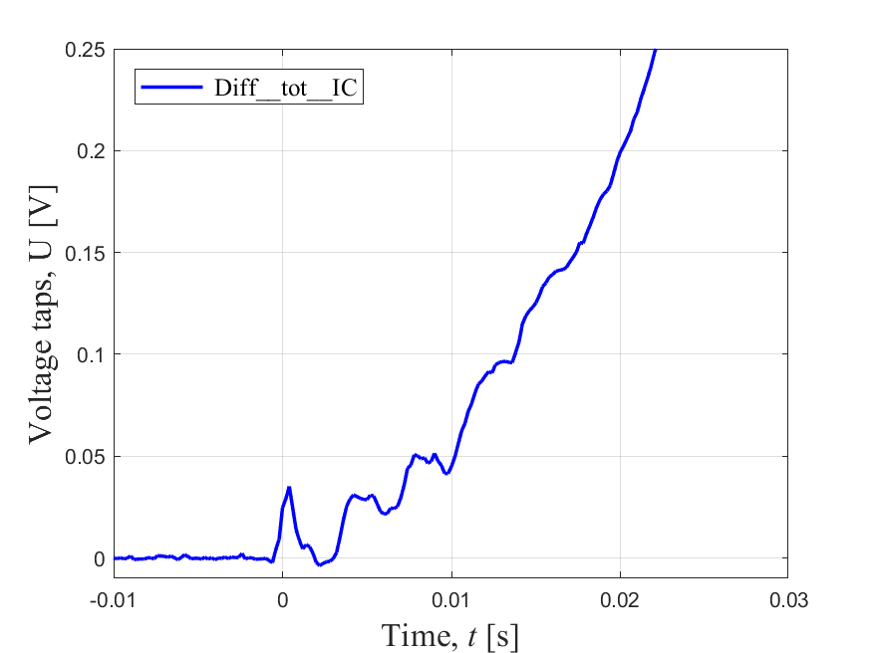
Q21: Quench in ID at 1625 A. Quench propagation velocity
Longitudinal quench propagation velocity calculated with the voltage taps information plus geometry (assuming velocity from quench to EEIC2.6 equals velocity to EEIC2.7): 12.6 m/s. SQUID: 7.4 m/s.
9 ms
Quench in the coil end pole turn.
2 ms
Quench
EEIC2.6
Turn-to-turn propagation time
EEIC2.7
SQUID: 1.5 ms
The SQUID underestimation of the initial longitudinal quench velocity compensates the overestimation of the transversal velocity.
10 ms

Slide 33
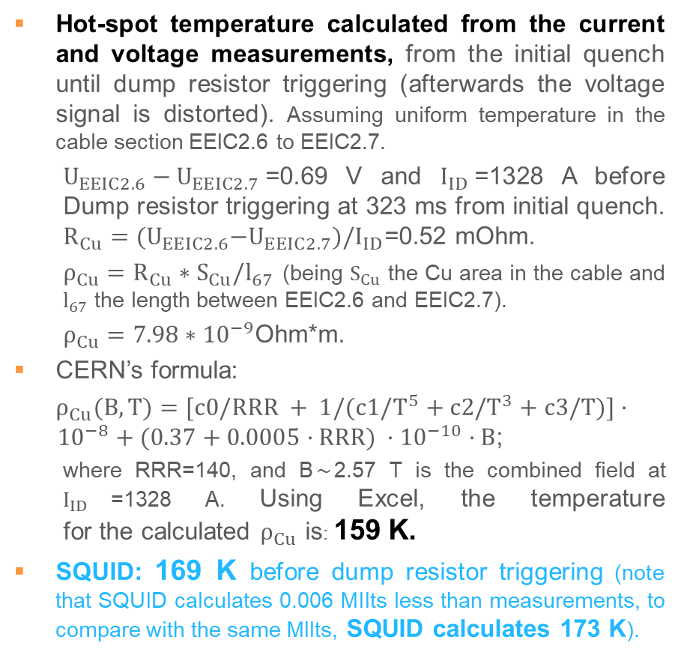
Q21: Quench in ID at 1625 A. Hot-spot temperature
Hot-spot temperature calculated from the current and voltage measurements, from the initial quench until dump resistor triggering (afterwards the voltage signal is distorted). Assuming uniform temperature in the cable section EEIC2.6 to EEIC2.7.
  $U_{EEIC2.6}−U_{EEIC2.7}$=0.69 V and $I_{ID}$=1328 A before Dump resistor triggering at 323 ms from initial quench. $R_{Cu}={(U}_{EEIC2.6}−U_{EEIC2.7})/I_{ID}$=0.52 mOhm.
  $ρ_{Cu}=R_{Cu}∗S_{Cu}/l_{67}$ (being $S_{Cu}$ the Cu area in the cable and $l_{67}$ the length between EEIC2.6 and EEIC2.7).
  $ρ_{Cu}=7.98∗{10}^{−9}$Ohm*m.
CERN’s formula:
$ρ_{Cu}(B, T)=[c0/RRR + 1/(c1/T^{5}+c2/T^{3}+c3/T)]·{ 10}^{−8} + (0.37+0.0005·RRR) ·{10}^{−10}·B$;
  where RRR=140, and B$\sim$2.57 T is the combined field at $I_{ID}$=1328 A. Using Excel, the temperature for the calculated $ρ_{Cu}$ is: 159 K.
SQUID: 169 K before dump resistor triggering (note that SQUID calculates 0.006 MIIts less than measurements, to compare with the same MIIts, SQUID calculates 173 K).
Quench
EEIC2.6
EEIC2.7
SQUID acceptably estimates the hot-spot temperature of the MCBXFB-ID, being conservative by ~8 %.

Slide 34
Predictions for the ID at ultimate current 1742 A
Test parameters | Model | Maximum voltage (V) | MIIts (MA²s) | Hot-spot temperature (K)
Dump resistor 0.3 Ohm; 350 ms delay | SQUID | 295 | 1.05 | 294
 | ROXIE | 408 | 1.17 | 312
Dump resistor 0.3 Ohm; 400 ms delay | SQUID | 297 | 1.07 | 309
 | ROXIE | 346 | 1.21 | 338
Without dump resistor | SQUID | 297 | 1.09 | 325
 | ROXIE | 174 | 1.28 | 377
Note that the calculated voltage is the voltage to ground in ROXIE simulations but it is only the resistive voltage in SQUID, so they cannot be directly compared. Moreover, ROXIE includes in the voltage calculation the voltage generated across the dump resistor, while SQUID takes into account only the magnet voltage.
After matching the current decay, the hot spot temperature predictions are higher, because of the cable insulation properties. It is a pessimistic assumption.
Results are also cross-checked with an adiabatic model. For real test data at nominal current, hot spot prediction is below 300 K without cable insulation, and below 200 K with cable insulation (G10).

Slide 35
Index
Magnet and cable specifications
Magnetic design
Mechanical design
Magnet protection
Manufacturing concept
Validation tests
Short Mechanical Model
Conclusions

Slide 36
Manufacturing concept
Double pancake coils of small NbTi cable with large aperture: large number of turns.
Traditional coils made with polyimide insulated cables would be too spongy: dimension control would be very challenging.
Fully impregnated coils would ease the dimension accuracy.
Resin should be radiation hard and have a good mechanical behaviour.
Cable should be insulated with a glass-fiber sleeve to ease the impregnation.
A binder is necessary to hold the first layer while winding the second one.
The binder must be compatible with the resin.
Coil pre-stress will be provided by self-supported stainless steel collars.
Iron yoke will be laminated and will not provide additional mechanical support.

Slide 37
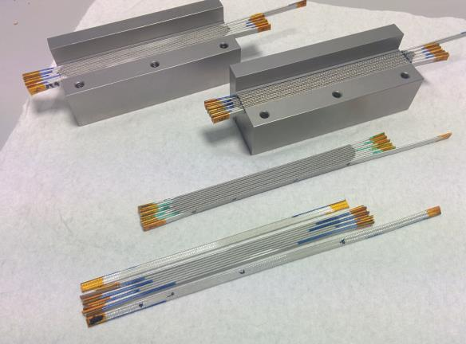
Validation Tests: Binder curing
Winding and impregnation process needs to be validated
  Binder needs to be stiff enough to hold properly the first layer while winding the second one.
  Binder needs also to be compatible with the impregnation resin.
A battery of test were carried out in collaboration with CERN Polymer Lab, using two candidate binders. Finally, 0.7 g of a 50/50 solution of CTD 1.1 and butanone for a 10 cable stack of 120 mm.
However, the dimensions of the cable stack were not stable…
Test applying heating during curing were carried out at CIEMAT in order to assure the complete evaporation of solvent.
First tests end up concluding that after a curing cycle of 150ºC during 10 hours the cable stack is stable. They keep their dimensions over time.
After additional tests, a lower temperature treatment will be applied to the real coils, using just 120ºC during 18 hours.

Slide 38
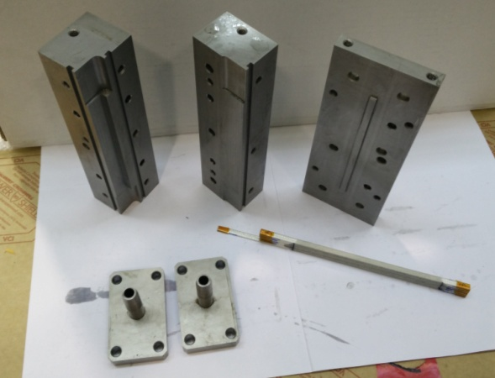
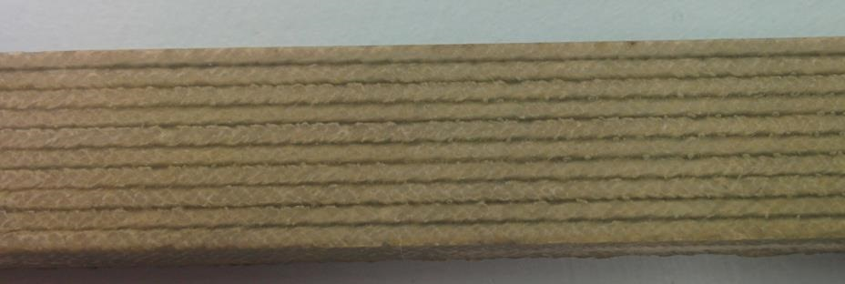
Validation Tests: Impregnation
Despite CTD 422 resin was validated for its use in combination with CTD 1.1 binder, it has been decided to switch to CTD 101K instead.
There were some doubts about the mechanical resilience of 422. The training of the octupole made at CIEMAT in 2013 was slow. It is more secure to use the CTD 101K that has been widely tested in other magnets.
The initial reason to use 422 was its higher radiation resistance, however MCBXF magnets are placed right next to other magnets (MQXF) with similar exposure and impregnated with 101K.
CTD 101K has been validated in combination with CTD 1.1 binder and Nomex in several tests with ten cable stacks.

Slide 39
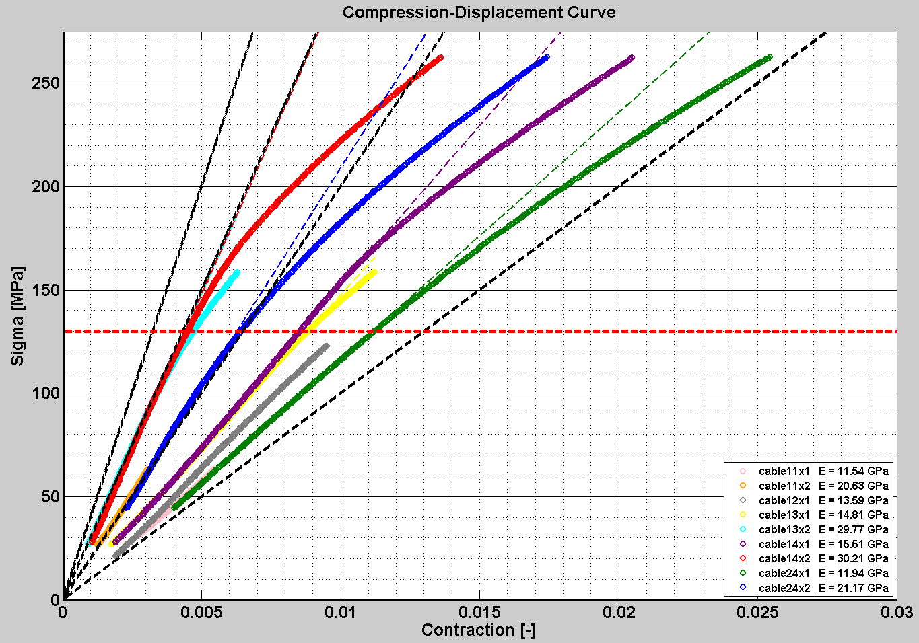
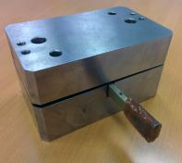
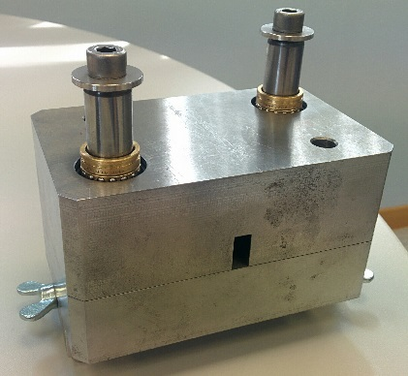

Validation Tests: Coil Young modulus
Custom tooling was used to obtain the Young modulus of ten-cable stack impregnated samples. First results showed half the expected rigidity.
After improving the tooling, the tests confirms that Young modulus of the coils is close to 20 GPa.

Slide 40

Mechanical design update (I)
The new cable rigidity (20 GPa) has been included in the mechanical model.
An additional 0.1 mm of interference is necessary to achieve the same coil pre-compression than before:
  Inner dipole: 0.35 mm instead of 0.25 mm.
  Outer dipole: 0.45 mm instead of 0.35 mm.
This is coherent considering coil smeared-out properties.
Stress distribution is checked at the different load steps.
40 GPa Cable blocks + 130 GPa copper wedges ≅ 70 GPa Coil
20 GPa Cable blocks + 130 GPa copper wedges ≅ 50 GPa Coil

Slide 41


Mechanical design update (II)
Gap | Original gap | ID Press | ID Spring Back | Before OD Press | OD Press | OD Spring back | Cool- down | 108% Power.
A | 0,2 | - | - | opens | 0,13 | opens | opens | 0,08
B | 0,1 | - | - | opens | 0,08 | 0,08 | 0,085 | contact
C | 0,5 | - | - | opens | 0,47 | opens | opens | 0,4
D | 0,55 | 0,42 | opens | opens | opens | opens | opens | opens
E | 0,3 | 0,18 | opens | opens | opens | opens | opens | opens
F | 0,03 | ≅0,03 | contact | contact | contact | contact | contact | contact
G | 0,7 | - | - | opens | 0,55 | opens | opens | opens
H | 0,6 | - | - | opens | 0,45 | opens | opens | opens
I | 0,03 | - | - | contact | contact | contact | contact | ºcontact
Motivation: There is no previous experience in nested collaring structures.
Undesired contact between parts could spoil the assembly.
Too large gaps could spoil the field quality or cause clattering during operation.
All values in mm
b
a)
b)
G
F
a
E
A
H
B
D
I
C

Slide 42
Index
Magnet and cable specifications
Magnetic design
Mechanical design
Magnet protection
Manufacturing concept
Validation tests
Short Mechanical Model
Conclusions

Slide 43




Short mechanical model: Motivation
A short mechanical model, as close as possible to the real magnet, becomes essential to:
  Validate the assembly process of the nested dipoles: feasibility, gaps, ground insulation, collaring shoes...
  Test part of the tooling to be used in the prototype assembly.
  Validate the FEM mechanical model.

Slide 44








Short mechanical model: Fabrication
Collars
(Laser + EDM)
Rivets insertion tool (ID & OD)
Kapton bending
tooling
Aluminium dummy coils
Collaring shoe preforming tooling
Handling scissors (ID & OD)

Slide 45




Short mechanical model: Assembly
120 Ton press refurbishing and calibration
Alignment
cage
Inner collapsible mandrel
Pressing cradles and stoppers
Handling/sliding
system
Support/assembly table

Slide 46




Short mechanical model: Instrumentation
Three sections are monitored by strain gauges
(ID & OD)
Four strain gauges per collar: on both sides of the collars and noses
Four displacement gauges: micrometric precision
All gauges configuration, installation, cabling and data acquisition have been developed in-house

Slide 47

Short mechanical model: Inner Dipole Results
Shim [mm] | Average displacement gauge [mm] | Average strain gauge [μe] | Average stress [MPa] | Press force [ton]
0.7 | 0.45~0.51 | 100 | 21 | -
0.6 | 0.1 | 189 | 40 | 28
0.5 | 0.2 | 247 | 52 | 26
0.4 | 0.3 | 337 | 71 | 34
0.3 | 0.4 | 429 | 90 | 40
0.2 | 0.5 | 507 | 106 | 40
Spring back | N/A | 343 | 72 | N/A
At the minimum gap of 0.2 mm, expected strain at the collar nose was about 530 μe, very close to the average of the measurements of the gauges (507 μe).
When the pressure is relieved, the inner dipole is left in its “spring-back” position. Calculated strain was 350 μe and the average of all measures is 343 μe.
The collapsible mandrel is retired without effort from the inner dipole aperture.

Slide 48

Short mechanical model: Outer Dipole Results
Shim [mm] | Average displacement gauge [mm] | Average strain gauge [μe] | Average stress [MPa] | Press force [ton]
1.4 | 0.25 | 32 | 7 | 4
1 | 0.4 | 109 | 23 | -
0.7 | 0.69 | 234 | 49 | 22
0.5 | 0.9 | 367 | 77 | 35
0.4 | 0.98 | 416 | 87 | 30
0.5 | 0.9 | 361 | 76 | 33
0.4 | 1 | 427 | 90 | 38
0.3 | 1.095 | 502 | 105 | 40
0.2 | 1.18 | 590 | 124 | 40
Spring back | N/A | 424 | 89 | N/A
At the minimum gap of 0.2 mm, expected strain at the collar nose was about 590 μe, not far from the average of the measurements (507). However, gauges in the lower half measured about one half of the upper ones.
The coils have not tried to collapse inwards. Gaps are correct.
Strain gauges are not equilibrated at the “spring back” position. Lower/male gauges indicate approximately twice the pressure than the upper/female ones. However the average is 424 μe, very close to the 385 μe expected from the simulation results.

Slide 49


Short mechanical model: Outer Dipole Results
A mistake was detected in the geometry, at the contact between the male and female collars.
When simulated in Ansys, the strain at the male and female collars is very different, 500 and 50 μe, respectively. It could explain the previous test results.
The upper collar package had only female instrumented gauges, while the lower one had male ones. We decided to mix-up the instrumented collars, so collar packs were fully disassembled.

Slide 50
Short mechanical model:
2nd Outer Dipole Test
Shim [mm] | Average displacement gauge [mm] | Average strain gauge [μe] | Average stress [MPa] | Press force [ton]
1 | 0 | 0 | 0 | 10
0.7 | 0.27 | 98 | 20 | -
0.5 | 0.47 | 181 | 38 | -
0.5 | 0.45 | 189 | 41 | -
0.3 | 0.68 | 322 | 67 | 40
0.2 | 0.78 | 398 | 83 | 50
0.2 | 0.78 | 405 | 85 | 50
Spring back | -N/A | 272 | 57 | N/A
Surprisingly, the strain gauges measure similar values this time.
Assembly procedure was a bit different, which could explain the difference.
Additional activities:
  Disassemble again the collar packs and repeat the test. Same results.
  New outer male collars with right geometry were launched to production and tests were repeated with same results.

Slide 51

Short mechanical model: cold test
The short mechanical model has been cooled down in a liquid nitrogen bath. Average measurements are very close to FEM results (250 µƐ).
Measured deformations at collar noses from room to liquid nitrogen temperature (µƐ)

Slide 52
Conclusions
MCBXF orbit correctors have been designed at CIEMAT.
The main challenge of the electromagnetic calculations is the variation of field quality with iron saturation.
The torque is hold by clamped nested collars. The coil ends are short to reduce the unsupported coil length.
The short inner dipole is self-protected. The long outer dipole needs a dump resistor. The others are under evaluation, but will likely need a dump resistor.
The coils will be fully impregnated, made with a NbTi Rutherford cable insulated with braided glass fiber.
Validation tests have been made to check the cable modulus of elasticity and to characterize the compatibility of binder and resin.
A short mechanical model has been produced to prove the feasibility of the nested collared assembly.

Slide 53
Thank you for your attention

Slide 54
Back up slides

Slide 55
Magnet configuration
Cosine theta:
  Winding and assembly procedures are well-known.
  Long coil ends (similar to the aperture diameter).
  High number of turns (large aperture and small cable).
Superferric:
  Field quality is not achievable within the available space (iron saturation and large aperture).
  Very simple configuration.
Canted cosine theta:
  Magnet protection in case of quench.
  Large radial forces (same as cosine theta case). Stiffness of mandrel? Long training?
  Long coil ends due to the large aperture.
  Azimuthal forces support and good field quality.

Slide 56
Single layer & Double layer designs VS old MCBX
(same central field comparison)
Inner coil (ID) & Outer Coil (OD) parameters | Units | Single layer design | Double Layer design (Small Collars) | Double Layer design (Large Collars) | Old MCBX (Series Model, both coils powered )
Nominal field 100% (ID) | T | 2.13 | 2.13 | 2.13 | 2.13
Nominal field 100% (OD) | T | 2.11 | 2.12 | 2.12 | 2.12
Nominal current (ID) | A | 2450 | 1250 | 1560 | 362.5x8=2900
Nominal current (OD) | A | 2150 | 1036 | 1340 | 331.25x8=2650
Coil peak field | T | 4.27 | 3.95 | 3.93 | 3.817
Working point | % | 60% | 44.7% | 48.1% | 39.54%
Torque | 10⁵ Nm/m | 0.92 | 0.98 | 1.19 | -0.455
Conductors height (h) | mm | 4.37 | 2x4.37 | 2x4.37 | 13.2 (8)
Mean stress at the coil and collar nose interface | MPa | 135 | 70 | 82 | 38
Aperture (ID) | mm | Ø150 | Ø150 | Ø156,2 | Ø90
Aperture (OD) | mm | Ø180 | Ø200 | Ø218 | Ø116.8
Iron yoke Inner Diam. | mm | Ø230 | Ø250 | Ø300 | Ø180
Iron yoke Outer Diam. | mm | Ø540 | Ø540 | Ø610 | Ø330
Number of conductors used (1st quad) | - | 162 | 357 | 324 | 800

Slide 57







Some useful expressions to understand where mechanical stresses come from
$$I_{T}=\int_{−π/2}^{π/2}{J\text{dl}}=\int_{−π/2}^{π/2}{J_{0}\cos{θ}R\text{d}\text{θ}}={2J}_{0}R$$
$$J_{0}={I_{IC}}/{2R}$$
J[A/m]=J₀cosθ
$$\vec{m}$$
d=2Rcosθ
dl
$$\frac{T}{l}=\frac{\vec{m}×\vec{B}}{l}=\frac{B_{OC}}{l}\int_{−π/2}^{π/2}{S∙I}=B_{OC}\int_{−π/2}^{π/2}{2R_{IC}\cos{θ}}J_{0}\cos{θ}R_{IC}\text{dθ}$$
R
θ
B_{OC}
$$T/l=\frac{μ_{0}π}{8}I_{IC}I_{OC}\frac{R_{IC}}{R_{OC}}\left(\frac{{{{R_{Y}}^{2}+R}_{OC}}^{2}}{{R_{Y}}^{2}}\right)$$
*
$$T/l=\frac{π}{2}R_{IC}B_{OC}I_{IC}$$
-I_{IC}
I_{IC}
* Linear Iron
h
F
$${σ_{θ}}_{cond}=\frac{F}{A}=\frac{T/{2R}}{lh}=\frac{T/l}{2Rh}$$
T
R
R
F

