Slide 1
MCBXF requirements for HL-LHC
R. De Maria

Slide 2
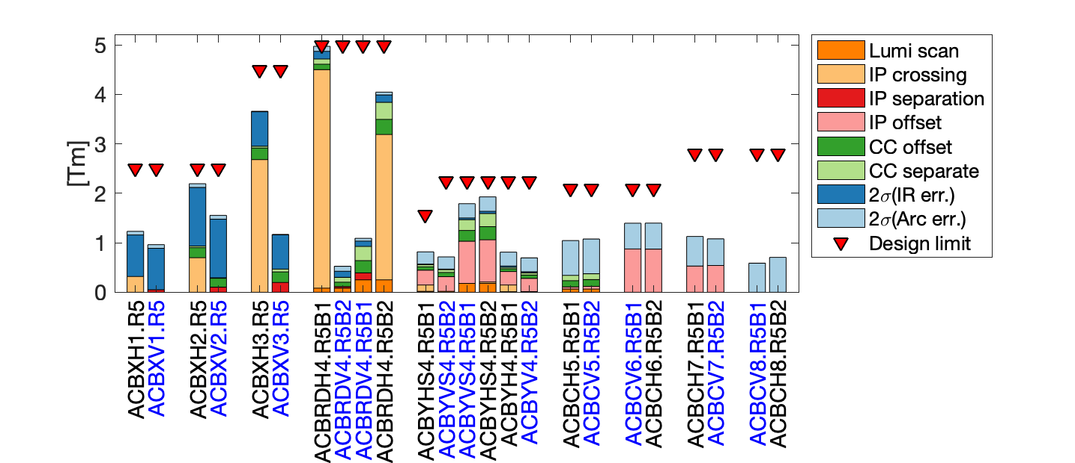
MCBXF requirements in HL-LHC
MCBXs are needed during normal operation to:
  crossing angle, beam separation -> known when plane and signs are decided, approximately scale with energy and with a dependency on beta*
  fine tuning at the crab cavities -> not deterministic, but small
  Compensate quadrupole mis-alignments -> not know before commissioning, scale with energy
  Compensate for the unknown fraction D1/D2 transfer function errors: -> expected to be small
During machine studies MCBX will be useful to try different crossing angle or planes and measure triplet apertures
Budget^{[1]} at 7 TeV
Squeezed optics
IR5 – H crossing^{[2]}
For
β*>15cm
^{[1]} Without signs
^{[2]} Symmetries applies for V crossing and left side

Slide 3
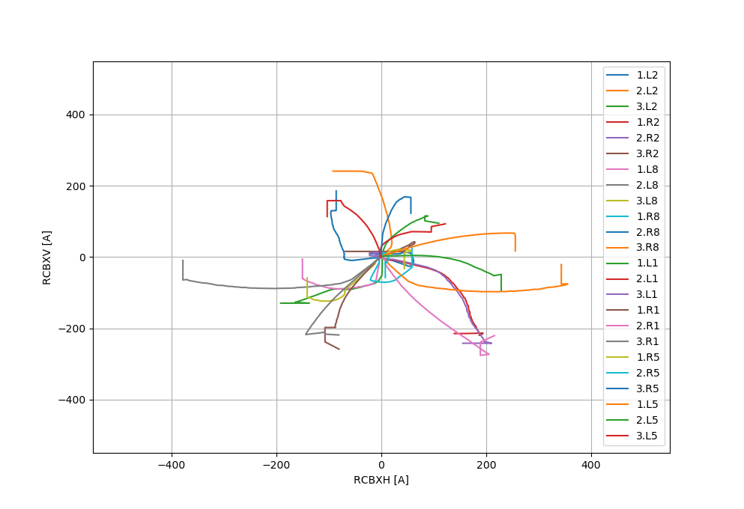
LHC usage one fill (3/5/2018-6638)

Slide 4
Summary of strengths with remote alignment
Knobs and correction for:
±295 µrad crossing angle in H/V plane (H in the figure)
±0.75 mm separation in V/H plane (V in the figure)
±2 mm IP offset Q1-Q4 displaced by 2 mm + Q5 1 mm + and correctors
±0.1 mm IP movement independent for B1/B2 for luminosity scan
2 σ correction of ±0.5 mm residual quad. misalignment and ±0.5 mrad dipole tilt.
Short range orbit adjustments (±0.2 mm CC adjustment)
Assume remote alignment for IP shift and orbit corrector minimization during beam commissioning.
NC 60 A
Example for Right 5 with H crossing.
Symmetries applies for V crossing and left side.

