Slide 1

Update on Magnetic Field Measurements for MQXF
Susana Izquierdo Bermudez
L. Fiscarelli, G. Ambrosio, P. Ferracin, J. Di Marco, E. Todesco, G.L. Sabbi, H. Song, X. Wang.
23 June 2019, WP2 meeting

Slide 2
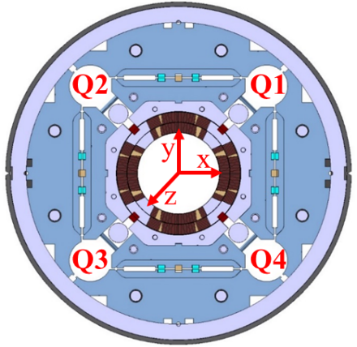
Overview on magnets built
Five short models and two long prototypes have been tested, two prototype magnets are under assembly.
Different conductors and coil geometries have been used, having an impact on the field homogeneity:
  In MQXFS1 and MQXFS3, coils produced in different manufacturing lines (US&CERN) are assembled together.
  In MQXFS4, coils with different inner coil radius insulation layout are assembled together.
  In MQXFAP1/1b, 1st generation and 2nd generation design coils are assembled together
 | Q1 | Q2 | Q3 | Q4
MQXFS1a/b/c | 103¹ | 3² | 104¹ | 5²
MQXFS3a/b | 106¹ | 7² | 105¹ | 107¹
MQXFS3c | 106¹ | 8⁵ | 105¹ | 107¹
MQXFS5a | 203³ | 205³ | 204³ | 206³
MQXFS4a/b | 108² | 110² | 109² | 111²
MQXFS6a | 210⁴ | 208⁴ | 212⁴ | 209⁴
MQXFS6b | 210⁴ | 203³ | 212⁴ | 204³
MQXFAP1 | 02¹ | 03⁵ | 04¹ | 05²
MQXFAP1b | 02¹ | 03⁵ | 04¹ | 06²
MQXFAP2 | 102² | 104² | 105² | 106²
MQXFA03 | 204² | 110² | 202² | 111²
MQXFBP1 | 108² | 107² | 105² | 104²
¹RRP 132/169; ²RRP 108/127; ³PIT 192; ⁴PIT 192 with Nb bundle barrier; ⁵RRP 144/169;
1st Generation Design / 2nd Generation Design
CERN Coils/ LARP (or US-AUP) Coils

Slide 3

Transfer Function
Decrease on the transfer function from injection to nominal by ~ 9 % due to iron saturation, in agreement with expectations.
At nominal operation conditions, the transfer function is within 15 units the expected values for all the magnets.
  This is in the level of the measuring system precision (∿ 10 units)
The longitudinal variation of the field along the magnet axis is within ± 5 units for the short models, ±10 units for the prototypes.
Transfer function saturation [%] in the magnet strait section
 | After loading |  | Nominal Gradient
 | RT |  | 1.9 K
ROXIE | 8.840 |  | 8.051
ROXIE + Deformation | 8.860 |  | 8.134
 | Average | σ | Average
MQXFS1a | 8.865 | 3.7 | 8.145
MQXS3a | 8.884 | 3.5 | n. a.
MQXS4a | 8.865 | 5.0 | 8.130
MQXS5a | 8.868 | 4.2 | 8.146
MQXS6a | 8.806 | 4.3 | --
MQXFAP2 | 8.832 | 7.0 | --
MQXFAP3 | -- | -- | --
MQXFBP1 | 8.838 | 6.7 | --
$$TF=\frac{Gradient}{Current}$$

Slide 4
Magnetic Length
Short models
Very reproducible behaviour in all built magnets.
Iron saturation effect in the magnetic length well capture by the model, which underestimates the magnetic length by 5 mm when assuming a longitudinal thermal contraction of 3 mm/m.
Summary of magnetic length at 1.9 K, I_{nom} in the short model magnets
Magnetic length (mm) | Measured (1.9 K, I_{nom}) | Computed (1.9 K, I_{nom})
MQXFS1 | 1198 | 1192
MQXS3 | 1204 | 1198
MQXS4 | 1203 | 1198
MQXS5 | 1203 | 1198
MQXS6 | 1203 | 1198
Magnetic length on the short model magnets as a function of the magnet current
Prototype magnets:
In MQXFAP2 and AP3, magnetic length at warm is 10 mm longer than expected.
In MQXFBP1, magnetic length is 14 mm longer than expected.
Coils are physically longer by 2-12 mm in MQXFA and by 12-15 mm in MQXFB.
Summary of magnetic length at RT, 15 A in the prototype magnets
Magnetic length (mm) | Measured (warm) | Computed (warm)
MQXFAP2 | 4210 | 4200
MQXFAP3 | 4207* | 4200
MQXFBP1 | 7173 | 7159
Requirement: Integrated gradient within 10 units spread.
Precise measurements at cold on the main field of the long magnets needed to evaluate if this requirement is fulfilled
This remains the most challenging requirement to fulfill from the magnetic point of view.
*Measurement on coil pack

Slide 5
Cycle to Cycle Repeatability
Reproducibility and stability of the integral field is within the noise level of the measurements (± 1 unit).
In average, the cycle to cycle reproducibility is better than 0.1 units.
Suitable for operation.
± 1 unit

Slide 6
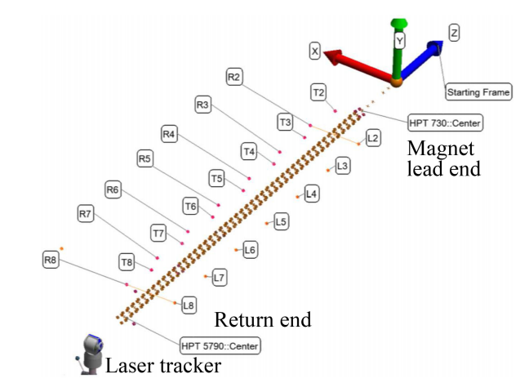
Magnetic axis
Requirements: Magnetic center within ±0.5 mm of the external fiducial axis and main field twist angle within ±2 mrad of the averaged twist angle.
MQXFAP2 is within the requirements.
Measurements also done in MQXBP1, analysis on-going to combine survey measurements of the magnet fiducials with magnetic measurements, but the magnetic center compared to a straight line ìs within ± 0.2 mm.
MQXFAP2, magnetic center (after magnet loading)
MQXFBP1, magnetic center (after magnet loading)
Deviation of the magnetic axis with respect to a straight line. Further analysis combining magnetic and survey measurements on-going
x: red solid circles
y: black open circuits

Slide 7
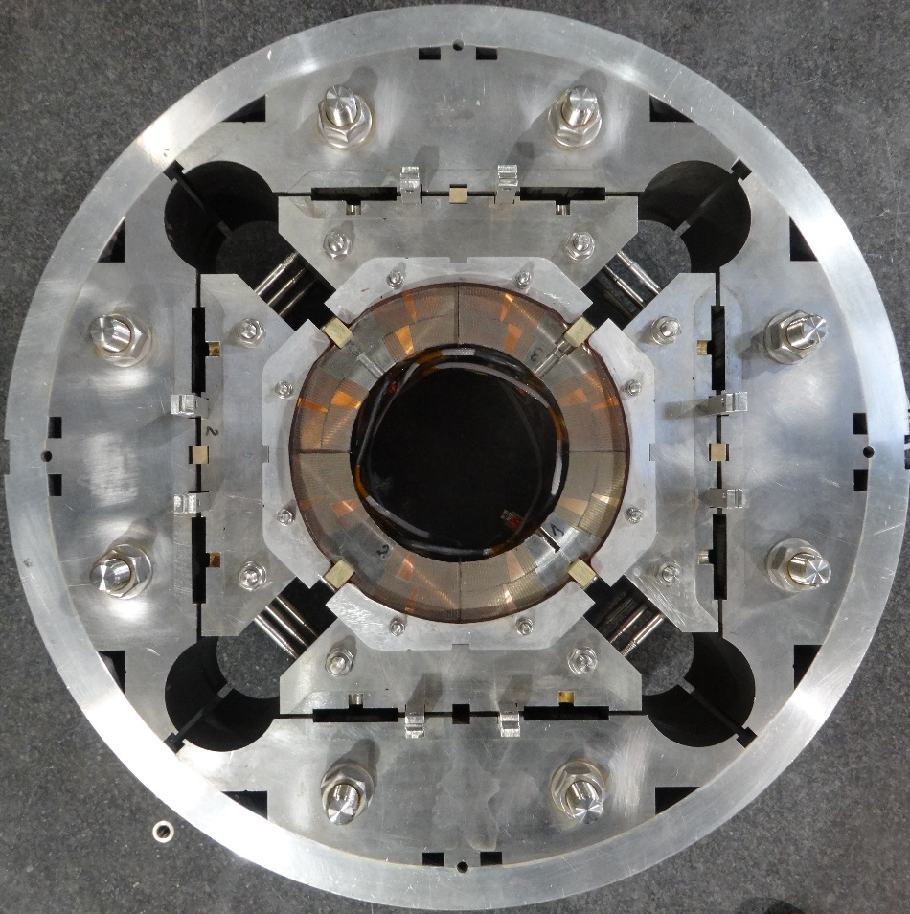
Geometric field errors
Source of field errors:
  Size difference among coils, requiring the use of asymmetric shimming in order to guarantee a uniform loading.
  Accuracy of the positioning of the turns within the coil cross sections.
  Coil parts manufacturing tolerances, in particular pole and wedges.
  Alignment of the coil within the magnet structure (secondary effect)
Alignment coil to structure through the pole to collar key
Ferromagnetic shims inserted in the bladder slots after magnet assembly to correct low-order non-allowed harmonics

Slide 8
Systematic non-allowed field errors
Average measured harmonics in the magnet straight (after loading)
Requirements:
At nominal/ultimate gradient
  Integrated multipoles within target tables
  On single magnet we aim to be within 3σ + σ of uncertainty
Much looser constrains at injection
Experience in the short models
Low order non-allowed multipoles above targets, in particular a₄ and b₅
MQXFS5 and MQXFS6, magnets assembled with four coils produced in the same manufacturing line with identical manufacturing parameters, have a remarkable better field homogeneity
ACTION (EDMS 1963788)
Length of the high order correctors has been increased in order to be able to cope with larger field errors
Remarks: Correction capabilities ± 4.5 units of b₃/a₃, ± 3 units of b₄ and +-1 unit of a₄
Allowed harmonics not shown in MQXFS1 because it is first generation design

Slide 9
Systematic non-allowed field errors
Field quality in the prototype magnets is better. MQXFBP1 is the magnet with better field quality built up to date.
As observed in the short models overall strength of the harmonics is not fundamentally altered from the initial assembly (coil pack) to the magnet loaded → The dominant source of field errors is the coil geometry and its initial assembly in the coil pack.
Average measured harmonics in the magnet straight after loading for BP1 and AP2 and after centering for AP3
Change on the average harmonics in the magnet straight section from coil pack assembly to magnet loaded.

Slide 10
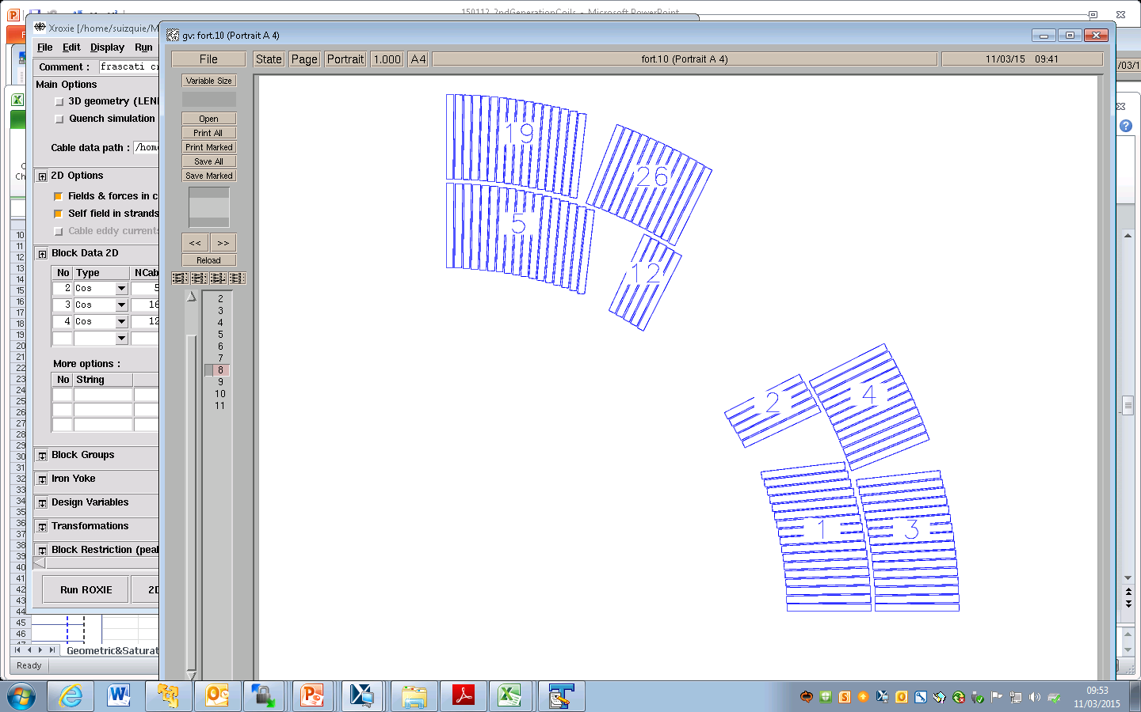
Systematic allowed field errors
Magnetic measurements of three short models and one prototype gave an indication of a systematic b₆ far from the target of 0 units at nominal current
  ACTION (EDMS 2019517): Increase the pole insulation by 0.125 mm and decrease the mid-plane shim by 0.125 mm.
    At CERN, implemented from coil 202 (MQXFBP2)
    At US-AUP, implemented from coil 114 (MQXFA4 or 5)
  Expected correction: + 5.3 units of b₆, +0.3 units of b₁₀.
b₁₀ and b₁₄ are within specifications.
b₆ [units] in the magnet straight section (R_{ref} = 50 mm)
b₆ (units R_{ref} = 50 mm) | Design | Measurements RT After Loading |  | Measurements I_{nom}
 |  | Straight Section | Integral | Straight Section | Integral
MQXFS1a | 1st Generation | 3.57 |  | 1.49
MQXFS3a | 2nd Generation | -1.90 | -- | -1.83
MQXFS4a |  | -4.36 | 0.10 | -3.79 | 3.52
MQXFS5a |  | -4.84 | 1.20 | -4.26 | 2.14
MQXFS6a |  | -2.96 | 2.15 | -3.50* | 2.49*
MQXFAP2 |  | -5.72 | -5.89 | -3.94** | --
MQXFA03 |  | -- | -- | -- | --
MQXFBP1 |  | -5.75 | -4.99 | -- | --
*At 16 kA instead of 16.47 kA. Expected iron saturation effect from 16 to 16.47 kA = - 0.2 units
** At 10 kA instead pf 16.47 kA. Expected iron saturation effect from 16 to 16.47 kA = - 1.2 units

Slide 11
Coil waviness
Field homogeneity is measured along magnet axis, using ~ 110 mm probe (MQXFA, LBNL&BNL) and ~ 600 mm probe (MQXFB, CERN).
  MQXFA measurements are averaged over 5 positions (5 x 110 mm) to allow direct comparison to MQXFB
The spread on the measurements along the magnet axis, indicate a 0.02-0.04 mm precision on the longitudinal position of the conductors block.
This spread is similar to what is obtained for the LHC dipoles.

Slide 12
Magnetic Shimming
Ferromagnetic shims inserted in the bladder slots can correct up to ± 4.5 units of b₃/a₃, ± 3 units of b₄ and +-1 unit of a₄
Four different magnetic shimming layout have been tested in the short model assemblies.
MQXFS1c
MQXFS3a
MQXFS5a
MQXFS4a
 | Computed | Measured
MQXFS1c | Δb₃ = 4.22; Δa₃ = -4.24 | Δb₃ = 3.51 Δa₃ = -3.92
MQXFS3a | Δb₄= -2.88 | Δb₄ = -2.55
MQXFS5a | Δa₄ = 0.84 | Δa₄ = 0.71
MQXFS4a | Δb₃ = 3.42 | Δb₃ =3.30
Obtained correction is in agreements with expectations.

Slide 13
Cold – Warm Correlation
Change on field errors (1.9 K, I*_{nom} – after loading)
Good correlation between room temperature and 1.9 K (nominal gradient) measurements, important for an efficient implementation of the magnetic shimming correction actions.
Remarkable change on a₄, b₆ and a₈ in MQXFS1 and a₃ in MQXFS6.
*In the case of :
MQXFAP02, field errors at 10 kA
MQXFS6, field errors at 16 kA

Slide 14
Conclusions
  Magnetic measurements give an indication of a systematic b₆ far from the targets → fine tuning of the cross section.
  Correction capabilities using magnetic shims have been demonstrated, but they are not enough to correct the high measured non-allowed harmonics in the short models→ strength of the high order correctors have been increased.
The full length prototype magnets, produced with identical manufacturing parameters have remarkable better field homogeneity than the previous magnets.
  Cycle to cycle repeatability is suitable for operation.
  Transfer function and integral field are in agreement with expectations. More measurements (and magnets) needed to evaluate if the difference among magnets is within the specifications.

Slide 15
References
Publications:
  Honghai Song, et. al., Vertical Magnetic Measurements of the First Full-Length Prototype MQXFAP2 Quadrupole for the LHC Hi-Lumi Accelerator Upgrade Project, IEEE Transactions on Applied Superconductivity, Year: 2019 | Volume: 29, Issue: 5
  Xiaorong Wang, et. al., Field Quality Measurement of a 4.2-m-Long Prototype Low-β Nb₃Sn Quadrupole Magnet During the Assembly Stage for the High-Luminosity LHC Accelerator Upgrade Project, IEEE Transactions on Applied Superconductivity, Year: 2019 | Volume: 29,Issue: 5
  Susana Izquierdo Bermudez, et. al., Magnetic Analysis of the MQXF Quadrupole for the High-Luminosity LHC , IEEE Transactions on Applied Superconductivity ear: 2019 | Volume: 29, Issue: 5 |
  L. Fiscarelli, et. al., Magnetic Measurements on the First CERN-Built Models of the Insertion Quadrupole MQXF for HL-LHC, IEEE Transactions on Applied Superconductivity, Year: 2018 | Volume: 28, Issue: 3
  Susana Izquierdo Bermudez, et. al., Geometric Field Errors of Short Models for MQXF, the Nb3Sn Low-β Quadrupole for the High Luminosity LHC, IEEE Transactions on Applied Superconductivity, Year: 2018 | Volume: 28, Issue: 3 |
  J. DiMarco, et. al., Magnetic Measurements of the First Nb₃Sn Model Quadrupole (MQXFS) for the High-Luminosity, IEEE Transactions on Applied Superconductivity, Year: 2017 | Volume: 27, Issue: 4
  Susana Izquierdo Bermudez, et. al., Magnetic Analysis of the Nb3Sn Low-Beta Quadrupole for the High-Luminosity LHC, IEEE Transactions on Applied Superconductivity Year: 2017 | Volume: 27, Issue: 4
Reviews and collaboration meetings with dedicated talks on field quality
  HiLumi-LARP meeting, SLAC, May 2016
  MQXF review, June 2016
  HiLumi collaboration meeting, Paris, November 2016
  Joint LARP CM28/HiLumi Meeting, April 2017, Napa

Slide 16
THANK YOU

Slide 17
Variation of the harmonics with cold powering
Change on field errors (warm after powering – warm before powering)
Small change of the harmonics after cold powering test
  No signs of permanent deformation on the coil visible on the geometric multipoles.

Slide 18
Magnetic measurement system and overview

Slide 19
Expected field harmonics
EDMS 2031083

Slide 20
MQXFBP1
Larger impact on the longitudinal variation of the harmonics from coil pack to magnet loaded than in previous magnets.
Longitudinal variation of a₄ in MQXBP1 along the magnet straight section for the different assembly steps

Slide 21
Coil waviness – short models

Slide 22
Measuring systems overview

Slide 23
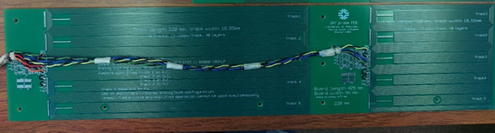
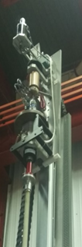

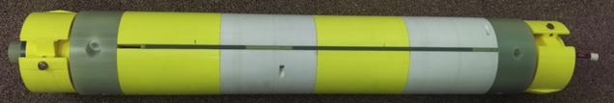
Magnetic Measurements System – US AUP
US-AUP:
Short (110 and 220 mm) rotating probes scanning the magnet bore
FNAL-developed PCB probe technology
50.5 mm radius (taking into account clear bore and anti-cryostat requirements)
Vertical test sled
(BNL VMTF)
Probe shaft & spring-loaded bearing blocks
Short models
Warm measurements during assembly at LBNL
  Probe supported by a temporary bore tube
  No automatic system for longitudinal positioning
Cold/warm measurements at Fermilab VMTF
  Probe shaft centered in anti-cryostat
  Vertical test sled positions and rotates probe
Prototypes & Series
Warm measurements during assembly at LBNL
  Probe supported by a temporary bore tube
  Automatic system for longitudinal positioning, 12 μm accuracy
Cold/warm measurements at BNL VMTF (magnet)
  Probe shaft centered in anti-cryostat
  Vertical test sled positions and rotates probe (accuracy on longitudinal position ≅ 0.5 mm)
  Due to the limitations on the cryostat length, the return end of the magnet is not covered.
All measurements reported at 50 mm ref. radius

Slide 24
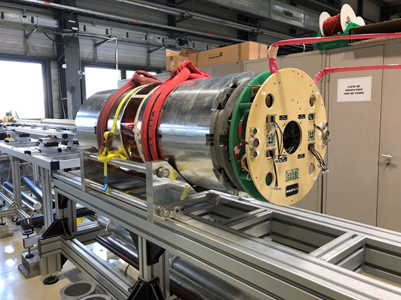
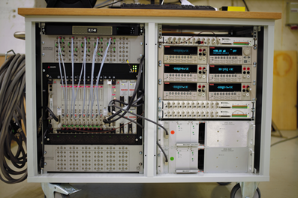
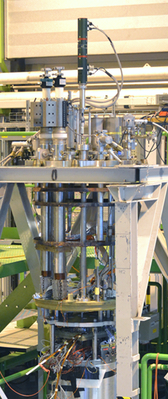
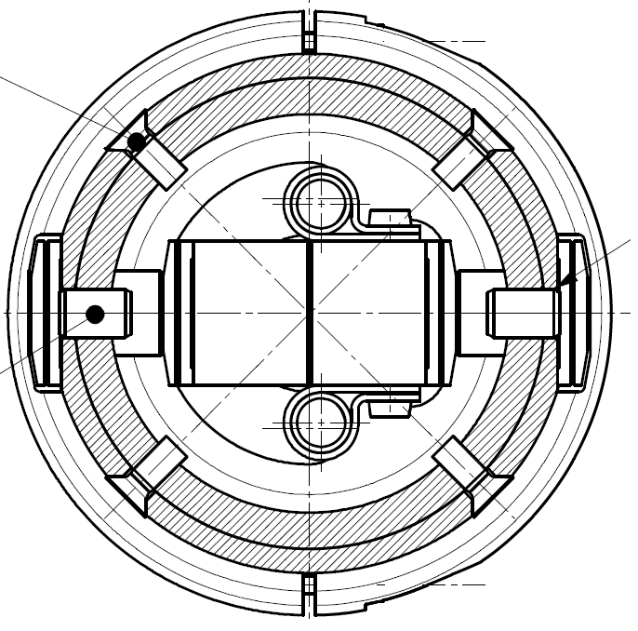
Magnetic Measurement System –
CERN Short Models
General approach:
Vertical rotating shaft in the helium bath.
CERN FAME (FAst-MEasurement) system (Fast digital integrators; Motor + encoder + slip-ring unit (MRU))
All measurements reported at 50 mm ref. radius
Warm measurements during assembly:
Horizontal rotating shaft.
The shaft has a radius of 45 mm, and length of 127 mm (& 1200 mm for integral measurements)
Cold/warm measurements at SM18:
Probe shaft rotate in the helium bath.
The shaft has 5 segments, 420 mm length each
  One segment covers the magnet straight section
  Each of the magnet ends is covered by a segment
  Two segments are covering the magnet extremities (field < 1 %, most of the segments are outside the magnet)

Slide 25
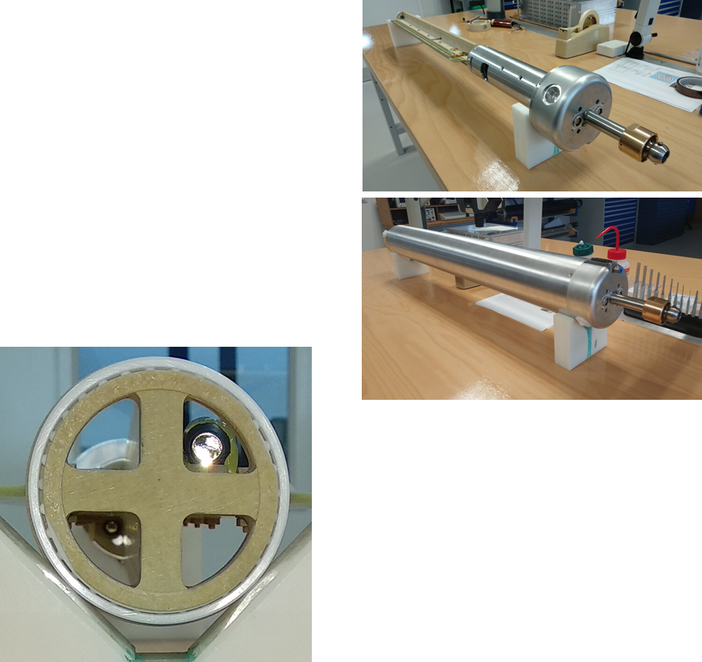
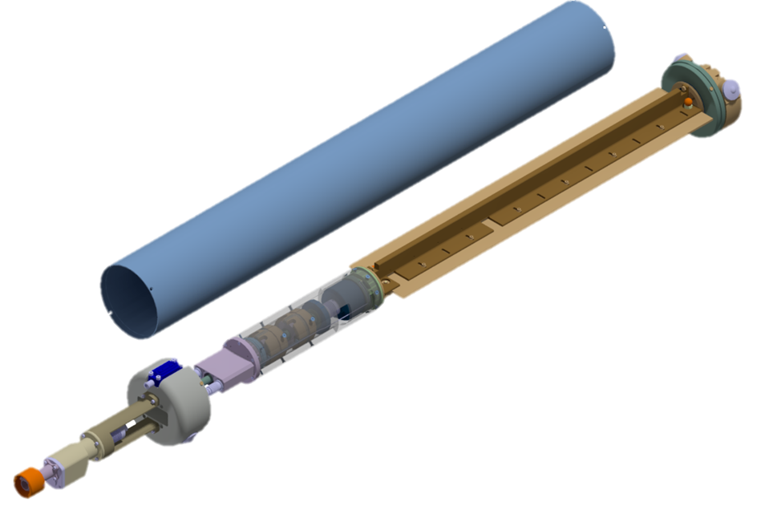
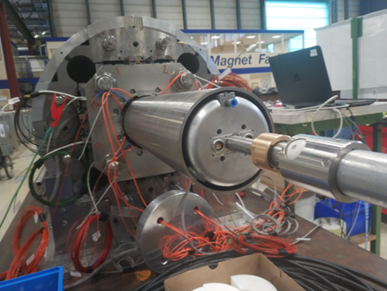
Magnetic Measurement System –
CERN Prototype at warm
  Ø 136 mm for the cold-bore
  Measurement radius 50 mm
  Measurement length 600 mm
  Based on PCB (printed circuit) coils
  Tilt sensor on the PCB coil
  Auto-alignment to gravity
  Retroreflectors mounted on the PCB
  On-board motor

Slide 26
Magnetic Measurements Overview
Large amount of data collected and reported in several occasions (see “References”). Today we focus on:
  Transfer function and integral field
  Geometric field errors
  Flux jumps effects
 | MQXFS (Short models) |  |  |  |  |  |  |  |  | MQXFA |  |  |  | MQXFB
 | S1 | S1b | S1c | S3 | S3c | S5 | S4 | S6 | S6b | AP1 | AP1b | AP2 | AP3 | BP1
Standard Magnetic Measurements
Warm during assembly | ✓ |  | ✓ | ✓ | ✓ | ✓ | ✓ | ✓ | ✓ |  | ✓ | ✓ | ✓ | ✓
Machine cycle to I_{nom} (or max current reached) | ✓ | ✓ |  | ✓ | ✓ | ✓ | ✓
Machine cycle to I_{ult} | ✓ | ✓ |  |  |  | ✓
Stair step measurements | ✓ | ✓ |  | ✓ | ✓ | ✓ | ✓ | ✓ |  |  |  | ✓
Ramp rate dependence | ✓ | ✓ |  | ✓ |  | ✓
Z-scan at selected currents | ✓ | ✓ | ✓ |  |  |  |  |  |  |  | ✓ | ✓ |  | .
Warm after cold test | ✓ |  | ✓ | ✓ |  | ✓
Extended Magnetic Measurements
Machine cycle with high precision on the main field |  |  |  |  | ✓ | ✓ | ✓
Stair step to ultimate current |  | ✓
Extended injection plateau |  | ✓
Effect of the reset current |  | ✓
Z-scan at intermediate temperatures |  |  | ✓
Transfer function repeatability studies |  |  |  |  |  | ✓
Machine cycle at 4.3 K |  |  |  | ✓
Impact of flux jumps on the field |  |  |  |  | ✓ | ✓

Slide 27
Effects of flux jumps on the magnetic field

Slide 28
Effects of flux jumps on the magnetic field
Flux jumps: fast events (>> 1 Hz) which occur during ramps mainly at low or intermediate field level.
  Typically observed in the differential voltage signals.
To evaluate their effect we need:
  Precise measurement of the current
  Precise measurement of the field
    Fixed coils for relative measurements during a ramp, with large bandwidth (~ 1 kHz)
    Rotating coils for measurements during a plateau with limited bandwidth (~ 1 Hz)
During a plateau
The noise on the field (at low, intermediate and high field level) has an amplitude of < 1∙10⁻⁴, limited by the measurement precision.
±1*10⁻⁴
MQXFS5 field measured at 1 Hz , rotation speed of the rotating coil

Slide 29
Effects of flux jumps on the magnetic field
During a ramp:
There is “noise” on the measured current with amplitude ~ 10⁻⁴. This must be check in respect of:
  Inductance of the circuit
  Control loop of the converter
The noise can be related to the flux jumps measured on the voltage
A proportional effect with amplitude ~ 10⁻⁴ is visible in the field
±4*10⁻⁴
MQXFS3c field measured at 7.5 kHz via a fixed coil

Slide 30
Strand magnetization effect

Slide 31
Strand Magnetization Effects
Change on b₆ from injection to nominal of 20 units for MQXFS5 (PIT) and 25-30 units for MQXFS1,3-4 (RRP), in agreement with expectations
Cycle to cycle repeatability is better than 0.1 units.

Slide 32
Multipole decay at injection
Very different behaviour for PIT and RRP magnets.
  At injection, in MQXFS5 (PIT) a net decrease of the average coil magnetization is observed (as traditionally observed in Nb-Ti magnets).
    In MQXFS3 and MQXF4 (RRP), the amplitude of the decay is comparable but there is an inversion of the sign.
  At the beginning of the ramp, the whole part of the magnetization that decayed/increased disappears rapidly (snapback)
    The process is slower for the PIT magnet.
(PIT)
zoom
(RRP)
(RRP)

Slide 33
Multipole decay
The operation temperature has a very large impact in the decay, sign an inversion of the sign of the decay at 4.3 K.
This is consistent with previous observation on the 11 T magnet, pointing to the idea that the state of magnetization of the filaments (including the effects of flux jumps) plays a major role.

Slide 34
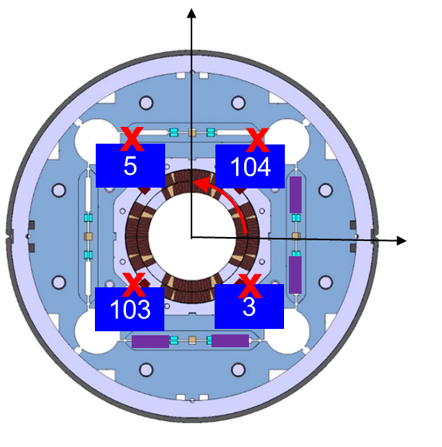
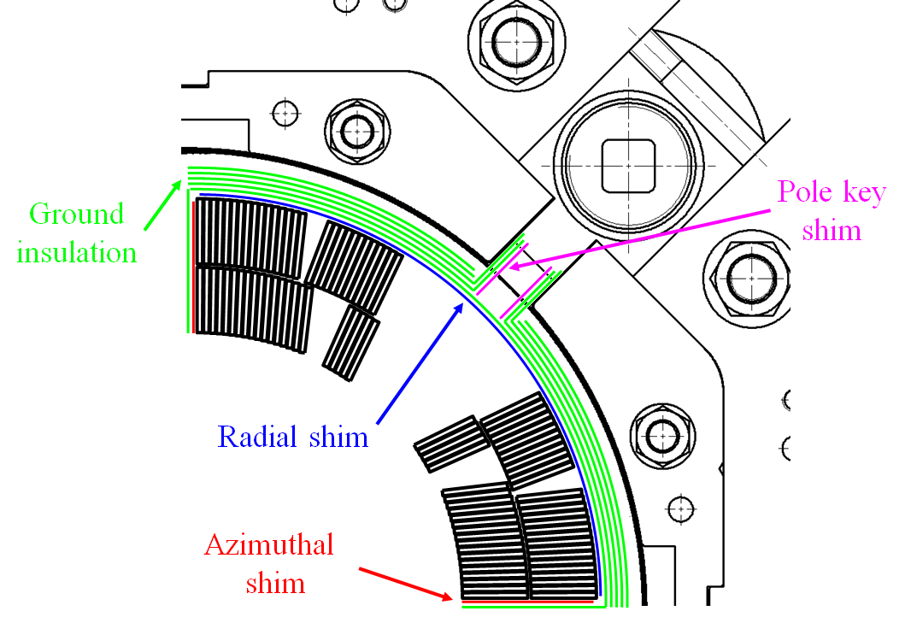
Faulty Assembly Procedures
Magnetic measurements: a powerful tool to detect assembly errors.
MQXFS1b
Magnetic shims did not provide the intended correction. Double error:
180° rotation on the MM reference frame
Insertion of the shims in a different location with respect to the one specified.
MQXFS5a
Pole-key to collar over-shimming provoked a radial misalignment of the coils, visible in the harmonics:
a₄= 14 units / a₈ = 1 unit.
MQXFS5a
Pre-assembly magnetic screws not removed from the pole → large spikes on the harmonics and transfer function.

