Slide 1

HL-LHC
WP9 Cryogenics, Technical Update
Serge Claudet,
On behalf of the Cryogenic project team
July 25th 2019

Slide 2
Content
Brief illustrated list of news-progress BA6 & P4
Brief illustrated list of news-progress P1/P5
Major concerns and working activities
Summary

Slide 3
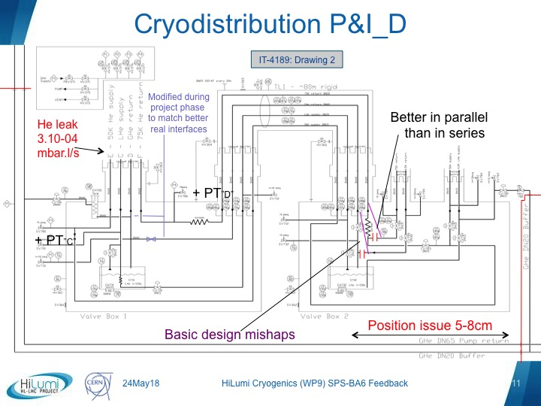
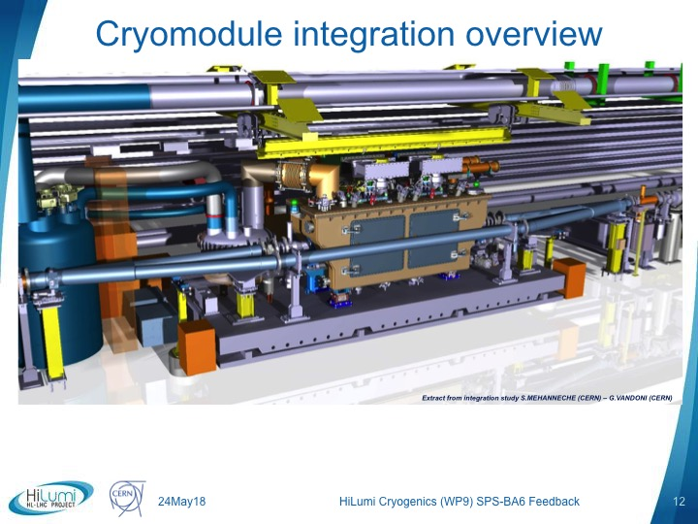
News – Progress (SPS-BA6)
SPS-BA6:
  Consolidations being organised: CERN + Criotec (order signed)
  Dismantling VB2 mid sept’19 for re-work at factory Oct’19
  (with check of flexibles lines to Service Module on the moveable table)
  Re-installation at BA6 Nov’19
  Re-commissioning and performance tests foreseen Spring’20

Slide 4
News – Progress (LHC-P4)
P4 upgrade:
  Contract signed with Linde Kryotechnik early 2019
  PDR@LKT done on 21May’19, approved with fabrication of turbines
  Clarification of Safety Valves requirements for modified circuits underway
  Next: Internal piping modification/routing to be studied
P4 complements:
  HeL interfaces to be further studied (provided HeL approved)
  (based on feasibility study done in 2018, EDMS#2061800)
  Feasibility study for mobile refrigerator and associated infrastructure to be started this summer, with generic case to be adapted elsewhere (surface)

Slide 5
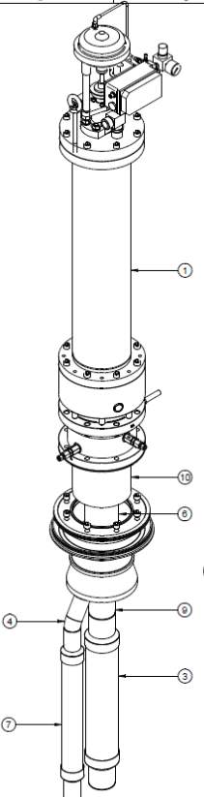
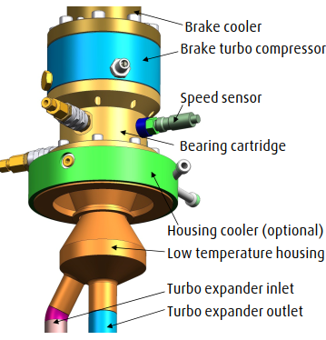
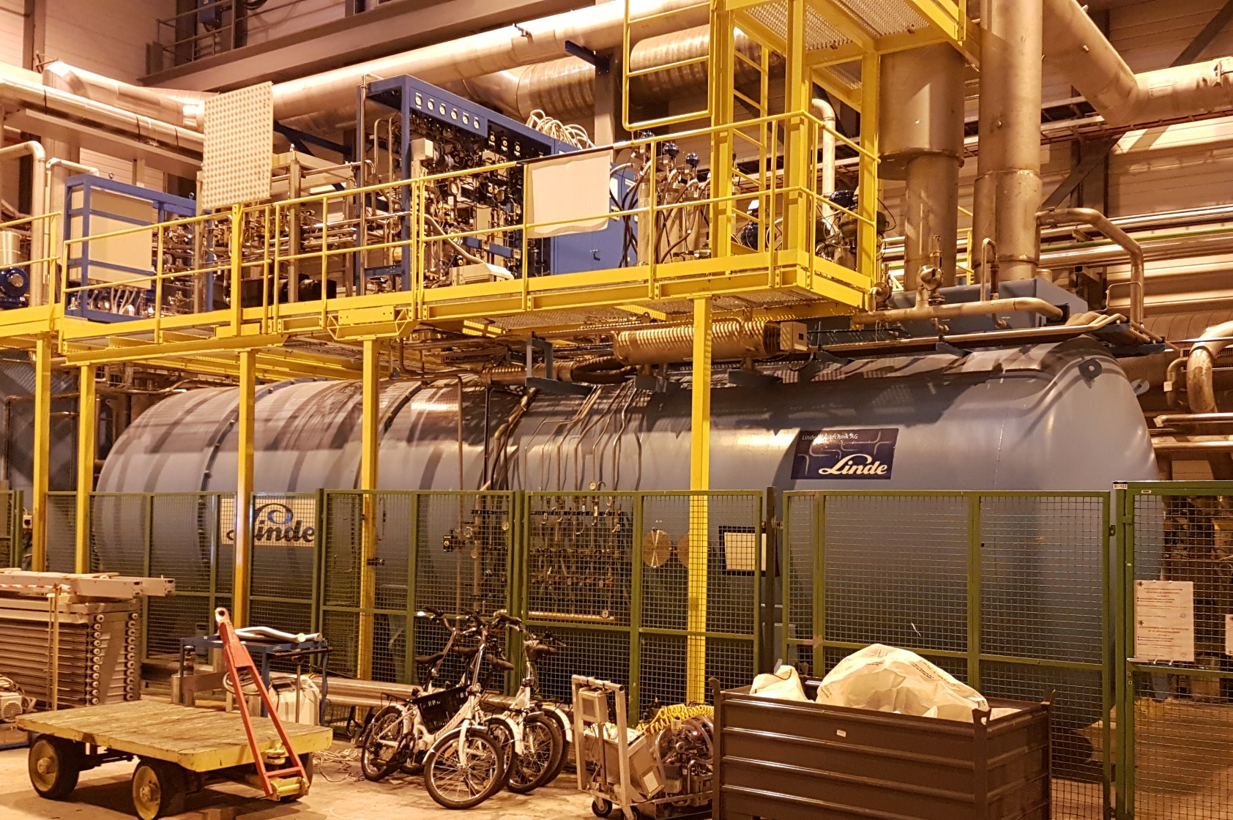
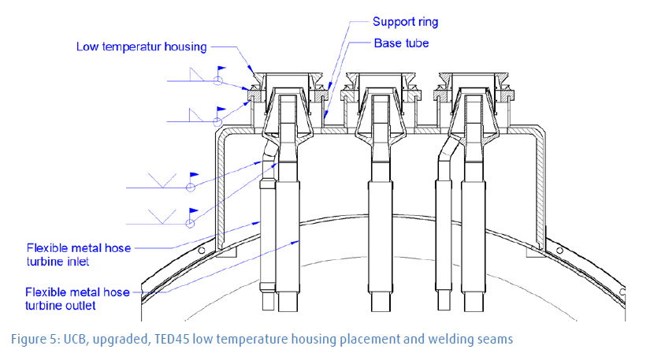
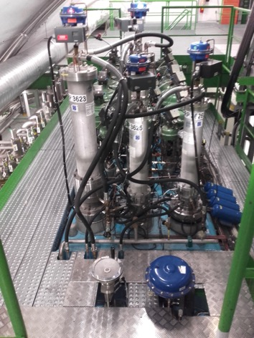
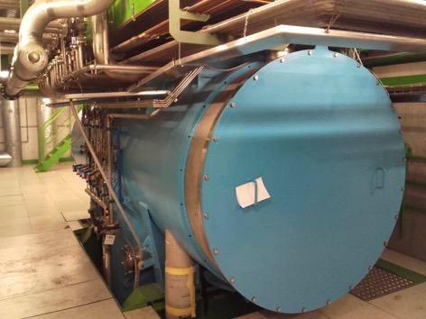
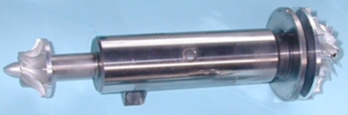
Upgrade of Helium Refrigerator at LHC Point 4 for HL-LHC – Upper and Lower Cold Boxes
Principle of the capacity upgrade: to replace 8 turbines by new type (more efficient)
This requires exchange of turbine housings & instrumentation
Site works: Q4-2019
Commissioning: Q2-2020
New turbine housings and instrumentation
Upper CB: 4 TU’s
Surface
Shaft
Cavern
Cut view of existing cold box
Spares and repairs: to ensure availability as for all helium refrigerators
Lower CB: 4 TU’s

Slide 6
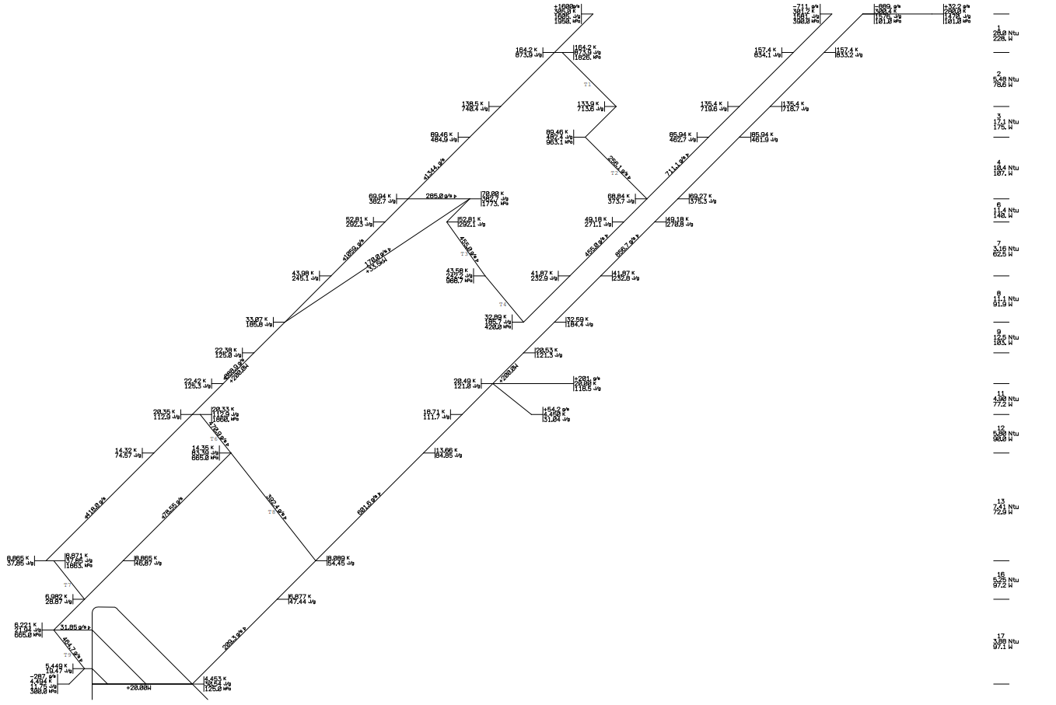
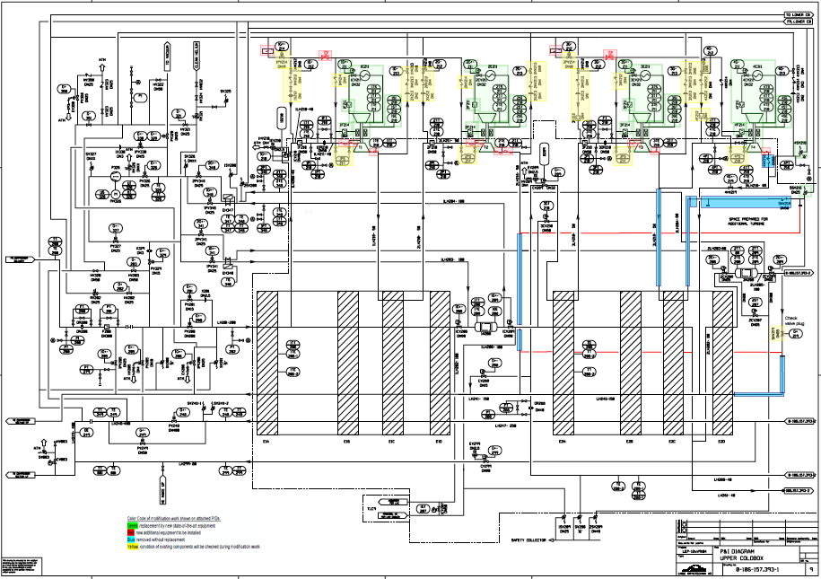
Process verification and design phase
Process: T,s diagram
Engineering: P&I diagram
(what to replace, cut, modify, install)
Next: studies for intervention on internal piping

Slide 7
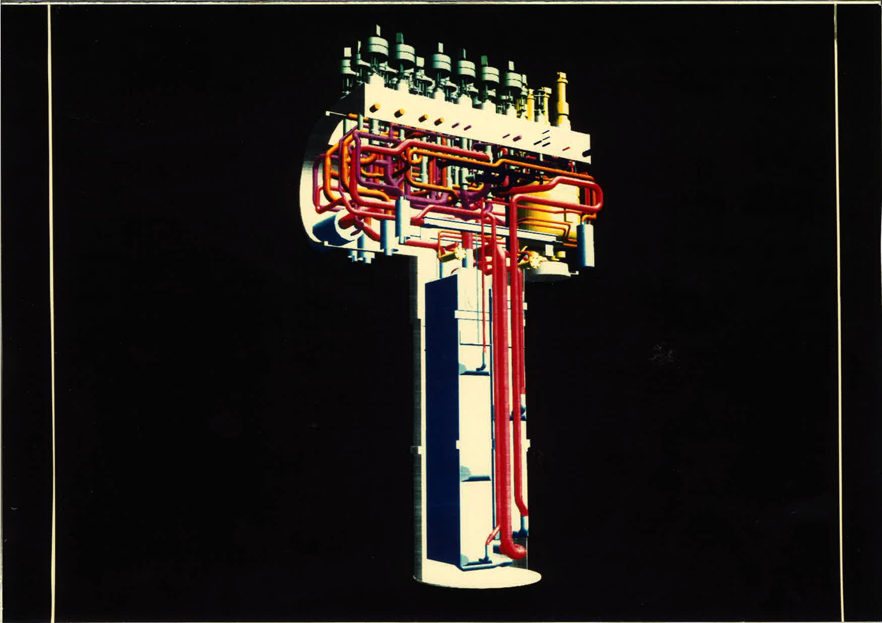
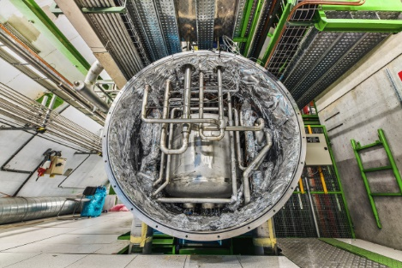
From documentation to reality !
Linde 12-18kW Lower Cold-Box
3D model of internal piping
(picture 25 yrs ago)
Valve actuators
Turbines
LHe phase separator
Cryolines interfaces
Heat exchangers
Serious engineering required for turbine housing upgrade and intervention on internal piping

Slide 8
Content
Brief illustrated list of news-progress BA6 & P4
Brief illustrated list of news-progress P1/P5
Major concerns and working activities
Summary

Slide 9
News – Progress (HL-P1/P5)
P1/P5 studies:
  QXL Cryoline:
    cross-section frozen following optimisation studies
    3D integration and Jumper interfaces: P5 L+R completed IT to JM
  DFX-DFM: Part of the technical design effort last 9 months
  D2 cooling: Proto HX fabricated (via CEA-SBT), to be tested in Sept’19
  IT_Beam-Screens: End of validation tests at Cryolab (EDMS#2042522)
  Crab Cavities: Evaluating possible independent CD-WUP
  New TE_CRG specific wg’s launched spring’19 with various specialists:
    Cryo-distribution and global process arrangement
    Functional analysis (to check foreseen circuits and instrumentation)
    Instrumentation & control architecture
    => Thanks to TE-CRG colleagues for fruitful meetings and suggestions

Slide 10
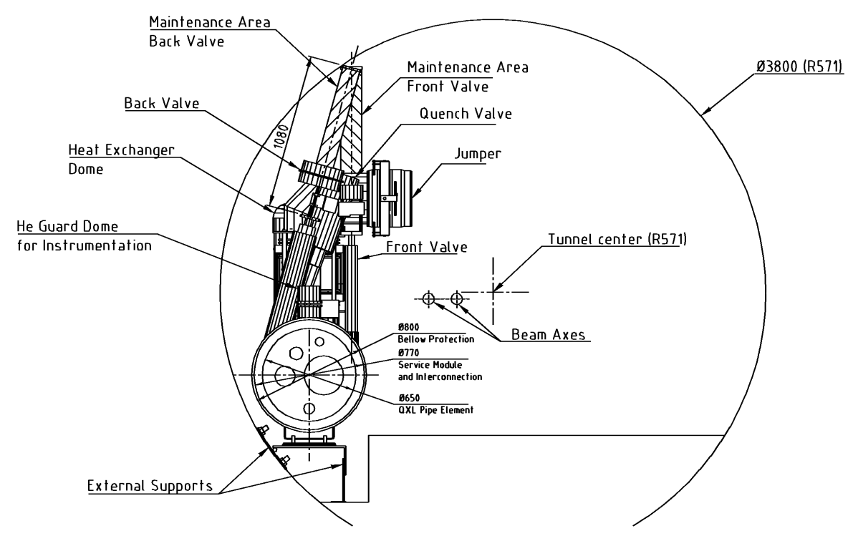
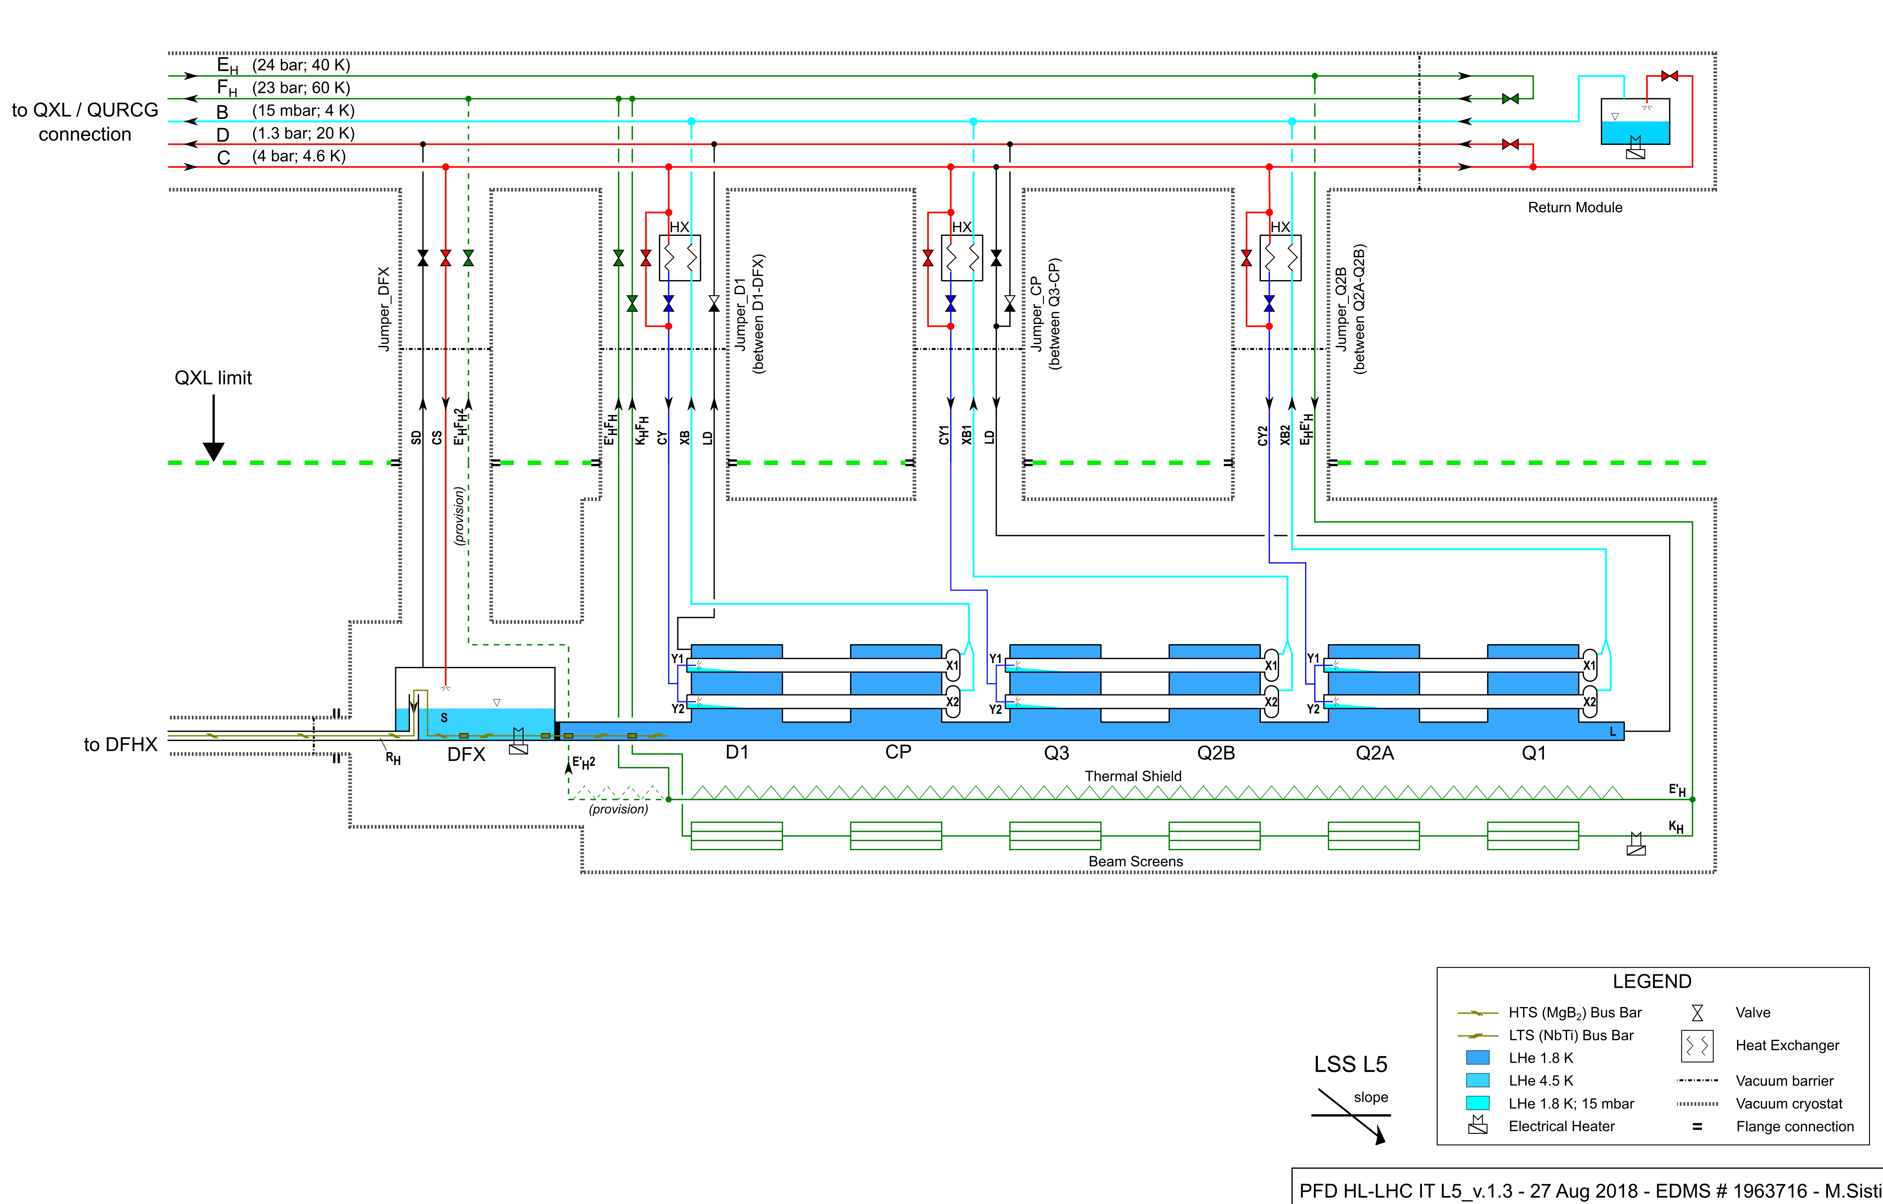
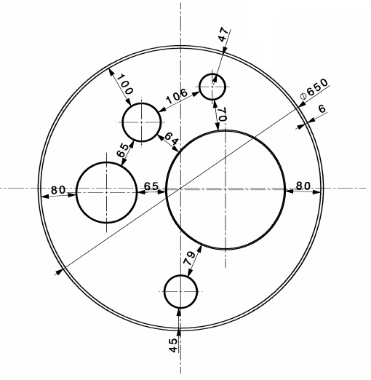
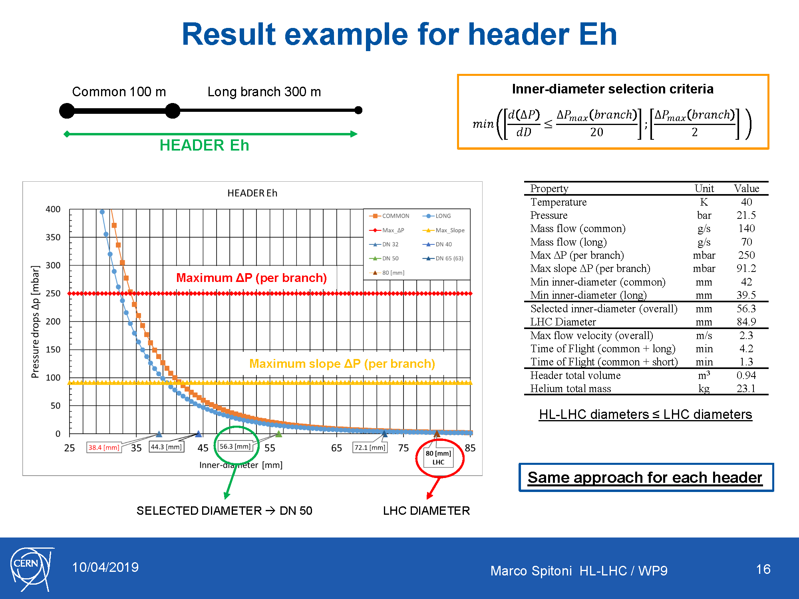
QXL headers
Typical Tunnel cross section
Inner Triplet flow scheme
QXL
Typical QXL cross section
Users
Eh
C
Header Eh → Supply of thermal shield and beam screen (IT only)
Header Fh → Return of header Eh
Header C → Supply of supercritical He
Header B → Return of superfluid He (very low pressure)
Header D → Return from DFX-DFM, beam screen (D2, CC, SAMs)
Various modes:
- Nominal
- Reduced capacity
- Cool-down
- Quench
- Other transients
D
B
Fh
Marco Spitoni HL-LHC / WP9
10

Slide 11
Summary results
Thermal shield
(Eh - Fh)
Header B
Header C
Header D
LHC
(mm)
80 - 80
267
100
150
Not yet started
Directly affects
QXL vacuum jacket
Study started
Maximum increase
→ to be investigated
Higher
DN
DN 300 @ caverns?
(damping reasons)
DN 100/125 ?
(damping reasons)
DN 200 @ LSS_
(quench buffer)
Former Baseline
HL-LHC (DN)
50 - 65
250
80
125
Lower
DN
DN 40 - DN 50
(ΔP reasons)
DN 200 @ LSS_
(encumbrance)
DN 65
(conservative)
Could be decreased
(ok for ΔP)
(not ok quench)
DN 50
(ΔP reasons)
Marco Spitoni HL-LHC / WP9
11

Slide 12
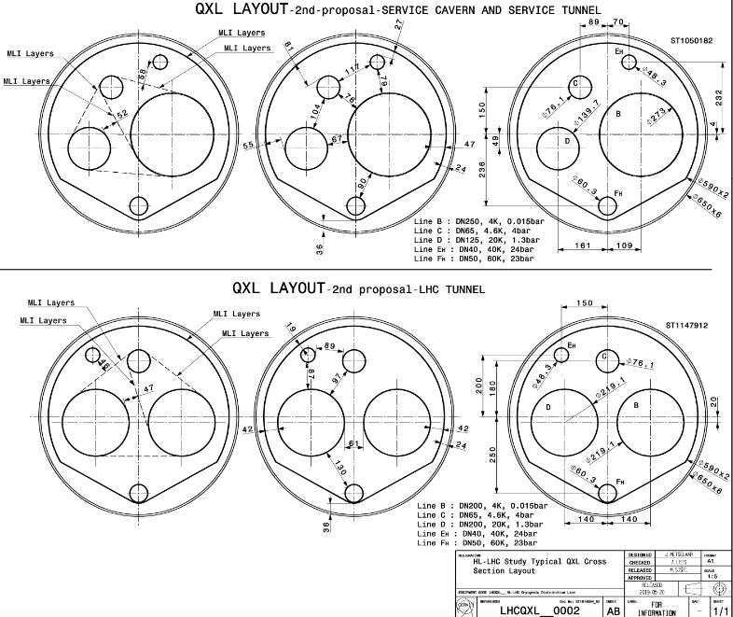
QXL latest dimensions
Constant outer diameter as boundary limit so far
Large “B” to match pressure drop criteria
Design Pressures:
defined (2016) EDMS#1573115:
- E,F: 25 Bar_abs
- B: 4 Bar_abs
- C,D: 20 Bar_abs
Increased “D” to provide cold quench buffer for triplets
Reduced “B” as not impacting pressure drop

Slide 13
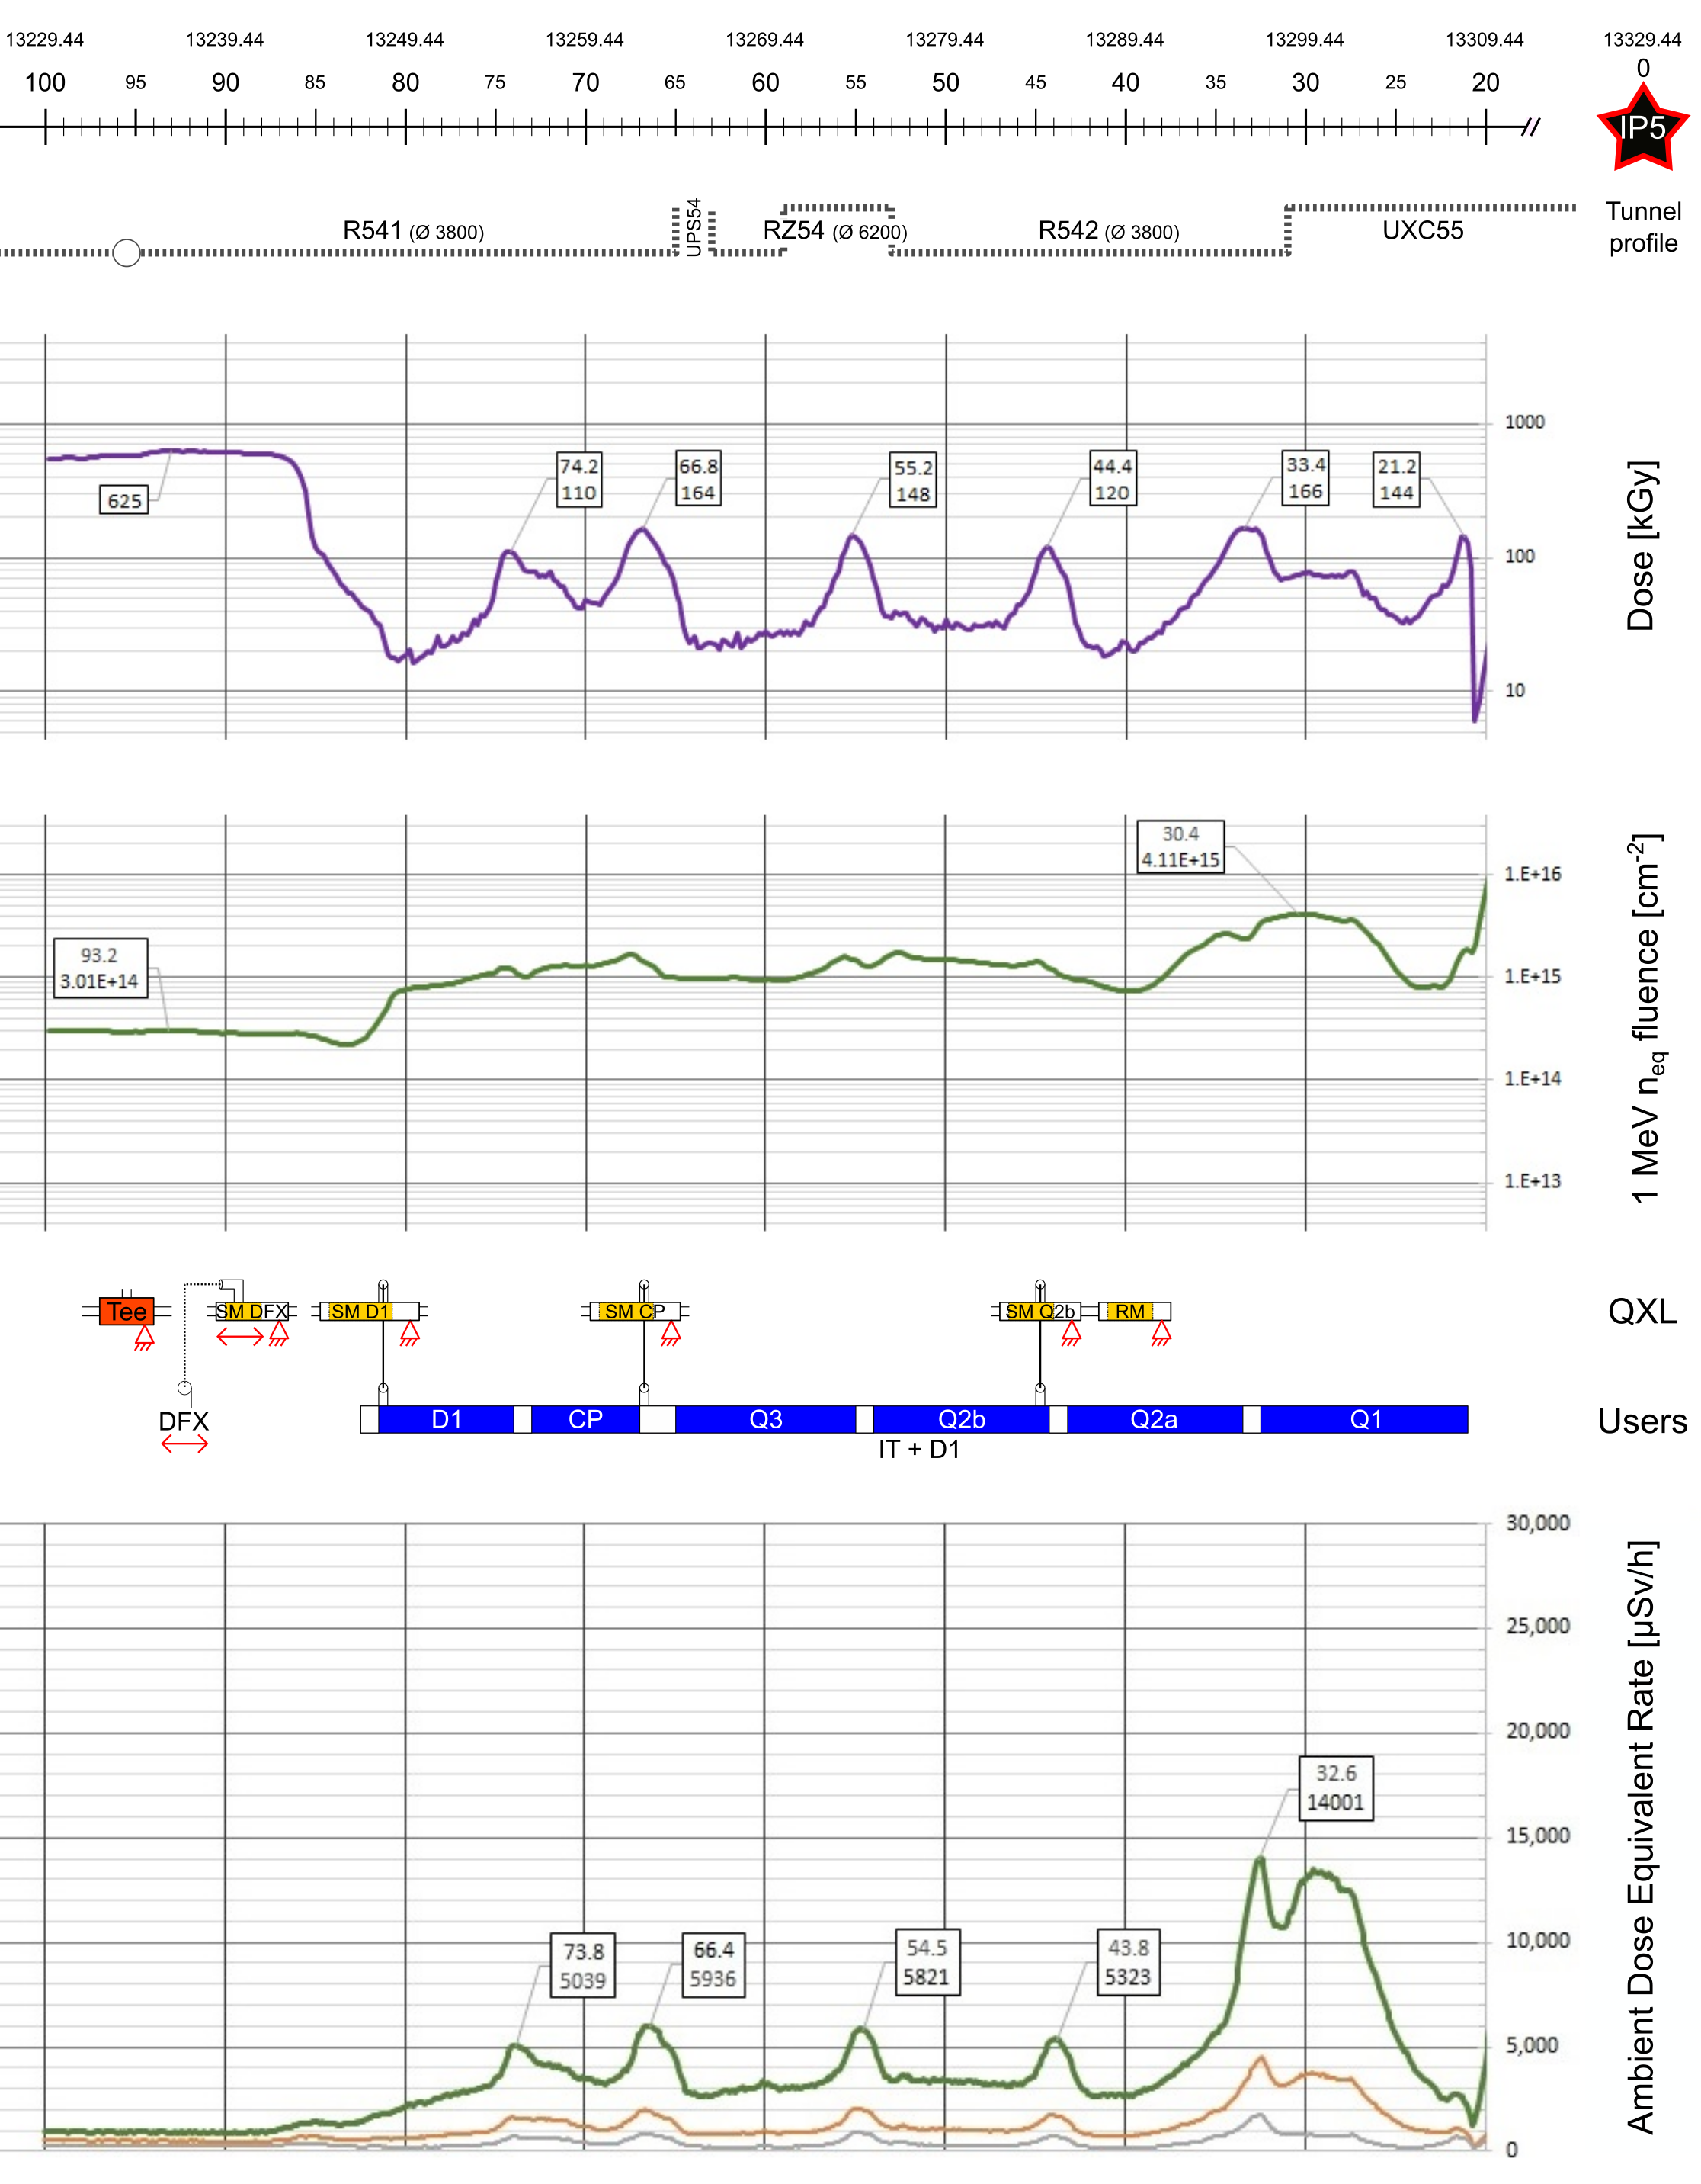
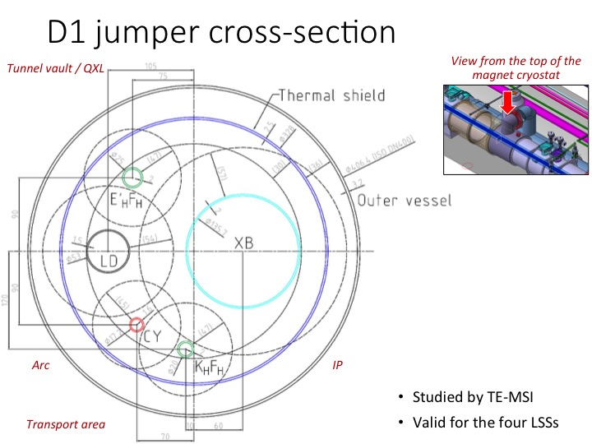
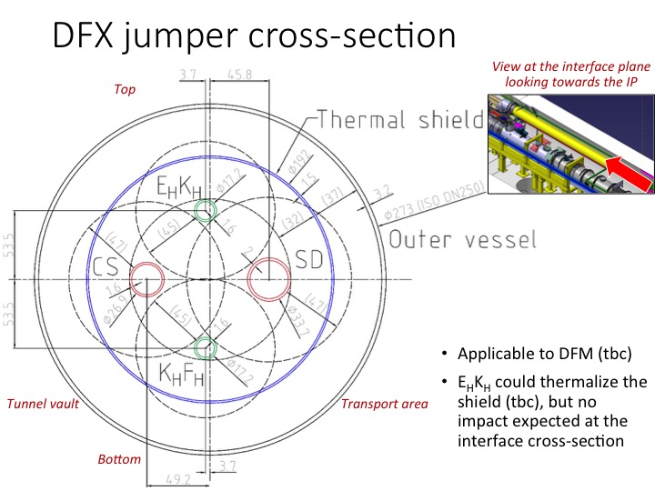
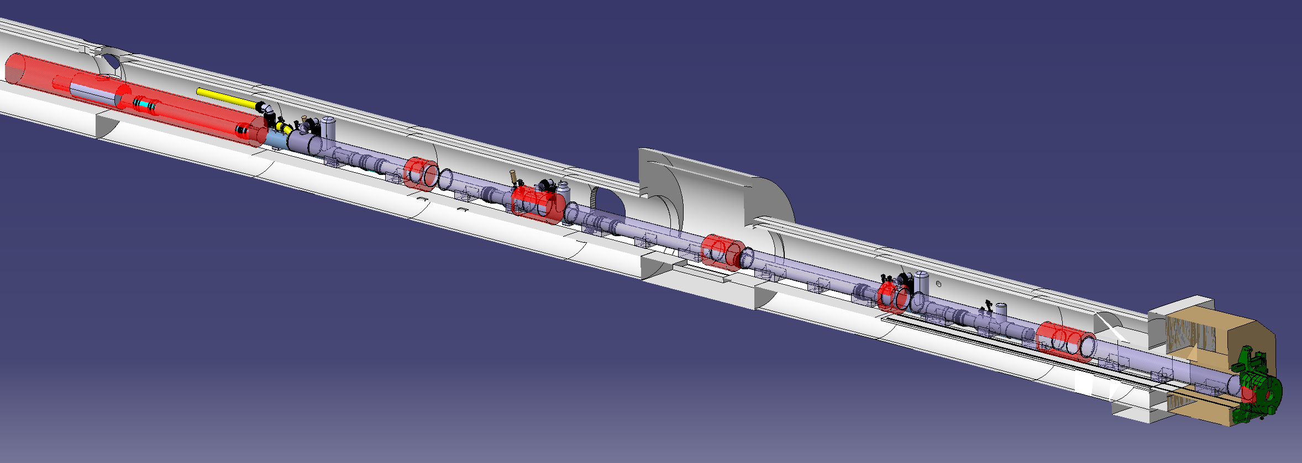
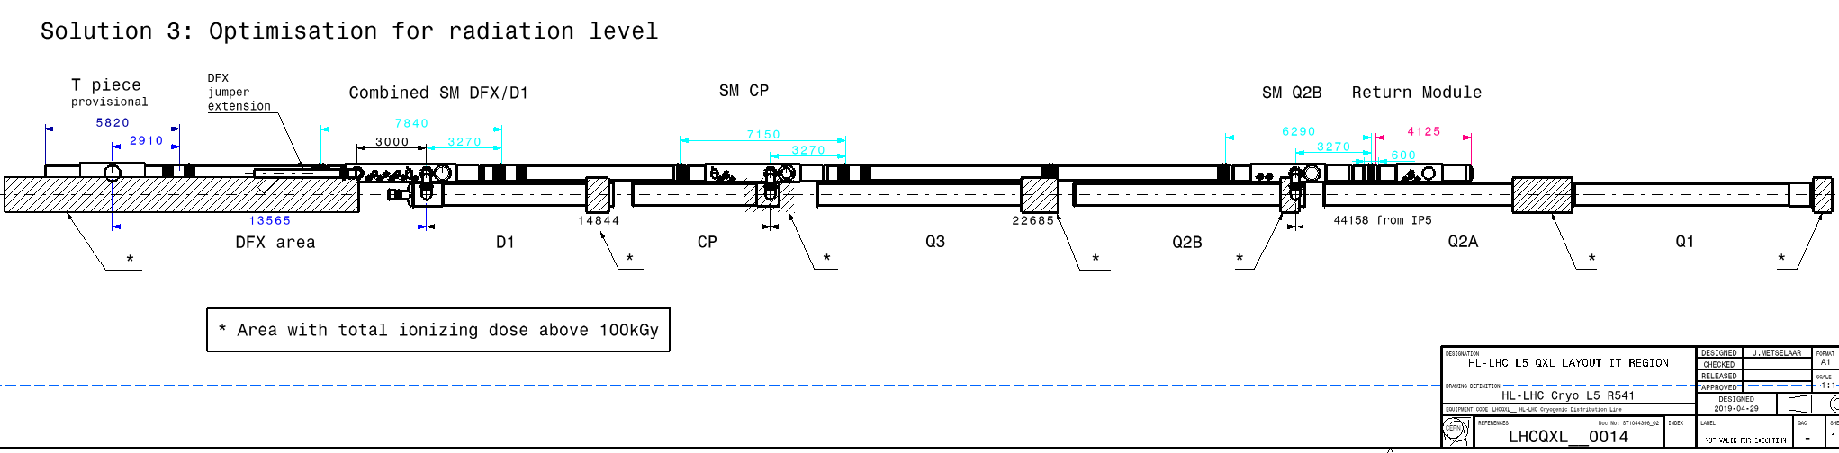
QXL Cryoline integration & interfaces
Radiation level: instrumentation considered OK up to 100kGy

Slide 14
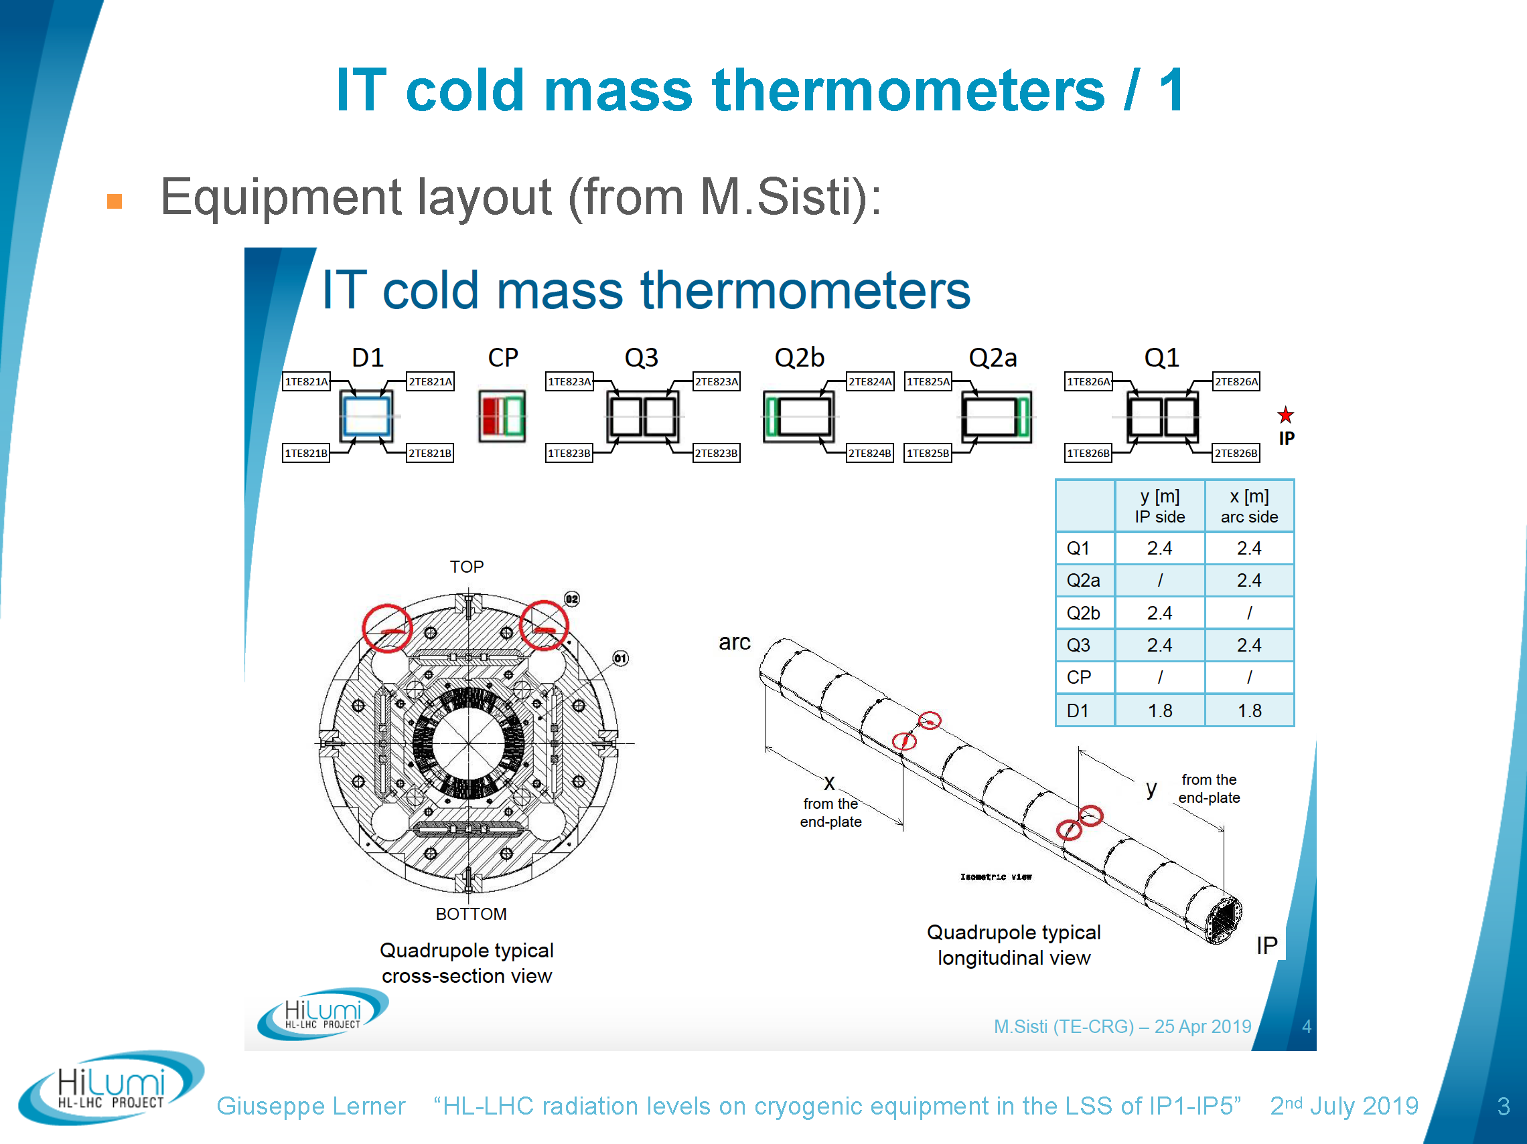
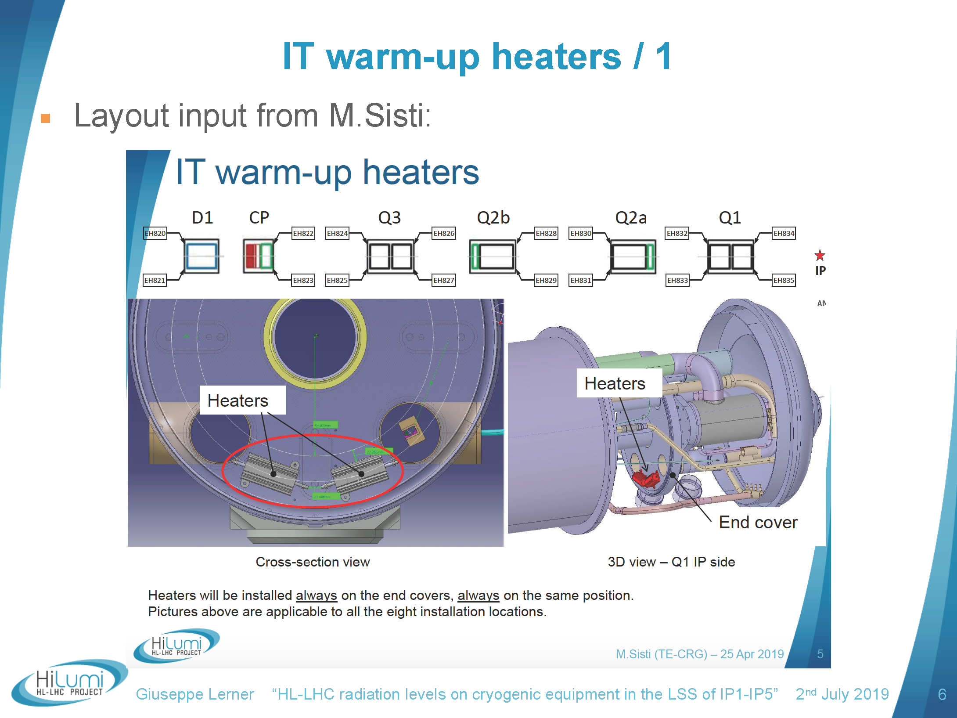
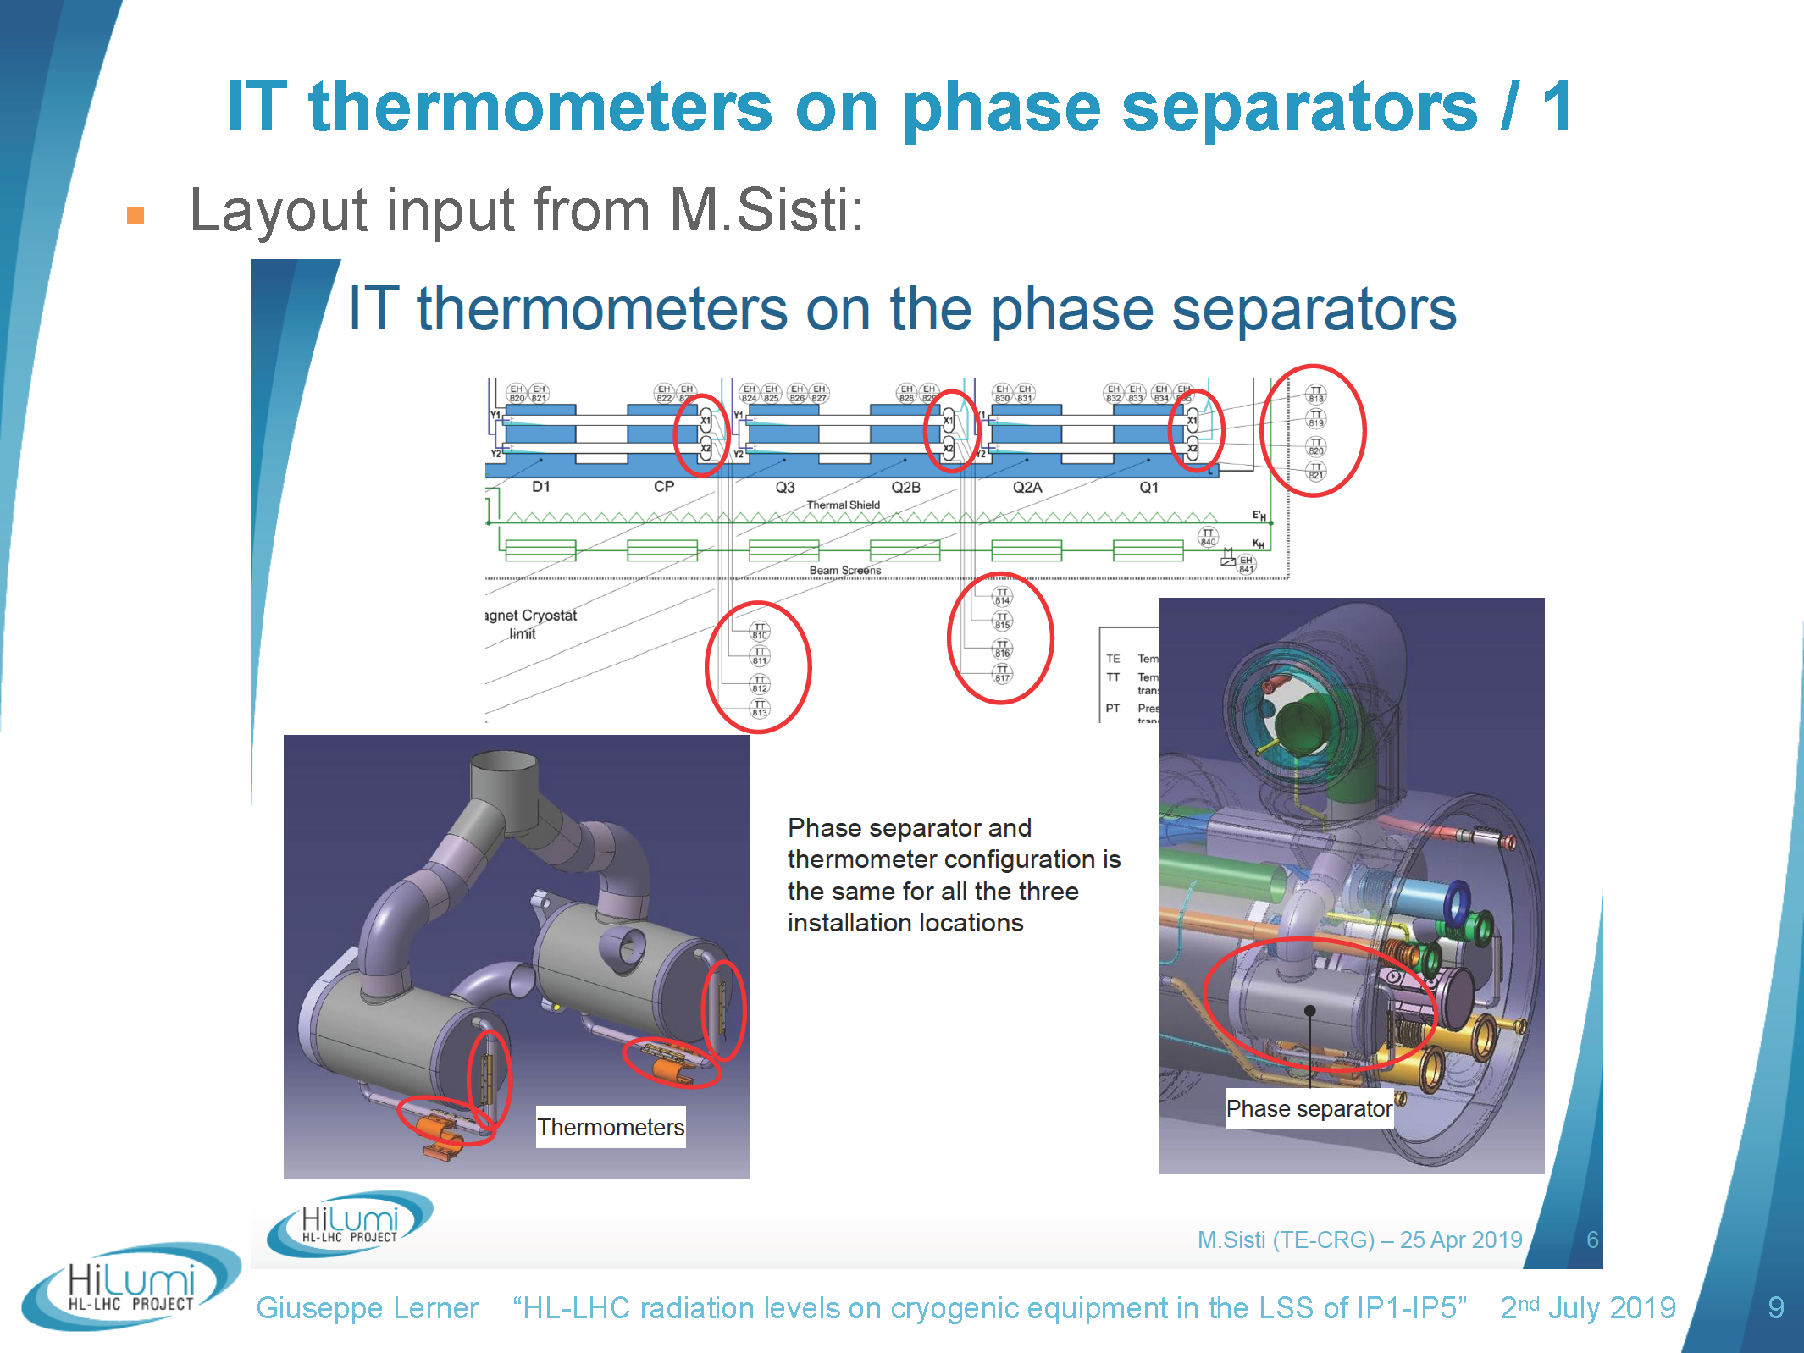
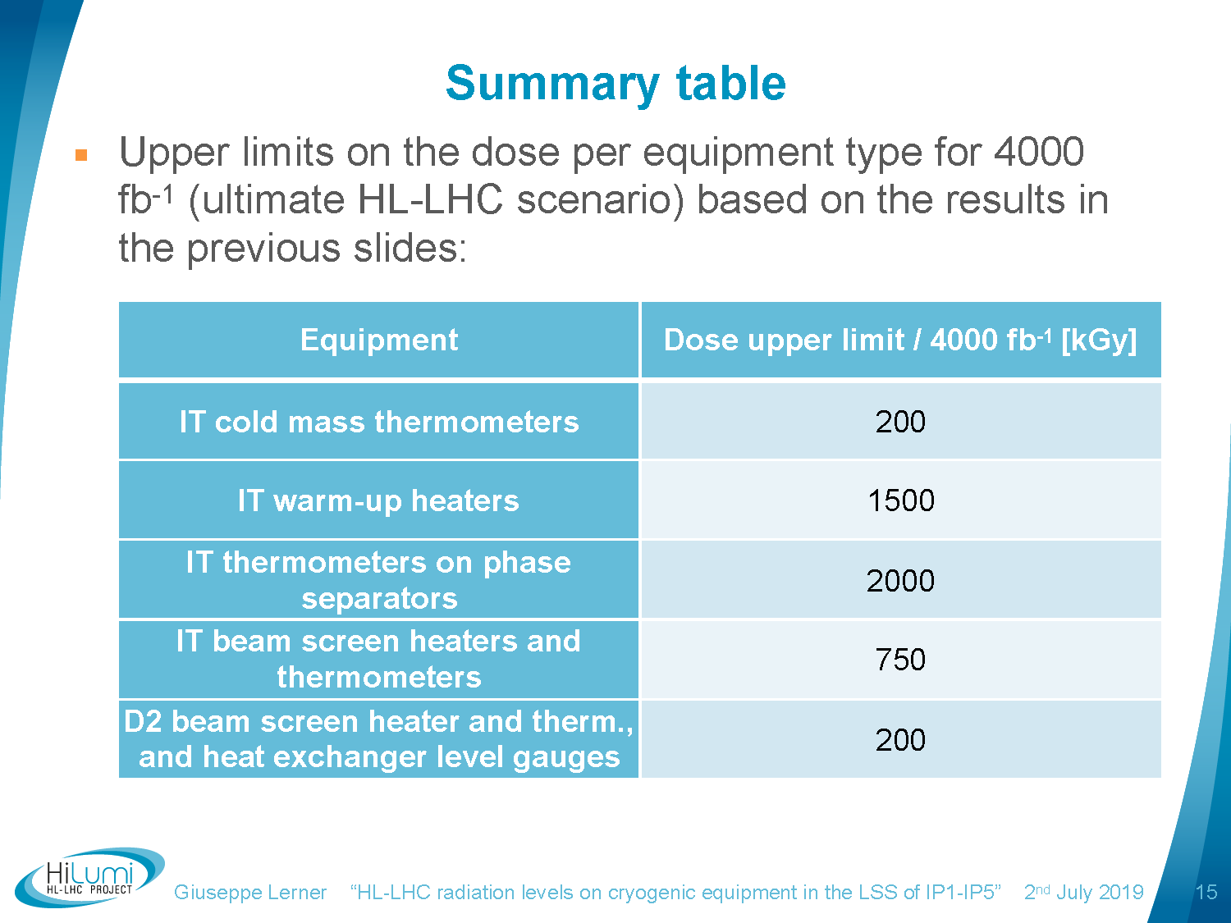
TID on Cryo instrumentation
Thanks to G. Lerner and EN-STI team
OK
NotOK, alternative!
Ok for less accurate technology

Slide 15
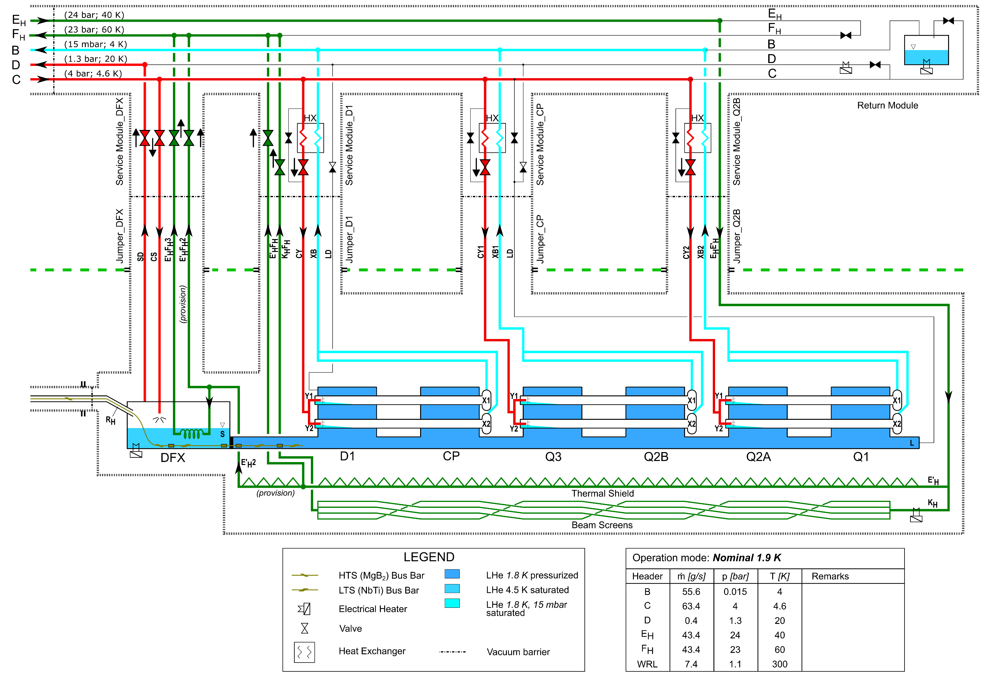
Cryogenics for DFX
Actuators:
JT valves
Outlet CVs for shield and beam screen
Sensors:
TT phase separators
EH cold mass
TT outlet shield and beam screen
News – Progress with triplets considered at a later stage
Updated P & F diagram, considered here for nominal operation mode

Slide 16
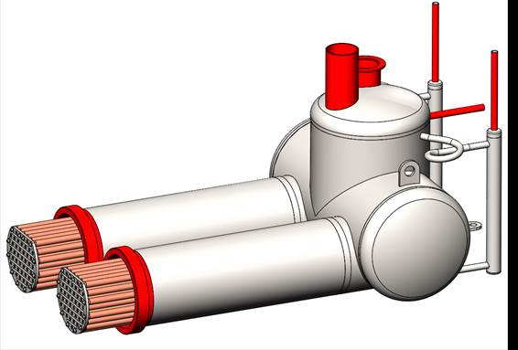
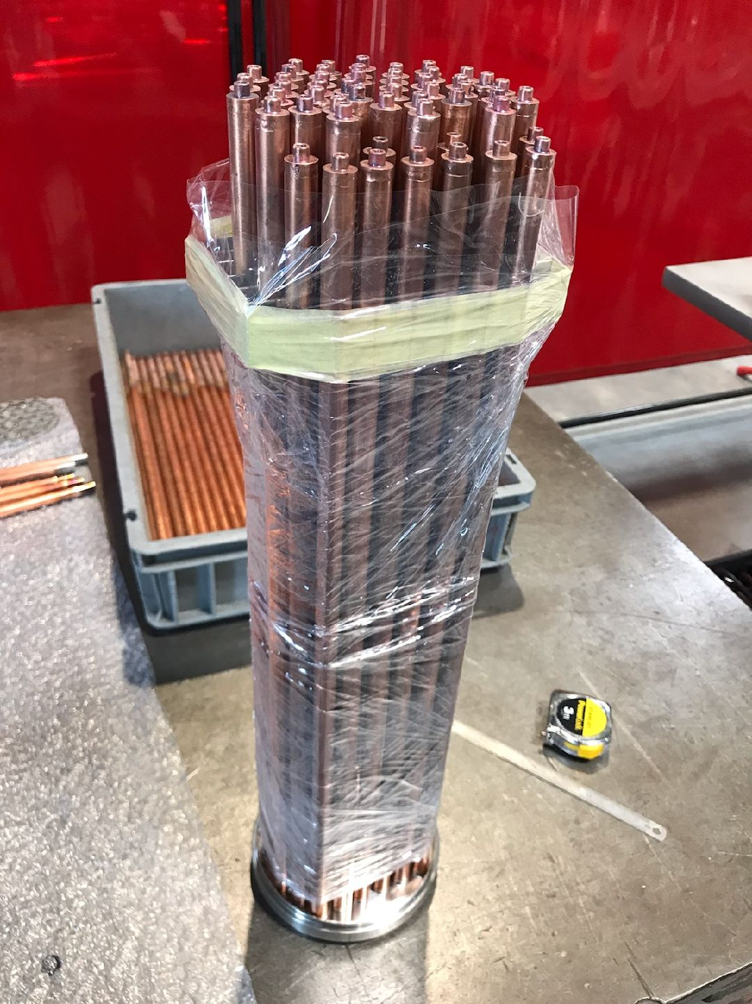
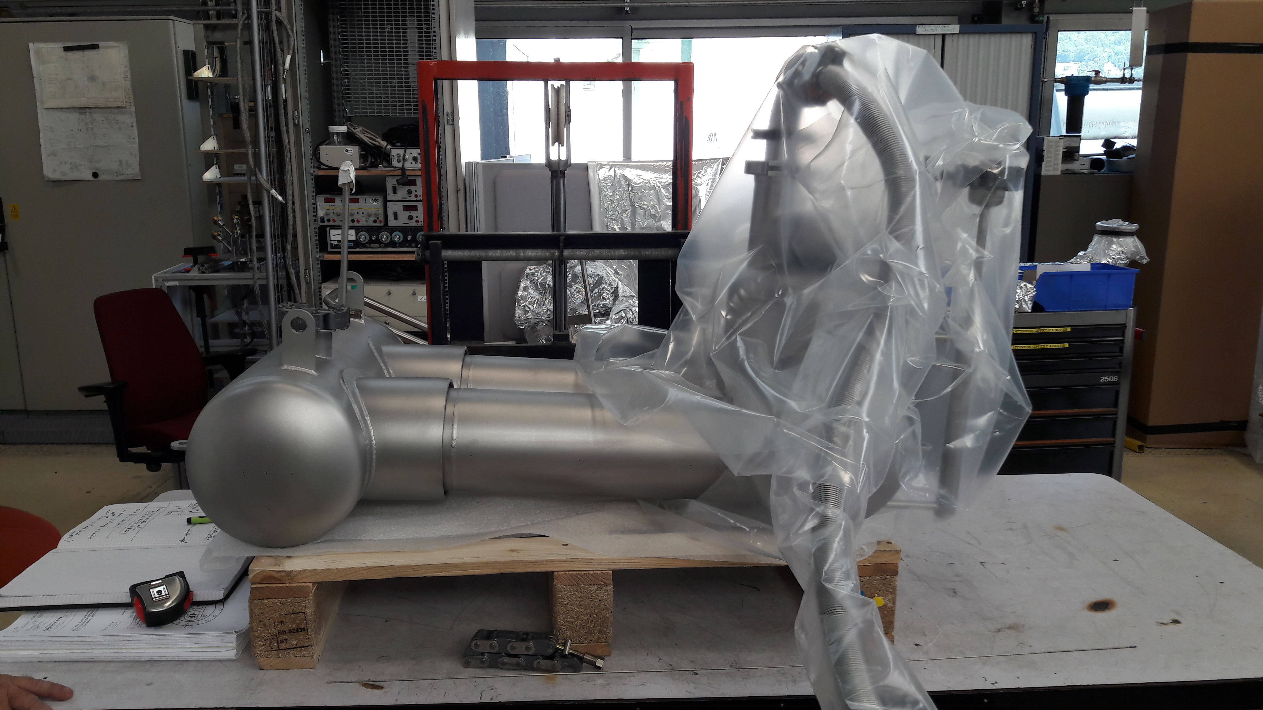
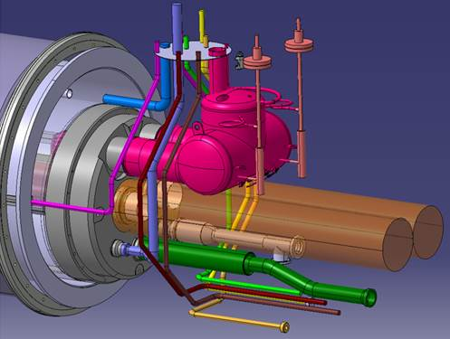
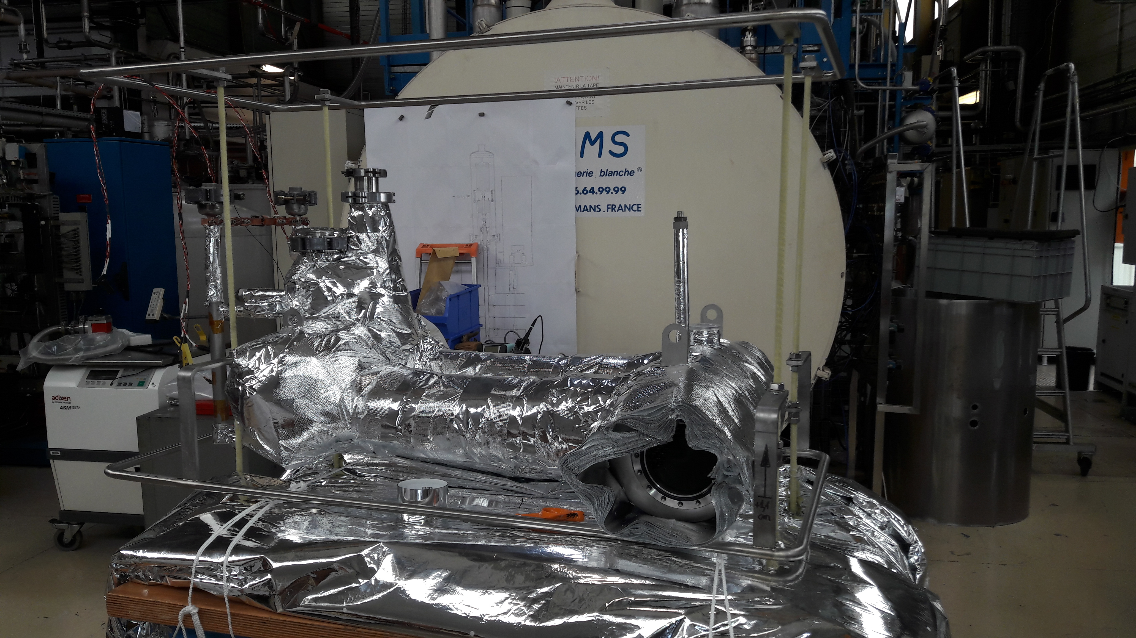
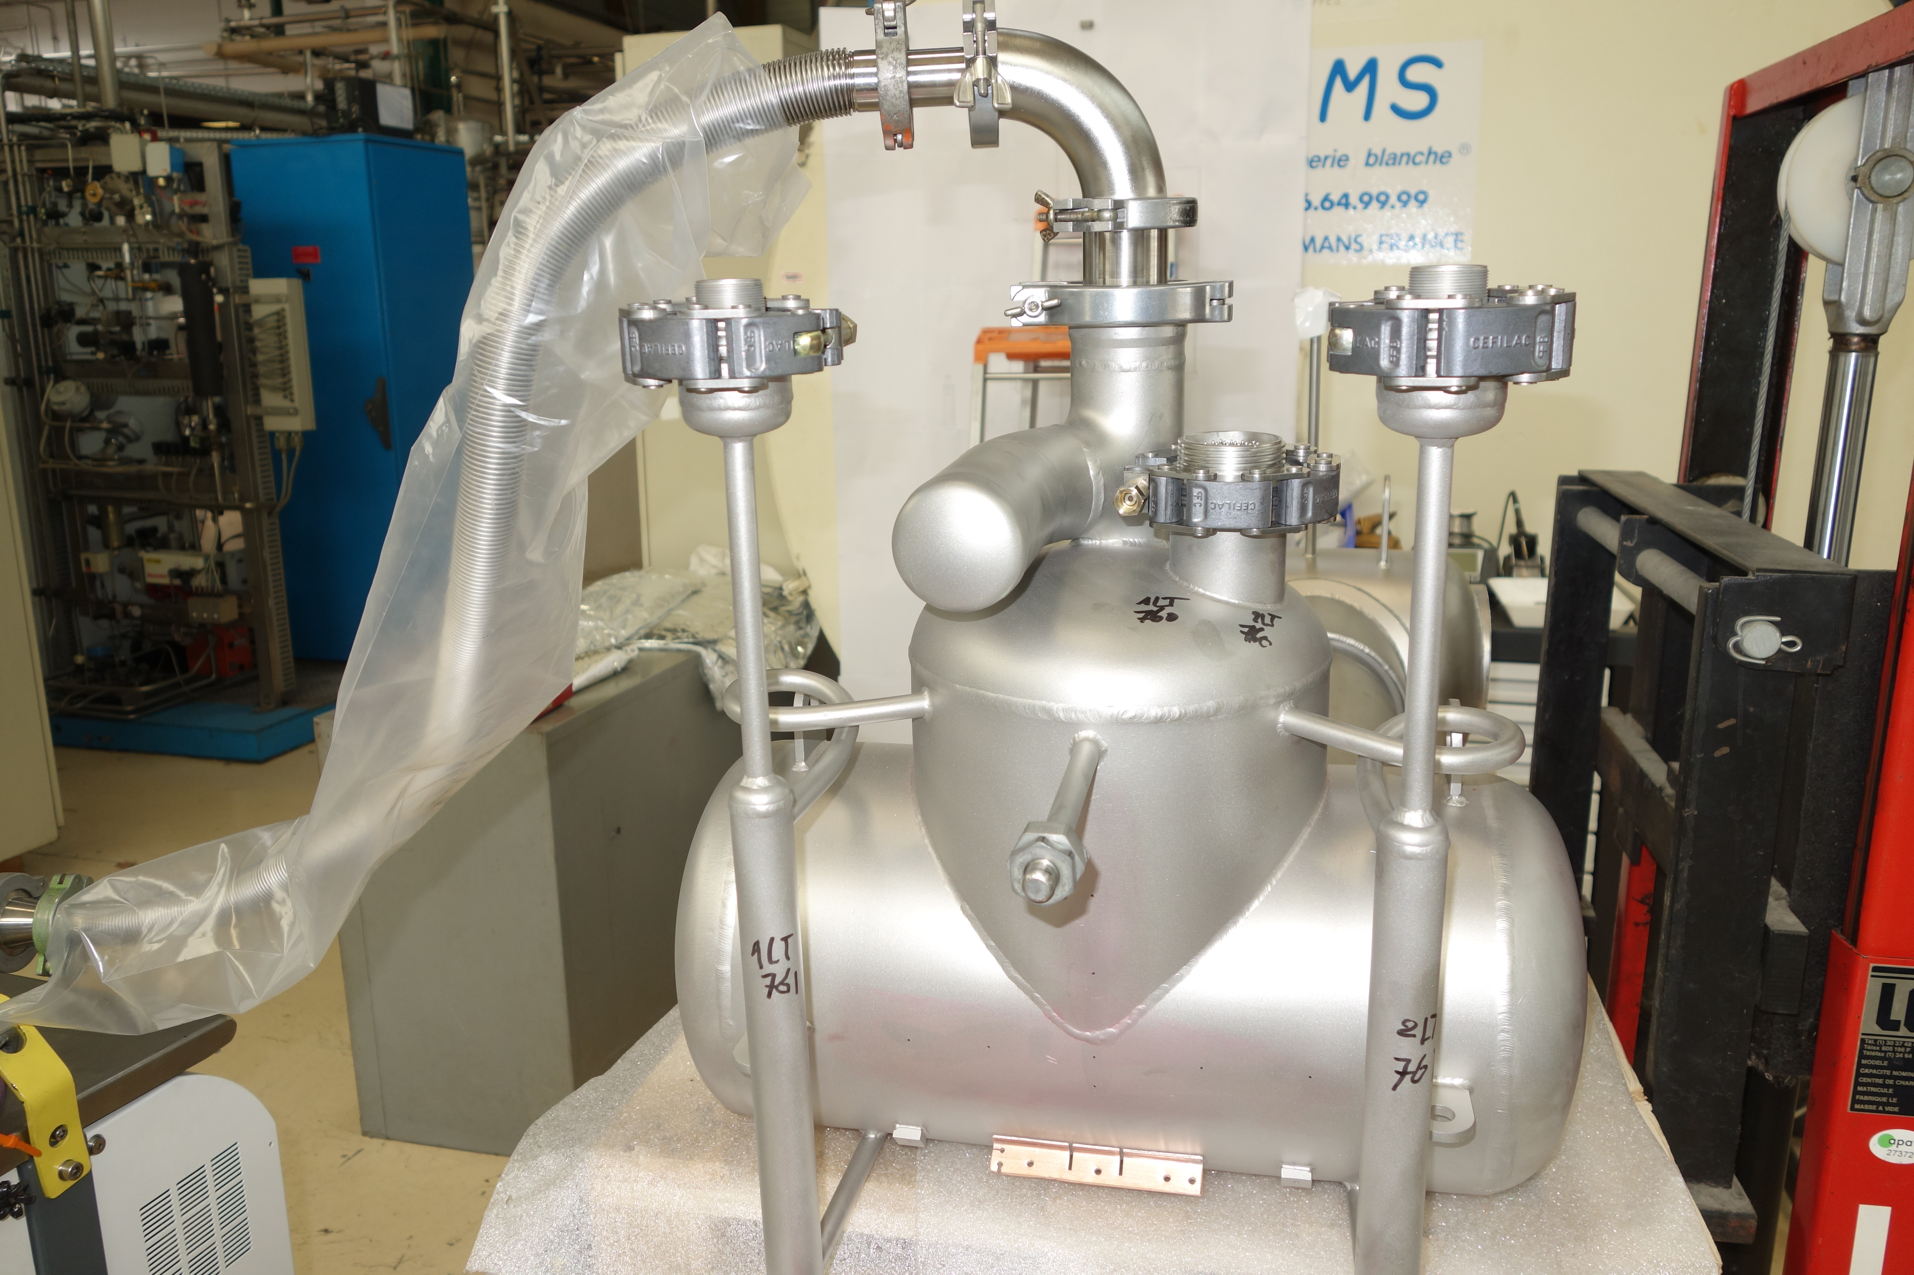
D2 heat exchanger
Studies, procurement and validations tests under collaboration with CEA-SBT Grenoble
Performance tests in Sept’19

Slide 17
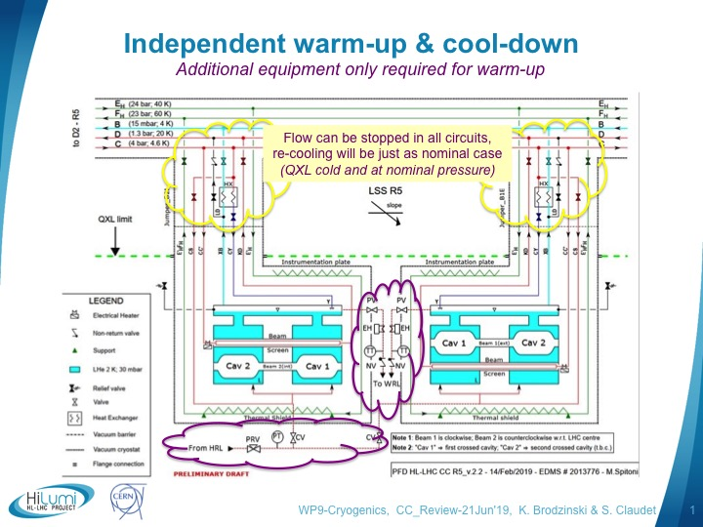
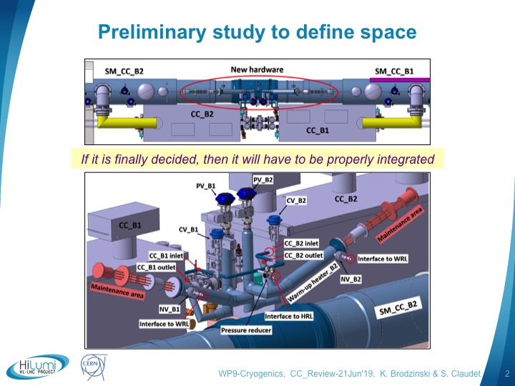
Crab cavities independent warm-up
Could this be useful-envisaged ?
As presented at CC review Jun’19
Feature used at LHC-P4 (for free during TS due to high static heat loads) and required in 2018 at SPS-BA6 for CC prototype test
=> Real need to be justified, and technical proposal to be improved

Slide 18
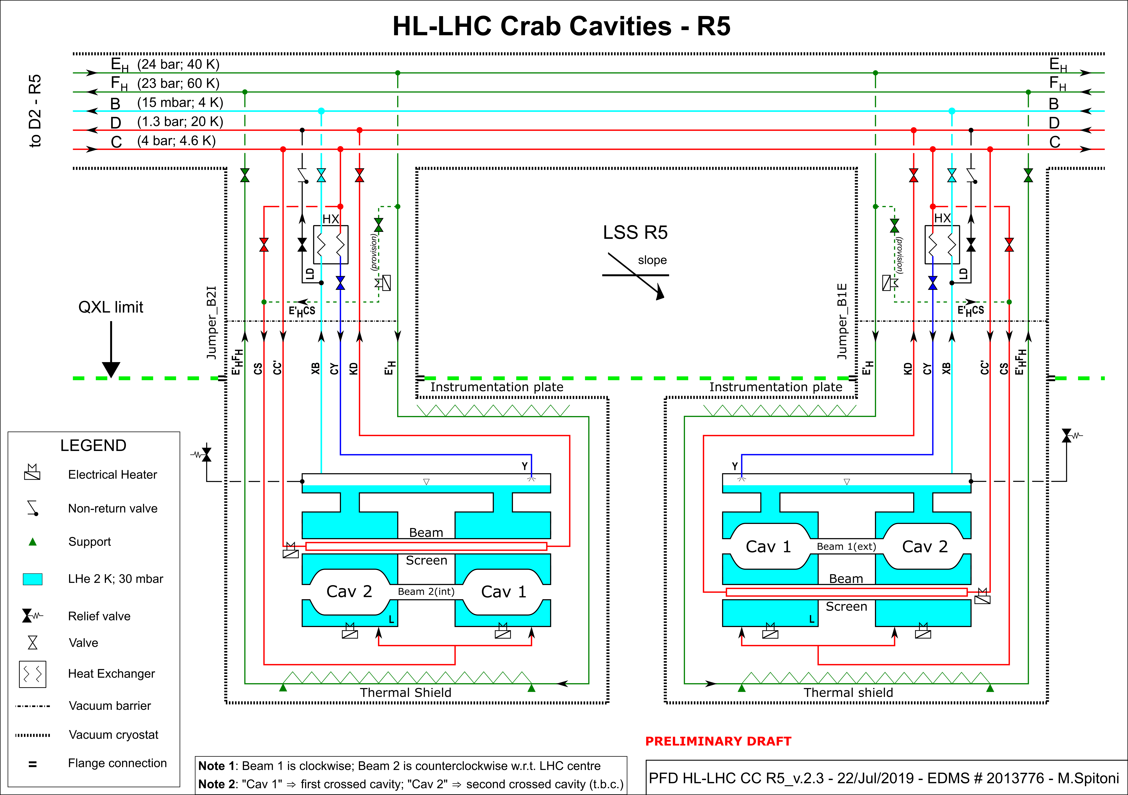
Crab Cavities: Independent warm-up & cool-down
Revised and improved concept being further studied
Improved proposal assuring limited thermal gradients and without modification of cryomodules
(sizing and model underway)

Slide 19
Content
Brief illustrated list of news-progress BA6 & P4
Brief illustrated list of news-progress P1/P5
Major concerns and working activities
Summary

Slide 20
Major concerns and present studies
Revision of heat loads at user interface and conversion into refrigeration capacity requirements
(Baseline few years old with few changes identified, not that bad but,
real need for a complete and comprehensive update, including BS temperature level, sc link requirements, impact of Matching Section Optimisation, management of transients)
Management of dynamic heat loads
The real specificity of HiLumi for Cryogenics!
  Maximum possible done with QXL Cryoline, but 10x shorter than QRL (smaller volumes) and so far not enlarged in machine tunnel, a moderate possibility in service galleries but not much gain expected
  Active control required, with reliable instrumentation and pre-loading heaters in 100 kGy environment

Slide 21
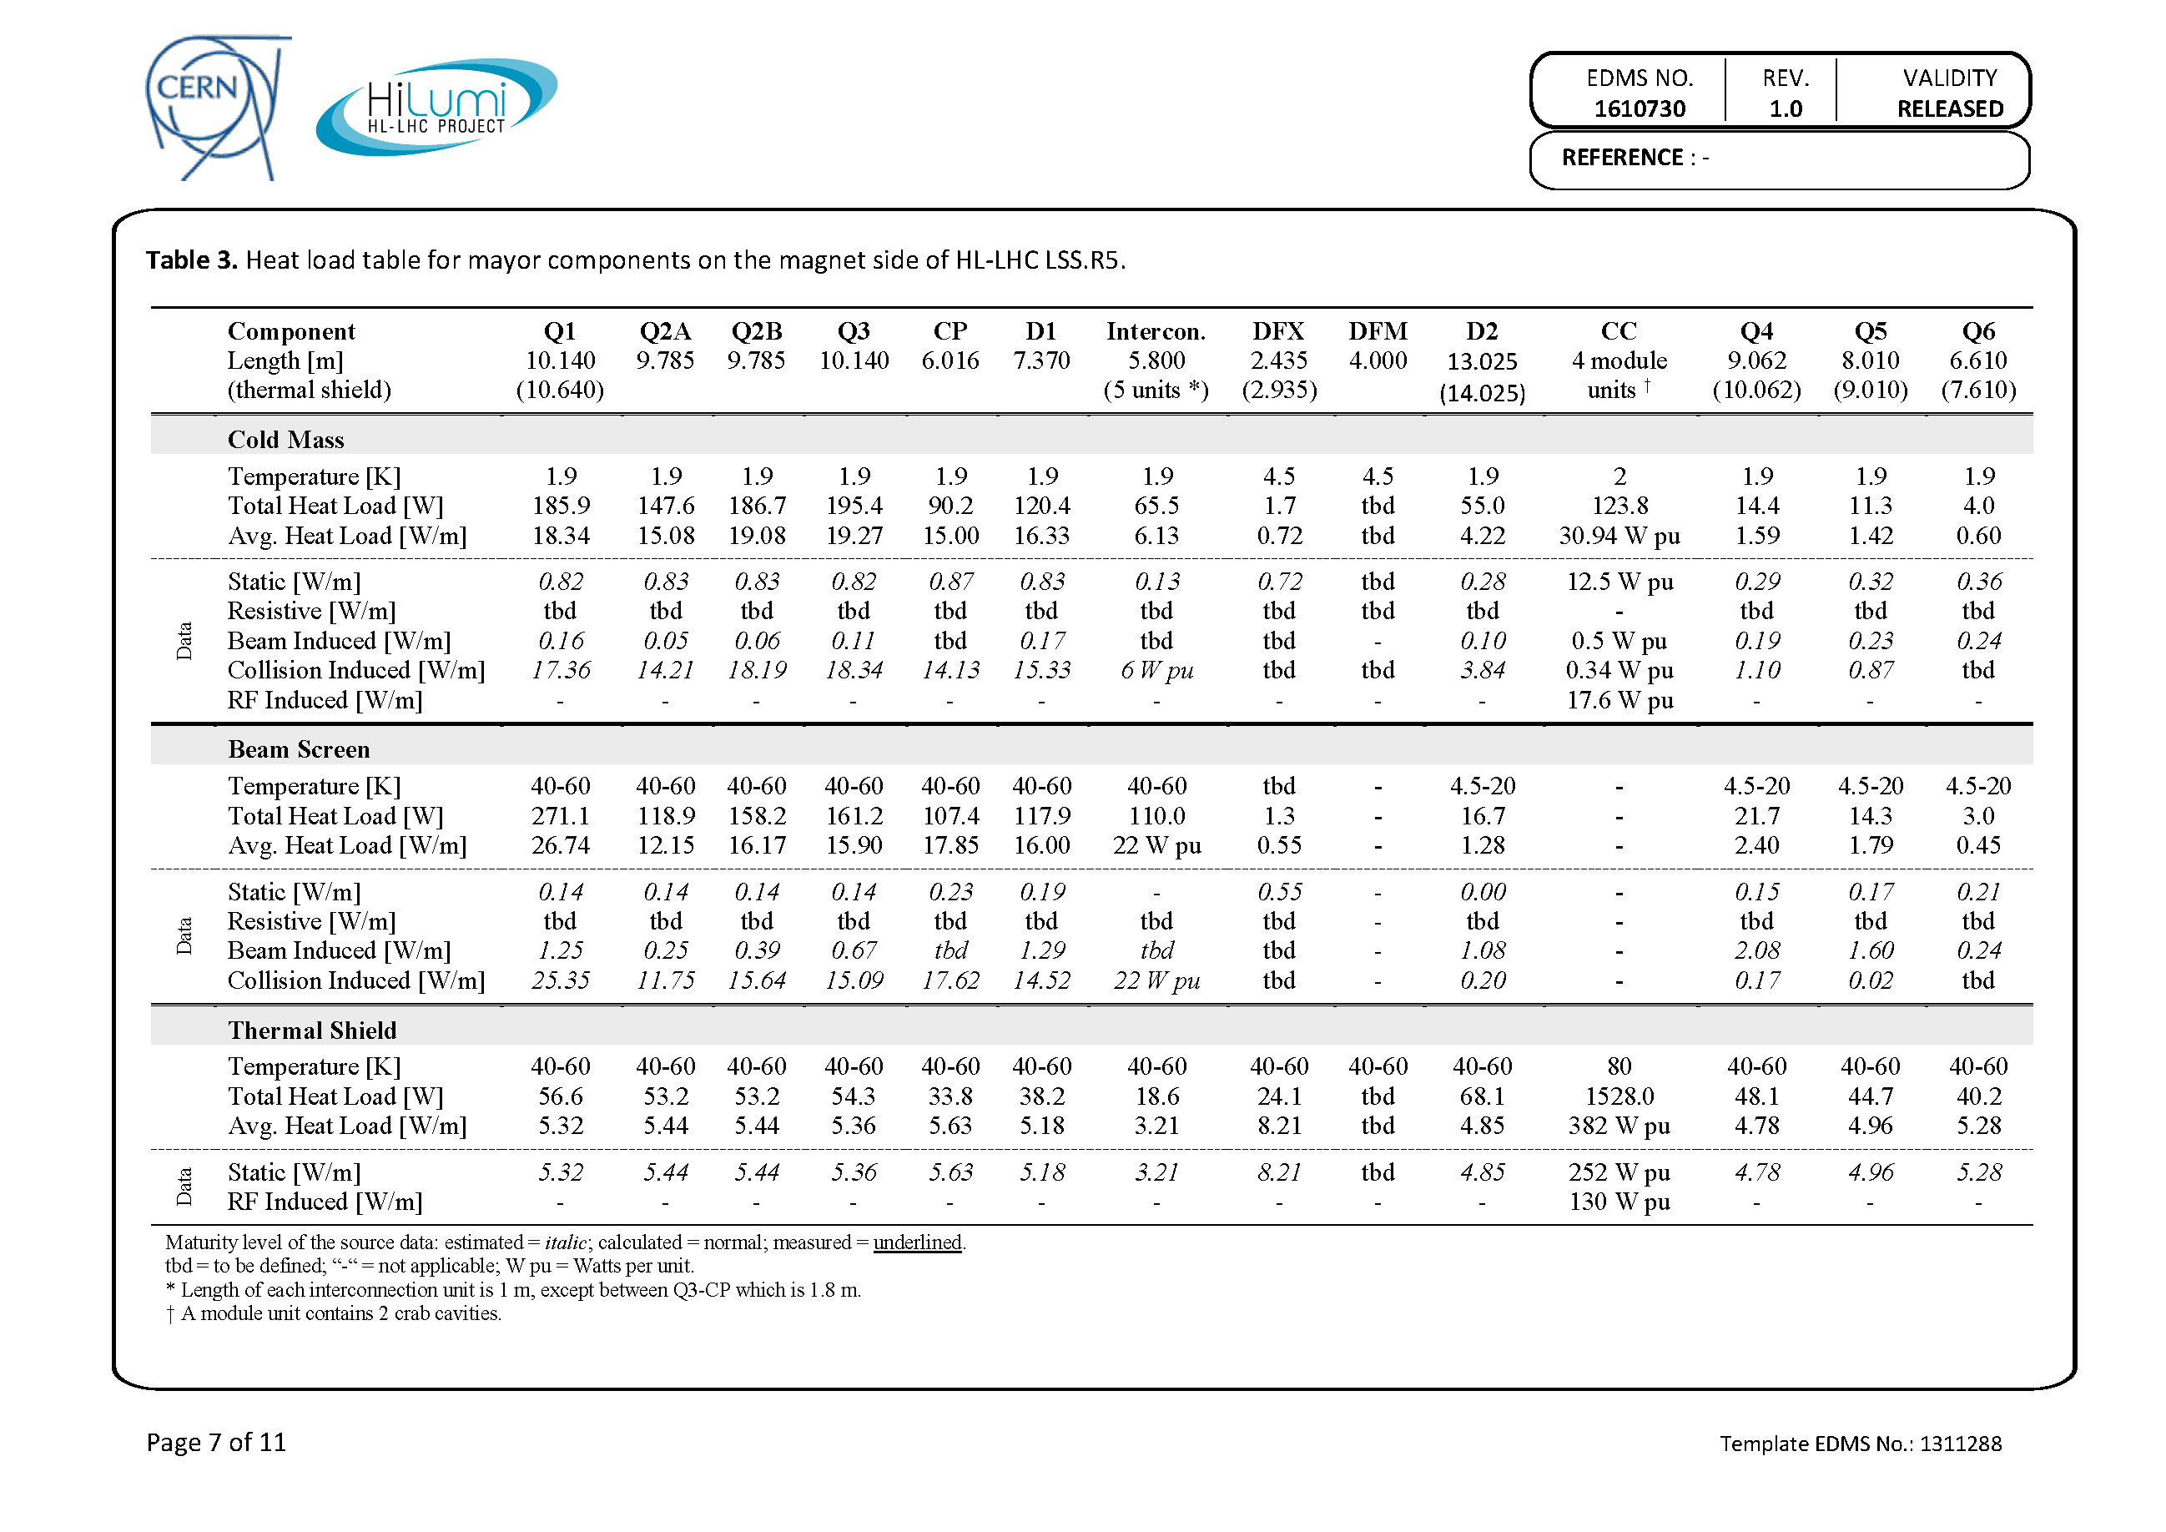
1st Evaluation of Heat Loads
No longer since MSO
1000 W
1200 W
Heat loads to be revisited as well for CC (1.9K, thermal shield, Beam-Screen)
To be revisited following design of cryostats and updated heat deposition studies

Slide 22
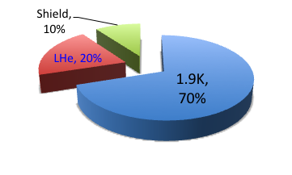
HL-LHC refrigeration capacity at Points 1 & 5
About 18kW eq. @ 4.5K, including 3kW @ 1.8K
Preliminary global values, being revised
~15kW
Temperature level | Cooling circuit | Specific heat load [W/m] (Static) | Capacity* / Point |  | Dynamic range
40-60 K | IT beam screen | 16 (0) | 3.2 kW | 13 kW | ~1.3
 | Thermal shield | 6 (6) | 3.6 kW
 | Crab cavity | - | 6 kW
20-300 K | Current lead & SC link | - | 40 g/s | 40 g/s | ~2
4.5-20 K | MS beam screen | 2 (0.1) | 0.1 kW | 0.1 kW | ~20
1.9 – 2 K | Cold-mass (1.9 K) | 14 (0.35) | 2.6 kW | 3 kW | ~10
 | Crab-cavity (2 K) | - | 0.4 kW
4.5-300K
20 g/s
0.3 kW
*: Including uncertainty and design capacity factor

Slide 23
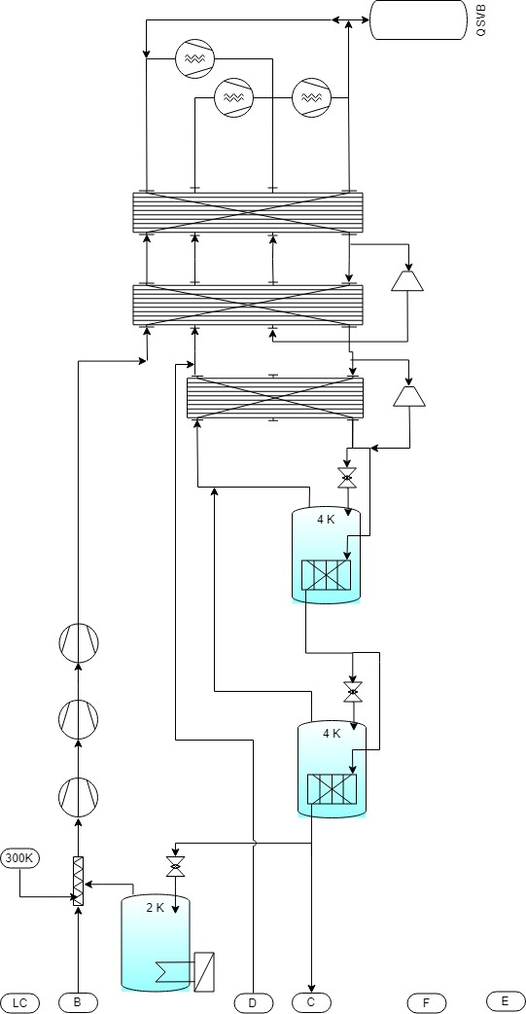
From Users requirements to Refrigeration capacity and process
300 K
LC
Load @
4.5-300K
QSCG
C
4,5 K
20 K
D
Load @
4.5-20K
QSRG
4 K
B
HX
Load @
1.9-2K
QPLG
E
40 K
60 K
F
Load @
40-60K
Heat Loads from users
  40-60K
    IT Beam Screen
    Thermal Shields
    (QXL, Mag, CC)
  4.5-300K
    SC link + Current Lead
QURCG
  4.5-20K
    Beam Screens (D2, CC)
  1.9-2K
    Cold masses (IT, D2)
    Crab Cavities

Slide 24
Major concerns and present studies
Revision of heat loads at user interface and conversion into refrigeration capacity requirements
(Baseline few years old with few changes identified, not that bad but,
real need for a complete and comprehensive update, including BS temperature level, sc link requirements, impact of Matching Section Optimisation, management of transients)
Management of dynamic heat loads
The real specificity of HiLumi for Cryogenics!
  Maximum possible done with QXL Cryoline, but 10x shorter than QRL (smaller volumes) and so far not enlarged in machine tunnel, a moderate possibility in service galleries but not much gain expected
  Active control required, with reliable instrumentation and pre-loading heaters in 100 kGy environment

Slide 25
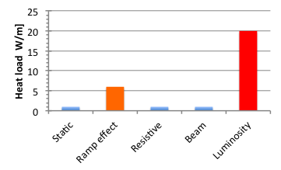
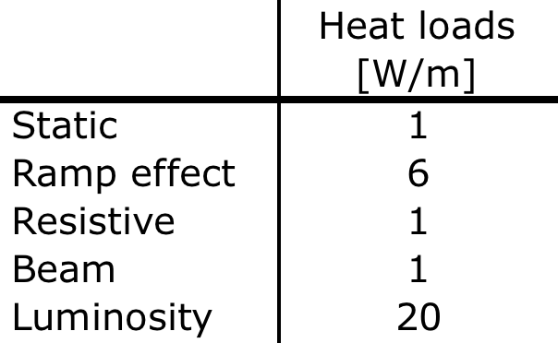
Introduction to heat loads per origin for triplets
Qualitative illustration (with not too bad orders of magnitude)
Important change in heat load for physics !!!
(well known for IT, but dominant user for HiLumi w.r.t LHC)
Magnet
Beam
Fluctuations (min/hours) in pumping line expected, however limited (max ~5mbar) to keep magnets at 1.9K
=> This will deserve specific strategy
Independent pressure control required for crab cavities (foreseen anyway)
(active control with heaters and feed-forward)

Slide 26
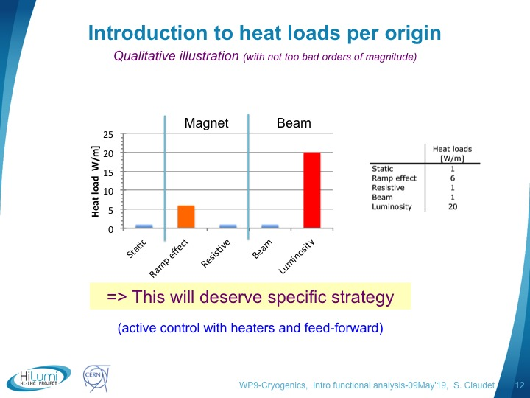
Schematic model
Refrigerator
HEX
Z max
Beam off
Beam on
Z min
Heater
J to He_{sub}
J to He_{press}
J to He_{press}
C
Cold Compressor
B
m’ = CC driven
Cryo-distribution
Magnet Cryostat

Slide 27
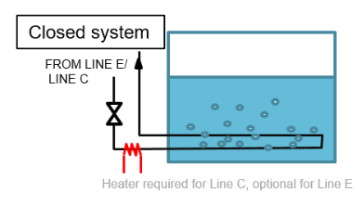
Cryo parameters evolution when colliding
Limited impact of header B volume, Big impact of flow rate
DN 250 → service galleries
DN 200 → tunnel level
DESIGN ESTIMATION |  | No pre-load on cold mass |  |  | 50% pre-load on cold mass
 |  | Cryostat | Bayonet | Header B | Cryostat | Bayonet | Header B
5 g/s/min | Max temperature [K] | 2.01 | 1.96 | 4.98 | 1.9 | 1.87 | 4.44
 | Max pressure [mbar] | 1304 | 27.7 | 27.7 | 1307 | 20.8 | 20.8
 | Min pressure [mbar] | 1127 | 0.016 | 0.016 | 1224 | 0.016 | 0.016
10 g/s/min | Max temperature [K] | 1.91 | 1.88 | 4.51 | 1.87 | 1.84 | 4.24
 | Max pressure [mbar] | 1343 | 21.7 | 21.7 | 1306 | 18.6 | 18.6
 | Min pressure [mbar] | 1205 | 0.016 | 0.016 | 1255 | 0.016 | 0.016
15 g/s/min | Max temperature [K] | 1.9 | 1.87 | 4.46 | 1.87 | 1.84 | 4.24
 | Max pressure [mbar] | 1384 | 21.1 | 21.1 | 1328 | 16.5 | 16.5
 | Min pressure [mbar] | 1213 | 0.02 | 0.016 | 1255 | 0.016 | 0.016
LHC Spec.
LHC now
Out of reach …
Collision ramp-up time → secondary effect
Header B available volume → negligible effect
Minimum pre-load of 50 %
strongly recommended
Active controls required with pre-load (heating),
GHe heating more robust than electrical systems required,
And 5-10 min to reach peak luminosity appreciated !

Slide 28
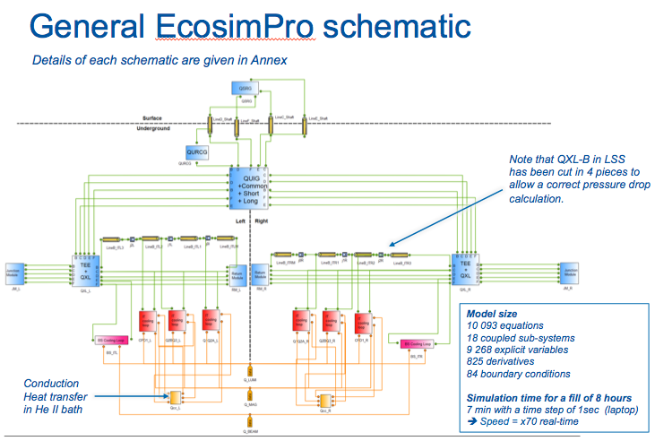
Model for dynamic process control studies
GHe heating more robust than electrical systems

Slide 29
Summary
Activities foreseen for SPS-BA6 consolidations or P4 Upgrade are progressing as foreseen
Further studies for P4 (HeL, mobile Refrigerator and infrastructure) about to start (team re-inforced)
Significant progress made for QXL cryodistribulion line definition, integration and interfaces
Revision of heat loads and cooling capacity requirements started
Strategy and equipment to properly manage dynamic effects under study and definition (lumi ramp?, GHe heaters?)
Complete definition of HiLumi cryogenics for P1-P5 during 2020 is a serious possibility, allowing to launch major procurements for LS3

Slide 30
Baseline configuration
CV position on the returning line could limit the control of the closed loop E-F

Slide 31
Reverse CV position study
Reversing the CV position allows better control on thermal shield and beam screen
The two supply lines routing are assumed to be same as in baseline
Assumed routing to join the two flows together at D1 end
Thermal shield and beam screen routing through the cryostat are assumed to be equal to that of the baseline
Assumed routing at Q1 end to decouple the two lines

Slide 32
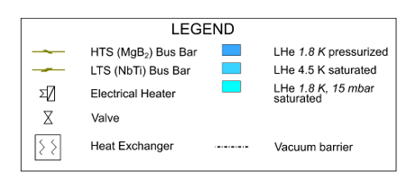
Option 2 – reverse CV + serpentine
4
5
5
TT?
Draft for discussion
Naming of thermal shield pipes are indicative
Thermal Shield pipes per jumper
Jumper_D1 | Jumper_CP | Jumper_Q2B
1 (-1) | 2 (+2) | 3 (+2)
Values in brackets → comparison w.r.t. baseline configuration

Slide 33
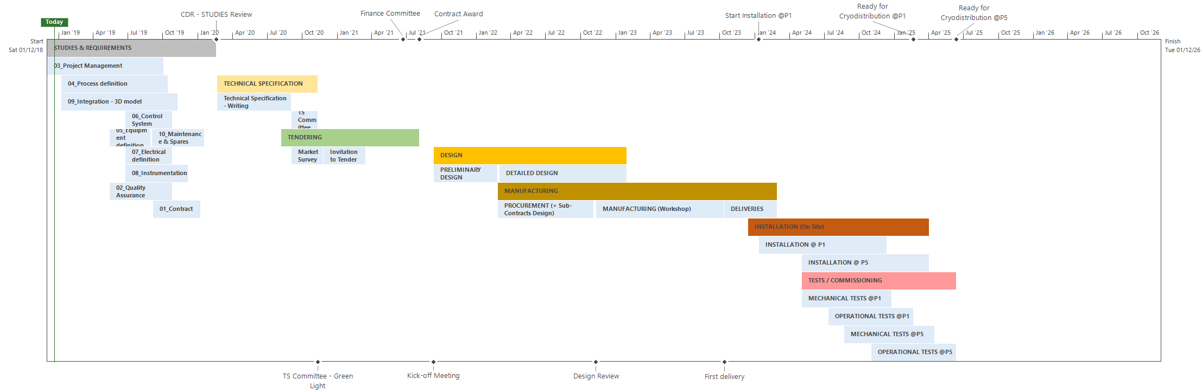
Project plans Refrigeration-Distribution
WP9-Cryogenics, PSM-20Dec'18, S. Claudet
Prepared by E. Monneret
2020
2021
2022
2023
2024
2025
2026
-
!
-
!
-
Surface buildings available
To be operated for QXL tests at cold, and LSS commissioning
Today
Cooling capacity and interfaces to be frozen by end 2020
Possible to anticipate delivery in 2023 (surface only),
it would require to freeze heat loads at the end of 2019 (why not, risky?)

Slide 34
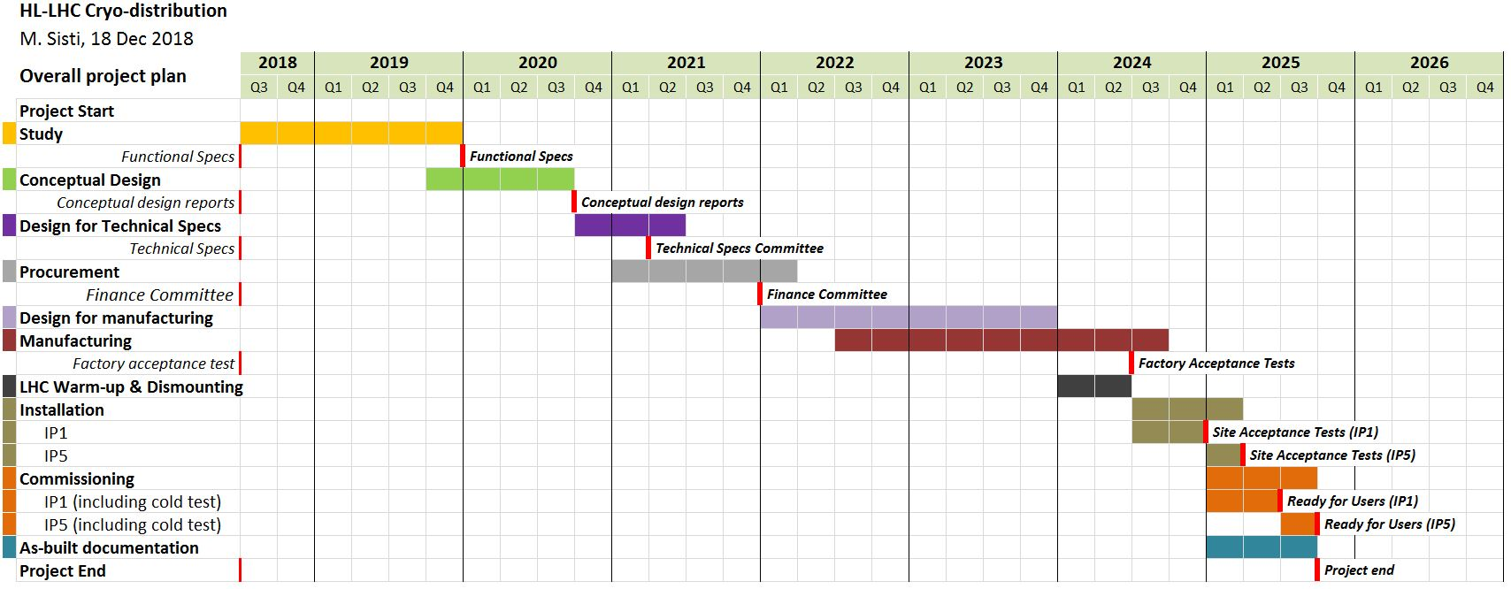
Project plans Refrigeration-Distribution
WP9-Cryogenics, PSM-20Dec'18, S. Claudet
UR’s available
+
UL’s available
-
Today
Interfaces to be frozen by end 2020
Used now to discuss for LS3 (ready to install, P1 w.r.t P5)
UR+UL should be available before mid 2024, only LSS could be later due to LHC dismantling

