Slide 1

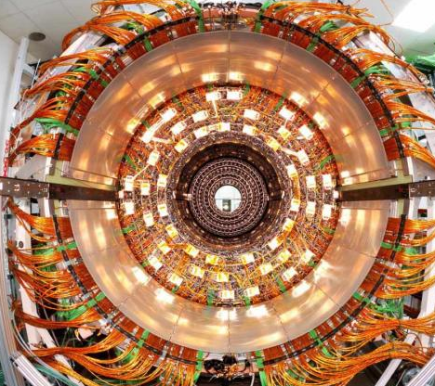
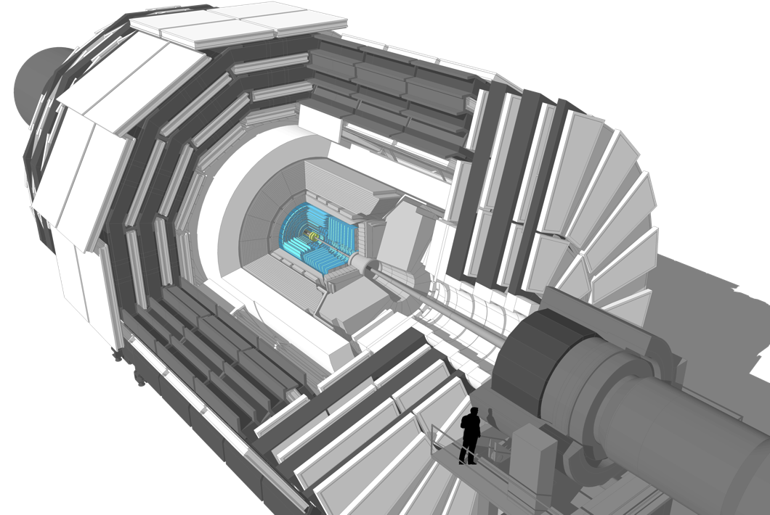
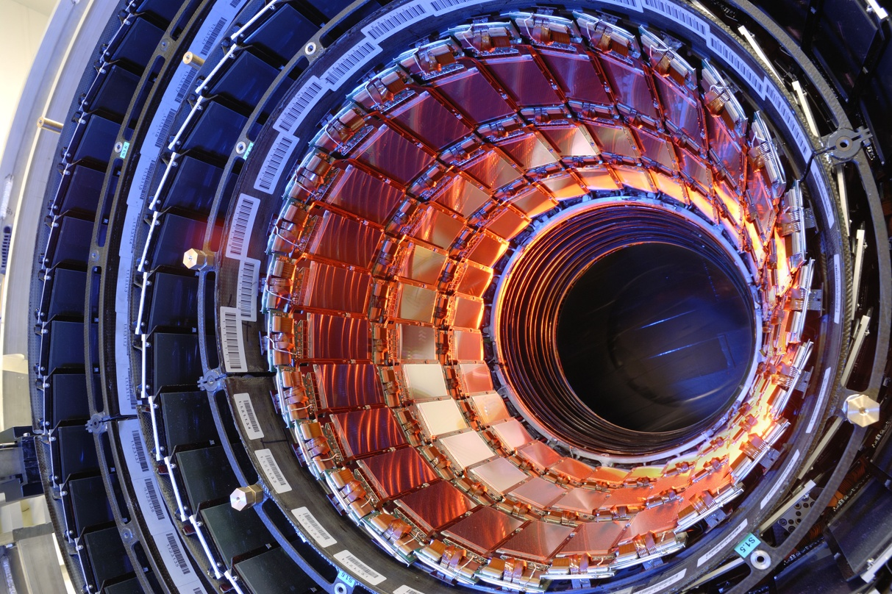
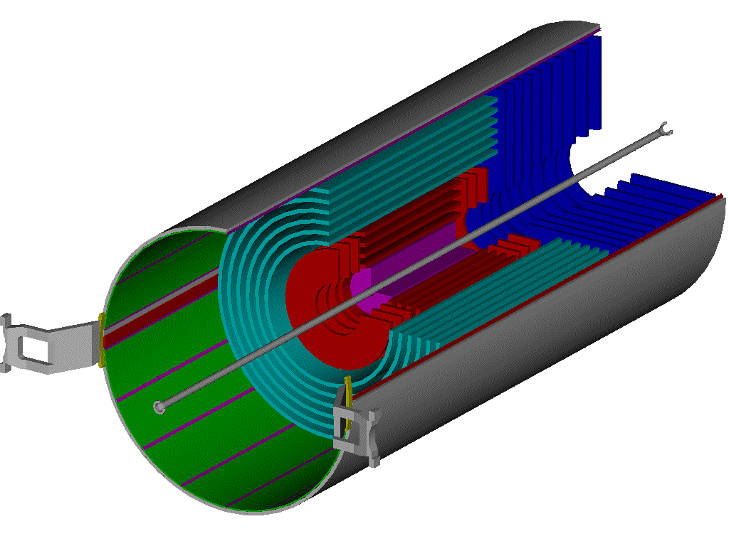
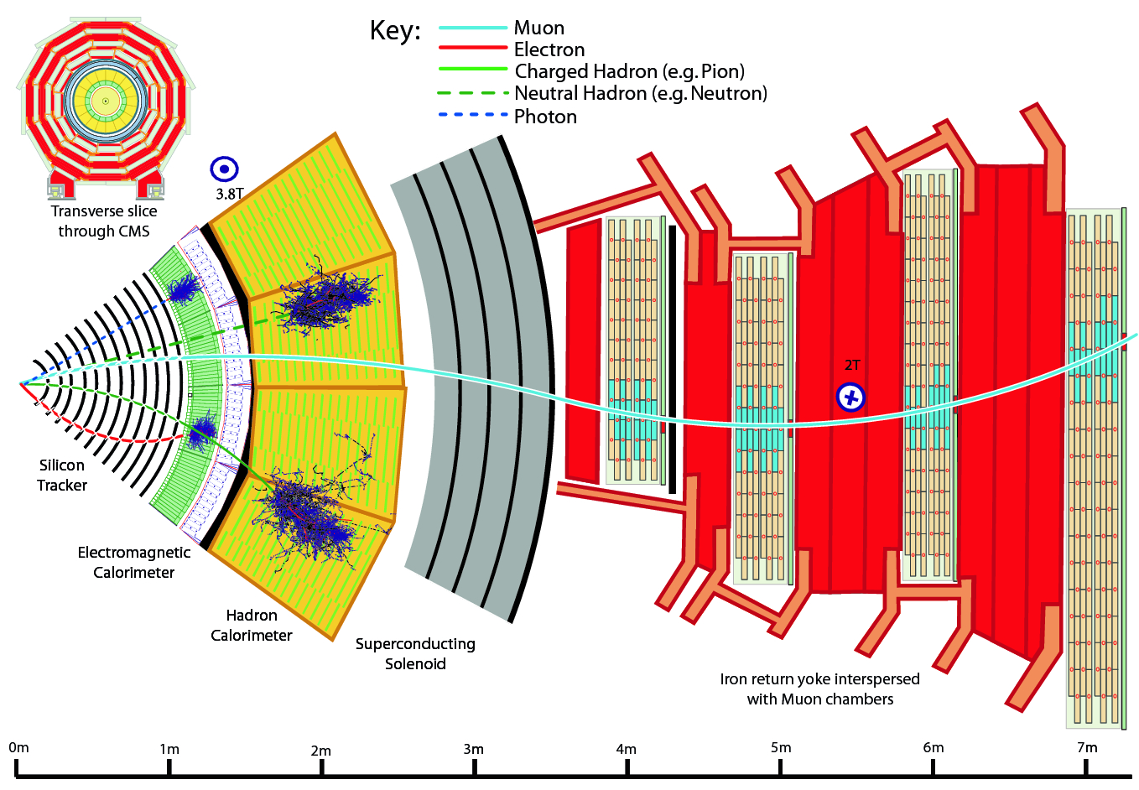
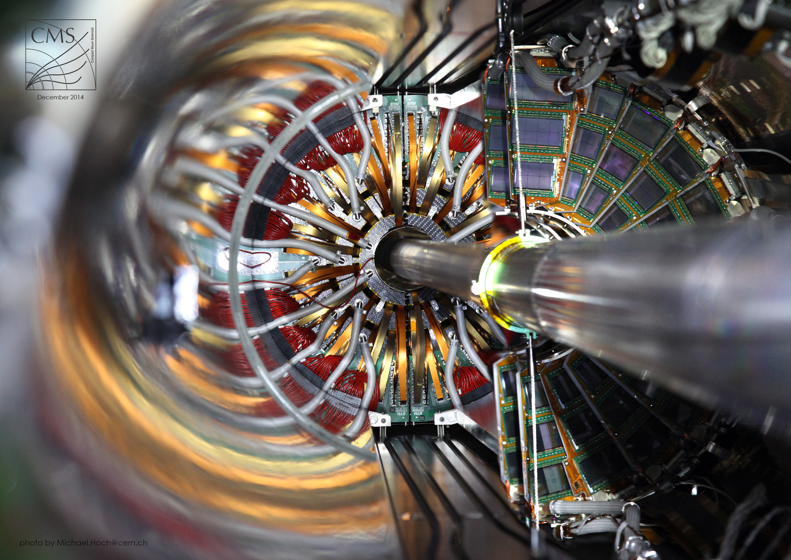

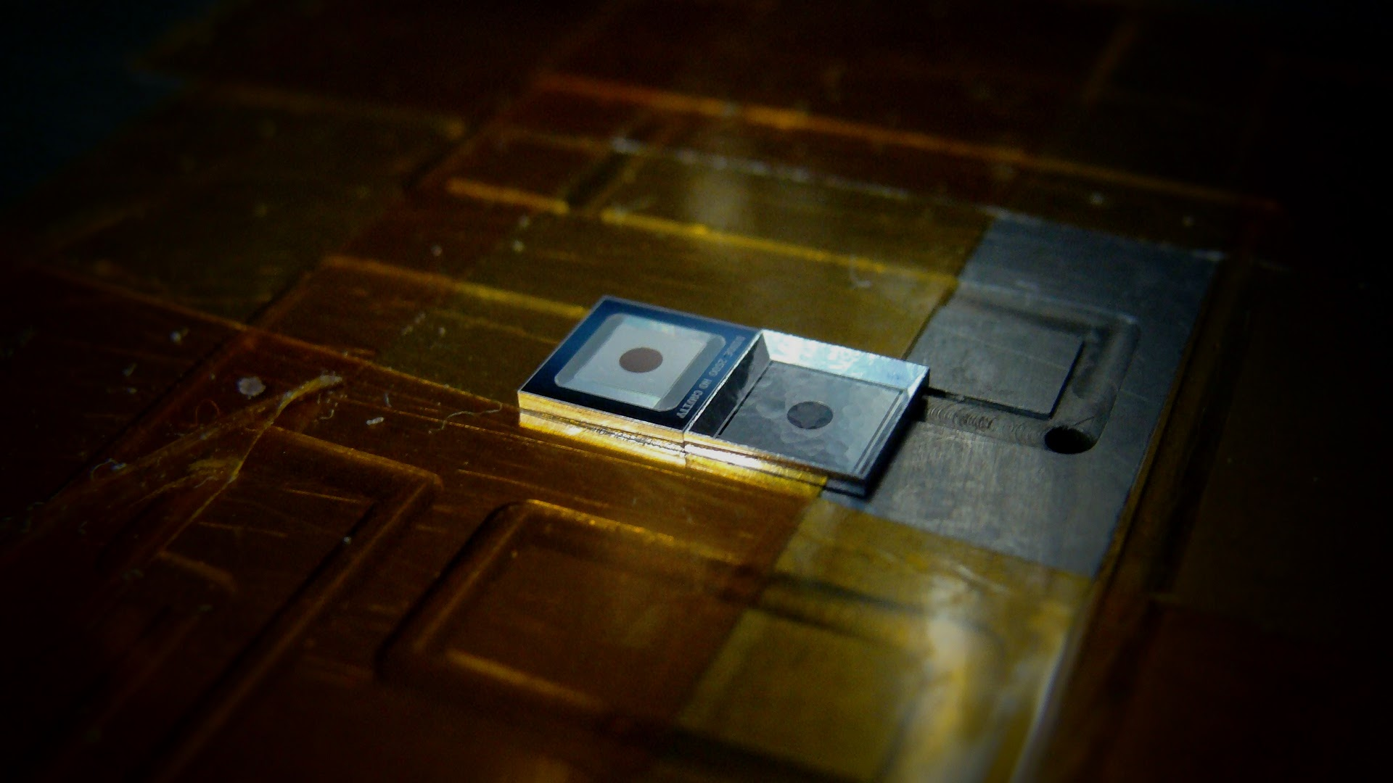
DETECTORS
Silicon Detectors in the LHC experiments
Détecteurs Silicium dans les expériences du LHC
The inner most detectors of the 4 LHC experiments are the silicon trackers. Their role is to resolve the trajectories of the many particles generated in the proton – proton collisions.
Why silicon?
Fine granularity at micrometric level.
Silicon detectors can live long in high radiation environments.
Sinergies with semiconductor industry.
Only moderate cooling required.
[French translation here] The inner most detectors of the 4 LHC experiments are the silicon trackers. Their role is to resolve the trajectories of the many particles generated in the proton – proton collisions.
Why silicon?
Fine granularity at micrometric level.
Silicon detectors can live long in high radiation environments.
Only moderate cooling required
The CMS Example L’Example de CMS
Outer Barrel (strip sensors)
Inner Barrel(strip sensors)
Inner tracker
The CMS detector Le détecteur CMS
Pixel sensor detail
Strip sensor detail
CMS in numbers
214 m² silicon strip sensors (11.4 million strips)
1m² pixel sensors (124 million pixels)
Journey of the different particle types in the detector
Comment les différentes particules voyagent dans le detecteur?
Pixel detector(pixel sensors)
Radiation Damage Dommage par radiation
20 000 000 000 000 000 / cm²
will be the cumulated flux of particles seen by the pixel detectors at the end of the High – Luminosity LHC lifetime.
[French] Will be the cumulated flux of particles seen by the pixel detectors at the end of the High – Luminosity LHC lifetime.
Little by little, these high energetic particles destroy the silicon lattice, changing the properties of the material and degrading the detector performance
[FRENCH]Little by little, these high energetic particles destroy the silicon lattice, changing the properties of the material and degrading the detector performance
The Solid State Detectors (SSD) Laboratory at CERN lis specialized in the characterization of irradiated silicon sensors and eads the RD50 collaboration , an international joint effort by more than 60 research institutes around the World to study radiation damage in Silicon detectors .
[French]The Solid State Detectors (SSD) Laboratory at CERN leads the RD50 collaboration , an international joint effort by more than 60 research institutes around the World to study radiation damage in Silicon detectors .
Simple test structures, very far away from the sophisticated detectors used in the LHC experiments, are used to study the fundamental properties of silicon
Radioactive source setup
Tests with radioactive sources mimic the detection of particles in the real experiments
IRRAD placeholder
Irradiation campaigns in facilities such as the CERN IRRAD facility allow , in few weeks, to damage the detectors at the HL-LHC levels.
TCT setup
Using lasers, we can create very precise 2D and 3D maps of detector features such as electric field, charge collection efficiency, etc.
Probe station placeholder
Electrical characterization of irradiated sensors helps predict how the operational parameters (Voltage, Current) will evolve during the detectors lifetime
DLTS setup
Electrical measurements from cryogenic to room temperatures give us information on the type of defects in the silicon lattice created by radiation.

