Slide 1

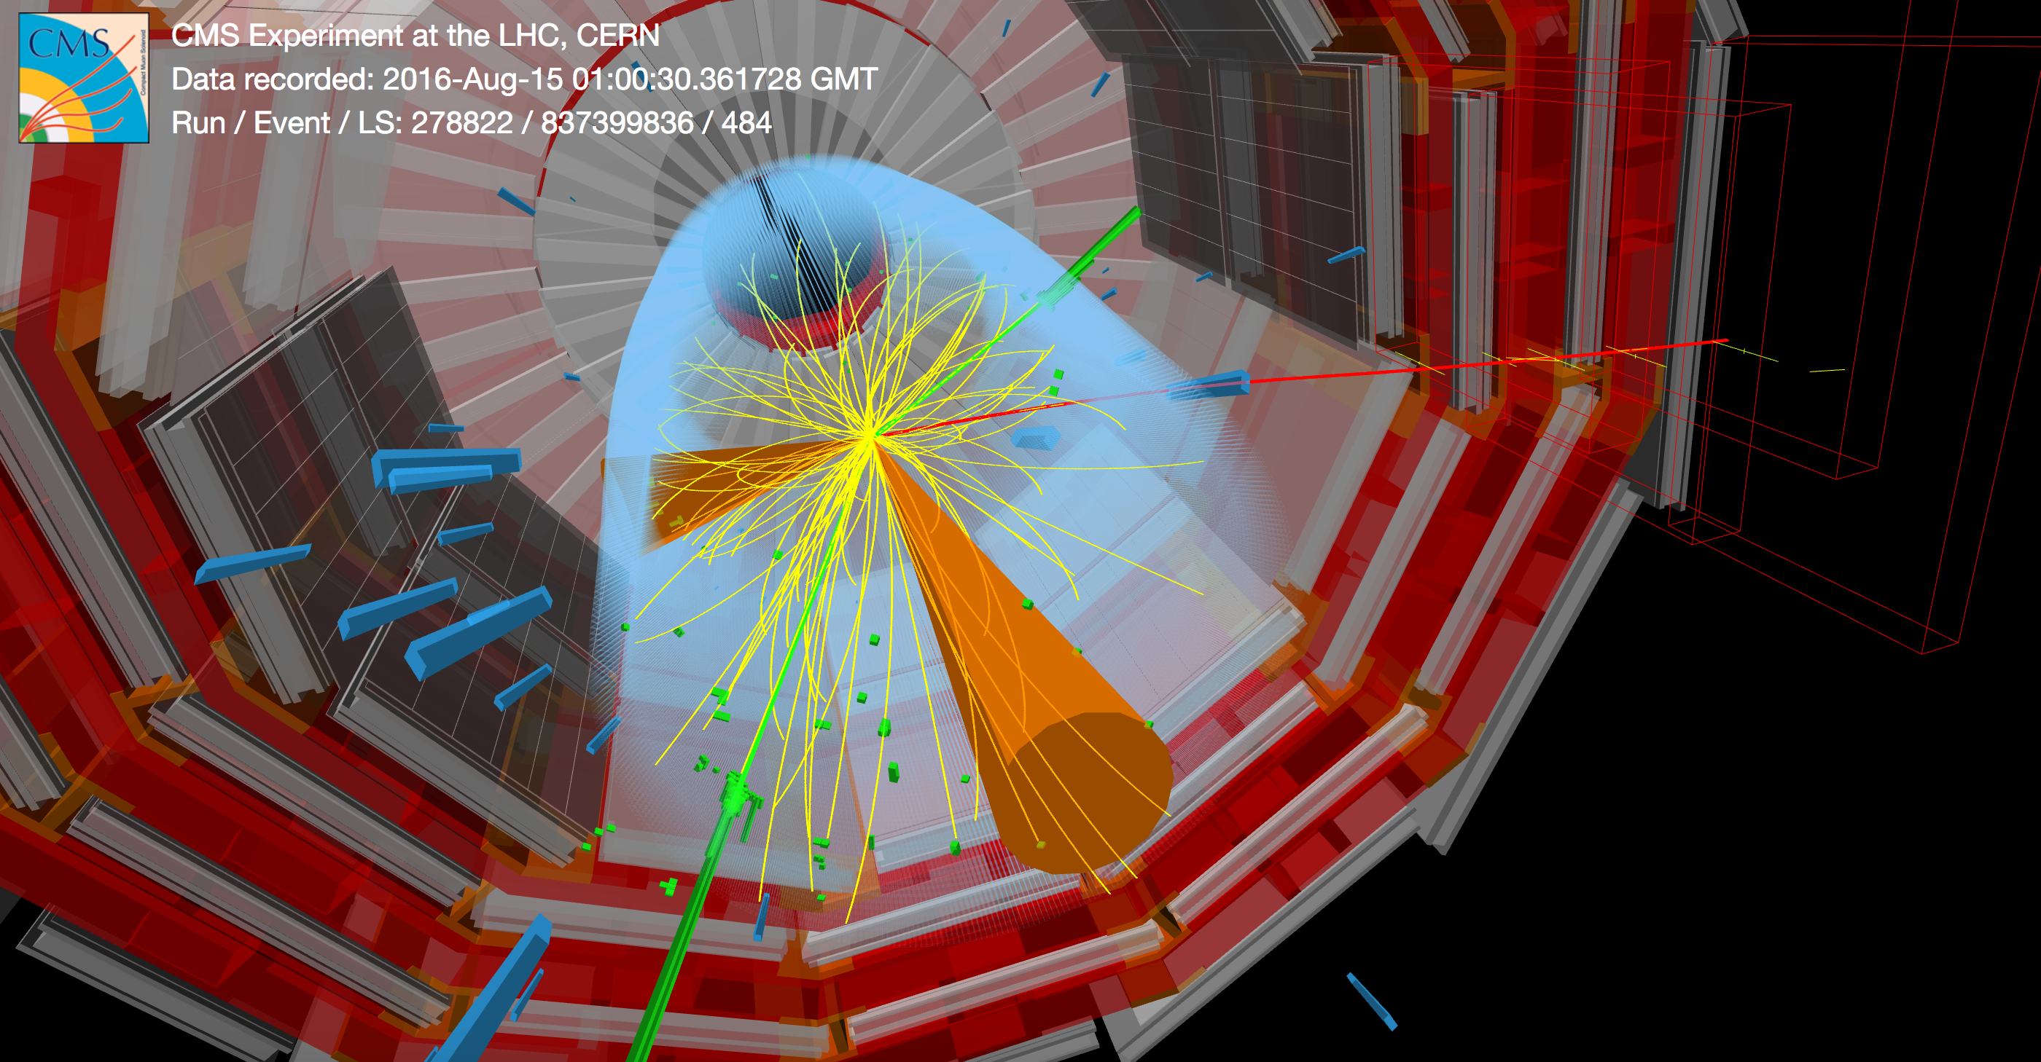
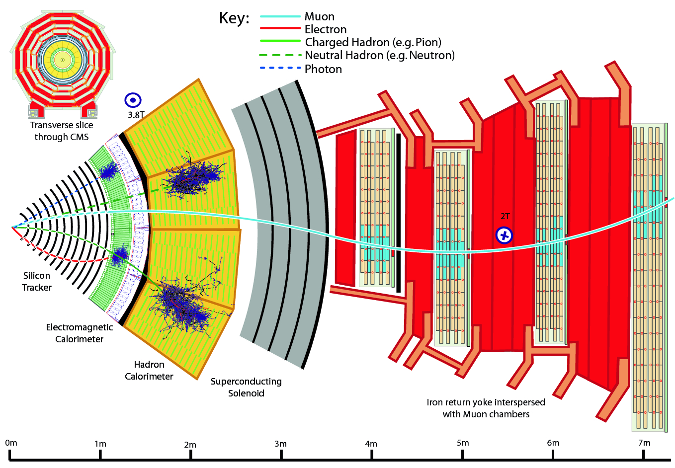
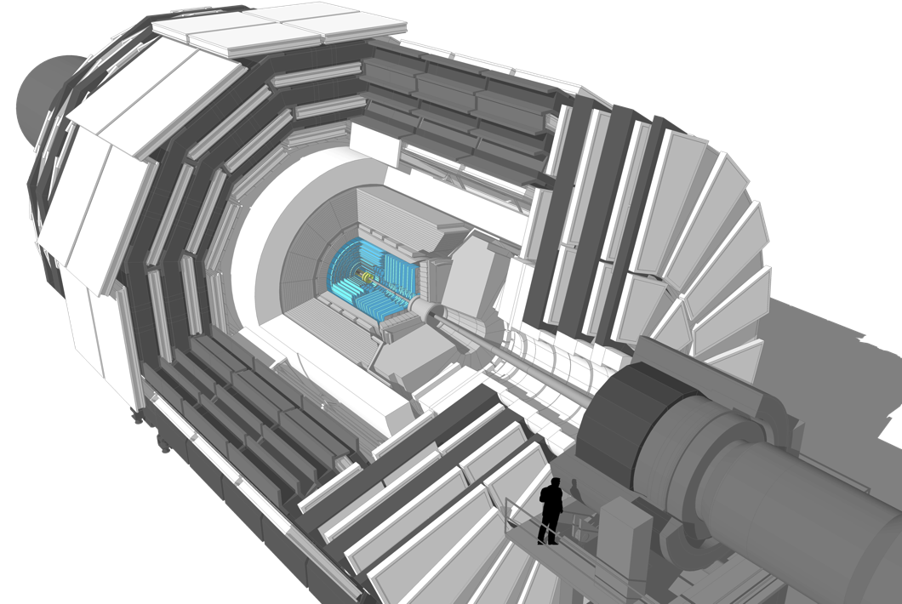
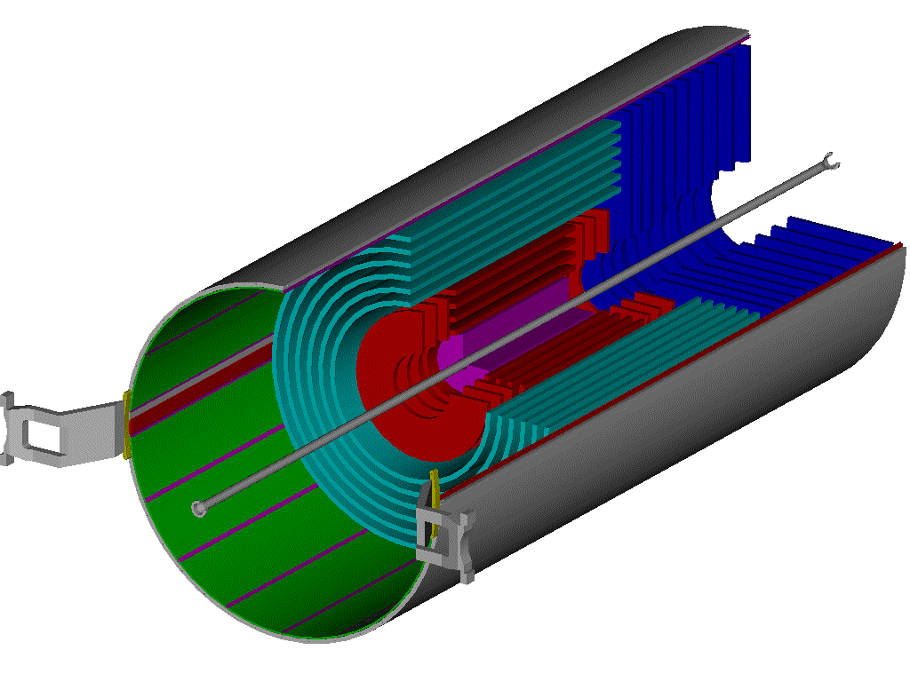
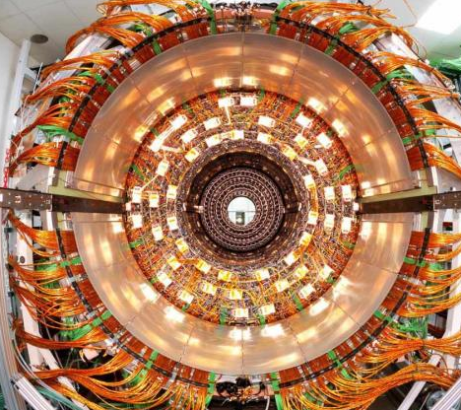
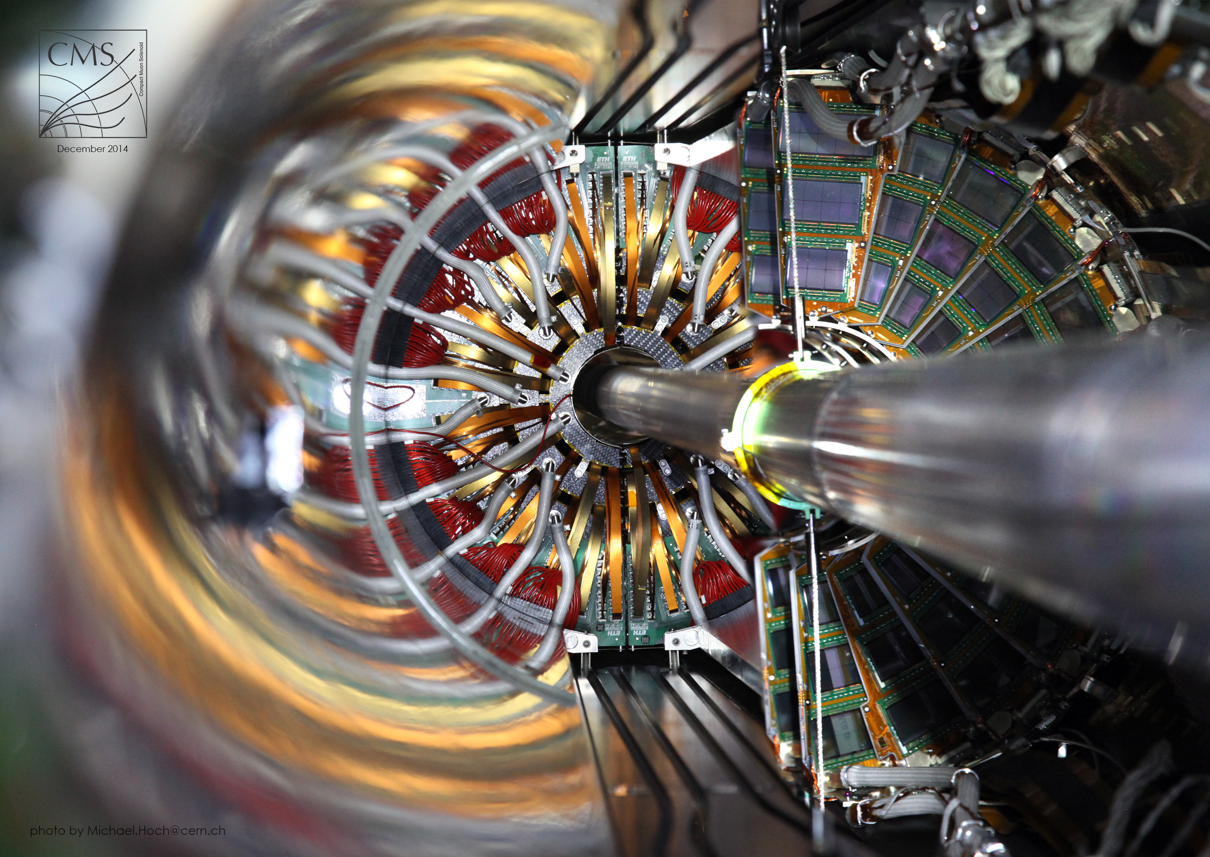
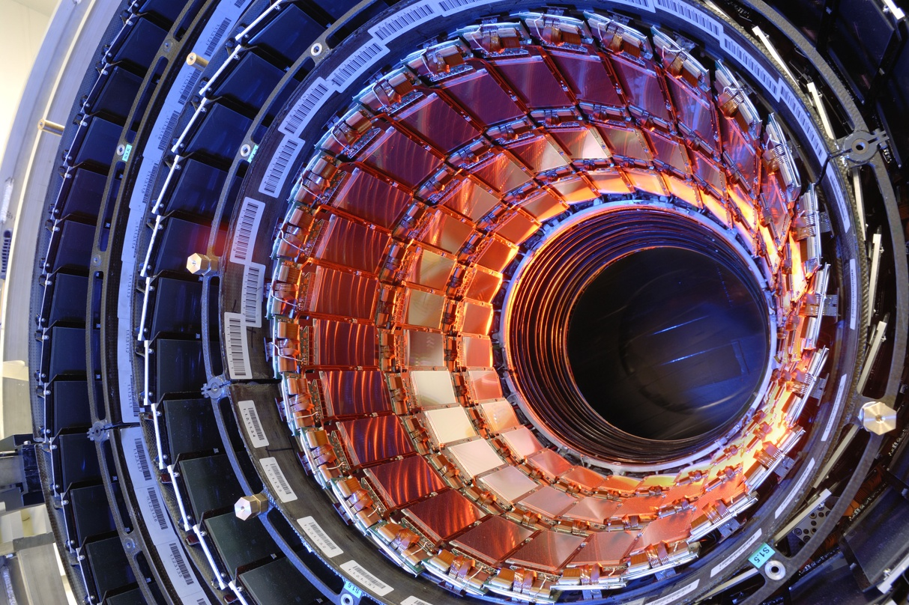

Silicon Detectors
40 million times per second, protons travelling in opposite directions cross at the center of the 4 main LHC experiments (ATLAS, CMS, ALICE and LHCb). Out of these collisions, millions of secondary particles are generated in all directions.
[French translation here] The inner most detectors of the 4 LHC experiments are the silicon trackers. Their role is to resolve the trajectories of the many particles generated in the proton – proton collisions.
To disentangle the paths followed by the different particles, silicon trackers are built at the very core of the LHC experiments. Like layers of an onion, thin layers of silicon sensors are disposed around the collision point. Each layer is segmented in millions of tiny pixel or strip sensors, thus providing a high resolution picture of the particle crossing positions. By combining the pictures of all the tracker layers, advanced computing algorithms are able to determine with high precision the path followed by the different particles.
[French translation here] The inner most detectors of the 4 LHC experiments are the silicon trackers. Their role is to resolve the trajectories of the many particles generated in the proton – proton collisions.
The CMS Example L’Example de CMS
CMS inner tracker
214 m² silicon strip sensors (11.4 million strips)
1m² pixel sensors (124 million pixels)
The CMS detector
Le détecteur CMS
Outer Barrel(strip sensors)
Pixel detector(pixel sensors)
Inner Barrel(strip sensors)

