Slide 1



Overview of HTS inserts built by other groups
Wroclaw, FP7 Meeting -Task 7.4
Jerome Fleiter (CERN, University of Grenoble)

Slide 2
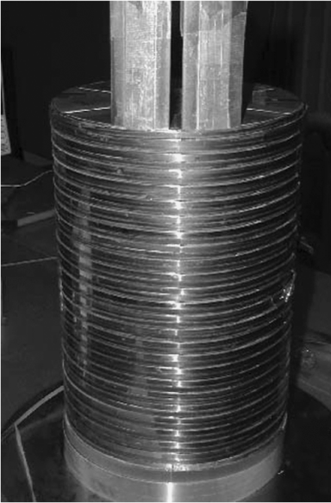
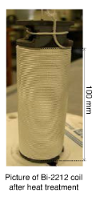
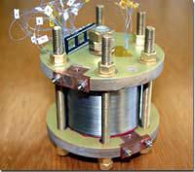
Summary
HTS solenoids tested
  Bi-2212 (R&W, W&R)
  Bi-2223 (R&W, W&R)
  Y-123 (R&W)
HTS dipoles tested
  Bi-2212 (W&R)
  Bi-2223 (R&W)
0.25m

Slide 3
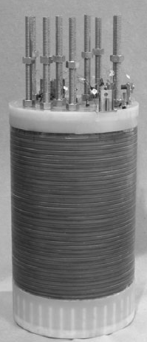
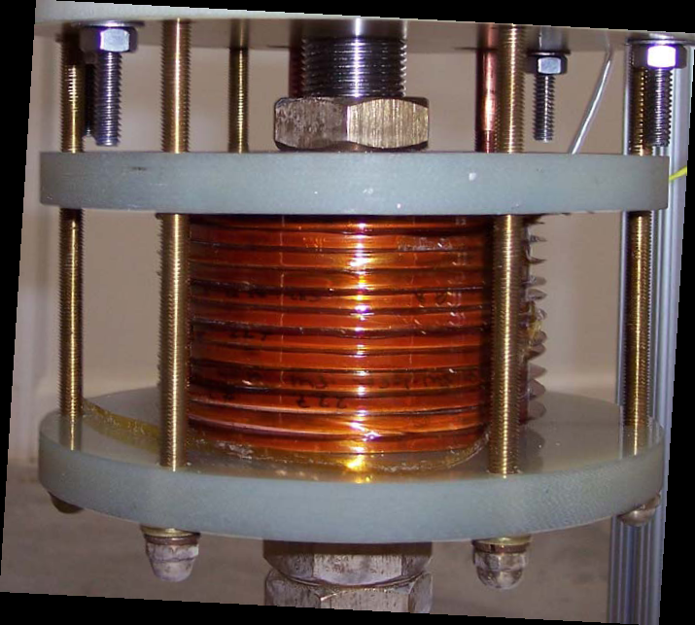
Laboratories where the insert were tested
FBML =Francis Bitter Magnet Laboratory, Cambridge USA
IHEP = Institute for High Energy Physics, Protvino Russia
IMR=Institute for Metals Research, Tohoku Japan
IST=Innova Superconductor Technology, Beijing China
ITP= Institute for Technical Physics, Karlsruhe Germany
KS=Kobe Steel ,Kobe Japan
LBL=Lawrence Berkeley National Laboratory, Berkeley USA
MTL= Material Technology Laboratory, Tokyo Japan
NHMFL=National High Magnetic Field Laboratory, Tallahassee USA
NRIM= National Research Institute for Metals, Tsukuba Japan
SRC=Superconductivity Research Center, Seongju-dong Korea
0.21m

Slide 4
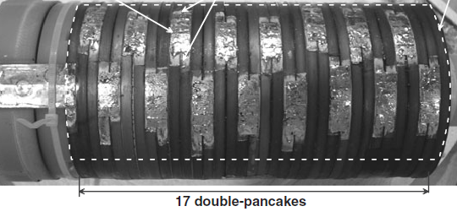
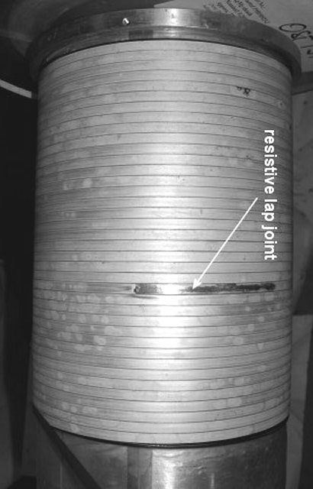
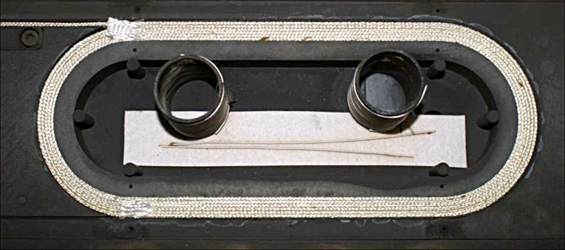
Winding solutions used
Solenoid
Dipole
Double Pancake stack
Layer coil
Racetrack
0.21m
0.3m
0.19 m

Slide 5
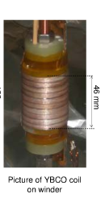
Y-123 solenoids R&W
Magnet parameters
Conductor
Year-Lab | Total (T) | Back ground (T) | From HTS (Stand Alone) (T) | ID-OD (mm) | Height (mm) | Coil constant (mT/A) | Io coil (A) | Winding solution | Materials (mm²) | Cond length ( m) | turn/turn Insulation | Impreg nation | TEMP | Je (A/mm²) | Coil Ic / Ic short sample
2009- NHMFL | 33.8 | 31 | 2.8 _ | 25-36 | 46 | 8.7 | >325 | DP (5) | Tape 4*0.1 Super Power | 36 | Varnish | NO | 4.2 | >459 | 60%
2009-NHMFL | 26.8 | 19 | 7.8 (9.8) | 19-87 | 52 | 44.4 | 175 | DP (6) | Tape 4*0.095 Super Power | 462 | Kapton | NO | 4.2 | 274 | _
2007-MTL | 1.1 | 0 | 1.1 | 60-110 | 144 | 2.7 | 400 | layer (14) | Tape 10*0.1 | 110 | _ | _ | 35 |  | _
2007-KS | 0.65 | 0 | 0.65 | 36-64 | 77 | 7.7 | 85 | SP(6) | Tape | _ | _ | _ | 65 | _ | _

Slide 6
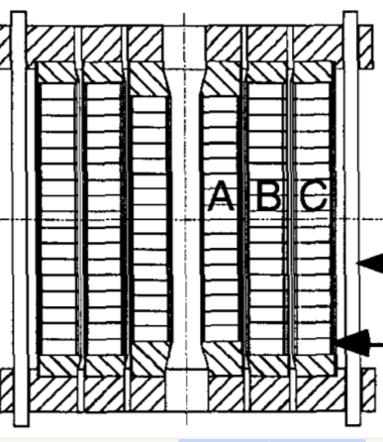
Bi-2212 solenoids R&W
All insert are impregnated
3 sections insert
Magnet parameters
Conductor
R &W Top=4.2K
Year-Lab | Total field (T) | Back ground field (T) | From HTS field (st. alone) (T) | ID-OD (mm) | Height (mm) | Coil constant (mT/A) | Io coil (A) | Winding Solution | Materials (mm²) | Cond length (m) | CO-WOUND | turn/turn Insulation | Je (A/mm²) | Coil Ic / Ic short sample
2004-NHMFL | 25.0 | 20 | 5.1 (6.6) | 41-96 106-146 156-165 | 185 185 209 | 23.7 14.7 2.7 | 120 | DP (17) DP (17) Layer (14) | Tape 5*0.2 OST 19 fil. | 801 1034 269 | Insulated SS Insulated SS SS 27um | 0.2mm Kevlar | 89 86 69 | _
1999-INHMFL | 20.9 | 19 | 1.9 (2.5) | 55-82 89-121 127-151 | 200 | 4.87 4.83 3.62 | 142 | layer (28) layer (30) layer (24) | 3*Tape 6*0.1 Coated both side | 528 854 924 | SS tape | Epoxy/ fiberglass | 42 40 41 | _
1997-NHMFL | 6.6 | 5.5 | 1.1 (1.2) | 63-138 | 76 | 8.2 | 125 | layer (-) | 3*Tape 6*0.1 Surface coated | 810 | 3*tape | epoxy | _ | _

Slide 7
Bi-2212 solenoids W&R
All insert are impregnated
Magnet parameters
Conductor
W & R Top=4.2K
 | Total field (T) | Back ground field (T) | From HTS field (st. alone) (T) | ID-OD (mm) | Height (mm) | Coil constant (mT/A) | Io coil (A) | Winding Solution | Materials (mm²) | Cond length (m) | CO-WOUND | turn/turn Insulation | Je (A/mm²) | Coil Ic /short sample | Jc oxyde A/mm2
2009- NHMFL | 32.1 | 31 | 1.1 | 15-38 | 100 | 9.1 | 120 | layer (10) | Wire 1 mm OST | 66 | _ | ceramic braid | 80 | 70% at 5T | _
2007- NHMFL | 19.5 | 19 | 0.47 (1.27) | 53-71 | 73 | _ | 80 | Layer (8) | wire 0.81 OST 85*7 | 83 | _ | ceramic | 109
2007- NHMFL | 20 | 19 | 1 (2.3) | 53-82 | 73 | _ | 125 | Layer (12) | wire 0.81 OST 85*7 | 133 | _ | ceramic | 170
2007- NHMFL | 19.7 | 19 | 0.74 (1.5) | 25-46 | 200 | _ | 100 | Layer (8) | wire 0.81 OST 85*7 | 132 | _ | ceramic | 127
2003-NIMS | 2.2 | 0 | 2.17 | 78-370 | 200 | 18.083333 | 120 | Layer | 2.3*1.18 660 filaments | 5240 | _ | Al203
2000-NRIM | 23.4 | 18 | 5.4 | 16-48 64-147 | 63 220 | 5.9 15.9 | 334 217 | DP (6) DP (20) | 2* Tape 5*0.24 55 fil. Tape 5*0.34 54 fil. | 34 1000 | _ 0.1 mm AgMgNi | Al2O3 0.1 mm Al2O3 0.1 mm | 112 73.9 | _ | _
2000-NRIM | 1.9 | 0 | 1.9 _ | 80-169 178-260 | 203 230 | 11.7 12.9 | 178 _ | layer | wire 1.8 wire 1.6 | 780 2265 | _ | Al203 | 89.5 113.8
1999-NRIM | 22.8 | 21 | 1.8 | 13-49 | 55 | 6.3 | 281 | DP (4) | Tape 5*0.15 PIT 54 fil. | _ | _ | Al2O3 0.1 *5 mm | 128 | _ | 951
1999-NRIM | 19.8 | 18 | 1.8 | 25-121 | 145 | 18.1 | 98 | DP (10) | Tape 5*0.15 PIT 54 fil. | _ | 0.1 mmAg- 0.5wt% Mg | Al2O3 0.1 *5 mm | 36 | _ | 294
1999-NRIM | 19.3 | 18 | 1.3 | 61-129 | 160 | 6.4 | 200 | DP (9) | Tape 5*0.35 PIT 54 fil | _ | 0.1 mmAg- 0.5wt% Mg | Al2O3 0.1 *5 mm | 54 | 30% | 570
1999 -NHMFL | 23.0 | 20 | 3 | 16-46 57-87 97-127 | 109 121 121 | 2.2 2.3 1.9 | 60 47 47 | DP (16) DP (17) DP (17) | Tape 3.0*0.20 Tape 3.1*0.20 Tape 3.1*0.20 OST 19 fil. | 198 488 764 | _ | _ | 75 56 56 | _ | _
1997-NRIM | 22.8 | 21 | 1.8 | 13-49 | 55 | 6.25 | 281 | DP (4) | 4*Tape 5*0.25 PIT 19 | 27.2 | _ | Al2O3 0.1 *5 mm | 130 | _ | 950
1997-NRIM | 21.7 | 21 | 0.7 | 13-46 | 40 | 2.2 | 330 | SP (1) | Tape 25*0.11 PIT 19 | 7.3 | _ | Mylar |  | _

Slide 8
Bi-2223 solenoids
Magnet parameters
Conductor
Top=4.2K *20K **4.5K ***1.8K ****40K
Year-Lab | Total (T) | Back ground (T) | From HTS (s. alone) (T) | ID-OD (mm) | Height (mm) | Coil constant (mT/A) | Io coil (A) | Winding Solution | HT | Materials (mm²) | Cond length ( m) | CO- WOUND | turn/turn Insulation | Impreg nation | Je (A/mm²) | Coil Ic /short sample | Jc oxyde A/mm2
*2009-SRC | 3.6 | 0 | 3.6 | 110-190 | 110 | 16.7 | 213 | DP(8) | R&W | tape ins 4.3*0.28 Sumitomo | 1140 | _ | Kapton | NO | 177 | _
**2007-IMR | 18.1 | 15.6 | 2.52 _ | 90-176 | 252 | 15.7 | 162 | DP (25) | R&W | Tape 4.3*0.21 _ | 3448 turns | SS 0.3 mm | _ _ | _ | 49 | _ | _
**2005-ITP | 16.9 | 11.5 | 5.4 _ | 50-185 | 177 | 35.4 | 151 | DP (16) | R&W | Tape - AMSC | 5402 turns | _ | Kapton _ | NO | _ | _ | _
2005-FBML | 15.9 | 14.1 | 1.75 _ | 78-126 | 401 | 20.1 | 87 | DP (48) | R&W | Tape 4.1*0.203 AMSC | 2194 | 2*SS 0.48um | Nomex 4.1*0.04 mm | NO | 59 | _ | _
2004-IST | 1.5 | 0 | 1.5 | 100-140 | 121 | 9.5 | 157 | DP(14) | R&W | Tape 3.43*0.21 PIT 37 fil. | 971 | _ | _ | epoxy | _ | _
2003-U. of Yonsei |  |  | _ | 100 |  |  | 122 | Layer (4) | R&W | Tape 4.1*0.3 AMSC | 3 | _ | Kapton |  | _ | _ | _
2003-FBML | 8.7 | 7.5 | 1.26 _ | 78-120 | 327 | 25.7 | 49 | DP (50) | R&W | Tape 3.1*0.17 AMSC | 2240 | 2SS 0.38um SS | Nomex 3.1*0.04mm | NO | 52 | _ | _
****2002-FBML | 0.21 | 0 | 0.21 | 75-107 | 47 | 10.5 | 20 | DP(6) | _ | Tape 3.2*0.23 | 252 | _ | _ |  | _ | _ | _
2001-U. of Durham | 1.5 | 0.3 | 1.18 (1.19) | 44-82 | 57 | 8.2 | 146 | DP (6) | R &W | Tape 3.3*0.33 PIT 37 fil. | 103 | _ | Kapton _ | Stycast | _ | 80% (strain) | _
1996-Sumitomo | 3.9 | 0 | 3.9 | 60-180 | 150 | 19.5 | 200 | DP | R&W | Tape Sumitomo |  | SS | Kapton |  | 67 | _ | 276
1995-FBML | 24.0 | 22.5 | 1.46 (2.3) | 40-108 | 113 | 12.6 | 116 | DP (17) | R&W | 3*Tape 3*0.2 Sumit.61 fil. | 1200 | 1SS 0.1 mm | Kapton | NO | 47 | <1 | 670
1995-NHMFL | 17.2 | 17 | 0.24 (0.57) | 26-46 | 76 | 4.3 | 56 | DP (5) | W&R | 2*Mono 6*0.11 _ | 100 | ceramic core | Ceramic | Epoxy | _ | _ | _

Slide 9
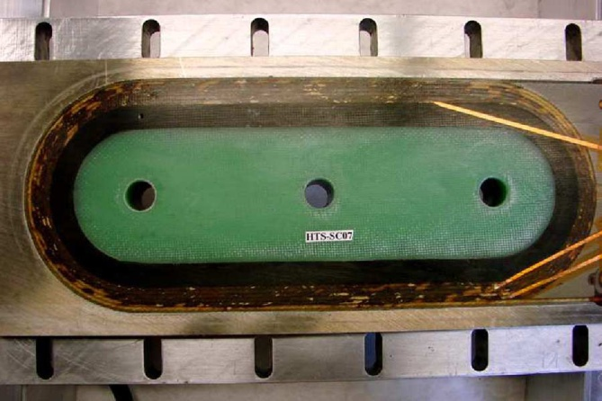
Bi-2212 dipoles W&R
Racetrack dipoles
0.3 m
Made at LBL between 2007 and 2010
Double pancake 6 turns Racetrack, Impregnated
17 strands Bi-2212 Rutherford Cable 1.46*7.80 mm²
W &R at 890deg in pure O₂
A design based on a measured strand Ic(4.2K,sf) of 400 A would give:
  2.6 T if the racetrack is stand alone, coil constant of 0.42 mT/A
  6.6 T if 2 racetracks are in dipole configuration

Slide 10
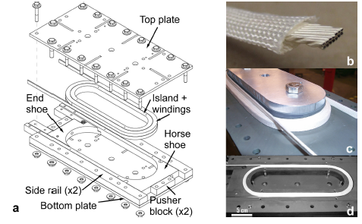
Bi-2212 Racetrack Dipole
extrapoled from Ic measurement on witness cable at 64K,
Ic Strand (4.2K,SF) =1.17*(Ic cable (64 K,SF)
Magnet parameter
Conductor
Top=4.2K
Year-Lab | Operational field (T) | Design field (T) | Expected field* (T) | Bo/Bd (1-total degradation) | Bo/Be | Be/Bd (1-cabling degradation) | Materials | Sleeve Sizing | Insulation | Confinement | Io coil (A)
2007-LBL | _ | _ | _ | _ | _ | _ | Showa | Present | Al2O3-SiO2 | Full | _
 |  |  |  |  |  |  | Untwisted
2007-LBL | 0.64 | 2.6 | _ | 25% | _ | _ | OST | ?? | Al2O3-SiO2 | Full | 1526
 |  |  |  |  |  |  | Untwisted
2007-LBL | 0.4 | 2.6 | 2.18 | 15% | 18% | 84% | Showa | 600deg/1hr | Al2O3-SiO2 | Full | 964
USA |  |  |  |  |  |  | Twisted
2010-LBNL | 0.72 | 2.6 | 1.03 | 28% | 70% | 39% | OST | 825deg/4hr | Al2O3-SiO2 | Full | 1711
 |  |  |  |  |  |  | Untwisted
2009-LBL | 0.43 | 2.6 | 1.97 | 17% | 22% | 76% | Showa | 825deg/4hr | Al2O3-SiO2 | No side | 1017
 |  |  |  |  |  |  | Twisted |  |  | No Top
2010-LBL | 1.11 | 2.6 | 1.48 | 43% | 75% | 57% | OST | 825deg/4hr | Al2O3-SiO2 | Full | 2636
 |  |  |  |  |  |  | Untwisted
2009-LBNL | _ | 2.6 | _ | _ | _ | _ | Showa | 825deg/4hr | Al2O3-SiO2 | No side | _
USA |  |  |  |  |  |  | Twisted
2009-LBL | _ | 2.6 | _ | _ | _ | _ | Showa | 825deg/4hr | Al2O3-SiO2 | No Top | _
 |  |  |  |  |  |  | Twisted

Slide 11
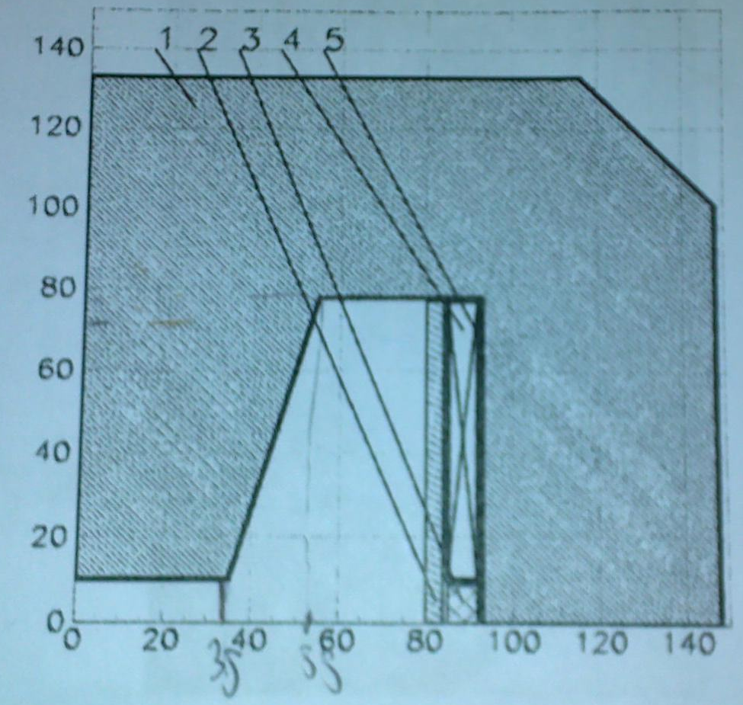
Bi-2223 dipole R&W
Racetrack dipole developed at IHEP (2002)
Magnet parameters
  Length
    straight part 400 mm
    Total 590 mm
  Pole
    width 70 mm
    Base width 110 mm
  Coil 6.8 mm*67 mm
  Gap between coils 21 mm
  Number of turns 712
  Iop=24 A -> 1T (4.2 K)
  Im =65 A -> 1.9T (4.2 K)
Conductor
  Bi-2223 Tape
  3.8 mm*0.25 mm 61 filaments
  Oxide insulation on the surface

Slide 12
Higher field inserts
Solenoid
Bi-2212
W->R : 5.4 T (in 18 T)
R->W : 5.1T (in 20 T)
Bi-2223
W->R : 0.2 T (in 0T) (only one)
R->W : 5.4T (in 12T)
Y-123
R->W : 7.8T (in 19 T)
Racetrack
Bi-2212
W->R :1.1T (in 0T)(stand alone)
W->R :2.5T* (in 0T) (dipole conf.)
*extrapoled from stand alone measured B with the
design scaling factor betwwen s.alone and dipole conf.
Bi-2223
R->W :1.9 T (in 0T)

Slide 13
Conclusions
A considerable number of both Y-123 and Bi-2212 solenoids were assembled and successfully tested
Very limited experience exists on dipole inserts.
Most of the insert are made with tape
In any case there is degradation from Ic short sample
The performance degradation of the Bi-2212 dipole inserts seems to indicate that moving from solenoid to dipole is not a straight forward extrapolation
Rutherford cable implies Ic degradation
Twisting of wires adds an additional degradation

Slide 14
Biblio
Bi-2223 solenoids
A High-Temperature Superconducting Double-Pancake Insert for an NMR Magnet
Haigun Lee, Juan Bascuñán, and Yukikazu Iwasa IEEE TRANS. APP. SUPERCOND, 13- 1546
Design and Test Results of 18.1 T Cryocooled Superconducting Magnet With Bi2223 Insert
Satoshi Hanai, Makoto Kyoto, Masahico Takahashi, Kenji Tasaki, Tsutomu Kurusu, Hiroyuki Takigami, Masami Urata, Gen Nishijima, Satoshi Awaji, and Kazuo Watanabe; IEEE TRANS. APP. SUPERCOND, 17-1422
Development and Test of a BSCCO-2223 HTS High Field Insert Magnet for NMR
Drew W. Hazelton and Joseph A. Rice, Yusuf S. Hascicek, Huub W. Weijers and Steven W. Van Sciver; IEEE TRANS. APP. SUPERCOND, 5- 234
An HTS Insert for Phase 2 of a 3-Phase 1-GHz LTS/HTS NMR Magnet
Haigun Lee, Emanuel S. Bobrov, Juan Bascuñán, Seung-yong Hahn, and Yukikazu Iwasa;IEEE TRANS. APP. SUPERCOND, 15-1299
Design, fabrication and performance of a1.29 T Bi-2223 magnet
A B Sneary, C M Friend and D P Hampshire Supercond. Sci. Technol. 14 (2001) 433–443
Manufacture and Test of a 5 T Bi-2223 Insert Coil
M. Beckenbach, F. Hornung, M. Kläser, P. Leys, B. Lott, and Th. Schneider;IEEE TRANS. APP. SUPERCOND, 15-1484
Characteristics of critical current of superconducting solenoidwound with the stacked tape
Min Cheol Ahn *, Seungje Lee, Min Chul Kim, Duck Kweon Bae, Chanjoo Lee,Minseok Joo, Tae Kuk Ko Cryogenics 43 (2003) 555–560
Development of a 1.5 T Ag-sheathed Bi-2223 magnet
Hongjie Zhang a,*, QingfuLi a, Jun Zong b, Ningbo Dong Physica C 412–414 (2004) 1235–1238
Fabrication and test results of 2 T conduction cooled HTS magnet
S. Kim *, M.H. Sohn, K. Sim, H.M. Kim, K.C. Seong, Y.K. Kwon, H.Y. Park, B.Y. EomPhysica C 469 (2009) 1799–1803
A ‘‘permanent’’ high-temperature superconducting magnetoperated in thermal communication with a mass of solid nitrogen
Benjamin J. Haid a,*, Haigun Lee a, Yukikazu Iwasa a, Sang-Soo Oh b, Young-Kil Kwon b,Kang-SikRyu bCryogenics 42 (2002) 229–244
High field generation using silver-sheathed BSCCO conductor
Ken-ichi Sato*, Kengo Ohkura, Kazuhiko Hayashi, Munetsugu Ueyama,Jun Fujikami, Takeshi Physica B 21611996) 258 260

Slide 15
Bi-2212 solenoids
The generation of 25.05 T using a 5.11 T Bi2Sr2CaCu2Ox superconducting insert Magnet;
HWWeijers, U P Trociewitz1, K Marken2, MMeinesz2, H Miao2 and J Schwartz , Supercond. Sci. Technol. 17 (2004) 636–644
Bi-2212rAg high-field magnets ;
M. Okada , K. Tanaka , T. Wakuda , K. Ohata , J. Sato, T. Kiyoshi, H. Kitaguchi, H. Wada Physica C 335 _2000. 61–64
Performance Tests of Bi-2212 Insert Magnets Fabricated by Ag Sheath Method and Dip-coating Method;
H. Kumakura, H. Kitaguchi, T. Kiyoshi, K. Inoue and K. Togano IEEE TRANS. APP. SUPERCOND, 7-646
HTS Insert Coils for High Field NMR Spectroscopy;
Drew W. Hazelton and Xing Yuan, Huub W. Weijers and Steven W. Van Sciver; IEEE TRANS. APP. SUPERCOND, VOL. 9-956
Generatian of 23.4 T Using Two Bi-2212 Insert Coils;
Tsukasa Kiyoshi, Michio Kosuge, Michinari Yuyama, Hideo Nagai arid Hitoshi Wada,; IEEE TRANS. APP. SUPERCOND, . 10-472
Fabrication of Bi-2212/Ag Magnets for High Magnetic Field Applications ;
Michiya Okada, Kazuhide Tanaka, Tsuyoshi Wakuda,Katsumi Ohata, Junichi SatoHiroaki Kumakura, Tsukasa Kiyoshi, Hitoshi Kitaguchi, Kazumasa Togano and Hitoshi Wada ; IEEE TRANS. APP. SUPERCOND, 9-920
Development of 3 T Class Bi-2212 Insert Coils for High Field NMR;
H.W. Weijers, Q.Y. Hu, Y.S. Hascicek, A. Godeke, Y. Vouchkov, E. Celik, J. SchwartzK. Marken, W. Dai, J. Parrell; IEEE TRANS. APP. SUPERCOND,. 9-563
HTS Insert Coils for Ultra High Field NMR Spectroscopy;
Drew W. Hazelton, Michael T. Gardner, John M. Weloth and Joseph A. Rice Leszek R. Motowidlo Yusuf S. Hascicek, Huub W. Weijers, W.Denis Markiewicz and Steven W. Van Sciver; IEEE TRANS. APP. SUPERCOND, 7-885
Conduction-Cooled Bi–2212–Ag Solenoid MagnetSystem With 50-mm RT Bore (III): Test Results
H. Morita, M. Okada, K. Tanaka, J. Sato, K. Ohata, H. Kitaguchi, H. Kumakura, K. Togano, K. Itoh, and H. WadaIEEE TRANSACTIONS ON APPLIED SUPERCONDUCTIVITY, VOL. 13, NO. 2, JUNE 2003
High Field Insert Coils FromBi-2212/Ag Round Wires
Hanping Miao, Kenneth R. Marken, Maarten Meinesz, Boleslaw Czabaj, Seung Hong, Andrew Twin,Paul Noonan, Ulf P. Trociewitz, and Justin SchwartzIEEE TRANSACTIONS ON APPLIED SUPERCONDUCTIVITY, VOL. 17, NO. 2, JUNE 2007

Slide 16
Y-123 solenoids
    Recent Developments in 2G HTS Coil Technology
  Drew W. Hazelton, Venkat Selvamanickam, Jason M. Duval, David C. Larbalestier, William Denis Markiewicz, Hubertus W. Weijers, and Ronald L. Holtz,IEEE TRANS. APP. SUPERCOND. 19-2218
Continued Developments in High Magnetic Fields Enabled by Second Generation High Temperature Superconductors
Hazelton, 2009, http://www.superpower-inc.com/
Fabrication Test of YBCO Coil and Multi-Tape Conductor
Takashi Hase, Mamoru Hamada, Ryoichi Hirose, Yasuhide Nagahama, Koji Shikimachi, and Shigeo Nagaya IEEE TRANSACTIONS ON APPLIED SUPERCONDUCTIVITY, VOL. 17, NO. 2, JUNE 2007
Development of Long Y-123 Coated Conductors forCoil-Applications by IBAD/PLD Method
Yasuhiro Iijima, Kazuomi Kakimoto, Yasunori Sutoh, Shoji Ajimura, and Takashi Saitoh, IEEE TRANSACTIONS ON APPLIED SUPERCONDUCTIVITY, VOL. 15, NO. 2, JUNE 2005
Preparation of conduction-cooled HTS coils using Y-123 coated conductors by IBAD/PLD process
H. Fuji *, S. Hanyu, K. Kakimoto, Y. Iijima, T. Saitoh; Physica C 463–465 (2007) 751–754
Development of Long Y-123 Conductor and Solenoid Magnet by IBAD/PLD Process
Hiroshi Fuji, Satoru Hanyu, Kazuomi Kakimoto, Yasuhiro Iijima, and Takashi Saitoh; IEEE TRANSACTIONS ON APPLIED SUPERCONDUCTIVITY, VOL. 17, NO. 2, JUNE 2007

Slide 17
Bi-2212 dipoles
Development of Wind-and-React Bi–2212 Accelerator Magnet Technology
Godeke, D. Cheng, D. R. Dietderich, C. D. English, H. Felice, C. R. Hannaford, S. O. Prestemon, G. Sabbi,, R. M. Scanlan, Y. Hikichi, J. Nishioka, and T. Hasegawa, MT 2007
Progress in Wind-and-React Bi-2212 Accelerator Magnet Technology
Arno Godeke, D. W. Cheng, Daniel R. Dietderich, C. R. Hannaford, Soren O. Prestemon, GianLuca Sabbi,, X. R. Wang, Y. Hikichi, J. Nishioka, and T. Hasegawa , IEEE TRANS. APP. SUPERCOND, 19-2228
Wind-and-react Bi-2212 coil development for accelerator magnets
AGodeke, P Acosta, D Cheng, D R Dietderich, MGTMentink, SOPrestemon, G L Sabbi, MMeinesz, S Hong, Y Huang, H Miao and J Parrell; Supercond. Sci. Technol. 23 (2010) 034022 (6pp)
Bi-2223 dipoles
Test results of HTS Diplole
A.I.Ageev,…..
IEEE TRANS. APP. SUPERCOND, 12-125

