Slide 1
EuCARD HFM
Wroclaw meeting
18-19/03/2010
Task 3 : High Field Magnet

Slide 2
Outline
Recall of the objectives of the Task
Working groups activities
Status
Global planning
Work for the next 6 months
Critical points
Conclusion

Slide 3
Recall of the objectives of the Task
Design, build and test a dipole model to upgrade the superconducting cable test facility FRESCA at CERN
  1.5 m long,
  100 mm aperture
  13 T magnetic field (with the possibility to go to 15 T for Fresca2)
  Nb3Sn high current Rutherford cables. The model will afterwards be used to from 10 T to 13 T
Dipole model as a test bed for large high field accelerator magnets.
What | Who
Magnet design | CEA and CERN
conductor characterization | CERN
thermal design and thermal component tests | PWR , with CERN and CEA
Coils fabrication | CEA
Magnet assembly | CERN
Cryogenic tests | CERN

Slide 4
Working Groups Activities
3 working groups identified :
  Specification Working Group
    Ezio Todesco; François Kircher; Gijs De Rijk; Jean-Michel Rifflet; Jean-Pierre Koutchouck; Luc Oberli; Maria Durante
  Magnet Predesign Working Group
    Ezio Todesco; Frank Borgnolutti; François Kircher; Françoise Rondeaux; Gijs De Rijk; Gleen Kirby; Jean-Michel Rifflet; Jean-Pierre Koutchouck; Maria Durante; Mélanie Bruchon; Pierre Manil; Attilio Milanese and Juan Carlos Perez must be added. + participation of Etienne Rochepault
  Cable Design Working Group
    Christophe berriaud; François Kircher; Françoise Rondeaux; Gijs De Rijk; Gleen Kirby; Jean-Michel Rifflet; Jean-Pierre Koutchouck; Luca Bottura; Luc Oberli and we would like to add Maria Durante

Slide 5
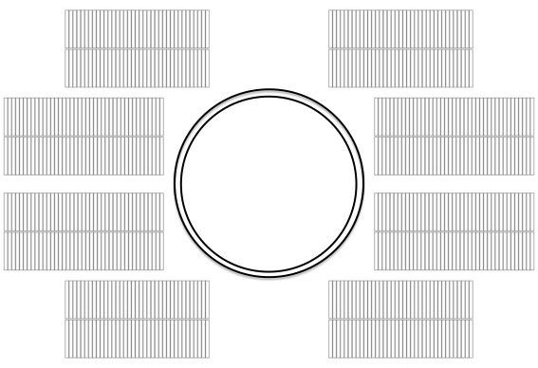
Specification Working Group
Works essentially by mail exchanges
The specification has been discussed and issued
The document will still evolve and is accessible at https://espace.cern.ch/EuCARD/WP7/SWGroup/Shared Documents/FRESCA2_magnet_specification-v2.0.docx
Content :
  EUCARD requirements (accelerator magnet)
  Fresca cable test station requirements (test magnet)
  Test station constraints : current and volume
  Furnace constraints : coil’s size
  Safety constraints : fringe field
  Cable specification
  HTS dipole insert
    >> Interface with HTS not yet clear
    >> New dedicated Working Group (already proposed by Gijs and Pascal

Slide 6
Magnet Predesign Working Group
Works with regular face to face meeting or phone conferences
Already 5 meetings have take place
  Comparison of cosθ and block configurations, mainly from mechanical point of view
  Comparison between different end shapes
  Definition and launching of a bending test
  Minutes available on the 7.3 Workspace
  New reference documents available on the 7.3 Workspace (MT21 and related projects documents)

Slide 7
Magnet Predesign Working Group
Cos-theta: model 2
azimuthal stresses
-130 MPa
Attilio Milanese

Slide 8
Magnet Predesign Working Group
Blocks: model 2
horizontal stresses
-122 MPa
Attilio Milanese

Slide 9
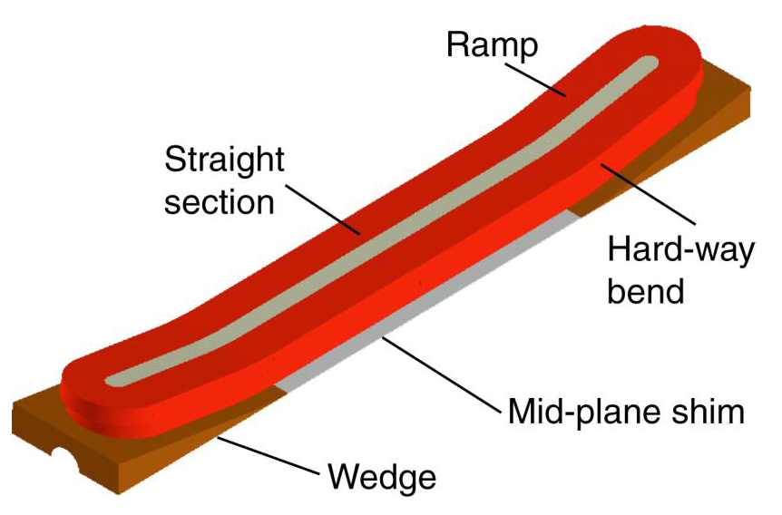
Magnet Predesign Working Group
Blocks layout: ideas for the ends
HD2 “flared ends”
R ~ 350 mm
10° angle
Attilio Milanese

Slide 10
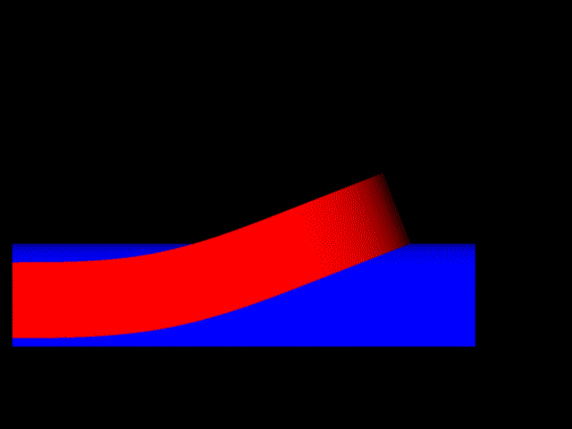
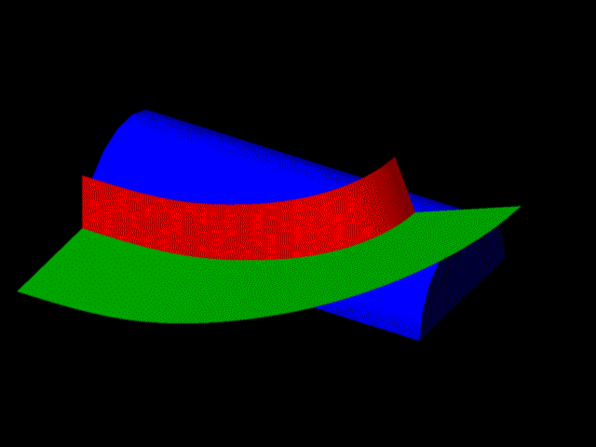
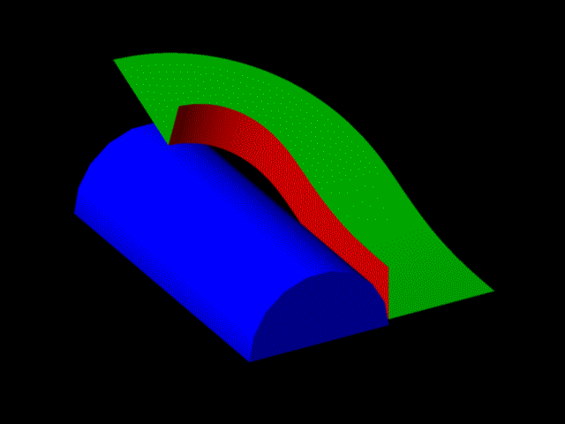
Magnet Predesign Working Group
Blocks layout: ideas for the ends
“Side”: double clothoid (curv. ∞ to 1/220 mm to ∞) + flat part
“Racetrack”: clothoid + circular arc
2 layers of cable
41 turns
Attilio Milanese

Slide 11
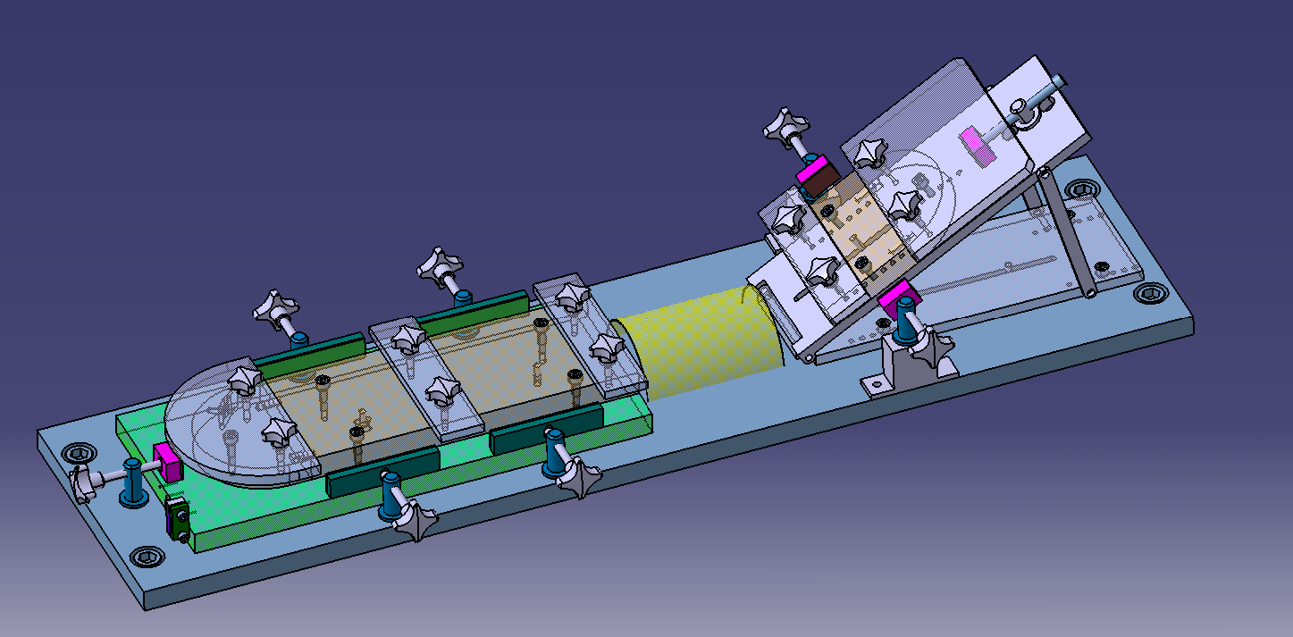
Magnet Predesign Working Group
We believe that if the winding of the block coils is possible, we can manage with mechanics
Pierre Manil
Bending test is planned 22-26 March at Saclay
Decision is to be taken by end of March

Slide 12
Cable Design Working Group
Works essentially by mail exchanges or dedicated meeting.
« Technical Specification for the superconducting Nb3Sn strand for the High Field Magnet program » to be used both for CEA and CERN calls for tenders: under final validation process CEA/CERN
Manufacturing process | PIT or ITD
Diameter | 1.000 ± 0.004 mm
Nominal sub-element diameter according to billet design | < 50 µm
Copper to non-copper volume ratio | 1.25 ± 0.10
Twist pitch | 24 ± 3 mm
Twist direction | right-handed screw
Critical current at 4.222 K at 15T | > 437 A
RRR (after full heat treatment) | > 150
n-value @ 15 T and 4.2 K | > 30

Slide 13
Cable Design Working Group
At CEA : Call for tenders preparation for ~10 km of qualification strand + 2 options for 20 km of final strand (French special contribution).
At CERN : Call for tender preparation for ~10km of qualification strand + 2 options for ~20 km of final strand.
Cable need for 1 pole : ~600 m → strand need /pole ~ 30 km
4 coils have to be wound (2 for HFM and 2 for French contribution to CERN) → ~120 km of strand
At the best 80 to 100 km will be available.
  Have we to foresee more procurements now ?
  funds ?

Slide 14
Global Planning
  Cabling at CERN : 1 month
  Total strand lengths needed for June 2011

Slide 15
Activities for next 6 months
Bending test at Saclay (MPWG) → next week
Magnet Design choice (MPWG) → 31/3
Dipole/Insert interface definition (SWG, MPWG) →31/3
MPWG → DWG → 01/4
Nb3Sn Strand commitment
Coil component characterization program → results in 1 year ?
Detailed magnet design :
  Manufacturing process (M. Durante, ?)
  Magnetic optimization (A. Milanese, M. Bruchon)
  Mechanical modeling and optimization (P. Manil, Attilio Milanese?, help of Etienne Rochepault)
  Manufacturing process (M. Durante, ?)
First Nb₃Sn racetrack coil (ceramic insulation) (June 2010)
Strong interaction needed

Slide 16
Critical points
Interaction with task 4 (HTS insert):
  The interface between Fresca2 and the insert is not totally defined
      Dedicated Working Group
Interaction with WP2
  Choice of NED insulation →
    Thermal modeling possible
    Losses coming from varying current
    No radiation resistance required
Only one furnace with adapted dimensions, located at CERN → organization between CERN and CEA to be found

Slide 17
Conclusions
3 working groups are defined and working efficiently:
  Specification WG
  Cable Design WG
  Magnet Predesign WG
The choice of magnetic configuration will occur end of march 2010
Procurement of Nb3Sn Strand in time
Detailed studies will start very soon
But :
  It is still mandatory to understand the bad behaviour of Nb3Sn Quad :
  Some critical points have to be solved

Slide 18
Milestones
 | EuCARD HFM Task3 Milestones (Start = 01/09/09) | EuCARD deliverable | EuCARD Milestone
M6 | EuCARD HFM Task3 Start
M12 | Internal Review for confirmation of magnetic configuration
M12 | 1st EuCARD Annual meeting
M18 | Start of detailled studies
M24 | 2nd EuCARD Annual meeting
M24 | End of detailled studies
M36 | 3rd EuCARD Annual meeting
M36 | End of coil winding |  | 7.3.1
M42 | End of magnet assembly |  | 7.3.2
M48 | 4th EuCARD Annual meeting
M48 | Magnet Test results | 7.3.1
Corrected to be in accord with Annex 1

