Slide 1


EuCARD-WP7-HFM meeting
18 March 2010
Progress in the design of the dipole
Attilio Milanese
Acknowledgements:
Gijs de Rijk, Ezio Todesco, Paolo Ferracin, Shlomo Caspi

Slide 2

Agenda
3 Preliminary considerations
15 Block design
2 4.2 K / 1.9 K
12 Cos-theta design
7 Effect of the iron

Slide 3
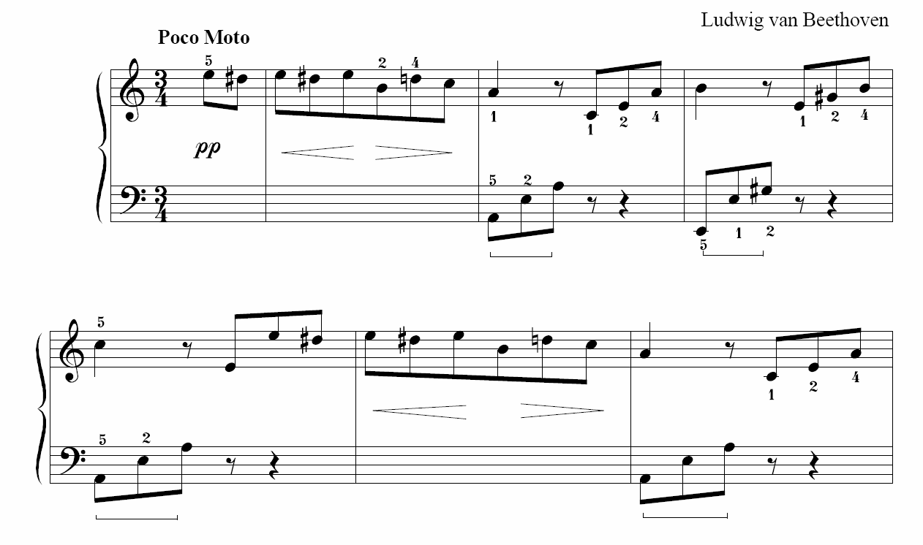
Notation
J_{c} = current density on the superconductor [A/mm²]
B_{c} = central (bore) field [T]
B_{ss, 4.2 K} = central field at the short sample limit, 4.2 K [T]
λ = peak field on the coil over central field [/]
b₃, b₅, b₇, … multipoles at 2/3 radius, i.e. 33.33 mm [/]
For mechanical analyses:
E = Young’s modulus [GPa]
ν = Poisson’s ratio [/]
μ = friction coefficient [/]

Slide 4
Data
Nb₃Sn strand, 1 mm
T = 4.2 K
J_{c} = 2500 A/mm² @ 12 T
J_{c} = 1250 A/mm² @ 15 T
Cu / non-Cu ratio = 1.25
Rutherford cable
40 strands, no keystoning
21.4 x 1.82 mm (bare)
21.8 x 2.22 mm (with 0.2 mm insul.)
filling factor κ = 0.289
100 mm

Slide 5

Critical surface fit
J_{c} = 2500*0.90 = 2250 A/mm² @ 12 T, 4.2 K
J_{c} = 1250*0.90 = 1125 A/mm² @ 15 T, 4.2 K
“extracted strand” J_{c}-fit with 10% degradation
(Summers I law)

Slide 6
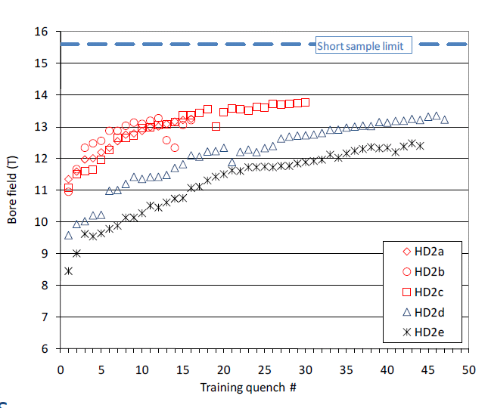
The blocks option
HD2
(61 turns)
36 mm
13.8/15.6 = 88%

Slide 7
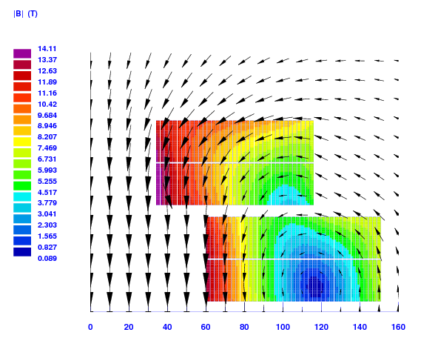
Blocks: where we were (Sept. 2009)
baseline 41-41-37-37
156 turns
B_{ss, 4.2 K} = 14.18 T
B_{ss, 1.9 K} = 15.37 T
I_{ss, 4.2 K} = 14.6 kA
= 1.086
b₃ = 0.0
b₅ = 0.0
b₇ = 1.8
L = 42.2 mH/m
E_{Bc = 13 T} = 3.8 MJ/m
(E_{LHC-MB} = 0.5 MJ/m)

Slide 8
Blocks: field quality or strength?
x₃
blocks_156_S
60 mm
blocks_156_Q
60 mm
y₁
Interlayer distance = 0.5 mm
Same number of turns per block
Optimizing the position for:
quality: cost = b₃² + b₅²
strength: cost = -B_{ss}
About 0.4-0.5 T between “good field” and “strong field” layouts.

Slide 9
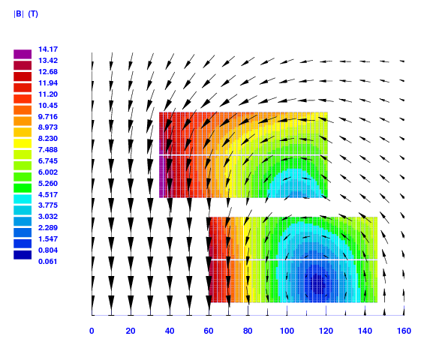
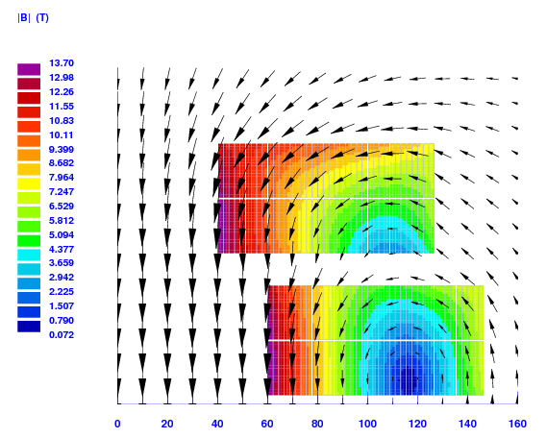
Blocks: field quality or strength?
blocks_156_Q
blocks_156_S
B_{ss, 4.2 K} = 14.04 T
I_{ss} = 13.8 kA
= 1.090
b₃ = -0.01
b₅ = -0.00
b₇ = -1.40
B_{ss, 4.2 K} = 14.46 T
I_{ss} = 13.6 kA
= 1.054
b₃ = 133.05
b₅ = 7.37
b₇ = 0.75

Slide 10
Blocks: field quality or strength?
Sensitivity analysis moving around a 39-39-39-39 …
blocks_156_Q at intersection of b₃ and b₅
blocks_156_S at top of B_{ss, 4.2 K}
b₃ “narrow”
b₇ “larger”

Slide 11
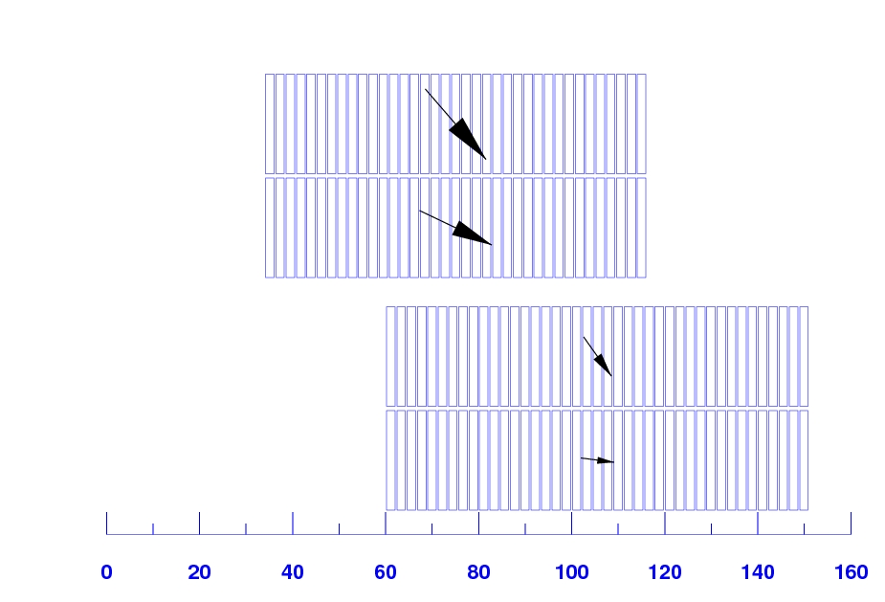
Blocks: Lorentz forces and stresses
baseline 41-41-37-37
Block | F_{x} [MN/m] | σ_{hor, ave} = F_{x}/w [MPa]
1 | 1.43 | 65
2 | 1.19 | 54
3 | 3.08 | 141
4 | 2.60 | 119
3.96
3.41
2.04
B_{c} = 13 T
1.44

Slide 12
Blocks: preliminary FEM for stresses
E_{coil} = 42 GPa
ν_{coil} = 0.3
E_{wedge} = 110 GPa
ν_{wedge} = 0.3
[copper alloy]
μ_{layer} = 1000
μ_{other} = 0.2
Lorentz forces strand by strand

Slide 13
Blocks: preliminary FEM for stresses
horizontal stresses
-122 MPa
B_{c} = 13 T

Slide 14
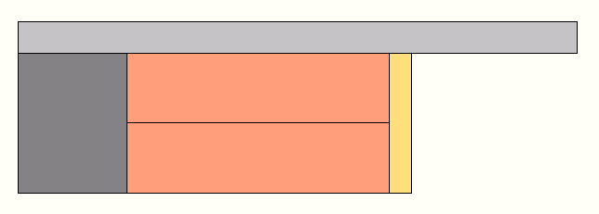
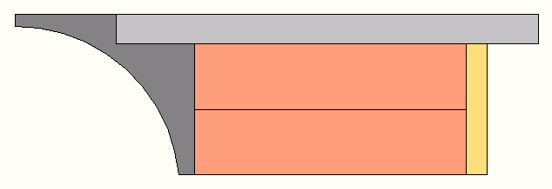
Blocks: ideas for the structure (2d)
Ti alloy / iron poles
bronze rail
coil, layer 4
coil, layer 3
Ti alloy poles
bronze rail
coil, layer 2
coil, layer 1

Slide 15
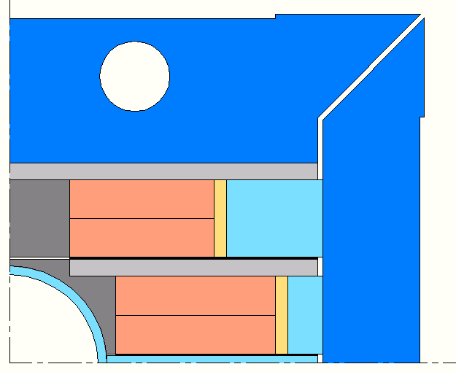
Blocks: ideas for the structure (2d)
vertical iron pad
steel rails
steel
tube
horizontal
iron pad
steel midplane shim

Slide 16
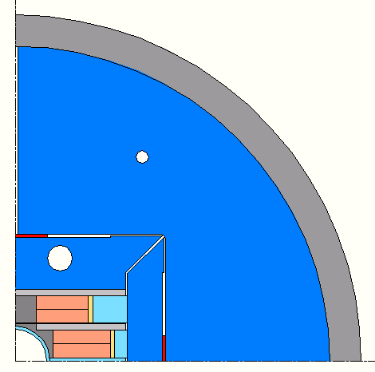
Blocks: ideas for the structure (2d)
horizontal bladder location
(split) iron yoke
Al alloy shrinking cylinder
vertical key
vertical
bladder location
horizontal key

Slide 17
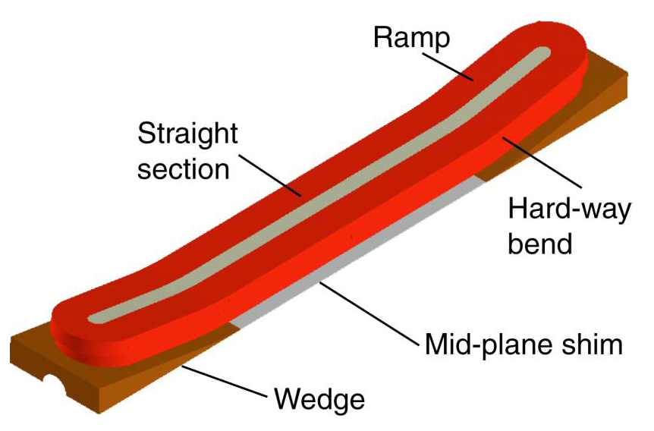
Blocks: ideas for the ends
HD2 “flared ends”
R ~ 350 mm
10° angle

Slide 18
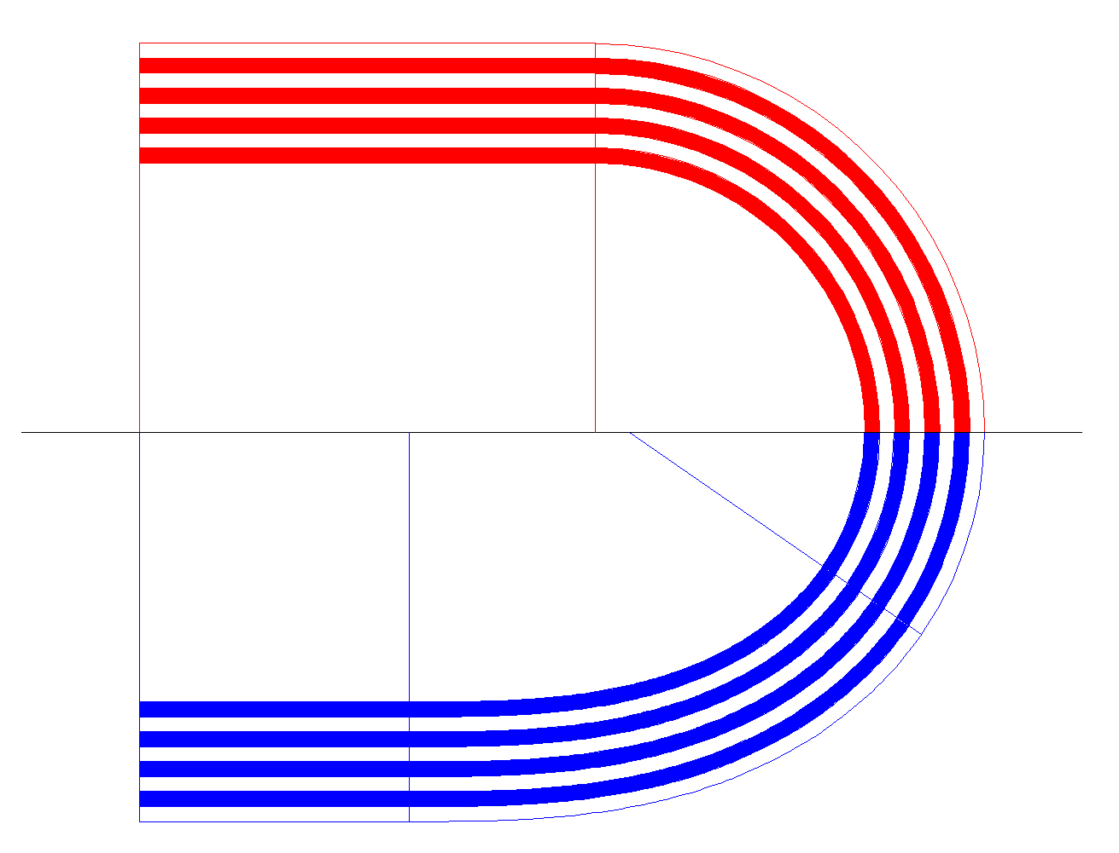
Blocks: ideas for the ends
Use transition curves that introduce gradual changes in curvature without discontinuities smoother.
Candidates:
clothoid
ellipse
superellipse
straight
arc
arc
straight
transition
curve

Slide 19
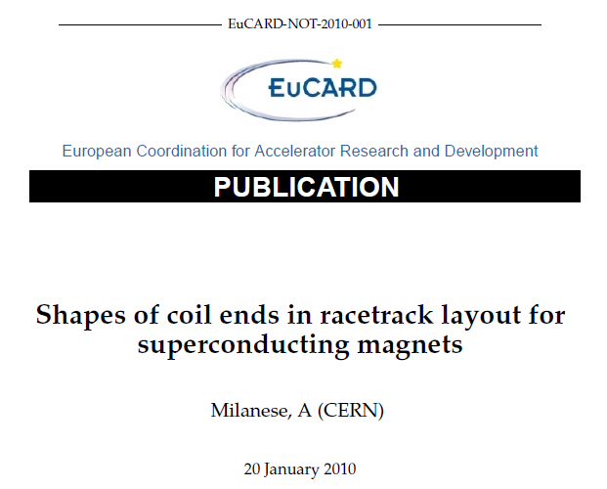
Blocks: ideas for the ends
“Proof of concept” winding tests planned at Saclay in late March 2010.

Slide 20
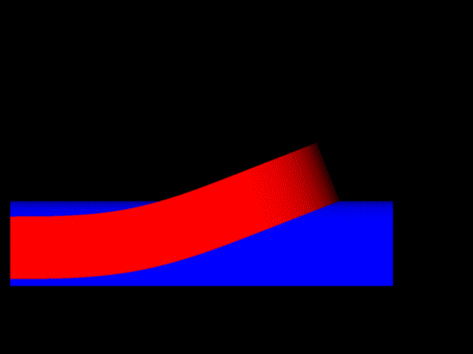
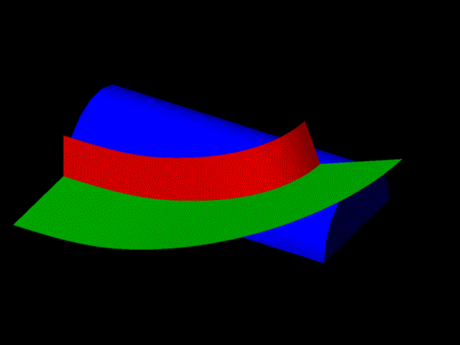
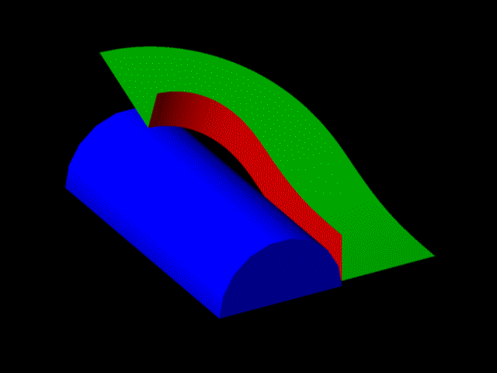
Blocks: ideas for the ends
“Side”: transition curves + flat part
“Racetrack”: transition curve + circular arc
2 layers of cable
turns

Slide 21

How much can we gain going from 4.2 K to 1.9 K?

Slide 22
4.2 K vs. 1.9 K
Using linear (“ironless”) load lines, the gain is about 8.3%.
With iron, the gain is slightly lower (7.5% with iron pole, pads and yoke).

Slide 23
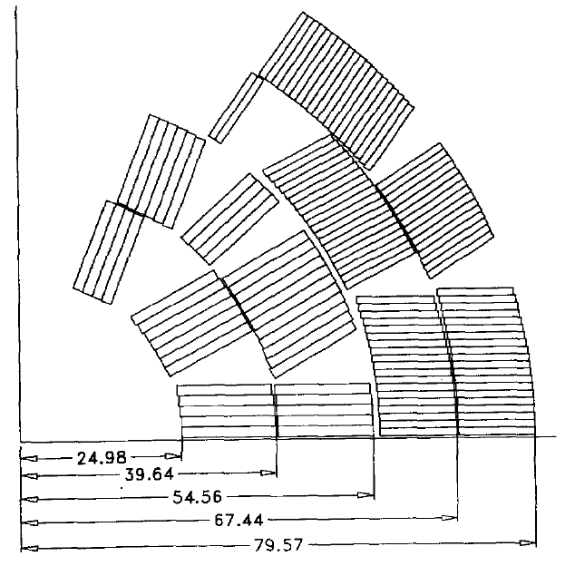
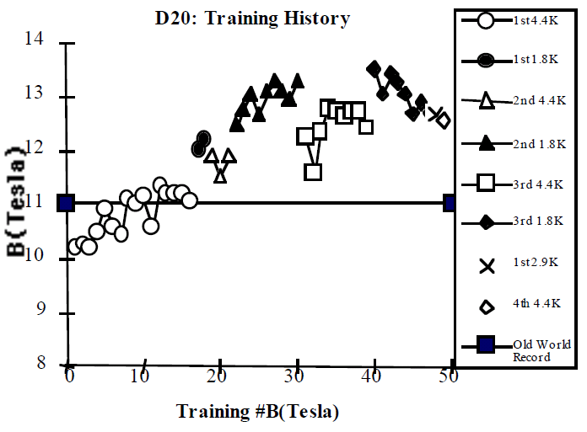
The cos-θ option
D20
(138 turns)
s.s. 4.2 K
12.5/14 = 89%

Slide 24
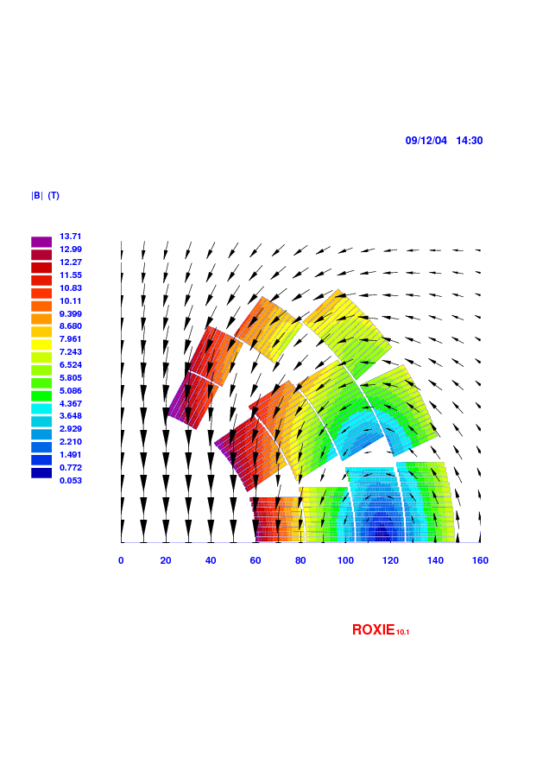
Cos-θ: where we were (Sept. 2009)
Baseline cos-θ with 4 layers (3-3-3-3)
156 turns
B_{ss, 4.2 K} = 14.57 T
B_{ss, 1.9 K} = 15.79 T
I_{ss, 4.2 K} = 14.6 kA
= 1.055
b₃ = 0.0
b₅ = 0.0
b₇ = 0.0
L = 41.7 mH/m
E_{Bc = 13 T} = 3.6 MJ/m
(E_{LHC-MB} = 0.5 MJ/m)

Slide 25
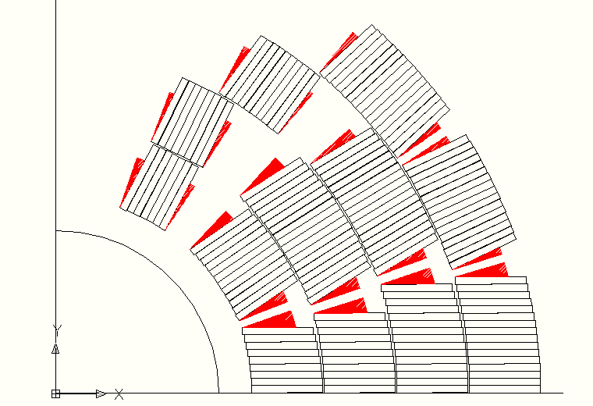
Cos-θ: where we were
The blocks are positioned “radially”.

Slide 26
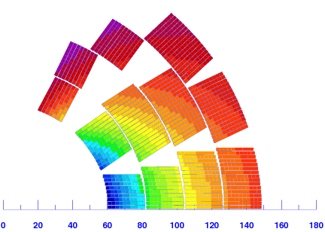
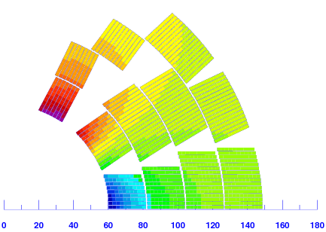
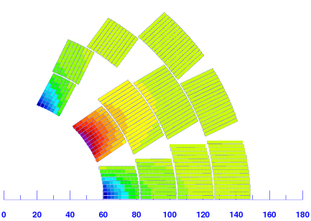
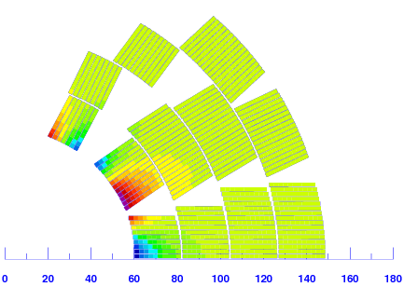
Cos-θ: who does what?
B₁
B₃
B₅
B₇

Slide 27
Cos-θ: field quality or strength?
Throwing away the “lazy” turns…
 | before | after
turns | 156 | 140
B_{ss} [T] | 14.57 | 14.56
λ [/] | 1.055 | 1.038
b₃ [/] | 0.00 | 96.5
b₅ [/] | 0.00 | -5.52
b₇ [/] | 0.02 | -0.03
b₉ [/] | 0.09 | 0.18
-7
-5
-4
B₁

Slide 28
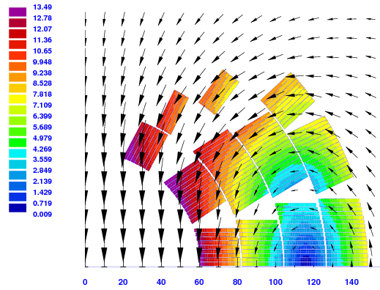
Cos-θ: field quality or strength?
156 turns
B_{ss, 4.2 K} = 14.57 T
I_{ss} = 14.6 kA
= 1.055
140 turns
B_{ss, 4.2 K} = 14.56 T
I_{ss} = 15.6 kA
= 1.038
b₃ = 0.00
b₅ = 0.00
b₇ = 0.02
b₃ = 96.47
b₅ = -5.52
b₇ = -0.03

Slide 29
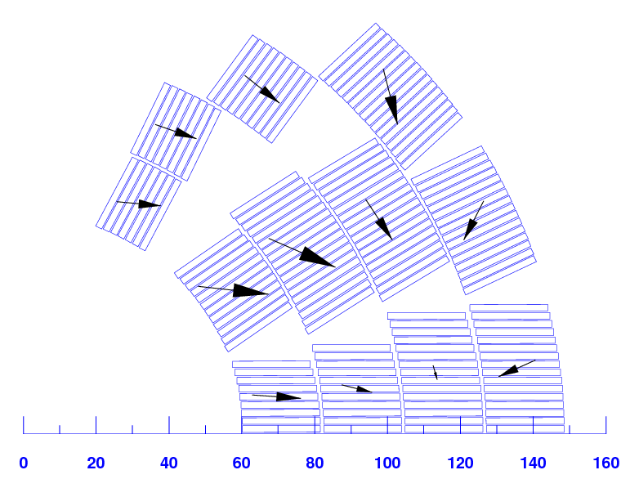
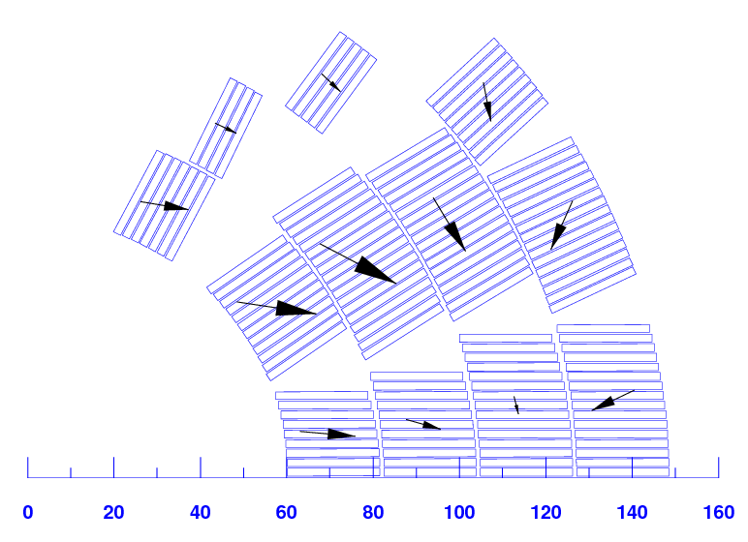
Cos-θ: Lorentz forces and stresses
before: 156 turns
after: 140 turns
B_{c} = 13 T
B_{c} = 13 T
Layer | ΣF_{θ} [MN/m] | mean σ_{θ} [MPa]
1 | 2.40 | 110
2 | 2.85 | 131
3 | 2.66 | 122
4 | 2.19 | 101
Layer | ΣF_{θ} [MN/m] | mean σ_{θ} [MPa]
1 | 2.66 | 122
2 | 2.64 | 121
3 | 2.50 | 115
4 | 1.99 | 91
For the azim. stresses on the midplane
mean σ_{θ} ~ ΣF_{θ}/w

Slide 30
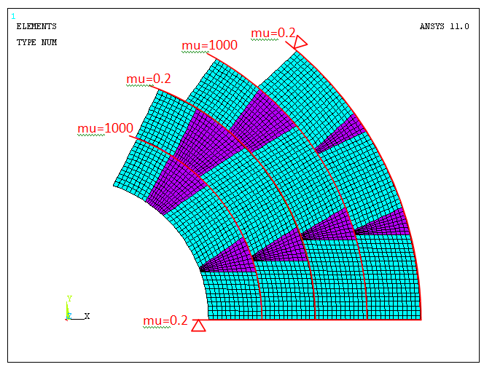
Cos-θ: preliminary FEM for stresses
E_{coil} = 42 GPa
ν_{coil} = 0.3
E_{wedge} = 110 GPa
ν_{wedge} = 0.3
[copper alloy]
Lorentz forces strand by strand

Slide 31
Cos-θ: preliminary FEM for stresses
azimuthal stresses
B_{c} = 13 T
-130 MPa

Slide 32
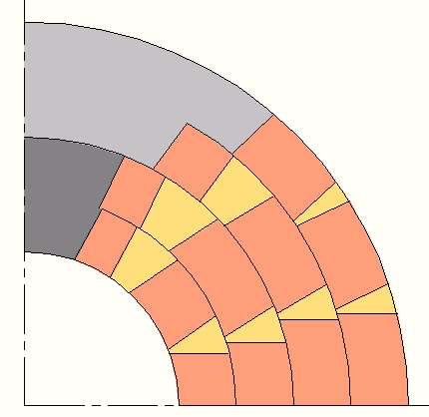
Cos-θ: ideas for the structure (2d)
coil
poles
Al bronze wedge

Slide 33
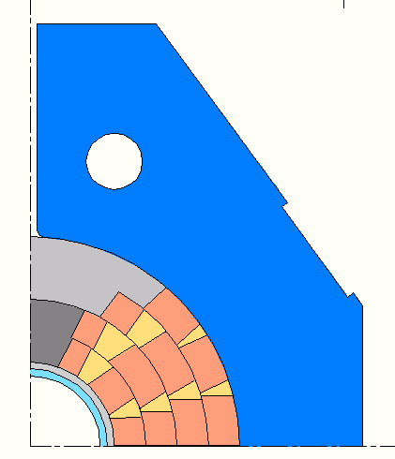
Cos-θ: ideas for the structure (2d)
iron pad
support
tubes
steel midplane shim

Slide 34
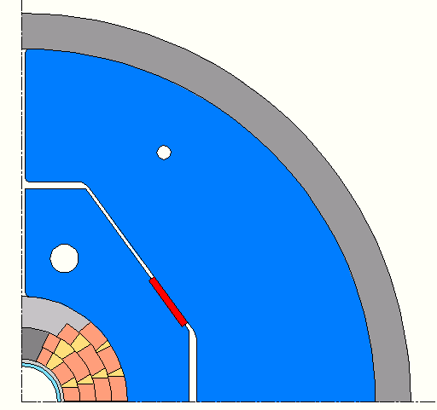
Cos-θ: ideas for the structure (2d)
Al alloy shrinking cylinder
split
iron yoke
key
bladder location

Slide 35
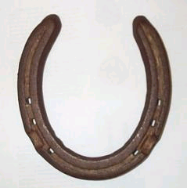
The effect of the iron

Slide 36
Iron contribution: blocks
r_{Fe} = 180 mm
relative permeability = 1000
B_{ss, 4.2 K} = 15.65 T (+8.2%)
BEM-FEM
LHC steel, saturation
B_{ss, 4.2 K} = 14.93 T (+5.3%)
(with baseline 41-41-37-37)

Slide 37
Iron contribution: cos-θ
r_{Fe} = 180 mm
relative permeability = 1000
B_{ss, 4.2 K} = 15.67 T (+7.5%)
BEM-FEM
LHC steel, saturation
B_{ss, 4.2 K} = 15.27 T (+4.8%)
(with baseline cos-θ 156 blocks)

Slide 38
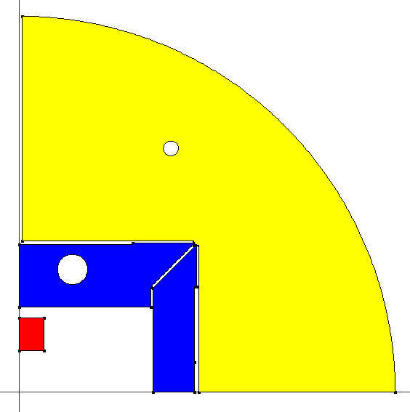
Iron effect in blocks design
yoke
The coil used is the baseline blocks 41-41-37-37.
pads
pole
55 mm
33 mm
500 mm

Slide 39
Iron effect in blocks design
BEM-FEM, LHC iron (with saturation)
(13.5 kA)
+10.4/9.5 %
(15.2 kA)
+6.6/6.1 %
(12.9 kA)
+4.0/3.7 %
(13.9 kA)
+1.3/1.2 %
(14.2 kA)
0 % (baseline)

Slide 40
Iron effect in blocks design
The multipoles are heavily affected by the iron pole.

Slide 41
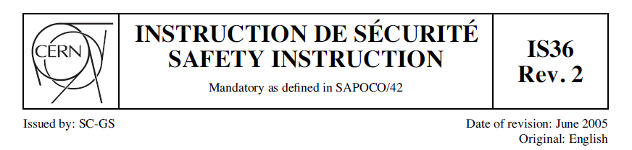
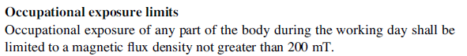
Iron effect in blocks design
B_{out} = maximum |B| 750 mm away from the bore
Case | B_{out} , B_{c} = 13 T | B_{out} , B_{c} = 15 T
blocks, no iron | 271 mT | 313 mT
pole | 268 mT | 310 mT
pads | 253 mT | 296 mT
pads & yoke | 156 mT | 205 mT
pole, pads & yoke | 152 mT | 200 mT
diameter yoke = 1.0 m

Slide 42
Thank you.

Slide 43
Blocks: field quality or strength?
x₃
n₁
Optimization with
2 continuous DOFs
n₁ + n₁ + n₁ + n₁ = 156
(n₁ = 39)
0.5 mm
n₁
60 mm
n₁
0.5 mm
n₁
y₁
60 mm
Field quality (b₃²+b₅²+b₇²)
y₁ = 6.3 mm, x₃ = 34.4 mm
B_{ss, 4.2 K} = 14.04 T
b₃ = 0.02, b₅ = 0.14
b₇ = -1.39, b₉ = -1.86
λ = 1.090
Maximum field (-B_{ss})
y₁ = 3.2 mm, x₃ = 40.1 mm
B_{ss, 4.2 K} = 14.46 T
b₃ = 133.03, b₅ = 7.44
b₇ = 0.76, b₉ = -1.11
λ = 1.054

Slide 44
Blocks: field quality or strength?
x₃
n₃
Optimization with
2 continuous DOFs
1 discrete DOF
n₁ + n₁ + n₃ + n₃ = 156
0.5 mm
n₃
60 mm
n₁
0.5 mm
n₁
y₁
60 mm
Field quality (b₃²+b₅²+b₇²)
n₁ = 26, n₃ = 52
y₁ = 4.2 mm, x₃ = 37.5 mm
B_{ss, 4.2 K} = 13.83 T
b₃ = -0.02, b₅ = 0.01
b₇ = -0.06, b₉ = -1.47
λ = 1.101
Maximum field (-B_{ss})
n₁ = 42, n₃ = 36
y₁ = 3.7 mm, x₃ = 39.1 mm
B_{ss, 4.2 K} = 14.46 T
b₃ = 125.59, b₅ = 7.07
b₇ = 0.43, b₉ = -1.25
λ = 1.054

Slide 45
Blocks: field quality or strength?
x₃
x₅
n₃
n₅
Optimization with
3 continuous DOFs
2 discrete DOFs
2 × (n₁ + n₃ + n₅) = 156
0.5 mm
n₃
n₅
60 mm
n₁
0.5 mm
n₁
y₁
60 mm
Field quality (b₃²+b₅²+b₇²+b₉²)
n₁ = 7, n₃ = 2, n₅ = 59
y₁ = 0.3, x₃ = 33.4, x₅ = 62.1 mm
B_{ss, 4.2 K} = 13.06 T
b₃ = 0.00, b₅ = 0.01
b₇ = 0.06, b₉ = -0.53
λ = 1.118
Maximum field (-B_{ss, 4.2 K})
n₁ = 39, n₃ = 1, n₅ = 38
y₁ = 4.1, x₃ = 33.46, x₅ = 37.9
B_{ss, 4.2 K} = 14.61 T
b₃ = 61.93, b₅ = 9.51
b₇ = 0.25, b₉ = -1.49
λ = 1.038

