Slide 1
LHC synchrotron light imaging system
“BSRT”
Run I-II and plans for Run III
LHC Beam Size Measurement Review
G. Trad on the behalf of BE-BI-PM
01/10/2019

Slide 2

CONTENT
System Introduction
Operational Experience in Run I/II
  Milestones and Challenges
  Optical System
  Cross-calibration
  Reliability
  Achieved Performance
Plans for Run III
Summary
G. Trad – LHC Beam Size Measurement Review
2

Slide 3
Introduction
Synchrotron radiation imaging system
Real time control system
Beam Emitted SR
SR Extraction
Optical System
Detector
Post-Process
BSRT MONITOR
SR focus for image formation.
Working point, magnification, & resolution:
(aberrations and diffraction)
2D distribution of photons.
Continuous, high rep rate acquisition
Sensitive
Profiles from images projections.
Fits .
Users displays
In-vacuum system dictated by machine aperture.
Critical beam interaction;
SR exposure.
Accurate source description.
(Especially when energy dependent)
System protection and cope with configuration changes
G. Trad – LHC Beam Size Measurement Review
3

Slide 4
Synchrotron radiation imaging system
Beam Emitted SR
SR Extraction
Optical System
Detector
Post-Process
BSRT MONITOR
G. Trad – LHC Beam Size Measurement Review
4

Slide 5
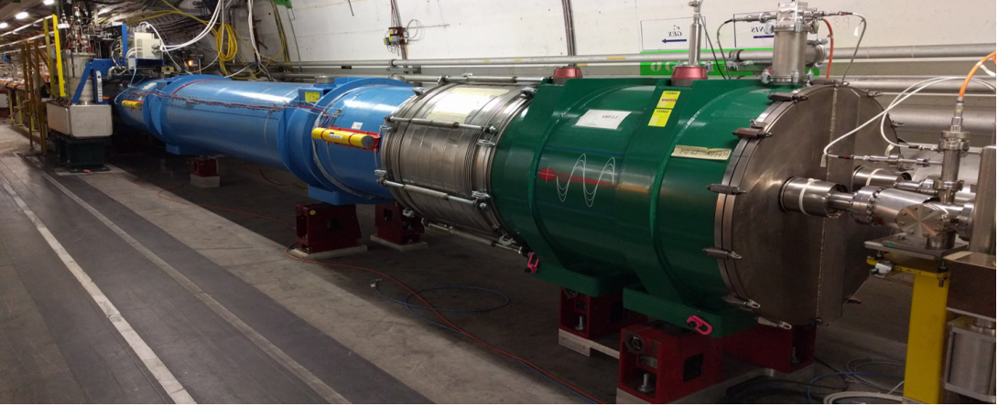
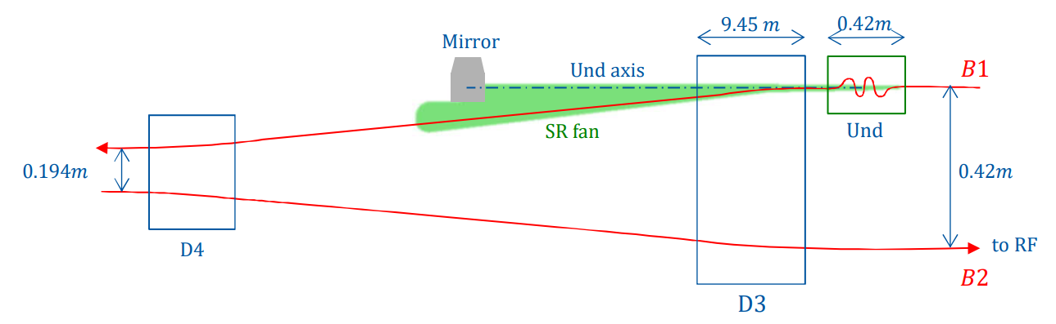
Visible SR in the LHC is emitted from:
an Undulator (5T superconductive, 2 periods of 28cm)
  Peak wavelength ~600 nm at 450 GeV
  Out of visible range ~0.8-1TeV
  Peak wavelength ~2nm at 7TeV
a D3 type dipole (~9.5m, 6Km bending radius)
  Edge radiation enters visible ~1 TeV
  Core radiation dominates visible >2-2.5 TeV
  Broadband radiation and DOF of few meters (~3m)
SR source
The LHC source is complex, with the energy change:
  Light intensity increase by 3 orders of magnitude
  Wavelength working point shifts from visible to NUV (intermediate energies = mix)
  Longitudinal position of the source shifts by ~3 m
  The source at high energy is longitudinally extended (few meters)
G. Trad – LHC Beam Size Measurement Review
5

Slide 6
Synchrotron radiation imaging system
Beam Emitted SR
SR Extraction
Optical System
Detector
Post-Process
BSRT MONITOR
G. Trad – LHC Beam Size Measurement Review
6

Slide 7
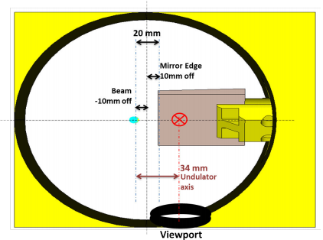
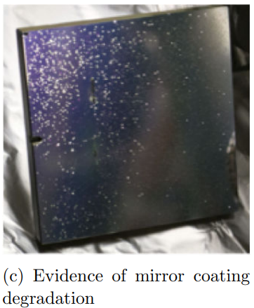
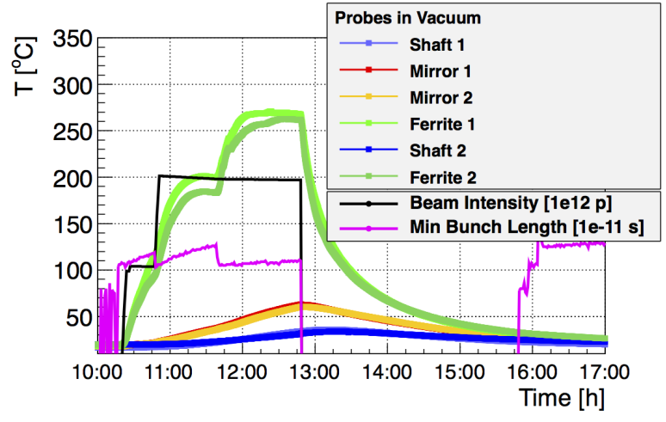
SR extraction
Light extraction:
Dictated by the minimum aperture to respect (distance beam mirror edge at injection).
Requested clearance (22mm: ~20 sigma) obtained at ~30 m after emission.
Problems in Run I:
Mirror heating due to beam coupling impedance resulted in mirror coating damage and mechanical structure failure.
G. Trad – LHC Beam Size Measurement Review
7

Slide 8
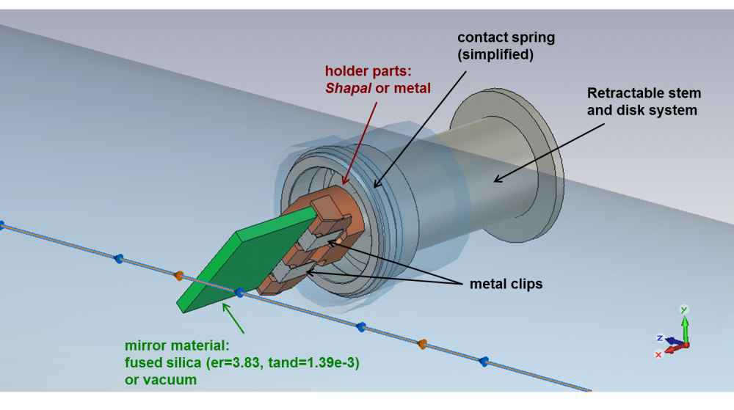
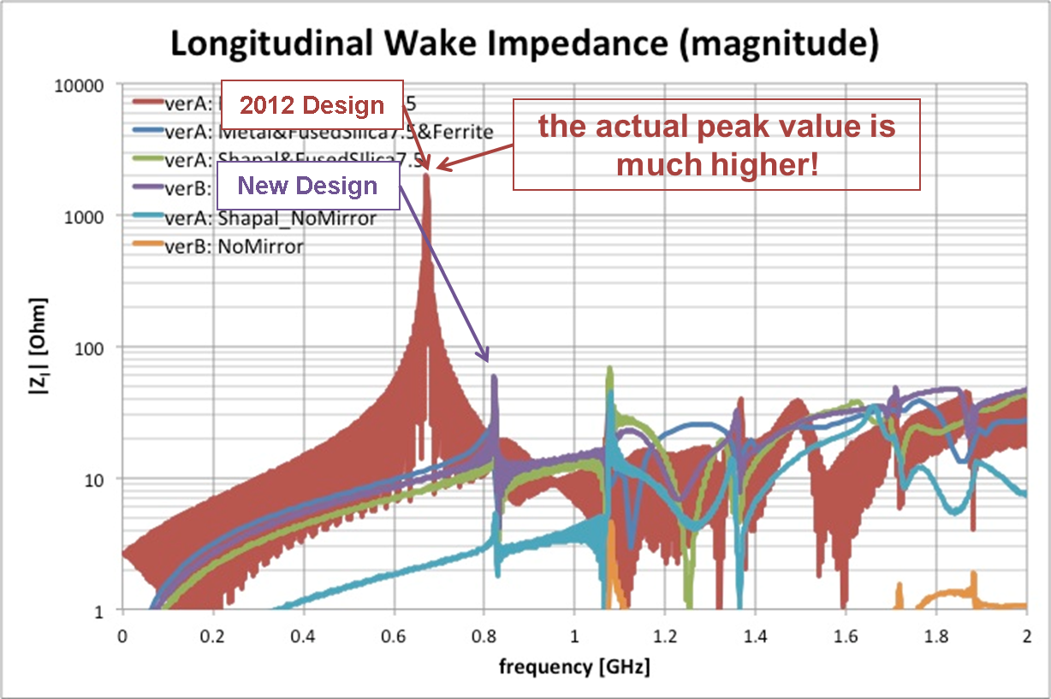
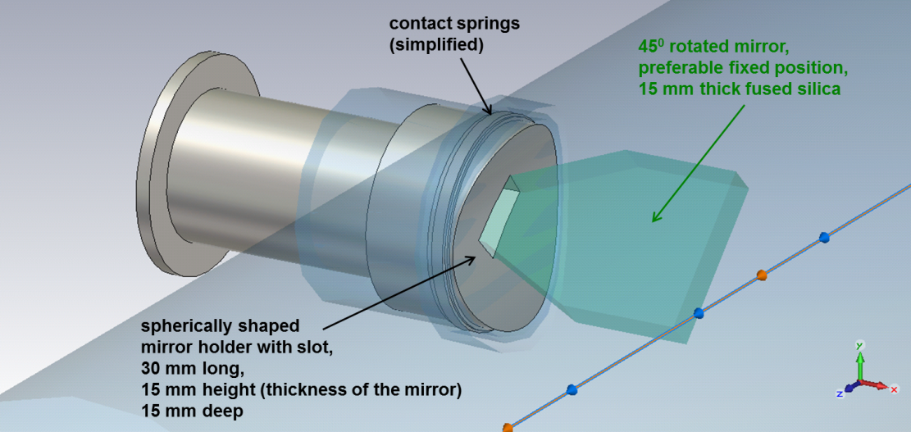
Extraction mirror support redesigned for Run II:
SR extraction
OLD Extraction Mirror
Reduced beam coupling impedance by design
No heating issues observed in Run II
NEW Extraction Mirror
G. Trad – LHC Beam Size Measurement Review
8

Slide 9
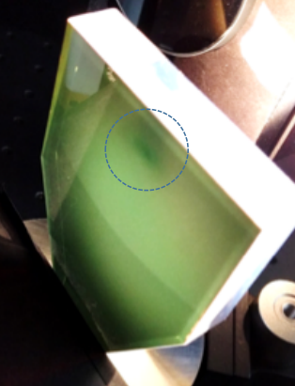
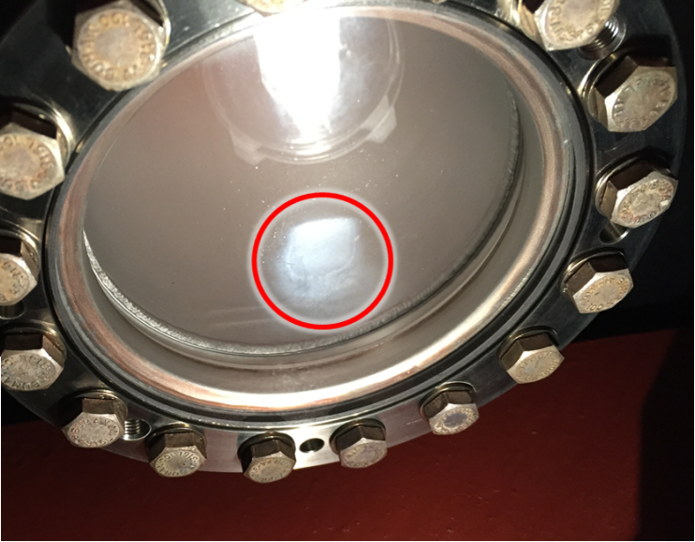
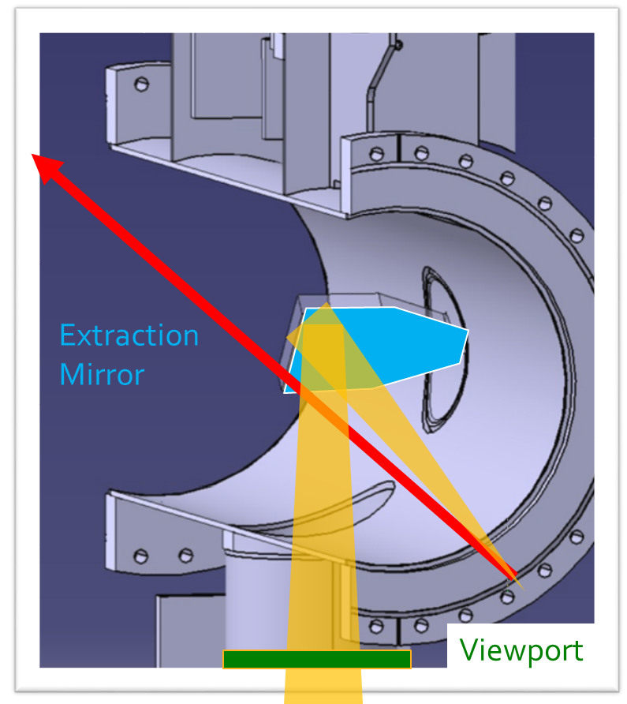
Experience in Run II
SR extraction
No deposit was found on the viewports surface.
Damage is localized on a really sharp region (only were SR hits)
It appears as an etching of the material itself.
Observed a fade black spot ~12 mm away from mirror edge
Loss of reflectivity in the damaged area of ~ 15 % (white light)
Damage coincide with undulator SR at 6.5 TeV in the soft X-ray region.
Damage seems a replica of the light distribution from the D3 for NUV
G. Trad – LHC Beam Size Measurement Review
9

Slide 10
Synchrotron radiation imaging system
Beam Emitted SR
SR Extraction
Optical System
Detector
Post-Process
BSRT MONITOR
G. Trad – LHC Beam Size Measurement Review
10

Slide 11
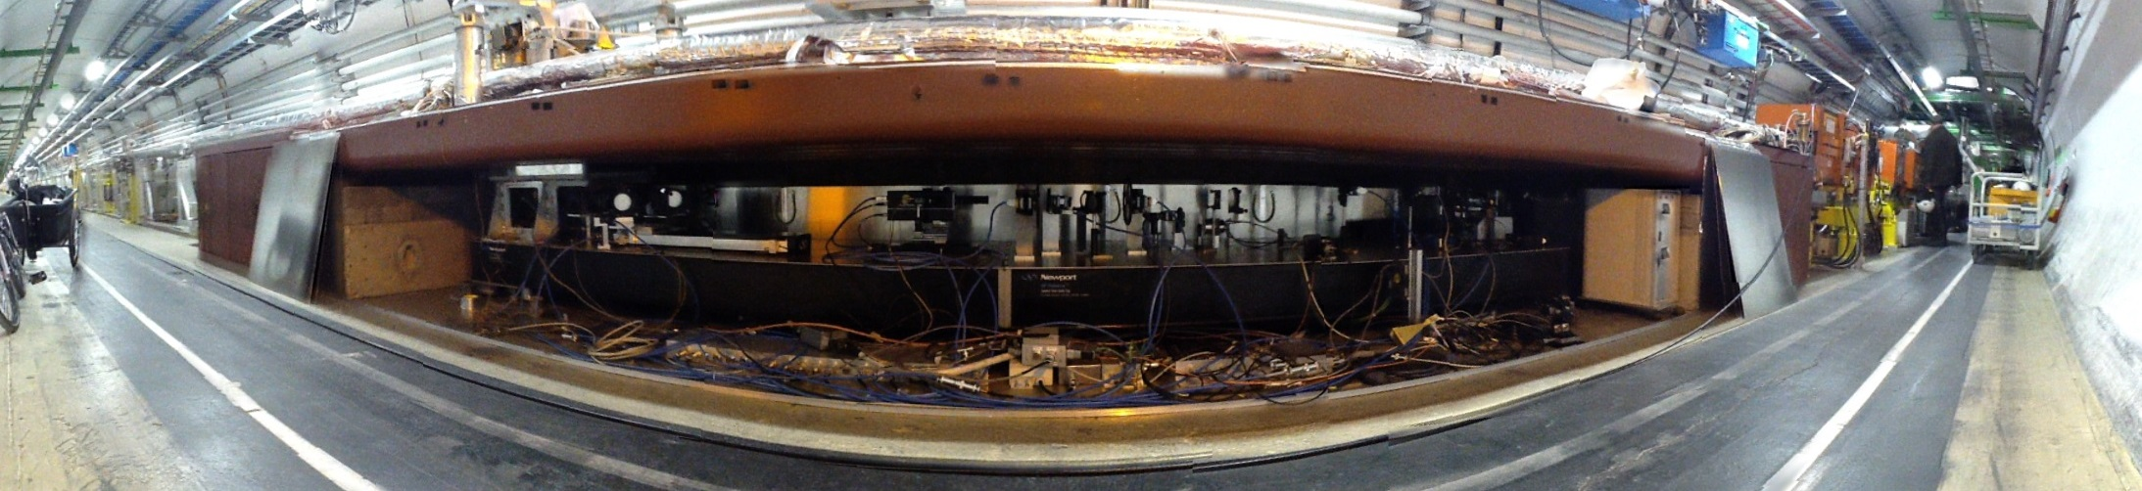
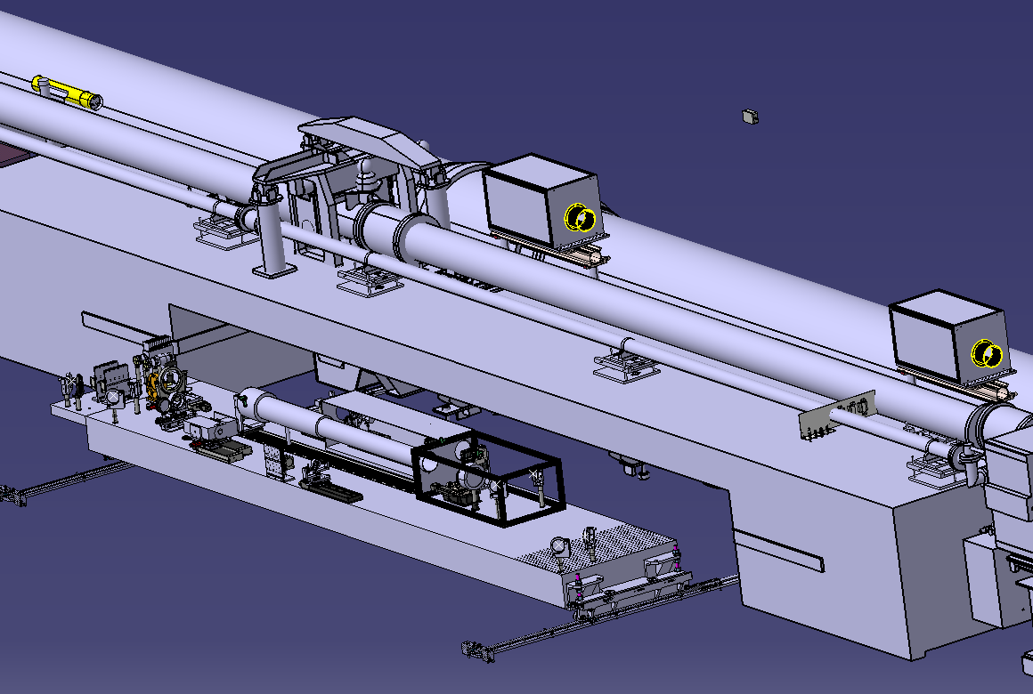
Run I
Optical System
Optical table mounted on rails to:
ease manipulation of the optics (minimizing risk of misalignment during interventions)
allow installation of complex systems (interferometry & coronagraph) in parallel to the imaging system.
Run II
G. Trad – LHC Beam Size Measurement Review
11

Slide 12
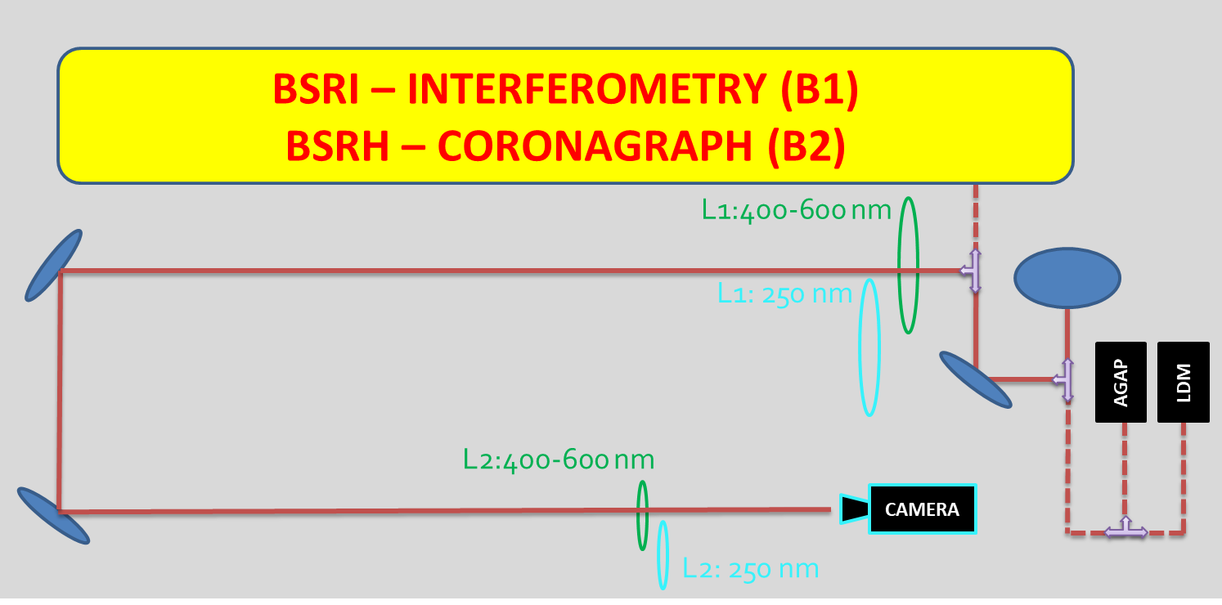
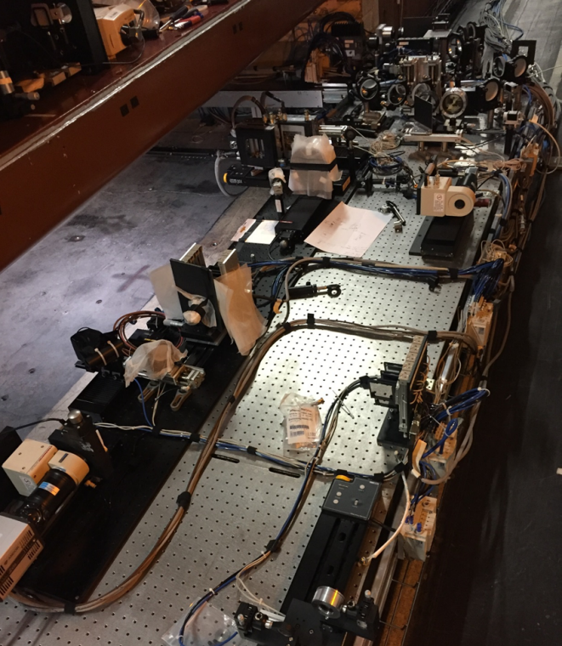
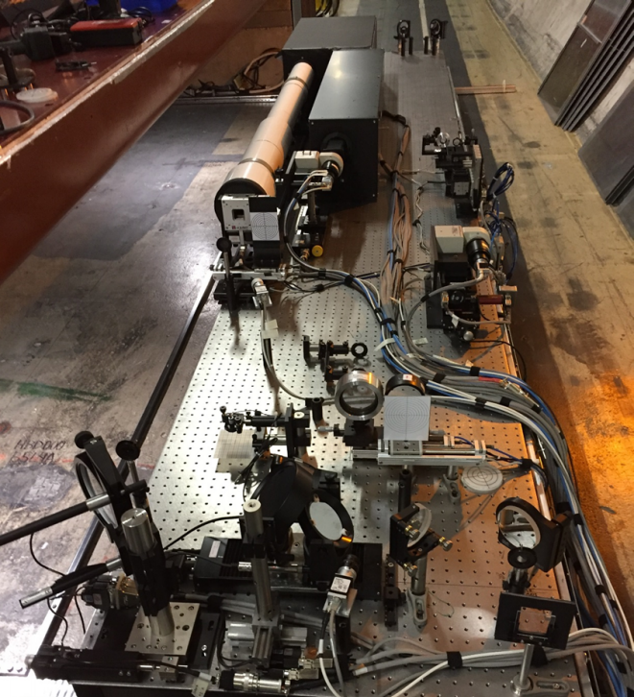
Due to the peculiar characteristics of the SR, the parameters of the optical system (magnification and resolution of the Keplerian telescope) can only be determined using the real beam as source.
This implies that the only way to calibrate the BSRT is by cross calibrating it with another system providing the absolute beam emittance, in our case the WS.
Optical System
Focal length:
L1 ~5 m
L2 ~0.3 m
Total MAG
~0.3
G. Trad – LHC Beam Size Measurement Review
12

Slide 13
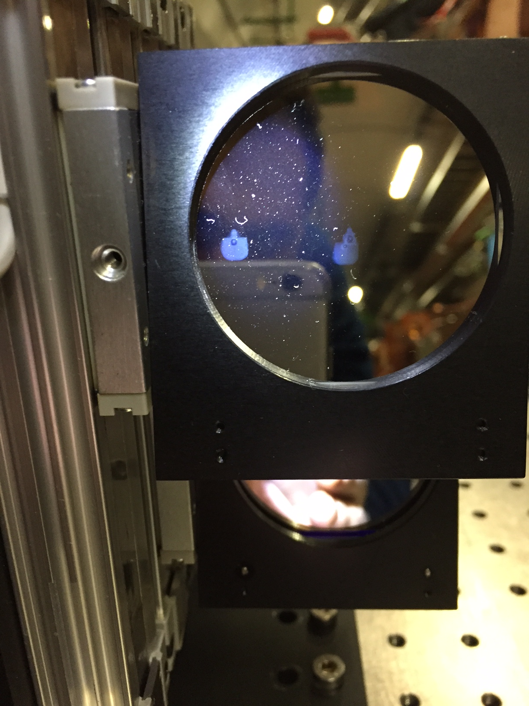
Experience in Run I:
Optical system based on reflective optics (focusing mirrors):
Very sensitive to alignment
Degraded resolution wrt nominal due to SR cuts in the optical path (8 mirrors trombone delay line to compensate source shift).
Experience in Run II:
Simplified system with refractive optics (2 achromatic lenses) with focusing obtained by moving L2.
Shifted operation at high energy to NUV to gain resolution (reduced diffraction, expected gain 20%, effective 10%). (Mention: External help for β increase in IR 4 from ABP.)
Issues:
Translation stages moving L2 from focus position at injection (source undulator) to Top energy (source D3) losing steps
-> losing focusing with time.
    Solved by offsetting the 2 lenses (Vis/UV) to avoid TS movement.
Optical filters (250 nm +/-10nm) degradation to the SR deposited power interaction
-> Resolution degradation with time.
    Solved by moving filters to a location where the SR spot is defocused.
Optical System
G. Trad – LHC Beam Size Measurement Review
13

Slide 14
Synchrotron radiation imaging system
Beam Emitted SR
SR Extraction
Optical System
Detector
Post-Process
BSRT MONITOR
G. Trad – LHC Beam Size Measurement Review
14

Slide 15
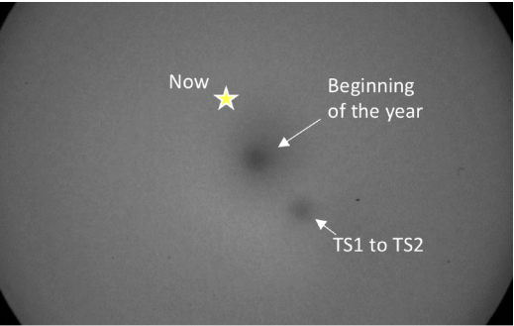
Image intensifiers are used in the LHC mainly for gating capabilities (bunch by bunch)
Rather than for light amplification
Experience in Run I:
Analog cameras (20ms exposure) fiber coupled to image intensifiers (Gen I) + In house frame grabber (25 Hz).
Slow, limited dynamic range, noisy images.
Experience in Run II:
Switched to digital cameras optically coupled to image intensifiers (Gen II).
Potentially 300 frame/sec, high dynamic range, high SNR.
Issues:
Intensifier lifetime:
Photocathode worn out
-> I.I non uniform response
Mitigated with the implementation of the “spot painting”
(x,y camera TS)
Detector
G. Trad – LHC Beam Size Measurement Review
15

Slide 16
Synchrotron radiation imaging system
Beam Emitted SR
SR Extraction
Optical System
Detector
Post-Process
BSRT MONITOR
Real time control system
G. Trad – LHC Beam Size Measurement Review
16

Slide 17
Control server in FESA 3 operational working reliably since Run II.
Bunch by bunch measurements of full ring in less than 1 minute.
Provides “profiles” bunch by bunch and estimated beam size.
Manages the configuration changes from injection to flat top and the online feedbacks (MCP gain, filters, steering and focusing positions).
Single point failures of the communication due to radiation SEU are being addressed.
Control system
G. Trad – LHC Beam Size Measurement Review
17

Slide 18



BSRT cross calibration
Characterize the optical system (coupled to the SR source): Compute MAG, LSF
True beam size from reference instrument: Wirescanner
Run I
MAG calculated by performing closed orbit bumps at the source location.
Bump amplitude read from BPMs
LSF recovered as correction in quadrature of the scaled BSRT sigma (from Gaussian fit)
Run II
BSRT performance
MAG and LSF computed by
Independent of BPMs
Requires a range of emittances in the LHC (typically from 1- 5um)
G. Trad – LHC Beam Size Measurement Review
18

Slide 19
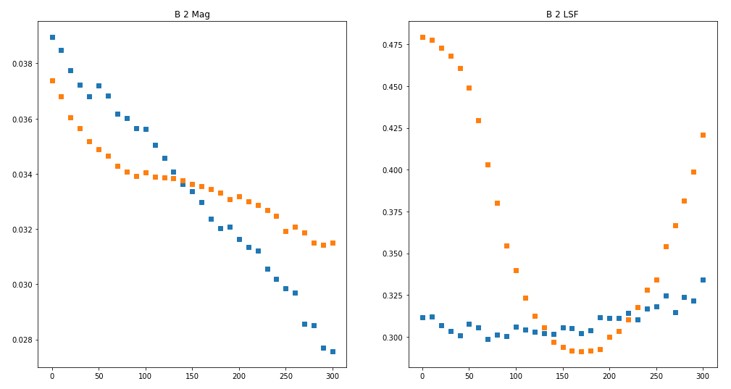
BSRT cross calibration
Typical output of a calibration in Run II
BSRT performance
At each position of the lens scan:
(MAG,LSF) computed
Focus defined as position with minimum LSF
Lens Scan [mm]
Lens Scan [mm]
G. Trad – LHC Beam Size Measurement Review
19

Slide 20
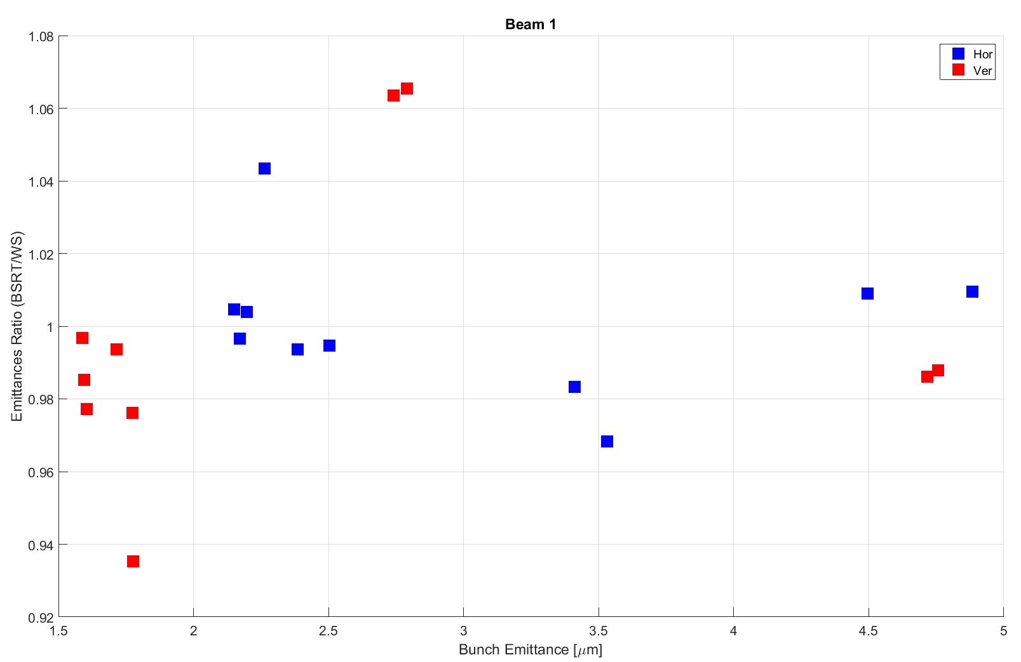
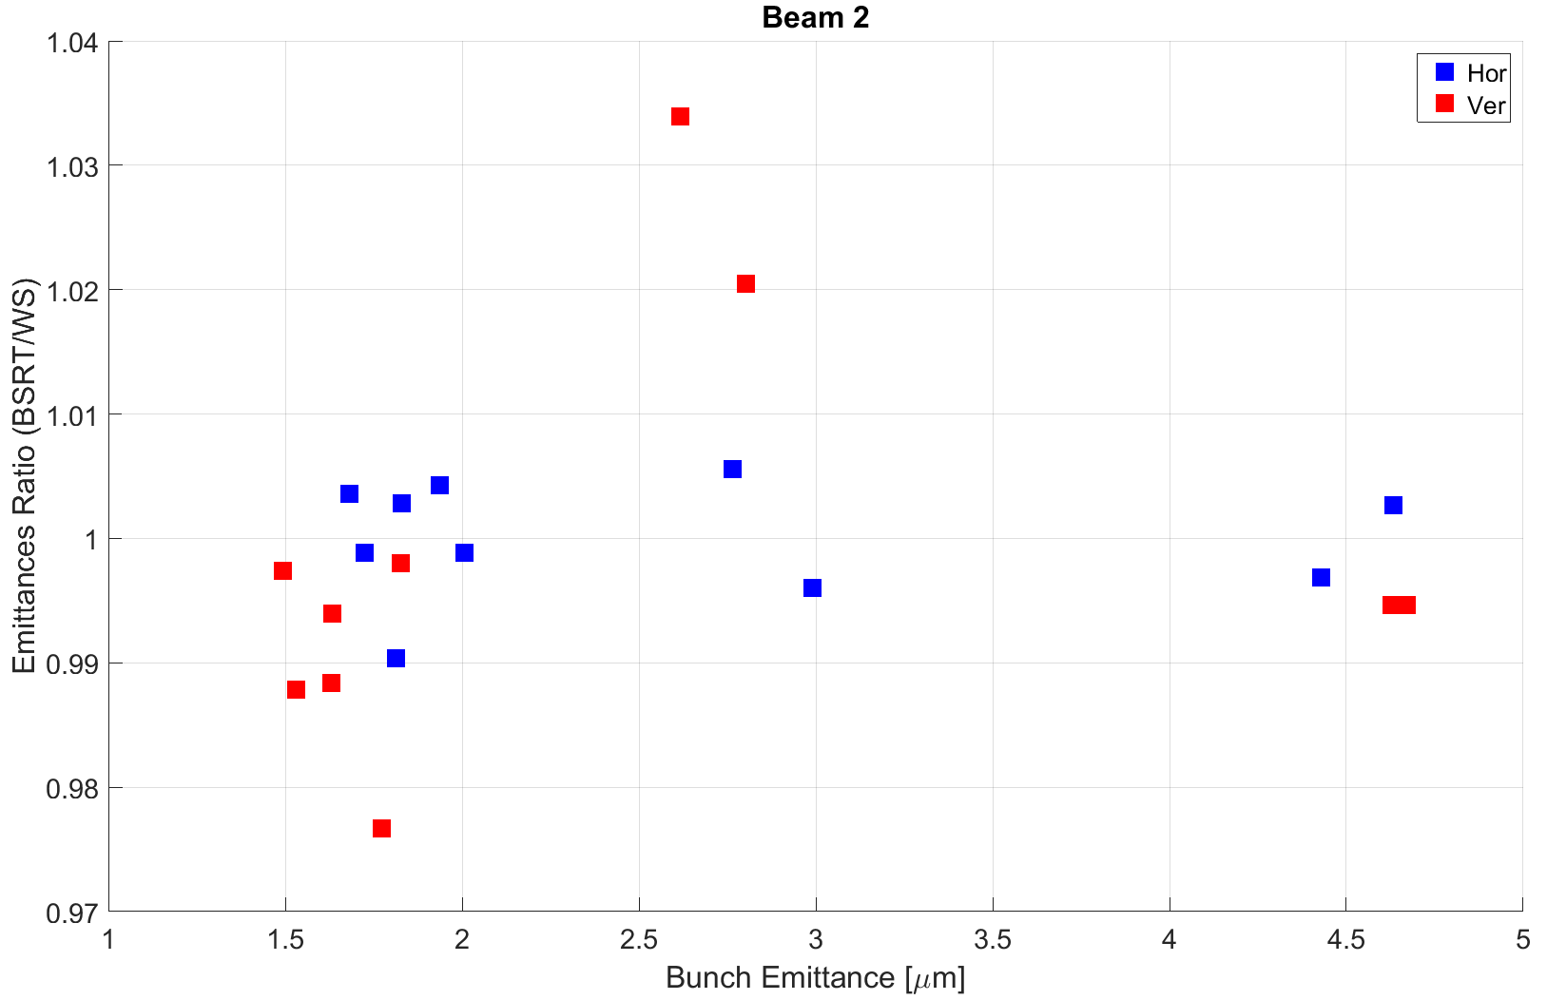
BSRT cross calibration
Calibration process (quadrature correction for resolution deconvolution) relies on:
Hyp1: LSF is Gaussian (by construction, it isn’t: trajectory effect in D3).
Hyp2: Beam is Gaussian (not always true, specially for small beam size)
Experimentally validated that such hypothesis do not deteriorate over the extreme range of emittances (1 um at Top energy)
BSRT performance
1.08
1.04
6.5 TeV
0.92
324th LMC – 18/10/2016
G. TRAD
20
0.97
G. Trad – LHC Beam Size Measurement Review
20

Slide 21
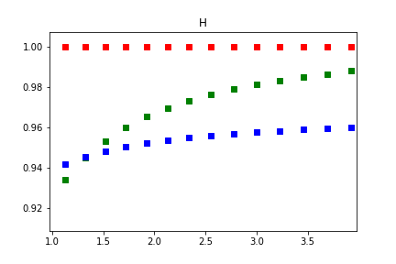
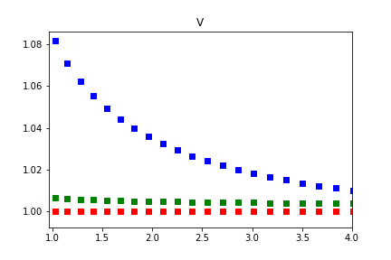
Recalibration reproducibility B2
In terms of emittance:
Applying several calibrations starting from same raw data (sigma in pixels)
BSRT performance
Emittance ratio
Emittance ratio
Emittance [μm]
Emittance [μm]
Any effect on changed optical functions in collision (as not measured) is folded into this “reproducibility”
G. Trad – LHC Beam Size Measurement Review
21

Slide 22

BSRT calibration during Ramp
Philosophy:
-> Keep the optics focusing and setup in FT configuration from 2TeV onward
-> Light source is shifting from undulator to dipole (interplay edge and core)
-> Work in “not on focus” condition: worst LSF.
-> Hope that the ratio LSF/σ stays relatively low.
-> Trust the WS single shot value as absolute true beam size at the scan energy
-> Hope that beta beating is not a limitation
BSRT performance
G. Trad – LHC Beam Size Measurement Review
22

Slide 23
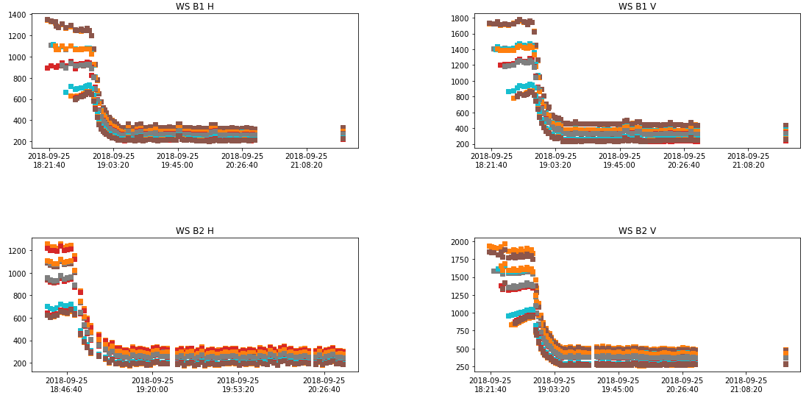
BSRT calibration during Ramp
BSRT performance
The WS noise level improvement was promising to try a BSRT Calibration during RAMP. (from 2 TeV upward)
Automatic WS to cross calibrate along the cycle;
G. Trad – LHC Beam Size Measurement Review
23

Slide 24
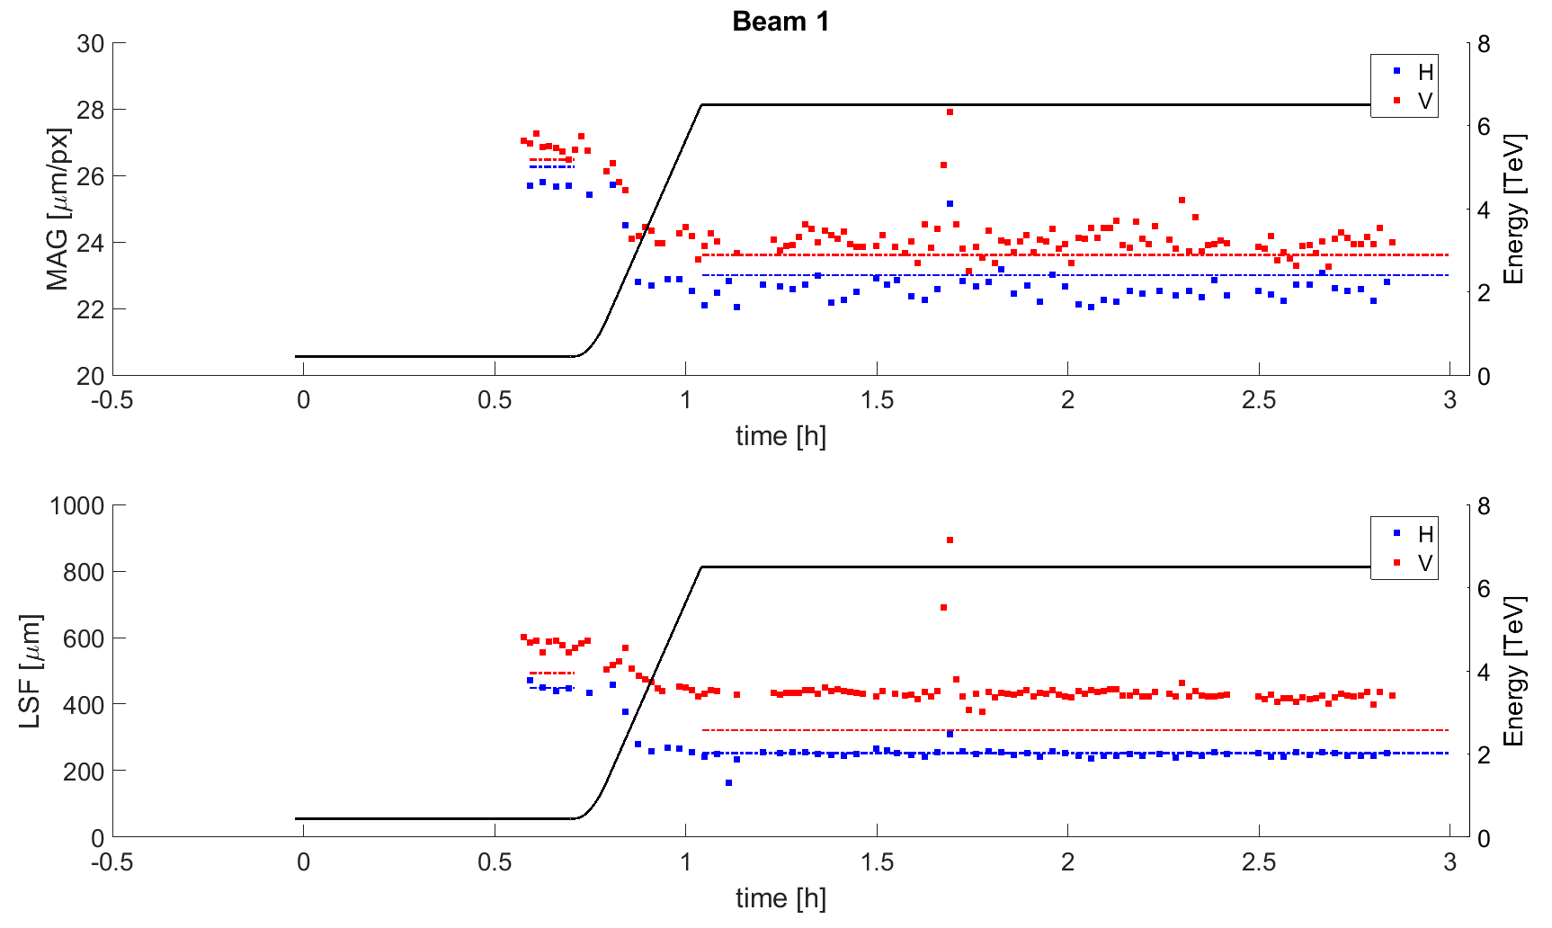
BSRT calibration during Ramp
Optics used :
<2 TeV injection optics
>2 TeV collision optics
Consistent calibration factors could be used from E >3 TeV
Optics knowledge and precision of WS dominate the error contribution to the calibration in the ramp.
Accuracy turned out much worse than at FT > 20%
BSRT performance
G. Trad – LHC Beam Size Measurement Review
24

Slide 25
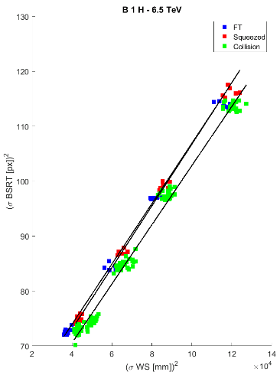
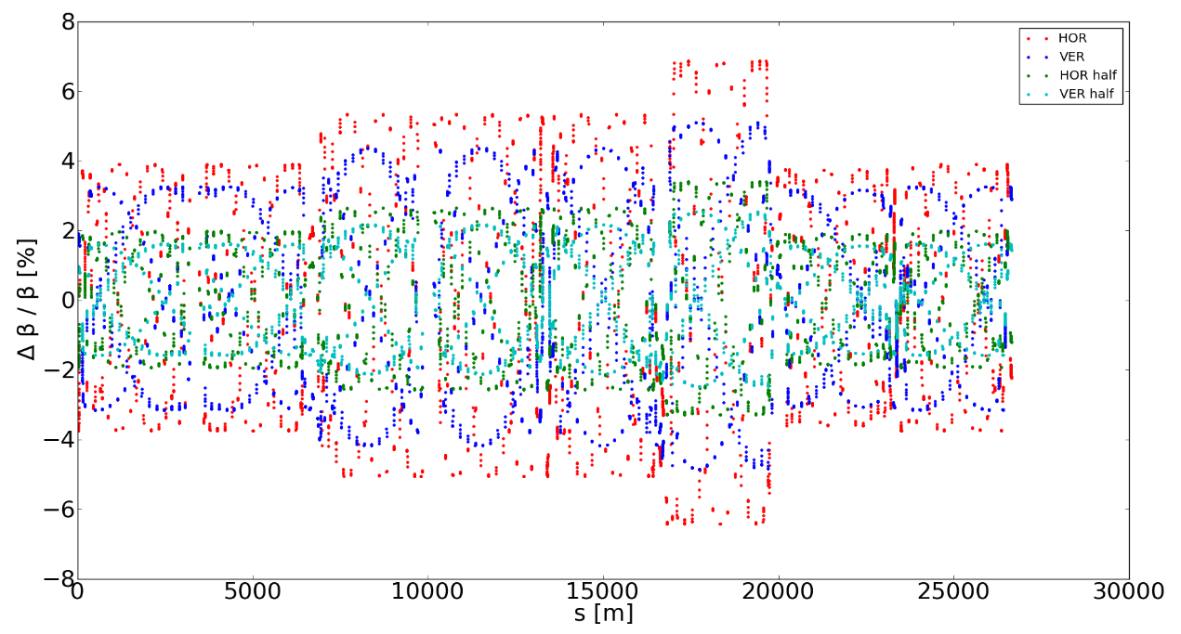

Miscellaneous
Beta Beating caused by HO collisions never accounted for:
B1H = 3.5%,B1V = 2.5%
B2H = -1%, B2V = -5.3%
Courtesy T.Pieloni
BSRT performance
Optical system and magnification linked to slope and offset of
${σ_{{BSRT}_{[px]}}}^{2}=f\left({σ_{ws[mm]}}^{2}\right)$
G. Trad – LHC Beam Size Measurement Review
25

Slide 26
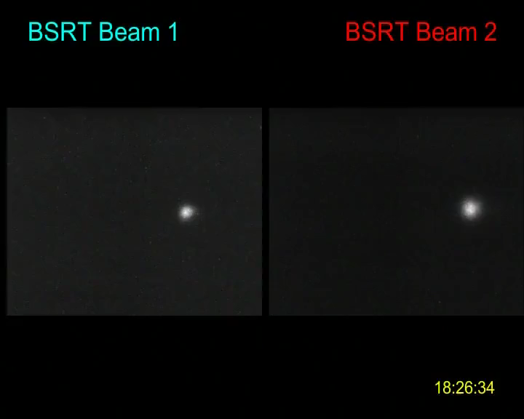
Miscellaneous
Beta Beating caused by HO collisions never accounted for:
B1H = 3.5%,B1V = 2.5%
B2H = -1%, B2V = -5.3%
Coupling effects are assumed small (can’t be observed) when 2D projection is ~round.
BSRT performance
G. Trad – LHC Beam Size Measurement Review
26

Slide 27
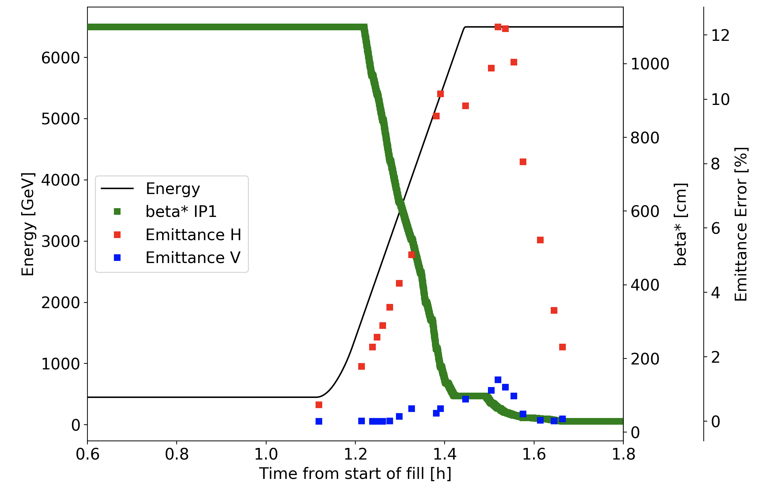
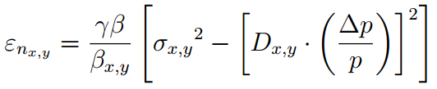
Miscellaneous
Beta Beating caused by HO collisions never accounted for:
B1H = 3.5%,B1V = 2.5%
B2H = -1%, B2V = -5.3%
Coupling effects are assumed small (can’t be observed) when 2D projection is ~round.
Dispersion is assumed null;
Beam 1
LHC 2018 nominal cycle
BSRT performance
For small emittances ( 1μm)
Emittance calculation not accounting for dispersion (pure model) results into significant changes
G. Trad – LHC Beam Size Measurement Review
27

Slide 28
Miscellaneous
Beta Beating caused by HO collisions never accounted for:
B1H = 3.5%,B1V = 2.5%
B2H = -1%, B2V = -5.3%
Coupling effects are assumed small (can’t be observed) when 2D projection is ~round.
Dispersion is assumed null;
Observation in 2017 (thanks to the new ADT activity monitor) showed a correlation between beam size from BSRT (sum of 200 2D images over 200 LHC turns) and the bunch oscillation.
=>Could be a limitation to the reproducibility of the calibration fills.
BSRT performance
G. Trad – LHC Beam Size Measurement Review
28

Slide 29
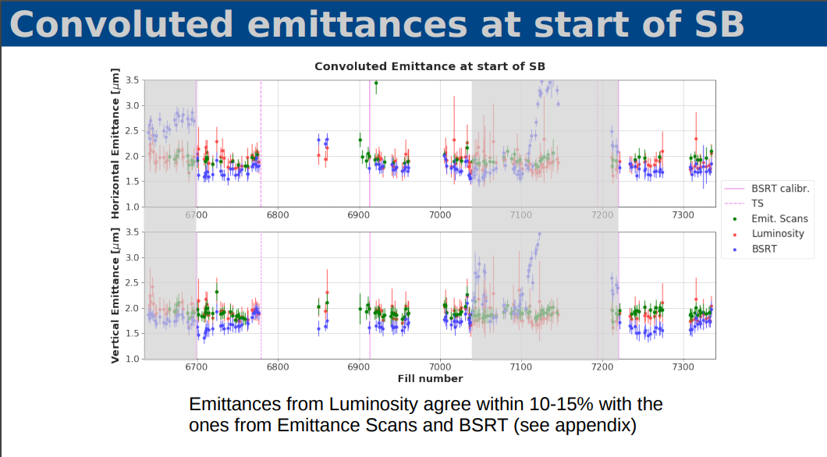
Performance
2018
SR MONITORS
S. Papadopoulo
G. Trad – 9th LHC Operations Evian Workshop
29

Slide 30
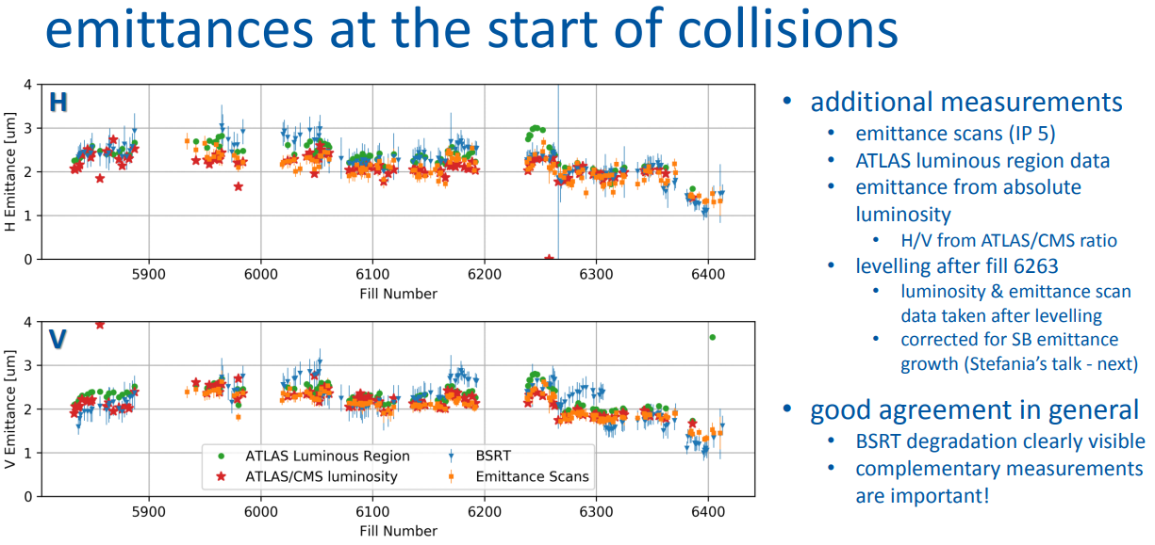
Performance
SR MONITORS
2017
M. Hostettler
G. Trad – 9th LHC Operations Evian Workshop
30

Slide 31
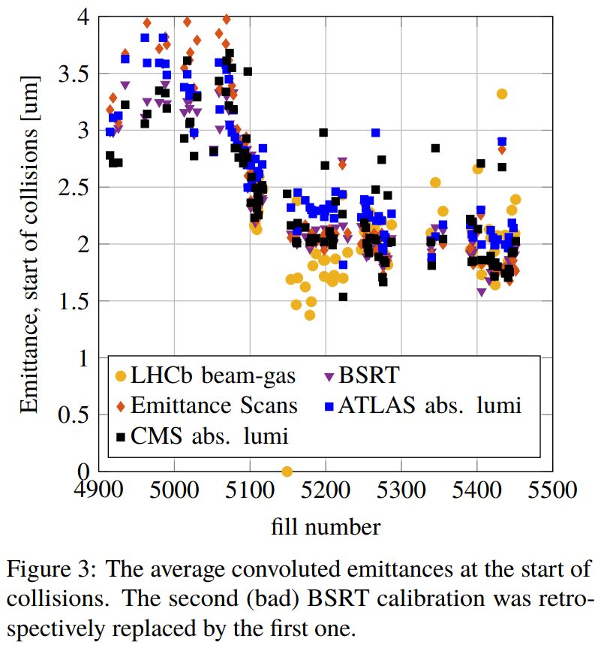
Performance
SR MONITORS
2016
M. Hostettler
G. Trad – 9th LHC Operations Evian Workshop
31

Slide 32
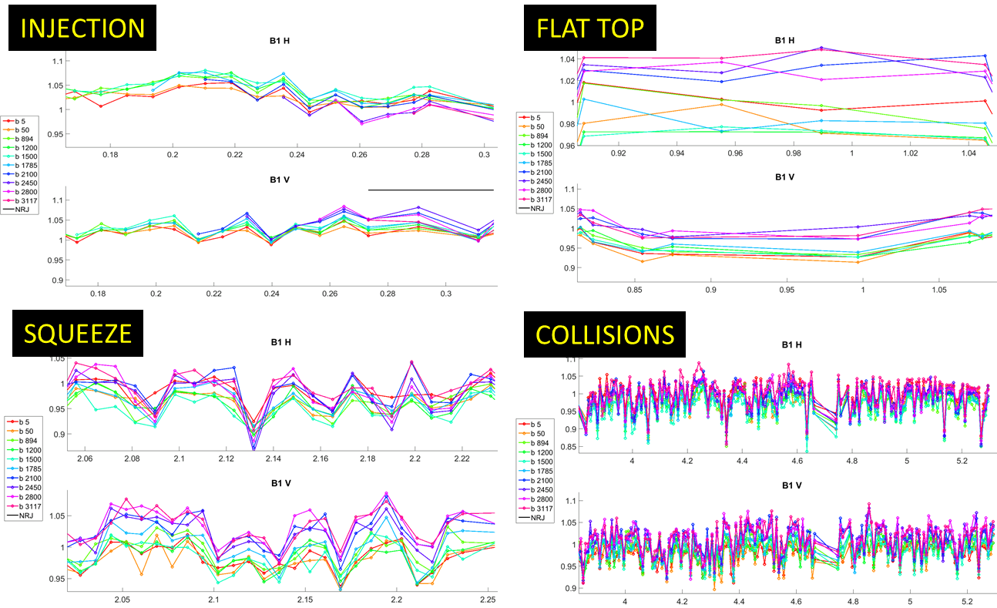
BSRT
Ratio of Emittances from WS vs BSRT
repeatability over 2 months period.
SR MONITORS
When everything went smooth!
G. Trad – 9th LHC Operations Evian Workshop
32

Slide 33
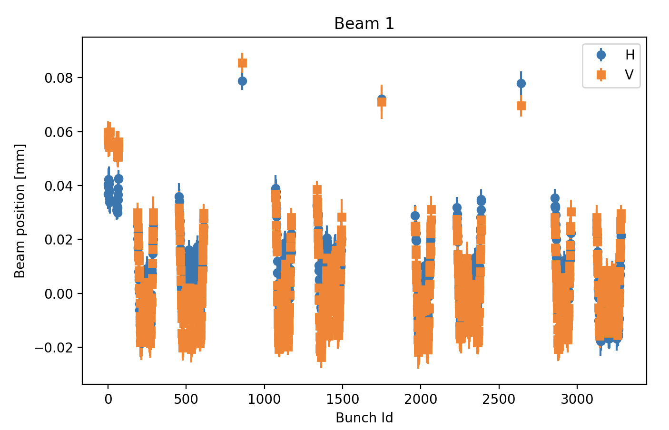
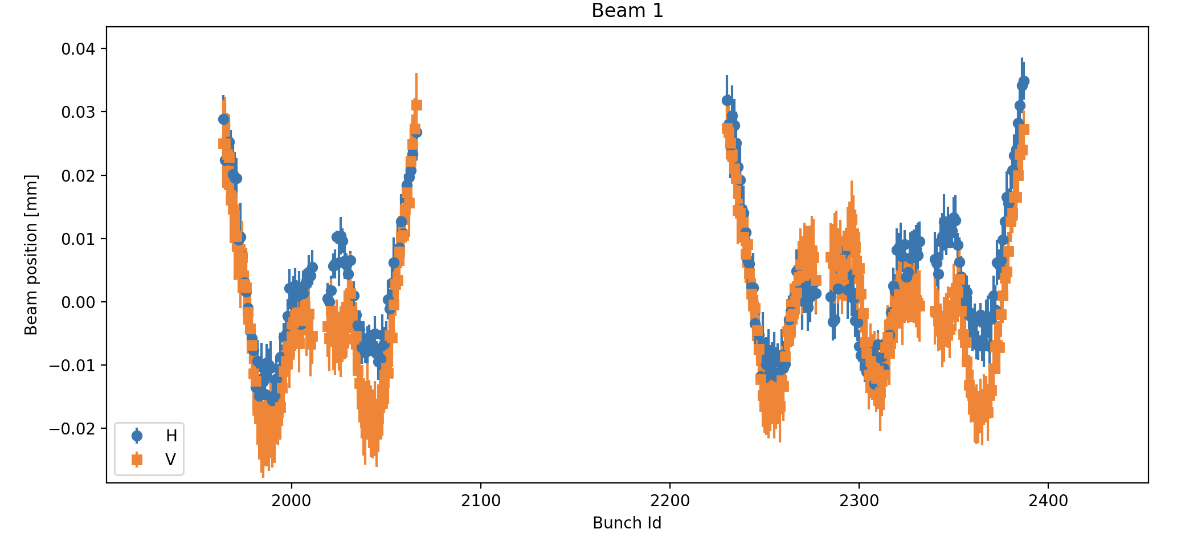
Performance
SR MONITORS
G. Trad – 9th LHC Operations Evian Workshop
33

Slide 34
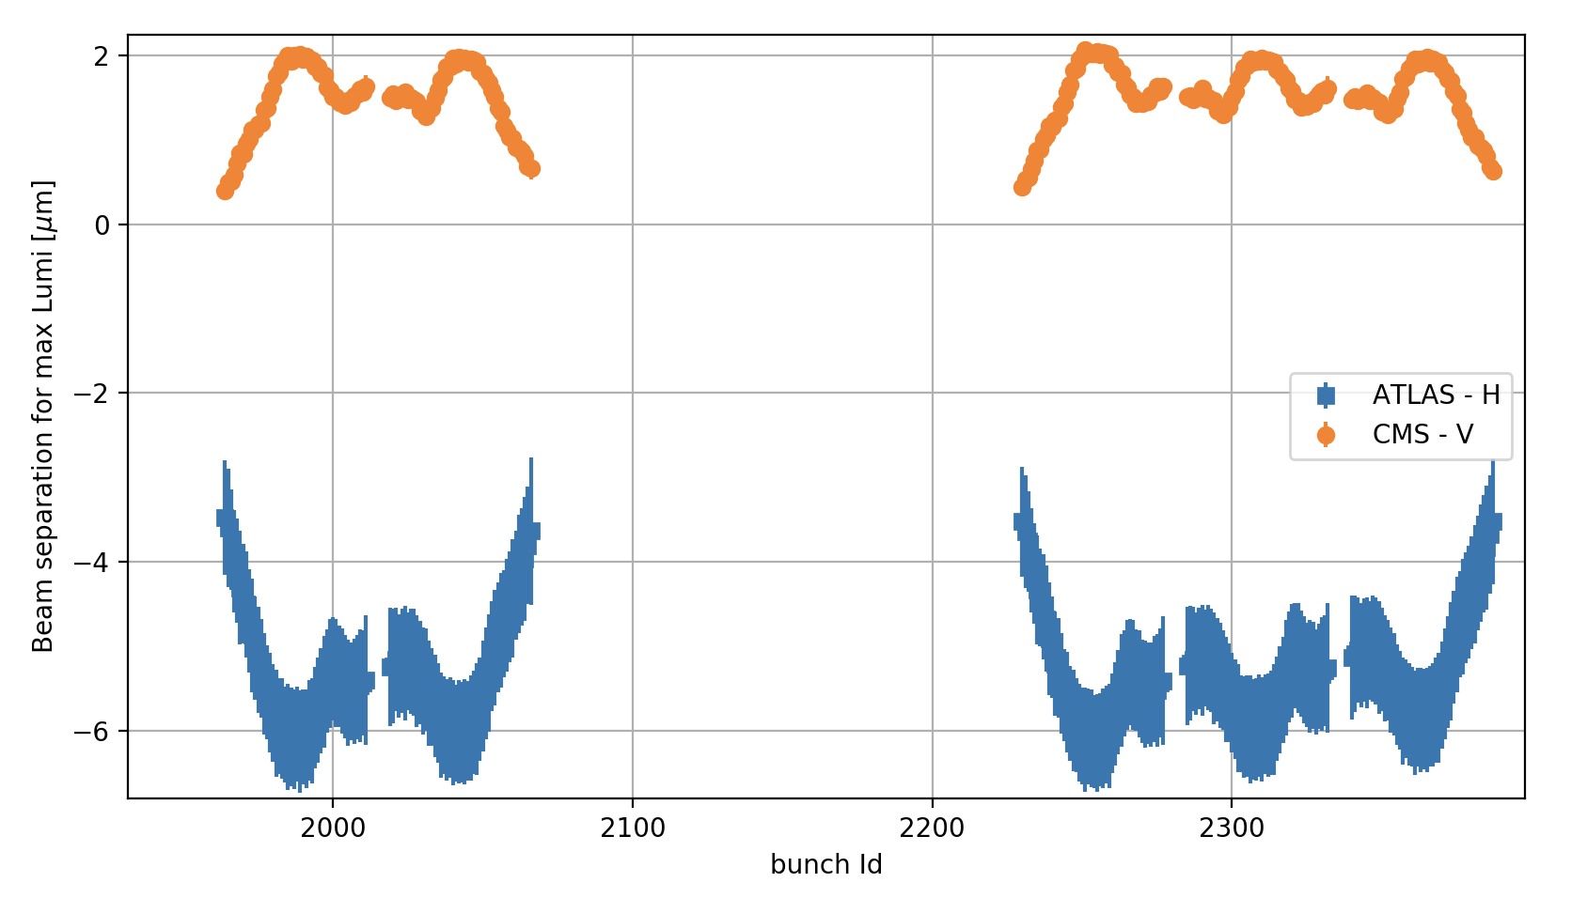
Performance
From the experiments
during a separation scan
SR MONITORS
G. Trad – 9th LHC Operations Evian Workshop
34

Slide 35
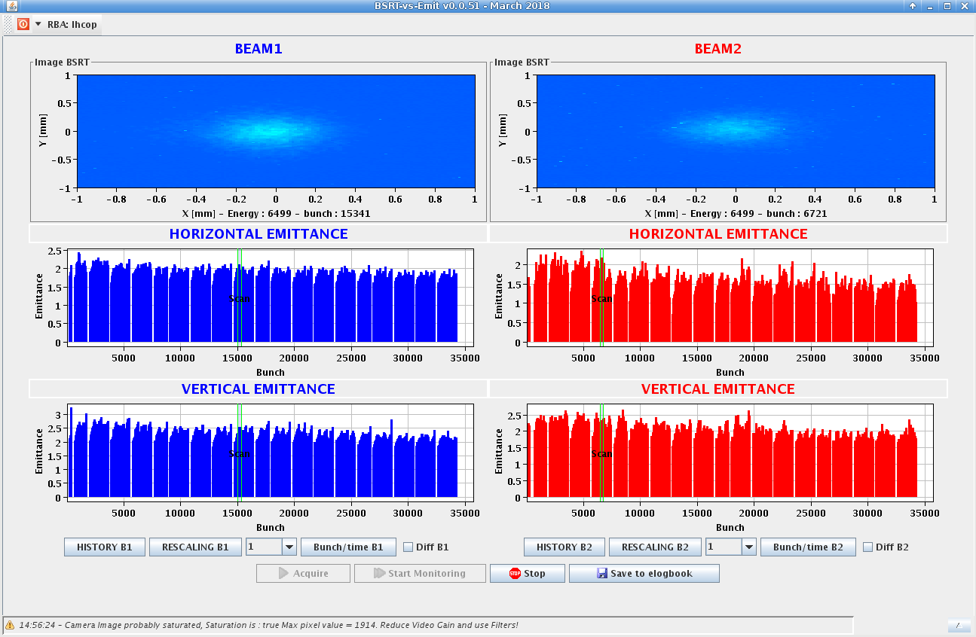
Performance
Typical BSRT scan at top energy in 2018
The instrument is well able to resolve very small differences between bunches
Precision (rms) is <5% on emittance
SR MONITORS
G. Trad – 9th LHC Operations Evian Workshop
35

Slide 36
Plans for Run III
Replace in vacuum extraction mirror
Replace view ports
Replace the mirrors with MgF coating layer on the table.
Pursue studies for improved measurement quality and reliability
SR MONITORS
G. Trad – 9th LHC Operations Evian Workshop
36

Slide 37
Summary
The understanding of the system has matured over the 2 LHC runs
The system is operational since 2015 and has improved over the years :
  Reliable SR extraction mechanism
  Stable FESA control (automatic steering and settings management)
  Move to digital cameras and new generation of image intensifiers
  New calibration technique independent of BPM scaling errors
Relative accuracy (B by B) probably of the order of few %, absolute accuracy not easy to estimate:
  from comparison with OP scans and emittances estimated from luminosity probably about 10-20 %
Main problem is the system reliability, the measurement of its accuracy is intrinsically entangled with that of the WS.
Stability of calibration values and repeatability of the calibration Runs.
G. Trad – 9th LHC Operations Evian Workshop
37

Slide 38
Thank you for your attention!

Slide 39






BSR Interferometry – WHY?
Quadrature correction for the BSRT
$${σ_{corr}≥σ}_{diff}$$
$${σ_{{BSRT}_{deduced}}}^{2}={σ_{{BSRT}_{meas}}}^{2}−{σ_{corr}}^{2}$$
Correction includes:
  Diffraction
  Aberration
  Magnification error…
How is $σ_{corr}$ determined ?
Calibrating with WS
$${σ_{corr}}^{2}={σ_{{BSRT}_{meas}}}^{2}−β_{ratio}.{σ_{WS}}^{2}$$
Uncertainties?
% rel. Error
Uncertainties?
% rel. Error
5th Evian Workshop
Transverse beam size measurement

Slide 40
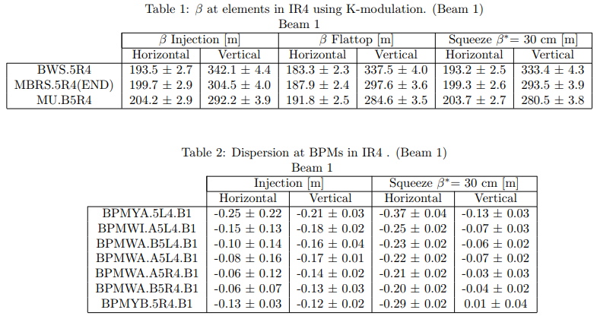
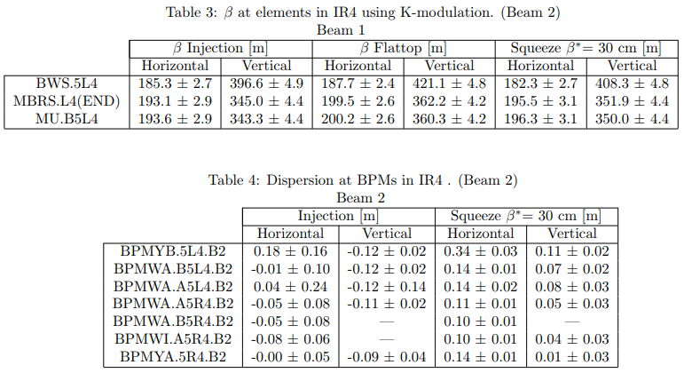
Optics in IR4
Courtesy: R. Tomas, M. Hofer et al.

Slide 41

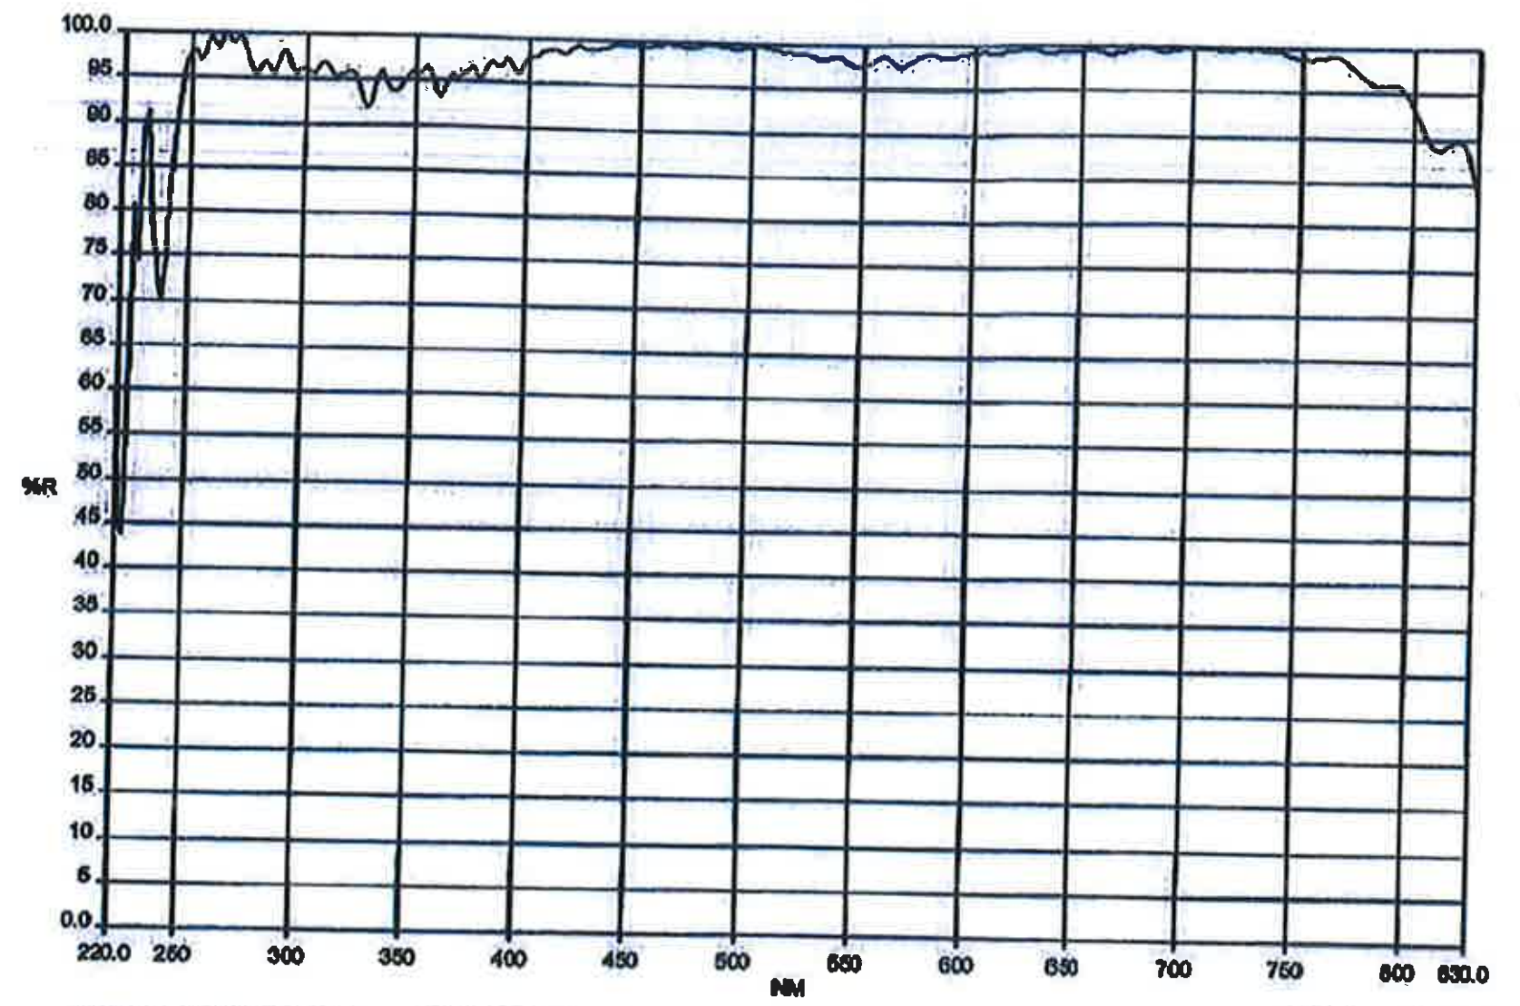
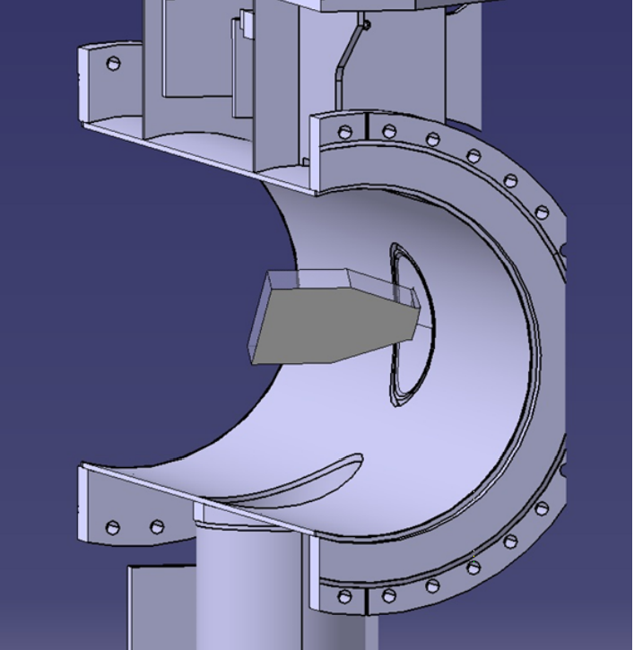
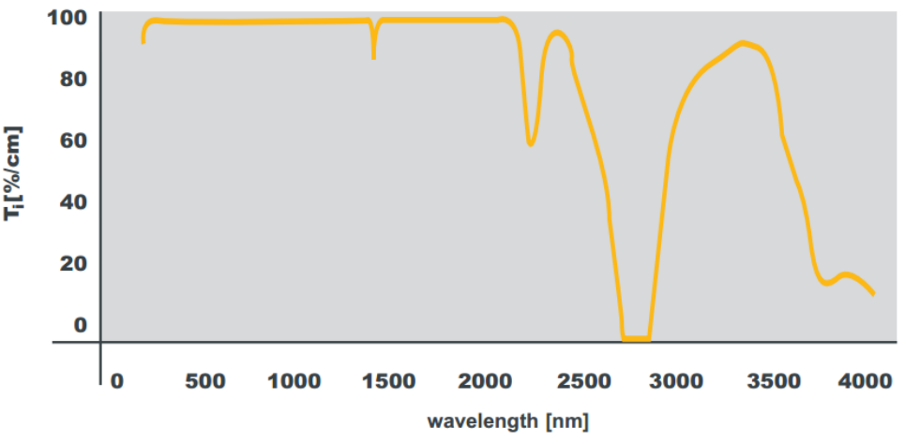

Optical properties
BSRT working point @ FT
Extraction Mirror Reflectivity
Extraction
Mirror
Experience in Run I-II
Viewport Reflectivity
Viewport
Viewport
G. Trad – LHC Beam Size Measurement Review
41

Slide 42
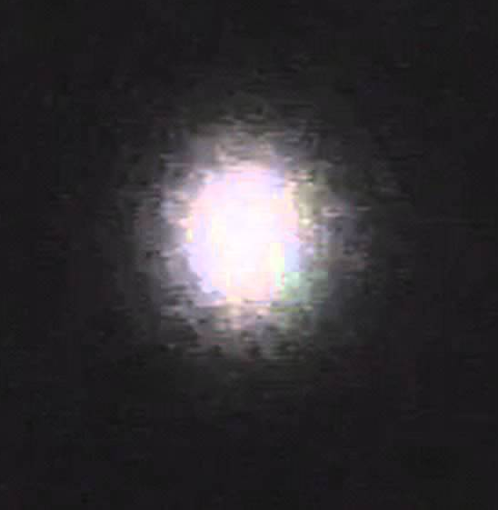
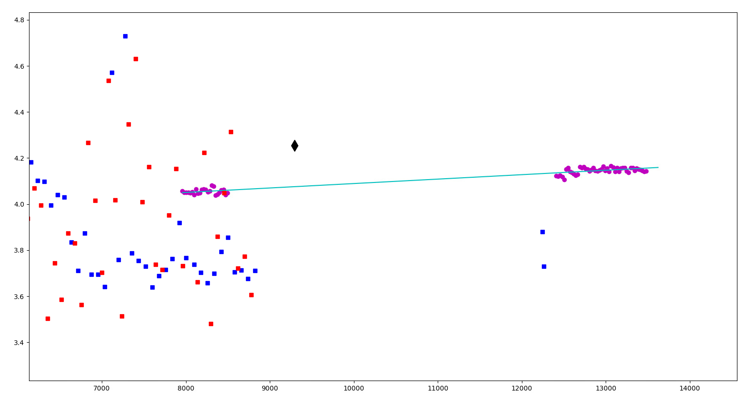
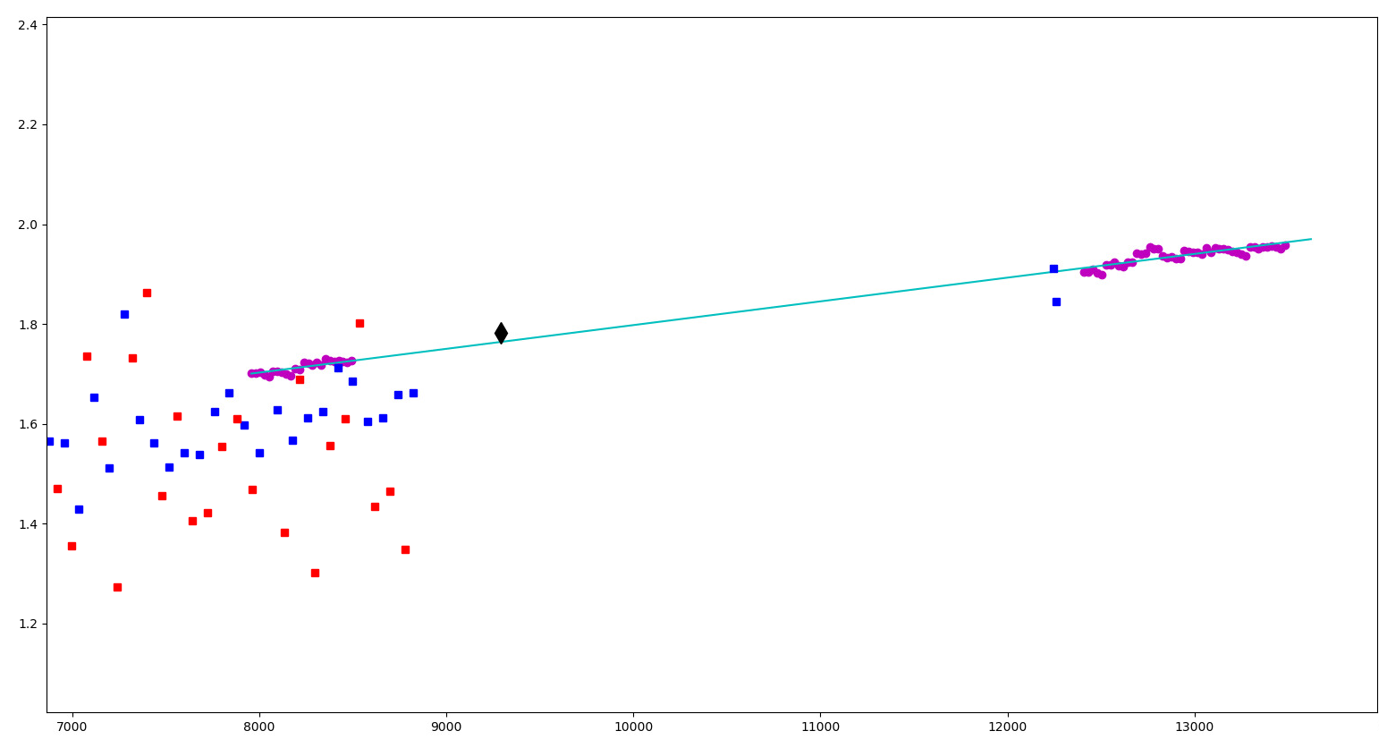
Can the EXP tell more?
Horizontal plane
Biggest bunch
Horizontal plane
Smallest bunch

Slide 43
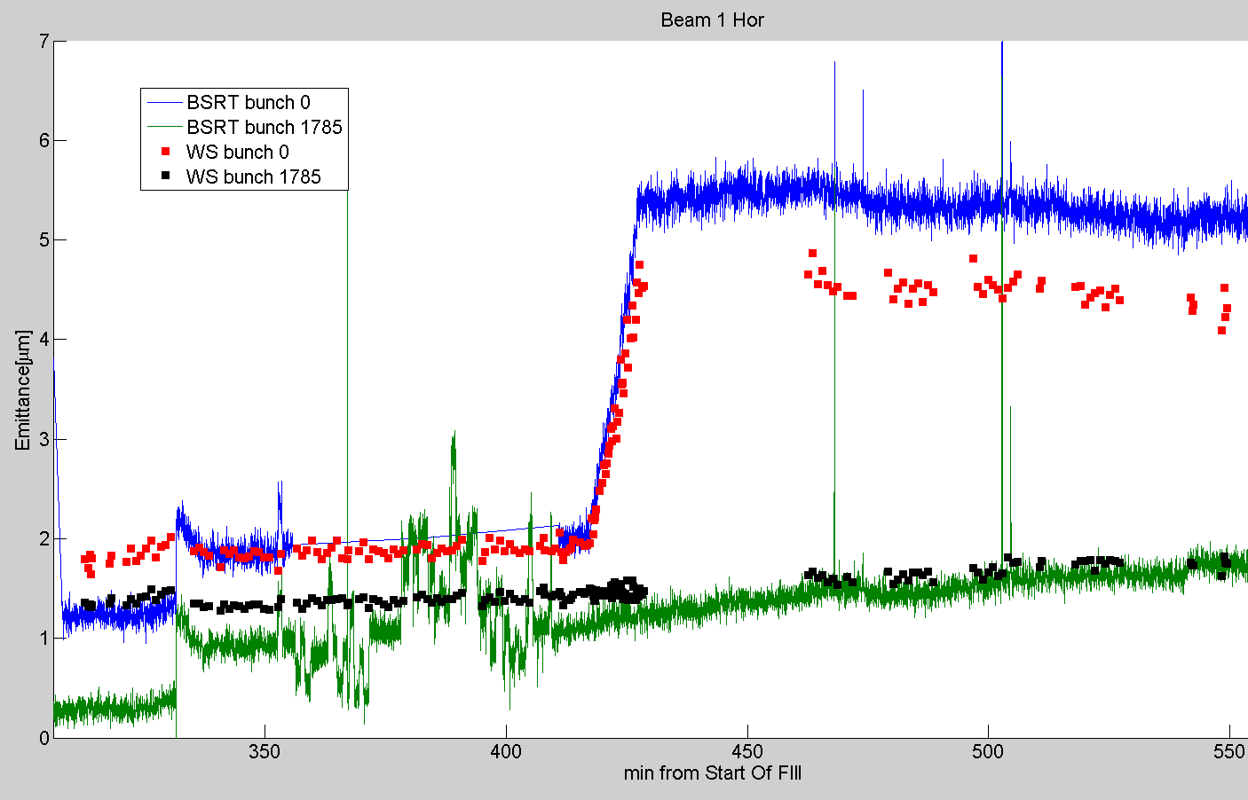
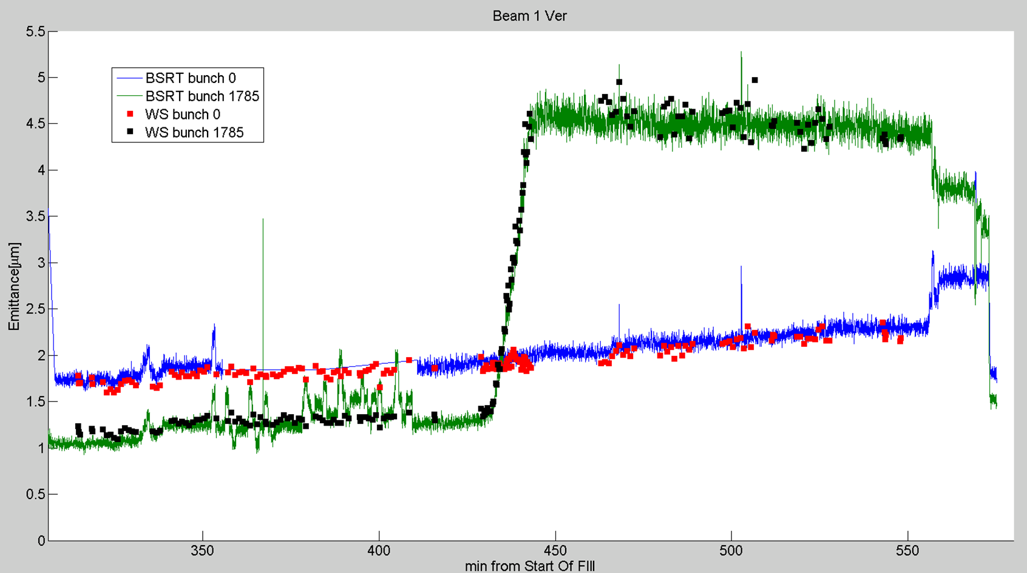
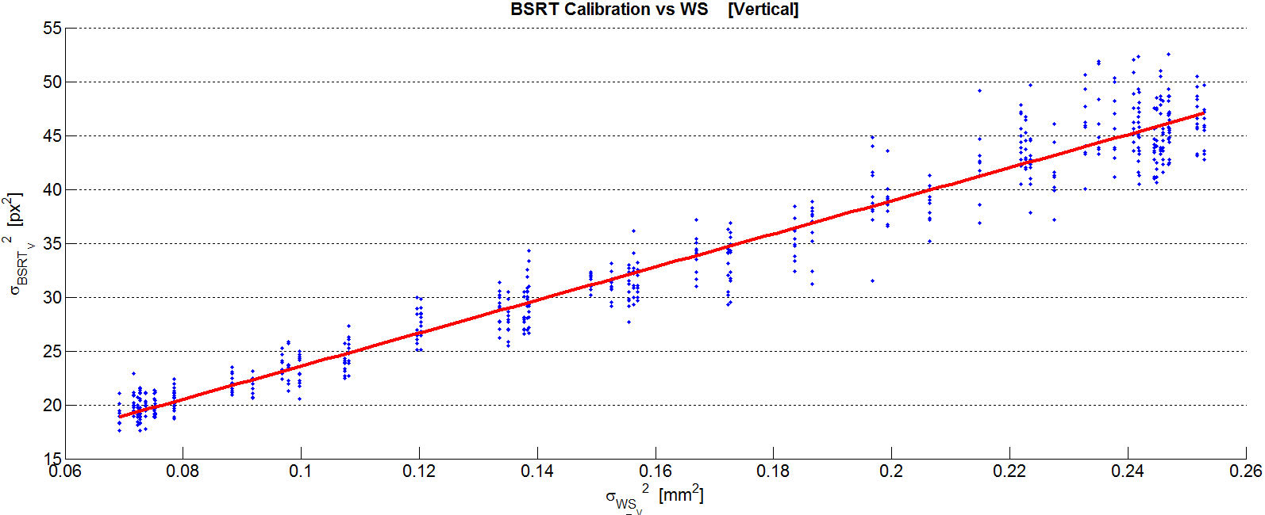
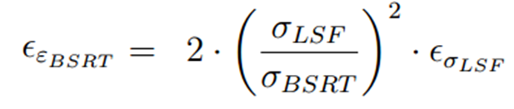


$$β_{ratio}=\frac{β_{BSRT}}{β_{WS}}$$
CROSS-CALIBRATION
$${\left({\left.{σ_{meas}}_{BSRT}\right|}_{px}\right)}^{2}=\left(\frac{β_{ratio}}{{MAG}^{2}}\right).{\left(σ_{WS}\right)}^{2}+{\left({\left.σ_{LSF}\right|}_{px}\right)}^{2}$$
BGI
Y
slope
X
intercept
Using BPM data
for magnification
Using WS data
for magnification
WS
BSRT
BGV
LHC Profile Monitors Status- 6th Evian Workshop, G. Trad – 16/12/2015

Slide 44


Can the EXP tell more?
Vertical plane
Biggest bunch
Vertical plane
Smallest bunch

Slide 45

Can the EXP tell more?
Horizontal
Emit Scan
WS
Vertical
Emit Scan
WS
To be investigated further

Slide 46




Emittance from WS vs BSRT
B1H
B2H
B1
Injection
Good agreement
(H+4% , V+2%)
FT
Bad as expected
B2
Injection
Good agreement
(H+5%, V+6.8%)
FT
Good agreement
(H-11%, V+12%)
B1V
B2V
Errors quoted for emittance:
2 um

Slide 47

Synchrotron Radiation Monitors - BSRT
3 Cross-Calibration this year:
April-August-October
August Calibration was “fishy” still investigating
All calibrations made such as no data loss even if a calibration goes wrong
B1V @ 6.5 TeV
This year observed a dependence of the calibration on the beam mode @ 6.5 TeV
Investigate bigger spread on B1 emittances (Observations correlated with beam behavior?)
Study dependence of the calibration on machine conditions, optics/ beam modes

