Slide 2
Gas Jet Diagnostics for HL-LHC
S. Mazzoni with contributions from the BGC team
LHC Beam Size Measurement Review meeting,
1-2 October 2019

Slide 3
Outline
Beam Gas Curtain project
Summary of 2018 LHC measurements
  Results for Pb+ ions at injection
  Data for protons at injection
Potential utilization as beam profile measurement technique

Slide 4
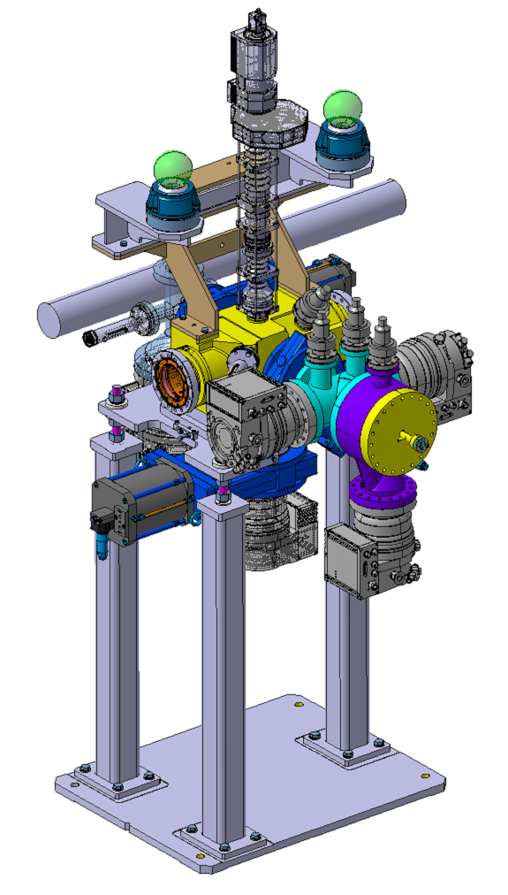
The Beam Gas Curtain in HL-LHC
BGC: baseline instrument for on-line monitoring of the overlap between proton and electron beams in the hollow e-lens
BGC is principally funded by HL-LHC in collaboration with Cockcroft Institute and GSI experts
Prototypes extensively tested with electron gun sources at Cockroft. LHC tests for:
  Operating scenarios in the LHC synchrotron light background
  Hadron shower noise background
  Operations with VSC in the baked LHC vacuum environment

Slide 5
The Beam Gas Curtain in HL-LHC
If this instrument is to be operational post- LS3, then some preliminary steps need to be taken in LS2 to allow for prototype testing during Run 3
  This instrument includes a new vacuum sector and significant cabling, long shutdown needed
BGC prototype installation for HL-LHC is now a stand-alone task (13.2) in HL-LHC WP13
  The instrument is a deliverable from the Cockcroft Institute

Slide 6
BIF/BGC in the LHC
2018: BIF tests in LHC using Neon with ex BGI injection system (-> no gas jet/curtain)
Feb-May 2020: LHC Vacuum chamber with all-metal gate valves – no injection. Under manufacture
Before end LS2: LHC Vacuum chamber with undirected gas injection to a pressure below 1x10⁻⁷ mbar (recycle LHC BGI/fluorescence test injection, same as BGV), ECR under preparation
20XX: Fully operating BGC. To be developed: Vacuum controls system, full test to prove LHC beam vacuum compatibility.

Slide 7
BIF/BGC in the LHC
2018: BIF tests in LHC using Neon with ex BGI injection system (-> no gas jet/curtain)
Feb-May 2020: LHC Vacuum chamber with all-metal gate valves – no injection. Under manufacture
Before end LS2: LHC Vacuum chamber with undirected gas injection to a pressure below 1x10⁻⁷ mbar (recycle LHC BGI/fluorescence test injection, same as BGV), ECR under preparation
20XX: Fully operating BGC. To be developed: Vacuum controls system, full test to prove LHC beam vacuum compatibility.

Slide 8
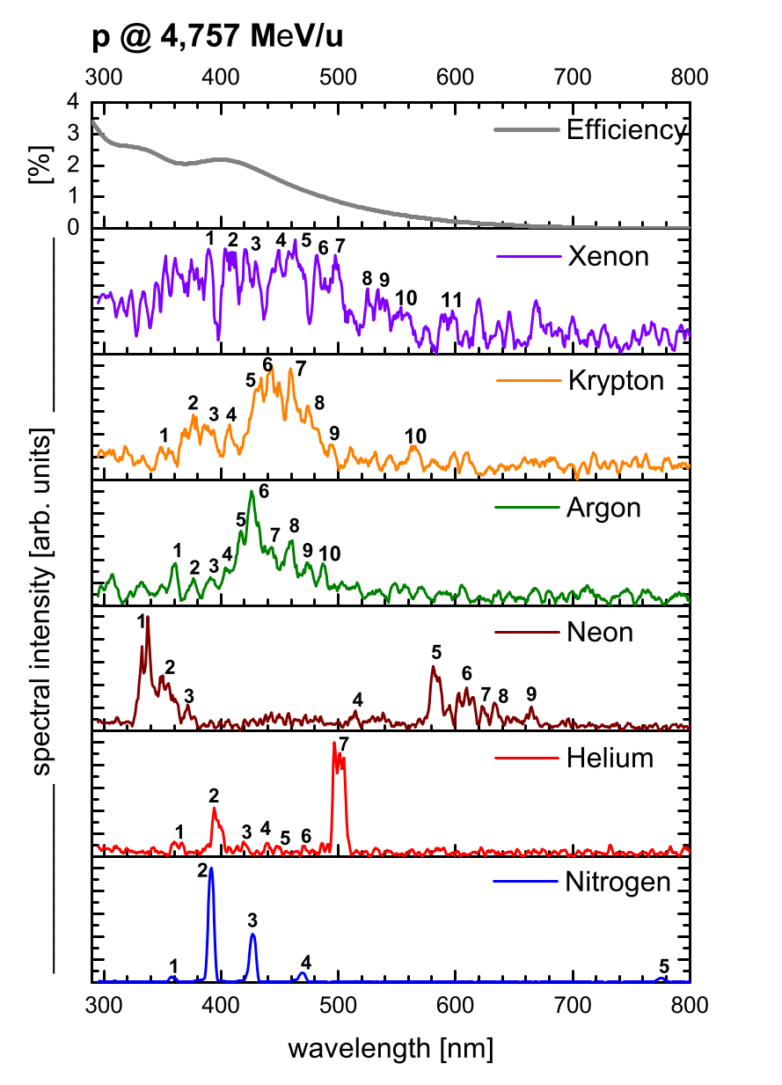
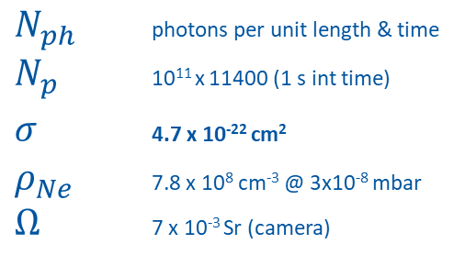
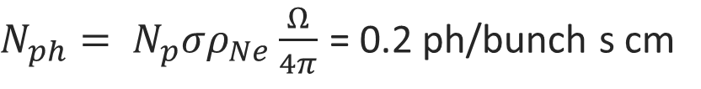
Fluorescence data (Ne)
Data for Ne is scarce. Emission occurs between 300-400 nm (Ne⁺) and 580-700 nm (neutral).
Strongest (neutral) line 585.4 nm. Fluorescence by direct excitation (negligible cascading, no optical excitation), cross section based on 2p₁ level excitation (Bretagne et al, J. Phys. D 1986, Puech & Mizzi, J. Phys. D 1991).
Short life time: approx. 10 ns
Data for electron impact up to 1 keV & protons up to 1 MeV. Extrapolated for 7 TeV protons
F. Becker (GSI), PhD thesis
$N_{ph}$ photons per unit length & time
$N_{p}$ 10¹¹ x 11400 (1 s int time)
$σ$ 4.7 x 10⁻²² cm²
$ρ_{Ne}$ 7.8 x 10⁸ cm⁻³ @ 3x10⁻⁸ mbar
$Ω$ 7 x 10⁻³ Sr (camera)
$N_{ph}= N_{p}σρ_{Ne}\frac{Ω}{4π}$ = 0.2 ph/bunch s cm
Low light yield!

Slide 9
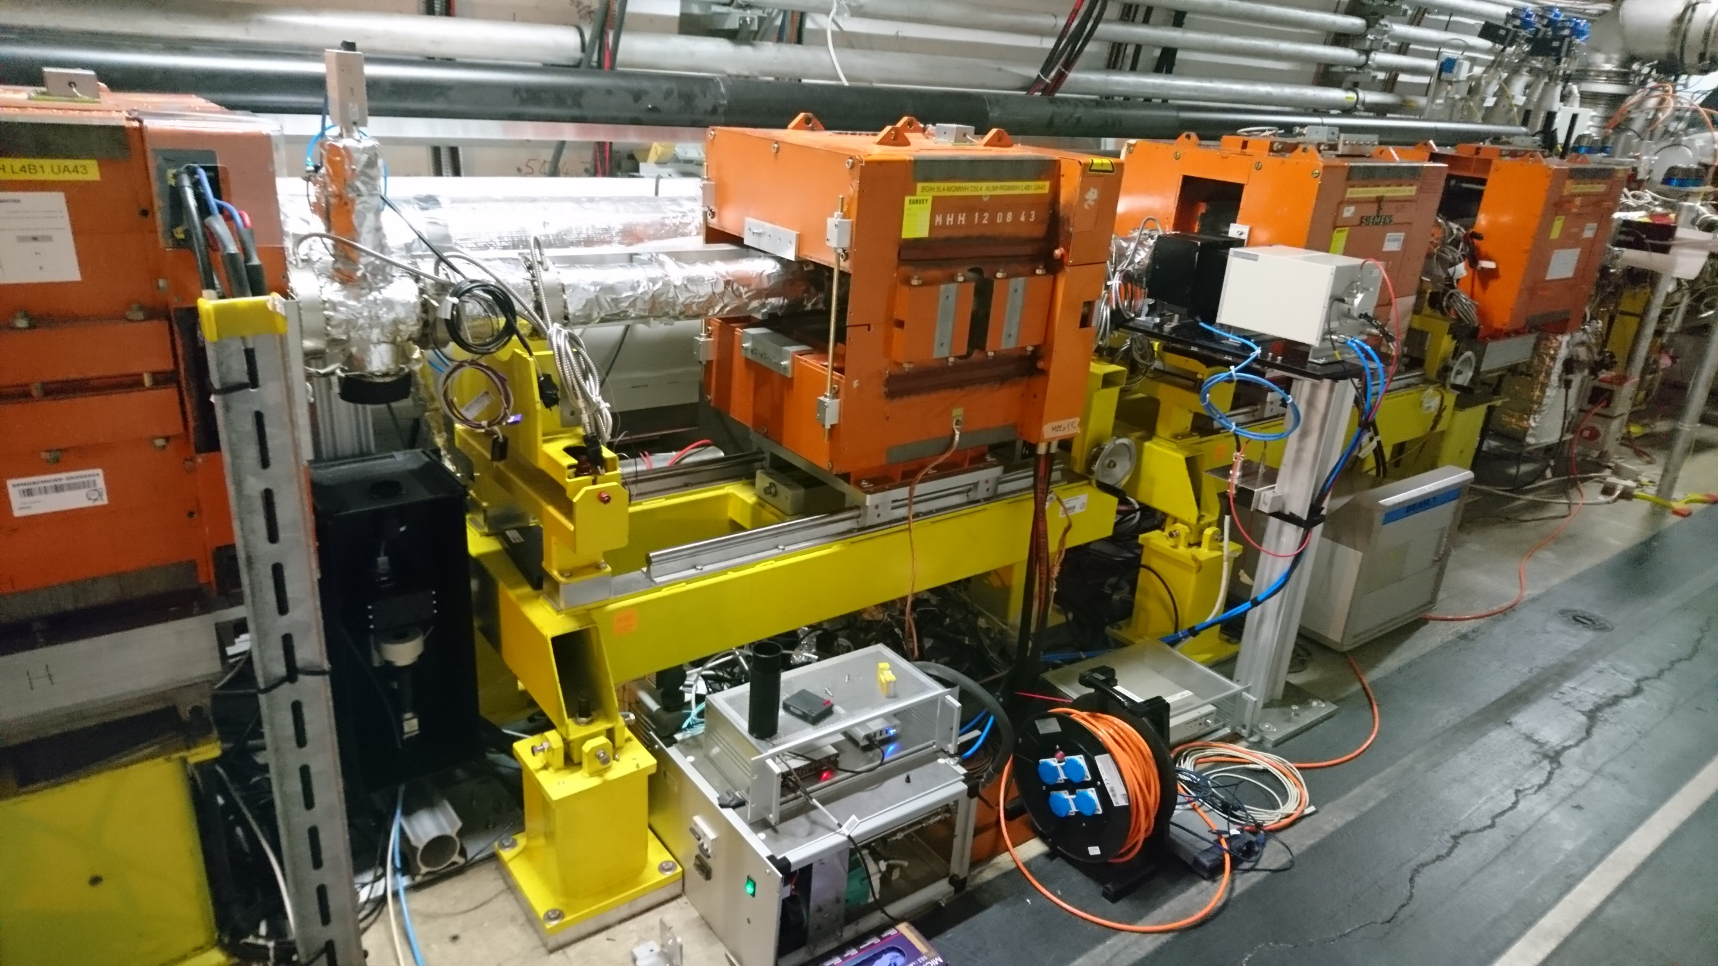
LHC BIF test
MCP-PMT photon counting
Time resolved measurement, 50 ps resolution over full LHC turn
Goal: measurement of cross section and (exponential) time constant of fluorescence
Installed YETS 17-18
Intensified camera
Image of horizontal beam profile (integrated over vertical plane)
20um resolution (15 pix per sigma at 6.5 TeV)
Goal: beam profile
Installed TS2

Slide 10
LHC BIF tests
Date | Fill # | #b | Device | Int. time [s] | comments
25/4 | 6612 | 603 | PMT | ? | First injection. Test
7/5 | 6650 | 2556 | PMT | ? | Again system test
16-17/5 | 6693 | 1887 | PMT | 360 | 6.5 TeV data plus BG data (no gas, block filter)
27/6 | 6854 | 1227 | Camera | 2.7 | First test with camera. GaAsP photocathode.
6/7 | 6891 | 1452 | Camera | 3 | 6.5 TeV, BG data (no gas)
10/7 | 6909 | 2556 | Camera | 9 (585nm), 3 (340 nm) | 6.5 TeV data, 585 and 340 nm.
27/9 |  |  | Camera | - | System test after TS2. New camera (multialkali photocathode), translation stage
28/9 | 7232 | 2556 | Camera | 133 (585 nm), 200 (BB) | 450 GeV data
17/10 | 7310 | 2556 | Camera | 420 (585 nm) | 450 GeV data. Also 6.5 TeV data with 340 nm filter (800 s int time)
18/10 | 7315 | 2556 | Camera | 600 | 450 GeV data, 585 nm filter
19/10 | 7319 | 2566 | Camera | - | Gas pressure increased to 4x10⁻⁷ mbar, beam dump
16/11 | 7448 | 648 | Camera | 5 | Ion run. 6.3 TeV data, 585 nm filter. BG data (no gas)
20/11 | 7457 | 648 | Camera | 38 | Ion run. 6.3 TeV data, 585 nm filter
26/11 |  |  | Camera
28/11 |  |  | Camera
1/12 |  |  | Camera |  | Ion run. Injection energy

Slide 11
LHC BIF tests
Date | Fill # | #b | Device | Int. time [s] | comments
25/4 | 6612 | 603 | PMT | ? | First injection. Test
7/5 | 6650 | 2556 | PMT | ? | Again system test
16-17/5 | 6693 | 1887 | PMT | 360 | 6.5 TeV data plus BG data (no gas, block filter)
27/6 | 6854 | 1227 | Camera | 2.7 | First test with camera. GaAsP photocathode.
6/7 | 6891 | 1452 | Camera | 3 | 6.5 TeV, BG data (no gas)
10/7 | 6909 | 2556 | Camera | 9 (585nm), 3 (340 nm) | 6.5 TeV data, 585 and 340 nm.
27/9 |  |  | Camera | - | System test after TS2. New camera (multialkali photocathode), translation stage
28/9 | 7232 | 2556 | Camera | 133 (585 nm), 200 (BB) | 450 GeV data, 585 nm & BB
17/10 | 7310 | 2556 | Camera | 420 (585 nm) | 450 GeV data. Also 6.5 TeV data with 340 nm filter (800 s int time)
18/10 | 7315 | 2556 | Camera | 600 | 450 GeV data, 585 nm filter
19/10 | 7319 | 2566 | Camera | - | Gas pressure increased to 4x10⁻⁷ mbar, beam dump
16/11 | 7448 | 648 | Camera | 5 | Ion run. 6.3 TeV data, 585 nm filter. BG data (no gas)
20/11 | 7457 | 648 | Camera | 38 | Ion run. 6.3 TeV data, 585 nm filter
26/11 |  |  | Camera
28/11 |  |  | Camera
1/12 |  |  | Camera |  | Ion run. Injection energy

Slide 12
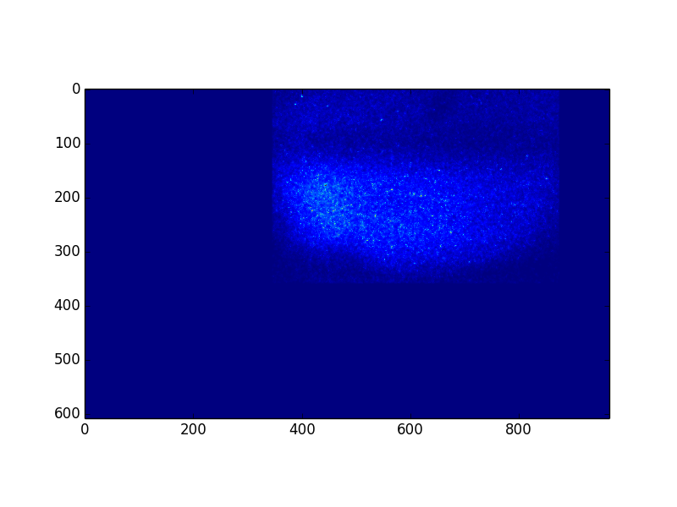
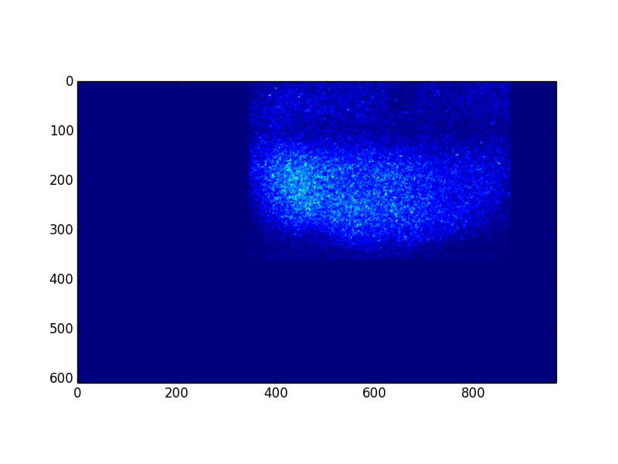
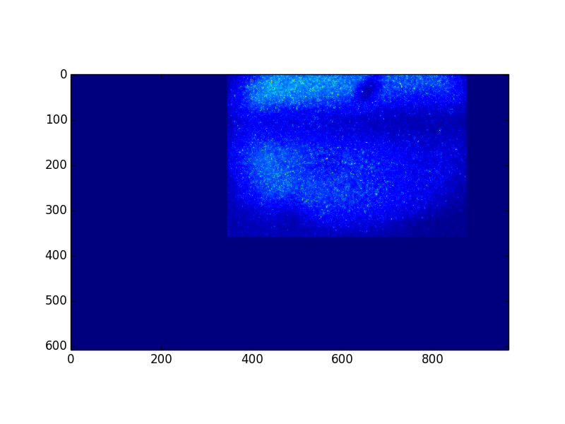
Data from Pb+ at injection
Fill 7481, 28/11/2018. Acquired data at injection:
  with / without gas and block filter, beam on
  with / without gas and 585 nm filter, beam on
Fill 7487, 30/11/2018. Acquired data at injection:
  With gas, no beam, 585 nm filter
  With gas, with beam, 585 nm filter
585 nm, gas ON, beam OFF
“photon counting” over 577.6 s
(1440 frames, 400 ms exp time)
585 nm, gas OFF, beam ON
“photon counting” over 210.8 s
(527 frames, 400 ms exp time)
585 nm, gas ON, beam ON
“photon counting” over 1286.4 s
(3216 frames, 400 ms exp time)

Slide 13
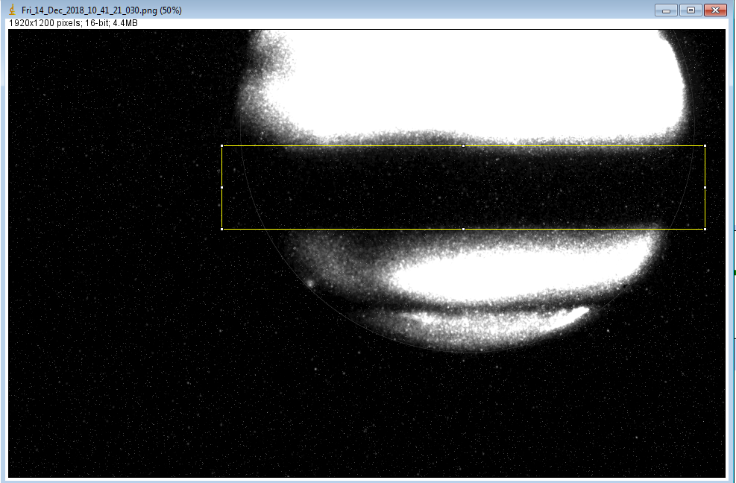
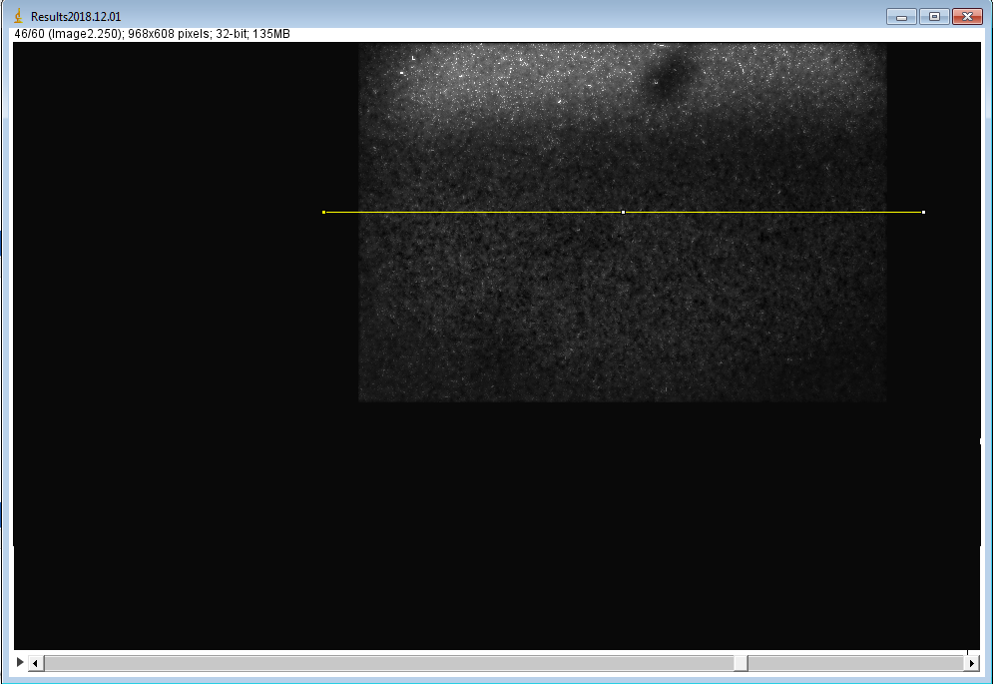
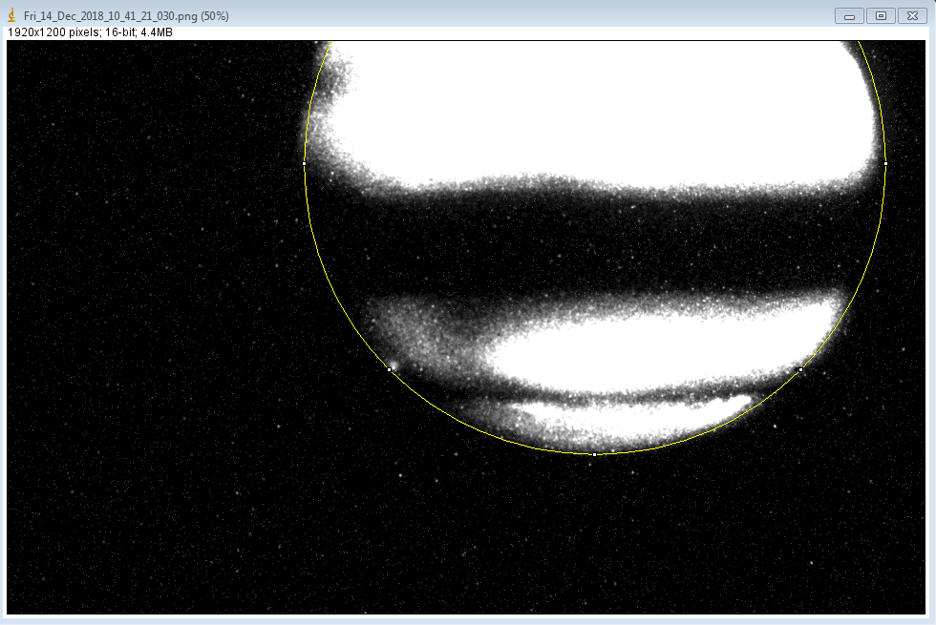
Position
Horizontal position off by 5.5 mm.
Vertical offset: 5.5 mm

Slide 14
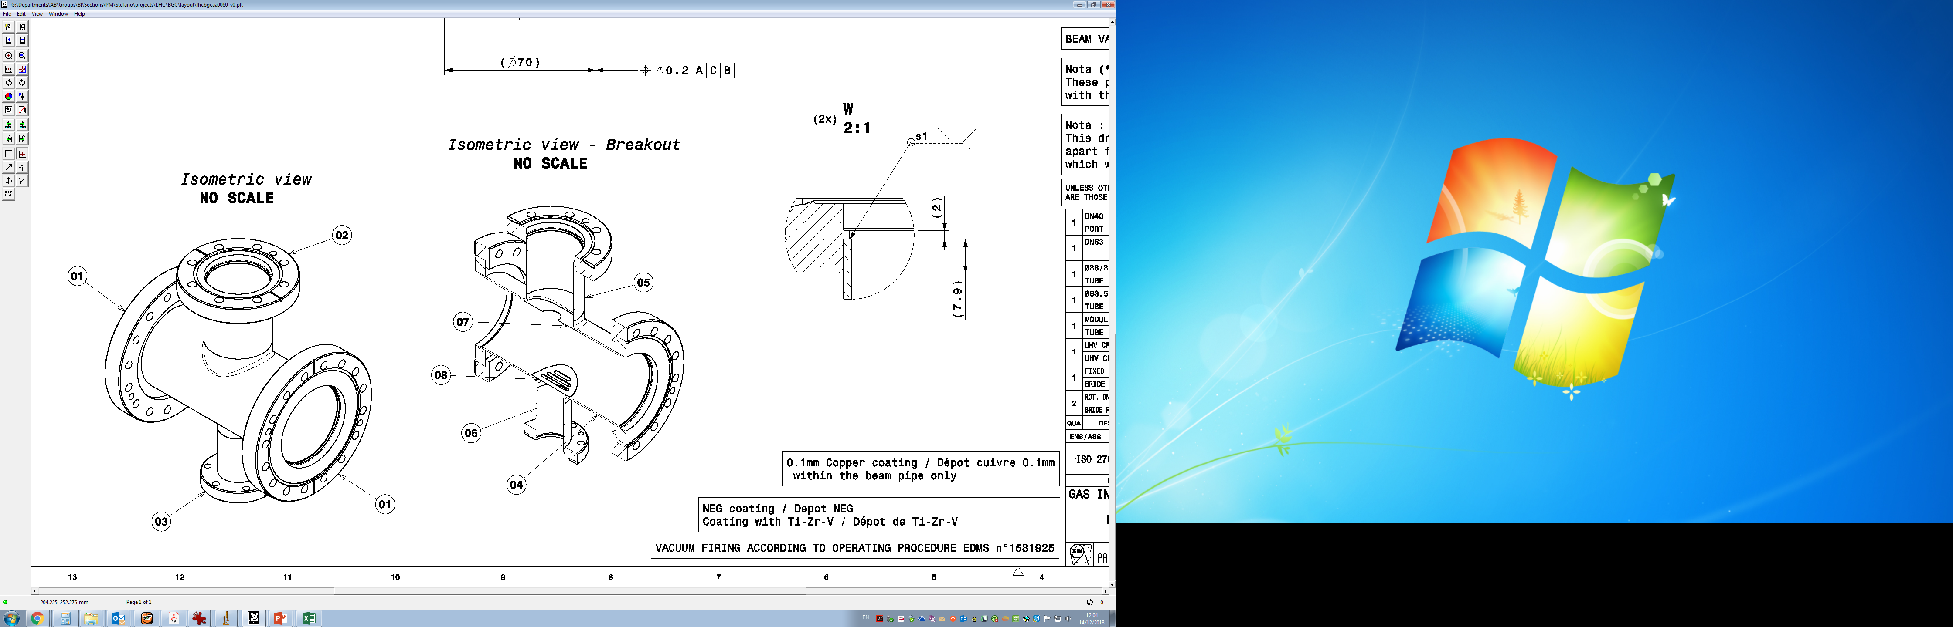
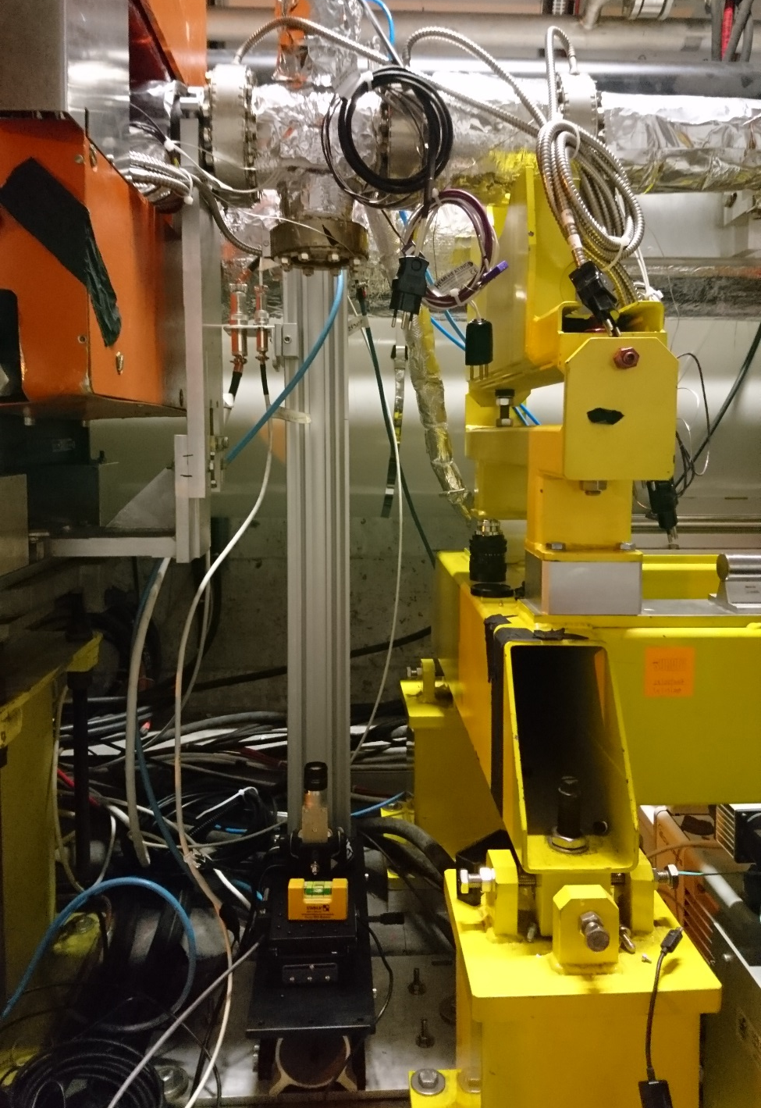
Position
35 mm
objective

Slide 15
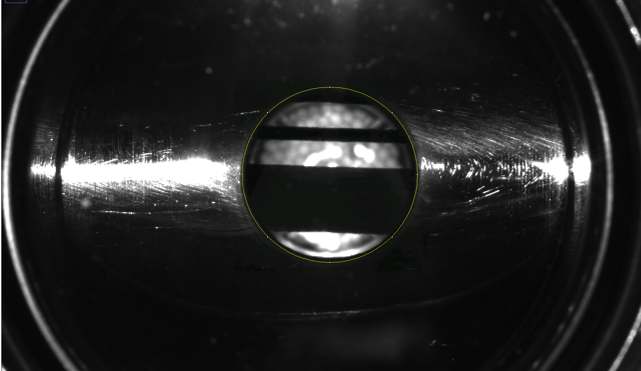
Position
+
BEAM
-
When compared to the centre of the viewport and beam screen, the beam appears to be approx. + 1.5 mm off
Closest BPM reads -0.5 mm

Slide 16
Position
+
BEAM
FOV
-
When compared to the centre of the viewport and beam screen, the beam appears to be approx. + 1.5 mm off
Closest BPM reads -0.5 mm

Slide 17
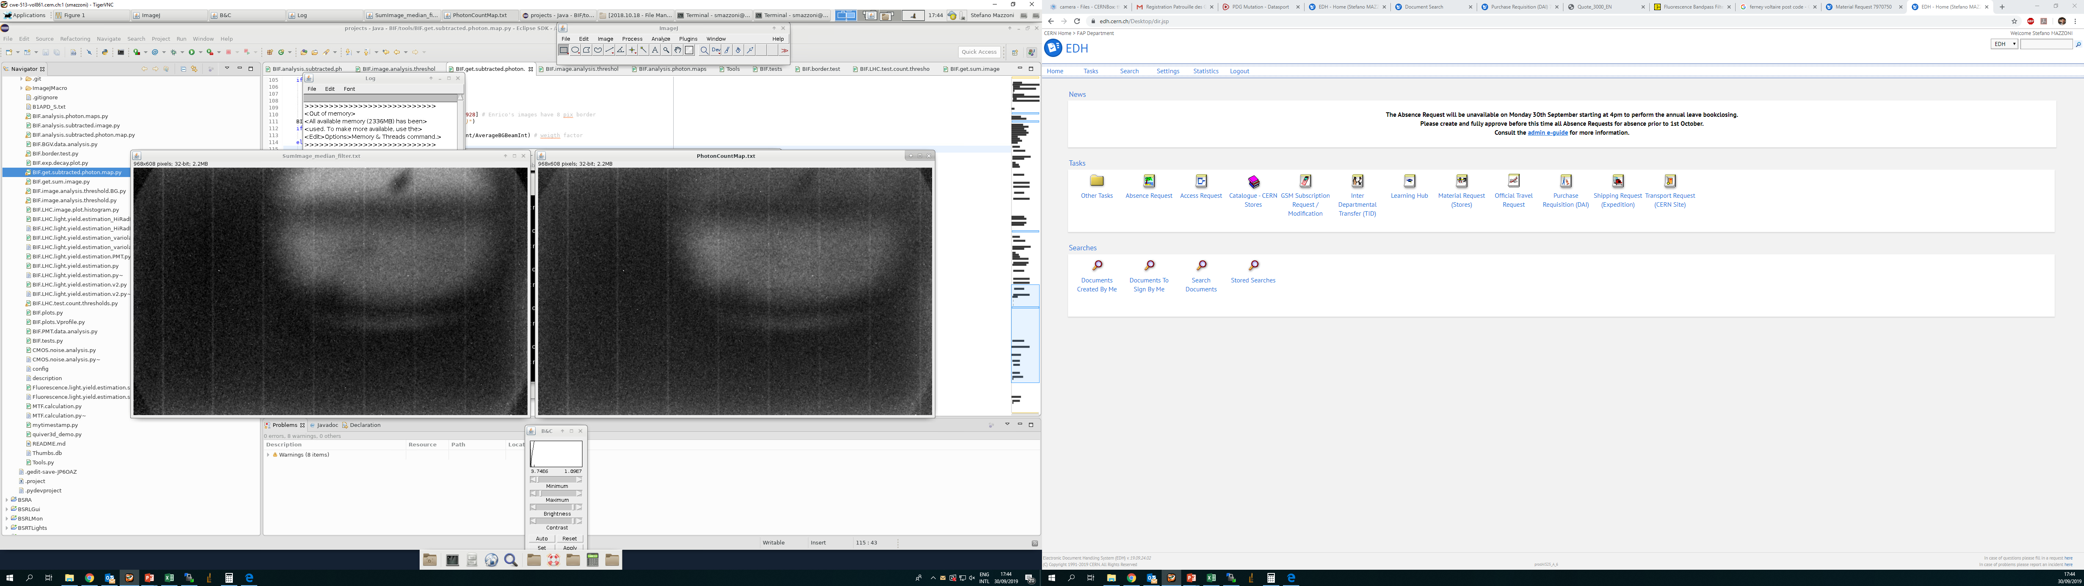
Profile from Ions
585 nm, gas ON, beam OFF
Integration over 577.6 s
(1440 frames, 400 ms exp time)
585 nm, gas ON, beam ON
Integration over 1286.4 s
(3216 frames, 400 ms exp time)

Slide 18
Profile from Ions
585 nm, gas ON, beam OFF
Integration over 577.6 s
(1440 frames, 400 ms exp time)
585 nm, gas ON, beam ON
Integration over 1286.4 s
(3216 frames, 400 ms exp time)
Compute vertical profile over ROI

Slide 19
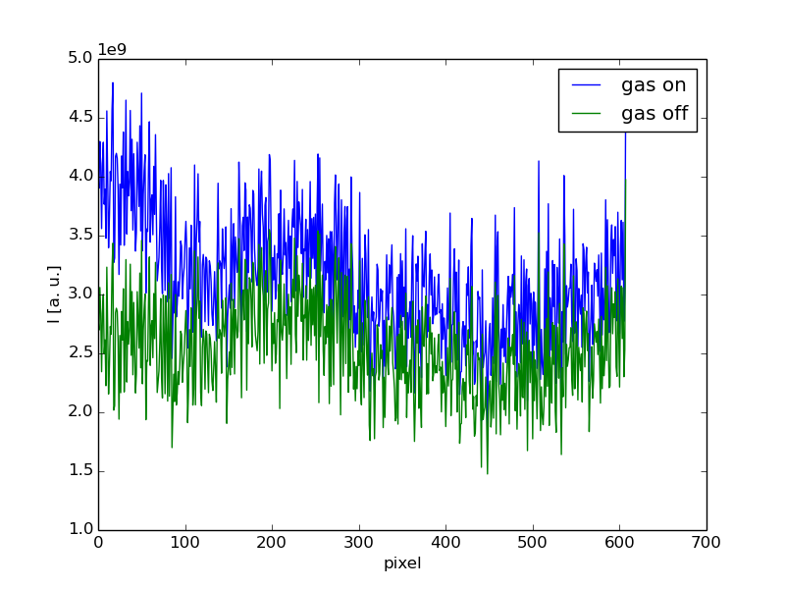
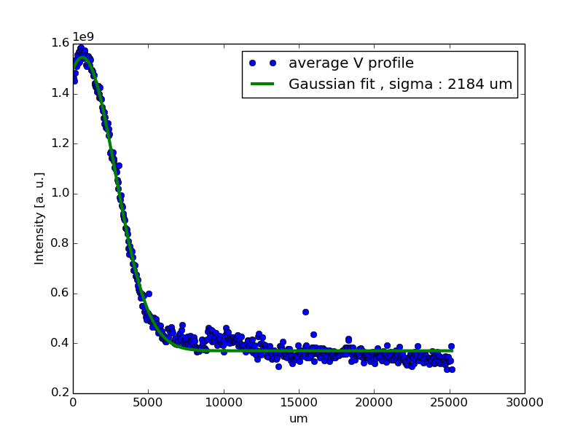
Profile from Ions
V Profiles from sum of
3215 images (gas on)=> 1285 s integration time
1443 images (gas off)=> 577 s i.t.
Difference corrected for different integration time, no other adjustable parameter.
Sigma 2.2 mm

Slide 20
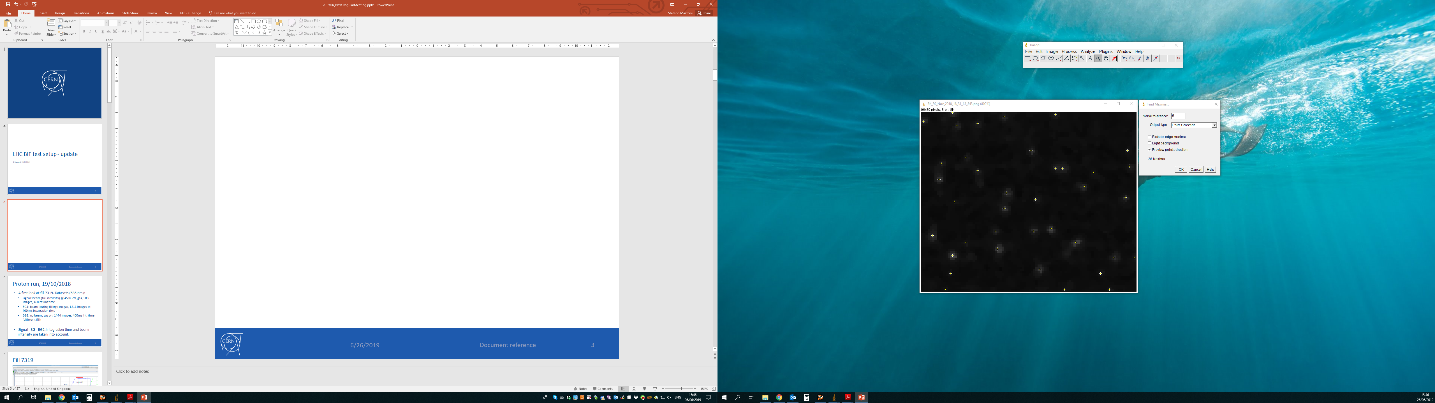
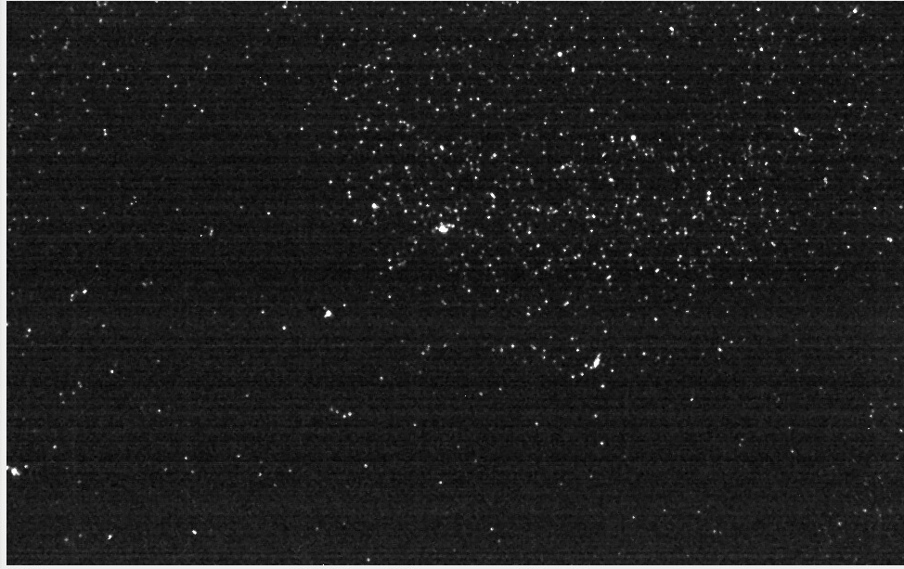
Photon counting
Due to low light yield, counting individual photons is possible:
CI algorithm
  apply median filter
  Run ‘Find maxima’ macro on ImageJ. Threshold adapted to image
My algorithm:
  Create binary map based on upper and lower threshold (= pixel =1 if its value is inside lower-upper threshold, =0 otherwise)
  Apply scipy.ndimage.measurements routine to count objects
  Discard objects smaller than minimum size
Both algorithms give comparable results, depend on (arbitrarily set) thresholds

Slide 21
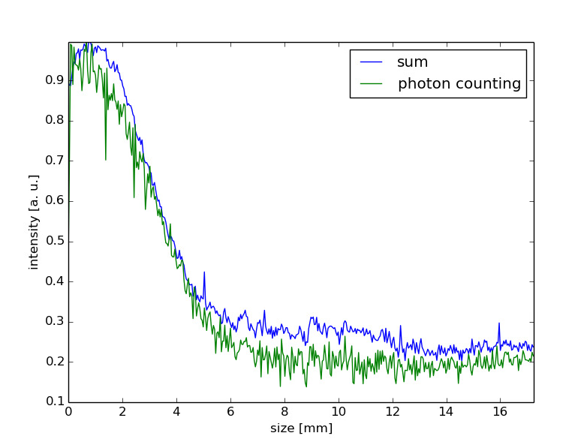
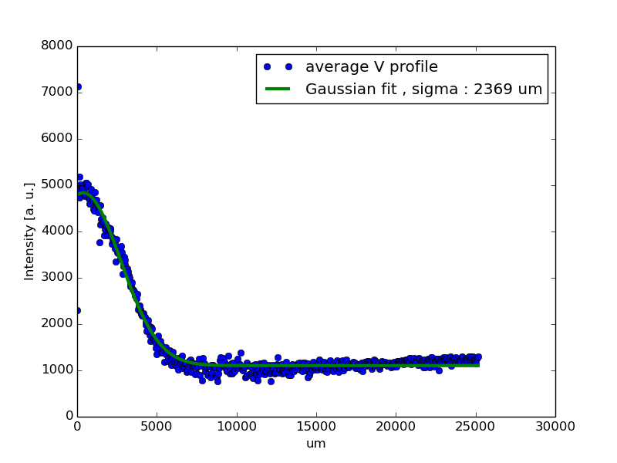
Profile from ions (photon counting)
Discrepancies arise when calculating profiles using photon counting: 2.4 mm sigma (vs. 2.2 mm)
Edge effects are observed when counting, however this does not explain discrepancy

Slide 22
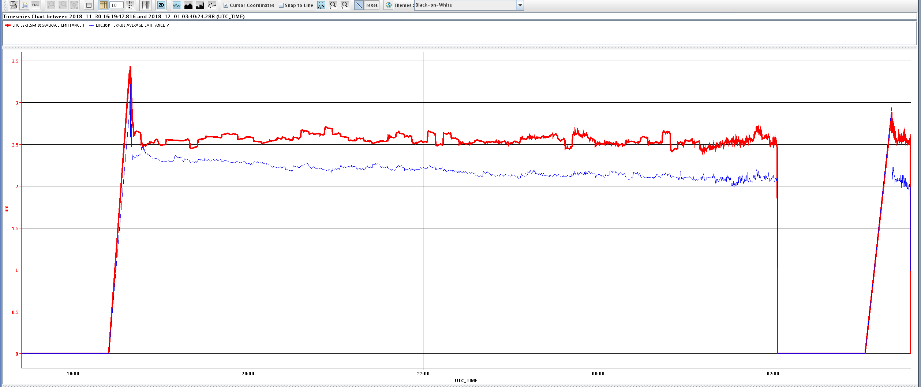
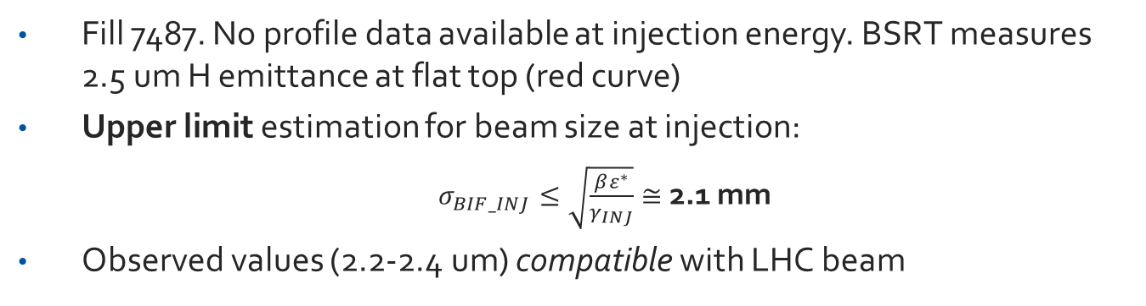
Estimation of expected profile
Fill 7487. No profile data available at injection energy. BSRT measures 2.5 um H emittance at flat top (red curve)
Upper limit estimation for beam size at injection:
  $σ_{BIF_INJ}≤\sqrt{\frac{βε^{∗}}{γ_{INJ}}}≅$ 2.1 mm
Observed values (2.2-2.4 um) compatible with LHC beam

Slide 23
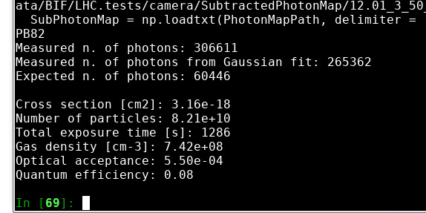
Photon Counting
Photon count is approx. 5 times higher when compared with expected from extrapolation for protons (and scaled for Z^2)
Very difficult measurement (absolute). Camera is not calibrated as photon counting instrument.
Tests at CI with other camera: approx. 1.6 lower counts wrt Proxitronic setup at CI

Slide 24
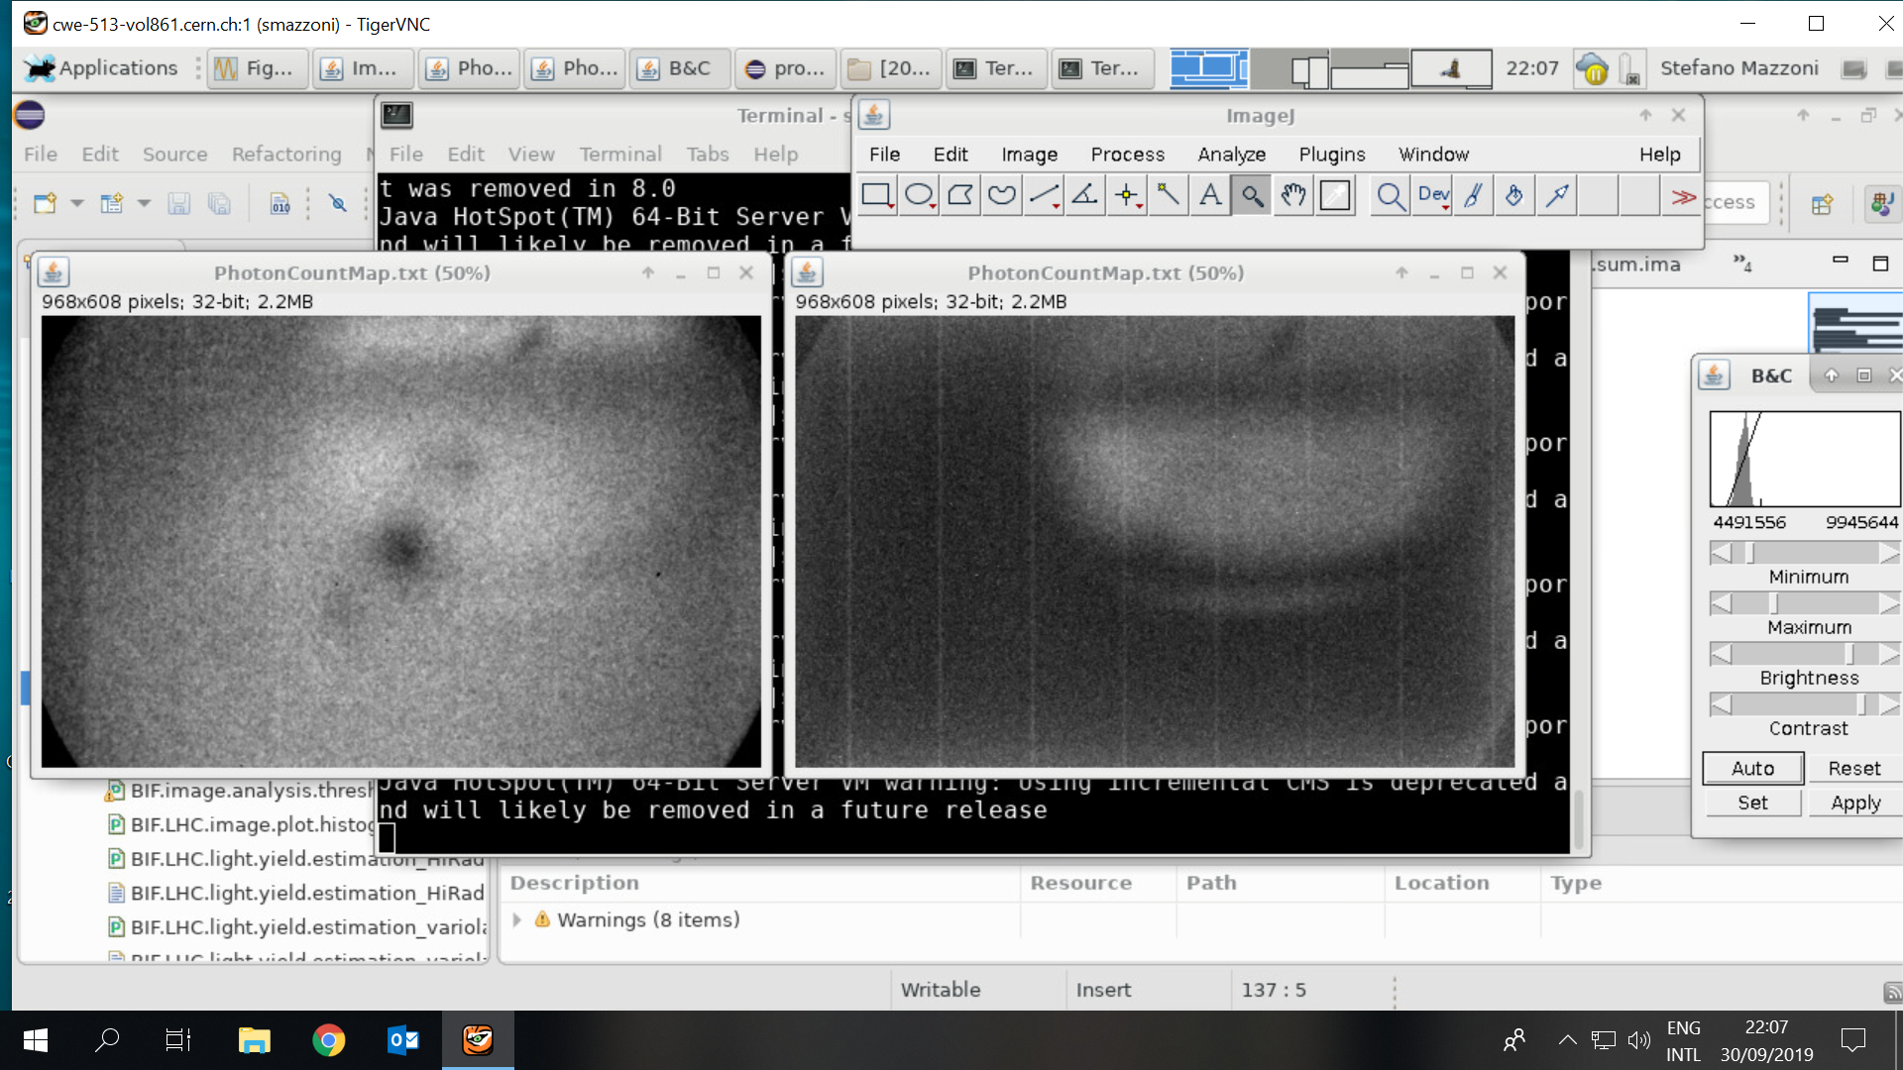
Profile from protons
585 nm, gas OFF, beam ON
Integration over 486 s
(1215 frames, 400 ms exp time)
585 nm, gas ON, beam ON
Integration over 205 s
(512 frames, 400 ms exp time)

Slide 25
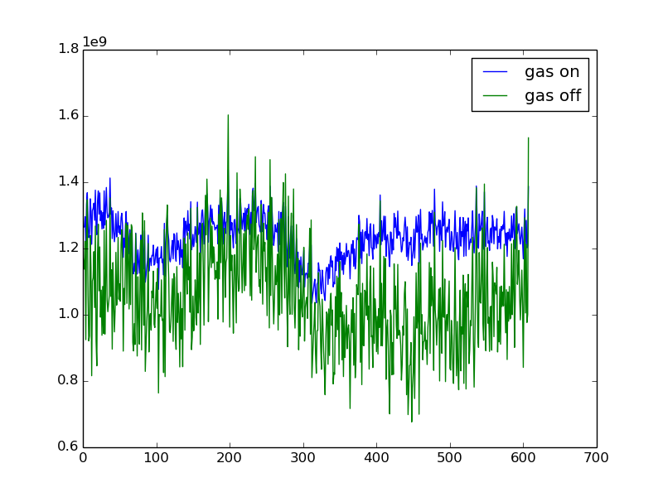
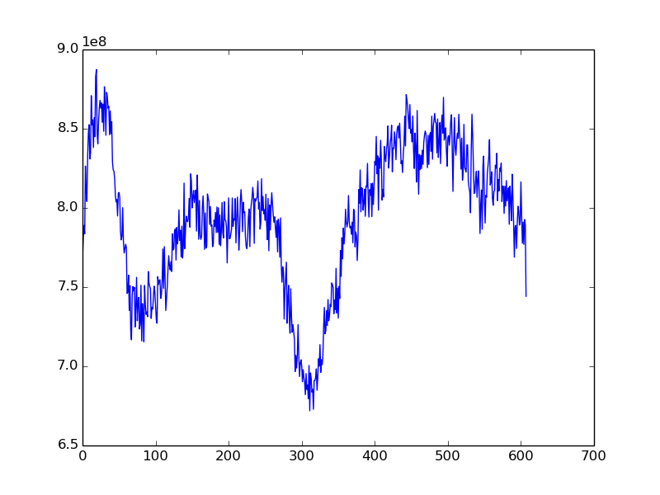
Protons
Same procedure for protons. Subtracted signal is corrected for different exp time. Int time shorter than Pb run (here 200 s approx. for both gas on/off)
Dip at 300 pix defect of photocathode
Background subtraction very poor: not understood!

Slide 26
Profile from protons
585 nm, gas OFF, beam ON
Integration over 486 s
(1215 frames, 400 ms exp time)
585 nm, gas ON, beam ON
Integration over 205 s
(512 frames, 400 ms exp time)

Slide 27
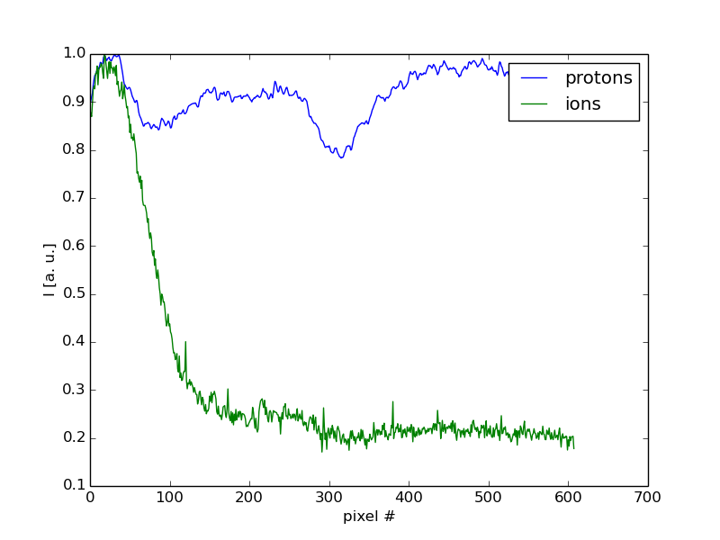
Protons vs ions
Protons vs Pb ions profiles normalized for peak intensity
Ion cross section per particle Z2 (82² = 6742) times the one for p.
Considering higher intensity of p beam (2.5E+14 vs 0.7E+11): overall expected light yield for ions is x2 times protons
However: losses signal is proportional to intensity => x 10⁻³ S/N wrt Pb+

Slide 28
Protons vs ions
Protons vs Pb ions profiles normalized for peak intensity
Ion cross section per particle Z2 (82² = 6742) times the one for p.
Considering higher intensity of p beam (2.5E+14 vs 0.7E+11): overall expected light yield for ions is x2 times protons
However: losses signal is proportional to intensity => x 10⁻³ S/N wrt Pb+

Slide 29
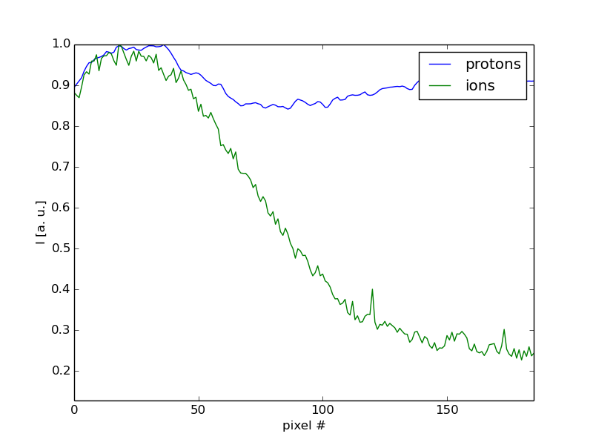
Protons vs ions
Protons vs Pb ions profiles normalized for peak intensity
Ion cross section per particle Z2 (82² = 6742) times the one for p.
Considering higher intensity of p beam (2.5E+14 vs 0.7E+11): overall expected light yield for ions is x2 times protons
However: losses signal is proportional to intensity => x 10⁻³ S/N wrt Pb+

Slide 30

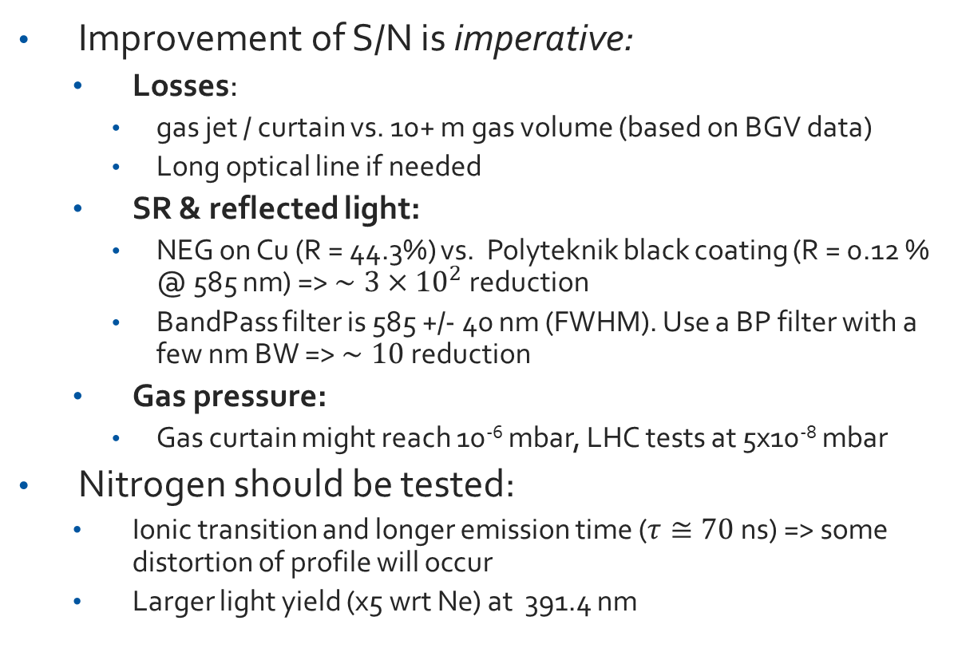


Final considerations
Improvement of S/N is imperative:
  Losses:
    gas jet / curtain vs. 10+ m gas volume (based on BGV data)
    Long optical line if needed
  SR & reflected light:
    NEG on Cu (R = 44.3%) vs. Polyteknik black coating (R = 0.12 % @ 585 nm) => $∼{3×10}^{2}$ reduction
    BandPass filter is 585 +/- 40 nm (FWHM). Use a BP filter with a few nm BW => $∼10$ reduction
  Gas pressure:
    Gas curtain might reach 10⁻⁶ mbar, LHC tests at 5x10⁻⁸ mbar
Nitrogen should be tested:
  Ionic transition and longer emission time ($τ≅70$ ns) => some distortion of profile will occur
  Larger light yield (x5 wrt Ne) at 391.4 nm
    =>$∼{10}^{3}$
    $$∼{10}^{3}$$
    =>$∼{10−10}^{2}$

Slide 31
Final considerations
Fluorescence:
  PROS. Very simple source: incoherent, isotropic, monochromatic. Detection is simple: imaging
  CONS. Low light yield, noise sources (SR, losses).
Potential for a precise average beam size measurement technique for protons, ions at injection. Ramp & high energy require better S/N.
Test during LHC Run 3 will clarify actual performance of BIF + BGC:
  Actual S/N improvement
  Choice of gas (profile distortion with N?)
  Actual gas curtain properties (pressure, shape,…)

Slide 33
Some extra slides

Slide 34
Experimental conditions for both measurements
Current of the electron gun = 0.65mA
Energy of the electron gun = 5KeV
Exposure time per image = 1s
Total integration time for the measurements = 100 seconds (100 images)
Inlet gas and pressure = Nitrogen at 5bar
Nozzle type = 30micron nozzle designed and manufactured at CERN

Slide 35
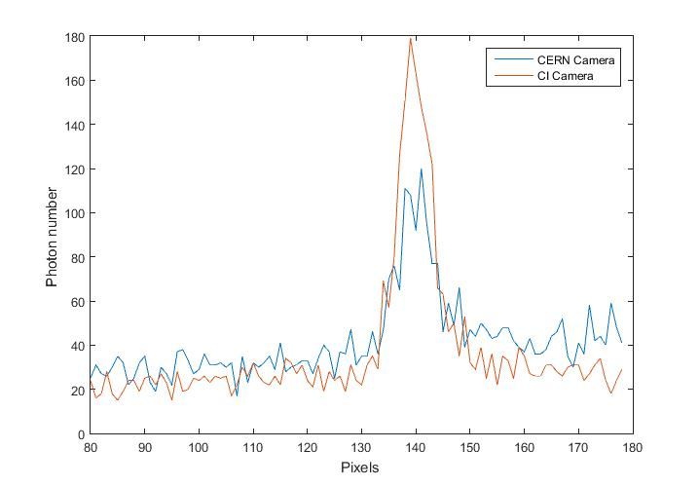

Slide 36
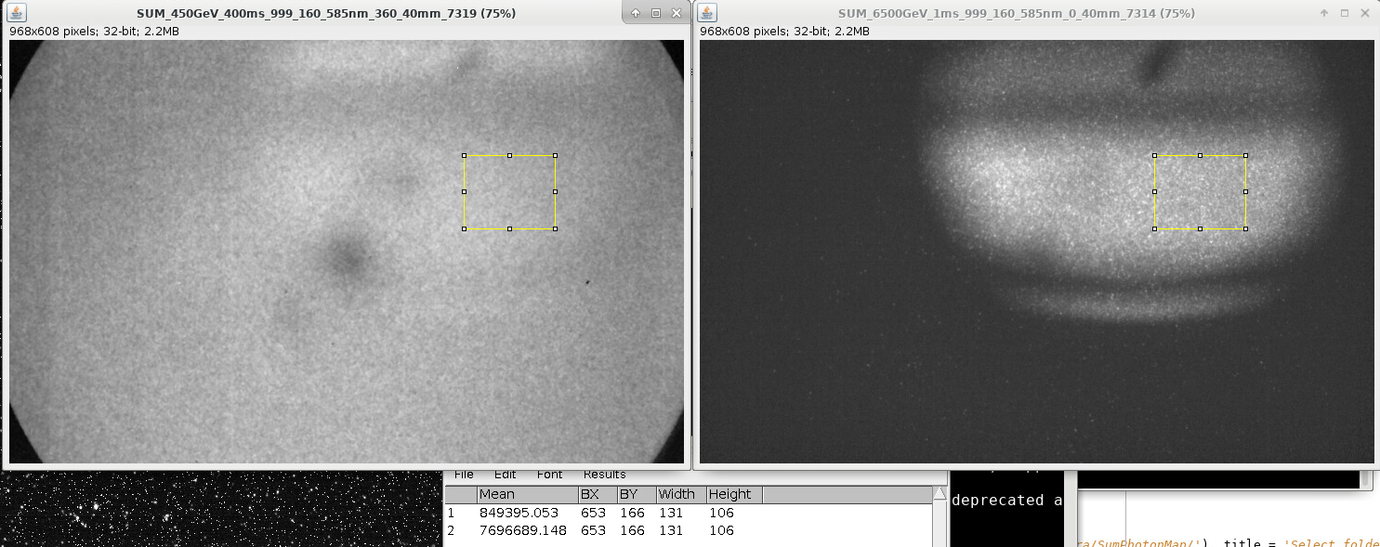
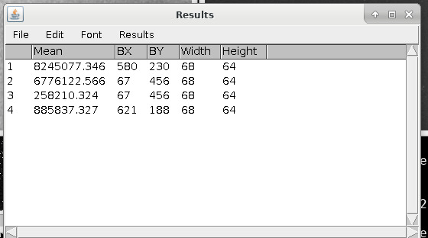
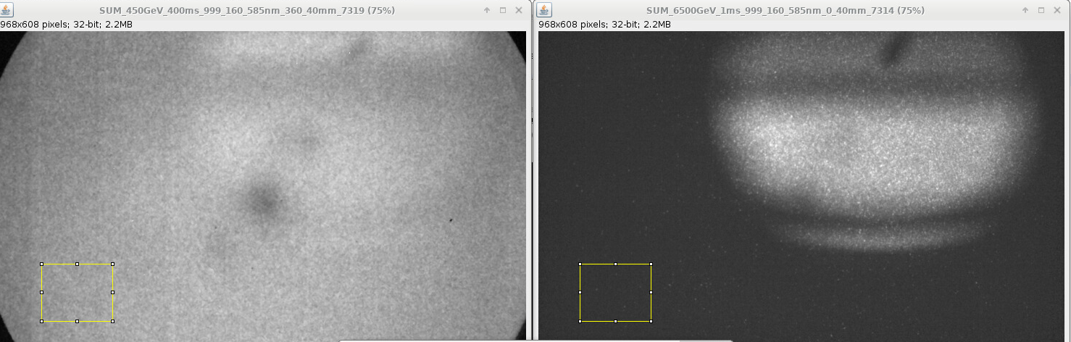
Injection vs Flat top
1: flat top
2: inj
Inj: 500 x 400 ms images, gain 360, fill 7315 (18/10)
Flat Top: 691 x 1 ms images, gain 0 fill 7315 (18/10)
Lab test: gain 360 = x65.8 factor
SR: compare reflected light
LOSSES: compare background
$\frac{{LY}_{FT_LOSS}}{{LY}_{INJ_LOSS}}= \frac{258210}{6776122}×\frac{500×400}{691}$ $×65.8=0.04×289×65.8=7.6E+02$
$\frac{{LY}_{FT_SR}}{{LY}_{INJ_SR}}= \frac{(885837−258210)}{(8245077−6776122)}×\frac{500×400}{691}$ $×65.8=0.82×289×65.8=8.1E+03$

Slide 37
Scripts summary
My scripts:
  BIF.LHC.image.analysis.threshold.png. Counts photons from LHC or CI images according to two parameters: threshold and minimum size of clusters. Results are saved in folder ‘results_<min size>_<threshold>’ as:
        Individual photon maps (txt files)
        In folder ‘Results’: AnalysisSummary.txt, PhotonCountMap.txt, PhotonMap.txt
  When photon maps are produced by Serban’s ImageJ script, I use BIF.LHC.image.analysis.Cockroft.macro to produce a ‘Results’ folder that contains AnalysisSummary.txt (for LHC images), PhotonCountMap.txt, PhotonMap.txt
  BIF.get.subtracted.photon.map calculates the correct subtracted photon map (es: photon map with gas and beam minus photon map with beam no gas) taking into account number of images that might be different between the two datasets. For LHC data sets takes into account different beam intensities.
  BIF.analysis.subtracted.photon.map.py is the macro that counts photons and fits profile with Gaussian

Slide 38
With ImageJ procedure: 2x median filter (1 pix), find maxima with noise tolerance at 5 pixels. This is according to the parameters set by CI team when performing the tests at CI.

Slide 39
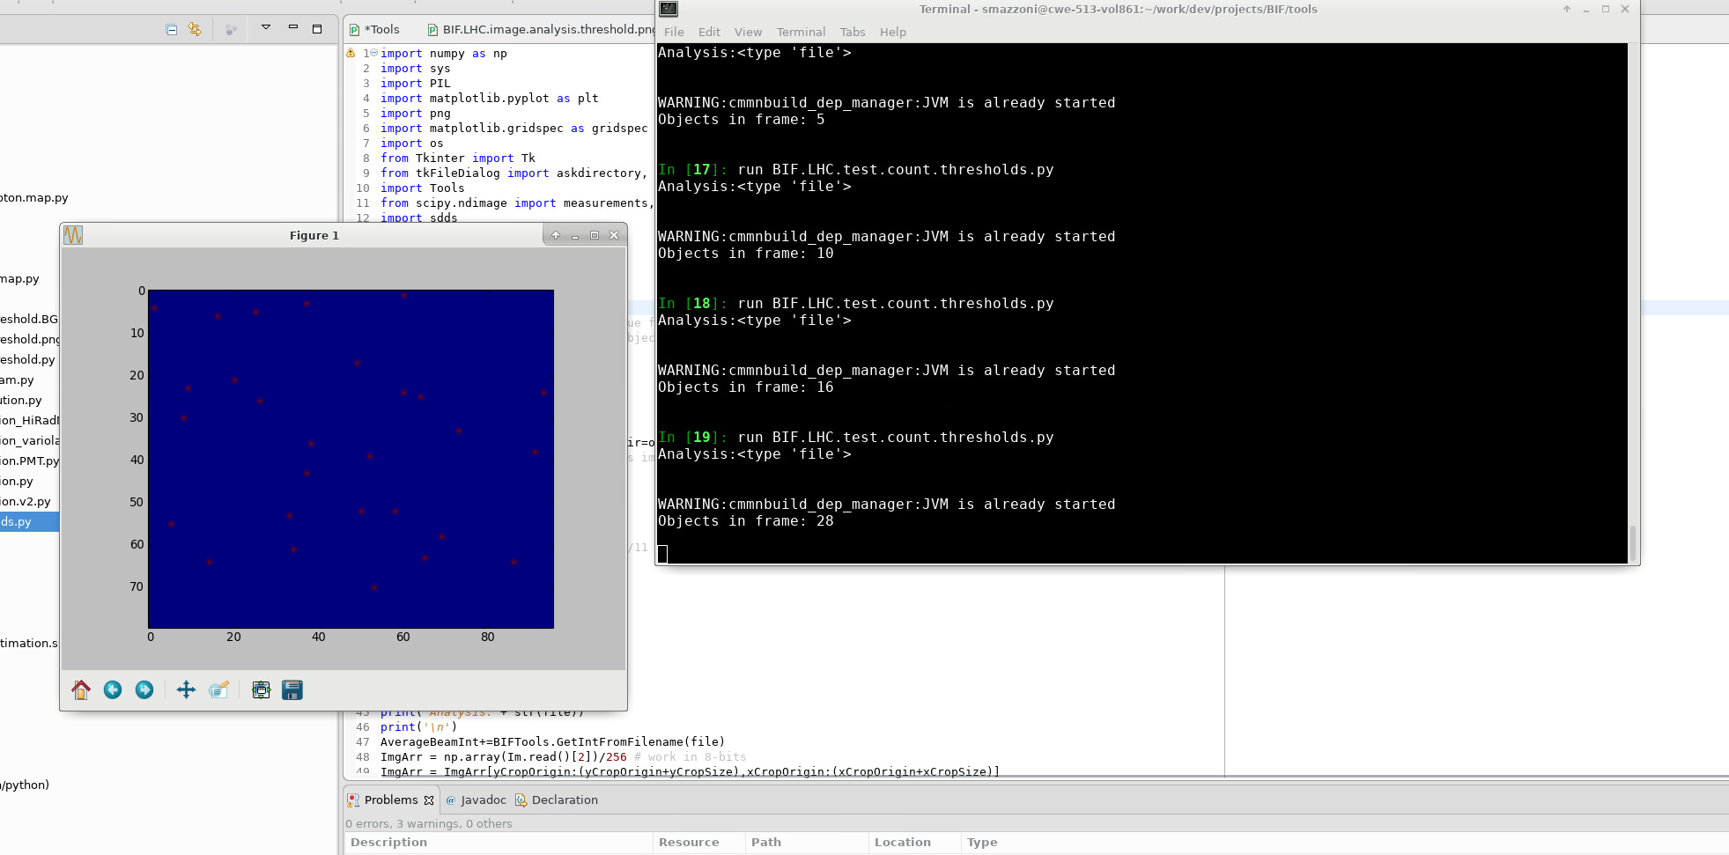
With ImageJ procedure: 2x median filter (1 pix), find maxima with noise tolerance at 5 pixels. This is according to the parameters set by CI team when performing the tests at CI. This corresponds to my python script with 50 levels threshold and 3 pix minimum size limit.

Slide 40
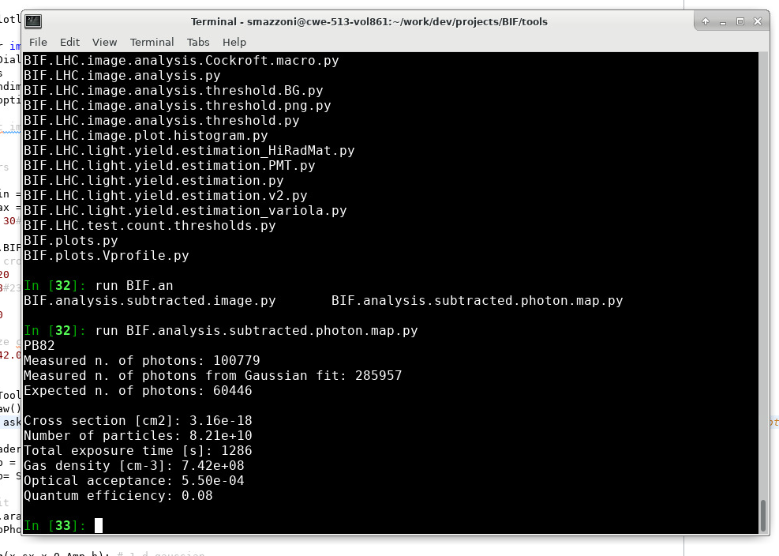
With same parameters (50 levels threshold, 3 pix min size) I get a x1.6 the expected number of photons with the cross section estimated by GSI.

Slide 41
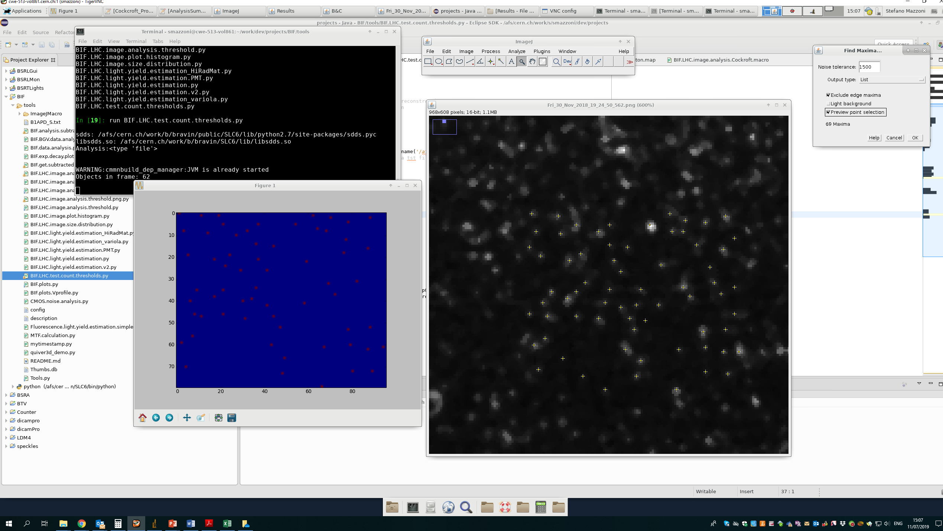
Comparison of mine vs CI routine for photon counting on area xCropOrigin = 450
xCropSize = 96 yCropOrigin = 53 yCropSize = 80 of last image of 12.01 ion run with gas & beam:
Mine with 50 min threshold, 3 min size: 62 objects
CI with 1500: 69
Ci with 5000: 41
CI with 10000: 21

Slide 42
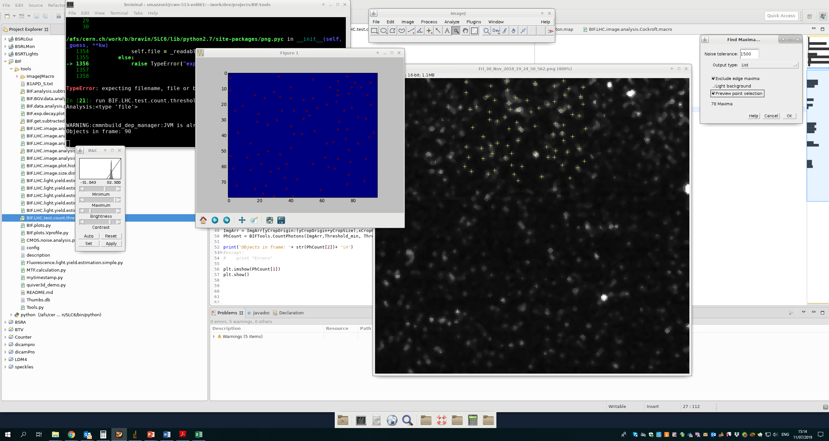
Comparison of mine vs CI routine for photon counting on area xCropOrigin = 450
xCropSize = 96 yCropOrigin = 0 yCropSize = 80 of last image of 12.01 ion run with gas & beam:
Mine with 50 min threshold, 3 min size: 90 objects
CI with 1500: 78
Ci with 5000: 45
CI with 10000: 30
=> When signal is higher looks like my routine sees more counts

Slide 43
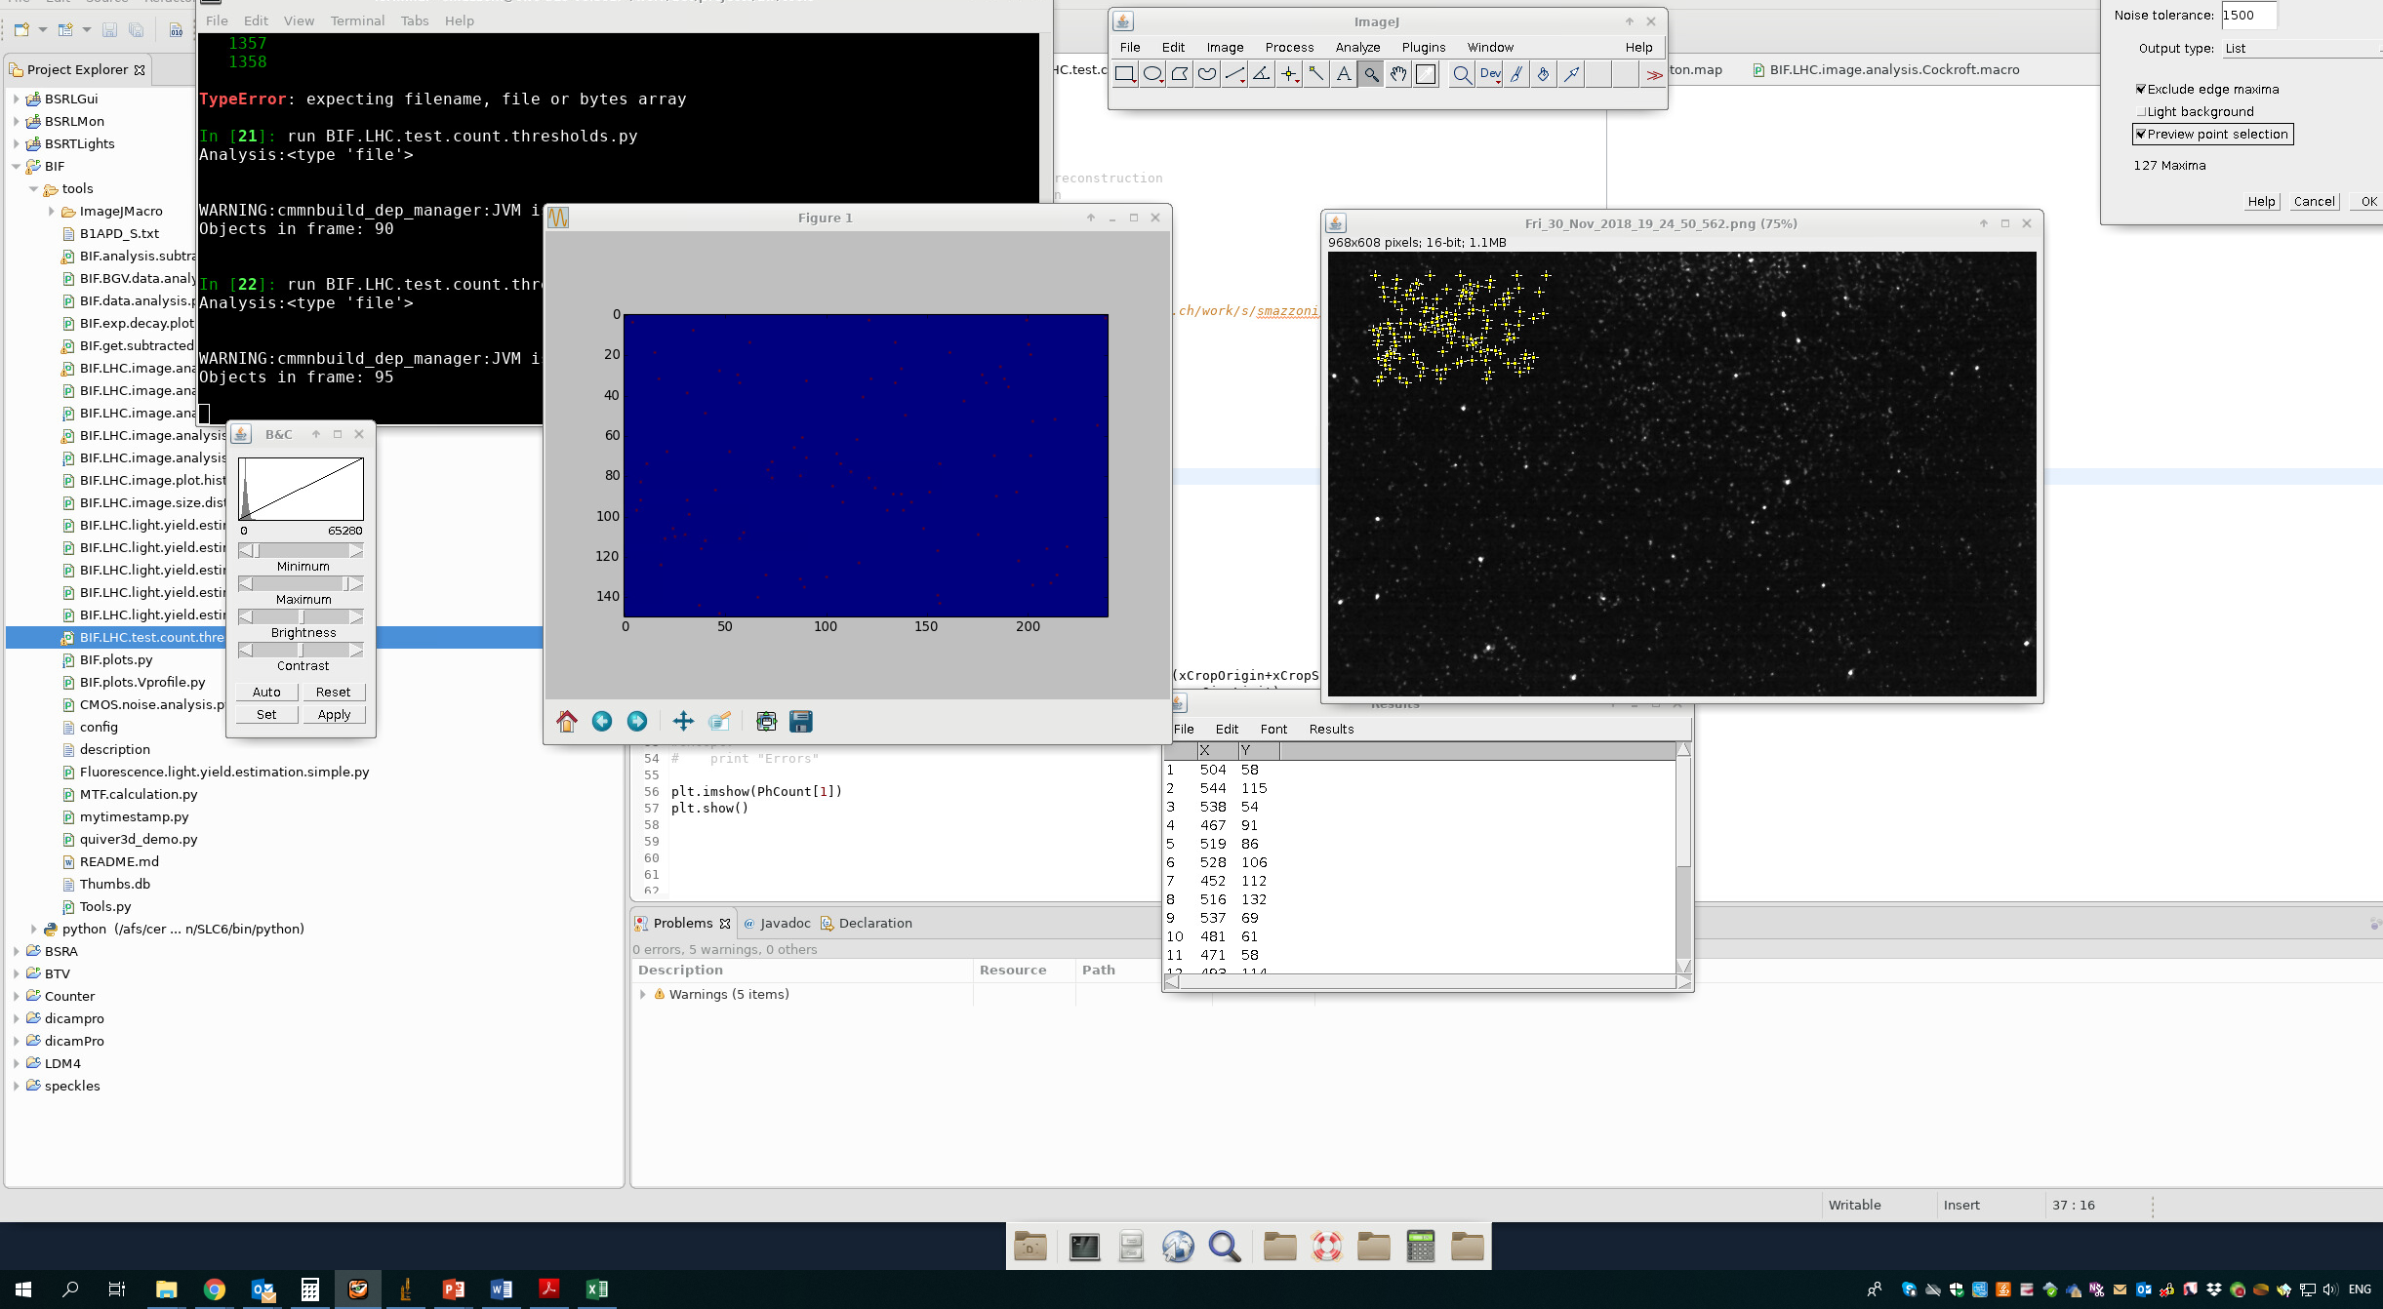
Comparison of mine vs CI routine for photon counting on area xCropOrigin = 60
xCropSize = 240 yCropOrigin = 30 yCropSize = 150 of last image of 12.01 ion run with gas & beam:
Mine with 50 min threshold, 3 min size: 95 objects
CI with 1500: 127
Ci with 5000: 65
CI with 10000: 24
=>BG: the background is much more enhanced by the CI routine

Slide 44
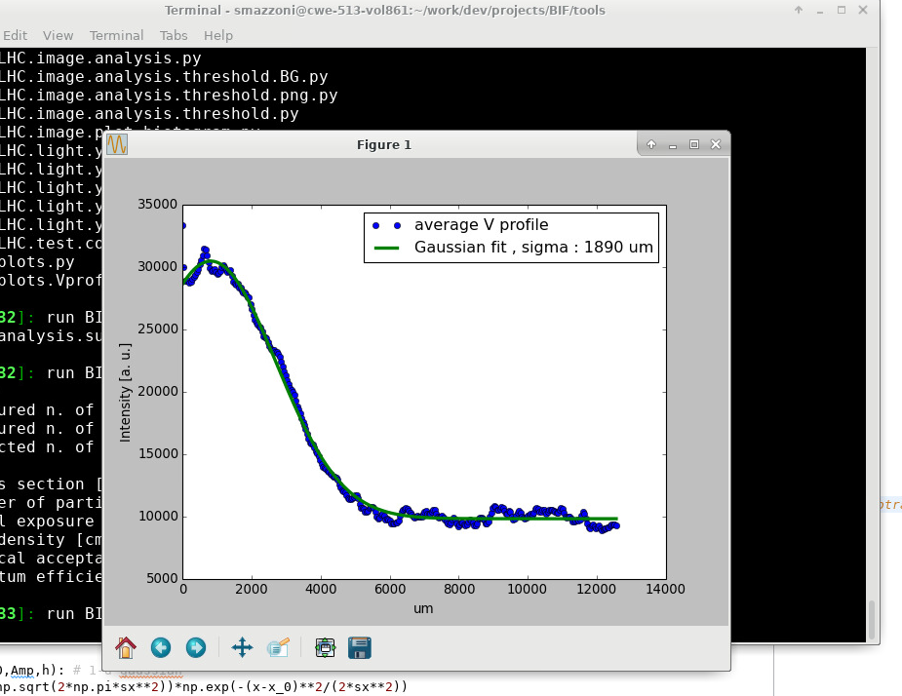
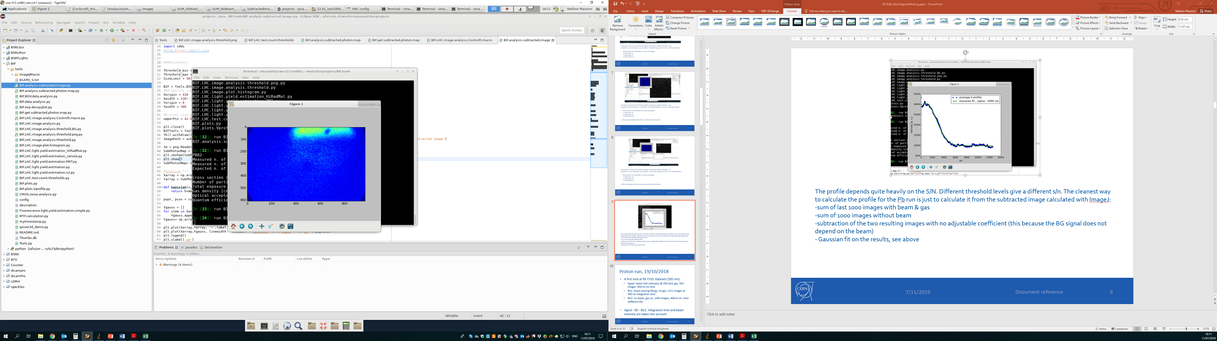
The profile depends quite heavily on the S/N. Different threshold levels give a different s/n. The cleanest way to calculate the profile for the Pb run is just to calculate it from the subtracted image calculated with ImageJ:
-sum of last 1000 images with beam & gas
-sum of 1000 images without beam
-subtraction of the two resulting images with no adjustable coefficient (this because the BG signal does not depend on the beam)
- Gaussian fit on the results, see above

Slide 45
BIF SW
BIF.image.analysis.threshold.py with 50 threshold, 3 min size is equivalent to the ImageJ routing with 1500 threshold
LHC images
Based on threshold and min size
CI images
BIF.image.analysis.threshold.py
BIF.get.subtracted.photon.map.py
Subtracted Photon map
Photon maps
ImageJ macro (Serban)
Photon map per image.
Whole image, no more BG area.
Produces a ‘Results’ folder with
AnalysisSummary.txt
PhotonCountMap.txt
PhotonCountMap.png
A BG data set is needed (es. No beam or no gas)
Final product analysed with
BIF.analysis.subtracted.photon.map
LHC images
Based on threshold
CI images

Slide 46
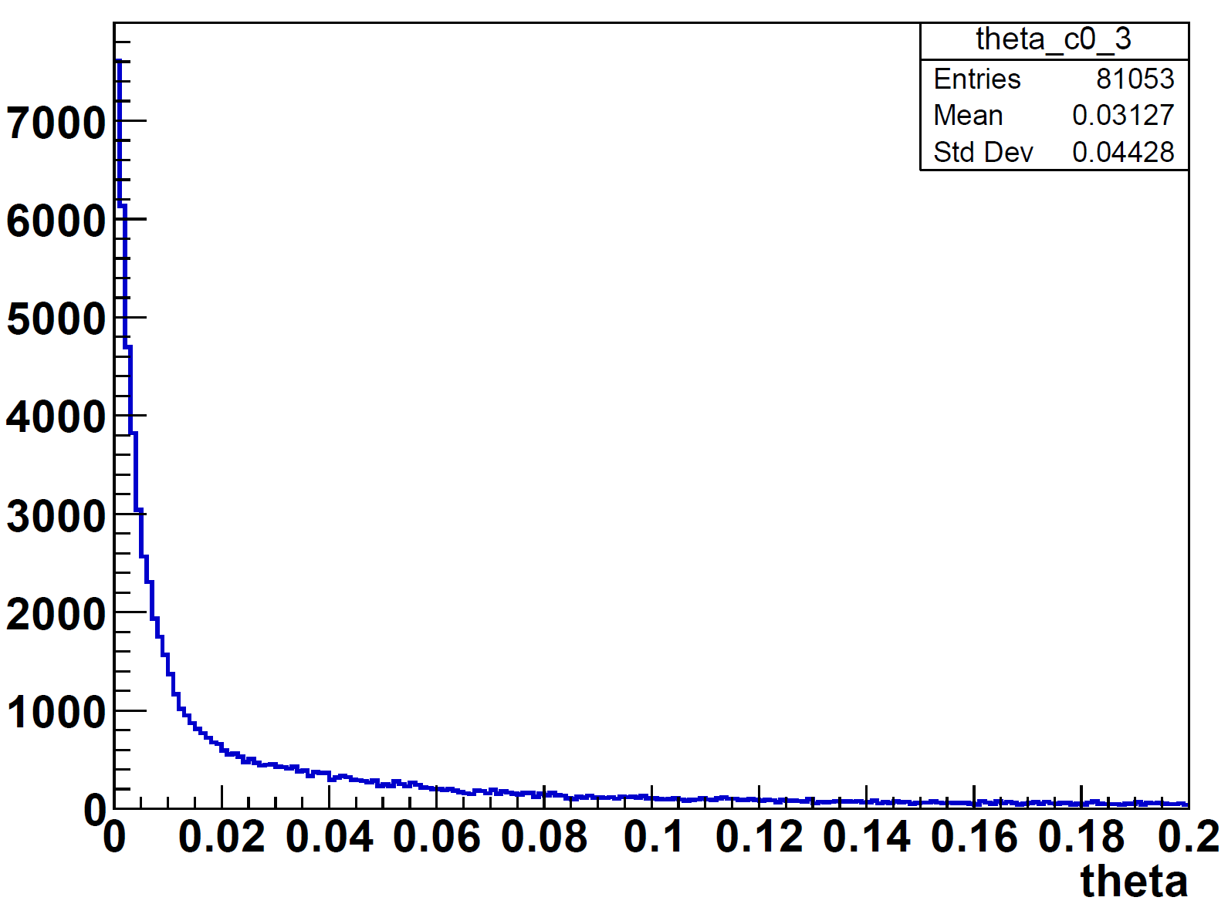
Beam – gas interaction
Cross section for p-Ne inelastic scattering:
  245 mb = 2.45 x 10⁻²⁵ cm² @ 450 GeV
  297 mb = 2.97 x 10⁻²⁵ cm² @ 7 TeV (= 0.5% of the 585.4 nm fluorescence one)
.DAT files with 3.6 x 10⁶ vertices
Thanks to BGV team: Benedikt, Robert, Sotiris!

Slide 47
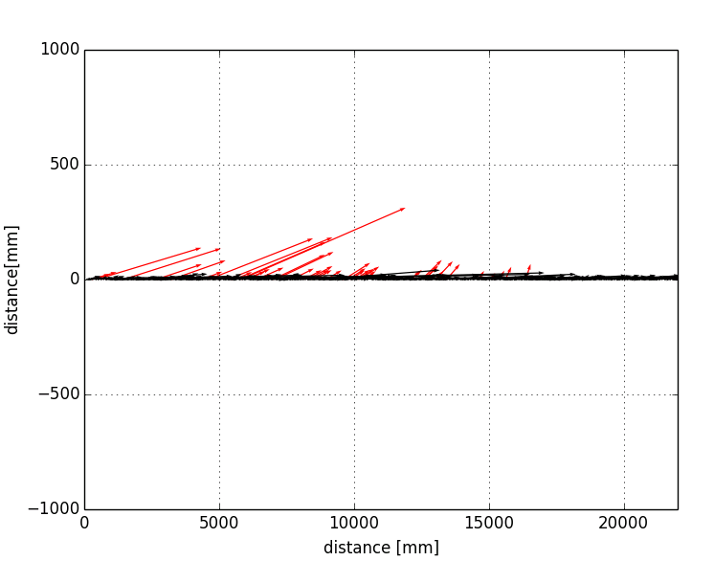
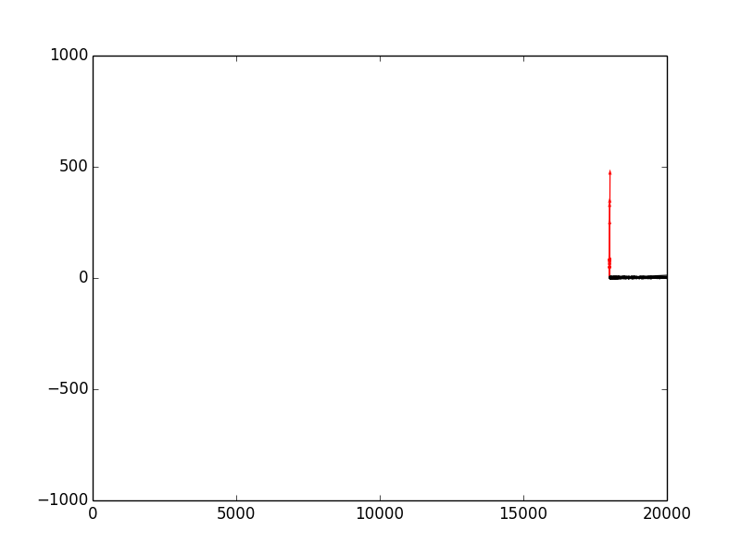
Beam – gas interaction
Monte carlo simulation with BGV vertex data (3.6x10⁶ events):
  Vertices randomly distributed in 22000 mm long, 80 mm dia tube
  Sensor is a cube of 25mm side at z= 18000 mm, r = 600 mm
  Counting vertices that cross the volume area:
Present case: 1.4x10⁻⁵ hit probability
BGC case (18000<z<18001): 5.3x10⁻⁶ hit probability
0.4 times per particle

Slide 48
Beam – gas interaction
Estimation of total number of gas particles for BGC vs present case ongoing
ROUGH ESTIMATE:
  Present 10⁻⁸ mbar over 10000 mm
  BGC: 10⁻⁶ mbar over 1 mm
10⁻² times BGV vs preset case

Slide 49
Beam – gas interaction
Total number of detected losses BGC vs present case:
0.4 per particle x 10⁻² particles = 4x10⁻³ losses
ROUGH ESTIMATE: order of 10-3 detected losses BGC vs present case

Slide 50
notes
Beta functions
  Ions:
    BGIH.5L4.B1: 314 H, 242 V
    MU.A5R4.B1 (BSRT): 203 H, 317 V
  Protons
    MGMWH.C5L4.B1: 323.7 H, 213.3 V (this should be the location)
    MU.A5R4.B1 (BSRT): 205.1 H, 287 V

