Slide 1
EDIPO Re-building Cable Trial 1
Ian Pong (ipong@lbl.gov)
24th of July, 2019

Slide 2
Outline
Wires
Cable Startup
Next step

Slide 3
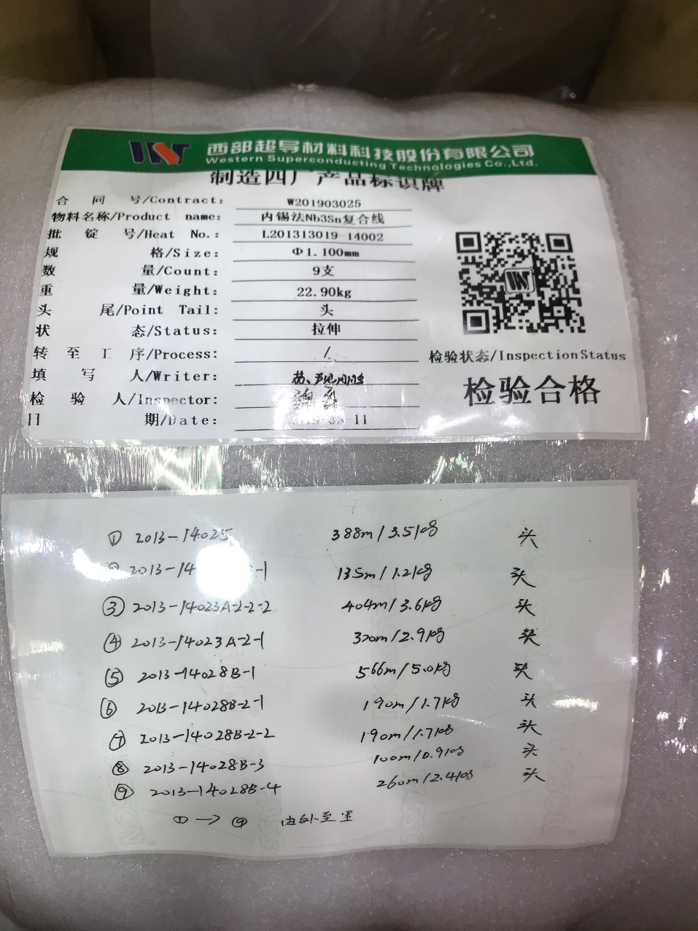
Wire - WST
Wire ID | WST length | LBNL length
WW11S14025A01U | 338 m | 412
WW11S14023A01U | 135 m | 422
WW11S14023B01U | 404 m | 139
WW11S14023C01U | 320 m | 335
WW11S14028A01U | 566 m | 571
WW11S14028B01U | 190 m | 202
WW11S14028C01U | 190 m | 204
WW11S14028D01U | 100 m | 109
WW11S14028E01U | 260 m | 273

Slide 4
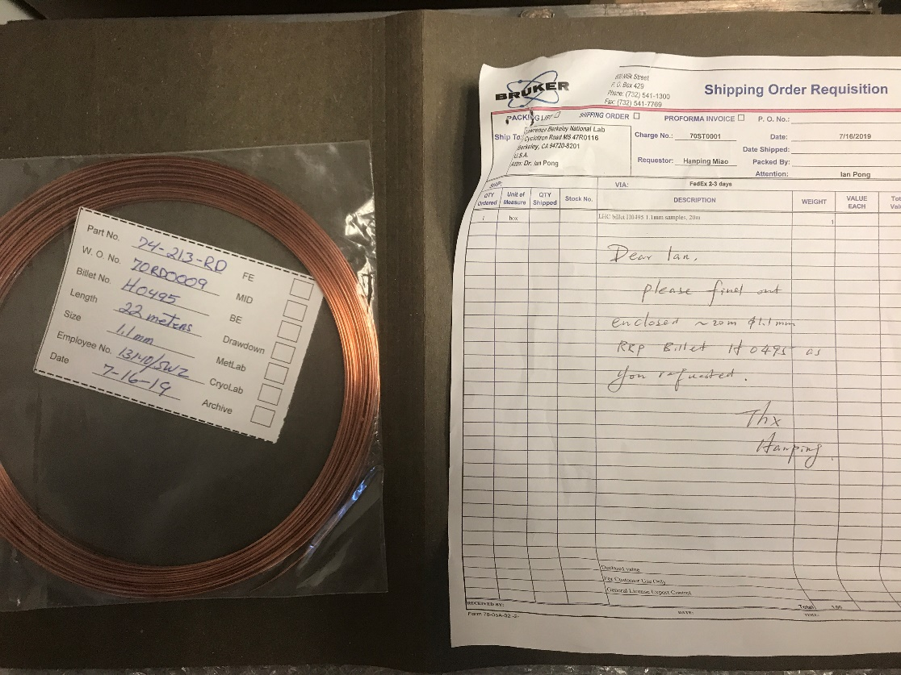
Wire - BOST
HiLumi spec RRP®
108/127, Ti-doped
1.1 mm diameter
Spliced 3 pieces (7 m each) to WST wire spools

Slide 5
Mechanical behaviour
WST
  ITER style, single barrier
  Sufficiently robust mechanical properties at 1.1 mm
  Joints were made by self-twisting
BOST
  RRP®, distributed barrier
  Feels softer than WST
Overall, cable is very stiff – we could not cut it using hand tool cutter

Slide 6
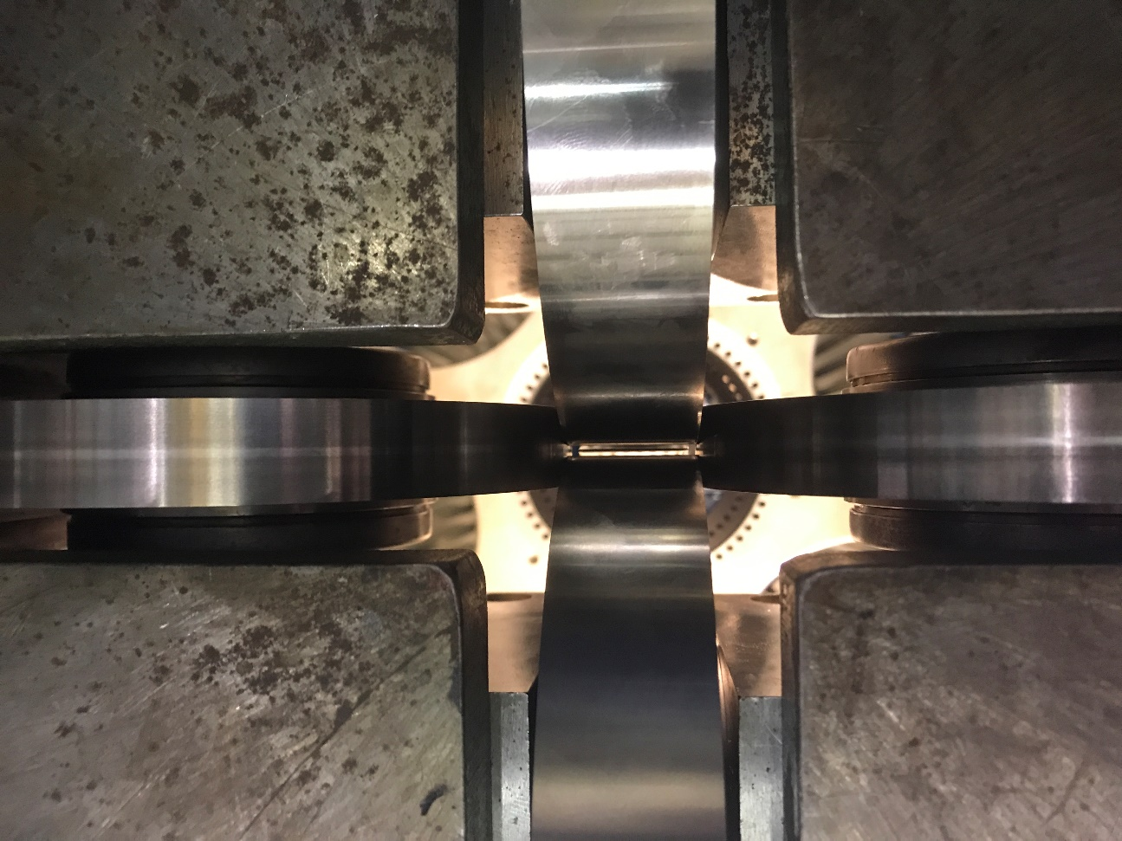
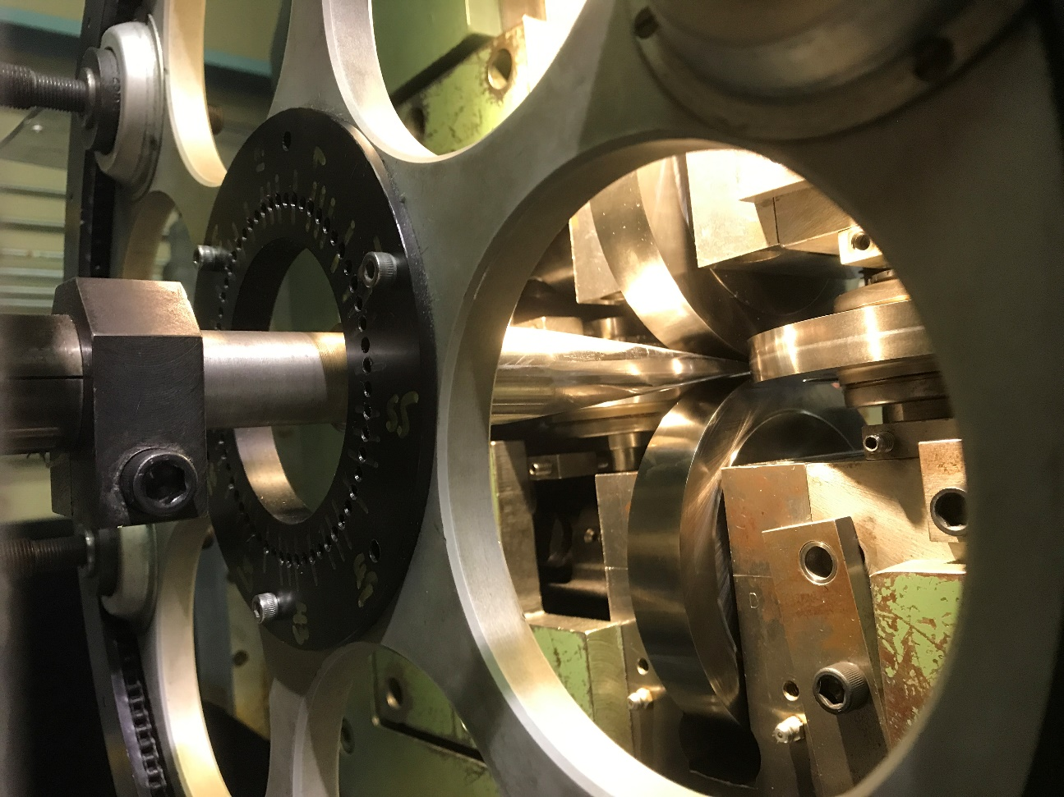
Cabling Machine Setup

Slide 7
Cabling Hardware
Mandrel
  NED 2 (2019 06 18)
    Tip Width: 25.24 mm
    Tip Thickness: 0.63 mm / 0.55 mm
  NED 2 (2019 07 18)
    Tip Width: 24.38 mm / 24.1 mm
    Tip Thickness: 0.85 mm / 0.9 mm
  NED 2 (2019 07 25)
    Width: 24.7 / 24.2 mm
    Tip Thickness: 0.7 mm
Rollers
  Top: P75 (2019 05 31),
  Bottom: P76 (2019 05 31)
    Width: 25.71 mm
    Angle: 0°
    Diameter: 149.5 mm
  Horizontal: H-Major A (2017 08 18), H-minor B (2017 08 18)
    Width: 15.9 mm
    Angle: 0°
    Diameter: 135.9 mm

Slide 8
Cable Startup
6 pieces total of ~12 m of cable with intermittent defects
Initial suspicion is related to mismatched physical properties, as most crossovers occurred at edges at or right after BOST strands; (but then considered unlikely…, see next slide)
Rubbing sound suggested some friction between components
Broad face suggested insufficient initial vertical compaction
Hand micrometer measurement suggested that the wires were pushing open the vertical rollers more than expected
Notes:
Tension 6.6 m

Slide 9
Cable Startup
Adjustments suggested the vertical aperture was >0.006” off
After adjustment, broad face facets suggested that the insufficient compaction has been corrected, which is confirmed by hand micrometer measurement
Edge deformation suggested sufficient to excessive compaction
Pinch point calculation suggested that the adjusted thickness shifts the vertical pinch point back by a few wire diameters

Slide 10
Cable Startup
1st Pinch point check inconclusive
Following Turkshead position adjustments, crossovers continued mostly at edges. Evidences point to vertical and horizontal pinch point misalignment at target thickness (1.9 mm)
2nd Pinch point check was removing edge crossovers before seizing up and displacing the mandrel
Inspection speculation: vertical pinching only
Mandrel re-measurement suggested thicker and narrower tip

Slide 11
Cable Startup
Mandrel ground back and repolished
Slightly shorter, tip slightly thinner and very slightly wider
Last 1+ sample collapsed and lost
3rd Pinch point check: a short section showed good cable before defects developed again and cannot be recovered – “sweet spot” window very narrow
Strand jerking observed on back of mandrel – believed to be a cause of top broad face irregularities

Slide 12
Cable QC
Residual twist:
  180°/m at 12.2 kg
  210°/m at 24 kg
Mechanical stability:
  Appeared to be pretty stable on hard way bend
Facet assessment:
  Edge facet can be reasonable, but cannot yet be controlled
  Broad face facet still some irregularities

Slide 13
Next Step
Extracting BOST strands from startup cable for metallography
Rolling BOST virgin strands for RRR measurements
10-stack measurements
Two pieces of ~10-15 m cable in August?
  Thickness? (Near limit)
  Twist?
  Acceptable with crossover? If not, it will require mandrel re-work.

Slide 14
Extra Slides

Slide 15
Design “Tuning” Plan
Make cables with slightly different target thickness, e.g. +0.01 mm, nominal, -0.01 mm
Based on facet size / metallography, adjust twist pitch if necessary to accommodate the width compaction
Based on residual twist, adjust planetary ratio or add static twist (not preferred) if necessary
In severe cases, modify to a two-pass process with intermediate annealing (HT tbd, cable dimension needs revision, extra rollers likely needed)

Slide 16
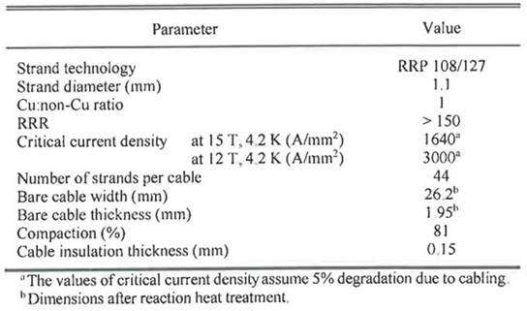
Cable Parameters
Courtesy of D M Araujo

Slide 17
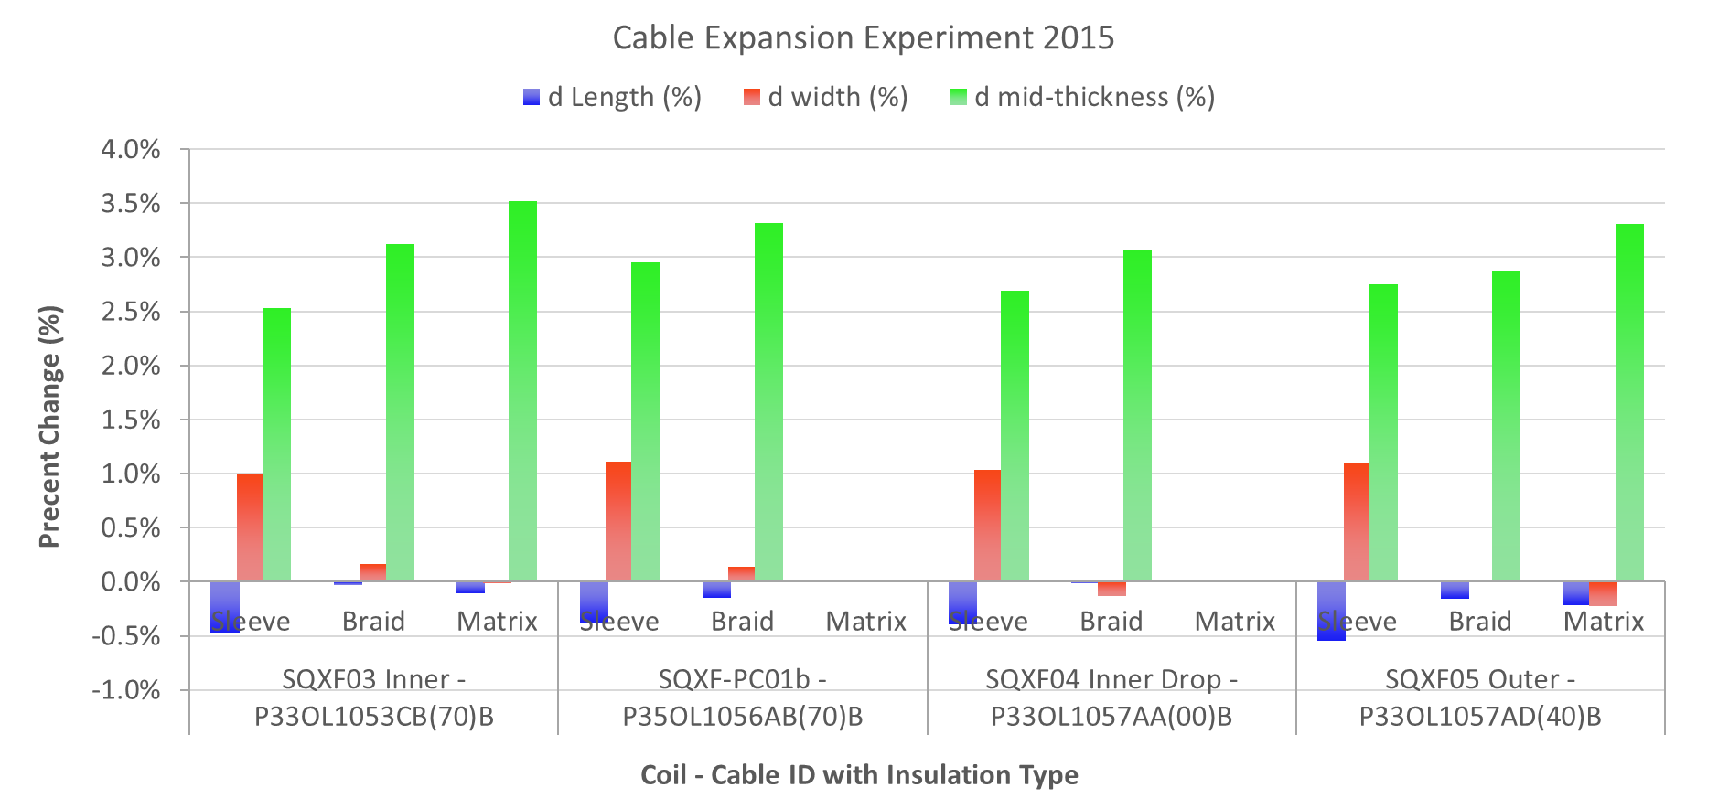
Cable Parameters
Cable dimensions
  Cable expansion assumption: Thickness ~3%, width ~1%
  Width spring back ~50 µm
  Target unreacted
    Thickness: 1.9 mm ± 1%
    Width: 25.7(5) mm
    closest rollers

