Slide 1


Computed Tomography
Technology + reconstruction
Helge Pettersen
Haukeland University Hospital
Notes:
Add some details and mathematics on how X-ray systems work

Slide 2
About me
Researcher HUS (imaging in therapy, pCT, …)
PhD in medical physics (proton CT): 2015 – 2018
Medical physicist working with CT 2012 – 2015
CT @ Haukeland:
Clinical work : Quality Assurance, optimization (better image quality & lower dose), teaching (UiB, HiB etc.), research and «technology pusher»
4 physicists responsible for 130+ x-ray machines at Helse Bergen, Helse Førde and private institutions
Notes:
$ QA: check radiation output, radiation to adjacent rooms, dose meter calibration
$ optimization: Doctor complains about IQ / I check dose readings and’m unhappy about a specific lab

Slide 3
Contents
This lecture (90 min): X-ray CT
  X-rays: Physics & production
  CT Technology
  CT Dose Reduction
  Image Reconstruction
    In 2D and 3D
Notes:
Intro: Intro to CT, includes x-rays, geometry and a few examples

Slide 4
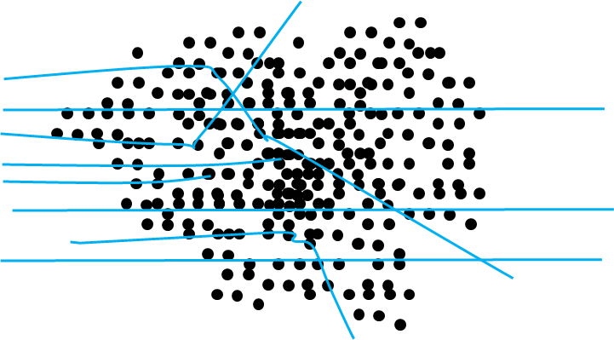
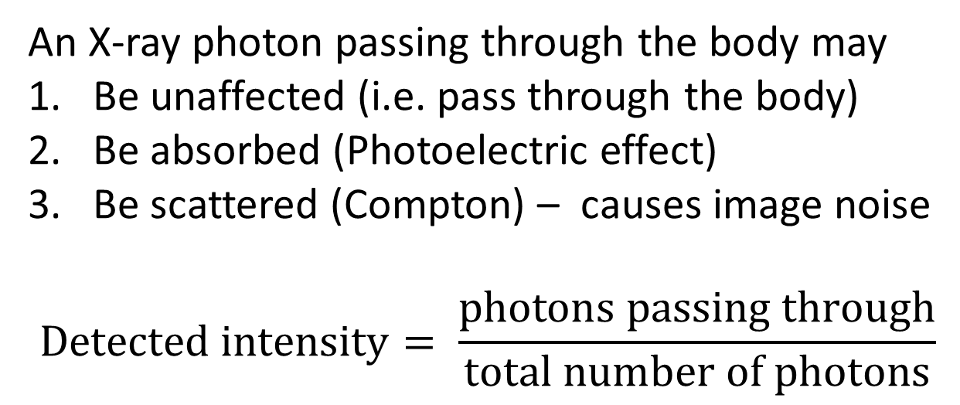
An X-ray photon passing through the body may
Be unaffected (i.e. pass through the body)
Be absorbed (Photoelectric effect)
Be scattered (Compton) – causes image noise
$$Detected intensity= \frac{photons passing through}{total number of photons}$$

Slide 5
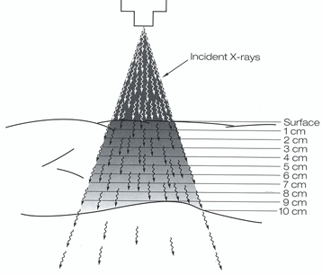
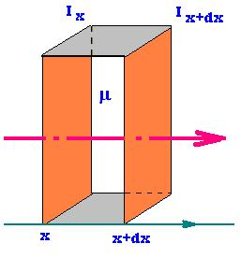
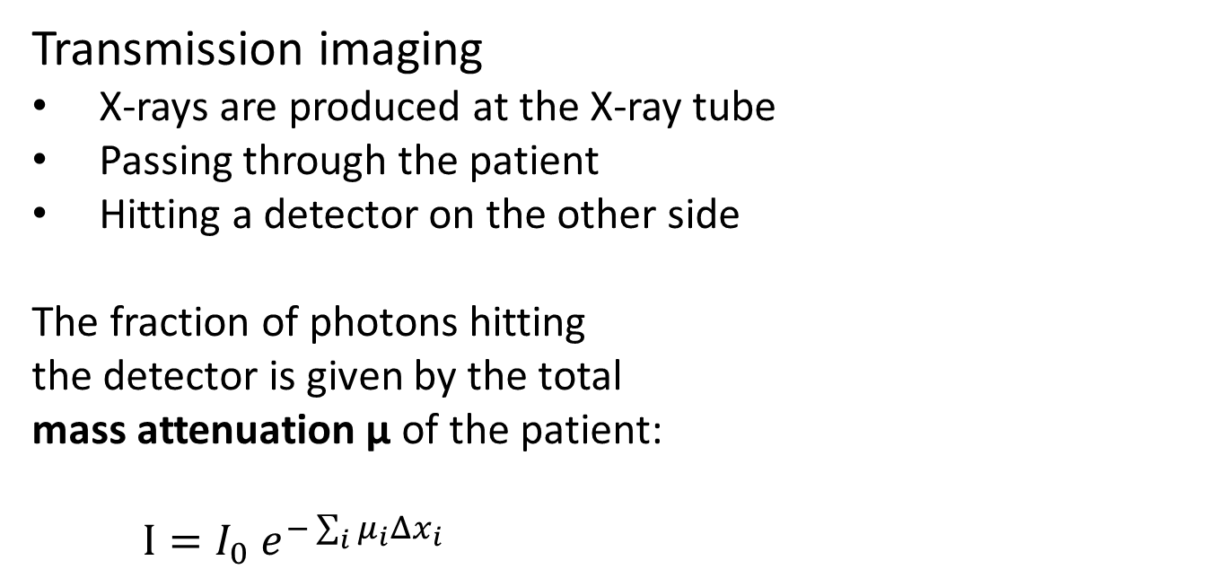
X-ray imaging
Transmission imaging
X-rays are produced at the X-ray tube
Passing through the patient
Hitting a detector on the other side
The fraction of photons hitting
the detector is given by the total
mass attenuation µ of the patient:
$I=I_{0} e^{−\sum_{i}{μ_{i}{Δx}_{i}}}$
Notes:
Index: differently attenuating organs or tissue

Slide 6
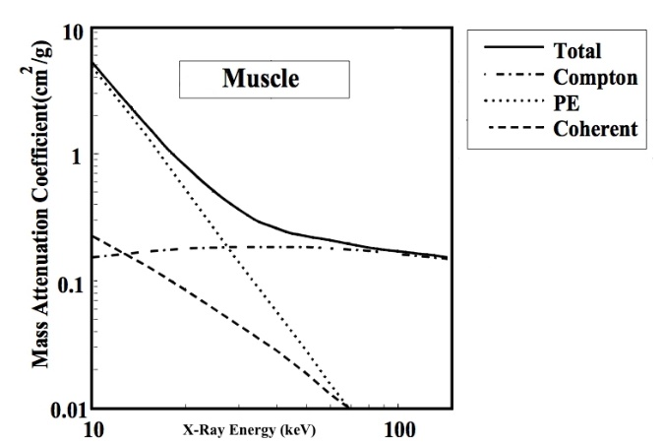
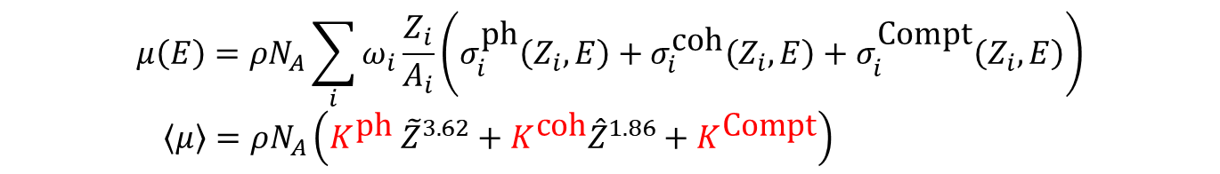
Compton scatter dominates in clinical energy levels >30 keV
$$μ\left(E\right)=ρN_{A}\sum_{i}{ω_{i}\frac{Z_{i}}{A_{i}}\left(σ_{i}^{\text{ph}}\left(Z_{i}, E\right)+σ_{i}^{\text{coh}}\left(Z_{i}, E\right)+σ_{i}^{\text{Compt}}\left(Z_{i}, E\right)\right)}$$
$\left\langle μ\right\rangle =ρN_{A}\left(K^{\text{ph}} {\tilde{Z}}^{3.62}+K^{\text{coh}}{\hat{Z}}^{1.86}+K^{\text{Compt}}\right)$
Convoluted energy dependence in calibration range

Slide 7
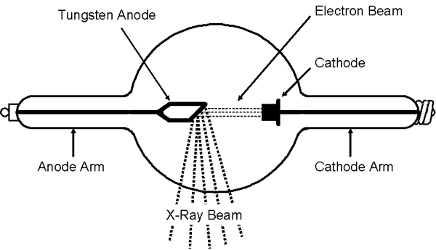
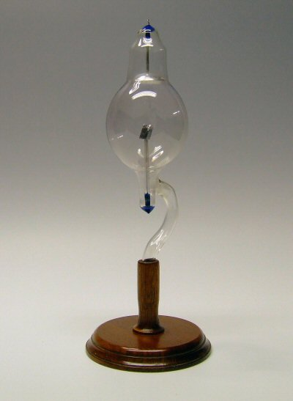
X-ray tube
Concave cathode:
better focus
Platinum
anode
© Paul Frame, Oak Ridge Associated Universities
The Jackson focus X-ray tube: ca 1896
© The Cathode Ray Site

Slide 8
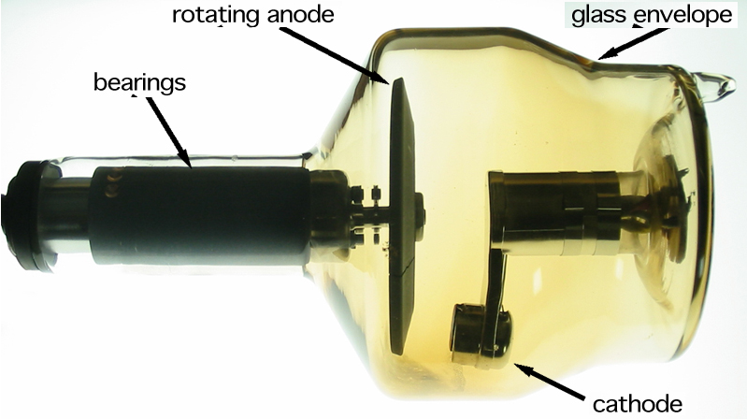
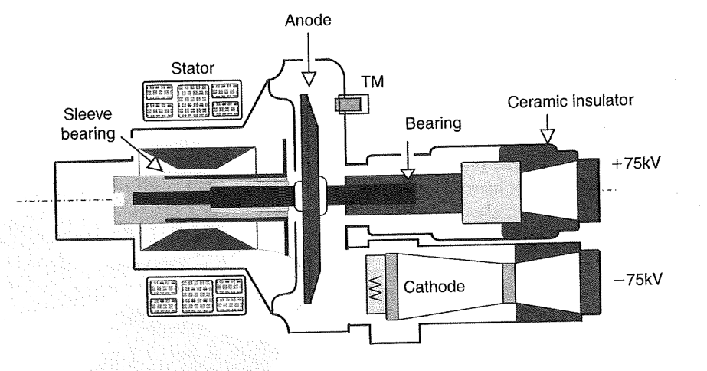
Modern X-ray tube

Slide 9

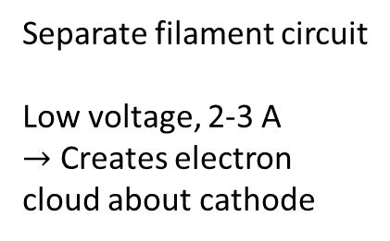
Anodes and cathodes
$e^{−}$ cloud
Separate filament circuit
Low voltage, 2-3 A
$→$ Creates electron cloud about cathode

Slide 10
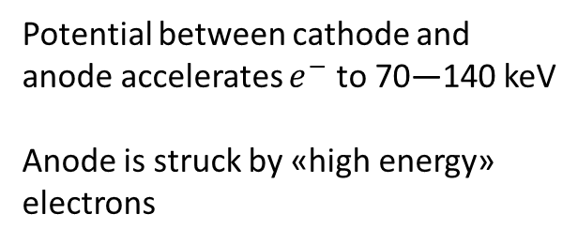

Anodes and cathodes
$e^{−}$ beam
+70 kV
-70 kV
Potential between cathode and anode accelerates $e^{−}$ to 70—140 keV
Anode is struck by «high energy» electrons

Slide 11
Anodes and cathodes
X-ray focus
Photon beam
X-ray beam is created by interactions between electrons in anode and anode material
Bremsstrahlung
Characteristic radiation by electron energies near the K edge
In addition, heating by ionizations

Slide 12
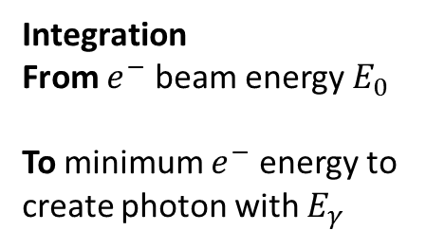
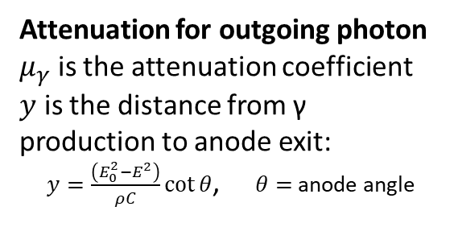
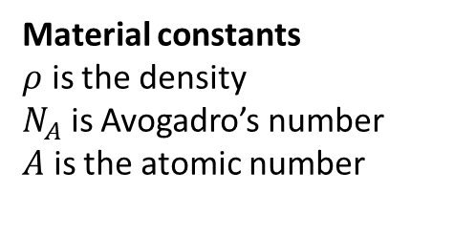
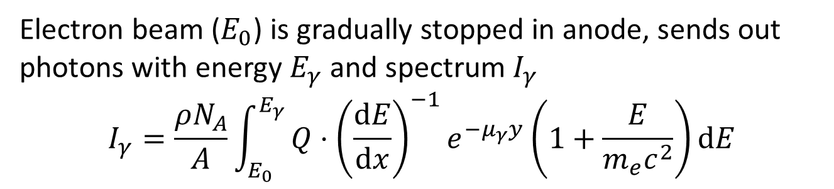
Energy spectrum (Birch & Marshall, 1979)
Electron beam ($E_{0}$) is gradually stopped in anode, sends out photons with energy $E_{γ}$ and spectrum $I_{γ}$
$$I_{γ}=\frac{ρN_{A}}{A}\int_{E_{0}}^{E_{γ}}{Q⋅{\left(\frac{dE}{dx}\right)}^{−1}e^{−μ_{γ}y}\left(1+\frac{E}{m_{e}c^{2}}\right)dE}$$
Material constants
$ρ$ is the density
$N_{A}$ is Avogadro’s number
$A$ is the atomic number
Relativistic corrections
Material stopping power for incoming electron
Bethe equation
Attenuation for outgoing photon
$μ_{γ}$ is the attenuation coefficient
$y$ is the distance from γ production to anode exit:
$y=\frac{\left(E_{0}^{2}−E^{2}\right)}{ρC}\cot{θ}$, $θ=$ anode angle
Normalization
X-ray intensity
per unit energy interval
per incident electron flux
per atom
Integration
From $e^{−}$ beam energy $E_{0}$
To minimum $e^{−}$ energy to create photon with $E_{γ}$
Notes:
Integrate the electron energy from incoming energy E0 to the min electron energy to create photon of energy Eγ.
The stopping power for the electron decreases the ENERGY and INTENSITY
the stopping power for the photons decreases the INTENSITY

Slide 13
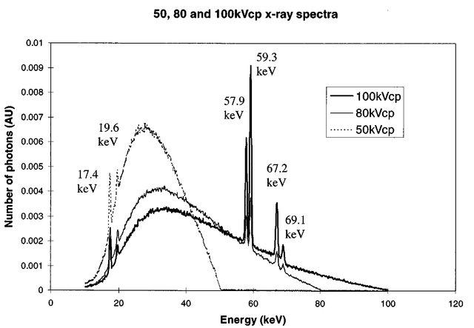
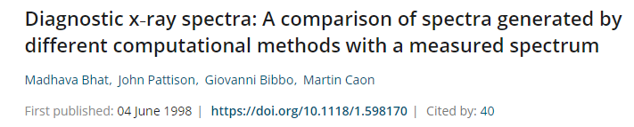
Characteristic K-edge
radiation
Unfiltered spectrum
kVp: kV peak
Bremsstrahlung
radiation

Slide 14
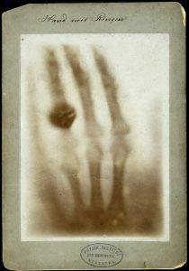
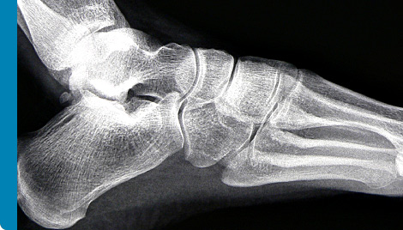
http://www.qioptiq.com/x-ray.html
Hand Mit Ringen; W Röntgen 1896

Slide 15
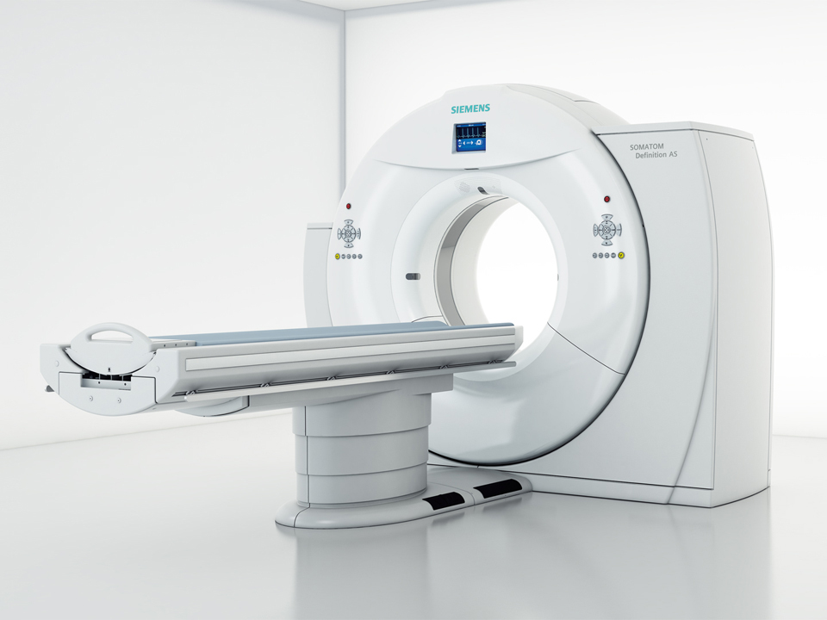
Computed Tomography
X-ray tube and detector system rotates about the patient
Makes cross-sectional images
Siemens Definition AS
From siemens.com

Slide 16
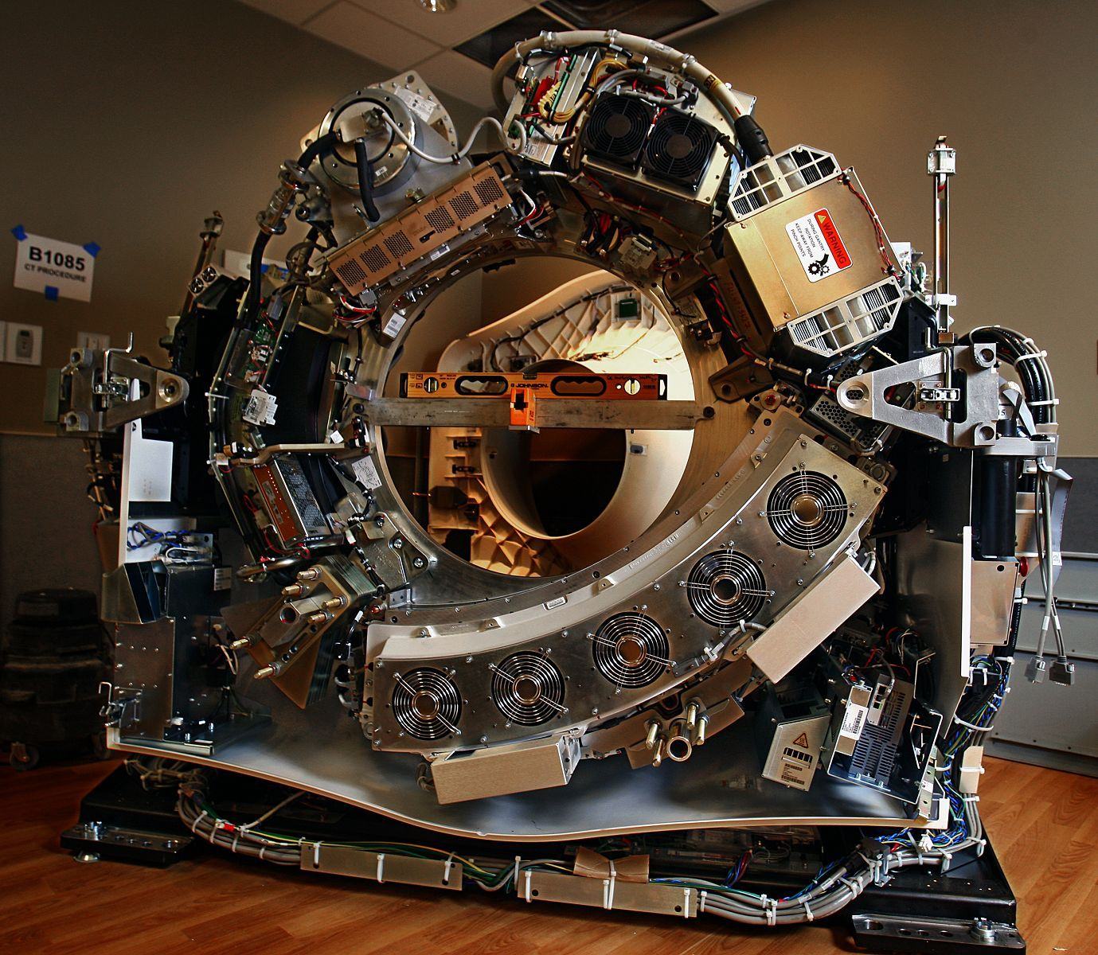
Introduction
Source: imgur.com ☺
High voltage generator
X-ray tube
Filtration
Collimation
Dose-meter
Detectors
Rotation 0.5- 4 Hz
Notes:
Video: 2 Hz (0.5 sec/rotation)

Slide 17
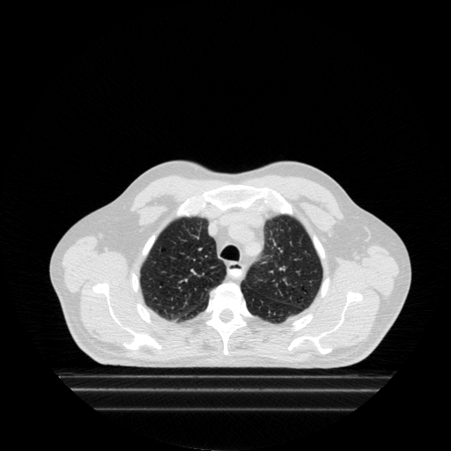
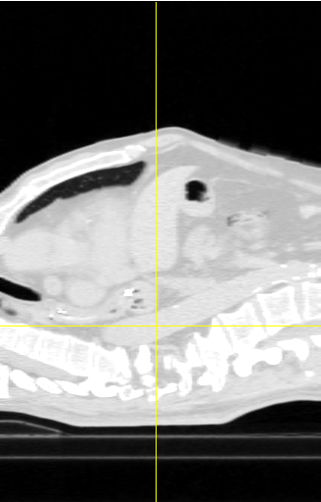
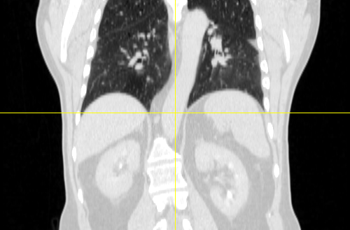
Axial projection
Sagittal projection
Coronal projection
Notes:
Note: No over-/underlying rib bones, better contrast of the lung anatomy and heart, can choose projection plane

Slide 18
Timeline
1895: Wilhelm Röntgen discovers X-rays
1917: Johann Radon develops mathematical method of cross-sectional reconstruction from transmission measurements
1963: Allan Cormack describes technique for calculating the absorption distribution of the human body
1971: Godfrey Hounsfield develops the first CT scanner
1975: First whole body clinical CT
1976: Filtered Back Projection introduced
1989: William Kalender + Peter Vock develops helical CT
1998: 4-slice CT scanners
2005: Dual Source CT
2008: Iterative Reconstruction methods; 320-slice CT scanners

Slide 19
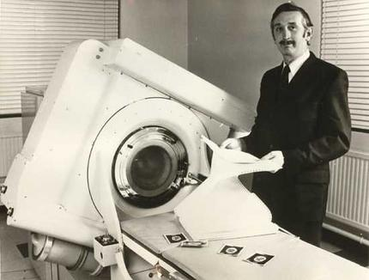
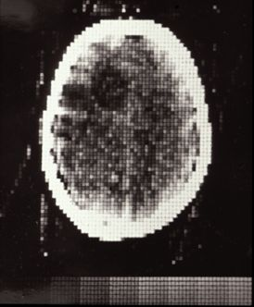
1971: EMI head scanner by Hounsfield
23.5 cm FOV, 3x3x8 mm voxel size (80x80 image matrix)
5 min scan, 5 min reconstruction
NaI-PMT detector

Slide 20
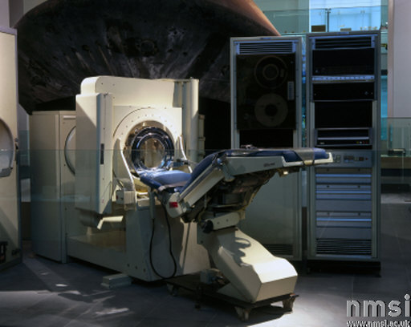
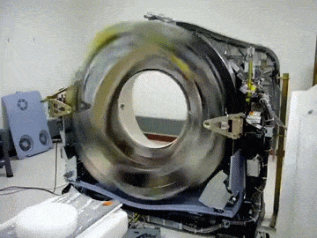
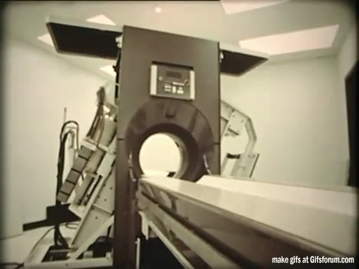
Medical imaging - CT
t=0
+ 3 år

Slide 21
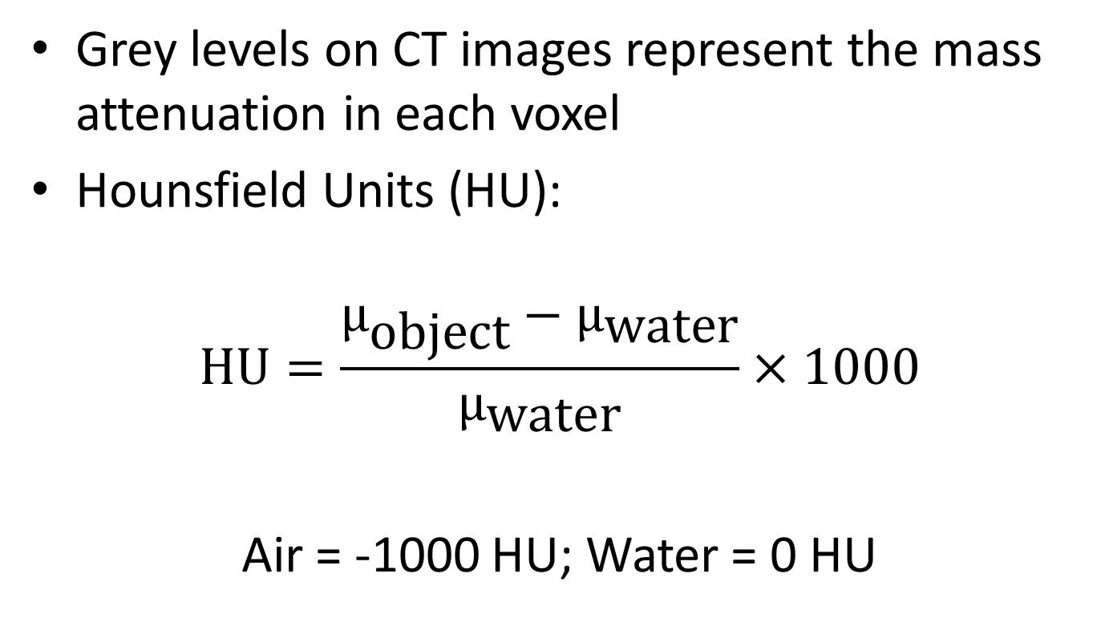
CT number scale
Grey levels on CT images represent the mass attenuation in each voxel
Hounsfield Units (HU):
$$\text{HU}=\frac{µ_{\text{object}}−µ_{\text{water}}}{µ_{\text{water}}}×1000$$
Air = -1000 HU; Water = 0 HU

Slide 22
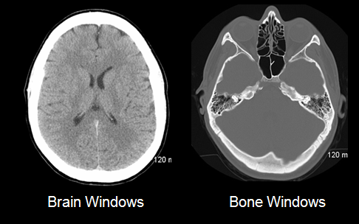
CT windowing (4096 greyscale values)
https://sites.google.com/a/wisc.edu/neuroradiology/image-acquisition/the-basics
Notes:
Axial images, seen from the bottom
Lung: Bronchial tubes (for air) and blood vessels

Slide 23
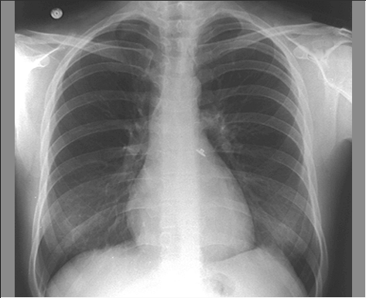
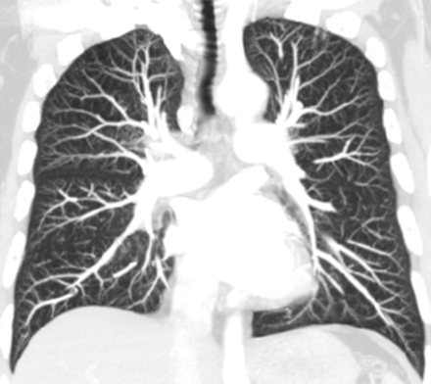
Planar X-ray vs CT
Overlying and underlying rib bones, no depth selection
Excellent tissue contrast
Planar X-ray
© Yale University, 2004
Coronal MIP-projection of CT image
RadioGraphics 5, 25 (2005) 1409-1428
Notes:
Note: No over-/underlying rib bones, better contrast of the lung anatomy and heart, can choose projection plane

Slide 24
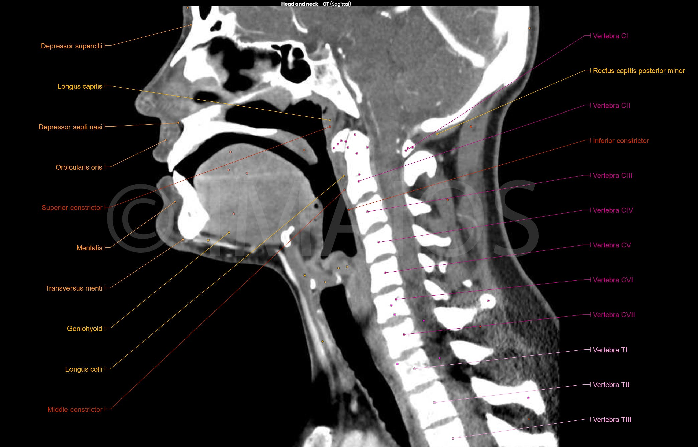
CT images: Head&neck
https://www.imaios.com/en/e-Anatomy/Head-and-Neck/Head-and-neck-CT
Notes:
Axial images, seen from the bottom
Lung: Bronchial tubes (for air) and blood vessels

Slide 25
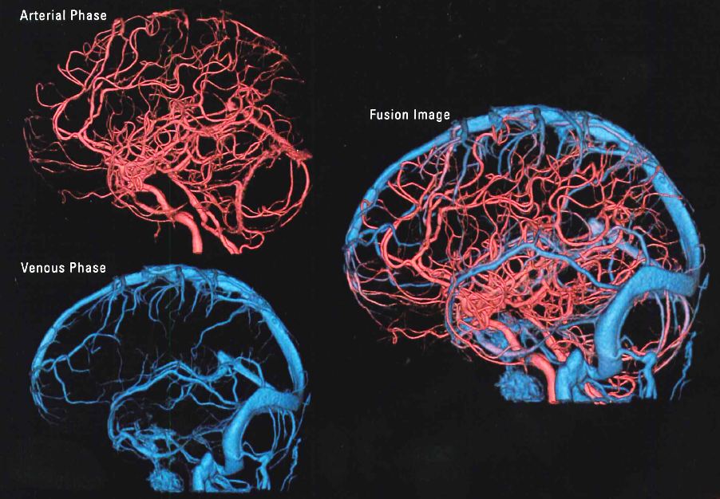
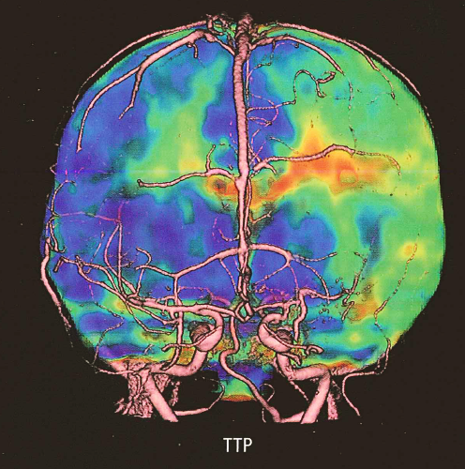
Functional imaging
Blood flow analysis – clot or bleed?
Dynamic image (blood flow/volume time
analysis in multiple scans)
Static image (subtraction angiography)
Notes:
Her satser Toshiba

Slide 26
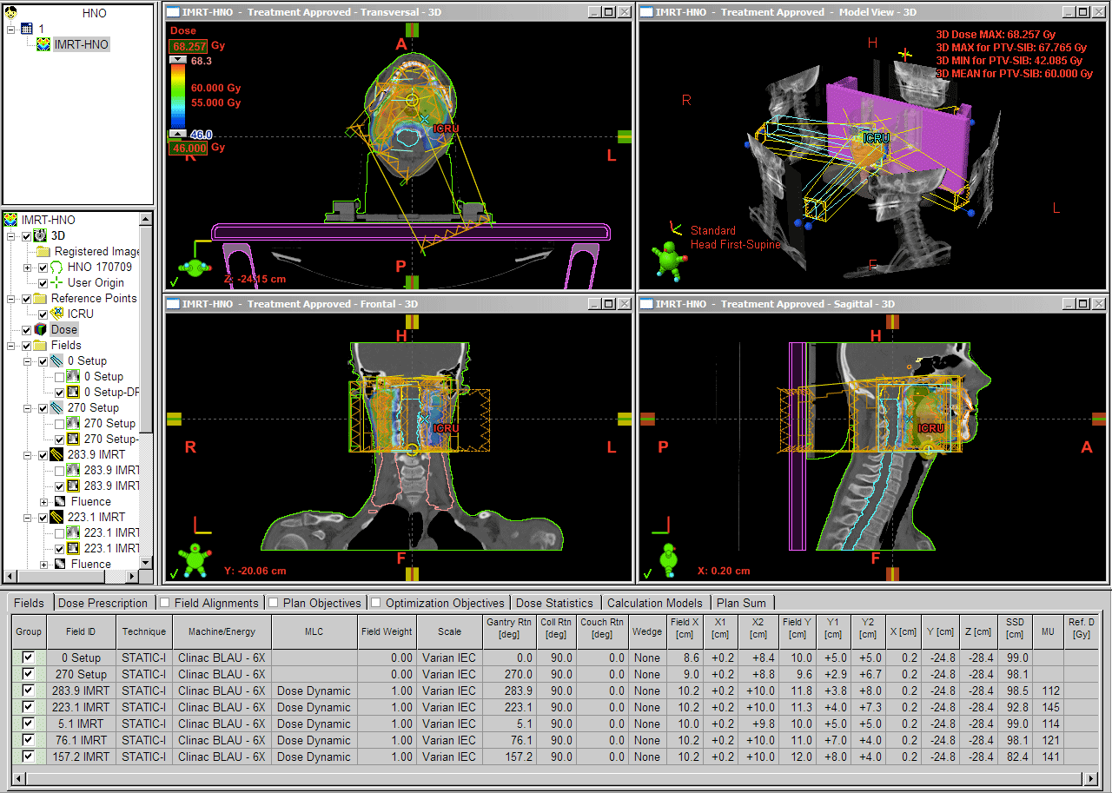
Dose calculation in radiotherapy
https://www.wienkav.at/kav/kfj/91033454/physik/eclipse/rapid1.htm
Notes:
Her satser Toshiba

Slide 27
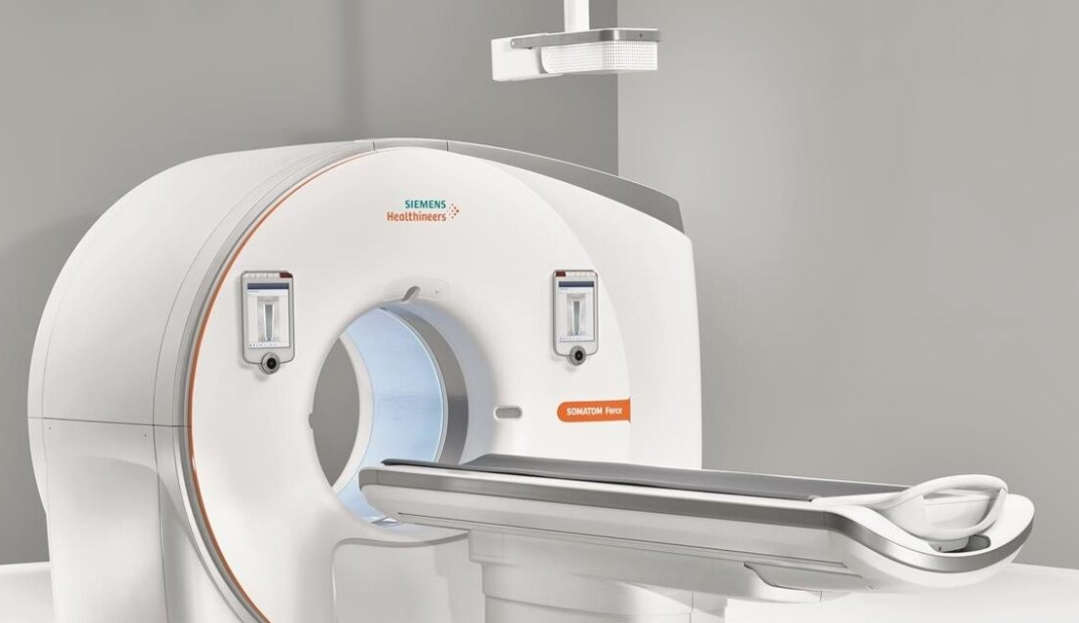
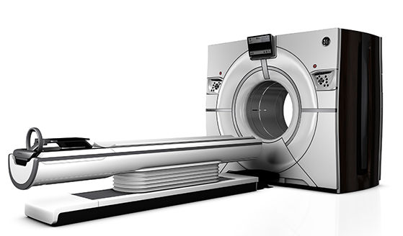
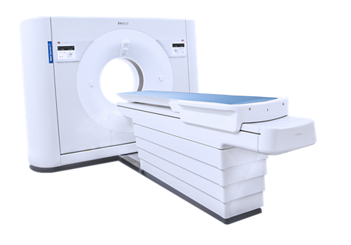
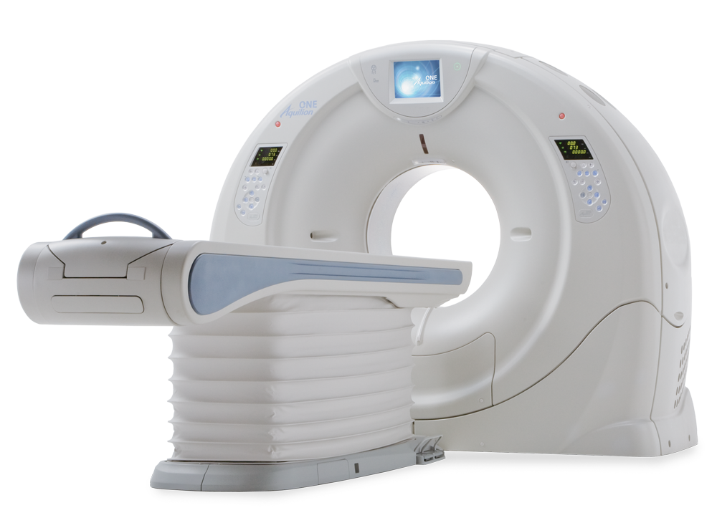
Today: 4 main vendors
SIEMENS
GE
Philips
Canon
(aka Toshiba)

Slide 28
CT technology

Slide 29
X-ray detectors
The radiation through the patient must be
measured.
Image basis: Non-absorbed X-rays
The rays pass through a scintillator. The x-rays are transformed to visible light and amplified
A detector transform the visible light to electrons (making a current)
Amplifiers and analogue-to-digital converters (ADC) create a digital signal from the current.
X-rays
Scintillator
Visible light
Detector
Current
ADC
Digital signal

Slide 30
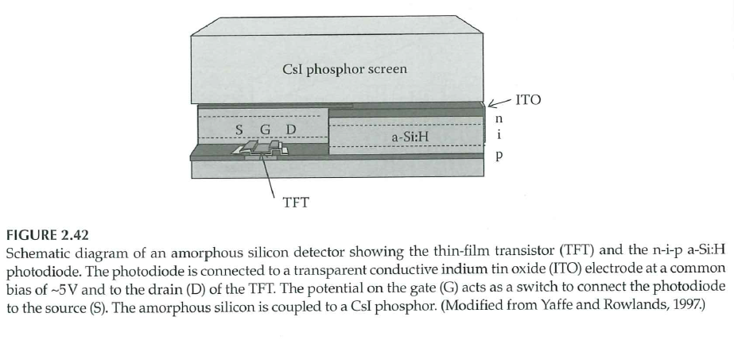
X-ray detectors
Anti-scatter grid (Pb/W)
Accept only X-rays from focus
Scintillator (CsI:Tl)
Photo diode (a-Si): light to electrons
The thin film transistor (TFT) chip stores the electrons in a capacitor, until a release current (switch) is applied
Webb, S. and M. A. Flower (2012)

Slide 31
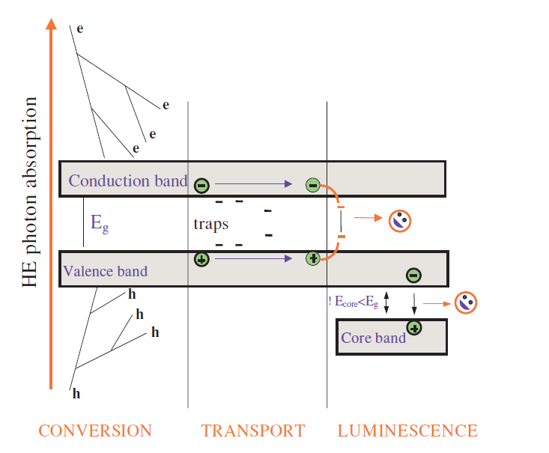
The scintillator
An incoming photon liberates e/hole pairs
  Compton scattering + PE
  Energy gap
Random movement until they find an (doping) activator and are recombined
The activator releases visible light when hit
  e/hole pair is reunited and energy is released
  CT needs very quick scintillators
Nikl M. Meas. Sci. Technol. 17 (2006) R37-R54
Notes:
Små mengder: Mellom 1:10^8 og 1:10^4

Slide 32
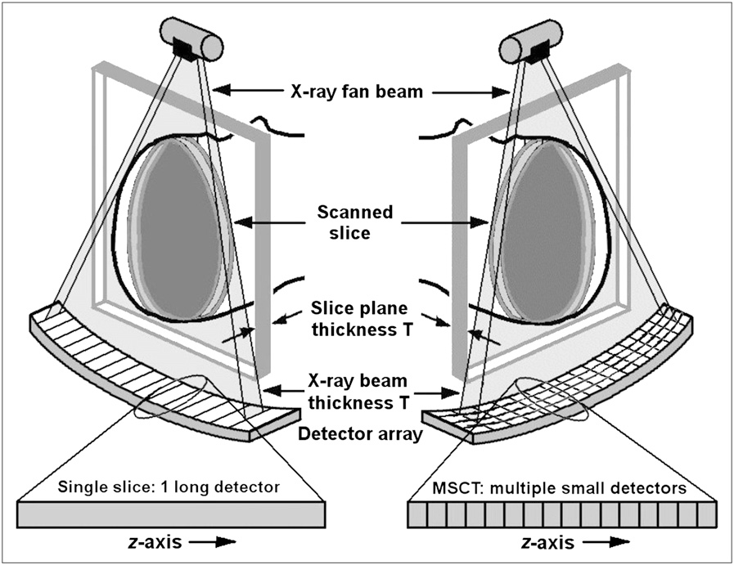
CT detectors
Thin fan-beam
in z direction
Thick
fan-beam
in z direction
Goldman L, Principles of CT and CT Technology. J Nucl Med Technol 2007; 35:115-128

Slide 33
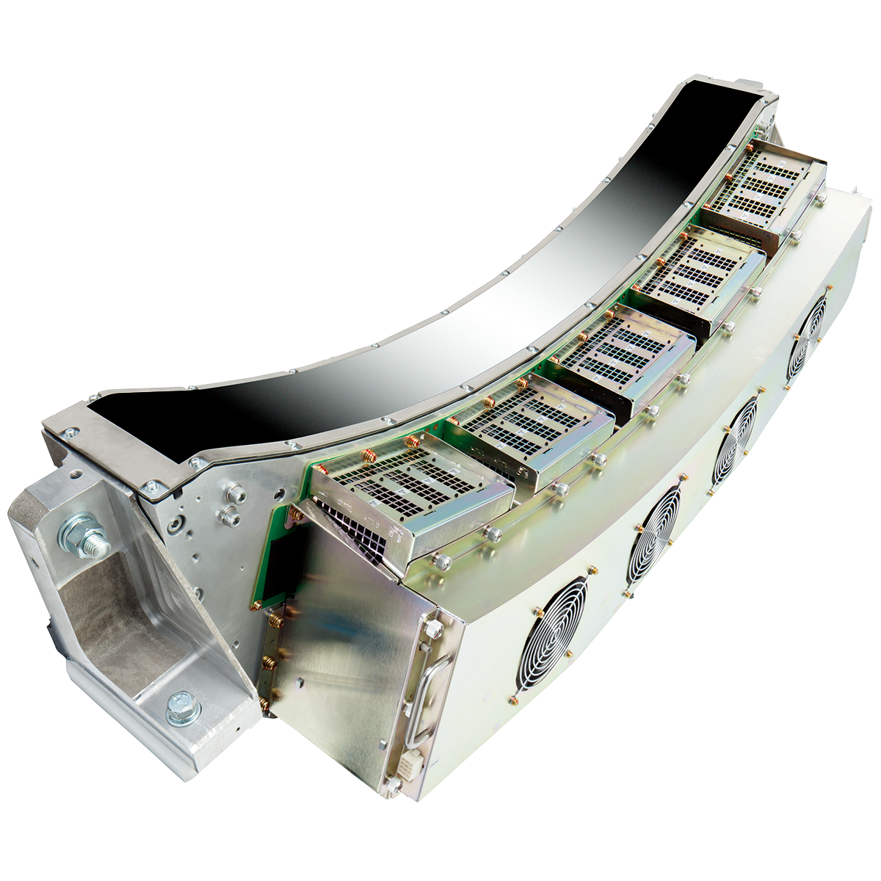
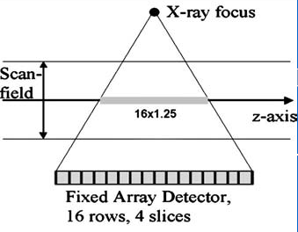
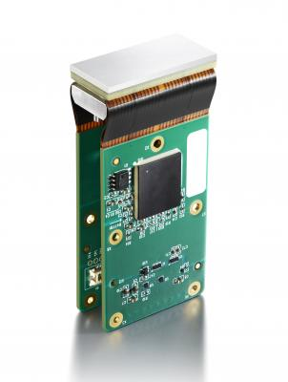
CT detectors
https://anz.medical.canon/products/computed-tomography/aquilion_lightning_80_technology
https://www.itnonline.com/content/detection-technology-introduces-shelf-tileable-ct-detector-module

Slide 34
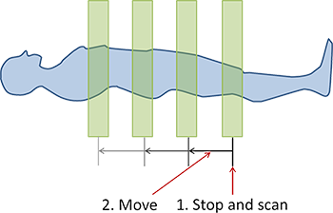


Image Acquisition
Axial vs Helical
Pitch: Distance between slices
Pitch: $\frac{\text{Distance} \text{between} \text{coils}}{\text{Coil} \text{width}\text{ (}\text{collimation}\text{)}}$
https://www.radiologycafe.com

Slide 35

Dose Reduction Tools in CT
($≃$ constant noise)

Slide 36

The Bow Tie filter
Equal image noise thorughout the image
Usually proprietary information (= hard to do Monte Carlo simulations)

Slide 37


Slide 38


Automatic Exposure Control
A 4 cm increase in patient size increase the attenuation by 2
$$e^{−µ × 4 cm}≃0.5$$
45 cm vs 28.8 cm: 16x more attenuated, 4x more noise
Sedlmair, M. (Siemens)
«CAREDose4D, CAREkV and
SureView»
Forchheim, 2013-10-22

Slide 39


Automatic constant mAs
Constant mAs based on weight or
2D «scout» image
  mAs: milliAmps * irradiation time
Adjusted to the patient
No modulation during scan (in z dir)
Less image quality variation between
patients
Söderberg M.,
PhD dissertation (2012),
Lund University

Slide 40

Z modulation
Can use the 2D scout to see what mAs we need in each slice
Integrated radiation dose
Dose is adjusted in Z direction
Reduced DLP (total dose)
Constant noise in Z direction
Can adjust the mean dose
manually
McCollough,H.C. et al.,
RadioGraphics 2006; 26:503-512

Slide 41


3D modulation
By using a lateral scout as well (2 scout images)
3D information about attenuation
Apply a sine shaped mAs modulation to match rotation speed
Keep signal to detector constant at all times
Quickest variation in shoulders
Lee C. H. et al.,
RadioGraphics (2008), 28:1451-1459
Kortesniemi M.,
NACP-Foredrag i Bergen (2013)

Slide 42



Slide 43
Dual Energy CT

Slide 44

Functional imaging – dual energy
Using a whole spectrum to obtain images gives a good estimate for the total attenuation; $I= e^{−μx}$
However, the body consists of more than one $µ$…
And $µ=µ\left(E\right)$
At low energies the photoelectric effect dominates
$μ_{PE}∝Z^{3}/E^{3}$ and heavy materials do lots of absorption
At high energies the Compton scattering dominates
Less Z dependence

Slide 45

Attenuation and energy
Iodine: High variation with E
Water
Calcium
Kaza R K et al.
Radiographics 2012;32:353-369

Slide 46


Spectrum separation
$$Δμ_{\text{PE}}=ΔZ^{3}/ΔE_{\text{eff}}^{3}$$
Need large $ΔE_{\text{eff}}$ (spectral separation) to separate low $ΔZ$
http://radiologyinthai.blogspot.no/2010/12/dual-energy-ct-2.html
http://radiologyinthai.blogspot.no/2010/12/dual-energy-ct-2.html
Notes:
Her må jeg skrive mer om Sn

Slide 47

Spectrum separation
Multiple ways to create a dual energy spectrum
Quick change between high / low kVp (between each rotation or contiuous)
Two physical x-ray tubes
Sandwich detector
Photon couting detector (not yet in clinical use for CT)

Slide 48


Spectrum separation
With two physical x-ray tubes (dual source)
Can use filtering (tin / Pb / W) on one of the tubes
100 kVp + Sn 140 kV_{p}
More separated effective
energies
100 kV_{p} = 58 keV
Sn140 kV_{p} = 81 keV
Effective energy
Effective energy
Johnson T. R. C,
AJR2012, 199:S3-S8
Notes:
Her må jeg skrive mer om Sn

Slide 49

Basis Material Decomposition
Each voxel with energy E as a linear combination of two basis materials $µ_{1}$ and $µ_{2}$:
$$μ\left(E\right)={\left(\frac{μ}{ρ}\right)}_{1}\left(E\right)×ρ_{1}+{\left(\frac{μ}{ρ}\right)}_{2}\left(E\right)×ρ_{2}$$
${\left(μ/ρ\right)}_{i}(E)$ is the mass attenuation
$ρ_{i}$ is the density of the material – a weighting factor

Slide 50

Basis Material Decomposition
Use this information in $I\left(E\right)=I_{0}e^{−μ\left(E\right)x}$
Insert for $μ\left(E\right)$
We have $I_{\text{80 }\text{kV}}(E)$ and $I_{\text{140 }\text{kV}}\left(E\right)$
Solve for $μ_{1}$ and $μ_{2}$, we get
A purely $μ_{1}$ image, e.g. bone
A purely $μ_{2}$ image, e.g. water

Slide 51

Bone (Ca, Z = 20)
Water (H, O; Z = 1, 8)
Raw data
Image
Yu L et al.
AJR2012, 199:S9-S15

Slide 52

Monochromatic images
We know how the voxels vary with energy
Can make a monochromatic image
Very good HU accuracy and beam hardnening corrections
PolyChr 120 kV_{p}
MonoChr 127 keV
Yu L et al.
AJR2012, 199:S9-S15

Slide 53
What more? Applications?
We know
The materials in the data
Can make three kinds of images
Optimal images: Choose the MChr with best contrast
  E.g. iodine uptake but with low noise
Identification of materials (ionide, bone, …)
  Bone removal
  Virtual non-contrast images
  Color code materials (uric acid)
Quantification of materials

Slide 54




Quantification of iodine
Sn 140 kV_{p}
More yellow, more iodine / calcium
100 kV_{p}
Johnson T. R. C,
AJR2012, 199:S3-S8
Comparison

Slide 55



Materials removal
Original image
Contrast agent removed
Bone removed
Johnson T. R. C,
AJR2012, 199:S3-S8

Slide 56

Applications
Kidney stone
classification
Thomas C. et al., Radiology 2010; 257:402-409

Slide 57

Applications
Gout
Nicolaou S. et al.
AJR2012, 199:S78-S86

Slide 58

Applications
Plaque (red) in arteries
filled with contrast agent (blue)
«Dual Energy CT – SOMATOM Definition»
Siemens whitepaper

Slide 59
Dual Energy CT and particle therapy
A new application for DECT is its application in particle therapy
Particle therapy: Electron density / atomic number, ionization potential
CT: Choose one (by calibration)
Dual Energy CT: Calculate both from the two spectra!

Slide 60


Accuracy of SECT vs DECT

Slide 61
Image reconstruction
Notes:
Bør har kommet hit til pausen!

Slide 62

Image reconstruction
Use a series of 2D projections of an object to calculate the 3D volume
Impact group
Notes:
OVERVIEW, not explain the concepts

Slide 63


Image acquisition
$$λ_{φ}\left(x^{′}\right)=−\ln\left[\frac{I_{φ}\left(x^{′}\right)}{I_{φ}^{0}\left(x^{′}\right)}\right]=\int_{−∞}^{∞}{\int_{−∞}^{∞}{µ\left(x,y\right)δ(x\cos{φ}+y\sin{φ}}−x′) dx dy}$$
Fig: Webb’s Physics of Medical Imaging (2012)
Notes:
This is the true value of µ(x,y)

Slide 64



Image acquisition
The attenuation map $λ_{φ}\left(x^{′}\right)$ corresponds to one row in the raw data / sinogram
When the gantry is rotated 1°, we get a new
row in the sinogram
We are dealing with a «rotating geometry»
A small structure in the object is curved in the sinogram
sinogram
Notes:
OVERVIEW, not explain the concepts

Slide 65

Projection direction

Slide 66

Image reconstruction
The reconstruction problem: How to reconstruct the image from the sinogram?
?
Notes:
OVERVIEW, not explain the concepts

Slide 67
2D Image Reconstruction
Two types of reconstructions:
  Iterative reconstructions
    Algebratic Iterative Reconstruction
    (Model Based Iterative Reconstruction)
  Projection methods
    Filtered Back Projection (FBP)

Slide 68
Algebraic Iterative Reconstruction
Historically, the first CTs used Algebraic Iterative Reconstructions from the sinogram
Illustrates the idea of modern iterative algorithms
Solve a set of linear equations
Scales poorly with large images
Noise sensitive
Input data: The projections
of the image matrix
Output data: The matrix itself
 | 5 | 6 | 3 | SUM X1
 | 5 | 3 | 4 | SUM X2
 | 5 | 6 | 7 | SUM X3
SUM DIAG | SUM Y1 | SUM Y2 | SUM Y3 | SUM DIAG

Slide 69
 |  |  |  | 7
 |  |  |  | 20
 |  |  |  | 10
12 | 10 | 15 | 8 | 13
 | 3.3 | 5 |  | 7
 | 3.3 | 5 |  | 20
 | 3.3 | 5 |  | 10
12 | 10 | 15 | 8 | 13
 | 3.3 |  |  | 7
 | 3.3 |  |  | 20
 | 3.3 |  |  | 10
12 | 10 | 15 | 8 | 13
 |  |  |  | 7
 |  |  |  | 20
 |  |  |  | 10
12 | 10 | 15 | 8 | 13
 | 3.3 | 5 | 2.7 | 7
 | 3.3 | 5 | 2.7 | 20
 | 3.3 | 5 | 2.7 | 10
12 | 10 | 15 | 8 | 13
 | 2.3 | 2.3 | 2.3 | 7
 | 6.7 | 6.7 | 6.7 | 20
 | 3.3 | 3.3 | 3.3 | 10
12 | 10 | 15 | 8 | 13
 |  |  |  | 7
 |  |  |  | 20
 |  |  |  | 10
12 | 10 | 15 | 8 | 13
 | 2.3 | 2.3 | 2.3 | 7
 |  |  |  | 20
 |  |  |  | 10
12 | 10 | 15 | 8 | 13
 | 2.3 | 2.3 | 2.3 | 7
 | 6.7 | 6.7 | 6.7 | 20
 |  |  |  | 10
12 | 10 | 15 | 8 | 13
1. Projections
2. Apply average projection
values along all axes (vertical)
3. Apply average projection
values along all axes
(horizontal)
 | 2.75 | 3.65 | 2.5 | 7
 | 5 | 5.85 | 4.7 | 20
 | 3.3 | 4.15 | 3 | 10
12 | 10 | 15 | 8 | 13
4. The iterative process
For each pixel, find the average
solution
If RMSE is below a limit: stop

Slide 70

Projection methods
Projection-Slice theorem: Given infinite 1D projections along infinite lines, we can reconstruct $μ\left(x,y\right)$ perfectly
  Called the Inverse Radon Transform
$$μ\left(x,y\right)=\int_{0}^{π}{\int_{−∞}^{∞}{M^{P}\left(ρ,φ\right){\exp\left\{2πiρ\left(x\cos{φ}+y\sin{φ}\right)\right\}}_{ }}}\left|ρ\right| dρ dφ \\ ≃\frac{π}{K}\sum_{i=1}^{K}{λ_{φ_{i}}^{†}\left(x\cos{φ_{i}}+y\sin{φ_{i}}\right)}$$
Where $x^{′}=x\cos{φ}+y\sin{φ}$ is a line along $φ$ and
$$λ_{φ}^{†}\left(x^{′}\right)=λ_{φ}\left(x^{′}\right)∗p\left(x^{′}\right)$$
Is the convolution between the attenuation map $λ_{φ}$ and a «ramp filter» $p$

Slide 71
Or, for the mathematically uninclined…

Slide 72




Back projection
For each row in the sinogram, project the data onto an empty image (corresponding to the angle $φ$)
$$φ={90}^{∘}$$
$$φ=0^{∘}$$
Sinogram
Back Projection
Notes:
OVERVIEW, not explain the concepts

Slide 73



Back projection
OK image with enough projections (-> 360)
Due to inherent problem with method, edges are blurry and smoothed
  Very evident in complex images
Need to find a way to remove this artifact
Filtering
Notes:
OVERVIEW, not explain the concepts

Slide 74




Filter
A filter is a mathematical operation which adjusts an image matrix
Is itself a matrix
Works on every pixel, but with local information (filter size – 3x3)
Above: For each pixel, 1*current value + 0*every neighbour value
Below: For each pixel, sum row pixel values, ignore above/below. This will smooth horizontally
$$\begin{matrix}0 & 0 & 0 \\ 0 & 1 & 0 \\ 0 & 0 & 0\end{matrix}$$
$$=$$
$$\begin{matrix}0 & 0 & 0 \\ 1 & 1 & 1 \\ 0 & 0 & 0\end{matrix}$$
$$=$$
Notes:
OVERVIEW, not explain the concepts

Slide 75



Filter
Many different possibilities. Normalization ++
We are interested in edge enhancing
-1: Enhance differences between neighbouring pixels
Result: Higher contrast edges
$$\begin{matrix}−1 & −1 & −1 \\ −1 & 9 & −1 \\ −1 & −1 & −1\end{matrix}$$
$$∗$$
$$=$$
Notes:
OVERVIEW, not explain the concepts

Slide 76





Different filters
Horizontal smoothing
Edge enhancing
$$\begin{matrix}0 & 0 & 0 \\ 1 & 1 & 1 \\ 0 & 0 & 0\end{matrix}$$
$$\begin{matrix}−1 & −1 & −1 \\ −1 & 9 & −1 \\ −1 & −1 & −1\end{matrix}$$
Notes:
OVERVIEW, not explain the concepts

Slide 77




Filtered back projection
Every sinogram row is filtered with a edge enhancing filter
Can choose between different filters to obtain smooth or sharp result images
$$∗$$
Notes:
OVERVIEW, not explain the concepts

Slide 78








Filtered back projection
The reconstructed image no longer has a «ghost»
Notes:
OVERVIEW, not explain the concepts

Slide 79


Slide 80


Reconstruction filters
Different reconstruction filters are choosen
by technicians at scan time.
Visibility of small lesions
Image texture
  Amount of noise
  Texture of noise
  Low contrast object visibility
Choose filter based on diagnostic task
Notes:
OVERVIEW, not explain the concepts

Slide 81





Caveat emptor… Fan Beam FBP
$$x$$
$$x$$
Path length correction:
$$λ_{φ_{i}}^{†}\left(x^{′}\right)=\int_{U}{λ_{φ}\left(x\right)}p\left(x^{′}−x\right) dx→\int_{U}{λ_{φ}\left(x\right)}p\left(x^{′}−x\right)\frac{d}{\sqrt{d^{2}+x^{2}}} dx$$
$d$: Distance between x-ray focus point and detector*
However: All the information is in the image
Figure: Kachelrieß, M. et al., 2004. Med. Phys. 31, 1623–1641.
Notes:
* Depending on your frame of reference, some gives focus point <-> isocenter

Slide 82
Reconstruction techniques
… in 3D …
Notes:
OVERVIEW, not explain the concepts

Slide 83

Reconstruction techniques
2D reconstructions:
Reconstruction plane = Detection plane
FBP as shown works nicely
3D reconstructions:
Reconstruction plane $≠$ Detection plane
  Large $z$-direction coverage, thin detectors
  FBP gives image artefacts
Notes:
OVERVIEW, not explain the concepts

Slide 84

Cone-beam artefacts
Single-slice
Four-slice
Multi-slice
z direction

Slide 85


Slide 86
3D Reconstruction techniques
Exact Cone Beam CT
  Tuy Conditions: Cannot use axial or helical source path; need two orthogonal rotations
  Katsevich (2003) simplified: Clinically available in Canon ConeXact™
Approximate Cone Beam CT
  Single Slice Rebinning (2D FBP with tilted planes)
  Feldkamp / Davis / Kress (FDK)-type algorithms
Notes:
Two more Tuy conditions: X-ray tube cannot enter patient; Must follow a sensible path around the patient

Slide 87


Single Slice Rebinning
One way of solving the 3D problem (remember the end result is parallel 2D slices): Make approximate 2D slices
2D filtered back projection with tilted plane
Castellano E, Reconstruction techniques for multi-slice and cone-beam CT (2013)
Notes:
OVERVIEW, not explain the concepts

Slide 88


Single Slice Rebinning
SSR is used for $Δz$< 30 mm helical reconstructions in some CT scanners (Siemens + GE)
For $Δz$< 30 mm + axial, 2D FBP is used. (2013)
[Canon + Philips uses modified FDK for < 30 mm; all use modified FDK for $≥$ 30 mm]

Slide 89





FDK-type algorithms
A 3D generalization of FBP
Assume parallel rays, but
make geometric correction
for increased pathlength
Use 1D ramp filter on
row-by-row basis (same $y^{′}$)
3D back-projection
(cone projection)
$$λ_{φ_{i}}\left(x^{′},y^{′}\right)$$
$$y^{′}$$
$$x^{′}$$

Slide 90

FDK-type algorithms
Remember that $μ(x,y) =\frac{π}{K}\sum_{i=1}^{K}{λ_{φ_{i}}^{†}\left(x\cos{φ_{i}}+y\sin{φ_{i}}\right)}$,
Where $λ_{φ}^{†}\left(x^{′}\right)$ is the filtered 1D attenuation map
Parallel beam: $λ_{φ}^{†}\left(x^{′}\right)=\int_{U}{λ_{φ}\left(x\right)}p\left(x^{′}−x\right) dx$
Fan beam: $λ_{φ}^{†}\left(x^{′}\right)=\int_{U}{λ_{φ}\left(x\right)}p\left(x^{′}−x\right)\frac{d}{\sqrt{d^{2}+x^{2}}} dx$
Cone beam (FDK): $λ_{φ}^{†}\left(x^{′},y^{′}\right)=\int_{U}{λ_{φ}\left(x,y^{′}\right)}p\left(x^{′}−x\right)\frac{d}{\sqrt{d^{2}+x^{2}+{y^{′}}^{2}}} dx$
  Still 1D integral: row-by-row convolution w/ geometric correction
  $\frac{d}{\sqrt{d^{2}+x^{2}+y^{′2}}}$: Ratio between the path length of parallel and cone beam

Slide 91
2008 and onwards: Resurgence of Iterative Reconstruction
Added computational power: «New» IR
Projection – Back Projection workflow
  Statistical noise modelling
  Model system properties for forward projection

Slide 92


Artifact reduction: Cone Beam artifact
Weighted FBP
IR + Weighted FBP
Raupach, R. (Siemens)
IRIS/SAFIRE

Slide 93


Fro
Figure by Mika Kortesniemi
  $$\hat{x}=arg\min_{x} \left\{\frac{1}{2}{\left(y−Ax\right)}^{T}D\left(y−Ax\right)+U(x)\right\}$$
  $U\left(x\right)$: Regularization step: Expected 2D noise image

Slide 94
Different IR solutions
Vendor | Iterative Image Filter | Statistical Noise Reduction | Model Based IR
GE | VISIR | ASIR-V | VEO
Siemens | IRIS | SAFIRE | ADMIRE
Philips |  | iDose | IMR
Toshiba | AIDR | AIDR 3D | First

Slide 95
Model Based Iterative Reconstruction
Model the physics in the forward projection
Artifact reduction
Model Based Iterative Reconstruction (MBIR)
Physical size of focal spot
Physical voxel sizes
Correct beam shape: Cone beam
Detector- and scintillator response
Simulate transport of photons through the system
  Full Monte Carlo… Can be very time demanding!

Slide 96




Philips IMR
GE VEO
Siemens Admire
Canon FIRST

Slide 97
Thanks for your attention

Slide 98



Recommended reading
General overview Reconstruction algorithms History of medical imaging
(anno 1988 but still good)

