Slide 1
The Bergen proton CT project
Helge Pettersen,
Haukeland University Hospital
Notes:
Add some details and mathematics on how X-ray systems work

Slide 2
3-slide introduction if Pierluigi did bad
Proton Computed Tomography

Slide 3
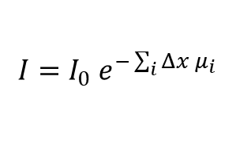





X-ray CT
$$〈μ〉(x,y,z)$$
$$SP(x,y,z)$$
$$I=I_{0} e^{−\sum_{i}{Δx μ_{i}}}$$
$$I=I_{0}$$
X-ray tube
$μ$,SP
$$Δx$$
X-ray detector

Slide 4







Proton CT
$$E=E_{0}$$
$$E=E_{0}−∫SP dl$$
$$l_{1}$$
$$l_{4}$$
High energy
proton beam
Energy detector
$μ$,SP
Position detectors
Position detectors
$$\text{SP}(x,y,z)$$

Slide 5
The energy detector
Range telescope
Scintillator

Slide 6
Proton CT with a Digital Tracking Calorimeter
First proof-of-concept detector

Slide 7
pCT – Digital Tracking Calorimeter
Digital Tracking Calorimeter
Patient
Beam
Assume proton
vector & position
Measure multiple protons’
vector, position &
track protons to find range

Slide 8
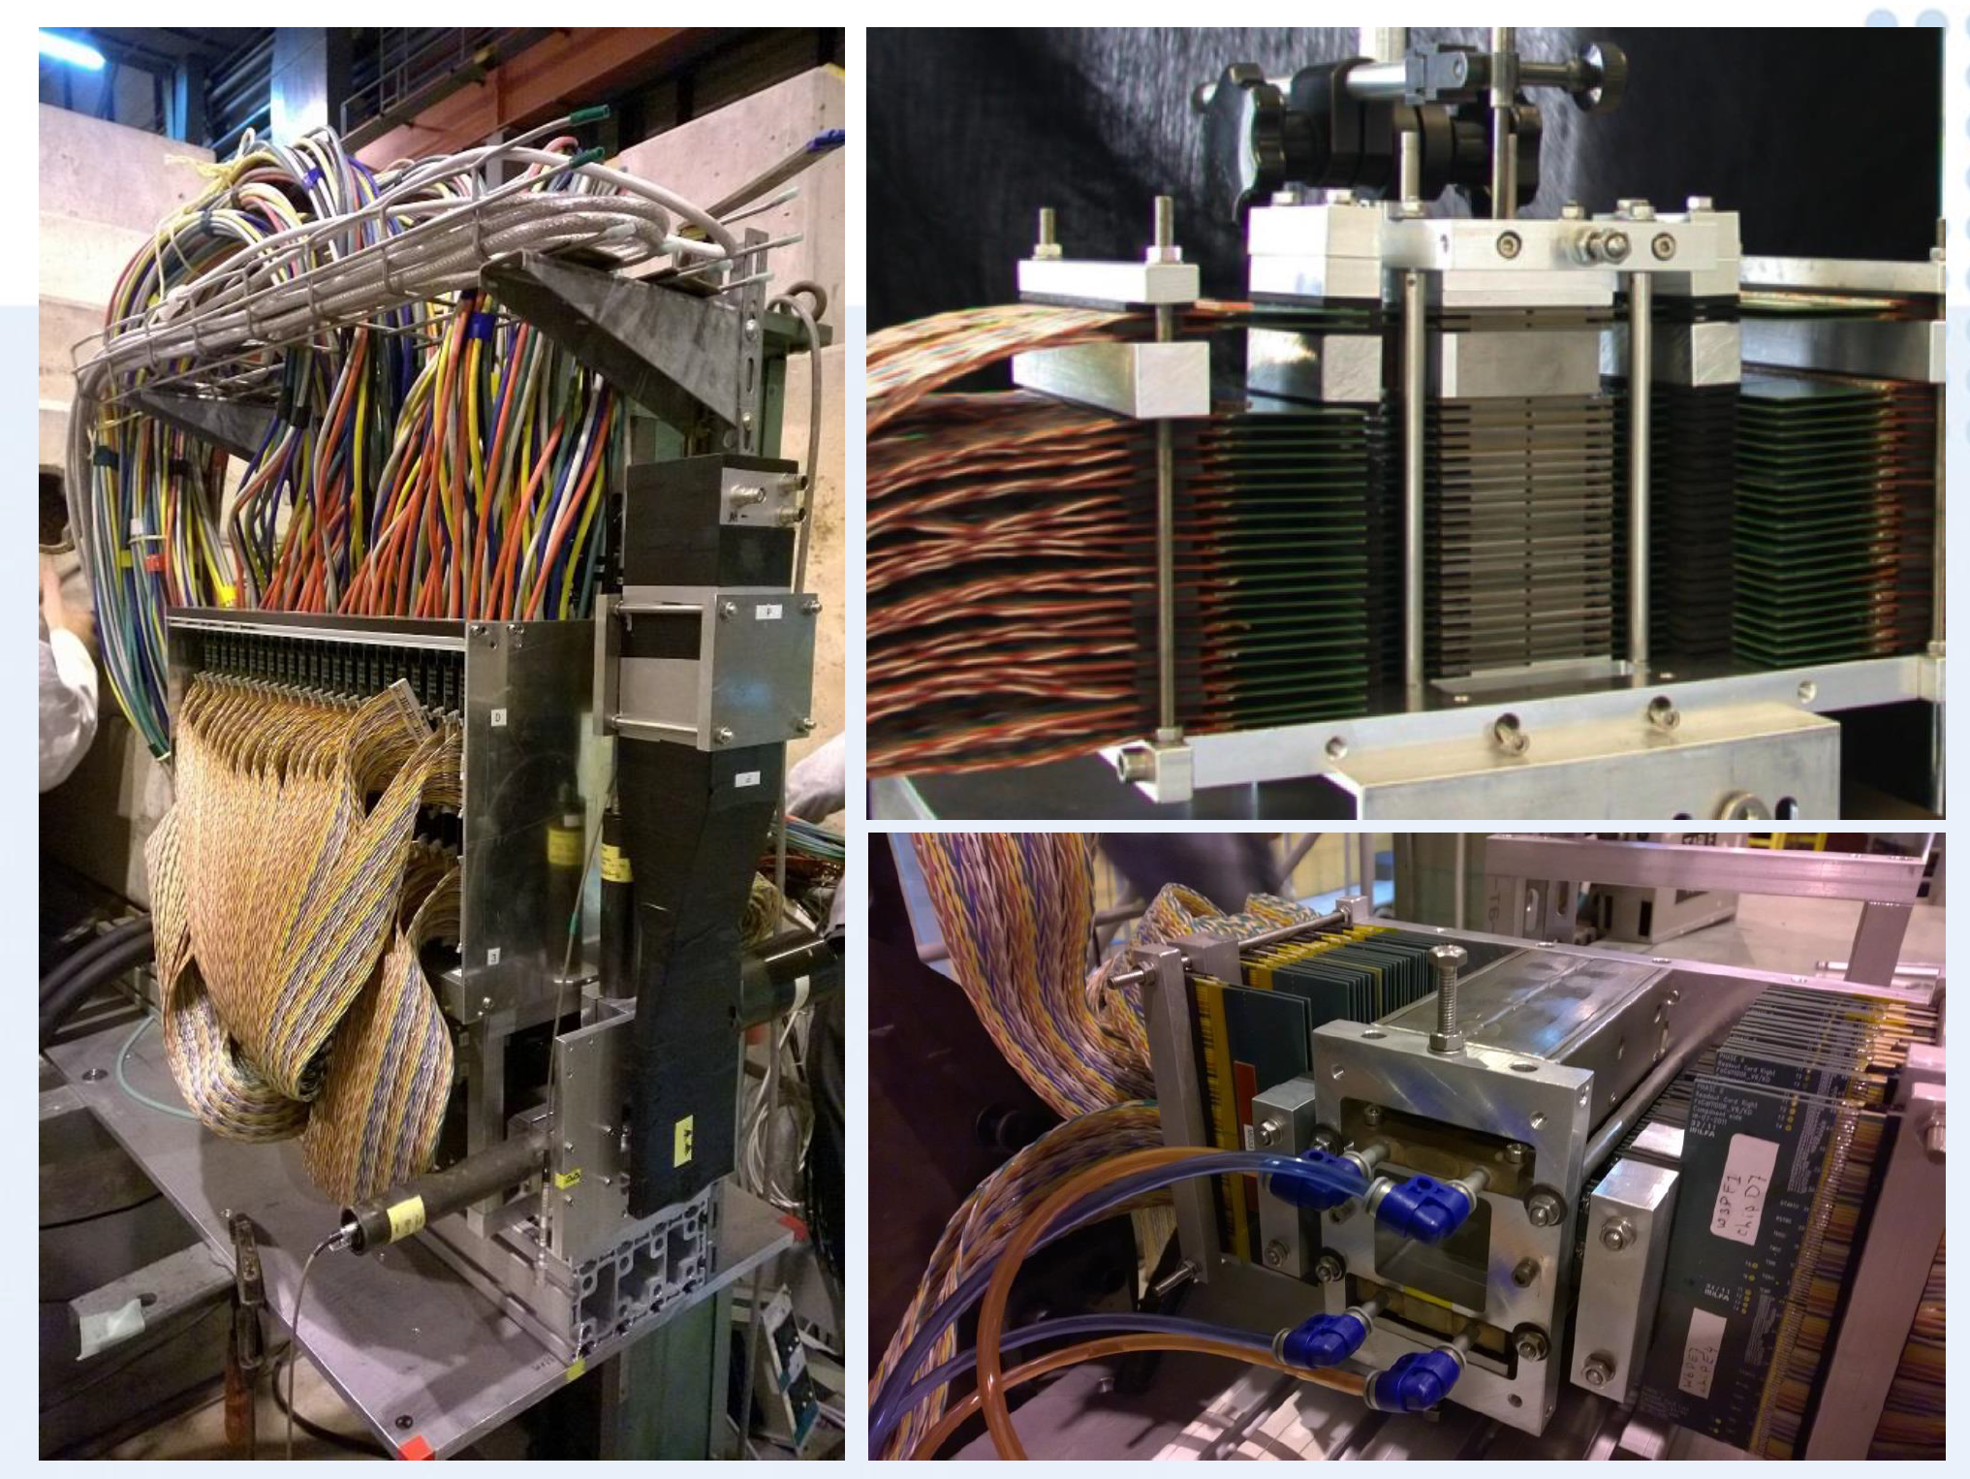
Beam tests in CERN + Groningen, NL (2014)

Slide 9
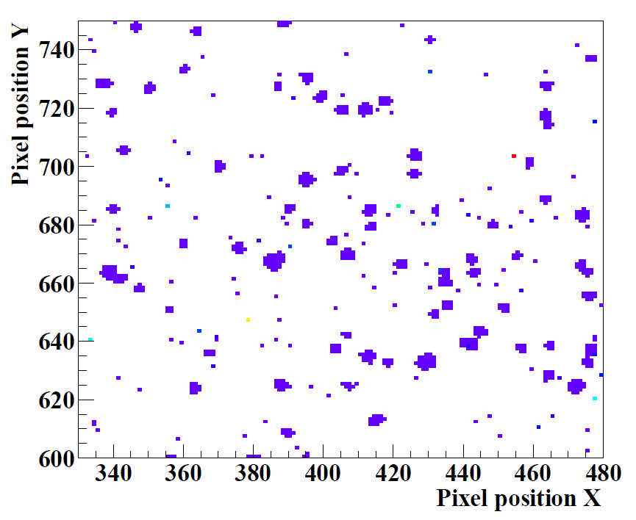
Protons hitting the pixel detectors
Pixel Position Y [Pixel number]
Pixel Position X [Pixel number]
Notes:
You have to play «Connecting the Dots», which, incidentally, is also the name of an internationally held workshop specializing on track reconstruction

Slide 10
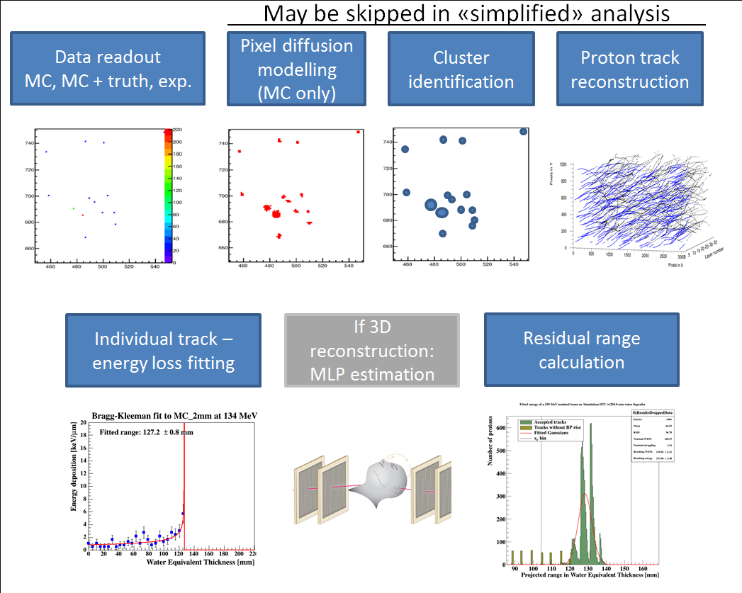
Analysis workflow

Slide 11
Proof-of-concept: ALICE-FoCal
From 2013: Analysis + beamtests with the ALICE-FoCal detector for pCT
Expectedly poor resolution
Track reconstruction possible at high rates
  ~1 million/s across 16 cm² @ 2 kHz readout

Slide 12
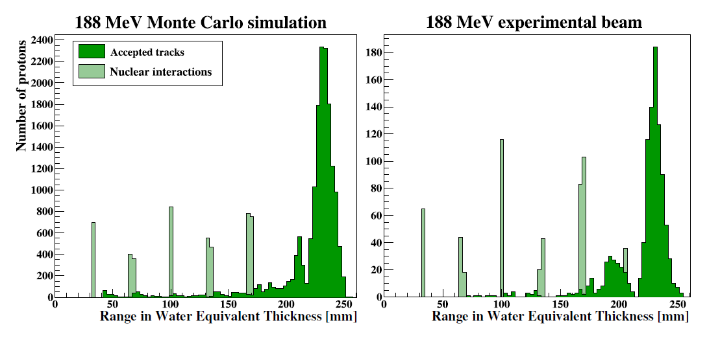


The ranges from many protons
$$〈\hat{R}〉=232.0±15.0 \text{mm} \text{WET}$$
$$〈\hat{R}〉=231.1±25.1 \text{mm} \text{WET}$$
Pettersen, H.E.S. et al., 2017. Nucl. Instr. and Meth. in Phys. Res. A 860, 51–61.

Slide 13
Proton CT with a Digital Tracking Calorimeter
Second prototype

Slide 14
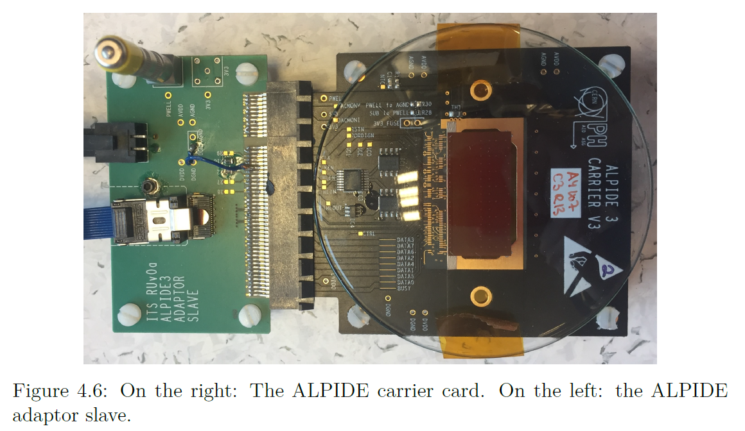
Alice Pixel Detector (ALPIDE)
More on ALPIDE in 34 minutes!
http://bora.uib.no/handle/1956/16041: Design of High-Speed Digital Readout System for Use in Proton Computed Tomography

Slide 15
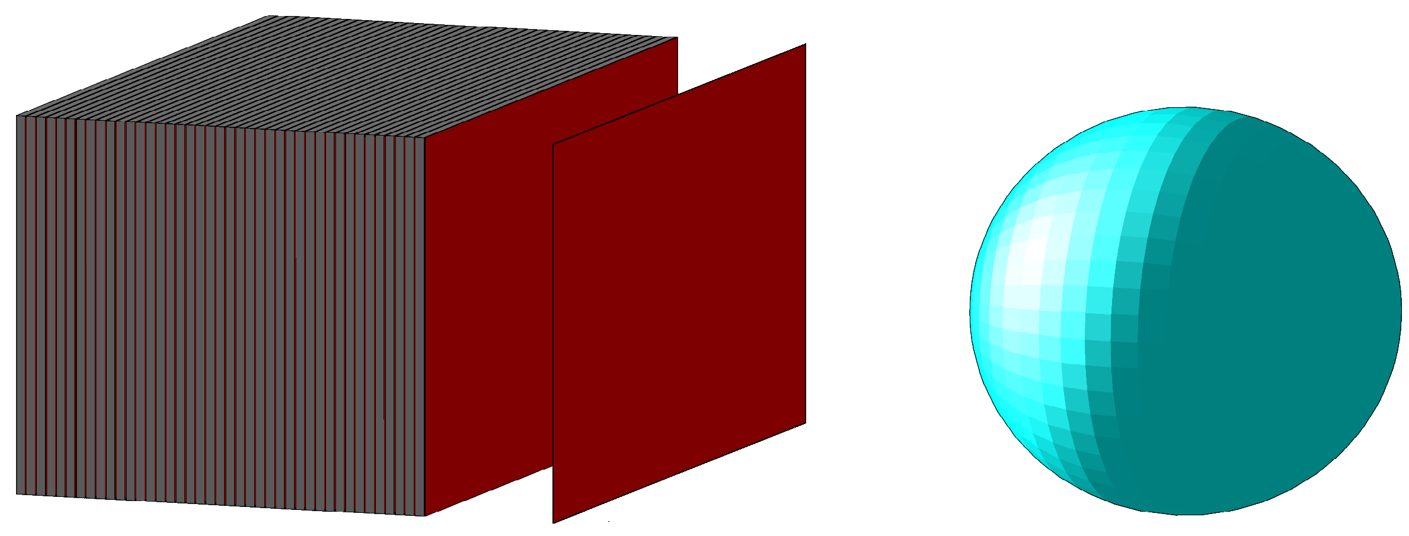
Monte Carlo simulations
A very important tool in detector development
  Define geometry, materials, beam, readout…
  Simulation of how the particles interact and how energy is deposited

Slide 16
GATE
Geant4-based MC framework
Macro-based, simple to automate, e.g. to test iterative designs:

Slide 17
Charge diffusion from proton tracks

Slide 18
Protons hitting the pixel detectors
Pixel Position Y [Pixel number]
Pixel Position X [Pixel number]
Notes:
You have to play «Connecting the Dots», which, incidentally, is also the name of an internationally held workshop specializing on track reconstruction

Slide 19
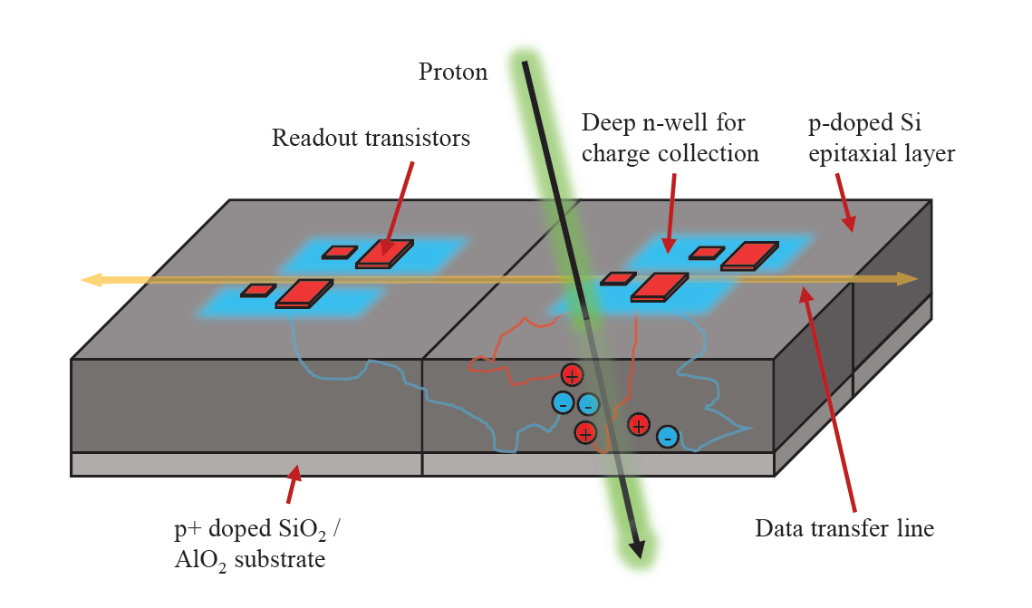
Charge diffusion in pixels
Pettersen, H.E.S., 2018. PhD thesis

Slide 20
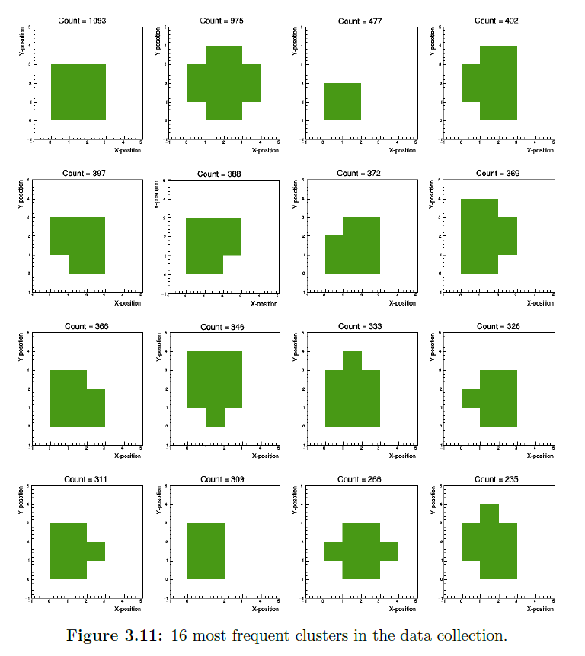
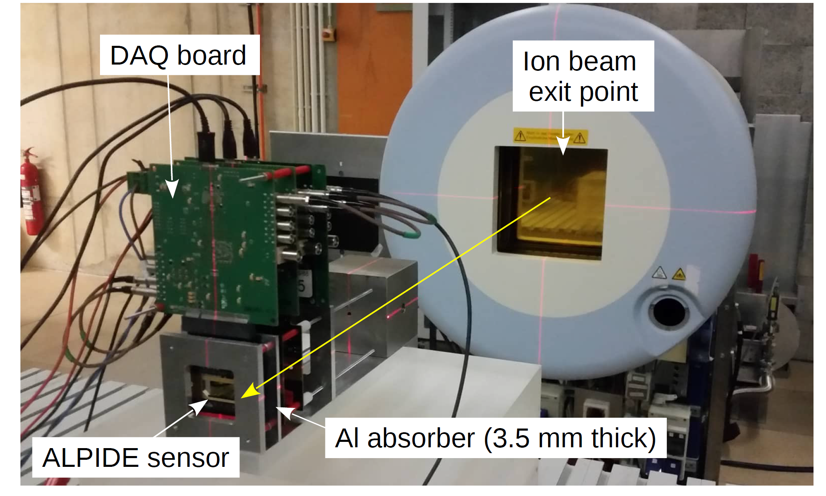

Heidelberg beam test: 2018
A list of 15 000 «good» clusters
+ Calculation of the ions’ $E_{D}$
Grimstad, S., 2019. MSc: Simulation and analysis of clustering for proton CT
Tambave, G. et al., 2019. Nucl Instr And Meth in Phys Res A; 162626

Slide 21
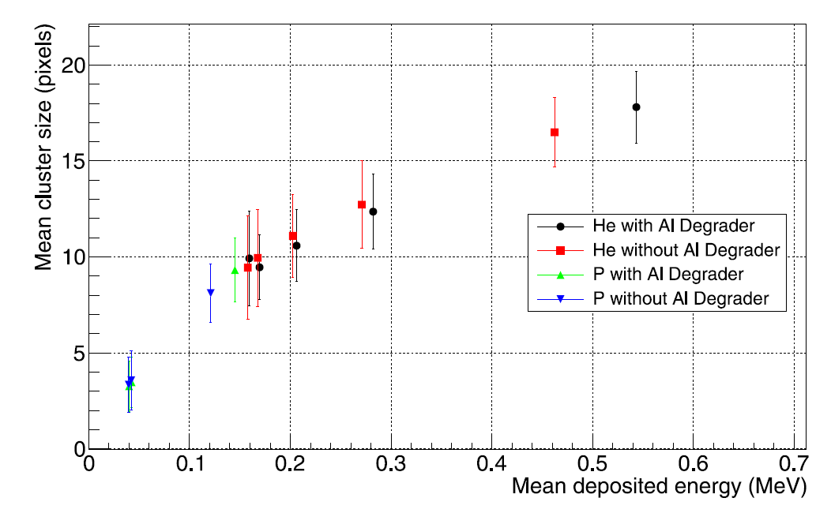
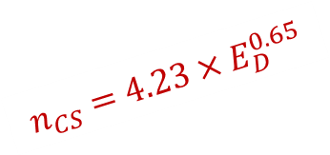
$$n_{CS}=4.23×E_{D}^{0.65}$$
Tambave, G. et al., 2019. Nucl Instr And Meth in Phys Res A; 162626

Slide 22
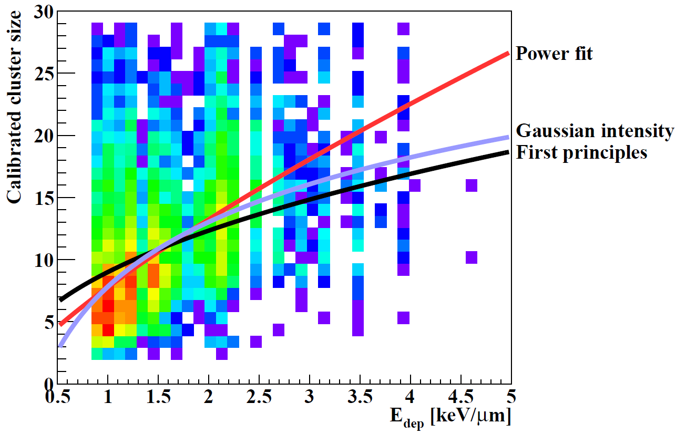


Compare this to MIMOSA (PoC)
$$n_{CS}^{\text{MIMOSA}}=7.9×E_{D}^{ 0.73}$$
$$n_{CS}^{\text{ALPIDE}}=4.23×E_{D}^{0.65}$$
Pettersen, H.E.S., 2018. PhD thesis
Notes:
So took all the clusters from the experimental data and characterized them regarding a) their residual energy, which gives the energy deposited in that layer and b) their cluster size after the different chips have been calibrated to yield similar cluster size distributions. This is a correlation plot between the two, and with this I’ve applied different models to describe the correlation. The First Principles-model was customized for this usage by the help of a master student.

Slide 23
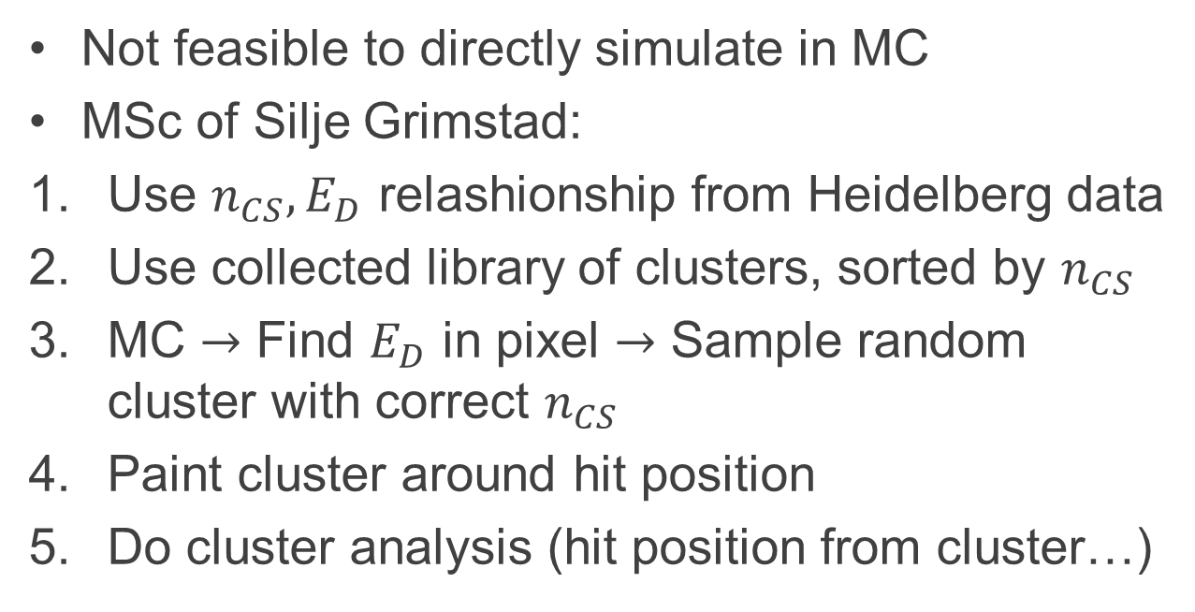
MC modeling of Cluster Sizes
Not feasible to directly simulate in MC
MSc of Silje Grimstad:
Use $n_{CS}, E_{D}$ relashionship from Heidelberg data
Use collected library of clusters, sorted by $n_{CS}$
MC $→$ Find $E_{D}$ in pixel $→$ Sample random cluster with correct $n_{CS}$
Paint cluster around hit position
Do cluster analysis (hit position from cluster…)

Slide 24
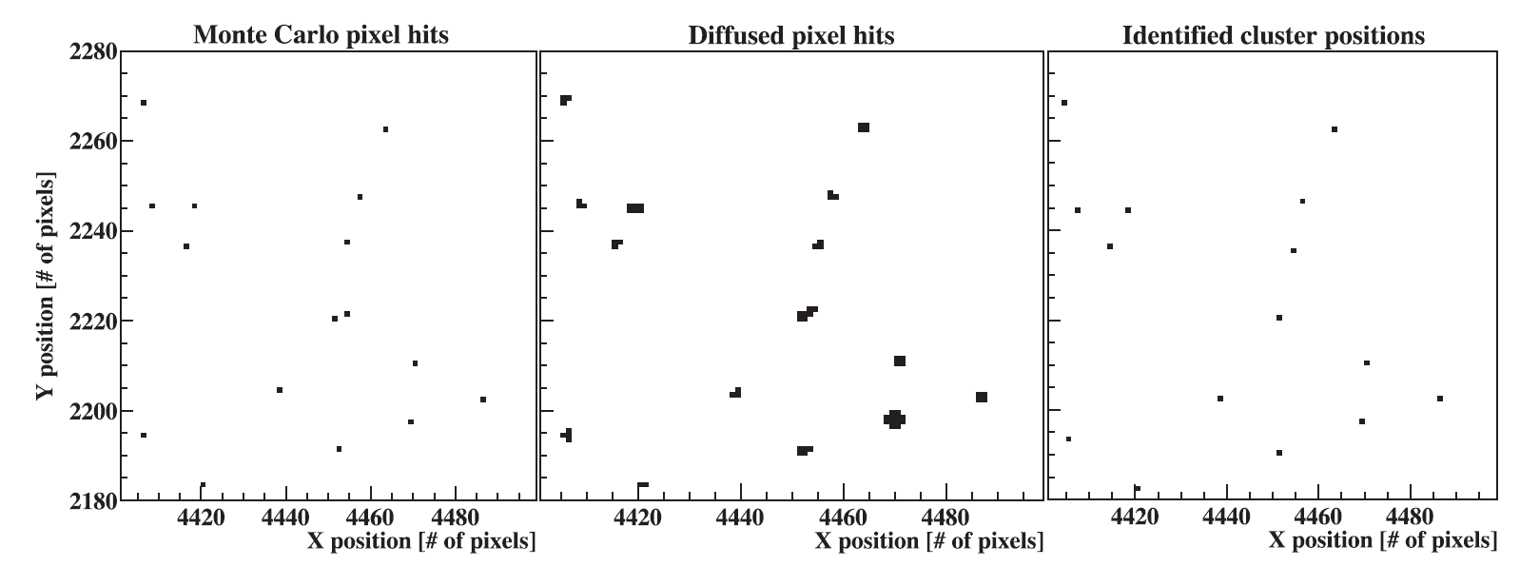
Pettersen, H.E.S. et al., 2019. Physica Medica 63, 87–97.

Slide 25

Accuracy of cluster reconstruction
$$∼98.5\%$$
Grimstad, S., 2019. MSc: Simulation and analysis of clustering for proton CT

Slide 26
Track reconstruction

Slide 27
Proton track reconstruction
With a DTC-type detector:
  Possible to reconstruct many protons in a single readout
  All proton hits throughout the detector must be «de-spaghetti-fied» into tracks

Slide 28
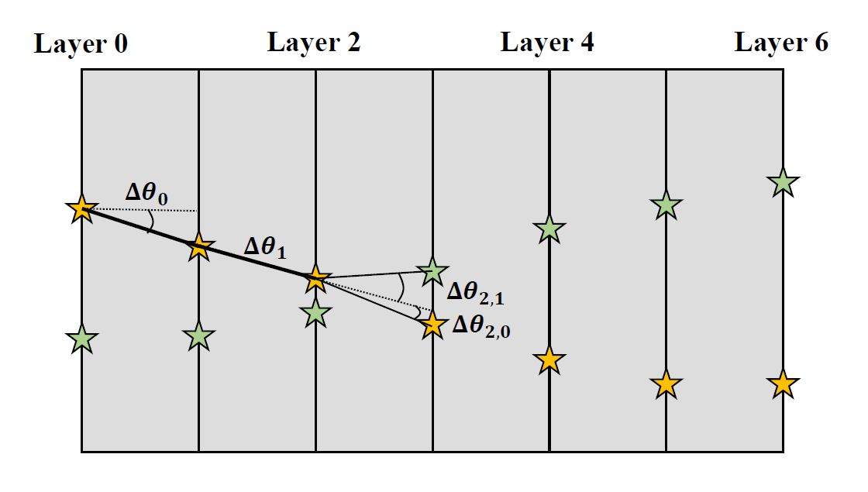
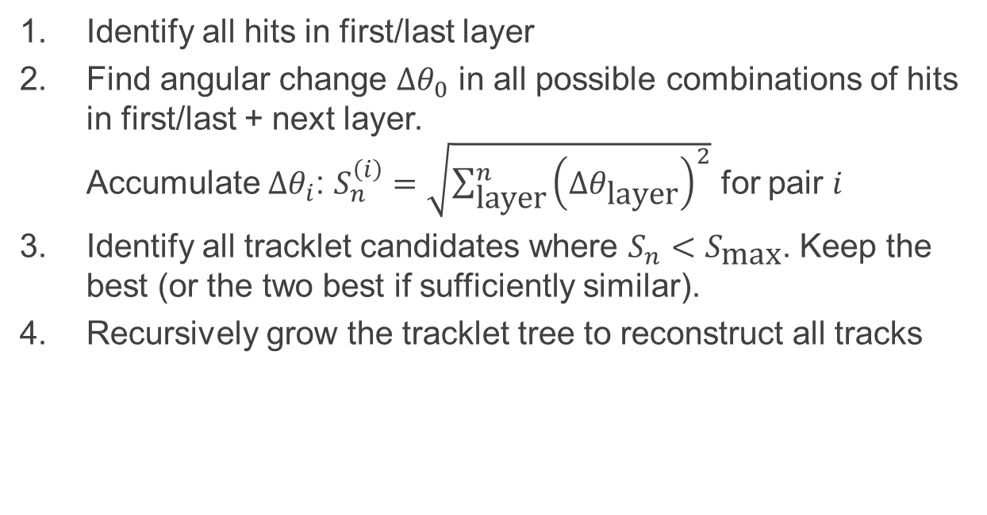
Tracking algorithm
Identify all hits in first/last layer
Find angular change $Δθ_{0}$ in all possible combinations of hits in first/last + next layer.
Accumulate $Δθ_{i}$: $S_{n}^{\left(i\right)}=\sqrt{\sum_{\text{layer}}^{n}{{\left(Δθ_{\text{layer}}\right)}^{2}}}$ for pair $i$
Identify all tracklet candidates where $S_{n}<S_{\text{max}}$. Keep the best (or the two best if sufficiently similar).
Recursively grow the tracklet tree to reconstruct all tracks
Pettersen, H.E.S. et al., 2019. EPJ WoC (in press).

Slide 29
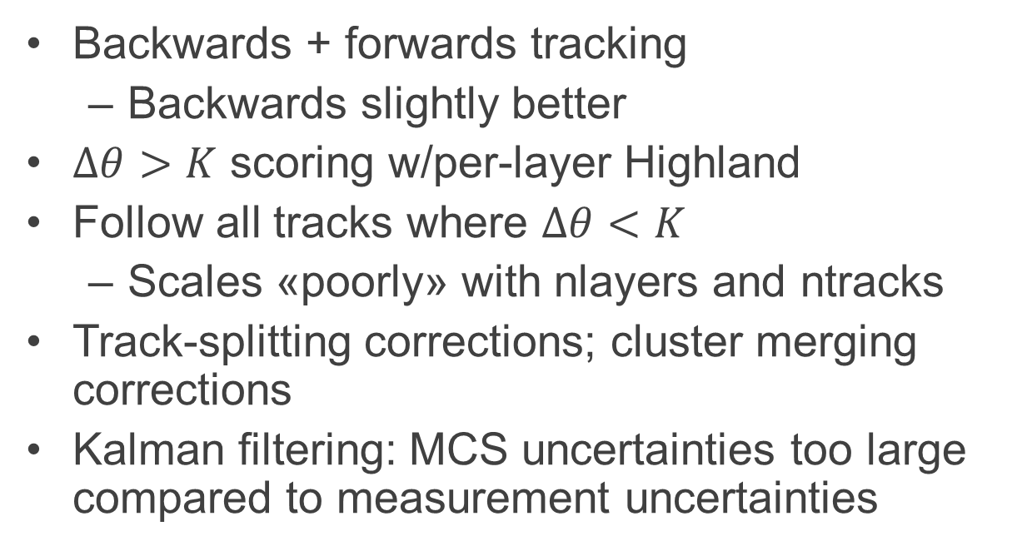
Stuff we’ve tried
Backwards + forwards tracking
  Backwards slightly better
$Δθ>K$ scoring w/per-layer Highland
Follow all tracks where $Δθ<K$
  Scales «poorly» with nlayers and ntracks
Track-splitting corrections; cluster merging corrections
Kalman filtering: MCS uncertainties too large compared to measurement uncertainties

Slide 30
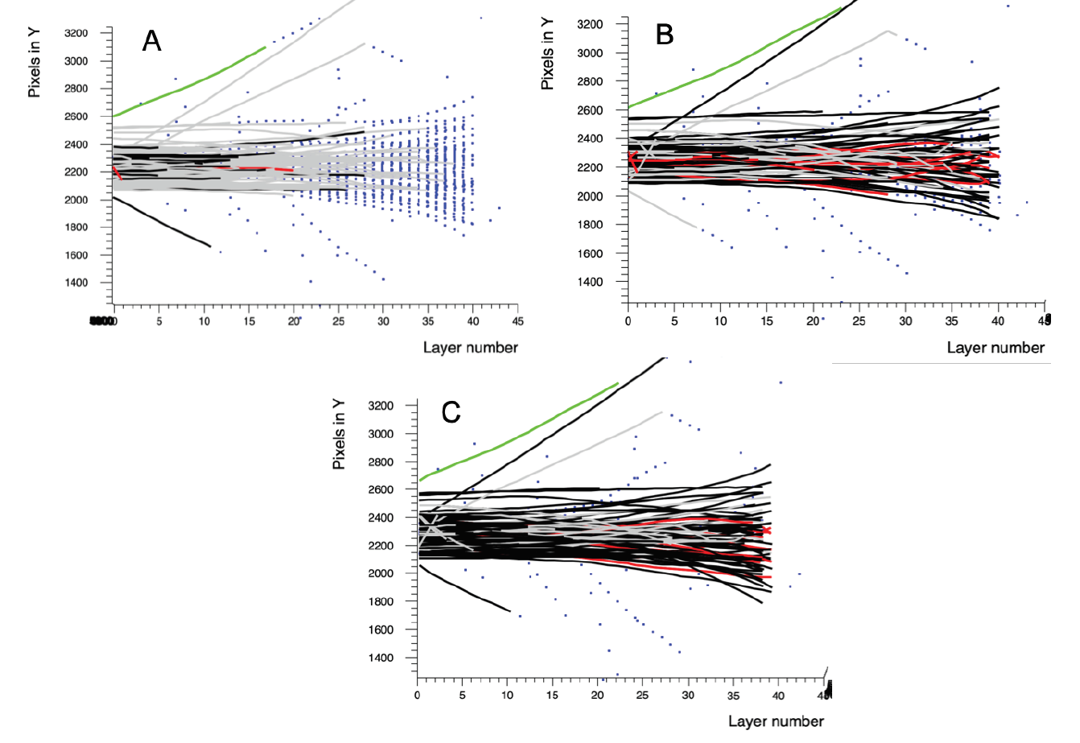



$$S_{\text{max}}=f_{\text{Highland}}$$
$$S_{\text{max}}={4f}_{\text{Highland}}$$
Good track
Incomplete track
Unfiltered secondary
Two tracks confused
Unused cluster
$$S_{\text{max}}=300 \text{mrad}$$
Garcia-Santos, A., 2019. Utrecht University, Delft. MSc: Optimization of the Track Reconstruction Algorithm in a Pixel Based Range Telescope for Proton Computed Tomography

Slide 31
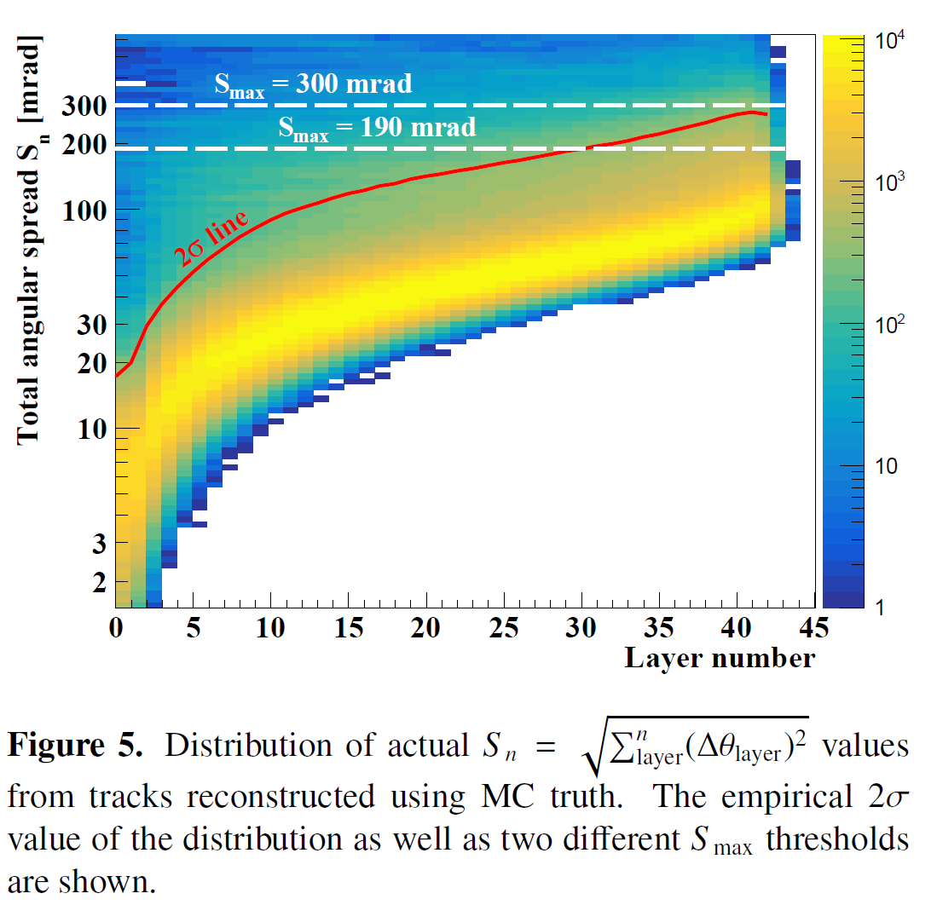
Pettersen, H.E.S. et al., 2019. EPJ WoC (in press).

Slide 32
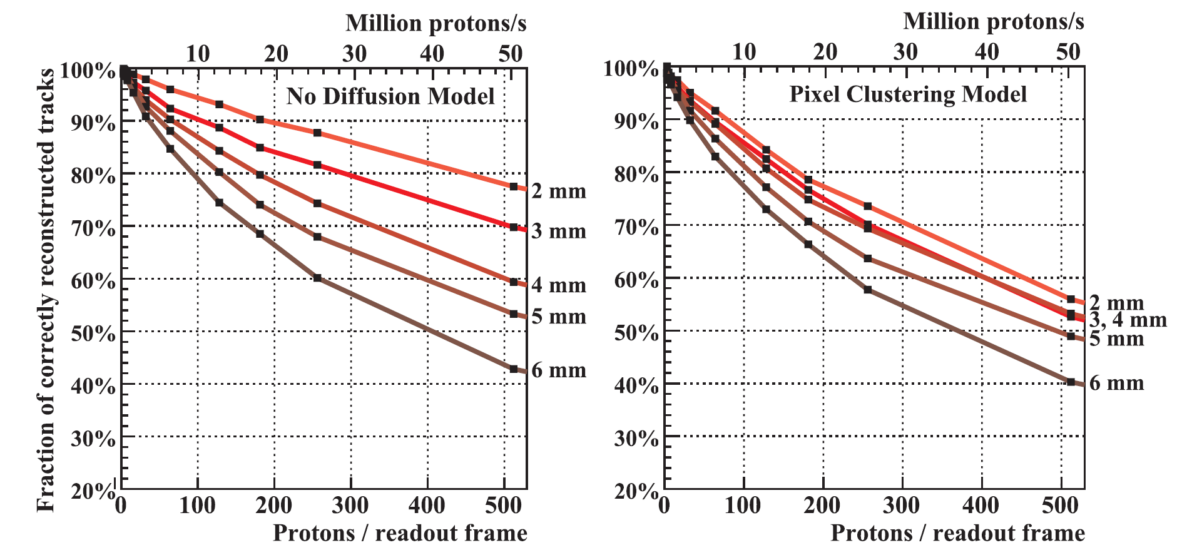

Now assuming a $σ=3 \text{mm}$ pencil beam
& 10 µs integration time
Pettersen, H.E.S. et al., 2019. Physica Medica 63, 87–97.
Aluminum absorber thickness (final = 3.5 mm)

Slide 33
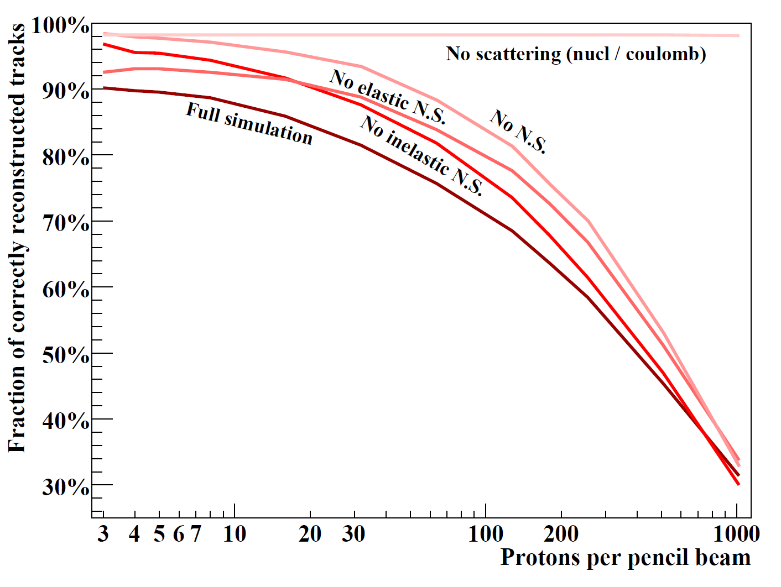
What are the degrading effects?
Pettersen, H.E.S. et al., 2019. EPJ WoC (in press).

Slide 34
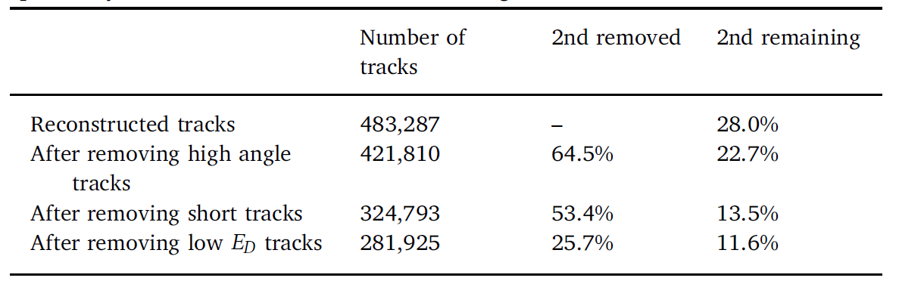

Track filtering
Need filter nuclear interactions in detector/patient
    3 sigma angular filter
    3 sigma filter on range per beam / voxel
    Filter on $E_{D}$ in the last layer
Pettersen, H.E.S. et al., 2019. Physica Medica 63, 87–97.

Slide 35
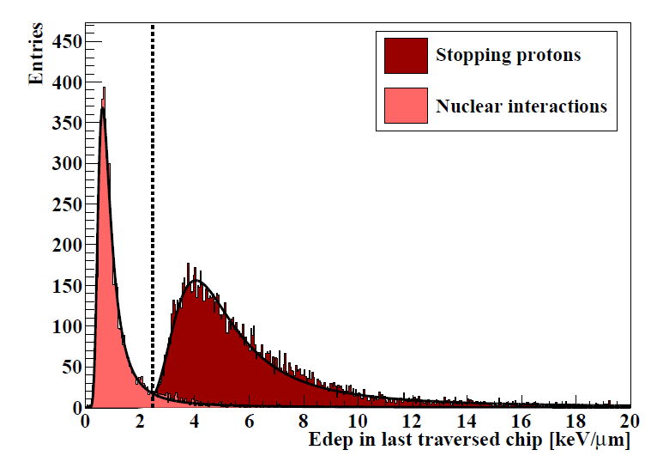
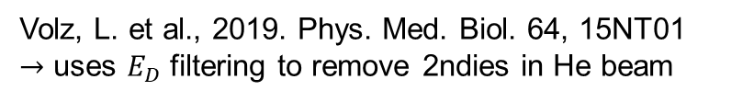
Pettersen, H.E.S., 2018. PhD thesis
Volz, L. et al., 2019. Phys. Med. Biol. 64, 15NT01
$→$ uses $E_{D}$ filtering to remove 2ndies in He beam

Slide 36
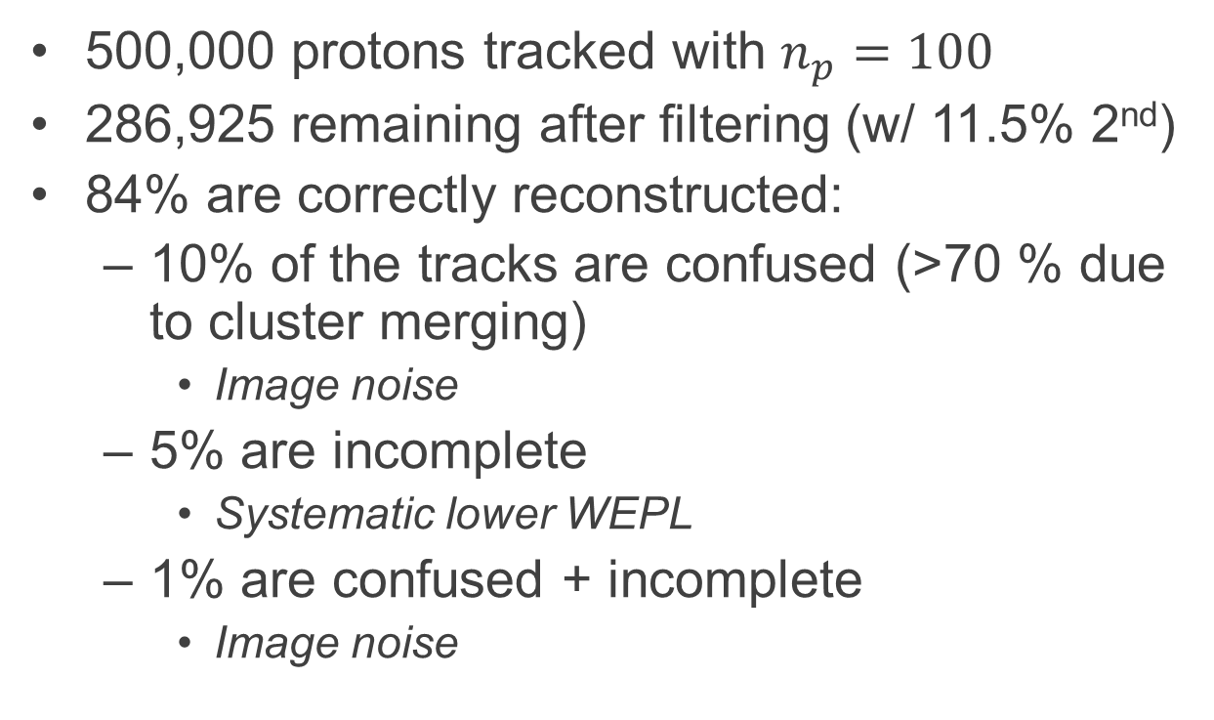
What happens to bad tracks?
500,000 protons tracked with $n_{p}=100$
286,925 remaining after filtering (w/ 11.5% 2nd)
84% are correctly reconstructed:
  10% of the tracks are confused (>70 % due to cluster merging)
    Image noise
  5% are incomplete
    Systematic lower WEPL
  1% are confused + incomplete
    Image noise

Slide 37
Range calculation

Slide 38
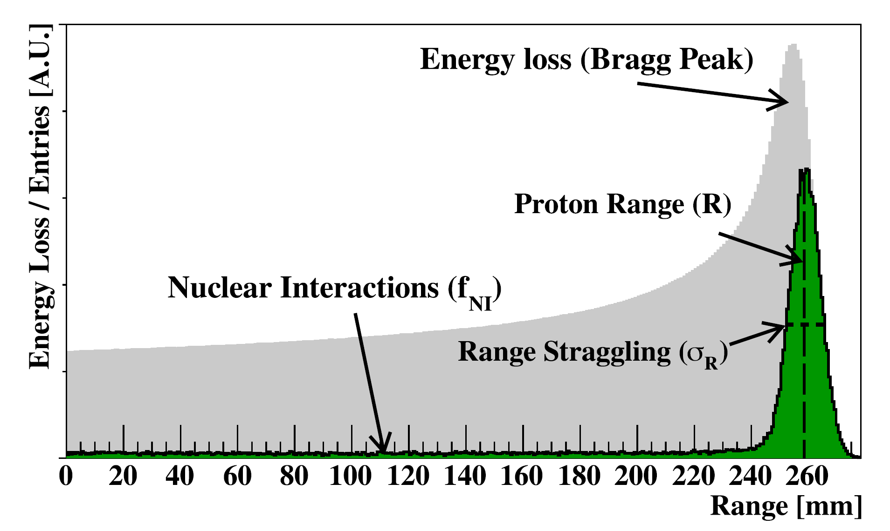

Finding the proton range
Pettersen, H.E.S., 2018. PhD thesis

Slide 39
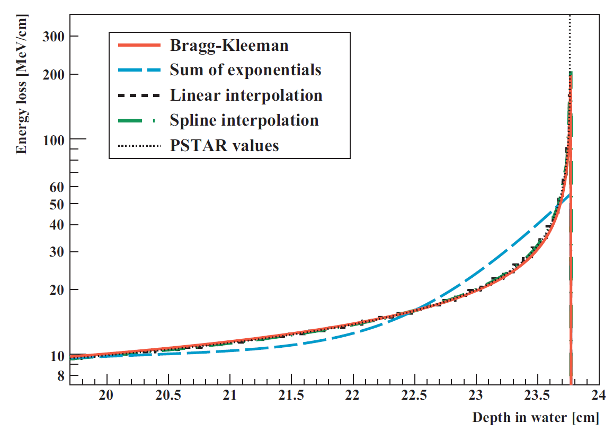

The Bragg-Kleeman range-energy relationship, $R=αE^{p}$, can be rewritten to give an accurate depth-dose curve for a single proton:
$$\frac{dE}{dz}=\frac{{\left(R−z\right)}^{1/p−1}}{pα^{1/p}}$$
Pettersen, H. E. S. et al., 2018. Radiat. Phys. Chem. 144, 295–297.

Slide 40
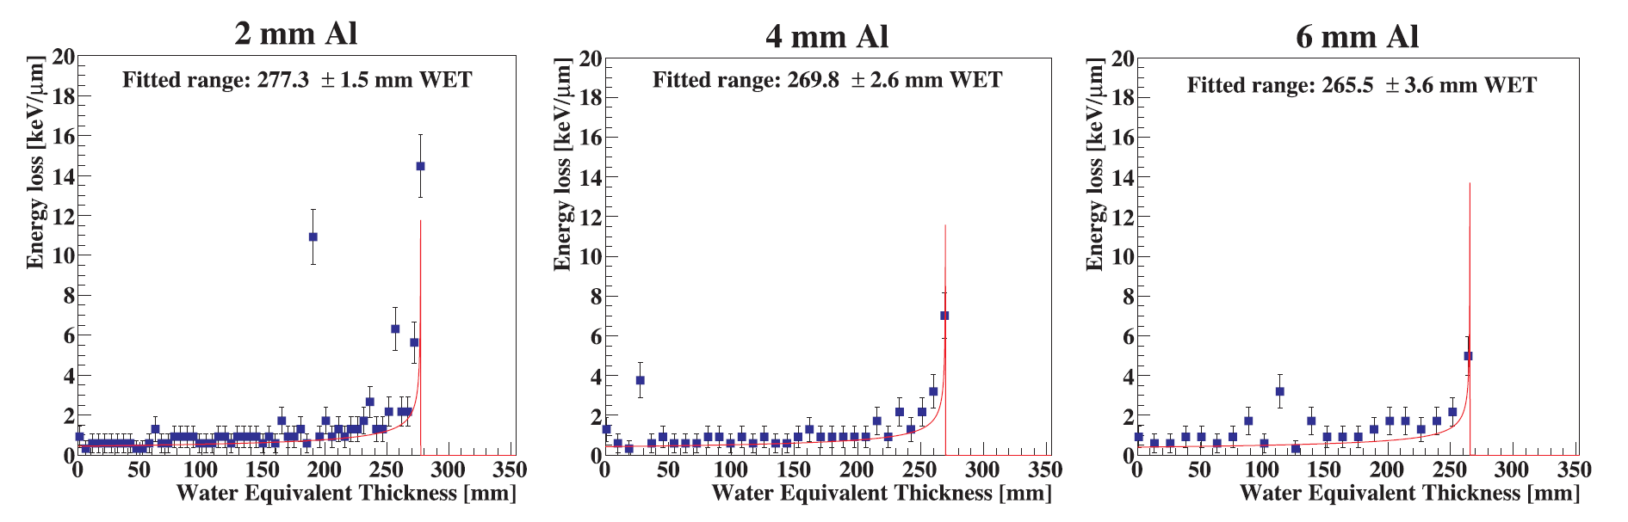
Range resolution from individual tracks
Pettersen, H.E.S. et al., 2019. Physica Medica 63, 87–97.

Slide 41
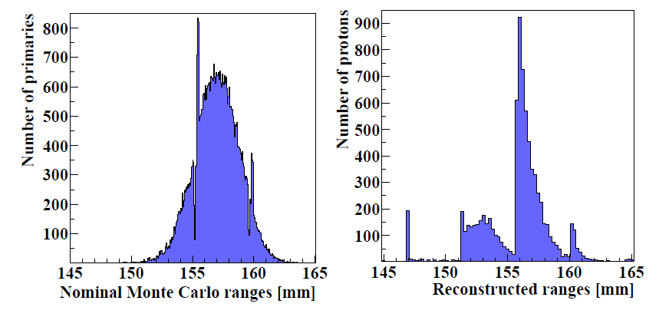
Range accuracy and precision
Range
straggling
Range
straggling
+
detector
uncertainty

Slide 42
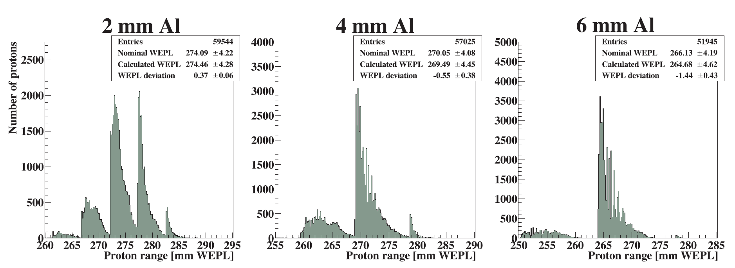
Range distribution per beam energy
Pettersen, H.E.S. et al., 2019. Physica Medica 63, 87–97.
Notes:
The thinner the absorber layers, the more sensor layers the Rang Straggling Distribution cover, increasing the resolution & accuracy

Slide 43
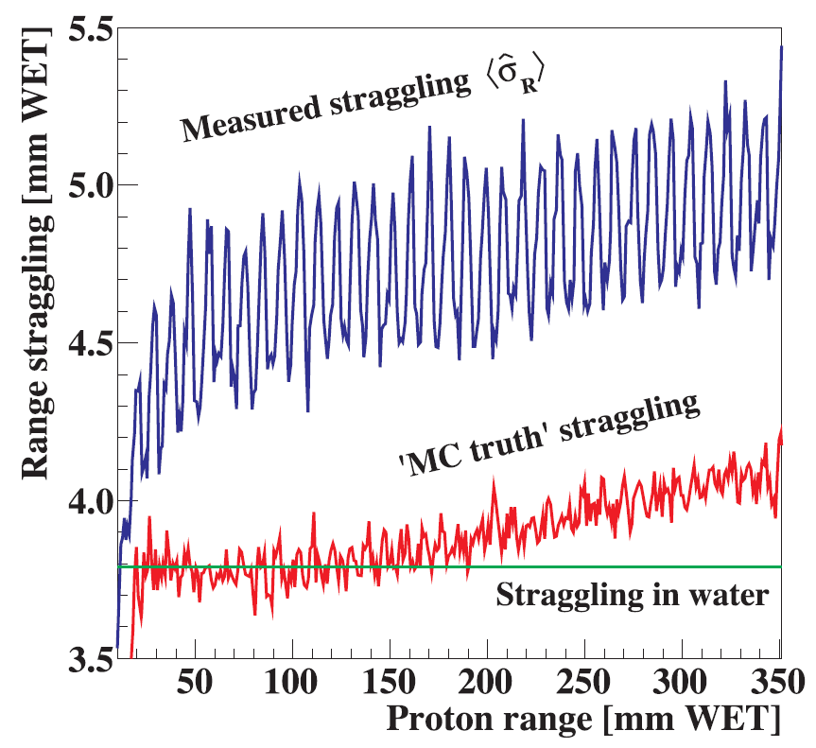
Pettersen, H.E.S. et al., 2019. Physica Medica 63, 87–97.

Slide 44
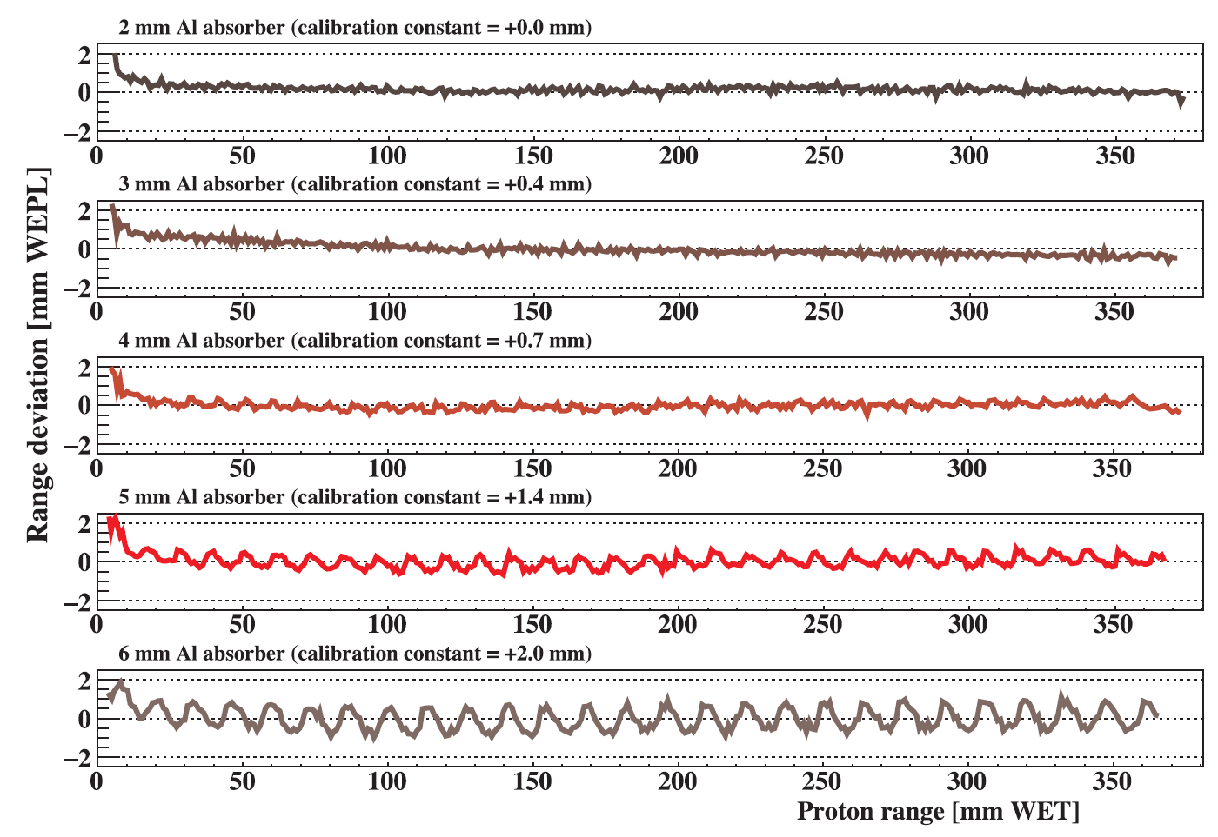
Pettersen, H.E.S. et al., 2019. Physica Medica 63, 87–97.

Slide 45
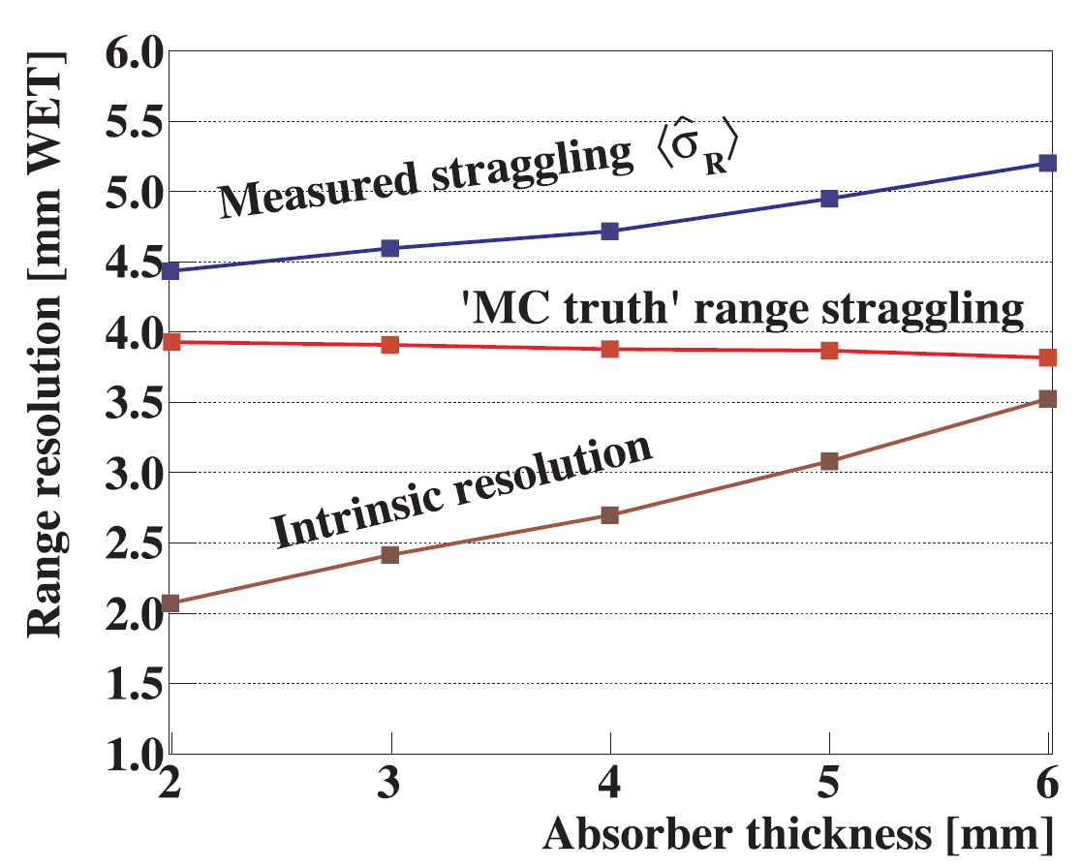
Design choice: 3.5 mm
Pettersen, H.E.S. et al., 2019. Physica Medica 63, 87–97.

Slide 46
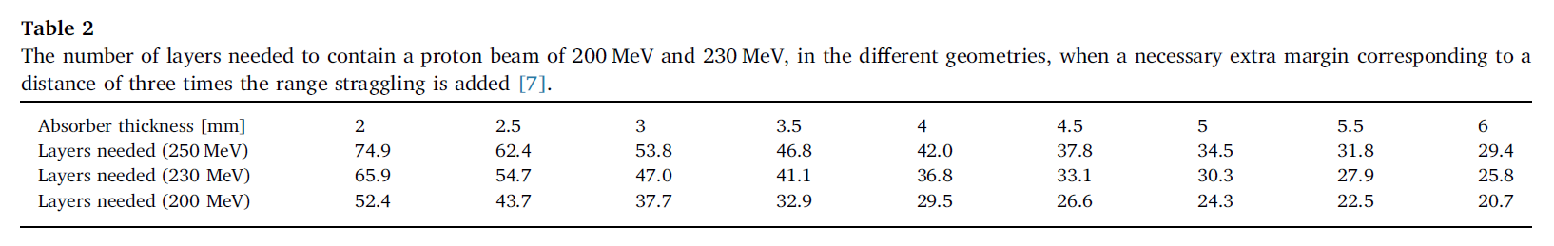
Number of layers needed
Pettersen, H.E.S. et al., 2019. Physica Medica 63, 87–97.

Slide 47
What about images?

Slide 48
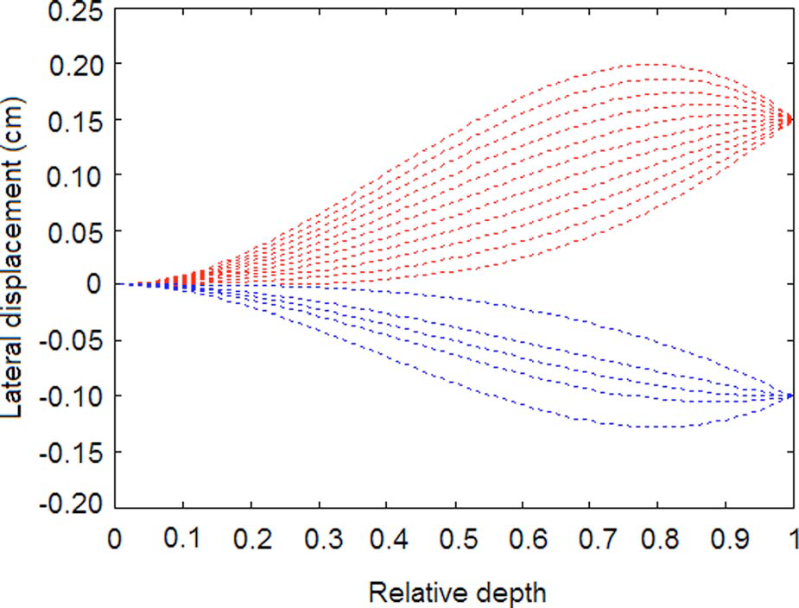
The Most Likely Path scheme
The Most Likely Path (MLP) of the proton through the object
A model fit to the entry and exit angle/position
Use the curves for image reconstruction
More on MLP on Thursday!
Li, T., et al., Reconstruction for proton computed tomography by tracing proton trajectories: a Monte Carlo study. Med Phys, 2006. 33(3): p. 699-706

Slide 49

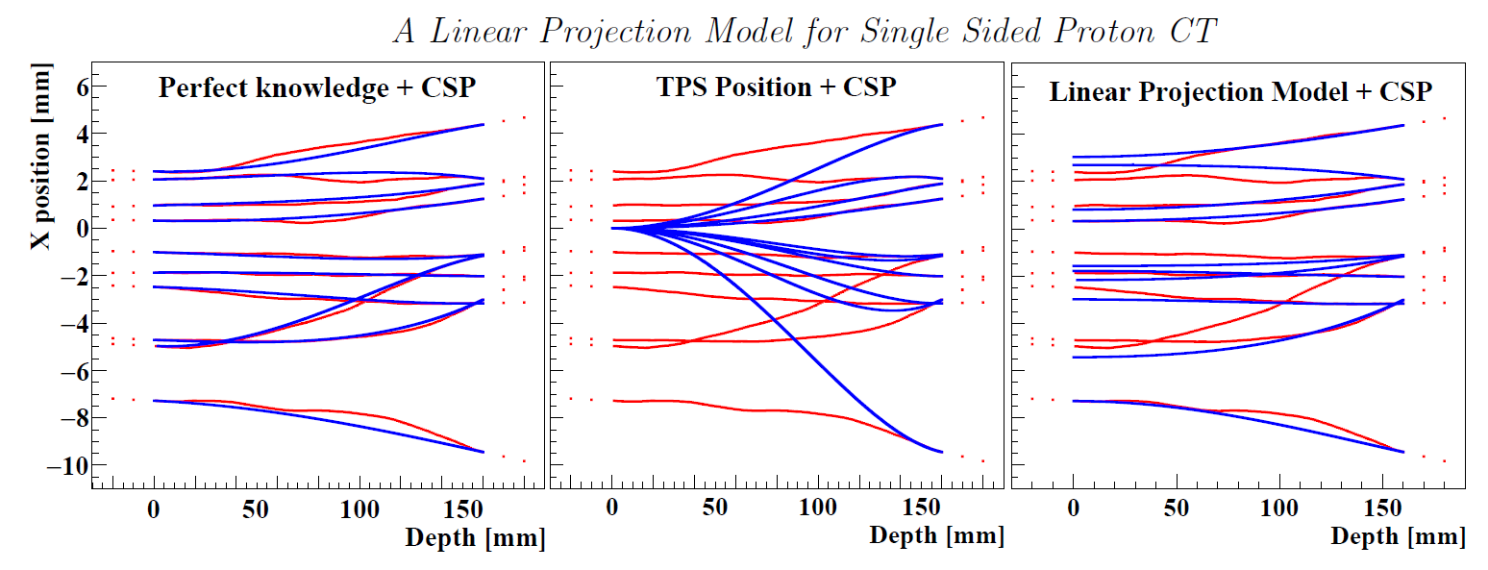
How to find the entrance position?
Measure before
the patient…
Use middle value
of pencil beam
Estimate from front
position (not too bad eh!)
More on single-sided imaging on Friday!
MC tracks
Estimated
tracks
Krah N et al. (2018) PMB 63 (13)
Also Pettersen HES, Volz L et al. Rejected by Phys Med Biol ☹

Slide 50
References
Garcia-Santos, A. (2019). MSc: Optimization of the Track Reconstruction Algorithm in a Pixel Based Range Telescope for Proton Computed Tomography. Utrecht University.
Grimstad, S. (2019). MSc: Simulation and analysis of clustering for proton CT.
Pettersen, H.E.S. (2018). PhD: A Digital Tracking Calorimeter for Proton Computed Tomography. University of Bergen.
Pettersen, H.E.S., Alme, J., Biegun, A., van den Brink, A., Chaar, M., Fehlker, D., Meric, I., Odland, O.H., Peitzmann, T., Rocco, E., et al. (2017). Proton Tracking in a high-granularity Digital Tracking Calorimeter for proton CT purposes. Nucl. Instr. and Meth. in Phys. Res. A 860, 51–61.
Pettersen, H.E.S., Chaar, M., Meric, I., Odland, O.H., Sølie, J.R., and Röhrich, D. (2018). Accuracy of parameterized proton range models; a comparison. Radiat. Phys. Chem. 144, 295–297.
Pettersen, H.E.S., Alme, J., Barnaföldi, G.G., Barthel, R., van den Brink, A., Chaar, M., Eikeland, V., García-Santos, A., Genov, G., Grimstad, S., et al. (2019a). Design optimization of a pixel-based range telescope for proton computed tomography. Physica Medica 63, 87–97.
Pettersen, H.E.S., Meric, I., Odland, O.H., Shafiee, H., Sølie, J.R., and Röhrich, D. (2019b). Proton Tracking Algorithm in a Pixel-Based Range Telescope for Proton Computed Tomography. EPJ Web of Conferences In press.
Pettersen, H.E.S., Volz, L., Sølie, J., Rohrich, D., and Seco, J. A Linear Projection Model to Estimate a Proton’s Position in a Pencil Beam For Single Sided List Mode Proton Imaging. Rejected PMB
Tambave, G., Odland, Odd Harlad, Pettersen, H.E.S., Alme, J., Genov, G., Grøttvik, O.S., Samnøy, A.T., Röhrich, D., Ullaland, K., Ur Rehman, A., et al. (2019). Characterization of Monolithic CMOS Pixel Sensor Chip with Ion Beams for Application in proton Computed Tomography. NIMA.
Krah, N., Khellaf, F., Rit, S., and Rinaldi, I. (2018). A comprehensive theoretical comparison of proton imaging set-ups in terms of spatial resolution. Physics in Medicine and Biology 63.

Slide 51
Thanks for your attention ☺

