Slide 1
Development of Readout Electronics for a Digital Tracking Calorimeter (pCT)
Here you can write unit / affiliation. Leave blank if not applicable.
To change content go to: Menu -> Insert (Mac = Display) -> Header and Footer
27th October 2019
Ola Slettevoll Grøttvik
Bergen pCT Collaboration

Slide 2
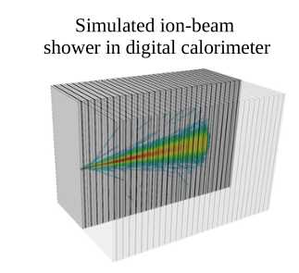
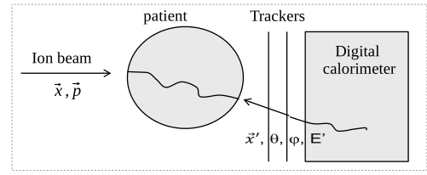
Digital Tracking Calorimeter / Bergen pCT
Multiple layers of high-granularity pixel detectors
  With absorption/conversion layers
41 planes/layers
  27 x 18 cm
  56 Megapixels
Post-phantom angle measurement:
  Very thin front-tracker layers
3.5 mm thick Al absorber between layers

Slide 3
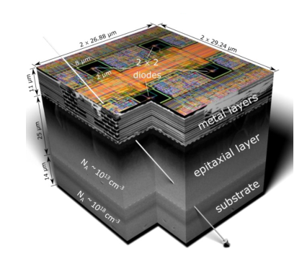
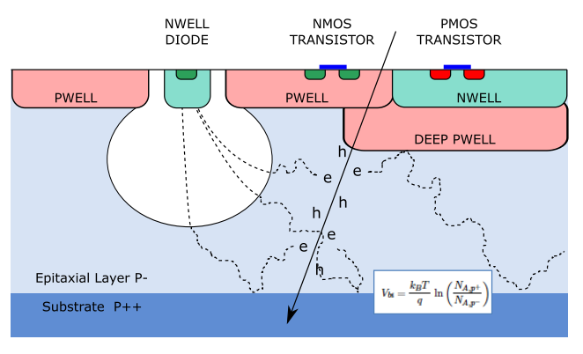
ALPIDE – ALICE Pixel Detector
Pixel detector developed for ALICE ITS
Monolithic Active Pixel Sensors (MAPS)
Chip size: 1.5 cm x 3 cm
Integration time: order of µs
1024 x 512 pixels
Pixel size: 27 µm x 29 µm
Digital readout: 1.2 Gb/s (8B10B)
Each pCT Layer: 108 ALPIDEs

Slide 4
Design Challenges
Structure requirements
  Homogeneity
  Density of connections
High number of high-speed links
High occupancy
  Quasi-online dose planning tool

Slide 5
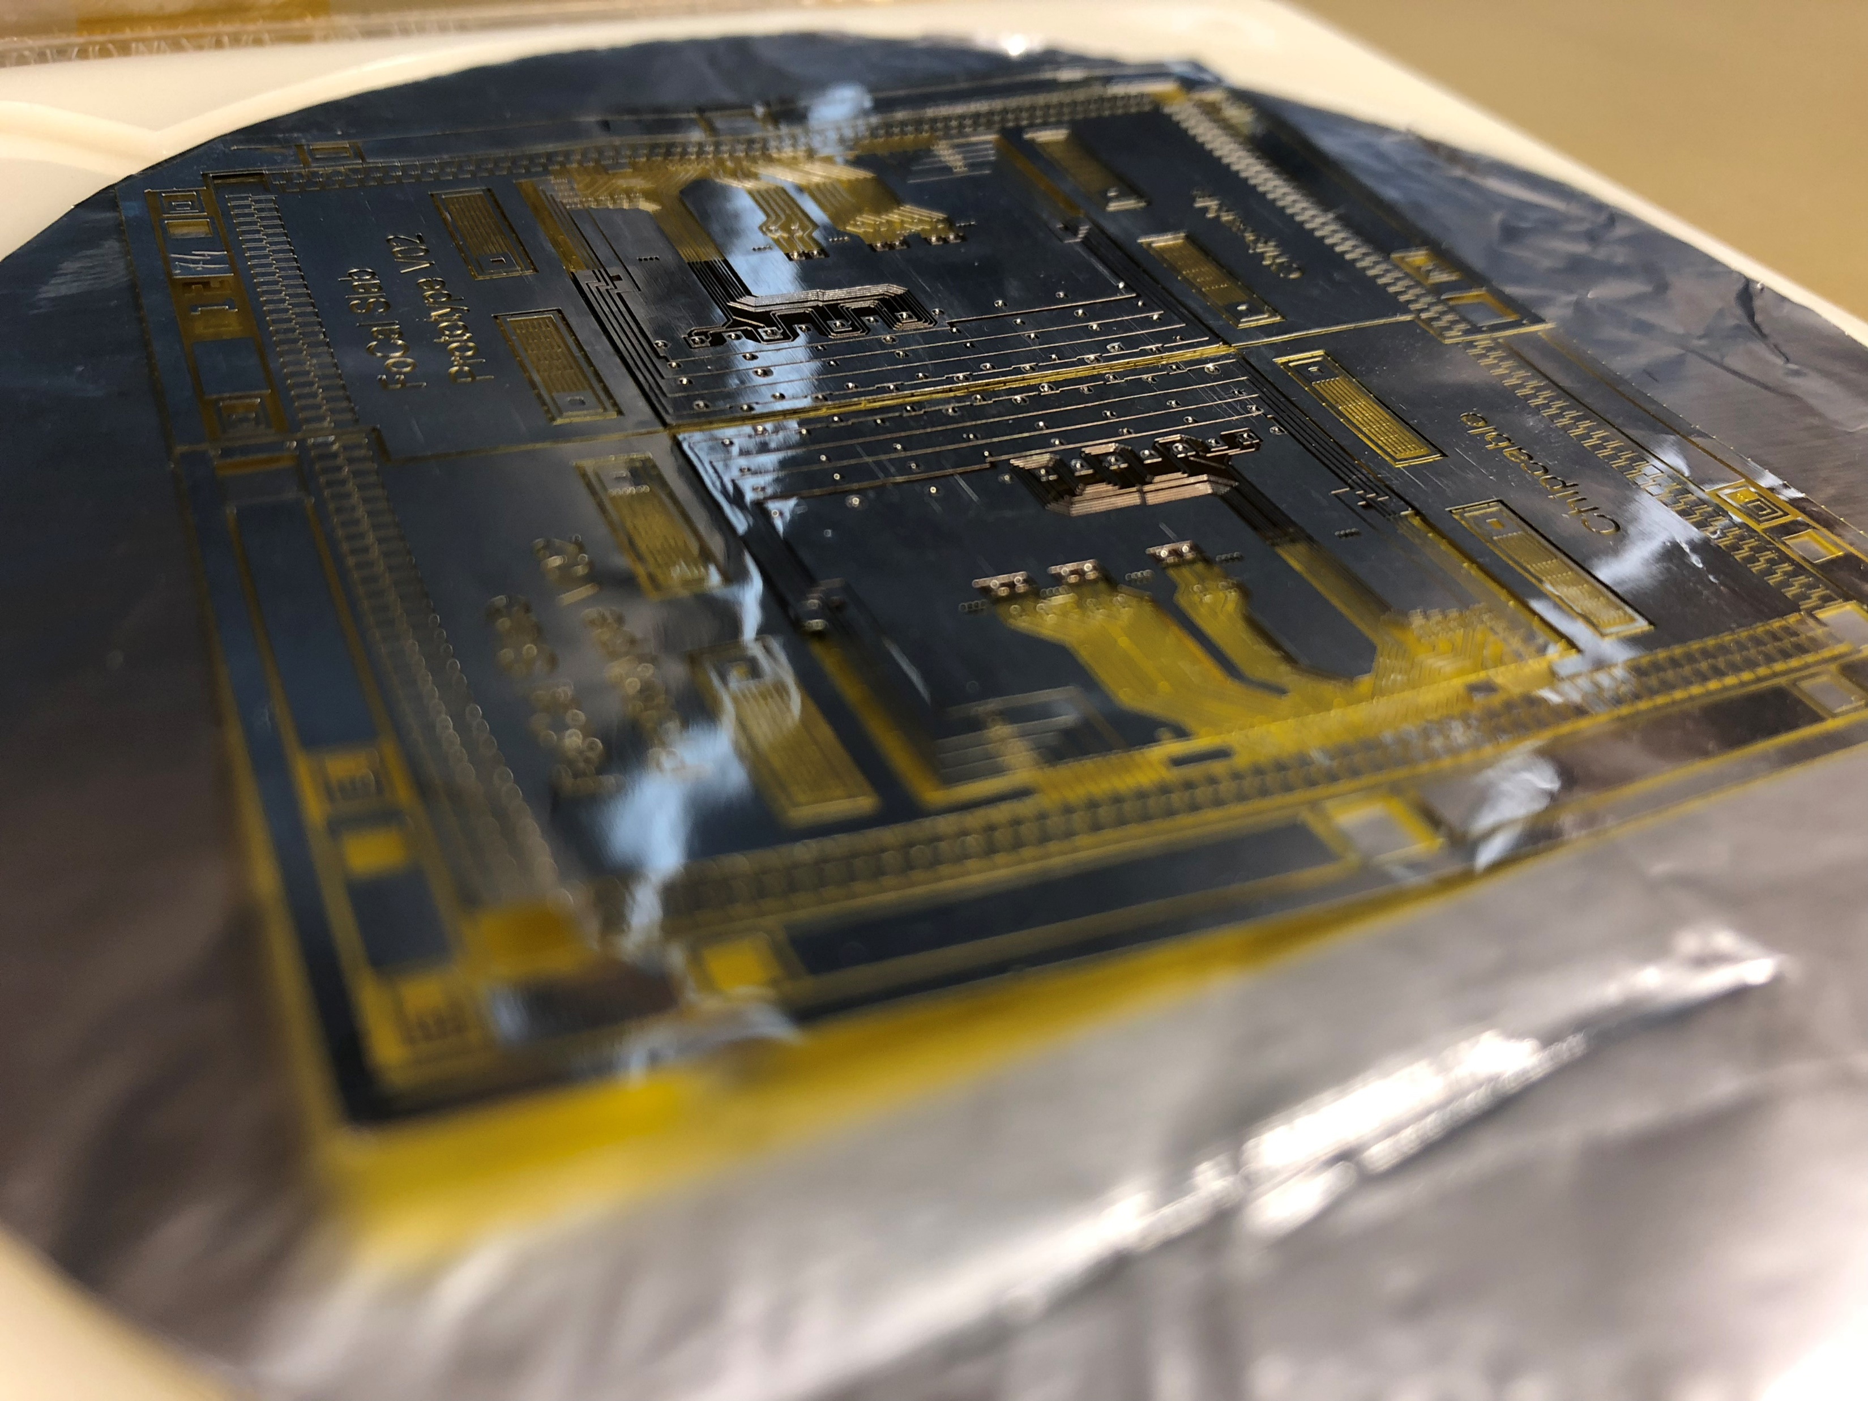
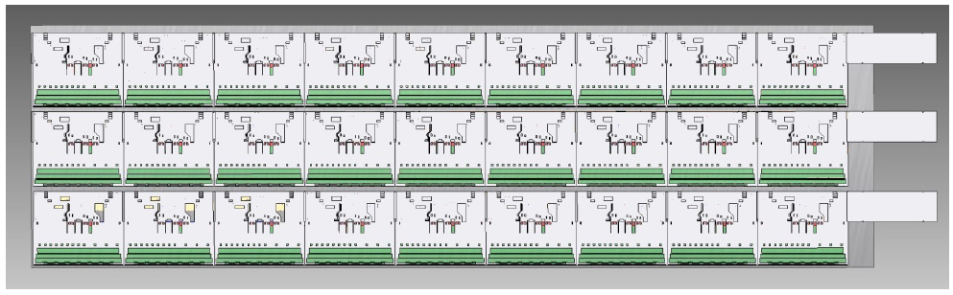
ALPIDE bonding and layer design
ALPIDE mounted on thin cables
  LTU, Kharkiv, Ukraine
  Ultrasonic welding / Single-point Tape-Automated Bonding (SpTAB)
  Aluminum-polyimide
    (30 µm Al, 20 µm kapton)
Carrier modules with 3 x 9 chips
Layers with 4 carriers, i.e. 108 ALPIDEs

Slide 6
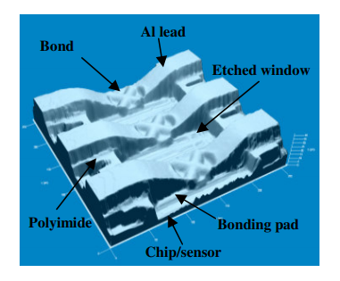
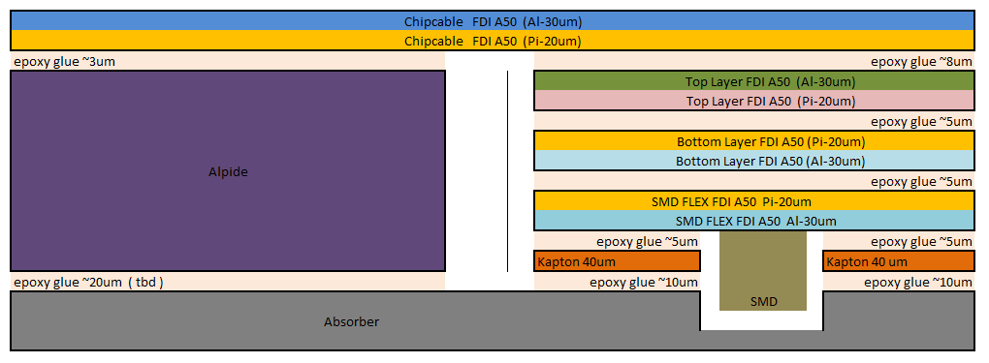
Cross-section and bonding

Slide 7
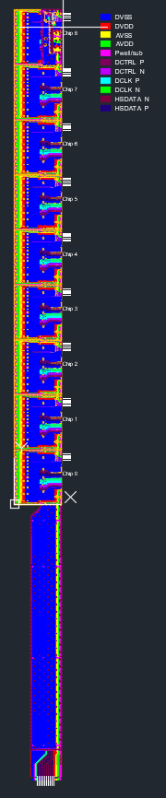
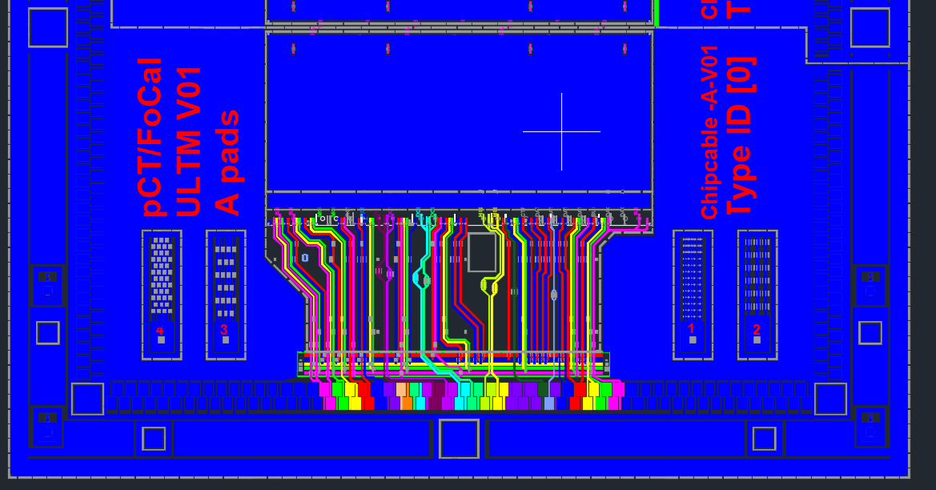
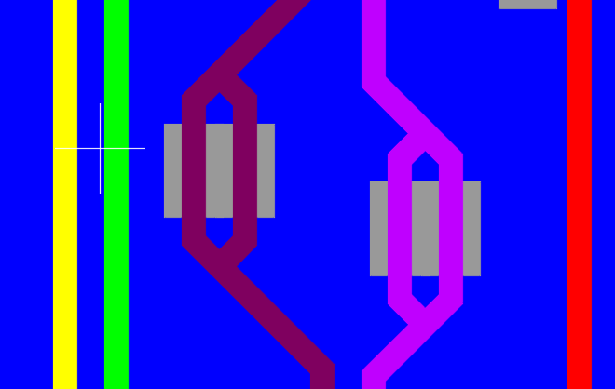
Design of FEE

Slide 8

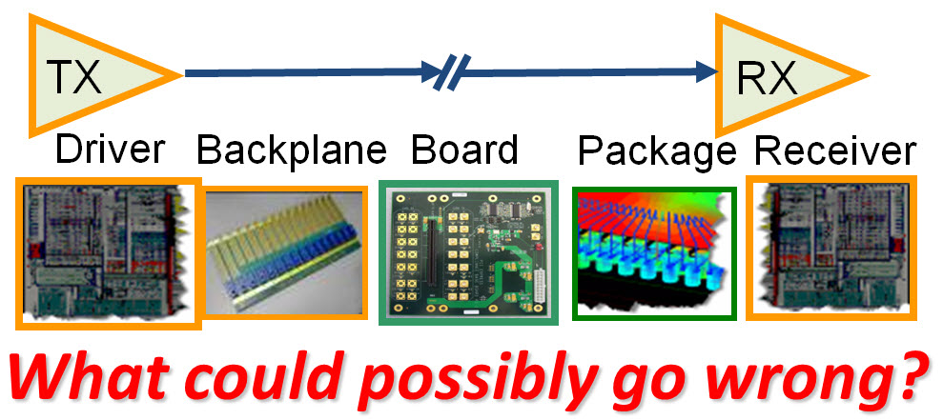
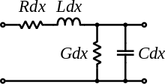
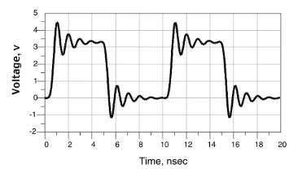
High-speed Data Links
What is high speed?
  Rise time < 1 ns
  Frequencies > 100 MHz
Interconnect becomes transmission line when propagation time comparable to rise time of a signal
Some common problems:
  Reflections
  Dispersion
  Attenuation of high-frequency components
  Cross-talk
  Electromagnetic interference
Notes:
Varying dielectrical constant over frequency

Slide 9
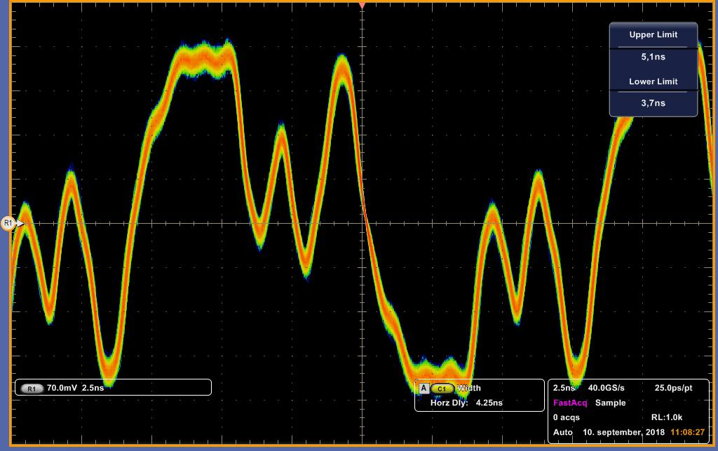
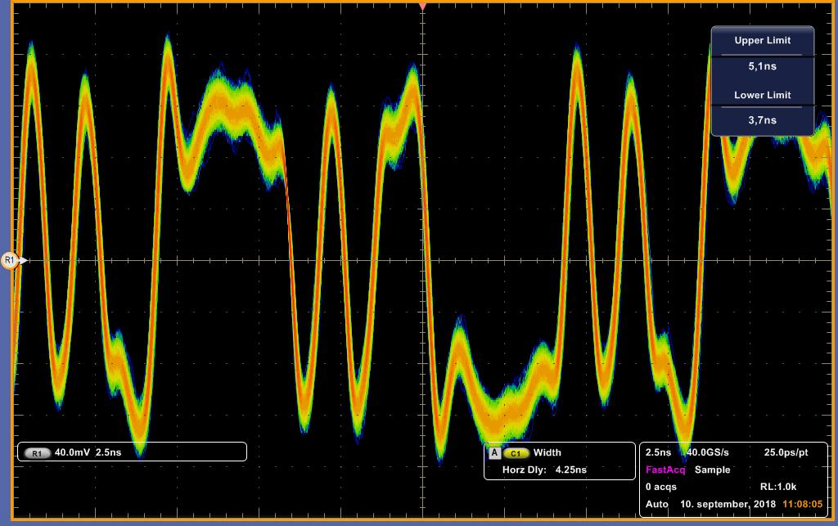

Slide 10
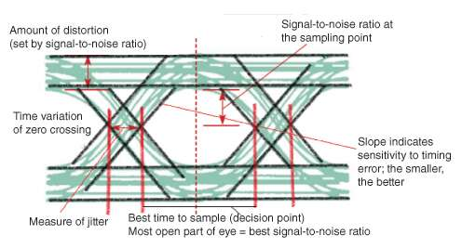
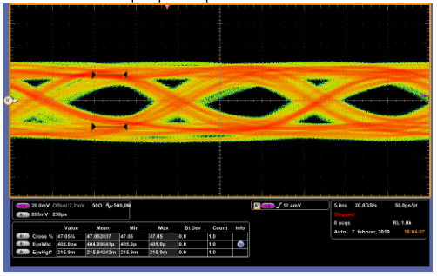
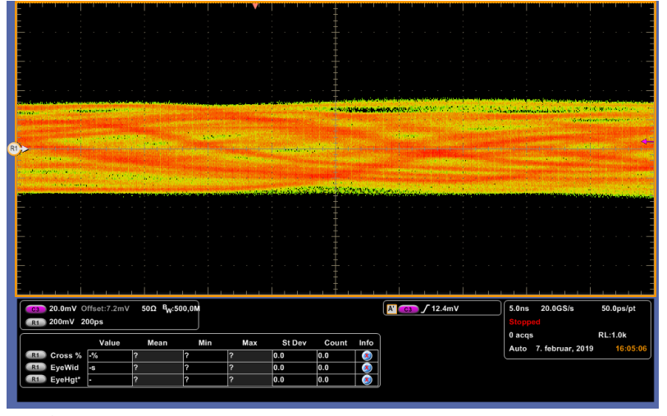
Eye Diagrams

Slide 11
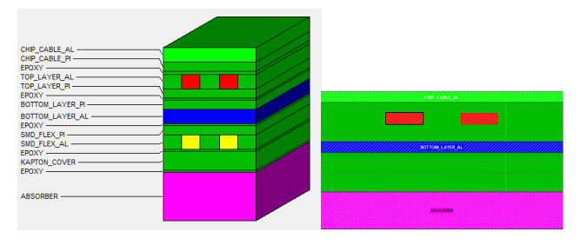
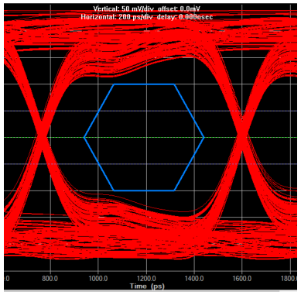
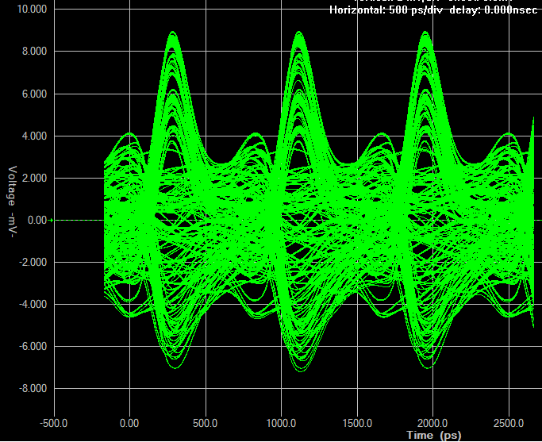
Simulation

Slide 12
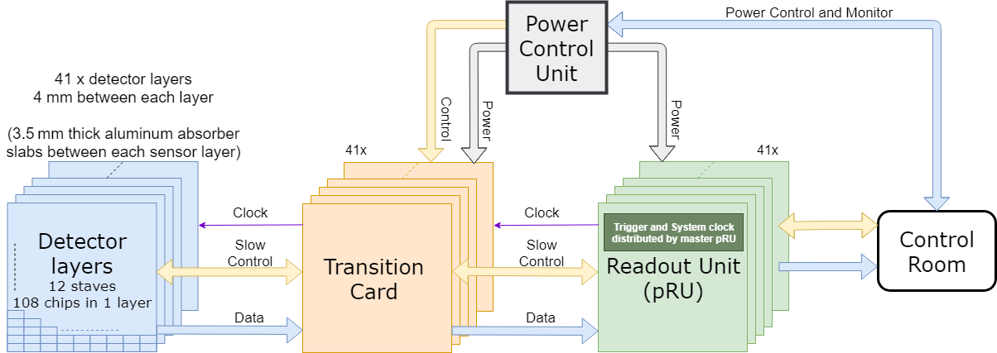
pCT Readout System Overview

Slide 13
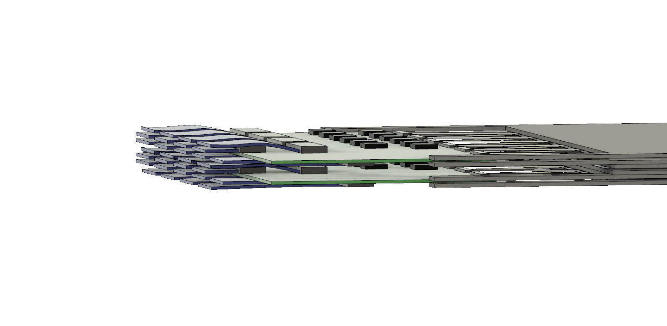
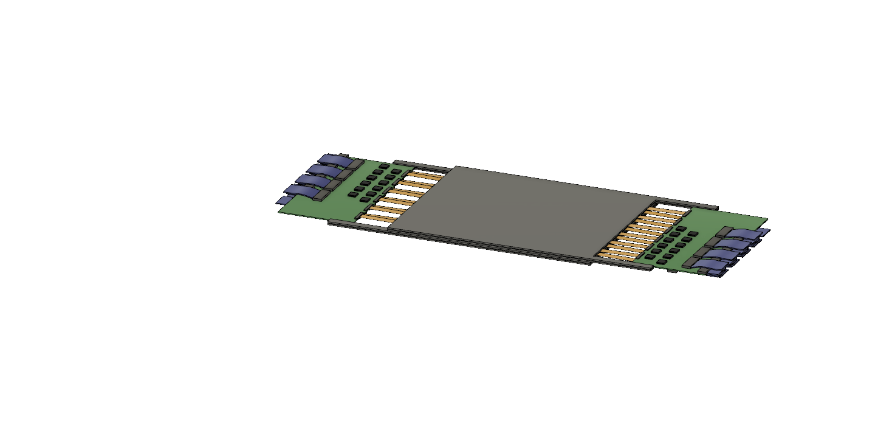
Physical and Electrical Design

Slide 14
How to interface high-speed links on FPGA?

Slide 15
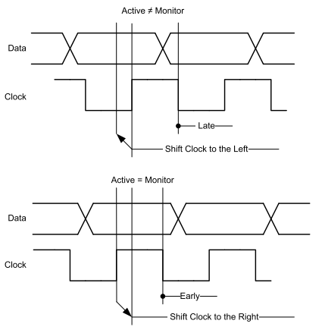
Automatic Phase Tracking
Delay P&N ½ clock period
  Steps in order of ps (512 steps per clock period)
Continuously Monitor P&N variations
  Alexander Bang-Bang Phase Detector
Use delay to sample either P or N in the middle of eye
  Update freq: 300 MHz

Slide 16
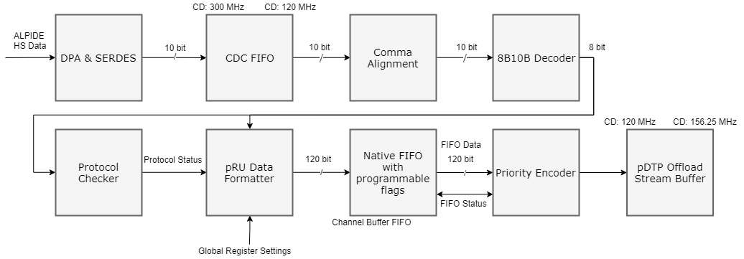
High-Speed Data Flow

Slide 17
How to avoid data loss with minimal buffering?

Slide 18
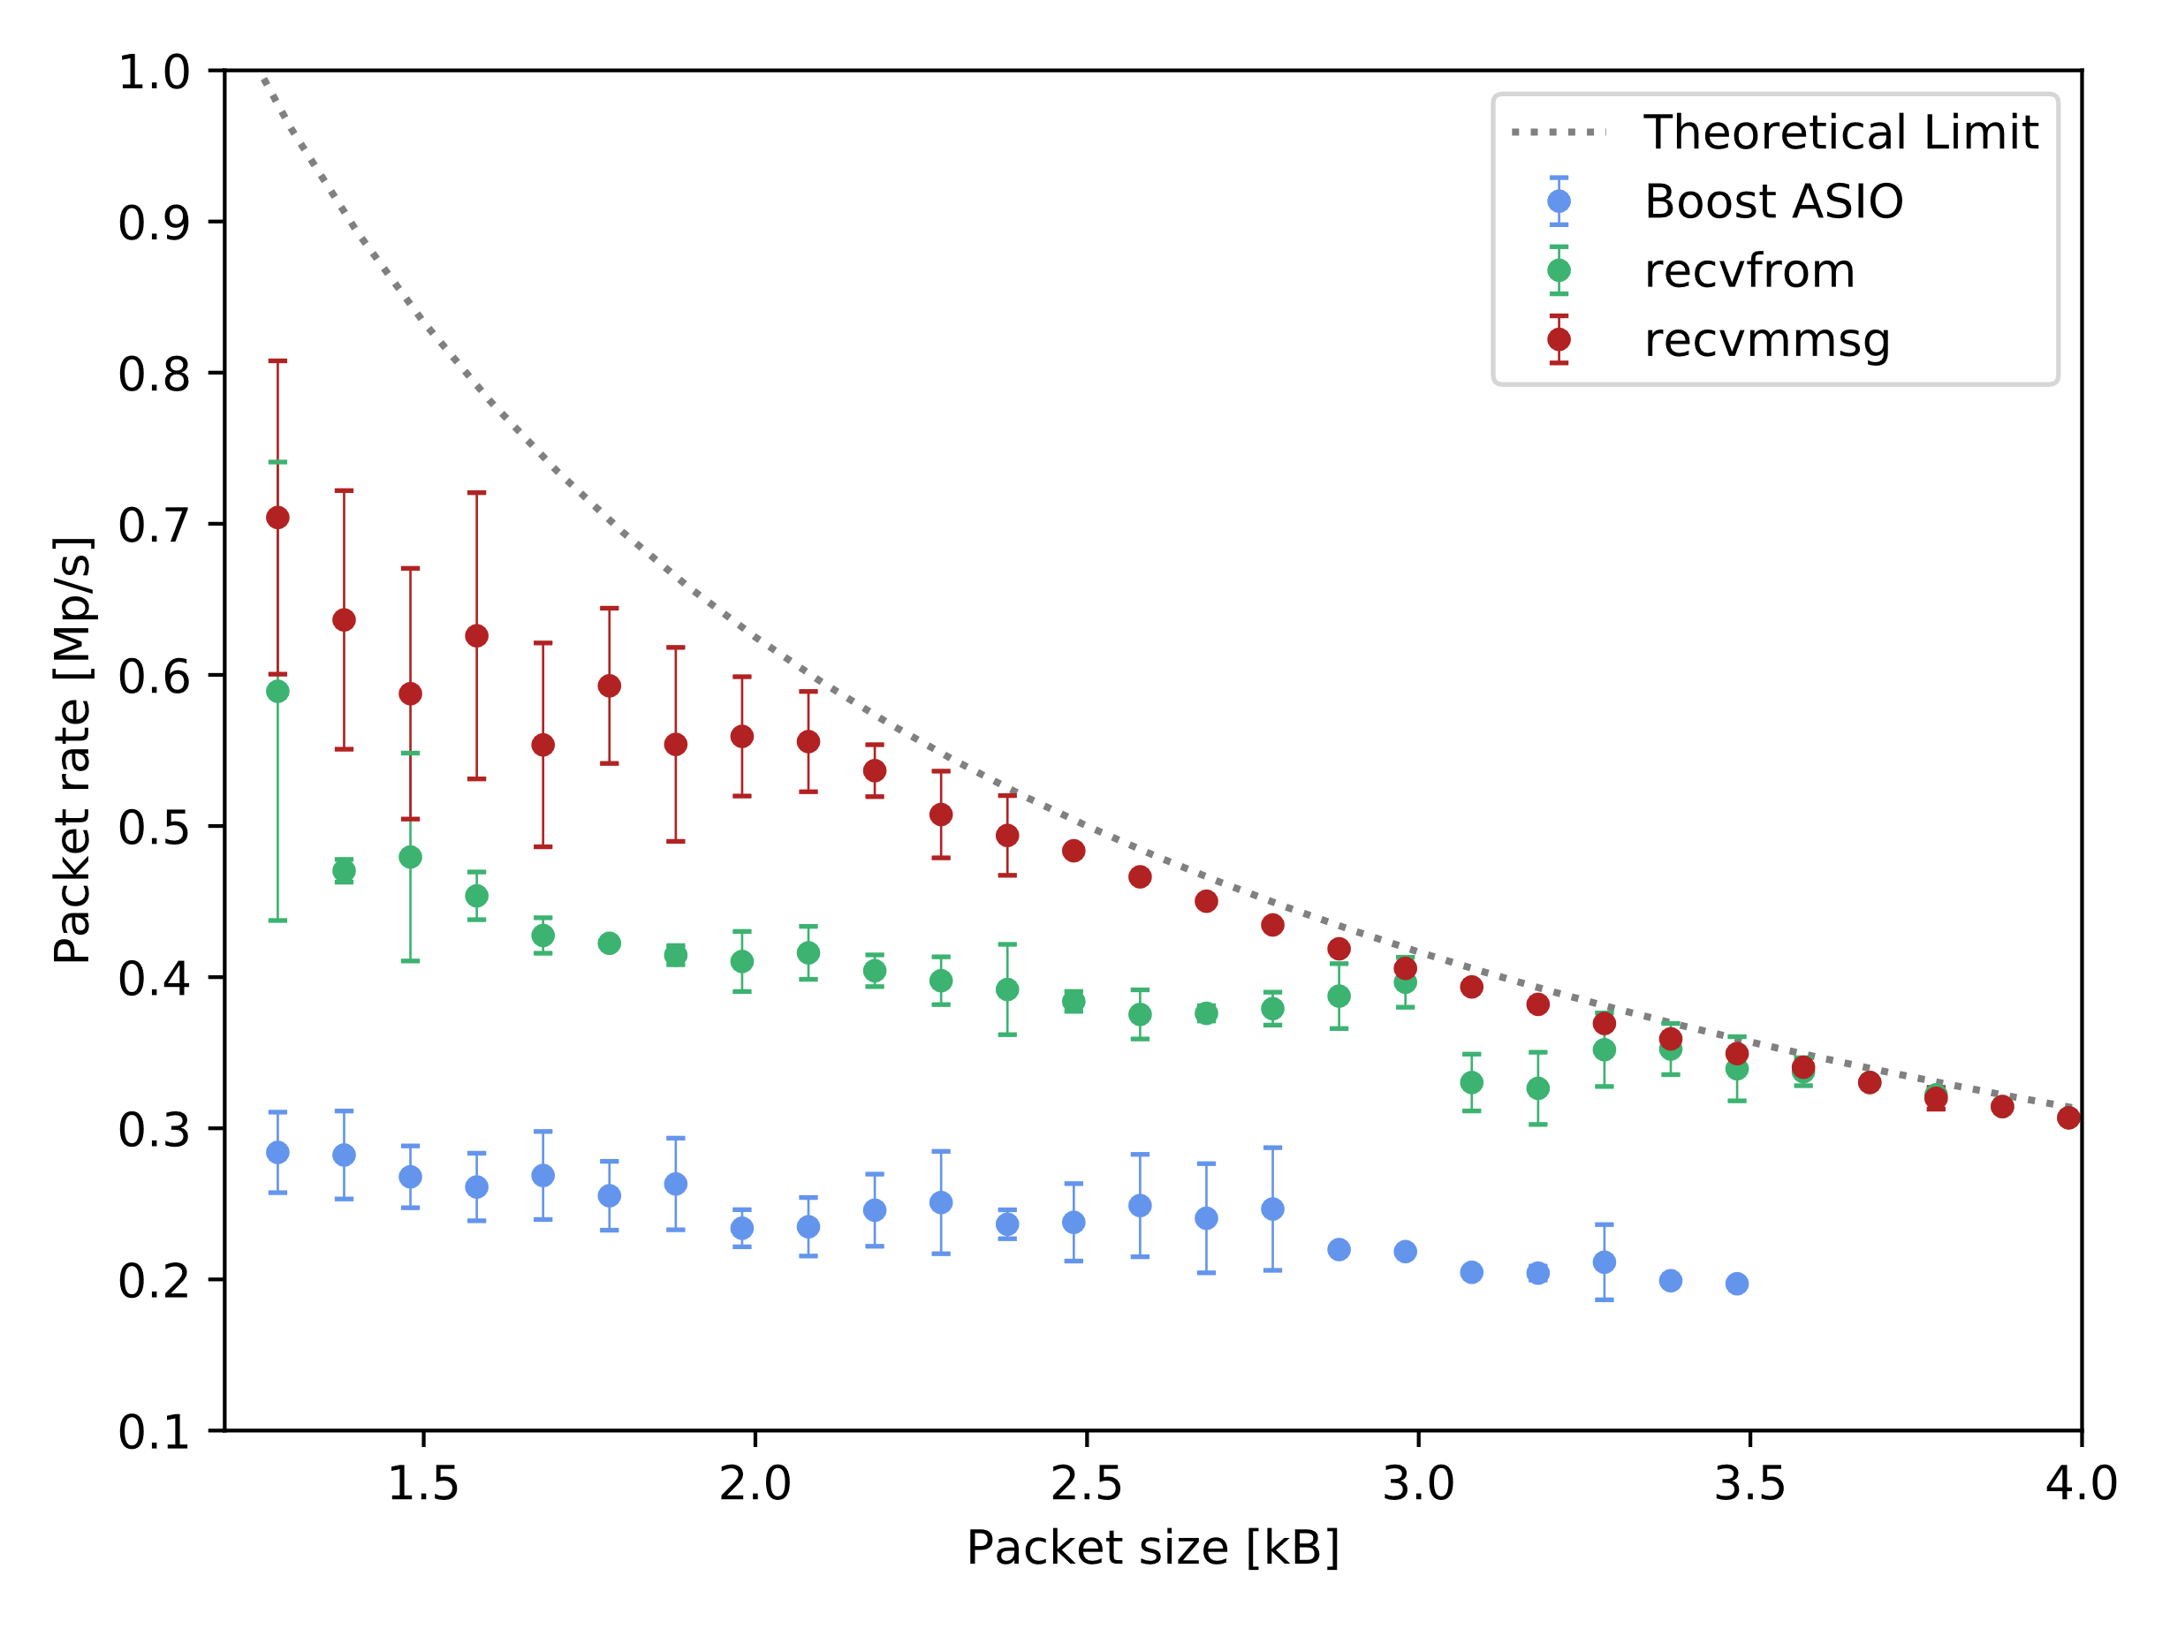
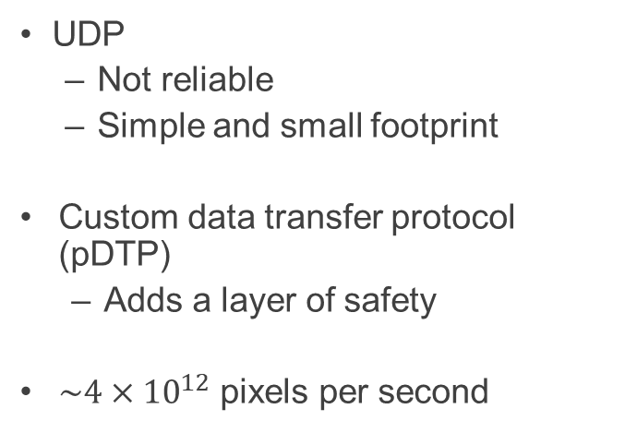
40 Gb/s UDP + custom protocol
UDP
  Not reliable
  Simple and small footprint
Custom data transfer protocol (pDTP)
  Adds a layer of safety
$\sim 4×{10}^{12}$ pixels per second

Slide 19








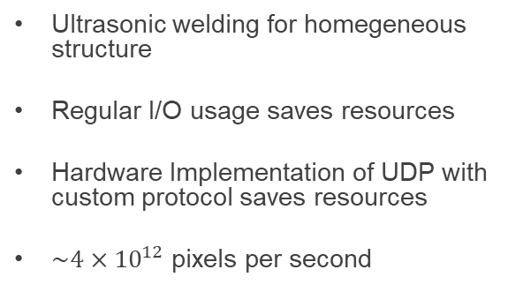
Summary
Ultrasonic welding for homegeneous structure
Regular I/O usage saves resources
Hardware Implementation of UDP with custom protocol saves resources
$\sim 4×{10}^{12}$ pixels per second

Slide 21
Backup Slides

Slide 22
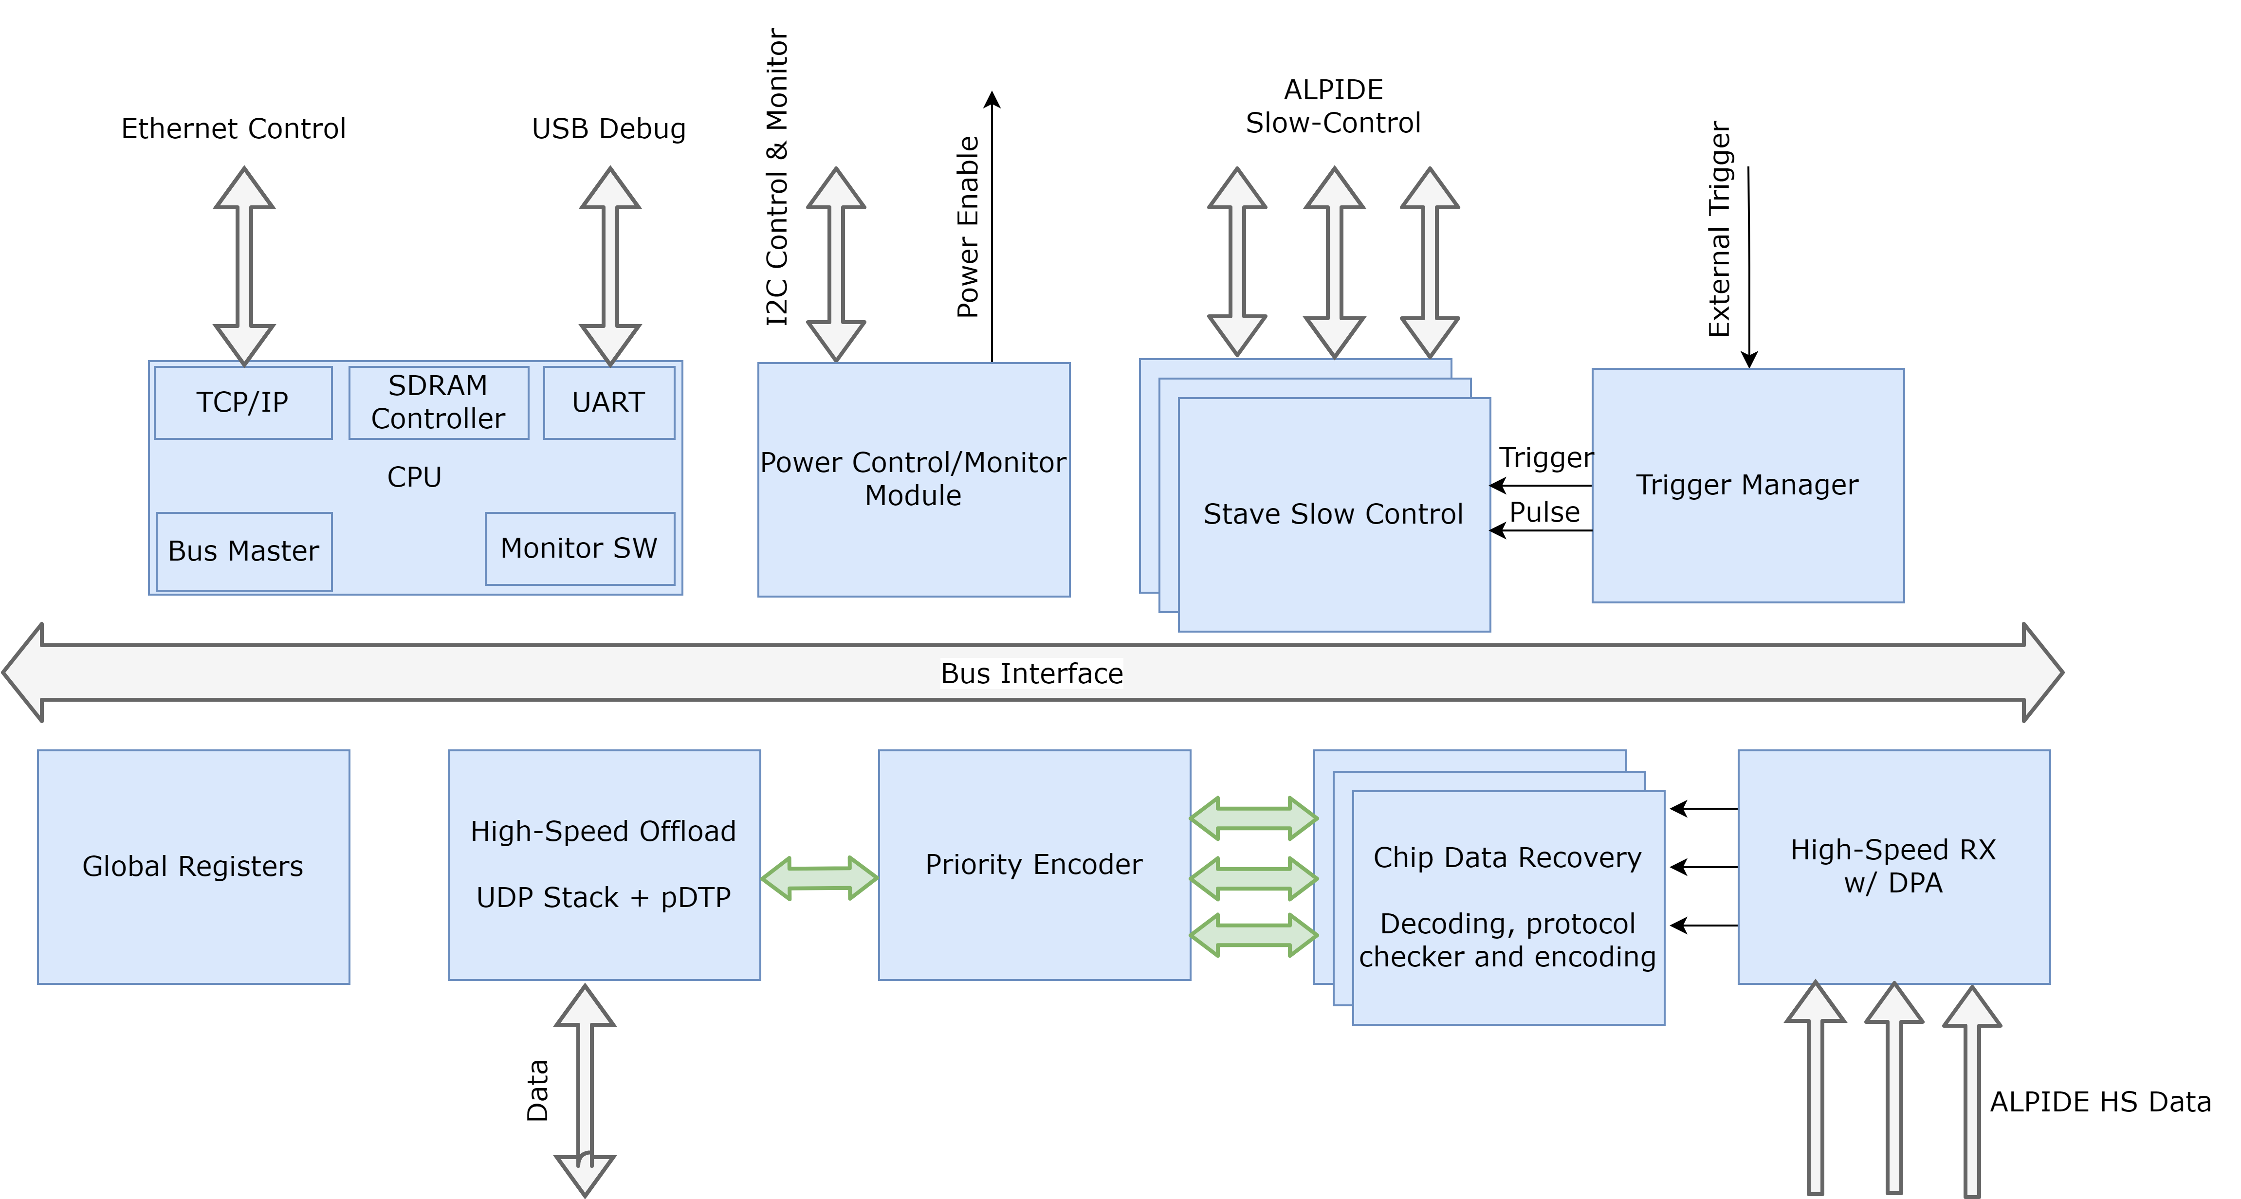
Firmware Top-Level Design

Slide 23
CT Units to Relative Stopping Power
Pettersen, Helge Egil Seime, ‘A Digital Tracking Calorimeter for Proton Computed Tomography’ (University of Bergen, 2018)

Slide 24
Proton Therapy
Pettersen, Helge Egil Seime, ‘A Digital Tracking Calorimeter for Proton Computed Tomography’ (University of Bergen, 2018)

Slide 25
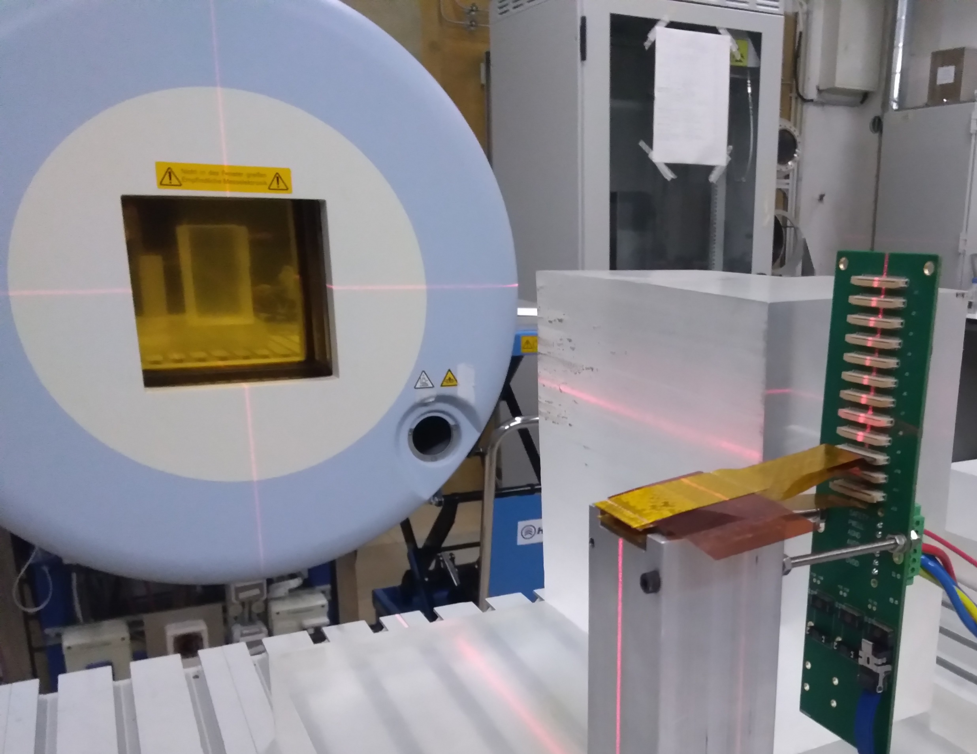
Heidelberg HIT Facility Experiment
Ion Beam
exit point
ALPIDE sensor
coupled to flat cable

Slide 26
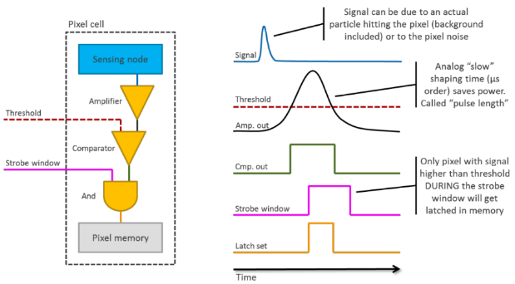
ALPIDE Pixel Circuitry

