Slide 1

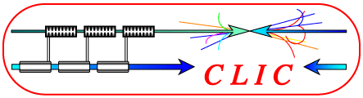
BRAINSTORMING ON LASER BASED SOLUTIONS FOR CLIC PRE-ALIGNMENT
INTRODUCTION
Status of the study
CLIC pre-alignment requirements
Strategy of pre-alignment
Components to be aligned
Baseline
Key-points
Agenda of the meeting
Hélène MAINAUD DURAND, BE/ABP/SU, 09/02/2010

Slide 2
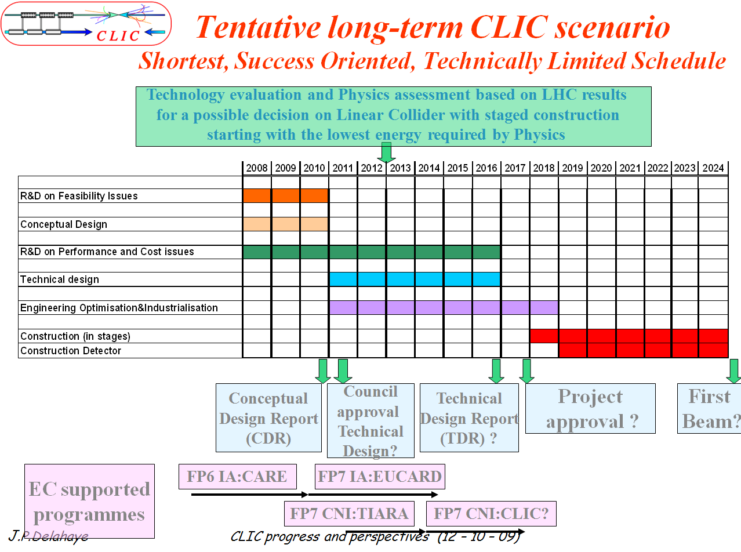
Status of the study
The Compact Linear Collider (CLIC) Study is a site independent feasibility study aiming at the development of a realistic technology at an affordable cost for an electron-positron Linear Collider in the post-LHC era for Physics up to the multi-TeV center of mass colliding beam energy range (nominal 3 TeV).
➔ next milestone of this project is a Conceptual Design Report (CDR) that must be ready end of 2010.

Slide 3
CLIC Pre-alignment requirements
Strategy of alignment
Mechanical pre-alignment
Within +/- 0.1 mm (1σ)
Implementation of active pre-alignment
Girders and quadrupoles within ± 10 μm (3σ)
Implementation of beam based alignment and beam based feedbacks
Active positioning to the micron level
Stability to the nanometer level on the MB quads

Slide 4
CLIC Pre-alignment requirements
Strategy of alignment
The expected performance on the active pre-alignment is of the order of several micrometers over sliding windows of at least 200 m.
➔ realistic data: 15 µm (1σ) (solution proposed in CDR)
➔ target: 10 µm (3σ)
CLIC accelerator will be « laser straight ».
The solution proposed in the CDR is based on overlapping stretched wires and Wire Positioning Sensors (WPS). This solution has some drawbacks: its cost, difficulties in its installation and in its maintenance, the sag of the wire is a limiting factor and will require modelization using HLS systems which perform measurements w.r.t. geoïd (which then must be known within an accuracy never reached before).
For the TDR, an alternative solution is needed, and other solutions based on laser beam should be studied.

Slide 5
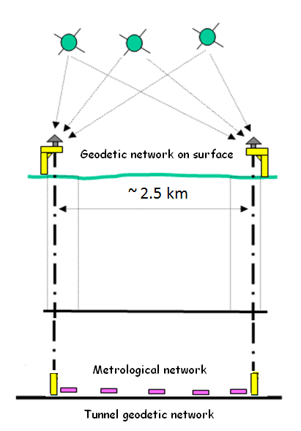
Strategy of pre-alignment
Installation and determination of the Survey network
Transfer of reference into tunnel
Installation and determination of the tunnel network
Absolute alignment of the elements
Relative alignment of the elements
Active prealignment
Control and monitoring of the alignment

Slide 6
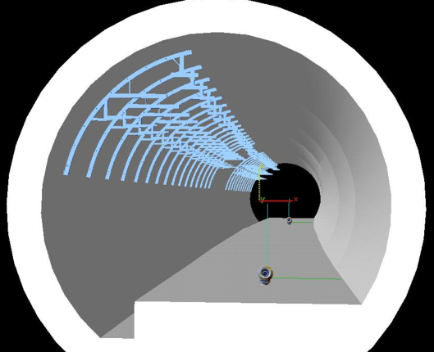
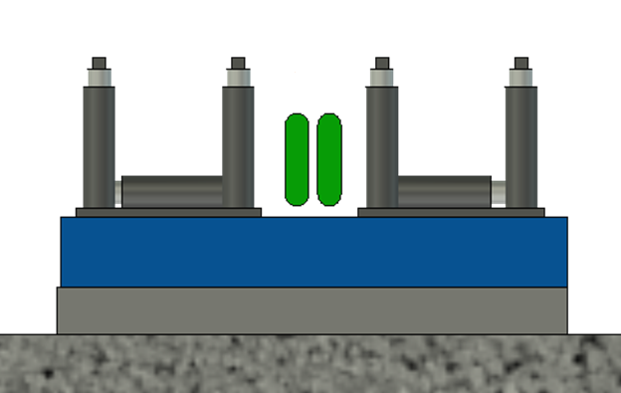
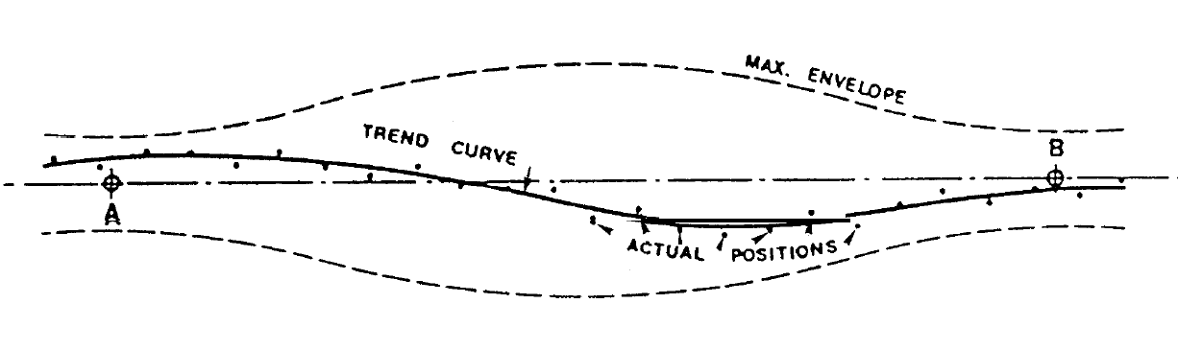
Strategy of pre-alignment
Installation and determination of the tunnel network
Installation of services
implantation of the metrological network
Installation and determination of the metrological network (propagation network)
Installation and determination of overlapping references
  Same than for the CLIC active pre-alignment
  Accurate installation of the module (sealing of vacuum performed ASAP after installation)

Slide 7


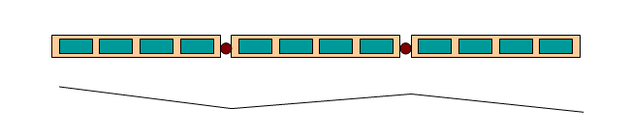
Strategy of pre-alignment
The straight reference line between the two ends of the linac is obtained through overlapping reference lines
Current strategy:
Simplification of the alignment by pre-aligning components on girders
Simplification of the alignment by linking adjacent girders by a common articulation point

Slide 8

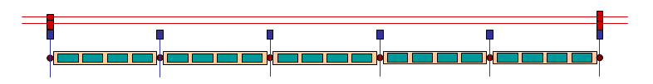
Strategy of pre-alignment
Association of a « proximity network » to each articulation point
Association of a « propagation network » to each articulation point

Slide 9
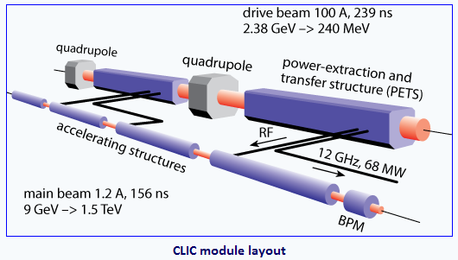
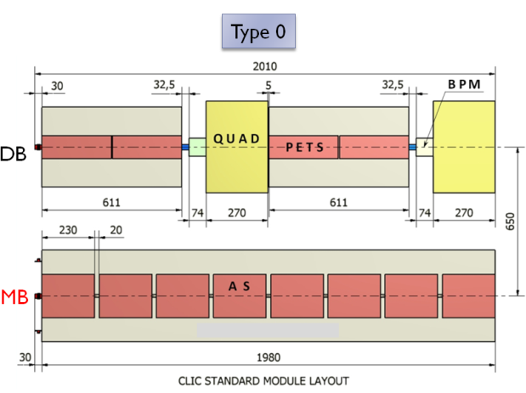


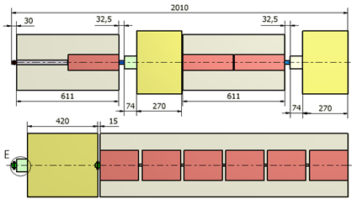
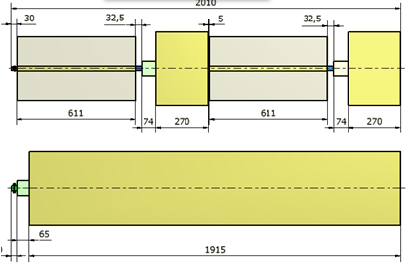
The components to be aligned
Based on a two beams technology (Drive Beam, Main Beam)
Basic components:
DB: PETS, quads and BPM
MB: RF structures, quads and BPM
Each main linac consists of sequences of 2m modules
4 lengths of MB quad (0.5 m, 1m, 1.5m, 2m)
➔ 5 types of modules
Girder
MB quad support

Slide 10
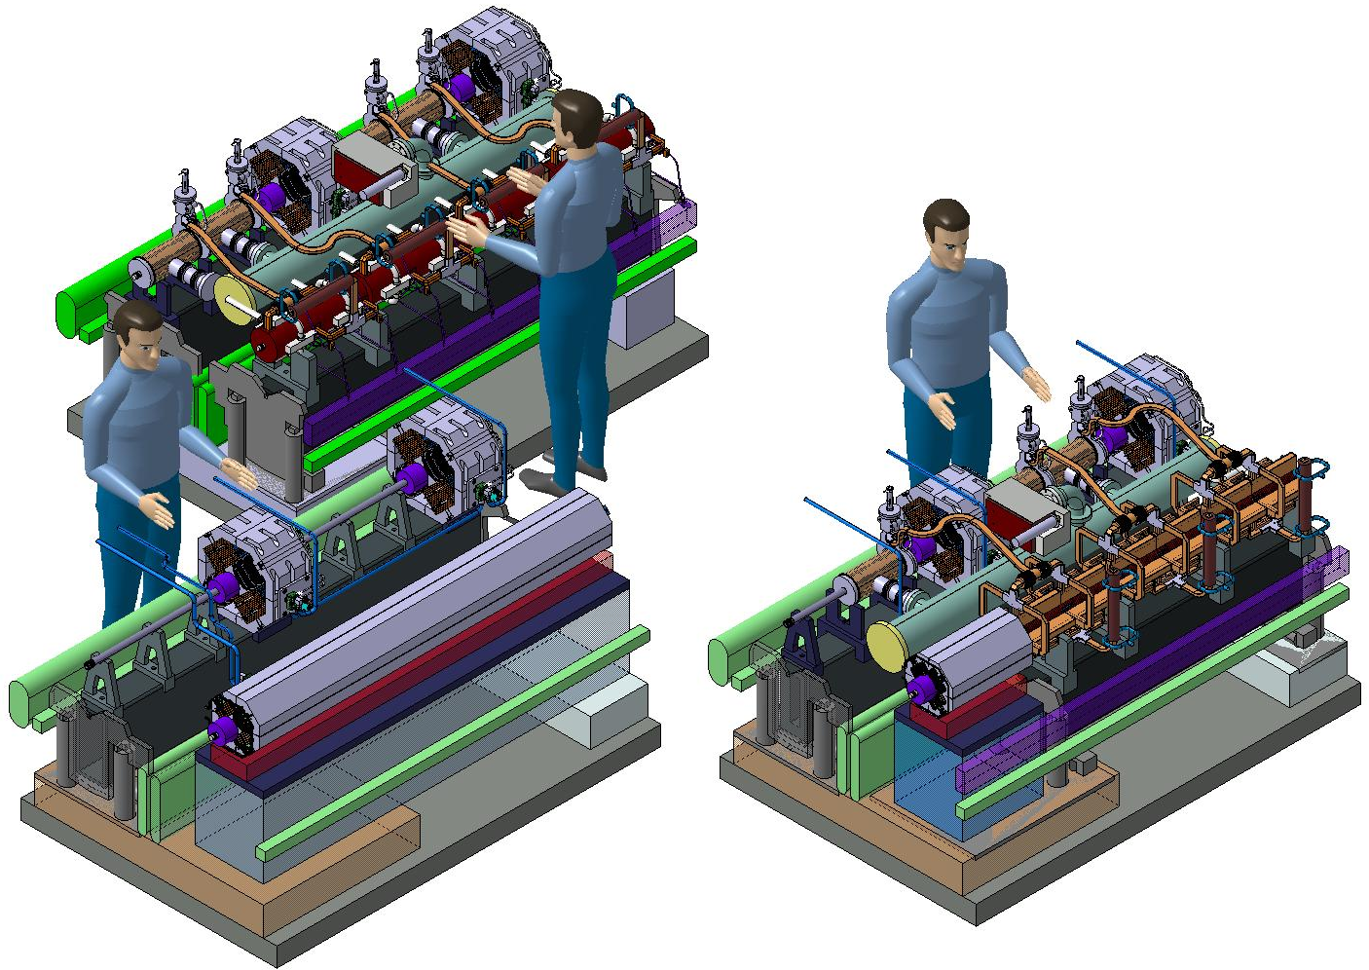
CLIC MODULES T0, T1 & T4
Inter axis between DB and MB axes: 650 mm
Beam height: 620 mm
Module length: 2m
Standard Module
Module
Type 1
Module
Type 4

Slide 11
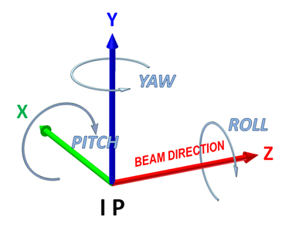
Baseline concerning pre-alignment
Repositioning:
  2 adjacent girders linked by a common articulation, supported by 3 high resolution linear actuators (one radial, two vertical) ➔ 3 DOF
  Each MB quad supported by 5 cam movers
Alignment input needed:
  For each articulation point: one transverse info + roll
  For MB quad: two transverse info + roll
  For each MB quad BPM: one transverse info + roll

Slide 12
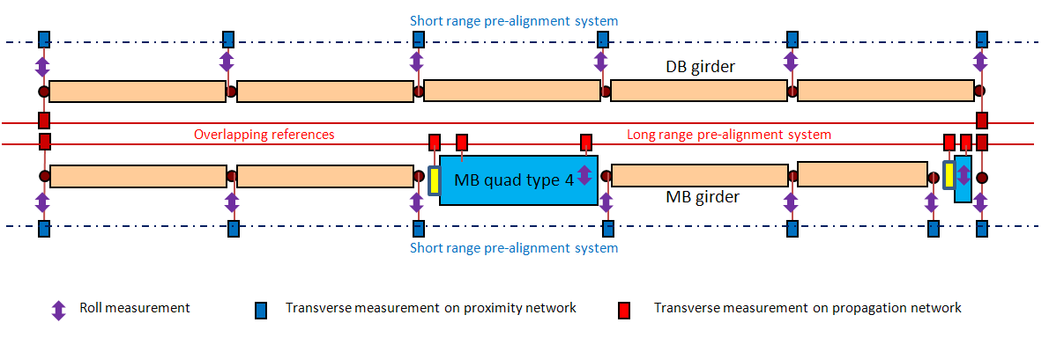
Baseline concerning pre-alignment

Slide 13

Key-points
Pre-alignment = « absolute » measurements
    zero of each alignment device must be determined within a few microns w.r.t the zero of each component to be aligned
    precision and accuracy of measurement of each alignment device within a few microns, no drift
    each alignment reference must be stable and determined within a few microns.
Non regular distances along the main beam. Smallest distance between two alignment device: ~ 300 mm
Regular distances along the drive beam
Over 200m: up to 140 alignment devices along the reference line [propagation network: devices for the overlap + devices for MB quad and BPM.
Short range devices: ~ 45 000 [rough estimate]
Long range devices:~ 16 000
Low cost
Robust
Budget error better than 15 µm r.m.s.

Slide 14
Key-points
Creation of workpackages:
  WP1: R&D on a « long range pre-alignment system » for the propagation network
  WP2: R&D on a short range pre-alignment system for the proximity network
  WP3: R&D specific alignment systems for the final focus
Strategy and schedule:
    By iteration, propose a R&D program on laser based solutions for the CLIC pre-alignment before end of March, concerning WP1 and WP2
  Still waiting for a specification from beam dynamics concerning WP3.
  To be defined:
    description and objectives of the solution(s) to be studied
    Estimation of ressources (material/manpower)
    Estimation of schedule and deliverables
    Distribution of responsibilities.

Slide 15
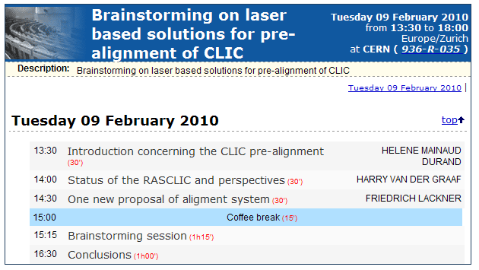
Agenda

