Slide 1
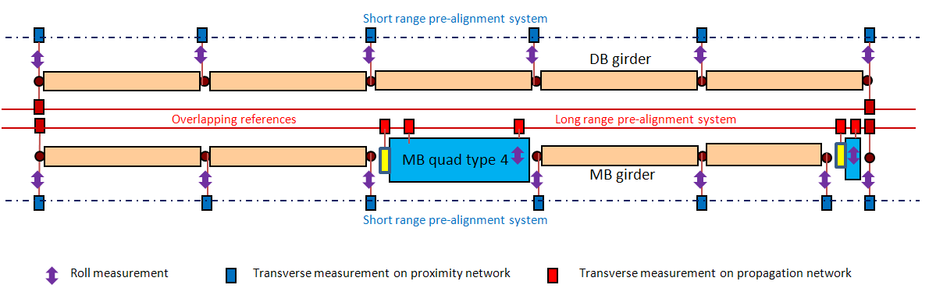
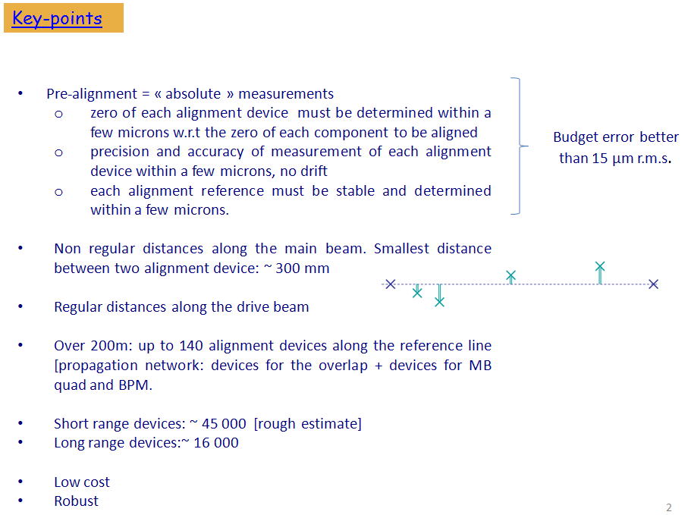
N- point?
non regular distances ?
200 m → 400 m
Mechanical link in vacuum
Redundancy
Configuration

