Slide 1

Tech Push
Innovation

Slide 2

Me -->

Slide 3
Tech push vs. Market pull
Market pull: the easiest way to innovate
Tech push: harder, but…
  too bad if we do not try
  bigger potential
  available funding

Slide 4
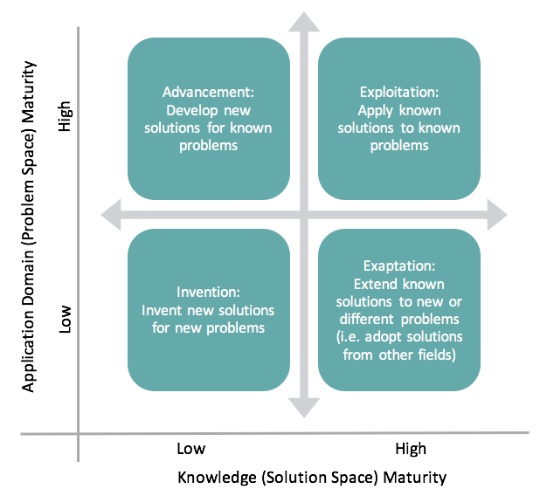
The knowledge innovation matrix
Gregor and Hevner (2015)

Slide 5
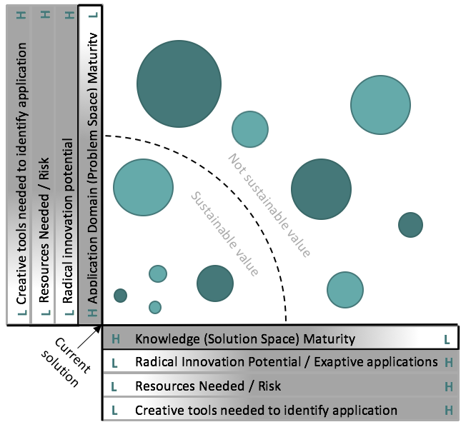

Slide 6
Tech push innovation: the steps
Understanding of the technology
Application identification
Application verification
Building a business case

Slide 7
Understanding the technology
“If a newcomer to a field has the requisite information, he/she is more likely to achieve a creative solution than a long-time worker in the field” (Mednich, 1962)

Slide 8
Application Identification
Everyone too busy to actively pursue this at CERN
The collective intelligence:
  Brainstorming in heterogenous groups
  …with creative traits
  …and high intrinsic motivation
Isolating the functions of the tech: Keyword searches
Serendipity

Slide 9
Application verification
Talk to people: experts, potential customers, competitors…
Learn as much as possible: Feasibility, usefulness, willingness to buy
Prototype (if possible)

Slide 10
Building a business case
The right team
The value proposition
The business model
Go to market strategy
IP situation and strategy
Fundraising

Slide 11
Challenges
Tech push can work, however often it turns out to be too specific
  Why we have started to speak more about know-how
Innovation gap between research and market opportunities
Need to have the right competences in the teams

Slide 12
Conclusion
Tech push is hard, but can have great potential
To find more ‘exaptive’ applications, creative methods are useful
One can still not forget about the customers…
CESP is tailored to find opportunities based on tech

