Slide 1
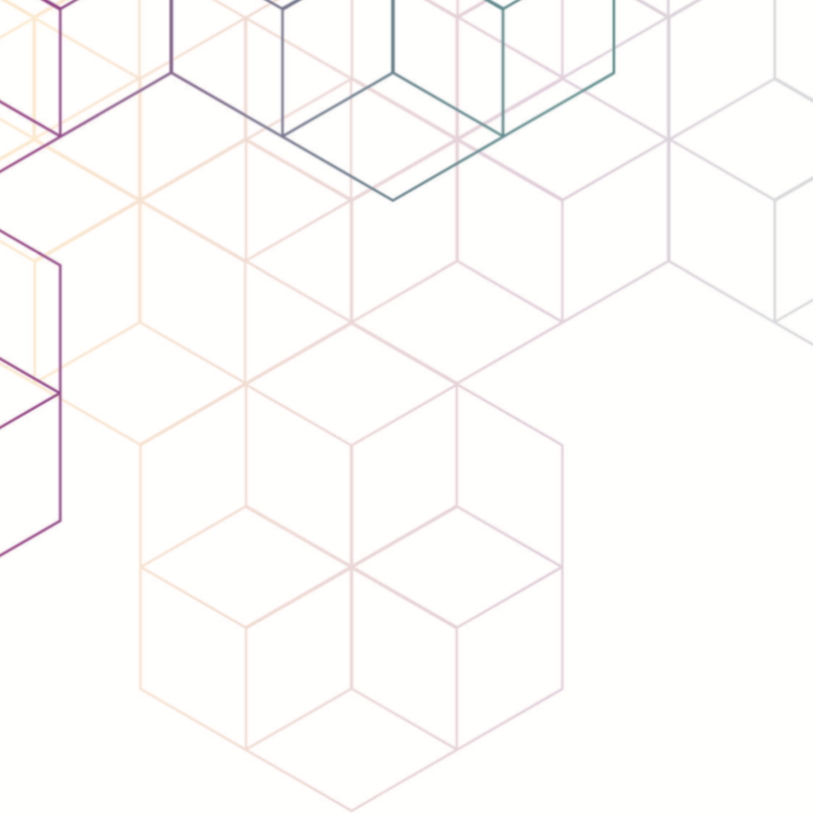
Structured Laser Beam
Amy Bilton
Knowledge Transfer Officer
CERN Knowledge Transfer
Miroslav Šulc
Knowledge Transfer Officer
Institute of Plasma Physics of the Czech Academy of Sciences

Slide 2



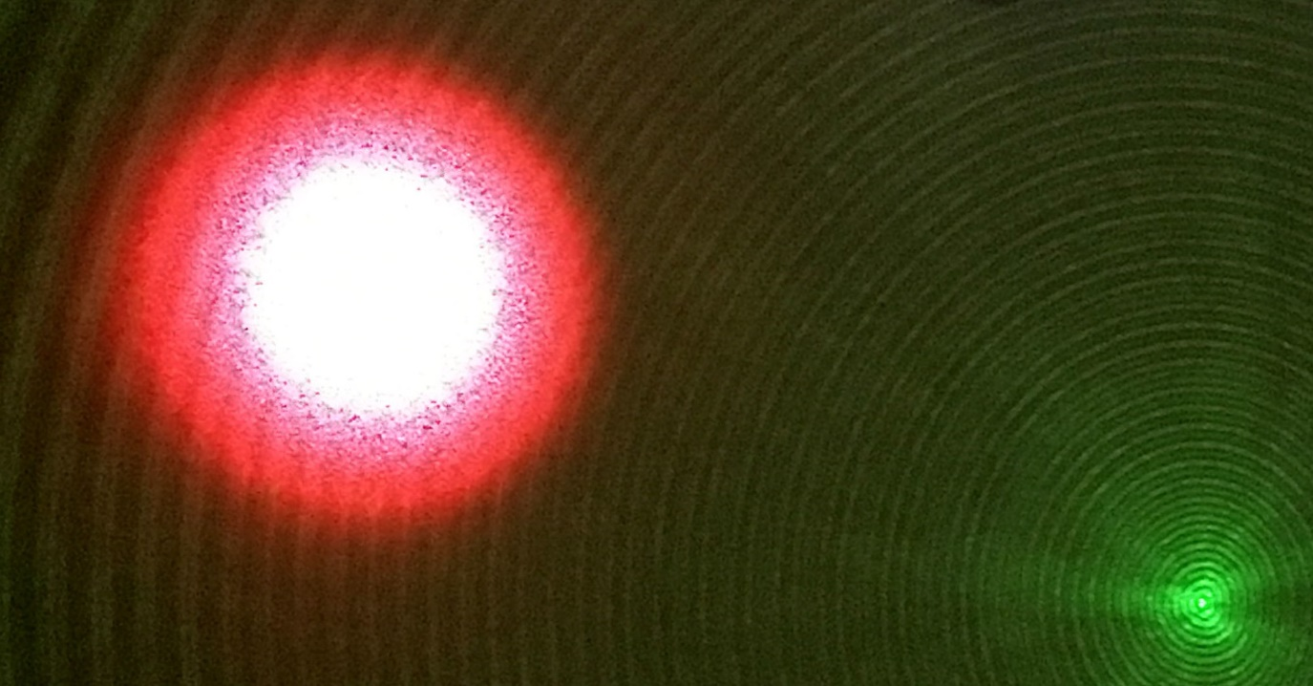
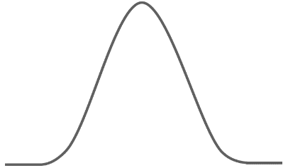
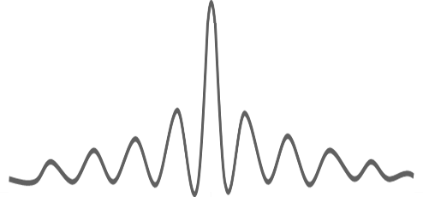
WHAT IS IT?
A simple, low-cost system and method for generating a structured laser beam (SLB) that can propagate over large distances while maintaining a low divergence and small central spot size.
Gaussian laser beam and its intensity distribution
Structured laser beam and its intensity distribution
Comparison of the SLB (Green) and a Gaussian beam (Red).
The Central spot of the SLB is much smaller than the Gaussian at the same distance from the electromagnetic radiation source.
‘Cross-section of the Bessel beam and graph of intensity’ modified from original version, attributed to Egmason, under CC BY-SA 3.0

Slide 3
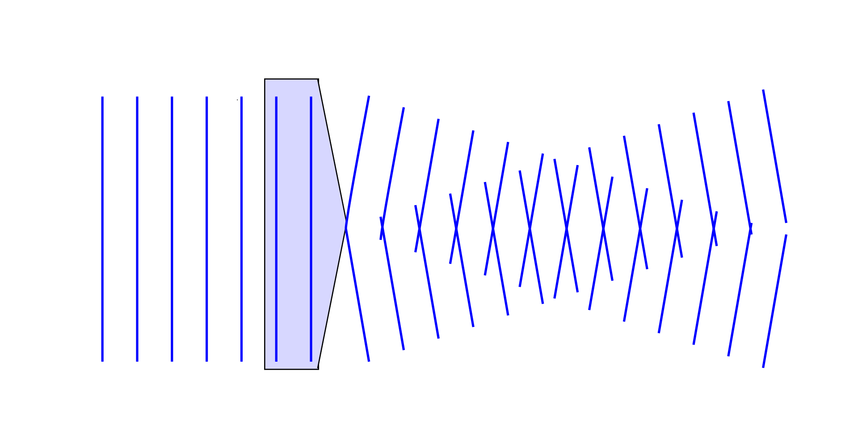
STATE OF THE ART
Bessel beam generation on short distances
Only for distances up to 100 mm
Gaussian beam
Axicon lense
‘Diagram of Axicon and resulting Bessel Beam’ attributed to Egmason, under CC BY-SA 3.0

Slide 4
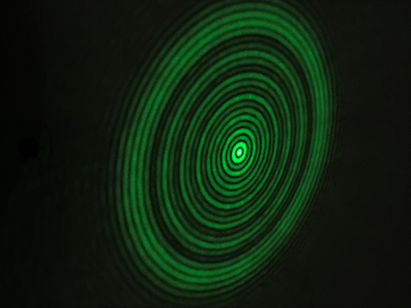
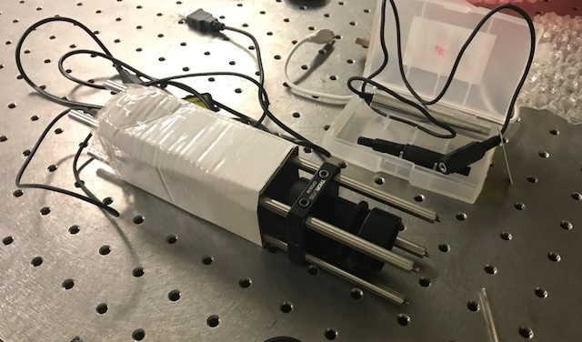
HOW IT WORKS
A coherent beam of electromagnetic radiation is illuminated on an optical system in such a way as to produce a structured beam.
The parameters of the system can be easily adjusted to modify the focus, the divergence of the beam, and the number and thickness of the rings.
Laser
BLACK
BOX
European patent application filed 2nd May 2018

Slide 5
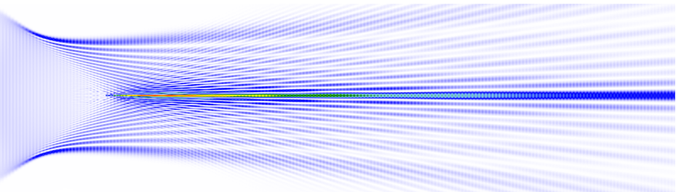
HOW IT WORKS
The SLB consists of a central part with surrounding fringes.
After the generator, only the central part is a continuous line.
European patent application filed 2nd May 2018.

Slide 6
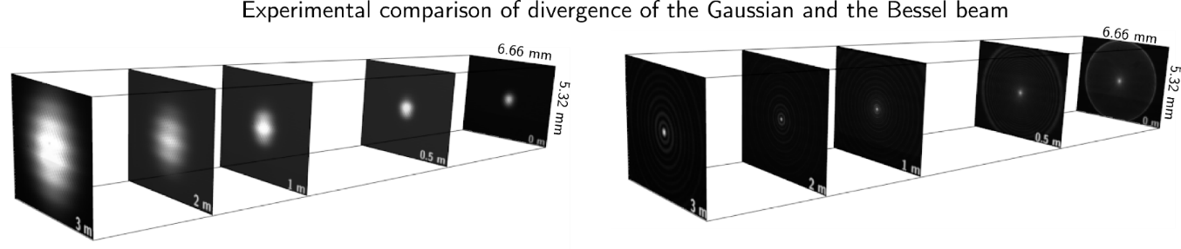
ADVANTAGES
 | Size at 3 m | Size at 100 m
Gaussian | 0.8 mm | 240 mm
SLB | 0.01 mm | 1.2 mm

Slide 7
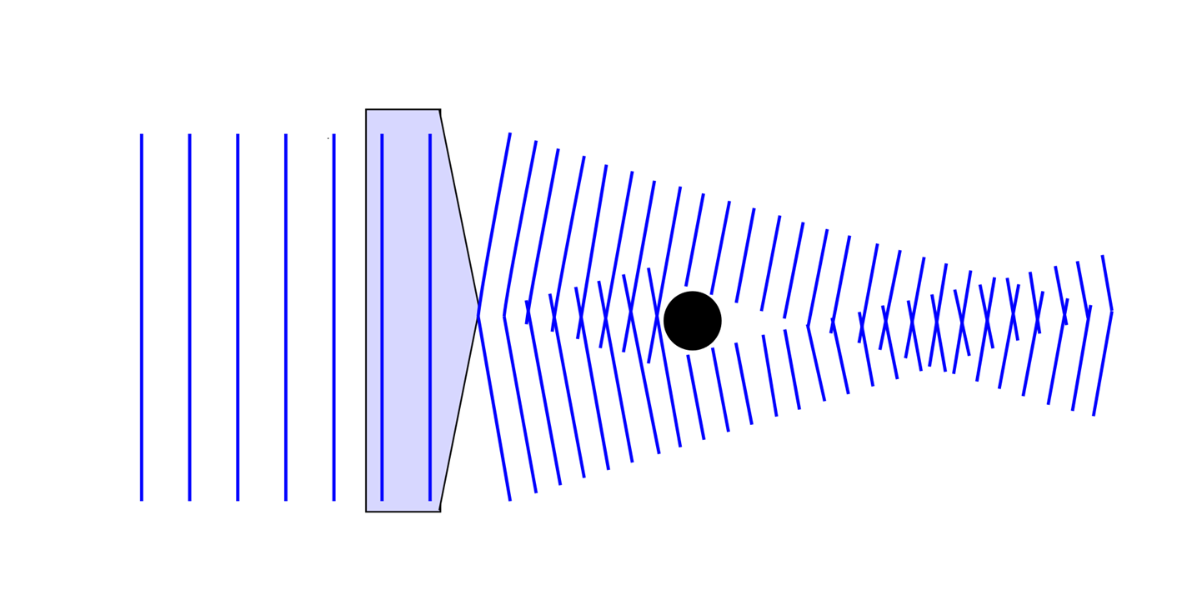
ADVANTAGES
The SLB can self-reconstruct after obstacles.
‘Bessel beam re-forming central bright area after obstruction’ attributed to Egmason, under CC BY-SA 3.0

Slide 8
ADVANTAGES
Compact spot size and very low divergence.
Self-reconstruction after obstacles.
Simple, low-cost, lightweight system.
Very robust to jitter, vibrations, and variations in the angle of the input beam; it also shows some robustness to fluctuations in air temperature.
The SLB can be produced for any wavelength and potentially for any power.

Slide 9
APPLICATIONS
Alignment
Metrology
Communication
Gas detection
Laser shows
Others?

