Slide 2


23rd July 2019 - Adrien Ledeul, Gustavo Segura on behalf of REMUS Team

Slide 3
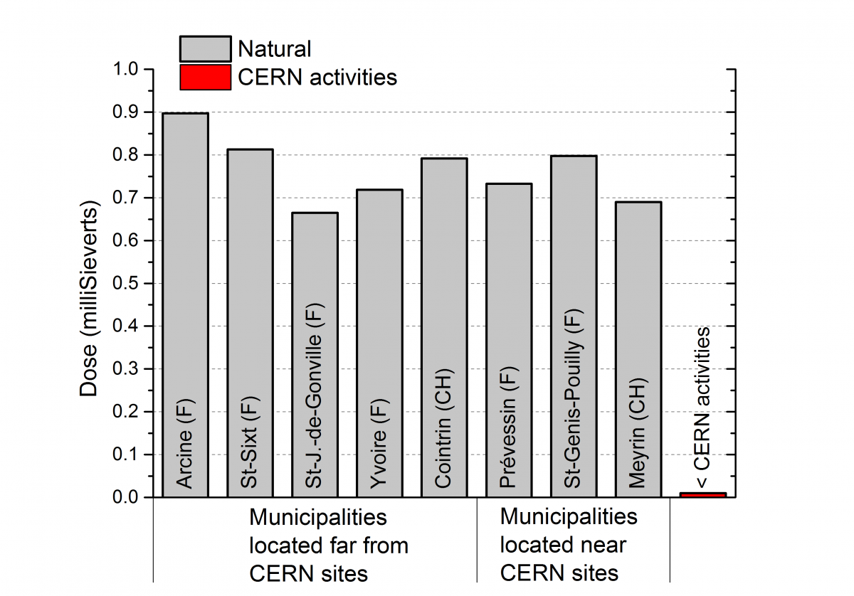

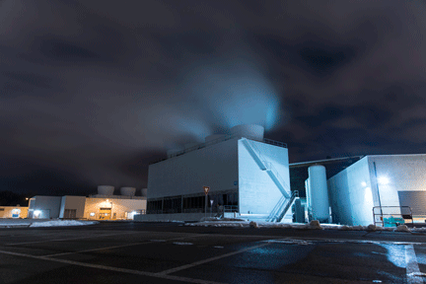
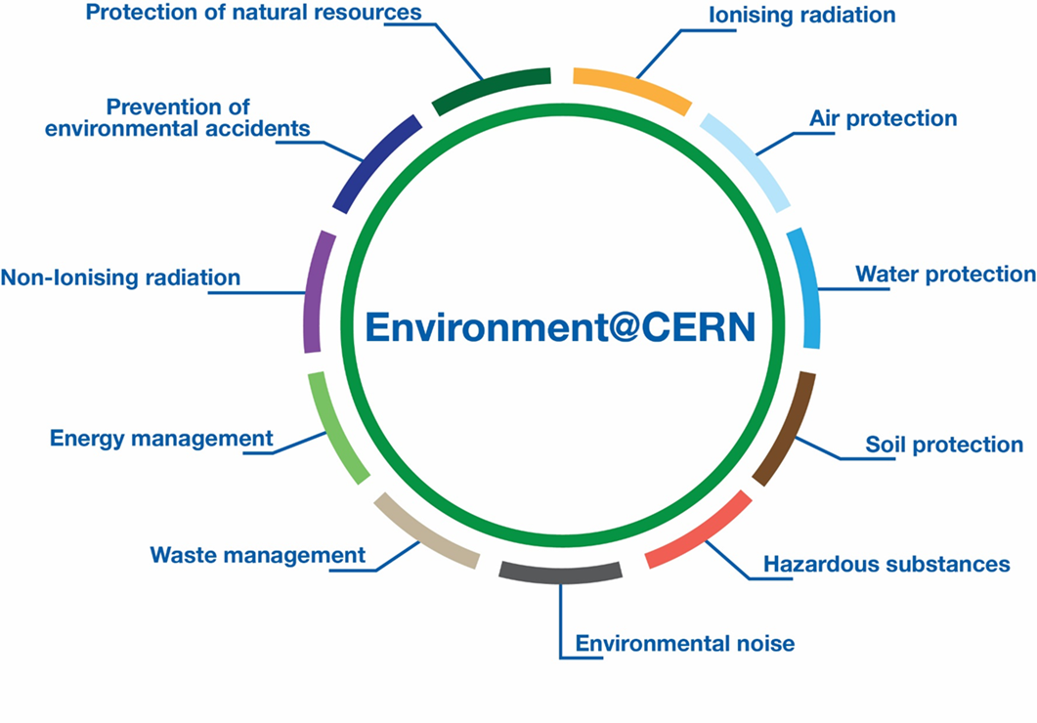
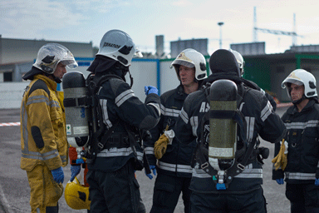
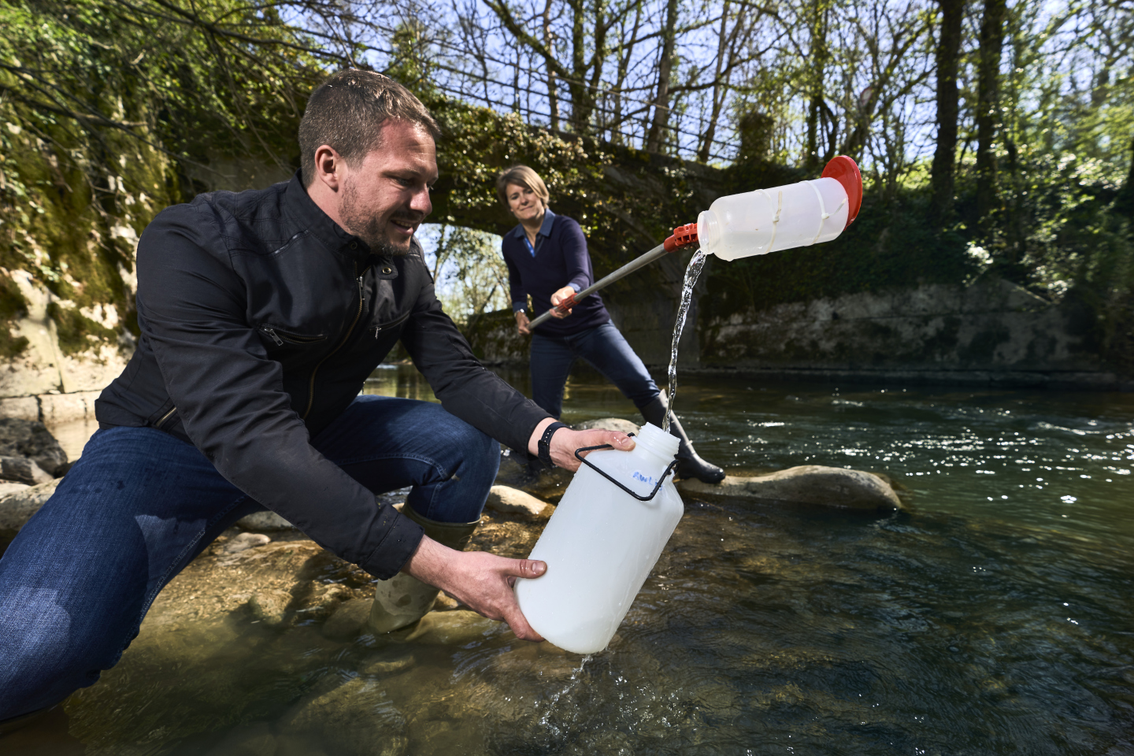
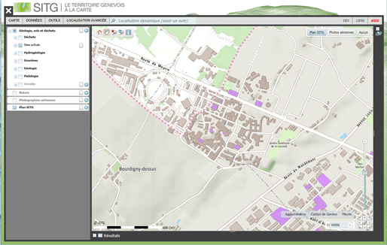
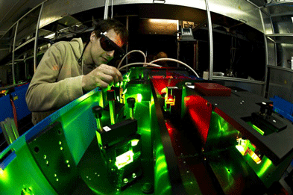
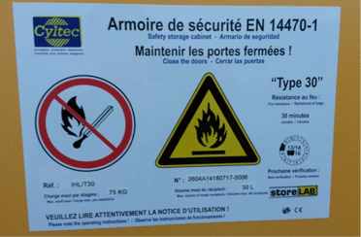
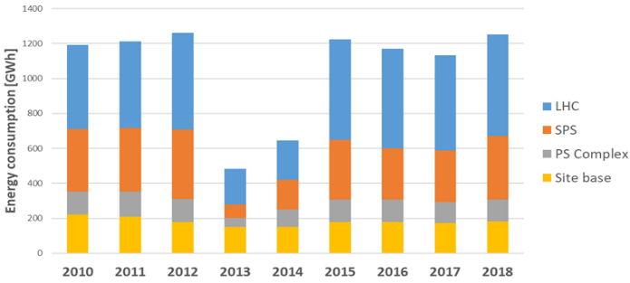
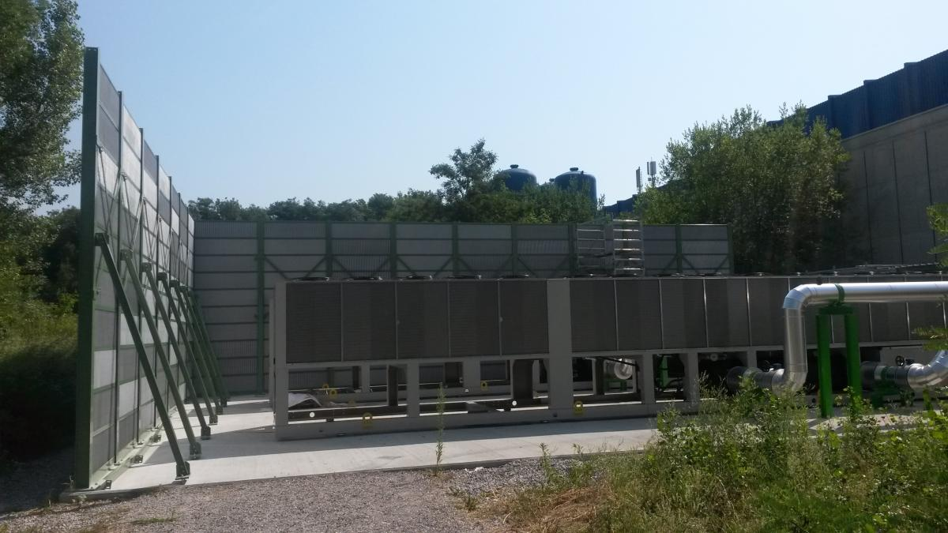
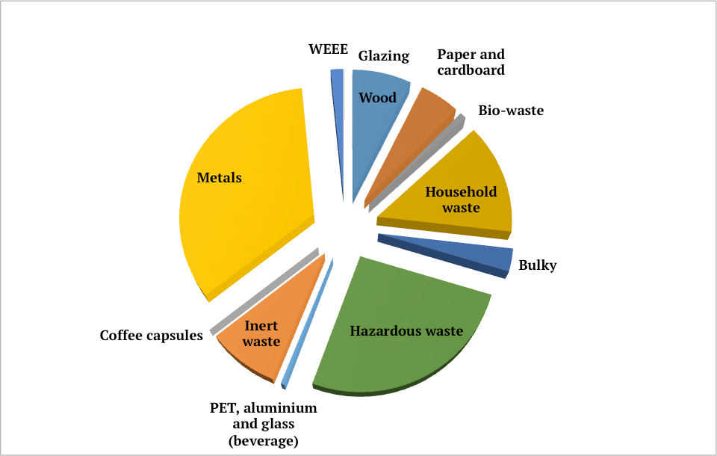
Context: Environmental Protection at CERN
Curtesy of HSE Environmental Protection Section
Context – SCADA Systems– Innovations – REMUS at CERN – Prospects

Slide 4
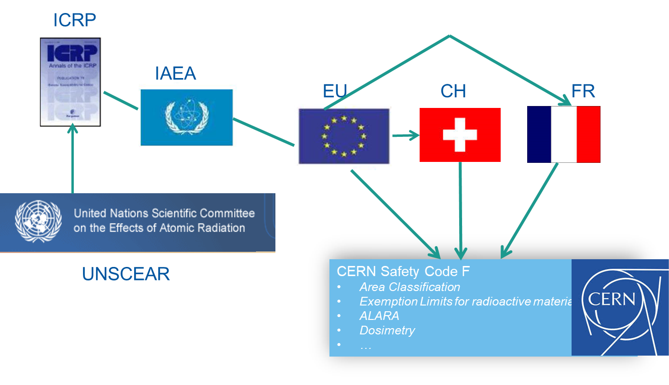

Context: Radiation Protection at CERN
Individual Dosimetry
  Monitoring of external and internal doses and reporting (CERN dosimetry service carries official accreditation in Switzerland)
  Operation of calibration facility
Operational Radiation Protection
  Risk assessments for personnel and public
  Definition of protective measures, authorization of operation
  Lead in implementation of ALARA principle
  Studies for projects and upgrades
  R&D for tools and methods, operation of shielding benchmark facility
Services
  Inter/intra-site radioactive transport
  Shipping (import/export) of radioactive goods
  Radiological characterization of material and waste, operation of analytical laboratory
  Radioactive sources service
Radioactive Waste Management
  Operation of pre-conditioning and interim storage facility
  Waste disposal towards host states
  Support to departments in radioactive waste minimization and treatment
Instrumentation
  Development, Procurement, Installation, Operation
  and Maintenance of radiation monitoring systems
Curtesy of HSE Radiation Protection Group
Context – SCADA Systems– Innovations – REMUS at CERN – Prospects
Notes:
Operational Radiation Protection
Risk assessments for personnel and public
Definition of protective measures, authorization of operation
Lead in implementation of ALARA principle
Studies for projects and upgrades
R&D for tools and methods, operation of shielding benchmark facility
Radioactive Waste Management
Operation of pre-conditioning and interim storage facility
Waste disposal towards host states
Support to departments in radioactive waste minimization and treatment
Individual Dosimetry
Monitoring of external and internal doses and reporting (CERN dosimetry service carries official accreditation
Instrumentation
Development, Installation and operation of radiation monitoring system
Services
Inter/intra-site radioactive transport
Shipping (import/export) of radioactive goods
Radiological characterization of material and waste, operation of analytical laboratory
Radioactive sources service

Slide 5
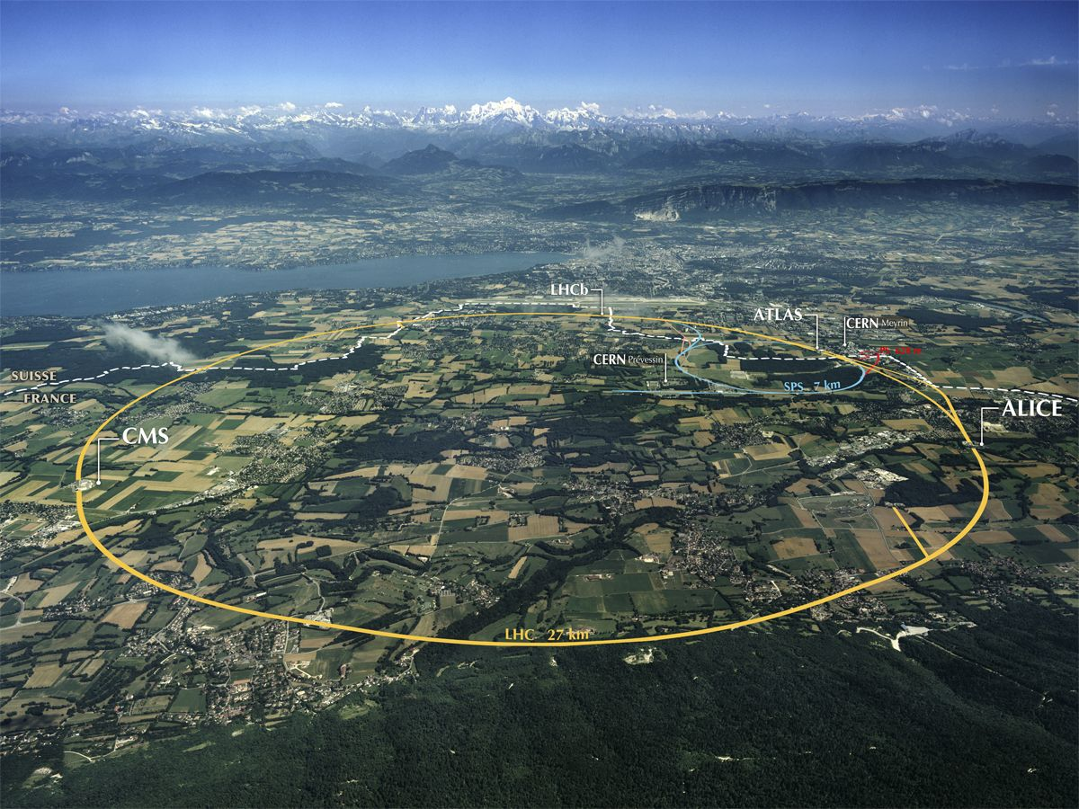
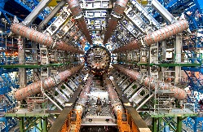
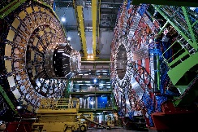

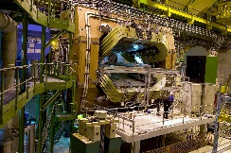
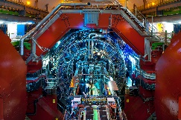
Context: Radiation Protection and Environmental Monitoring at CERN
50 km Accelerator Tunnel - 60 Access Points - 160 Experiments - 8,000 Radiation Workers
ATLAS
CMS
LHC Tunnel
LHCb
ALICE
Context – SCADA Systems– Innovations – REMUS at CERN – Prospects

Slide 6
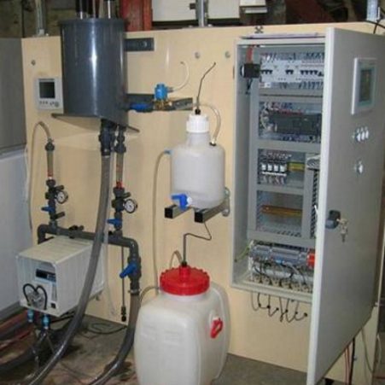
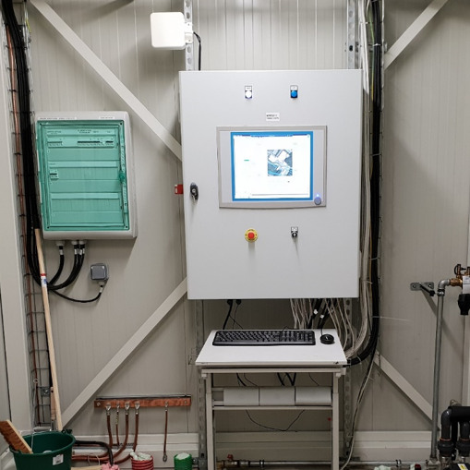
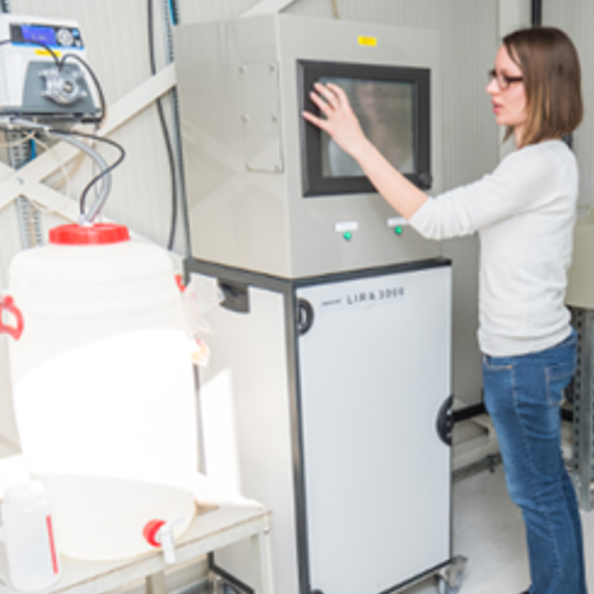
Context: Radiation Protection and Environmental Monitoring at CERN
Water Monitoring
50 km Accelerator Tunnel - 60 Access Points - 160 Experiments - 8,000 Radiation Workers
Water Monitoring Station (x7)
SMART Water Monitoring Station (x6)
ATLAS
CMS
LHC Tunnel
LHCb
ALICE
Release Water Monitor for Radioactivity (x13)
Context – SCADA Systems– Innovations – REMUS at CERN – Prospects

Slide 7
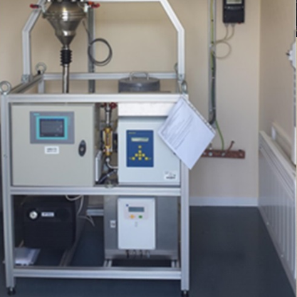
Context: Radiation Protection and Environmental Monitoring at CERN
Ventilation Monitoring
50 km Accelerator Tunnel - 60 Access Points - 160 Experiments - 8,000 Radiation Workers
Ventilation Monitoring Stations (x10)
ATLAS
CMS
LHC Tunnel
LHCb
ALICE
Context – SCADA Systems– Innovations – REMUS at CERN – Prospects

Slide 8
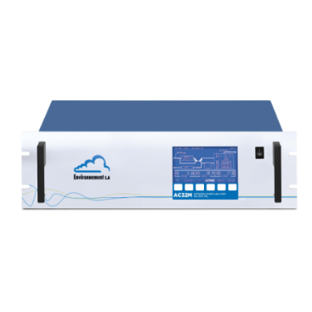
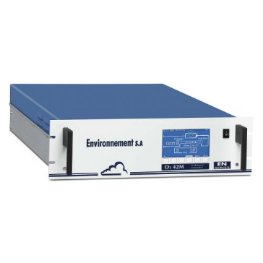
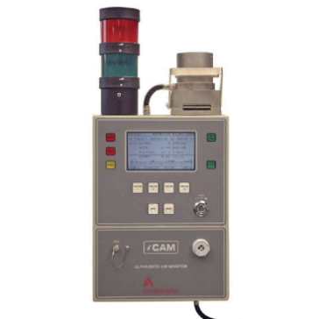
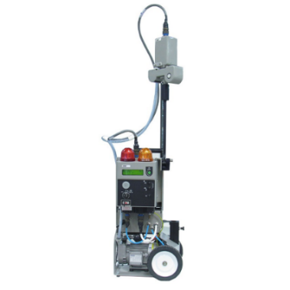
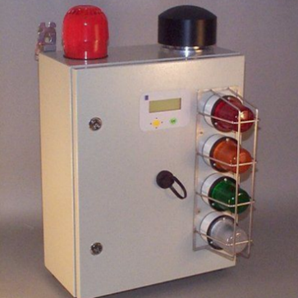
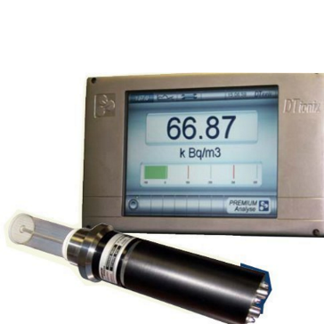
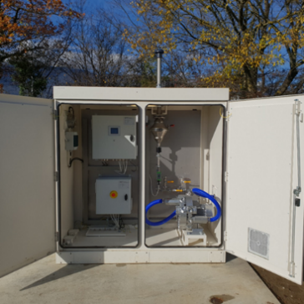
Context: Radiation Protection and Environmental Monitoring at CERN
Air Monitoring
50 km Accelerator Tunnel - 60 Access Points - 160 Experiments - 8,000 Radiation Workers
NO, NOx,NO2 Monitor (x5)
O3 Monitor (x5)
Air Alpha/Beta Monitor (x4)
Alpha/Beta Particulate Monitor (x8)
Radon Monitor (x4)
Tritium Monitor (x3)
SMART Aerosol Sampler (x8)
ATLAS
CMS
LHC Tunnel
LHCb
ALICE
Context – SCADA Systems– Innovations – REMUS at CERN – Prospects

Slide 9
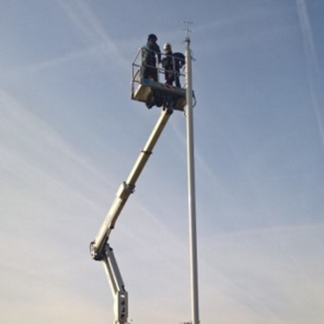
Context: Radiation Protection and Environmental Monitoring at CERN
Meteorological Monitoring
50 km Accelerator Tunnel - 60 Access Points - 160 Experiments - 8,000 Radiation Workers
Meteorological Monitoring Stations (x10)
ATLAS
CMS
LHC Tunnel
LHCb
ALICE
Context – SCADA Systems– Innovations – REMUS at CERN – Prospects

Slide 10
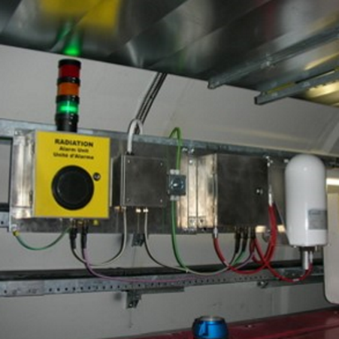
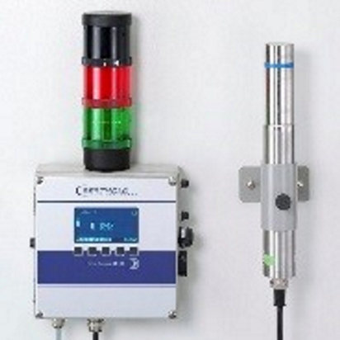
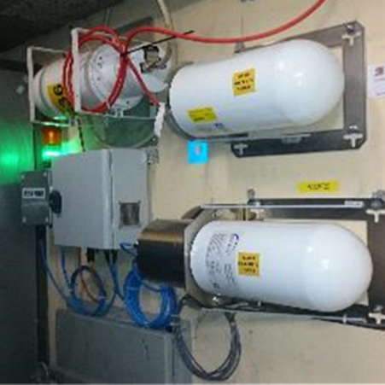
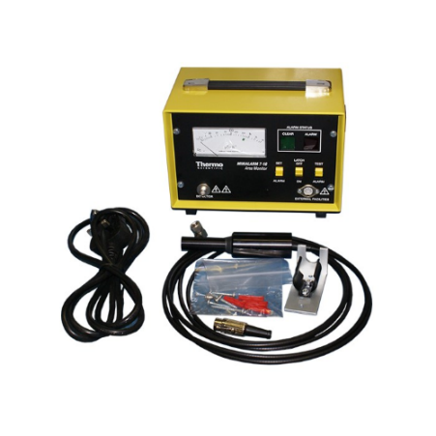
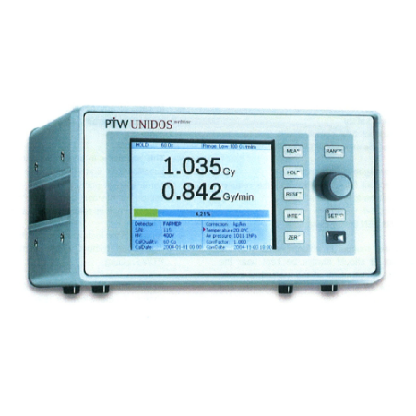
Context: Radiation Protection and Environmental Monitoring at CERN
Operational Radiation Protection Monitoring
50 km Accelerator Tunnel - 60 Access Points - 160 Experiments - 8,000 Radiation Workers
DA Monitoring Station (x142)
LB112 Monitoring Station (x114)
CROME Monitoring Station (x14)
ATLAS
CMS
LHC Tunnel
LHCb
ALICE
MinAlarm Monitor (x1)
UNIDOS Dose Meter (x2)
Context – SCADA Systems– Innovations – REMUS at CERN – Prospects

Slide 11
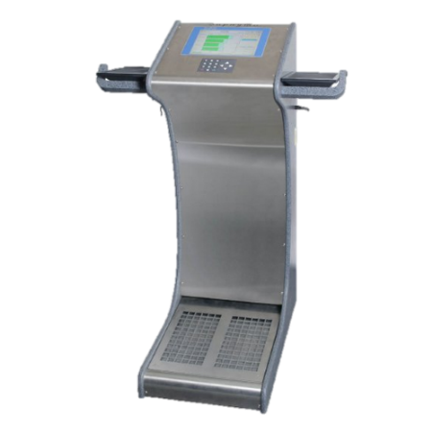
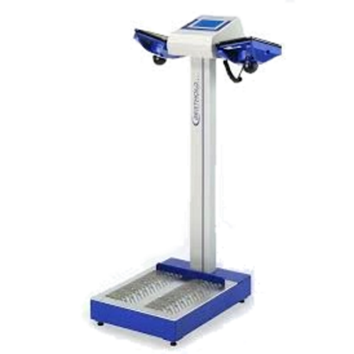
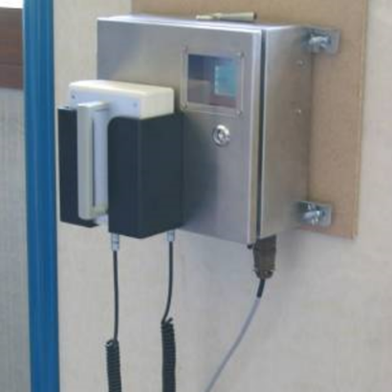
Context: Radiation Protection and Environmental Monitoring at CERN
Contamination Monitoring
50 km Accelerator Tunnel - 60 Access Points - 160 Experiments - 8,000 Radiation Workers
Hand & Foot Contamination Monitor (x18)
LB147 Hand & Foot Contamination Monitor (x49)
ATLAS
CMS
LHC Tunnel
LHCb
ALICE
Material Control Monitor (x19)
Context – SCADA Systems– Innovations – REMUS at CERN – Prospects

Slide 12
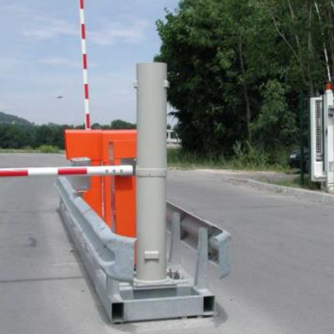
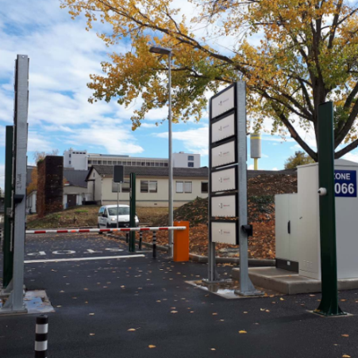
Context: Radiation Protection and Environmental Monitoring at CERN
Gate Monitoring
50 km Accelerator Tunnel - 60 Access Points - 160 Experiments - 8,000 Radiation Workers
Site Gate Monitor (x22)
Truck Gate Monitor (x2)
ATLAS
CMS
LHC Tunnel
LHCb
ALICE
Context – SCADA Systems– Innovations – REMUS at CERN – Prospects

Slide 13
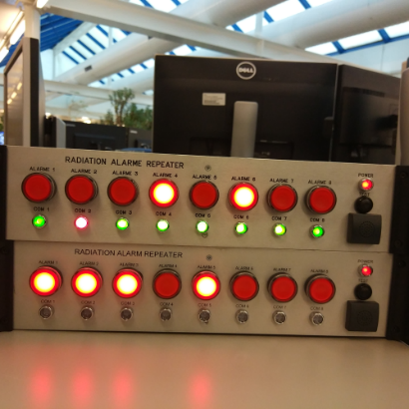
Context: Radiation Protection and Environmental Monitoring at CERN
Signal Repeaters
50 km Accelerator Tunnel - 60 Access Points - 160 Experiments - 8,000 Radiation Workers
Alarm repeaters (x28)
ATLAS
CMS
LHC Tunnel
LHCb
ALICE
Context – SCADA Systems– Innovations – REMUS at CERN – Prospects

Slide 14
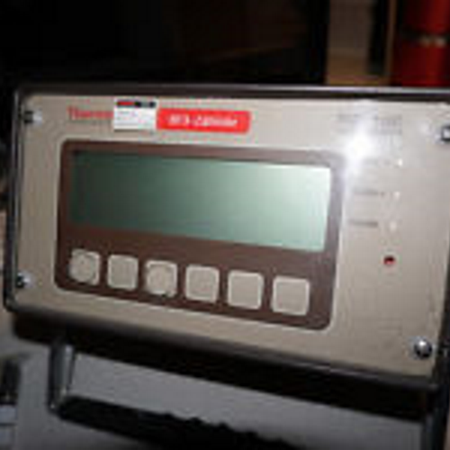
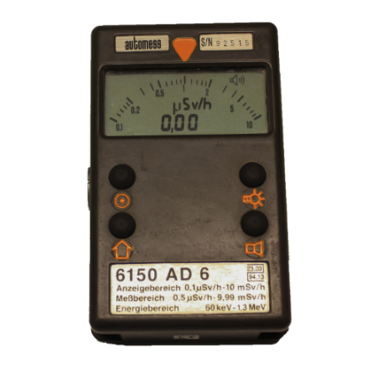
Context: Radiation Protection and Environmental Monitoring at CERN
Mobile Monitoring
50 km Accelerator Tunnel - 60 Access Points - 160 Experiments - 8,000 Radiation Workers
FHT1100 Mobile Monitor (x4)
AD6 Mobile Monitor (x14)
ATLAS
CMS
LHC Tunnel
LHCb
ALICE
Context – SCADA Systems– Innovations – REMUS at CERN – Prospects

Slide 15
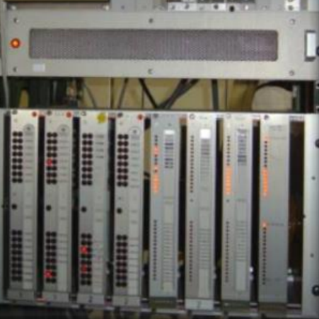
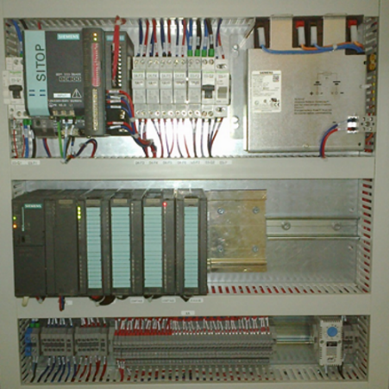
Context: Radiation Protection and Environmental Monitoring at CERN
Multi purpose Controllers
50 km Accelerator Tunnel - 60 Access Points - 160 Experiments - 8,000 Radiation Workers
Area Controller (x4)
SMART Controller (x1)
ATLAS
CMS
LHC Tunnel
LHCb
ALICE
Context – SCADA Systems– Innovations – REMUS at CERN – Prospects

Slide 16
Context: Radiation Protection and Environmental Monitoring at CERN
540 Monitoring Stations:
  27 different types
  Commercial Off-the-Shelf & Internally Developed Stations
  Surface and Underground areas
3,100 Measurement Channels:
  1,000 measurements archived / second
  Workplace and Environment Safety
  Reporting to authorities:
  - Nature and quantities of emitted ionizing radiation
  - Conventional environmental measured values
50 km Accelerator Tunnel - 60 Access Points - 160 Experiments - 8,000 Radiation Workers
ATLAS
CMS
LHC Tunnel
LHCb
ALICE
Context – SCADA Systems– Innovations – REMUS at CERN – Prospects

Slide 17
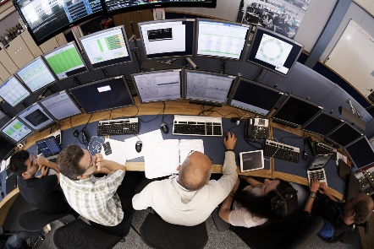
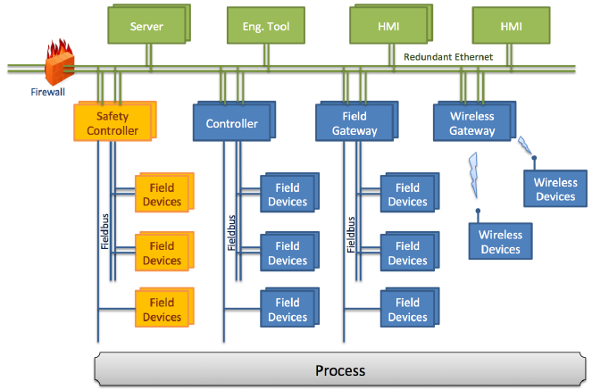
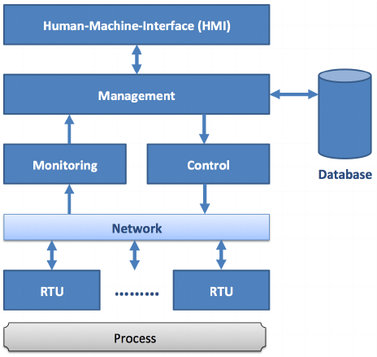

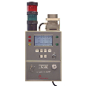



SCADA Systems
What do we need?
  A SCADA system: Supervisory Control And Data Acquisition
Measurements
Alarm signals
Faults
Process Statuses
Commands
On, Off, Sample, etc.
Parameters
Thresholds, Units, etc.
*
*
Source: State of the Art in Industrial Automation, Thomas Bangemann et. al, 2014
Source: State of the Art in Industrial Automation, Thomas Bangemann et. al, 2014
Basic Functionalities of a SCADA system
Typical Software Architecture for a SCADA System
State-of-the-art Distributed Control System
Context – SCADA Systems – Innovations – REMUS at CERN – Prospects
*Remote Terminal Unit

Slide 18
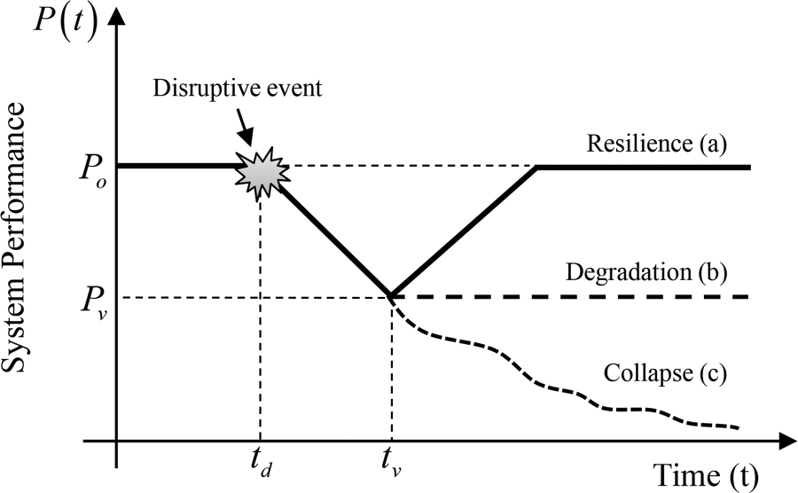

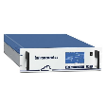




SCADA Systems
But we need more than “just” a Distributed system! We need a system that is:
  Scalable
  Absorb Growing number of instruments
  Secured
  Reliable
  Low failure rate
  Tailorable
  Users can define their Own Interface
  Resilient
  Recover from Disruptive events
  Versatile
  Interface Heterogeneous devices (vendors, protocols, networks, etc.)
  Multiplatform
Source: Engineering Resilience Quantification and System Design Implications: A Literature Survey, Nita Yodo et. Al, 2016
  Extensible
  New types of equipment can be easily interfaced
  Performant
  Serve the users in a Timely Manner
  Continuous
  Run-time upgrades and maintenance
Context – SCADA Systems – Innovations – REMUS at CERN – Prospects
Notes:
Versatile
to interface heterogeneous devices (vendors, protocols, networks, etc.)
Scalable
to absorb the growing number of instruments
Resilient
24/7, 365 days a year: Environmental protection does not have technical stops
Multiplatform
Users can use Windows, Linux or mobile devices (read only)
Tailorable
to be suitable for operators, physicists, RP engineers, Environmental engineers, fire brigade, instrumentation maintenance teams, software maintenance team

Slide 19







WinCC Open Architecture
SCADA Technology selected by CERN as standard for Control Systems. Why?
  Allows:
  Distributed
  Scalable
  Secured
  Multiplatform
  Redundant
  Reliable
Slides from WinCC OA User days 2017
  Performant
LHC Cryogenics Control System
QPS (Quench Protection System)
PSEN (Electrical installations)
REMUS (Radiation & Environment)
…
Context – SCADA Systems – Innovations – REMUS at CERN – Prospects

Slide 20







WinCC Open Architecture + REMUS Layer
WinCC OA is a pertinent choice, but we still need to add some features!
  REMUS:
Water Monitoring Station
touch screen
CERN Fire Brigade Control Room
  WinCC OA features
CERN Control Center
  +
  Handling Heterogeneous Instrumentation
  Handling Diversity of Users
  Run-time Updates
  Secured Data Streaming
Context – SCADA Systems – Innovations – REMUS at CERN – Prospects

Slide 21





What does REMUS look like?
Context – SCADA Systems – Innovations – REMUS at CERN – Prospects

Slide 22

What does REMUS really look like?
REMUS Simplified Architecture
Context – SCADA Systems – Innovations – REMUS at CERN – Prospects

Slide 23

Heterogeneous equipment integration handling
Challenges
  HSE owns very diverse types of monitoring equipment, for 2 reasons:
    Wide scope of measurements to acquire
    Long lifetime of equipment, costly to replace: electronics of different generations overlap
  This is a common challenge for supervisory systems
Aim
  Uniformity of instrumentation from users’ perspective
  Uniformity of instrumentation from developers’ perspective (code simplification)
REMUS Solution
  Abstraction of instrumentation technical specificities by modeling:
    3 concepts only: Channel, Device, Monitoring Stations
    All types of instrumentation are modeled using the same concepts
Example of REMUS Device model
Context – SCADA Systems – Innovations – REMUS at CERN – Prospects

Slide 24




REMUS Applications
Users have different needs
  Many different user profiles use REMUS (accelerator & experiments operators, radiation protection engineers, environmental engineers, physicists, firefighters, maintenance teams…)
Customized User interfaces
  REMUS is split into several Applications (subsets of REMUS instrumentation), with a customizable layout (synoptic, widgets)
Advantages
  Users can focus on the part of the supervision they are interested in
  Improved Performance
  Distributed maintenance effort
RP Maintenance Application
Environmental Monitoring Application
RP Operation Application
Context – SCADA Systems – Innovations – REMUS at CERN – Prospects
REMUS Applications

Slide 25







Tailored User Interfaces
REMUS final users can build their own user interfaces (Application)
  REMUS provides users with a tool to build their own tailor-made user interface
  Graphical tool to draw user interfaces with “drag and drop”
  No knowledge of programming languages necessary
  User interface can be modified in minutes
  New user interfaces can be deployed at run-time
User Interfaces Editor
Tailored User Interfaces
User Interfaces deployment
Context – SCADA Systems – Innovations – REMUS at CERN – Prospects

Slide 26


Continuous Operation
Challenges
  HSE needs to operate its supervisory system 24/7, 365 days a year:
    Monitoring is necessary during accelerator runs AND shutdowns
Solution implemented in REMUS
  Redundancy of the Servers and all sub-systems
  All software components are designed to be resilient
  Maintenance and support operations designed to be executable at Run-Time:
    Deployment of new User Interfaces
    Declaration and connection of new equipment in the system (“plug-and-play”)
    Framework upgrades
    Operating System upgrades
REMUS average down time 2013-2018: 7mn / year
REMUS Redundancy
Context – SCADA Systems – Innovations – REMUS at CERN – Prospects

Slide 27
















Data Streaming
Apache Kafka®: an open-source distributed streaming platform
Challenges
  REMUS needs to exchange data with external systems
  (In and Out)
Solution implemented in REMUS
  Implementation of a Driver allowing data exchange between WinCC OA and Apache Kafka
Benefits
  Easy Integration of IoT Devices
  De-coupled and secured exchange with other SCADA (WinCC OA, EPICS, TANGO, …)
  Stream Processing, Data Enrichment capabilities
  Archiving (Hadoop, InfluxDB, Elasticsearch, …)
  Near real-time data visualization (Desktop, Mobile, Web)
…
Source: https://kafka.apache.org
Context – SCADA Systems – Innovations – REMUS at CERN – Prospects
Notes:
Apache Kafka® is an open-source distributed streaming platform. What exactly does that mean?
A streaming platform has three key capabilities:
Publish and subscribe to streams of records, similar to a message queue or enterprise messaging system.
Store streams of records in a fault-tolerant durable way.
Process streams of records as they occur.
https://cwiki.apache.org/confluence/display/KAFKA/Powered+By

Slide 28

Data Streaming: Application: REMUS Web (under development)
Provides real time visualization of REMUS processes and measurements from a Web browser
Provides Statistics on REMUS (Users, I/O, etc.)
Provides Configuration tools (i.e. Notifications)
Highly demanded:
  Maintenance entry point
  Reports generation
  On-site intervention (mobile)
Can be used by ANY Control System!
  Utilizes generic JSON messages for Near Real-Time data visualization
Context – SCADA Systems – Innovations – REMUS at CERN – Prospects

Slide 29











Data Streaming: Application: Waste-Monitoring IoT Pipeline (project)
Replace manual containers checks by automated Waste Monitoring
[5]
[4]
[2]
[3]
Single measurement data format:
[1]: 2019-07-23 09h30;5.2356;110110
[2]: {"date":"2019-07-23 09h30","meas":5.2356,“tags":110110}
[3]: {“id":"1165,"timestamp":1563867000000,"value":5.2356,"flags":{unit:23,mode:1}}
[4]: {“id":"1165,"timestamp":1563867000000,"value":5.2356,"flags_unit":23 ,"flags_unit_enr":"ct/s","flags_mode":1 ,"flags_mode_enr":“measure"}
[5]: [x,y]
[1]
Context – SCADA Systems – Innovations – REMUS at CERN – Prospects

Slide 30


REMUS at CERN: Project
REMUS Project Started in 2012. Goal:
  Unify all CERN Radiation and Environment supervisory systems
  Reduce delay and the cost of adding new devices to the supervision
  Provide light and fast clients, customized for each user’s requirements
  Reduce overall maintenance needs for operation
  Take advantage of 30 years of experience providing Safety Systems to CERN
Core Project Team
  G. Segura, A. Ledeul, B. Styczen, A. Savulescu
  K. Szkudlarek, R. Silvola, D. Vazquez, L. Leone, L. Sienko (former members)
Domain Experts representatives
  J. Regnard (Environment), M. Widorski (Radiation Protection)
Context – SCADA Systems – Innovations – REMUS at CERN – Prospects

Slide 31










REMUS at CERN: Main Functionalities
GUI Editor
Data Visualization
Application Editor
Supervision
20 Applications
Control
Data Acquisition
Supervision
8Bn Meas.
Client
686 Synoptic
603K
Data Points
27
Station
Types
Data Exchange
Alarm Screen
LASER
DIP
Meas. DB
Kafka
3 143
Channels
540
Stations
Client
84K Alarms
defined
Data Archiving
Online
Control/Command
38Bn Meas./year
2Bn after reduction
1 000
Meas./sec
Client
55k parameters
REMUS Functional Diagram
Context – SCADA Systems – Innovations – REMUS at CERN – Prospects

Slide 32

Prospects: Deployment outside CERN: Technical Requirements
Hardware
  1-2 WinCC OA Servers (Windows or Linux, REMUS uses CentOS 7)
  1 Oracle Database Server (PostgreSQL can be used instead, spending ~70 man-days)
Software Licenses
  1-2 WinCC OA Licences
  1 Oracle licences (if Oracle used)
Support Services
  Administration and support for: OS, DB and Network infrastructure
Installation/Set-up/Tests
  ~15 man-days assuming Databases, Servers and Network infrastructure are ready
REMUS is essentially non-CERN dependant
Can be used for other processes than RP/Environment Monitoring
Context – SCADA Systems – Innovations – REMUS at CERN – Prospects

Slide 33




Prospects: “Cloud” service
All operations of the systems can be done without any SCADA or IT expertise
The system can be hosted remotely (“SaaS” Windows/Linux)
Real example: IGLUNA Installation (June 2019):
  CERN RP Expert set up two CROME (Radiation Monitors)
  on Zermatt Glacier
  A 4G modem is installed to send the data to CERN
  From Zermatt, a Remote Desktop connected to
  a dedicated REMUS Synoptic allowed
  the Configuration, Control and Supervision of the monitors
  No SCADA infrastructure nor service was necessary on site
  No intervention of the SCADA team was necessary
CERN, Geneva
Klein Matterhorn, Zermatt
Context – SCADA Systems – Innovations – REMUS at CERN – Prospects

Slide 34
Prospects: Collaborations
Possible Clients:
  Devices manufacturers
  Laboratories, Research Institutes
  Plants, Governmental Environmental Monitoring Programs
  Clients of supported devices
  ...
Possible Models:
  Open Source / Proprietary
  Cloud / On-premise
  License / Partnership / Subscription / Support / Sponsored functionalities (e.g. extension of supported instrumentation catalog)
REMUS Web can be distributed separately
Context – SCADA Systems – Innovations – REMUS at CERN – Prospects

Slide 36
List of instrumentation supported by REMUS (1-14/27)
GROAC (CERN) General Purpose (counting cards)
MSDA (CERN+) Radioactivity
MMS (CERN+) Meteorological Monitoring Station
VMS (CERN+) Ventilation Monitoring Station
RWM (Bertin) Release Water Monitor for Radioactivity
HFM (Nuvia Instrument) Hand & Foot contamination Monitor
PCM (Bertin) Material Control Monitor for Radioactivity
SGM (Bertin) Site Gate Monitors for Radioactivity
WMS (CERN+) Water Monitoring Station
AC32 (Environnement S.A.) NO, NOx,NO2 Monitoring
O342 (Environnement S.A.) O3 Monitoring
LB112 (Berthold) Gamma Radiation Monitor
FHT1100 (Thermo) Rate-meter (mobile)
AD6 (Automess) Radioactivity (mobile)
COTS (Commercial Off-The-Shelf) instrumentation
CERN developed instrumentation
“CERN+”: CERN & COTS instrumentation

Slide 37
List of instrumentation supported by REMUS (15-27/27)
ICAM (Canberra) Air Alpha/Beta Monitor
SMART (CERN) General Purpose (PLC)
LB147 (Berthold) Hand & Foot contamination Monitor
iWMS (CERN+) Water Monitoring Station
RADHOME (Algade) Radon Monitoring
ABPM (Mirion) Alpha/Beta Particulate Monitor (mobile)
DTionix (Premium Analyze) Tritium Monitoring
MinAlarm (Thermo) Radioactivity
UNIDOS (PTW) Dosemeter
iAS (CERN+) Aerosol Sampler
Alarm Repeater (CERN) Alarm Signals
FHT1388 (Thermo) Truck Gate Monitor for Radioactivity
CROME (CERN) Radioactivity
COTS (Commercial Off-The-Shelf) instrumentation
CERN developed instrumentation
“CERN+”: CERN & COTS instrumentation

Slide 38



































Use Case : Continuous Operation
Situation
  Expert plugs in a new monitor
  Declares the MS, Devices, Channels in REMUS
  Downloads the Application he needs to update
  Updates the Application with the Editor
  Uploads the Application back on REMUS
  Defines, Configures & Parameterizes the Station
  Visualizes the Real-Time Data
What happened, in the Backend
  New instance of existing model created in DB
  New online variables added to WinCC OA
  New alarms/faults added to WinCC OA
  New connection added in the selected Driver
  Application versioned
  Run-time update of all clients using this App.
  Parameters & Configuration set-up
  Data Archiving & Streaming set-up

